Slide 1
‘As Iron Sharpeneth Iron’
Principles of True Friendship
An Introduction

Slide 2
Friendship
Psalm 133
Rotherham's Emphasised Bible
Lo how good and how delightful for brethren to dwell together even as one.
Like the precious oil upon the head. Descending upon the beard; The beard of Aaron which descends unto the opening of his robe:
Like the dew of Hermon which descended upon the mountains of Zion. For there did Yahweh command the blessing, Life unto age abiding
- An
Introduction

Slide 3
Friendship
Psalm 133
Rotherham's Emphasised Bible
Lo <how good and how delightful> for brethren to dwell together even as one
Like the precious oil upon the head. Descending upon the beard; The beard of Aaron which descends unto the opening of his robe:
Like the dew of Hermon which descended upon the mountains of Zion. For there did Yahweh command the blessing, Life unto age abiding
- An
Introduction

Slide 4
Friendship
Psalm 133
Rotherham's Emphasised Bible
Lo <how good and how delightful> for brethren to dwell together even as one
Like the precious oil upon the head. Descending upon the beard; The beard of Aaron which descends unto the opening of his robe:
Like the dew of Hermon which descended upon the mountains of Zion. For there did Yahweh command the blessing, Life unto age abiding
- An
Introduction

Slide 5
Friendship
Psalm 133
Moffat’s Translation
How rare it is, how lovely, this fellowship of those who meet together.
Sweet as the sacred oil poured on the head, that flows down the beard, down the very collar of his robe;
Vital as the dew of Hermon that falls on the hills of sion.
For in this fellowship has the Eternal fixed the blessings of an endless life.
- An
Introduction

Slide 6
‘Friendship is the highest form of fellowship’

Slide 7
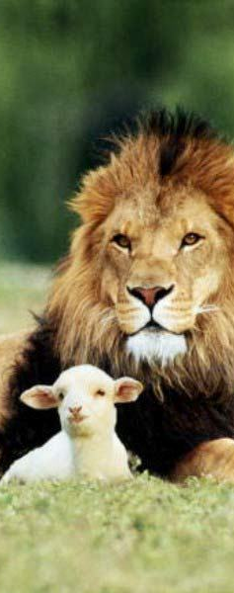
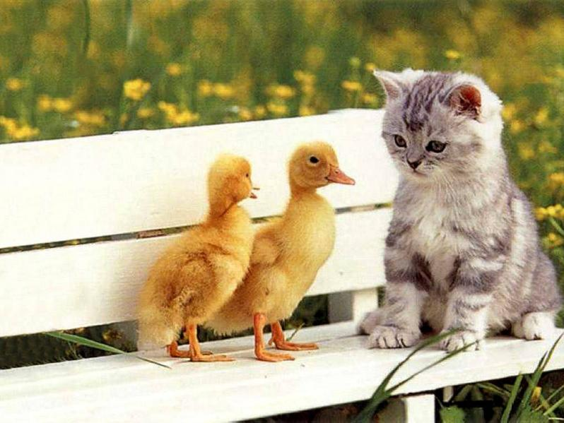

Friendship
and the Gospel

Slide 8
Friendship
God
The English word God is identical with the Anglo-Saxon word for ‘good’, and therefore it is believed that the name God refers to divine goodness
New Ungers Bible Dictionary
and the Gospel

Slide 9
Friendship
Help-meet
Literally – a helper as before him
One who is able to help
New Kings James – Footnote
A companion that was suitable
(the animals being unsuitable)
and the Gospel

Slide 10
Friendship
Not Good To Be Alone
“Man is created a social creature. His full powers cannot be developed by physical and mental work alone; nor his moral being by self discipline in solitude. His faculties and his character require to be expanded and beautified by the duties of domestic and social life, as a member of a family, as a friend, as a fellow worker, as a citizen. To be alone is not good. It does not promote his fullest life or his best service”
Cambridge Bible Commentary
and the Gospel

Slide 11
Friendship
Loneliness Kills
% Risk of an early death
19% - Poverty
14% - Loneliness
7% - Obesity
and the Gospel

Slide 12
Friendship
Quote
‘The worst solitude is to be destitute of sincere friendship’
Sir Francis Bacon Author, Statesman, Scientist 1561-1626
and the Gospel

Slide 13
Friendship
Our Relationship to God
Creator – creation
Potter – clay
King – subjects
Master – servants
Teacher – disciples
Father - children
and the Gospel

Slide 14
Friendship
Enemies
Romans 5v10
“For if when we were enemies”
Enemies – Grk – echthros
= active hostility
deep seated hatred
irreconcilable enmity
and the Gospel

Slide 15
Friendship
Enemies
Romans 5v10
“we were reconciled”
Reconciled – Grk – katallasso
= to change mutually
kata – an exact point
allasso – to change
Hence to change positions from enemies to friends
and the Gospel

Slide 16
Friendship
Enemies
We have peace (v1) because we have received this reconciliation. The two are inseparably linked. There can be no peace without friendship with God in any sphere of human life. How vain are human efforts to attain it! How the Bible goes to the root of the matter, not only laying bare the source of the trouble but also making known the only remedy.
Bro John Carter – Paul’s Letter to Romans pg 59
and the Gospel

Slide 17
Friendship
Enemies
Matthew 7v22-23
“I never knew you”
Knew – Grk – ginosko
= to get to know, grow in knowledge
Hence I never got to know you
and the Gospel

Slide 18
Friendship
Hebron
Hebrew – Hebron = ‘Fellowship’
Arabic – El-Khalil = ‘The Friend’
‘Friendship is the highest form of fellowship’ D. Gillett
and the Gospel

Slide 19
Friendship
Abraham ‘The Friend of God’
2 Chronicles 20v7
Isaiah 41v8
James 2v23
and the Gospel

Slide 20
Friendship
Yahweh and Abraham
Genesis 18v18
Now Yahweh had said ‘Am I going to hide from Abraham what I do, when Abraham shall surely become a great and mighty nation – and all nations of the earth shall be blessed in him.
and the Gospel

Slide 21
Friendship
Yahweh and Abraham
Genesis 18v19
For I have become his intimate friend. To the end that he may command his sons and his house after him, so shall they keep the way of Yahweh by doing righteousness and justice – To the end that Yahweh may bring unto Abraham, what he hath spoken concerning him. So Yahweh said…
and the Gospel

Slide 22
Friendship
Friend
Old Testament
= to have an affection for
Mostly translated ‘love’
Youngs lit = Abraham my lover
and the Gospel

Slide 23
Friendship
Friend
Friend
2 Chron 20v7; Isa 41v8
Prov 18v24 ‘A friend sticketh closer…’
Prov 27v6 ‘ …the wounds of a friend’
Love
Gen 22v2 ‘…son whom thou lovest’
1 Sam 18v1 ‘Jonathan loved him as…’
Psa 38v11 ‘my lovers and my friends…’
and the Gospel

Slide 24
Friendship
Friend
New Testament
Grk – Philos = dear
i.e. a friend; to act friendly
and the Gospel

Slide 25
Friendship
Summary
It is not good for us to be alone. We were made social beings
Although we are God’s children, he has invited us to be His friends
The death and resurrection of Christ are at the core of that invitation
We are to follow the example of Abraham – The Friend of God
and the Gospel

Slide 26
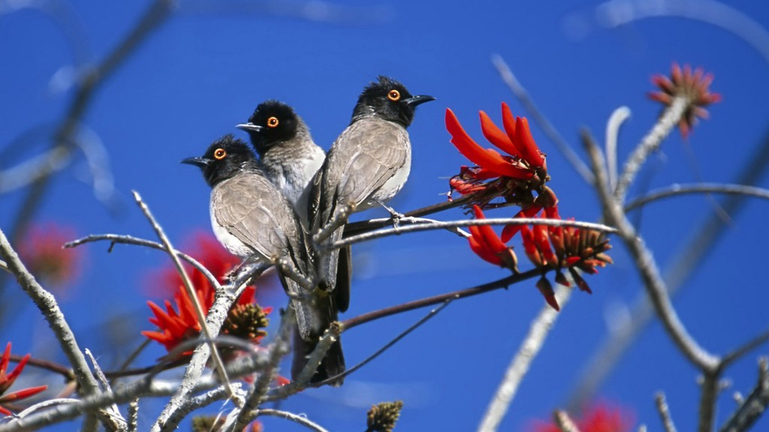
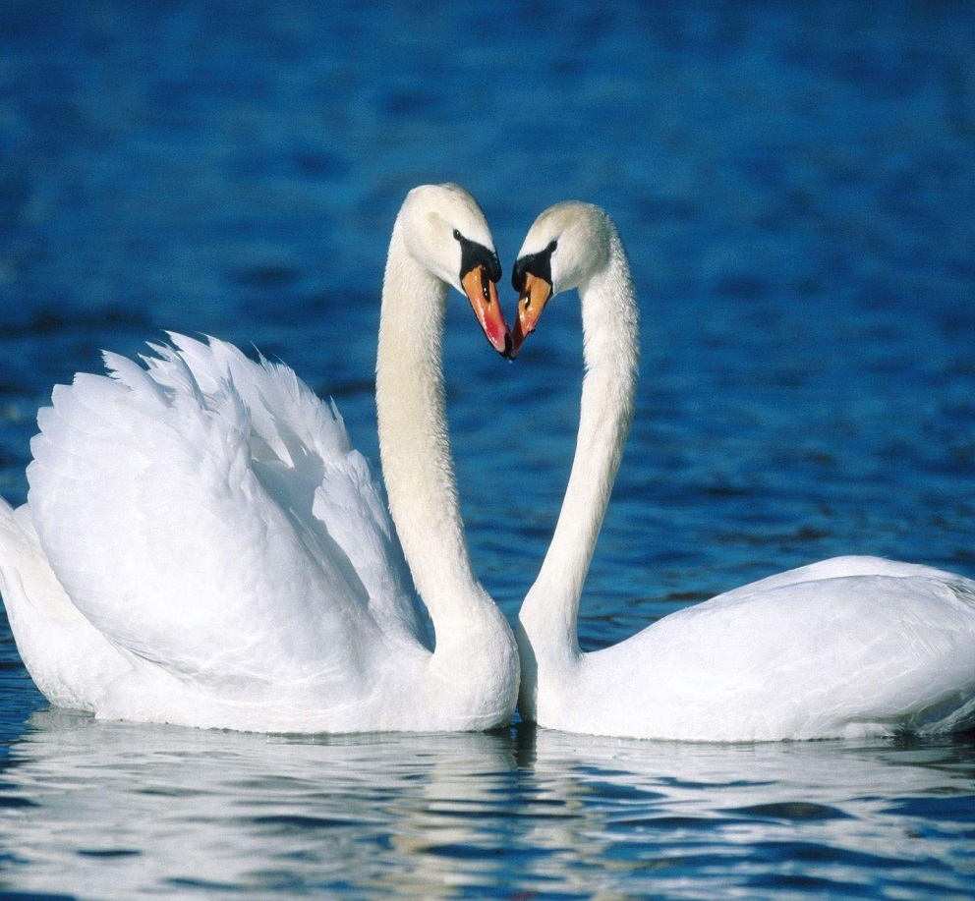
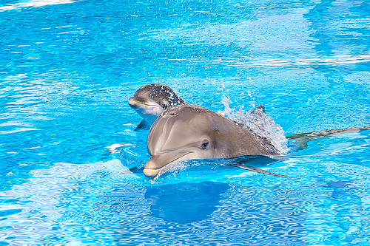
Friendship
and Faith

Slide 27
Friendship
What is Faith
Faith is the means of making God, the Creator of the universe, real and living.
It is the foundation to the promises made in the past and the eye for seeing their future fulfilment.
It is the backbone to a spiritual life and the means for making prayer powerful.
It provides certainty and stability in times of doubt and hope and understanding in times of distress.
It gives us security and blessings, a reason to be happy and a meaning to our existence.
It is our whole life.
and Faith

Slide 28
Friendship
Quote
“You become like the 5 people you spend the most time with – so choose carefully”
and Faith

Slide 29
Friendship
Proverbs 18v24
Jerusalem Bible
There are friends who point the way to ruin, others are closer than a brother.
NIV
One who has unreliable friends soon comes to ruin but there is a friend who sticks closer than a brother
and Faith

Slide 30
Friendship
Proverbs 18v24
A man that has many friends but of the wrong type
is far worse off
than the man who has just one friend but of the right type
and Faith

Slide 31
Friendship
Aristotle
A friend to all is a friend to none
and Faith

Slide 32
Friendship
Proverbs 18v24
1. Friends
Heb – rea = a close associate
(Motive for the association is unknown)
2. Friend
Heb – aheb = one who loves
(Motive is clearly love)
and Faith

Slide 33
Friendship
Judah and Jacob
Tricked by a woman wearing a veil.
Bound to her even though he didn’t want her.
Had children by her he didn’t want.
Extremely protective of his youngest son.
and Faith

Slide 34
Friendship
Almost Ruined
Left the ecclesial environment
Received attention in the world
‘Took’ a Canaanite wife
Not there for his children’s births
Children ended up worse than him
Friendship with Hirah was a disaster
and Faith

Slide 35
Friendship
Hirah the Adullamite
V12, 20 called ‘his friend’
Judah appears to rely on Hirah for
Counsel – v2 Showed him the ways of the Canaanites.
Business – v12 Developed a partnership in keeping sheep.
Keeping secrets – v20 Sent the kid by the hand of his friend.
and Faith

Slide 36
Friendship
Friends of the World
Have no accountability to God
– live as you wish
Are not bound by a moral code or set of values that are godly
– marry who you like
Have no family policies that are God directed
– children act as they want
and Faith

Slide 37
Friendship
Jonadab’s True Colours
Suggests a plan he must have known the consequences to.
Before the eyewitness details reach David – Jonadab already knew:-
Only Amnon is dead – (repeated)
That the killers were Absalom’s servants.
That Absalom had been plotting this for two years.
and Faith

Slide 38
Friendship
Jonathan the True Friend
1 Samuel 18v1-4
Jonathan the Instigator
Went out to befriend David
A friend is LIKEMINDED
and Faith

Slide 39
Friendship
Likeminded
Jonathan David
1 Sam 14 1 Sam 17
‘Uncircumcised’ v6 v26
‘Come up to us’ v12 v44
Met the enemy v13 v48-49
‘Into our hands’ v10 v47
Yahweh’s battle v6 v47
God of Israel v12 v46
and Faith

Slide 40
Friendship
Jonathan the True Friend
1 Samuel 19v4-7
Jonathan the Intercessor
Seeks assurance on behalf of his friend
A friend displays LOYALTY
and Faith

Slide 41
Friendship
Jonathan the True Friend
1 Samuel 20
Jonathan the Truth Seeker
Seeks to establish truth while still trusting his friend
A friend shows TRUST
and Faith

Slide 42
Friendship
Jonathan the True Friend
1 Samuel 23v16-18
Jonathan the Strengthener
Strengthens David with encouraging words – not feed his self-pity.
A friend provides SUPPORT
and Faith

Slide 43
Friendship
Jonathan the True Friend
1 Samuel 31v2 and 2 Samuel 1v17-27
Jonathan the Selfless
Willing to lay down his life for his friend.
A friend is motivated by LOVE
and Faith

Slide 44
Friendship
Summary
Choosing the right friends is vey important
Friends of the world will bring us to ruin
Friends in the truth are only helpful if they are likeminded, loyal, trusting, supportive and selfless
and Faith

Slide 45
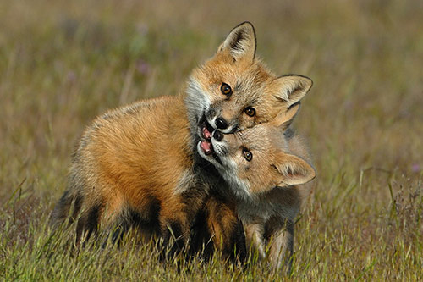
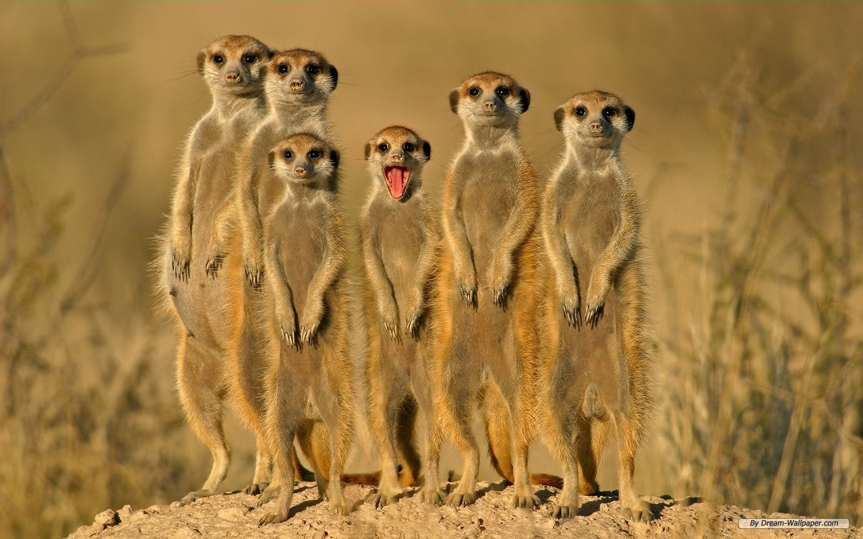
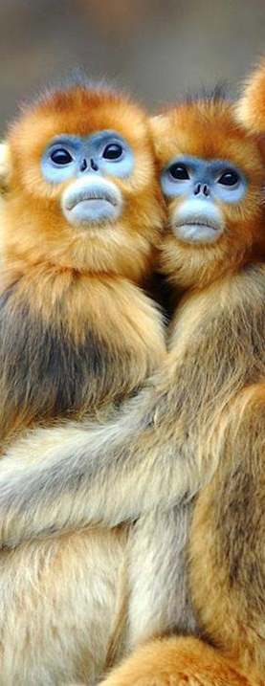
Friendship
and Adversity

Slide 46
Friendship
Grief
Jacob losing Joseph
Naomi and Ruth losing their husbands
David losing Saul and Jonathan
David losing Absalom
Daniel spent three weeks mourning
Nehemiah on hearing the state of Jerusalem
The widow of Nain losing her son
Mary and Martha losing their brother
and Adversity

Slide 47
Friendship
National Oppression
Israel in Egypt
Israel in the times of the Judges
Israel in captivity – Assyria
Judah in captivity – Babylon
Judah after their return – by the Samaritans
Judah under the Romans
and Adversity

Slide 48
Friendship
Sickness
Life threatening
Hezekiah – Set your house in order
Job – Cursed the day he was born
Lazarus – Although he died the Lord raised him
Non life threatening
Timothy – Regular stomach upsets
Paul – Had a constant ‘Thorn in his side’
and Adversity

Slide 49
Friendship
Human Conditions
Blind
Lame
Deaf
Dumb
Epilepsy
Schizophrenia
Sun stroke
and Adversity

Slide 50
Friendship
Stress
Job – Shouldered all his pain and torment from his ‘friends’ on his own
Moses – Who was told by Jethro his father-in-law that he was doing too much and to get help with judging such a great number of daily cases
Paul – ‘Besides those things that are without, that which cometh upon me daily the care (anxiety) of all the ecclesia's 2 Cor 11v28
and Adversity

Slide 51
Friendship
Infertility
Sarah
Rachel
Hannah
and Adversity

Slide 52
Friendship
Financial Hardship/Poverty
Joseph in Egypt and the seven year famine
Job who lost all his livestock
Taxes under Solomon and Rehoboam
Elisha and the widow whose sons were to be taken by the creditor
The widow with the two mites
The prodigal son
The Jerusalem poor fund
and Adversity

Slide 53
Friendship
Depression
Possibly Adam and Eve – Guilt depression?
Jacob – Grief depression, ‘he would not be comforted’
King Saul – Mood swings
David – Guilt depression (after Bathsheba incident – Psa 32)
Elijah – Manic depressant (1 Kings 19)
Job?
Jeremiah?
John the Baptist?
and Adversity

Slide 54
Friendship
Marriage Breakdown/Trouble
Jacob and his four wives
David and Michal
Ahasuerus and Vashti - Unreconciled
Hosea and Gomer – Reconciled
Herod Antipas and his brother Philips wife
and Adversity

Slide 55
Friendship
Family Trouble
Cain and Abel
Sarah and Hagar
Jacob and his sons – Incident at Shechem
Joseph and his brothers
Moses, Aaron and Miriam
David and the sons of Zeruiah
David and Absalom/Adonijah
Eli and his sons
Samuel and his sons
and Adversity

Slide 56
Friendship
Ecclesial Trouble
Korah, Dathan and Abiram
Achan
Samuel and the setting up of the school of the prophets
Elijah and Mt Carmel/Mt Horeb/School of the prophets
The Jerusalem Conference
The Corinthian ecclesia
and Adversity

Slide 57
Friendship
Accidents
Eli falling of his stool – 1 Samuel 4v18
Ahaziah falling through the lattice – 2 Kings 1v2
Tower of Siloam falling on 18 – Luke 13v4
Eutychus falling out the window – Acts 20v9-12
and Adversity

Slide 58
Friendship
Physical Bullying
Joseph’s brothers – put him in the pit, sold him
Hophni and Phineas – took the meat by force
Saul to David – threw spears at him, hunted him
Pashur to Jeremiah – punched him, put him in stocks, put him in the pit with mud
and Adversity

Slide 59
Friendship
Verbal Bullying
Ishmael to Isaac - teasing
Joseph’s brothers – ridicule, sarcasm
Potiphar’s wife to Joseph – manipulation
Job’s three friends – criticism, accusations
Delilah to Samson – nagging
Saul to David – threats
Michal to David – mocking
Jezebel to Elijah – threats, intimidation
Hananiah to Jeremiah – mocking, undermining
Haman to Mordecai - undermining
and Adversity

Slide 60
Friendship
Argument/Dispute
Aaron and Miriam with Moses over Zipporah
Paul with Barnabas over John Mark
and Adversity

Slide 61
Friendship
Sexual Abuse/Harassment/Rape
Lot’s daughters to Lot
Onan to Tamar
Potiphar’s wife to Joseph
The Benjamites to the Levite’s concubine
Hophni and Phineas to the women that came to the altar
Amnon to his half sister Tamar
and Adversity

Slide 62
Friendship
Cruelty and Torture
Abel – killed
Naboth – killed
Hezekiah – put through the fire
Jeremiah – put in stocks
Daniel’s 3 friends – put in the fiery furnace
Daniel – put in the lions den
John the Baptist - beheaded
Stephen – stoned
James the apostle – killed
Paul – stoned, beaten with sticks and whipped
and Adversity

Slide 63
Friendship
Workplace injustice
Laban to Jacob – changed his wages 10 times
The Jews of Isa 58v4 – ‘exact all their labours’ even on fast days
Parable of the unjust steward
and Adversity

Slide 64
Friendship
Acts of Terrorism
The Samaritans to the Jews building the wall
Ezra 4v4, Zech 1v18-21
and Adversity

Slide 65
Friendship
Domestic Violence
The Levite to his concubine
Amnon to Tamar
Saul to Jonathan
The men of Malachi’s day to their wives – ‘one covereth violence with his garment’ (Mal 2v16)
and Adversity

Slide 66
Friendship
Prejudice
Isaac towards Esau, Rebekah towards Jacob
Jacob towards Joseph
Aaron and Miriam against Zipporah
Saul against David – 1 Sam18v8-9
Jonah towards Israel and against Assyria
Princes of Babylon against Daniel
Haman against Mordecai and the Jews
Nathanael against Jesus – ‘can any good thing come out Nazareth’
The Pharisee in the parable who thanked God he was not like the poor sinner
The rich man and poor man of James 2v3-4
and Adversity

Slide 67
Friendship
Suicide
7 suicides are recorded in scripture
Abimelech – Shame Judges 9v52-54
Samson – Faith Judges 16v25-30
Saul – Failure 1 Sam 31v4
Saul’s armourbearer – Impulse 1 Sam 31v5
Ahithophel – Bitterness 2 Sam 17v23
Zimri – Rejection/cowardice 1 Kings 16v15-20
Judas – Guilt/self pity Matt 27v3-5
and Adversity

Slide 68
Friendship
Not to Mention
The effects of War
Economically, politically, emotionally, psychologically, as well as the human cost
AND
Natural disasters
Earthquakes, hurricanes, flood, drought, storms, plagues and pestilence
and Adversity

Slide 69
Friendship
The Right Questions
Not when and where?
(Often and everywhere)
But how and what?
How can I help? and What can I learn?
and Adversity

Slide 70
Friendship
Gold
Ductile
Malleable
Non corrosive
Dense
and Adversity

Slide 71
Friendship
Gold
Ductile – How ductile is your faith
Malleable – How malleable is your faith
Non corrosive – How durable is your faith
Dense – How solid is your faith
and Adversity

Slide 72
Friendship
3 Steps to Helping
Knowing the symptoms
Understanding the problem
Administering the remedy
and Adversity

Slide 73
Friendship
Job’s Three Friends
Indignant
Insistent
Incompetent
Inaccurate
Intolerant
and Adversity

Slide 74
Friendship
What Did Job Learn?
Patience – James 5v11
Don’t call God unfair Job 9v22-24
Not to have a high opinion of our own innocence – Job 23v3-10;32v1
God is sovereign – Job 38-41
Focus on the ‘Latter end’ not the present suffering – James 5v11
and Adversity

Slide 75
Friendship
The Good Samaritan
He was willing to get involved – he ignored racism and prejudice
He was prepared with skills & equipment – he was not reactive or impulsive
He had a good name – he was known and trusted by the innkeeper
and Adversity

Slide 76
Friendship
The Good Samaritan
He was generous and willing to pay the price to help – In time, money and emotions
He was committed to the entire healing process – however long that might be
and Adversity

Slide 77
Friendship
How you might help a friend
Be an active listener
Don’t act on impulse but neither let a problem fester
If you don’t have the answer and an answer is needed, investigate and find someone with the best answer to help you or them or both
and Adversity

Slide 78
Friendship
How you might help a friend
Be prepared to decide if immediate intervention is needed or if time and space is needed.
Be there for the long haul
Help by giving prayers, conversations, time, writing, caring, visiting, meals, financing, gifts, hospitality,
and Adversity

Slide 79
Friendship
How you might help a friend
What type of helper are you?
and Adversity

Slide 80
Friendship
Different Responses –
Of the Helper
1. People who didn’t understand the problem
2. People who didn’t know how to help, were too weak in their attempts to help or ignored the need to help.
3. People whose help caused more problems than solutions.
and Adversity

Slide 81
Friendship
Different Responses –
Of the Helper
4. People who gave the wrong help even though they meant well.
5. People who refused to help.
People who only helped to boost their own pride, power or wealth.
People who knew what was needed and had the patience and/or courage to administer it.
and Adversity

Slide 82
Friendship
Different Responses –
Of the Helped
1. People who wouldn’t accept the advice given to help them.
2. People who didn’t believe they needed help – were in denial.
3. People who didn’t appreciate the help given to them.
and Adversity

Slide 83
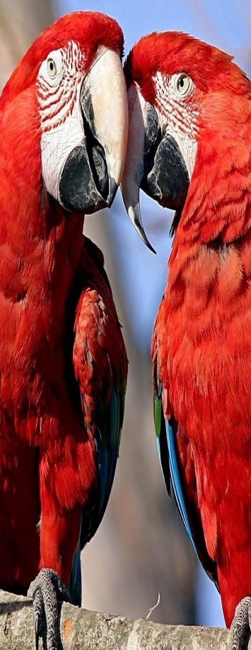
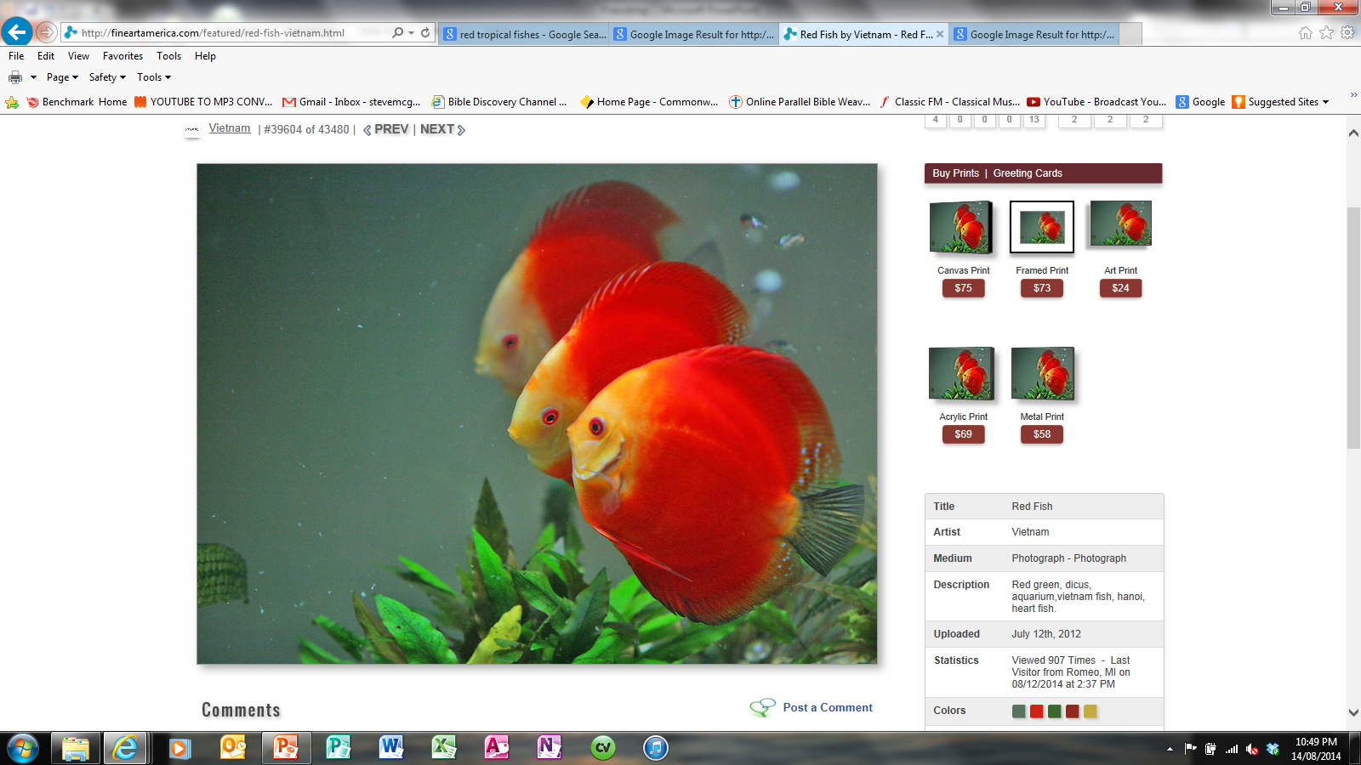
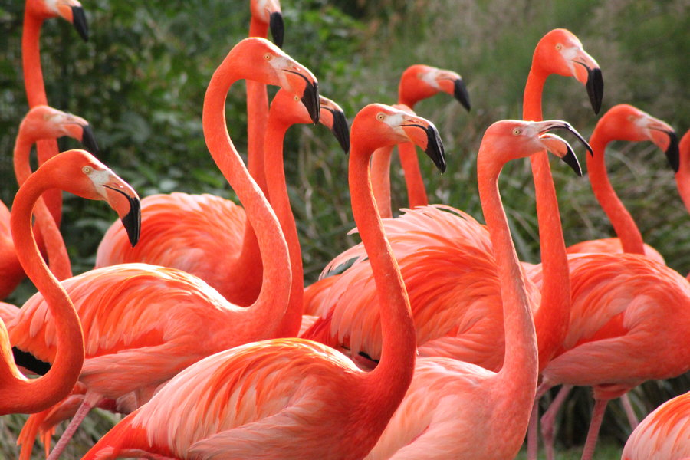
Friendship
and Betrayal

Slide 84
Friendship
Three Responses
1. Bitterness
Interaction is difficult and tense.
Act as if the other person is inferior to you.
2. Hatred
Interaction is avoided.
Act as if the other person doesn’t exist.
3. Vengeful
Interaction is solely to bring ruin.
Act in every way possible to destroy the other person.
and Betrayal

Slide 85
Friendship
A Fourth Response
4. Forgiveness
Interaction is solely to win the other person for Christ. It may still be difficult, tense or even sometimes necessary to be avoided for a while, but the ultimate salvation of the other person is the motive.
Act as Christ would act.
and Betrayal

Slide 86
Friendship
Forgiveness
Before God
Recognition of sin – Heb 4v12
Confession of Sin – Psa 32v5; 1 John 1v9
Sorrow for having sinned – 2 Cor 7v9-10
Forsaking of sin – Prov 28v13; Acts 2v38
and Betrayal

Slide 87
Friendship
Forgiveness
To our Brothers and Sisters
If they have ought against you – Matt 5v23-24; Matt 18v15-17 (‘..leave your gift and go be reconciled..’)
If you have ought against them – Mark 11v25 (NLT ‘..first forgive anyone you are holding a grudge against..’)
Forgive them ‘from the heart’ – Matt 18v35
and Betrayal

Slide 88
Friendship
Forgiveness
To our Brothers and Sisters
Forgive them without measure – Luke 17v3-4 (‘..until seventy times seven..’)
A continually forgiving attitude – Eph 4v31-32 (‘..kind, tenderhearted, forgiving..’)
and Betrayal

Slide 89
Friendship
‘Maschil’ Psalms
Maschil
= A Psalm for public instruction
and Betrayal

Slide 90
Friendship
‘Maschil’ Psalms
Psalm 52
How to react when betrayed by an enemy
Psalm 53
How to react when betrayed by a fool
Psalm 54
How to react when betrayed by your own people
Psalm 55
How to react when betrayed by your family and your own personal friend
and Betrayal

Slide 91
Friendship
Jesus Towards Judas
The love for Judas
Trust – The bag John 12v6
Promise – Twelve thrones Matt 19v28
Rebuke – The wasted ointment Jn 12v7
Difficulty – The secret directions Lk 22v10
Honour – A chief seat John 13v26
Service – Washing feet John 13v5
Warning – Ye are clean but not all Jn 13v10
Prophecy – He that eateth bread with me John 13v18
and Betrayal

Slide 92
Friendship
Jesus Towards Judas
The love for Judas
Warning – One of you shall betray me John 13v21
Warning – Better…never been born Matt 26v24
Friendship – The sop John 13v26
Revelation – Is it I, Thou hast said Matt 26v25
and Betrayal

Slide 93
Friendship
Summary
Seek to be reconciled to our brother in a spirit of humility
Have a forgiving attitude at all times
Know that vengeance belongs to God
Be careful that we betray not the Son of God – Heb 6v4-8; Heb 10v25-31
and Betrayal

Slide 94
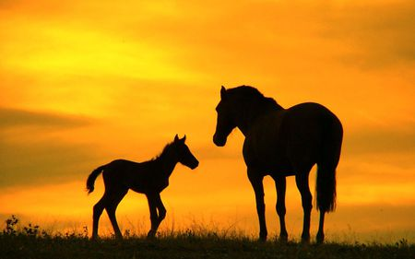
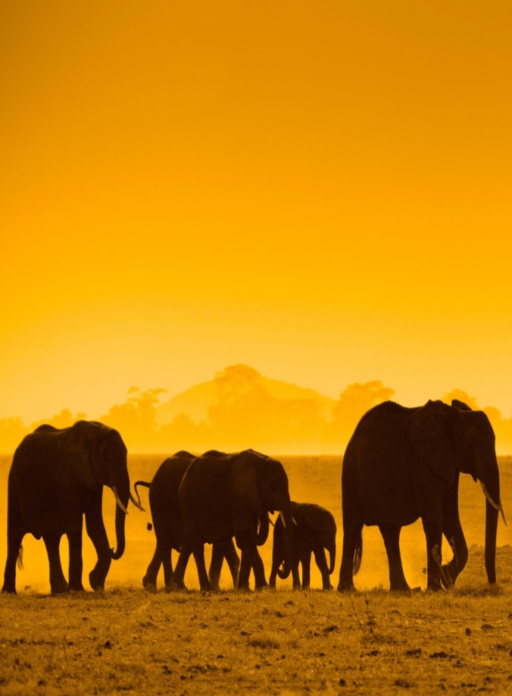
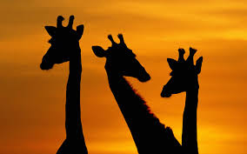
Friendship
for Eternity

Slide 95
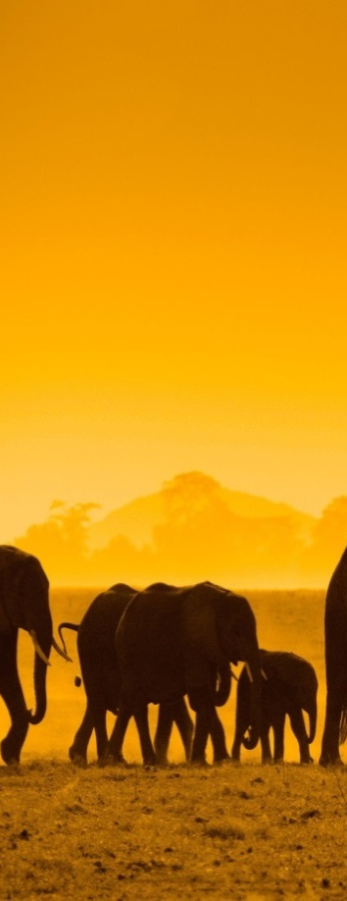
Friendship
The Lost Elder Brother
Luke 15v 29-30
Resentful
Self Righteous
Jealous
Disloyal
Unforgiving
for Eternity

Slide 96
Friendship
Quote
The only way to have a friend is to be one
If you want to attract a certain type of friend, you have to first be that type of friend
for Eternity

Slide 97
Friendship
Two Parts
How we treat others
How we influence others
for Eternity

Slide 98
Friendship
Quote
“Oh I’m sorry I forgot, I only exist when you need something”
for Eternity

Slide 99
Friendship
Prayer
Pray with your friends
Col 4v2, Eph 6v18, Rom 12v12,
(without ceasing)
Pray for your friends
Phil v4, 2 Tim 1v3, 1 Thess 1v2, 2Thess 1v3, Col 1v3, Phil 1v3-4
(I give thanks to God for you)
for Eternity

Slide 100
Friendship
What you need to be
Committed
Reliable
Watchful
Thoughtful
Friends and heirs together of the grace of life
for Eternity

