Slide 1
“Significant prophetic events in the financial world, Britain, Europe and the Papacy”
Signs of our times
To Armageddon
Royal Oak Ecclesia – 4 November 2014

Slide 2
The signs are numerous
Here is the one that is unmistakeable!
70 years of almost unbroken prosperity in much of the world is about to end and a time of trouble never before experienced will begin.
Men’s hearts will then truly fail for fear of things coming on the earth.
Listen to this

Slide 3
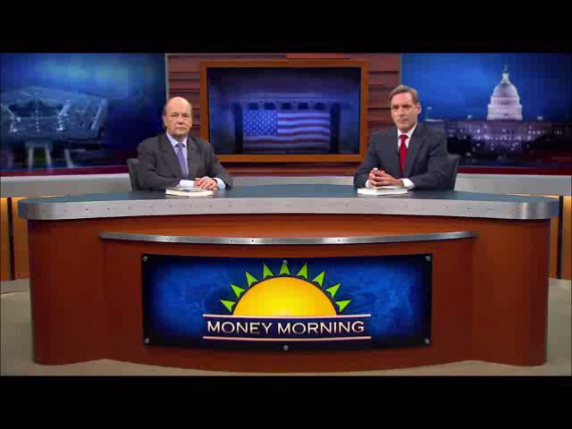
The coming 25 year Depression
…that will not last that long!

Slide 4
Prosperity at return of Christ!
Luke 17:26-30
Eating and drinking – gluttony and excessive drinking – culture of enjoyment and revelry.
Marrying and being given in marriage – implies multiple marriages – culture of pleasure.
Buying and selling – pre-occupation with acquisition – never satisfied = materialism.
Planting – business pursuits - culture of increase and gain.
Building – continual upgrading to improve status – culture of luxury and comfort.
...and then all their prosperity collapsed in a day when the saints were taken away
The days of Noah and Lot!

Slide 5
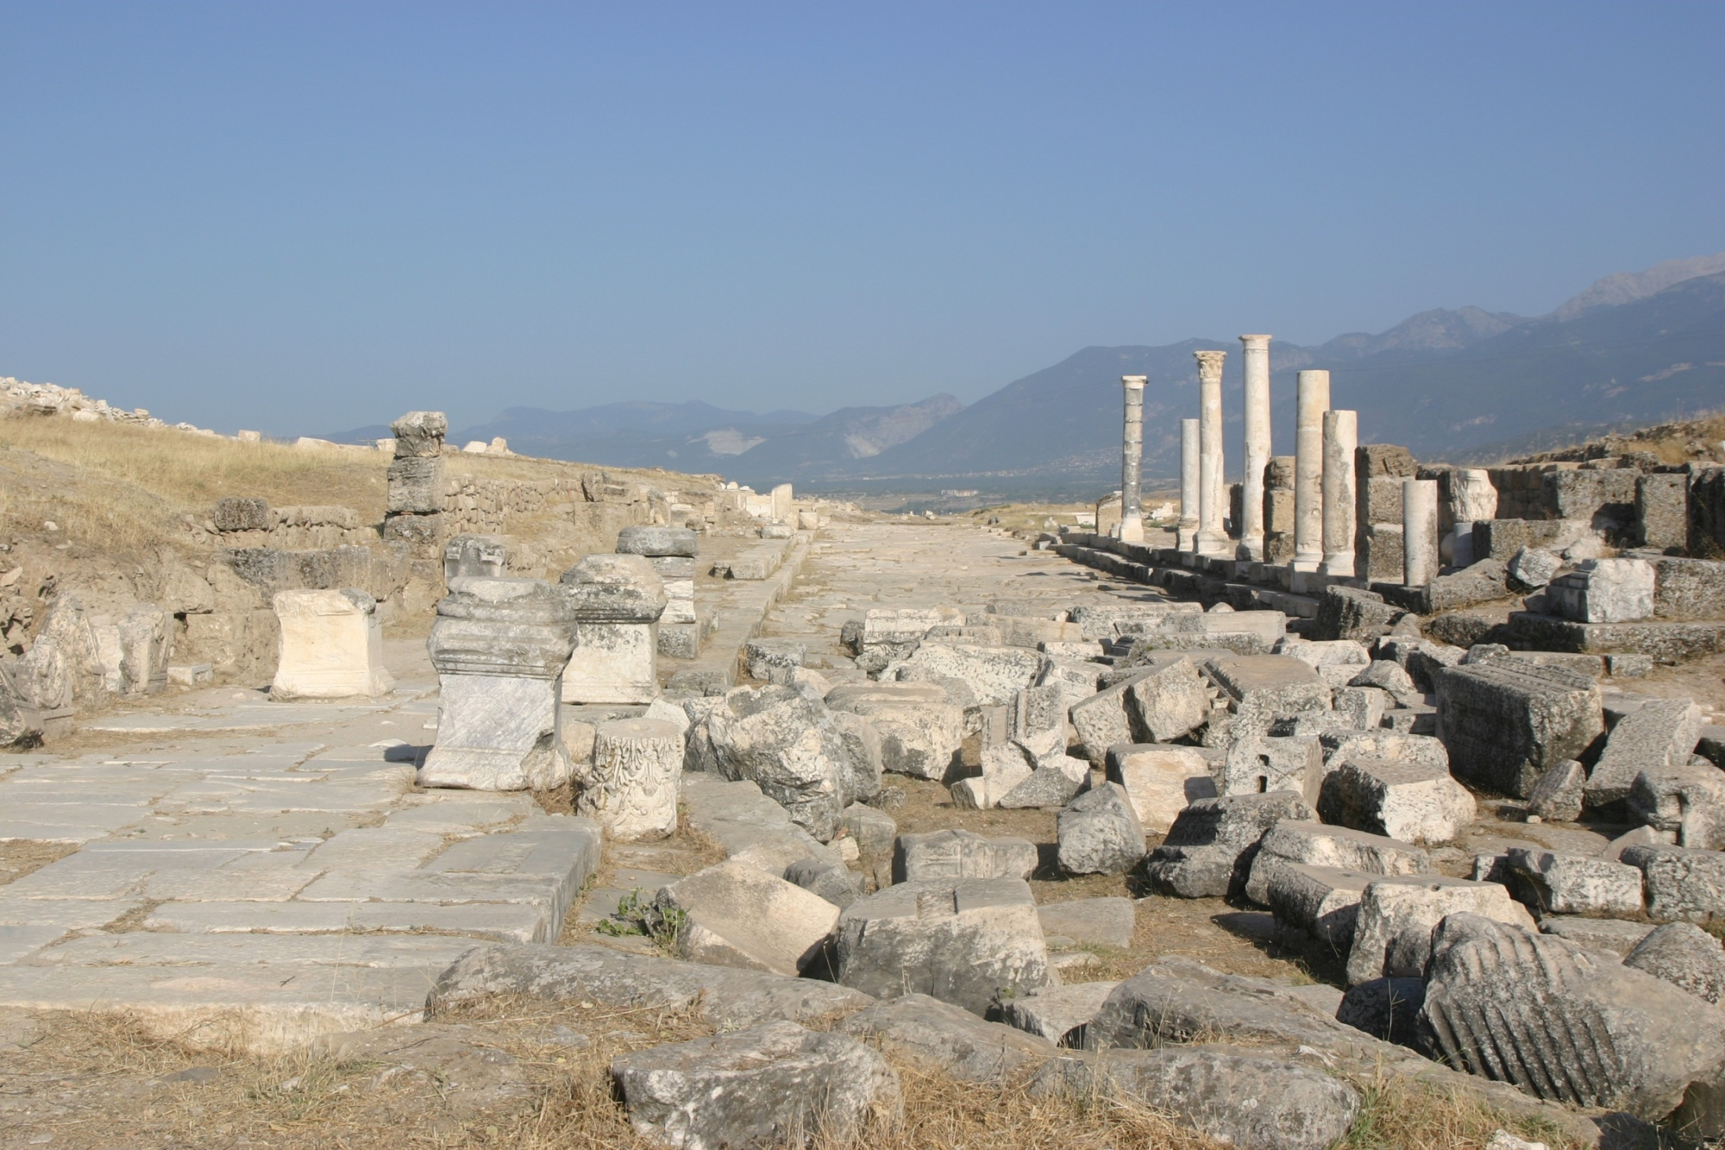

Ruins of ancient Laodicea
.
“Because thou sayest, I am rich, and increased with goods, and have need of nothing; and knowest not that thou art wretched, and miserable, and poor, and blind, and naked.” – Rev. 3:17
We are in the Laodicean era of Ecclesial history – A time of unparalleled prosperity!
“Behold, I stand at the door, and knock…”

Slide 6


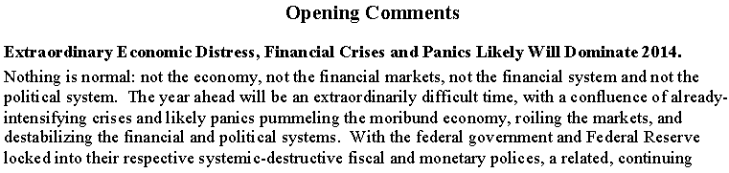
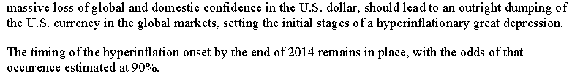
John Carroll Williams (born June 12, 1962) is the President and Chief Executive Officer of the Federal Reserve Bank of San Francisco. He serves on the Federal Open Market Committee.
90% chance of hyperinflationary great depression beginning in 2014

Slide 7
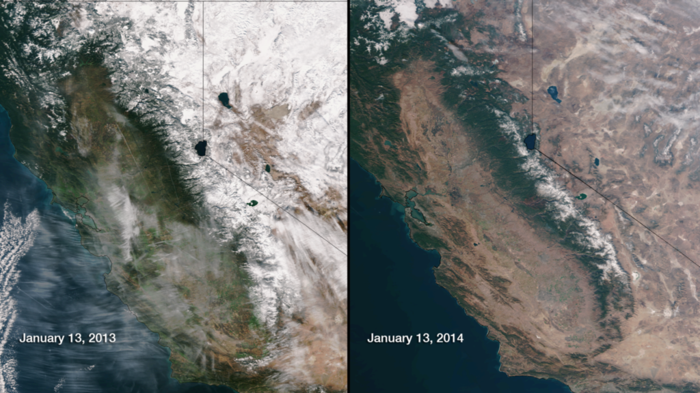
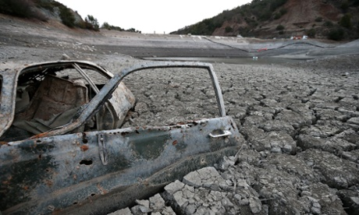
What might the triggers be?
It may be the collapse of the world’s once 4th largest economy from a 3 year drought.
California
A dam in San Jose

Slide 8
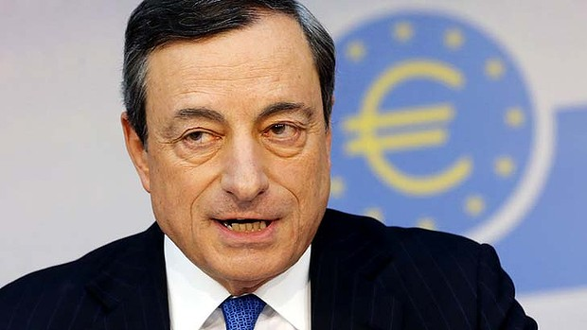
European Central Bank moves to negative interest rates
ECB CEO Mario Draghi
A strong Euro, the threat of Deflation, ballooning debt levels and slow growth forced the ECB to slash interest rates – now negative! (5 June 2014)
Decision made to use Quantitative Easing should these extraordinary measures fail.
This is just another of many possible triggers for a collapse of the financial system that many pundits expect soon.
The ‘End Game’ begins for Europe

Slide 9
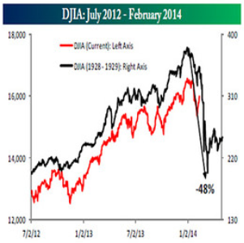
The Dow Jones Industrial Average (Stock Market activity) from 1928-29 and 2012-14

Slide 10
Timeline of Depressions
World War 2
1929
10 years
1939
War
Times of prosperity become times of poverty and unemployment
1930
This is the last cycle because of the events of 2,060
201?
10 years
Times of prosperity become….
A huge
financial crisis
is long overdue!
A time of trouble such as never was – Dan. 12:1-2
Armageddon

Slide 11
Revival of the Holy Roman Empire
Graphic from the book “The Principality and Power of Europe – Britain and the Emerging Holy Roman Empire”
From a stained glass church window
European Flag
French Euro coin
12
Stars
Christ and the Saints destroy the revived Holy Roman Empire

Slide 12
The H.R.E. and Papal dominion must end by 2060 – Dan. 7:8,23-27
Rev. 19:20
Sir Isaac Newton knew this date
Holy Roman Empire

Slide 13
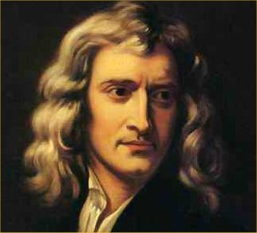
Sir Isaac Newton
1642-1727 - mathematician and physicist, one of the foremost scientific intellects of all time.
Wrote on religion. Rejected the Trinity as unscriptural and predicted 2060 as the year of the demise of the Papacy.
There is a note in the margin of his Bible to this effect – seen by a Christadelphian.
His private papers were kept secret for fear of the church.
How could anyone living nearly 300 years ago predict the demise of the largest Christian organisation on earth in 2060?

Slide 14
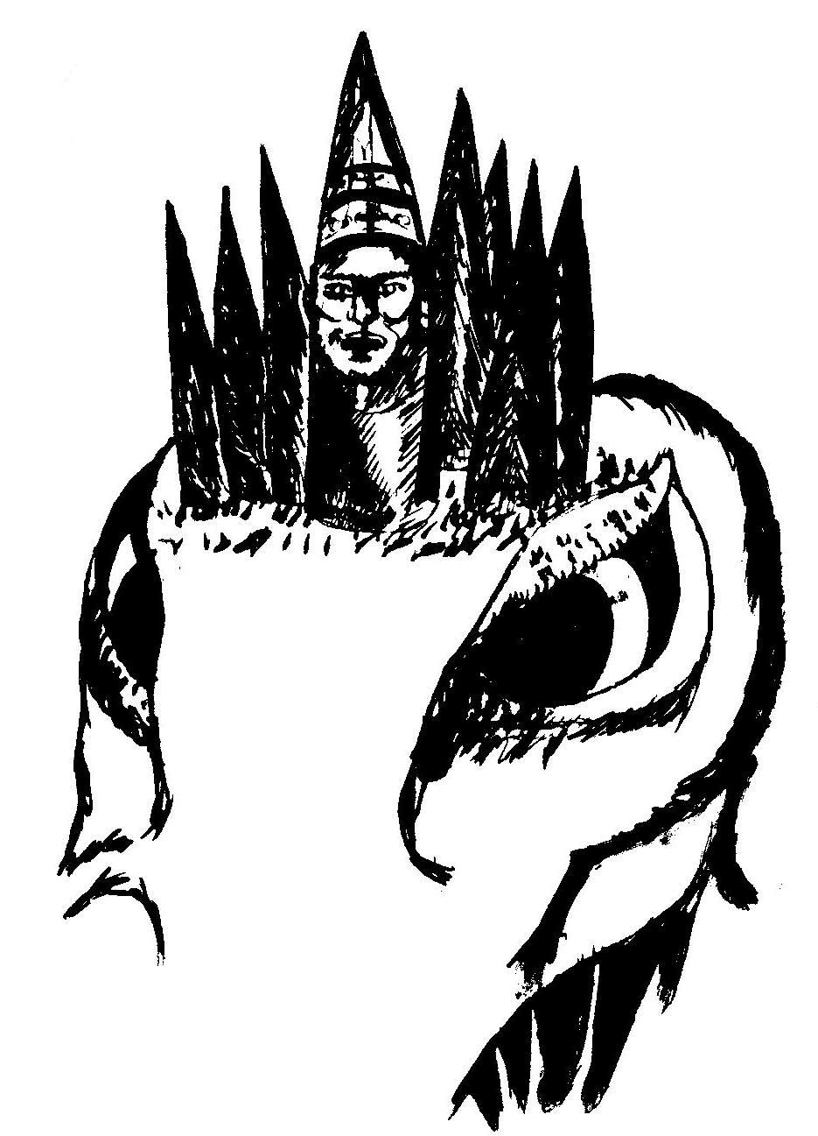
The rise and fall of the Holy Roman Empire
Dan. 7:8
Holy See
I considered the horns, and, behold, there came up among them another little horn, before whom there were three of the first horns plucked up by the roots: and, behold, in this horn were eyes like the eyes of man, and a mouth speaking great things.
Encyclical mouth
The Roman 4th Beast

Slide 15
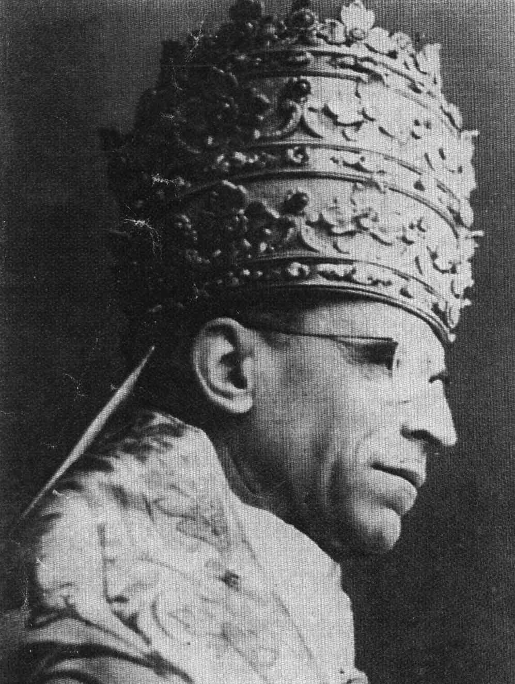
3 Horns plucked up - Dan. 7:8
The Papacy fell out with Constantinople over idols in the 7th century AD.
Troubled by the Lombards the Pope called on Pepin king of France.
Pepin gave the 3 states (horns) to the Pope 758 AD.
Holy See
Encyclical mouth
The 4th Beast - Rome
Triple tiara crown

Slide 16
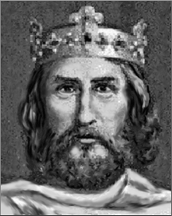

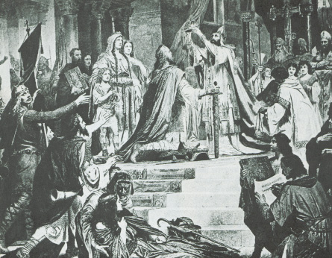
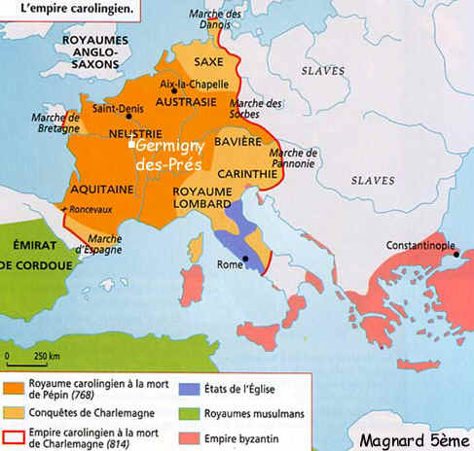
Charlemagne AD 800-814
Pope Leo lll crowned Charlemagne as Emperor of the Holy Roman Empire in 800 AD – he became protector of the Church
Christmas Day 800 AD

Slide 17
Interpretation - Daniel 7:23-26
23 Thus he said, The fourth beast shall be the fourth kingdom upon earth, which shall be diverse from all kingdoms, and shall devour the whole earth, and shall tread it down, and break it in pieces.
24 And the ten horns out of this kingdom are ten kings that shall arise: and another shall rise after them; and he shall be diverse from the first, and he shall subdue three kings.
25 And he shall speak great words against the most High, and shall wear out the saints of the most High, and think to change times and laws: and they shall be given into his hand until a time and times and the dividing of time.
26 But the judgment shall sit, and they shall take away his dominion, to consume and to destroy it unto the end.

Slide 18
A time, times and a dividing of time
Dan. 7:25 – 360 + 720 + 180 = 1260 days/yrs.
AD 312 – Triumph of Constantine + 1260 = 1572 – Massacre of St Bartholomew’s Day.
AD 529-533 – Justinian Decrees giving Bishop of Rome headship of the church (political power) + 1260 = 1789-1793 – French Revolution – Papacy loses control of ‘eldest son’ of the church.
AD 608-610 – Decree of Phocas granting Papacy temporal (political) power + 1260 = 1868-1870 – Garabaldi drives Pope out of Vatican – loss of temporal power.

Slide 19
The times of the HRE
The Holy Roman Empire had two important dates at its inception:
758 AD – Pepin king of France conquered 3 Barbarian states in Italy and gave them to the Pope.
800 AD – Pope Leo crowned Charlemagne Emperor of the Holy Roman Empire.
Add 1260 years and the reverse happens:
758 + 1260 = 2018 – Papacy likely regains immense political power in Europe.
800 + 1260 = 2060 – The year of the destruction of the HRE and Papal system.
Triple tiara worn by Pius 12
Christmas Day 800 AD

Slide 20
Events of the Jubilee Period
50 years
Marriage
of Lamb
Yahweh Sabaoth manifested in power
for 40 years but glory unseen by the world
Elijah’s mission to scattered Jewry
Papacy abolished 2060
THE SECOND EXODUS OF ISRAEL
Return of Christ - Resurrection
Judgement Seat
Arabs subdued
The smiting and healing of Egypt
Christ’s universal rule over all nations
Judah saved and settled in Land
10 years
Gog buried – Land cleansed & divided
40 years
ARMAGEDDON
Rome destroyed
Mid-heaven
Proclamation
10 years
Catholic Europe destroyed – 30 years
Marriage
Supper
Britain submits
All nations submit to Christ
Temple built

Slide 21
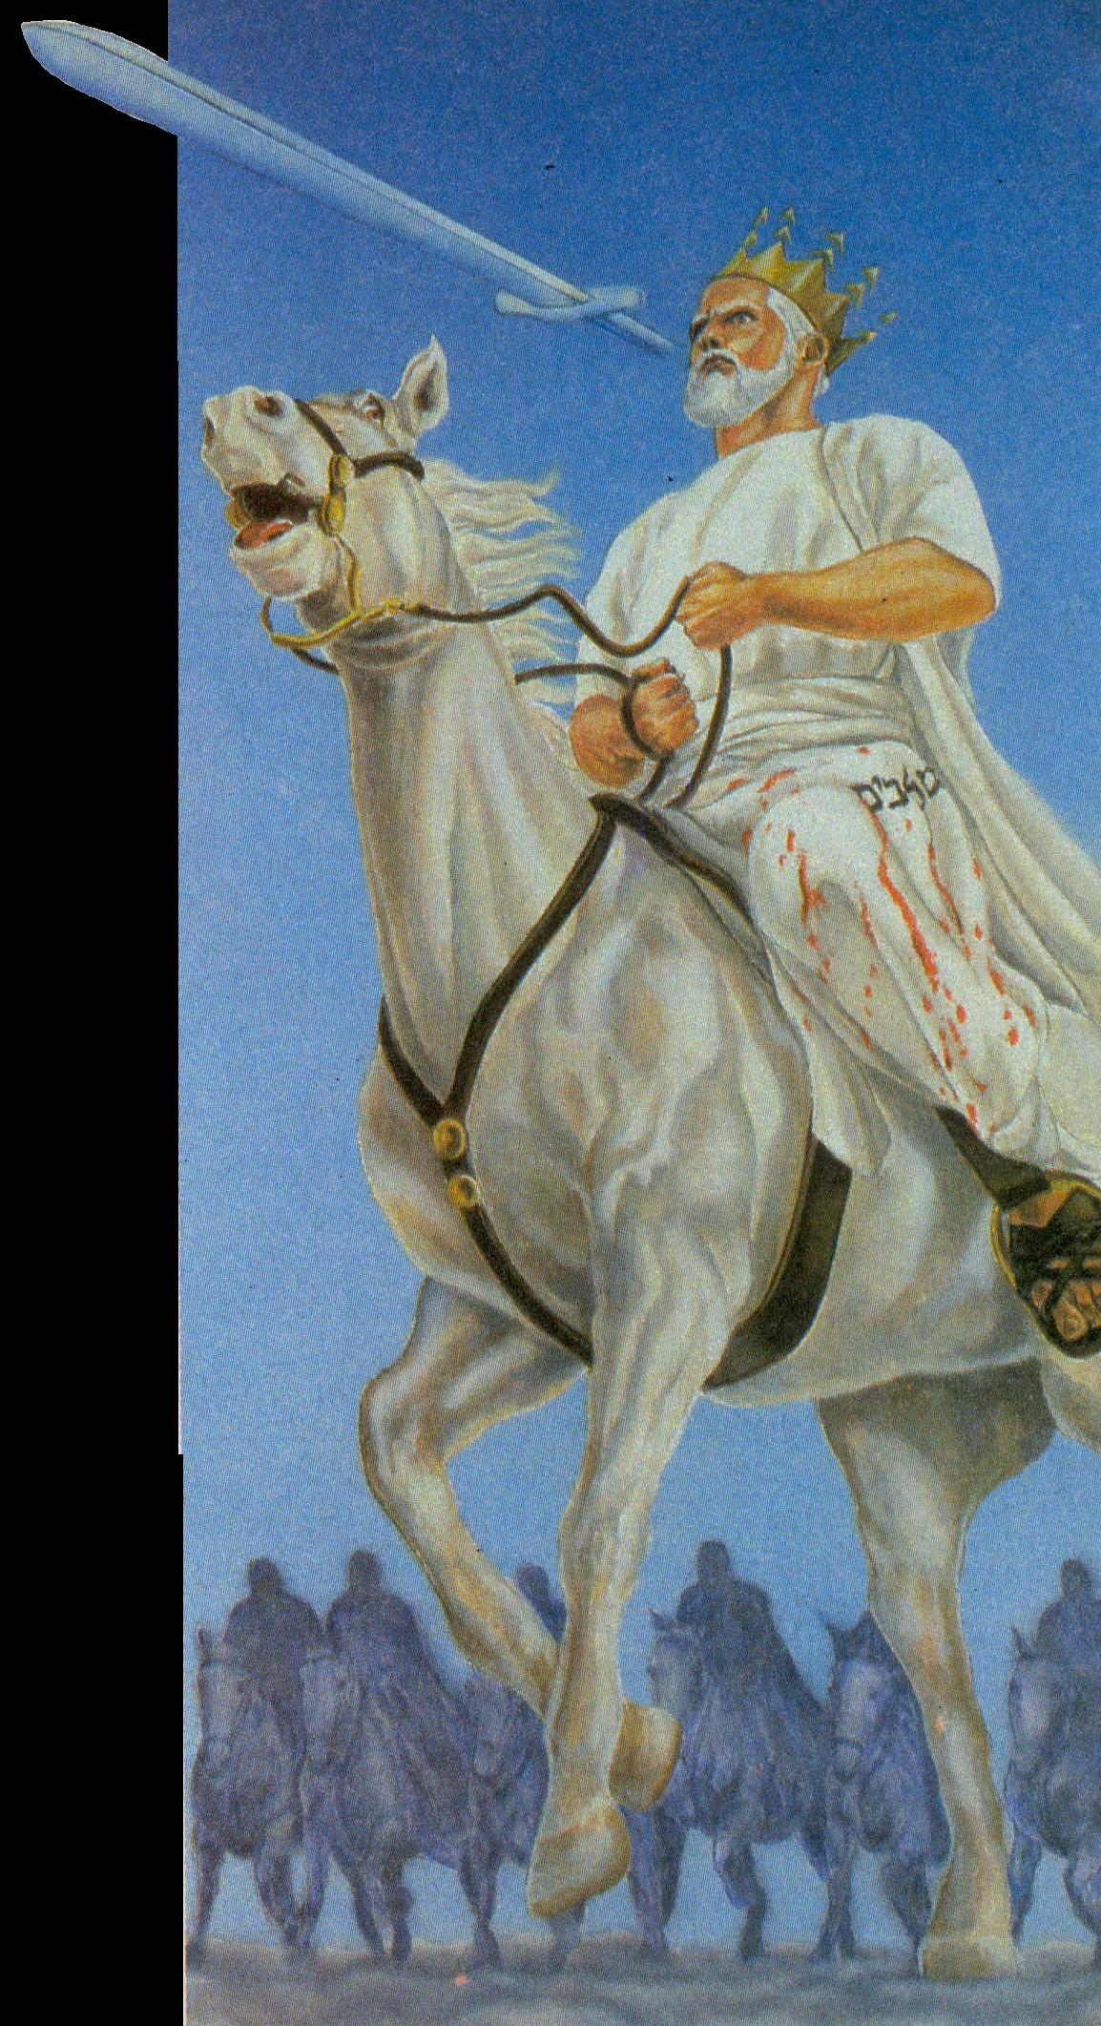
Rev. 19:19-20
¹⁹ And I saw the beast, and the kings of the earth, and their armies, gathered together to make war against him that sat on the horse, and against his army.
²⁰ And the beast was taken, and with him the false prophet that wrought miracles before him, with which he deceived them that had received the mark of the beast, and them that worshipped his image. These both were cast alive into a lake of fire burning with brimstone.

Slide 22
Rev. 19:21
²¹ And the remnant were slain with the sword of him that sat upon the horse, which sword proceeded out of his mouth: and all the fowls were filled with their flesh.
i.e. subjected nations
The destruction of the revived HRE and the Papacy does not bring to an end all adherence to Catholic doctrine and practice.

Slide 23
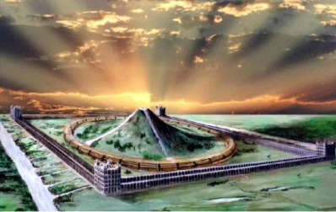
How long do we have?
50 years
The length of this period will determine how long we have!
Bride walked around House
Armageddon
4 years = 2014
5 years = 2015
6 years =2016
Etc.
Papacy and H.R.E. destroyed
Resurrection
10 years
40 years
2060
Rev. 19:21 – How long?

Slide 24
There is only one fixed date/year here that we can know
50 years
Bride walked around House
Papacy and H.R.E. destroyed
Armageddon
Resurrection
10 years
40 years
2060
Rev. 19:21 – How long?

Slide 25
World history revealed to Nebuchadnezzar
Dan. 2:29
As for thee, O king, thy thoughts came into thy mind upon thy bed, what should come to pass hereafter: and he that revealeth secrets maketh known to thee what shall come to pass.

Slide 26
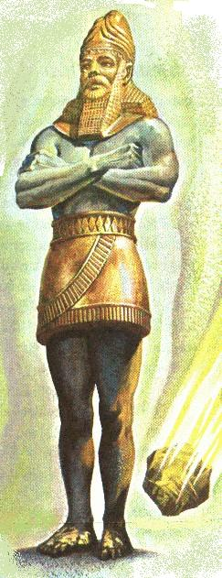
Nebuchadnezzar’s Image
Babylonian Empire
BC 606-539
Gold
Medo-Persian Empire
BC 539-334
Silver
Grecian Empire
BC 334-67
Brass
Roman Empire
BC 67-AD 476
Iron
Modern Europe
Iron & clay

Slide 27
Prophecy of the Latter Days
Dan 2:35
Then was the iron, the clay, the brass, the silver, and the gold, broken to pieces together, and became like the chaff of the summer threshingfloors; and the wind carried them away, that no place was found for them: and the stone that smote the image became a great mountain, and filled the whole earth.
The Kingdom of God replaces
the kingdom of men!

Slide 28

Britain not part of the Image
Papacy in Rome – Babylon the Great in the west
Gog as “king of the north” and “little horn of the goat” in Constantinople
Between 395 and 420 AD the Roman Empire was finally resolved into two legs – with an emperor in Rome and another in Constantinople.
Rome left Britain between 383 and 410 AD. When the legs were formed Britain was no longer part of the Roman Empire.

Slide 29
The Roman Empire – Two legs
When Theodosius died in AD 395, his sons Honorius (12) became emperor of the west, and his brother Arcadius (17) of the east.
This division of the empire into eastern and western parts was the decisive one, which sent the two on separate ways. One of the two emperors had always enjoyed seniority over the other. However, the accession of Arcadius and Honorius is widely seen as the division of the Roman empire into two completely separate parts. By 410 the separation was almost complete.

Slide 30

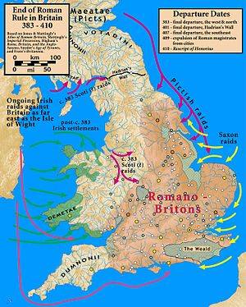
End of Roman rule
Britain is clearly the Tarshish of Ezek. 38:13.
Britain with its young lions will oppose Gog’s invasion of the Land.
The historical ‘young lions’ – Australia, Canada, India, New Zealand.

Slide 31
But Britain is now part of the EU!
Both Conservative and Labour parties in the UK have strongly supported being part of the European Union since 1968.
However, Britain has strenuously refused to use the Euro and retained the pound as its currency.
Current Conservative PM David Cameron is a strong supporter of continued membership, but the British public has different intentions.
How has this happened?
Video time

Slide 32

Britain will leave the European Union

Slide 33

Britain and her allies
1st World War poster
Among the countries who survived the Global Financial Crisis of 2008 the best were Australia, Canada, India and New Zealand. All have a British system of government and three share the Queen as titular head of state.
Ezek. 38:13
Sheba, and Dedan, and the merchants of Tarshish, with all the young lions thereof, shall say unto thee, Art thou come to take a spoil?
Tarshish can be identified in Scripture and by history with Britain

Slide 34
Bro. Thomas on Young Lions
In the many references made to the Young Lions in his writings he never mentions America in that context.
Herald of the Kingdom and Age to Come – 1860 pgs. 107-8 he wrote in response to a question:
THE DESTINY OF THE UNITED STATES
By “America,” in the inquiry, we presume is meant the United States. In reply, we remark, that this confederacy is not represented by any prophetic symbols, nor are there any verbal predictions concerning it after the manner of those concerning: Babylon, Persia, Macedonia, Rome, the Ten Kingdoms, Russia, and so forth.

Slide 35
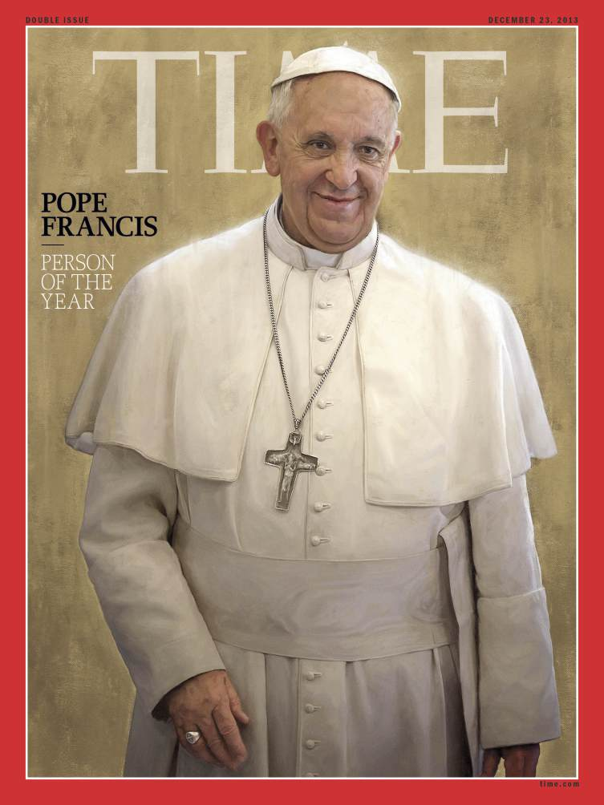
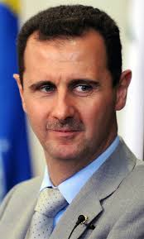

Pope Francis I – ‘Time’ Person of the Year for 2013
‘Time’ awards Person of the Year to the individual adjudged most influential in the world during the year.
Pope Francis beat Edward Snowden and Bashar al-Assad.

Slide 36
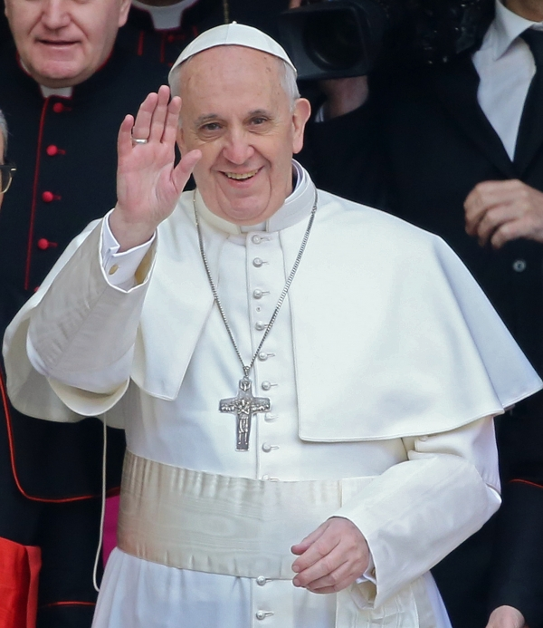
The Papacy and Modernism
Pope Francis presents himself as a liberal-minded caring figure – a man of the people.
He has recently given hope to homosexuals that they have a place in the church.
Nov. 2013 - began worldwide consultation of Catholic dioceses including questions about pastoral care for same-sex couples and re-married divorcees.

Slide 37
Significant shifts in the church
John Paul II and Benedict XVI were professors of theology. Francis is a former janitor, nightclub bouncer, chemical technician and literature teacher. And behind his self-effacing facade, he is a very canny operator. He makes masterly use of 21st century tools to perform his 1st century office.
But what makes this Pope so important is the speed with which he has captured the imaginations of millions who had given up on hoping for the church at all.
From the ‘Time’ web site

Slide 38
Iron and clay – Can they mix?
He is quoted saying of women who consider abortion because of poverty or rape, “Who can remain unmoved before such painful situations?” Of gay people: “If a homosexual person is of good will and is in search of God, I am no one to judge.” To divorced and remarried Catholics who are, by rule, forbidden from taking Communion, he says that this crucial rite “is not a prize for the perfect but a powerful medicine and nourishment for the weak.”
From the ‘Time’ web site

Slide 39

Daniel 2:41&43
And whereas thou sawest the feet and toes, part of potters’ clay, and part of iron, the kingdom shall be divided; but there shall be in it of the strength of the iron, forasmuch as thou sawest the iron ¹mixed with miry clay.
And whereas thou sawest iron ¹mixed with miry clay, they shall ¹mingle themselves with the seed of men: but they shall not cleave one to another, even as iron is not ¹mixed with clay.
¹garav – to commingle. Rt. to braid, i.e. intermix; to traffic (as if by barter): also to give or be security (the idea of a guarantor). Translated “be surety” Gen. 44:32; Prov. 6:1; 11:15; 20:16.

Slide 40
Iron mingled with clay!
In the second chapter of Daniel the kingdoms of men are represented by a composite image, consisting of four principal elements: first, gold; second, silver; third, brass; and fourth, iron; each element representing some phase of the kingdoms of men. The fourth element in its latter day phase assumes the aspect of clay and iron mixed; i.e., republicanism and autocracy, shown, perhaps, in one of its most subtle aspects, in the silent capture of democracy by autocratic ecclesiasticism, enabling the latter to ride into power thereby.
Henry Sulley, Temple of Ezekiel’s Prophecy

Slide 41
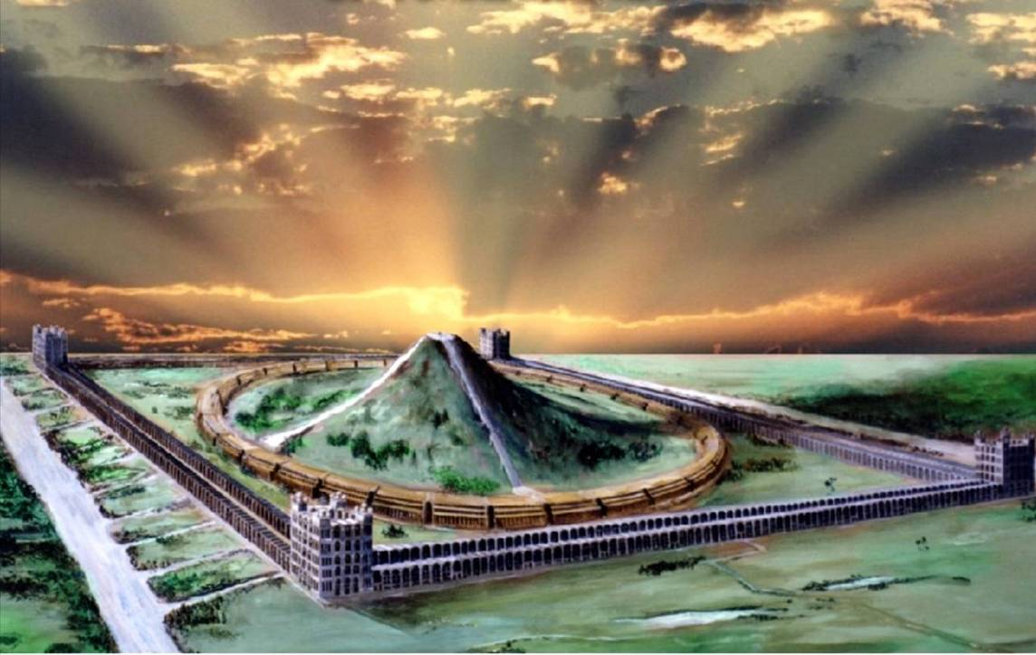
“Even so, come, Lord Jesus.”
“…the path of the just is as the shining light, that shineth more and more unto the perfect day.” – Prov. 4:18
Cameos of the Kingdom

Slide 42
...
.

