Slide 1
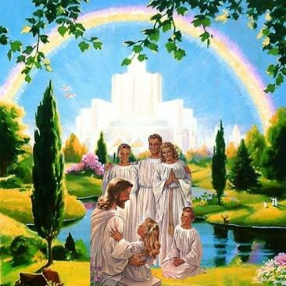
Living as a member of God’s Family
Class 1: What does God require of You?

Slide 2
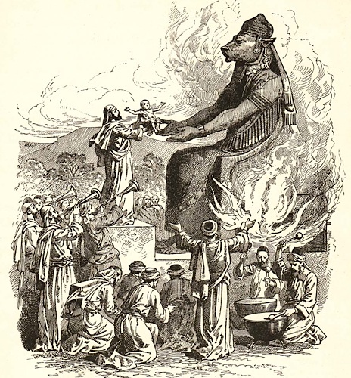
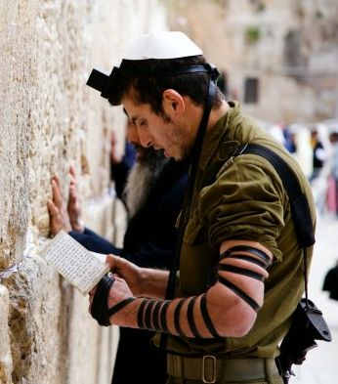
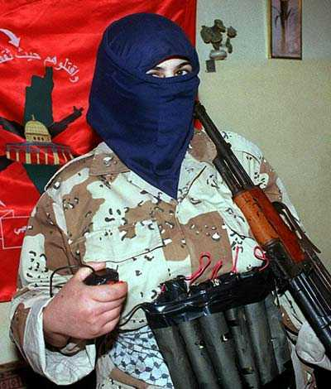
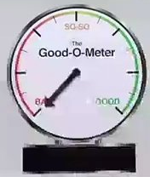

How some people think…
they can earn Salvation

Slide 3

For it is by grace you have been saved, through faith — and this not from yourselves, it is the gift of God— not by works, so that no one can boast. (Eph 2:8-9 NIV)
but God shows his
love for us in that while we were still sinners, Christ died for us.
(Rom 5:8 ESV)

Slide 4

Deuteronomy 29:1-15
A New Covenant
1 These are the words of the covenant which the Lord commanded Moses to make with the children of Israel in the land of Moab, besides the covenant which He made with them in Horeb.
2 Now Moses called all Israel and said to them: "You have seen all that the Lord did before your eyes in the land of Egypt, to Pharaoh and to all his servants and to all his land — 3 the great trials which your eyes have seen, the signs, and those great wonders. 4 Yet the Lord has not given you a heart to perceive and eyes to see and ears to hear, to this very day. 5 And I have led you forty years in the wilderness. Your clothes have not worn out on you, and your sandals have not worn out on your feet. 6 You have not eaten bread, nor have you drunk wine or similar drink, that you may know that I am the Lord your God. 7 And when you came to this place, Sihon king of Heshbon and Og king of Bashan came out against us to battle, and we conquered them. 8 We took their land and gave it as an inheritance to the Reubenites, to the Gadites, and to half the tribe of Manasseh. 9 Therefore keep the words of this covenant, and do them, that you may prosper in all that you do.
→
This covenant was based on what God had done and will do for His people

Slide 5
Deuteronomy 29:1-15
A New Covenant
10 "All of you stand today before the Lord your God: your leaders and your tribes and your elders and your officers, all the men of Israel, 11 your little ones and your wives — also the stranger who is in your camp, from the one who cuts your wood to the one who draws your water — 12 that you may enter into covenant with the Lord your God, and into His oath, which the Lord your God makes with you today, 13 that He may establish you today as a people for Himself, and that He may be God to you, just as He has spoken to you, and just as He has sworn to your fathers, to Abraham, Isaac, and Jacob.
14 "I make this covenant and this oath, not with you alone, 15 but with him who stands here with us today before the Lord our God, as well as with him who is not here with us today.
This covenant was based on God’s promises to Abraham that He swore to bring to pass

Slide 6
Deuteronomy 30:11-16
You aren’t expected to earn this gift from God
11 Now what I am commanding you today is not too difficult for you or beyond your reach. 12 It is not up in heaven, so that you have to ask, "Who will ascend into heaven to get it and proclaim it to us so we may obey it?" 13 Nor is it beyond the sea, so that you have to ask, "Who will cross the sea to get it and proclaim it to us so we may obey it?" 14 No, the word is very near you; it is in your mouth and in your heart so you may obey it.
15 See, I set before you today life and prosperity, death and destruction. 16 For I command you today to love the Lord your God, to walk in his ways, and to keep his commands, decrees and laws; then you will live and increase, and the Lord your God will bless you in the land you are entering to possess.
God doesn’t expect more than we can do

Slide 7
Romans 10:1-13
The Jews tried to establish righteousness
1 Brethren, my heart's desire and prayer to God for Israel is that they may be saved. 2 For I bear them witness that they have a zeal for God, but not according to knowledge. 3 For they being ignorant of God's righteousness, and seeking to establish their own righteousness, have not submitted to the righteousness of God. 4 For Christ is the end (goal - NASBmg) of the law for righteousness to everyone who believes.
They didn’t understand God’s righteousness

Slide 8
Romans 10:1-13
God did the impossible by providing Jesus
5 For Moses writes about the righteousness which is of the law, "The man who does those things shall live by them." 6 But the righteousness of faith speaks in this way, "Do not say in your heart, 'Who will ascend into heaven?'" (that is, to bring Christ down from above) 7 or, "'Who will descend into the abyss?'" (that is, to bring Christ up from the dead). 8 But what does it say? "The word is near you, in your mouth and in your heart" (that is, the word of faith which we preach): 9 that if you confess with your mouth the Lord Jesus and believe in your heart that God has raised Him from the dead, you will be saved. 10 For with the heart one believes unto righteousness, and with the mouth confession is made unto salvation. 11 For the Scripture says, "Whoever believes on Him will not be put to shame."
We need to believe & trust God, and confess His salvation to others

Slide 9
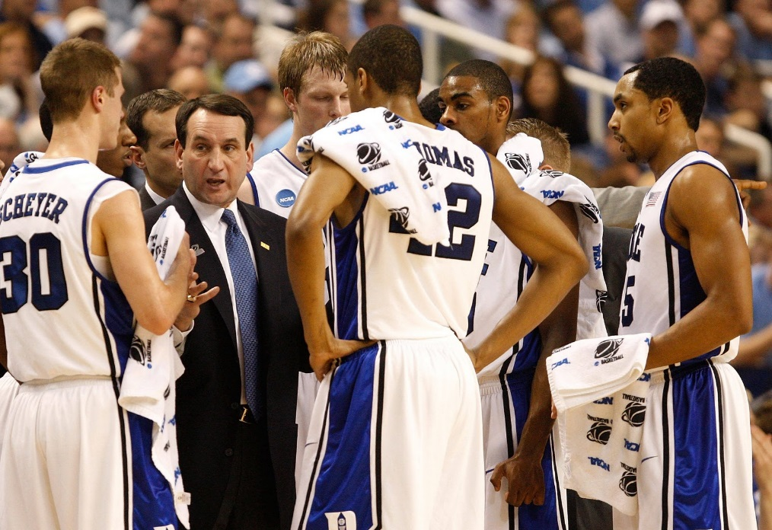
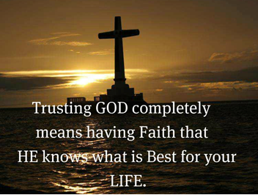
God is our Coach
He financed the team
He chose the players
He sets the game-plan
He guarantees success
He knows what we need to play on his team
All He has ever required of His children is to trust Him, love Him, and walk in His ways
Notes:
Financed: paid the price of the death of his son Acts 20:28
Chose: you were chosen in him before the foundation of the world – Eph 1:4
Set game plan: who has known mind of Lord or been his counsellor? – Rom 11:34
Guarantees success: who can separate us from the love of God? - Rom 8
Knows what we need – Before we ask him Matt 6:8

Slide 10
Micah 6:6-8
What God is after from us
6 With what shall I come before the Lord, and bow myself before the High God? Shall I come before Him with burnt offerings, with calves a year old? 7 Will the Lord be pleased with thousands of rams, ten thousand rivers of oil? Shall I give my firstborn for my transgression, the fruit of my body for the sin of my soul?
8 He has shown you, O man, what is good; and what does the Lord require of you but to do justly, to love mercy, and to walk humbly with your God?
God is creating a family with members who live like Him – not trusting in rituals

Slide 11

This is the piece we must provide!

Slide 12
Hebrews 11:1-6 (NIV)
Faith is the Key!
1 Now faith is being sure of what we hope for and certain of what we do not see. 2 This is what the ancients were commended for.
3 By faith we understand that the universe was formed at God's command, so that what is seen was not made out of what was visible.
6 And without faith it is impossible to please God, because anyone who comes to him must believe that he exists and that he rewards those who earnestly seek him.
Faith is the motivator to live for God

Slide 13
Hebrews 3:7-19
Those who lack faith will not join God’s Family
7 Therefore, as the Holy Spirit says: "Today, if you will hear His voice, 8 do not harden your hearts as in the rebellion, in the day of trial in the wilderness, 9 where your fathers tested Me, tried Me, and saw My works forty years. 10 Therefore I was angry with that generation, and said, 'They always go astray in their heart, and they have not known My ways.' 11 So I swore in My wrath, ‘they shall not enter My rest.'"
12 Beware, brethren, lest there be in any of you an evil heart of unbelief in departing from the living God; 13 but exhort one another daily, while it is called "Today," lest any of you be hardened through the deceitfulness of sin. 14 For we have become partakers of Christ if we hold the beginning of our confidence steadfast to the end, 15 while it is said: "Today, if you will hear His voice, do not harden your hearts as in the rebellion."
16 For who, having heard, rebelled? Indeed, was it not all who came out of Egypt, led by Moses? 17 Now with whom was He angry forty years? Was it not with those who sinned, whose corpses fell in the wilderness? 18 And to whom did He swear that they would not enter His rest, but to those who did not obey? 19 So we see that they could not enter in because of unbelief (no faith).
Faith provides the motive to trust God

Slide 14
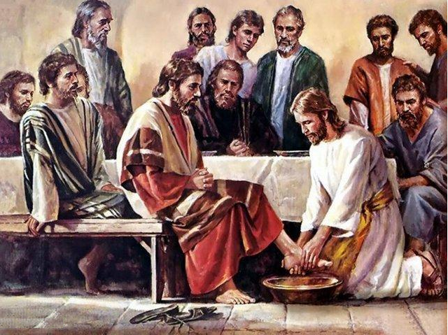
Faith motivates us to serve God & others

Slide 15
James 2:14-26
Faith must be active!
14 What does it profit, my brethren, if someone says he has faith but does not have works? Can faith save him? 15 If a brother or sister is naked and destitute of daily food, 16 and one of you says to them, "Depart in peace, be warmed and filled," but you do not give them the things which are needed for the body, what does it profit? 17 Thus also faith by itself, if it does not have works, is dead.
18 But (back to v. 16) someone [like James] will say, "You have faith, and I have works. Show me your faith without your works, and I will show you my faith by my works.” [Note: quotes should end here as in the NASB]
Our faith should motivate us to live for God

Slide 16
James 2:14-26
Abraham & Rahab justified by works
19 You believe that there is one God. You do well. Even the demons believe — and tremble! 20 But do you want to know, O foolish man, that faith without works is dead? 21 Was not Abraham our father justified by works when he offered Isaac his son on the altar? 22 Do you see that faith was working together with his works, and by works faith was made perfect? 23 And the Scripture was fulfilled which says, "Abraham believed God, and it was accounted to him for righteousness." And he was called the friend of God. 24 You see then that a man is justified by works, and not by faith only.
25 Likewise, was not Rahab the harlot also justified by works when she received the messengers and sent them out another way?
26 For as the body without the spirit is dead, so faith without works is dead also.
Our faith must generate Godly works

Slide 17
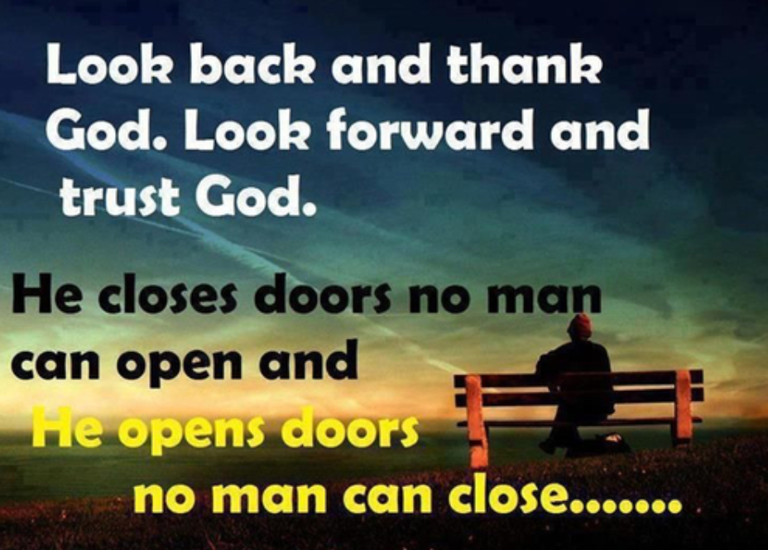
Faith Trusts God in ALL circumstances of life
Daniel’s 3 friends in the fiery furnace (Dan 3)
Joseph in prison in Egypt (Gen 39)
David, when his men wanted to stone him after the Amalekites raided Ziklag (1Sam 30)
Jesus, after he asked God if there was any other way (Mat 26:39)
Faith allows them to move forward, no matter what happened, confident God was working in their lives

Slide 18
Faith Trusts God in ALL circumstances of our lives
We might be frustrated with our family or ecclesia
We may not get the boyfriend or girlfriend we want so bad
We may have lost our health or job
We might experience an accident or major health issue
Faith allows us to move forward, no matter what has happened, confident God is working in our lives

Slide 19
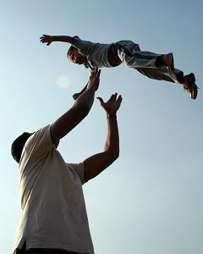
God wants a relationship with you where you will trust Him as your Father, so He can raise you into His Family

Slide 20

Let’s use this weekend to
enhance our
8
Our Father in Heaven
To grow our Faith

Slide 23
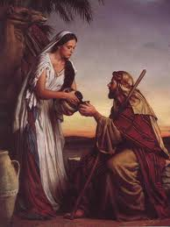
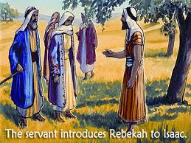
A Wife for Isaac
Abraham’s Faith in Action!
Gen 23:2 Sarah is now dead
24:2-3 Abraham has Eliezar swear he won’t let Isaac marry a Canaanite
27:46; 28:1 Rebekah later on reminds Isaac to do same for Jacob
26:34 Esau had already married 2 Hittite women
24:6 Don’t take Isaac back there! (Abraham knew)
Isaac was the only patriarch to not leave the land
24:12 Eliezar prays, Abraham prays, Isaac prays (24:63)
Good choices & Godliness requires effort, planning and lots of prayer – it doesn’t happen by itself!

Slide 24
2 Corinthians 6:14-18 (RSV)
Marriages should be “in the Lord”
14 Do not be mismated with unbelievers. For what partnership have righteousness and iniquity? Or what fellowship has light with darkness?
15 What accord has Christ with Be'lial? Or what has a believer in common with an unbeliever?
18 and I will be a father to you, and you shall be my sons and daughters, says the Lord Almighty."
God wants what’s best for US !

Slide 25
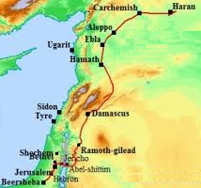
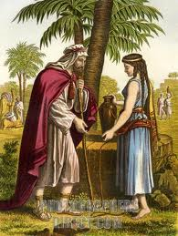
Marriages should be “in the Lord”
Eliezar travelled a long way so Isaac could marry a believer!
600 miles
1 Corinthians 7:39
A wife is bound by law as long as her husband lives; but if her husband dies, she is at liberty to be married to whom she wishes, only in the Lord.
This is the goal for our children to grow up with both Mom and Dad directing them in the ways of the Lord. Remember what God said of Abraham:
"For I have known him, in order that he may command his children and his household after him, that they keep the way of the LORD, to do righteousness and justice, that the LORD may bring to Abraham what He has spoken to him.“ (Gen 18:19)

Slide 26
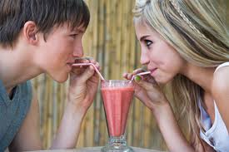
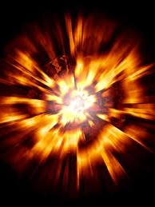
Then what does this mean about Dating?
God wants us to marry a believer
God expects us to date believers
Dating unbelievers is not Biblical.
It is playing with fire and dynamite, and then expecting God to save us out of the resulting explosion!
Dating is not a game! Your spiritual future is at stake. Pray for help & guidance!

Slide 27
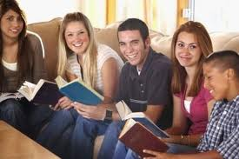

To the Unmarried (but considering marriage)
Look and date among Godly believers
Look for a spiritual partner who will love God (and you), no matter what happens
Pray about it constantly
Enter marriage knowing it will require daily work & compromise
Don’t expect a “Cinderella” marriage!
Do not be mismated with unbelievers. For what partnership have righteousness and iniquity? Or what fellowship has light with darkness? (2 Cor 6:14-16 RSV)

Slide 28

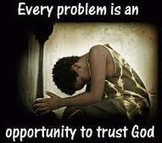
Marriages should be “in the Lord”
The Family Unit is the basis for ecclesial life and life in God’s family
The aim is to get both Mom and Dad striving together for the hope of the gospel
Marriages work best when you are heirs together of the grace of life.
Don’t give up if mistakes are made. Pray for God to bring something good out of the situation and be ready to help.

Slide 29
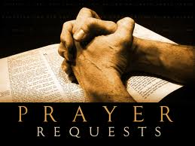
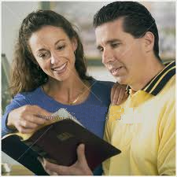


Good Marriages are the result of Daily Prayer and effort!
Pray for God’s help and blessing
Recognize it takes daily effort
Read the Bible together
Work on projects together
Don’t try to change your partner! Change yourself Let God change your partner
Marriage is a work in progress!

Slide 30
Proverbs 19:14
Thank God for success!
Houses and riches are an inheritance from fathers, but a prudent wife is from the LORD.
Thank God daily for success in marriage. One plants, another waters, but it is God who gives the growth!

Slide 31

Lessons from This Class
God doesn’t expect us to do some impossible act to earn salvation – He did that in Christ
God loves you and wants to give you His free gift of grace
God is looking for Faith in us – He wants us to trust His game plan and promises to save us into His family
Look for a Godly partner to marry and Godly friends. People who will help you grow in faith every day

Slide 34


Slide 35
Philippians 4:4-7 (NIV)
Faith leads to Joy!
4 Rejoice in the Lord always. I will say it again: Rejoice! 5 Let your gentleness be evident to all. The Lord is near. 6 Do not be anxious about anything, but in everything, by prayer and petition, with thanksgiving, present your requests to God. 7 And the peace of God, which transcends all understanding, will guard your hearts and your minds in Christ Jesus.
This is the only true peace in this life – trust God & put everything in His hands

Slide 36
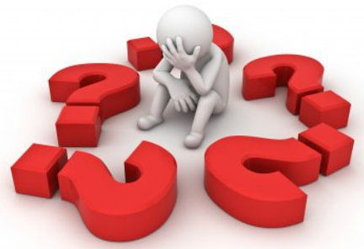

So, how do we do it?
Understand the game plan – God is trying to help us understand how to play on His team
Slow down & notice what God is doing in your life
Talk to God all the time & ask for help to understand
Be aware of the angels He sends to help us out
Be patient! Great players develop over years and so will we.
Let’s go home with confidence in our God

Slide 37
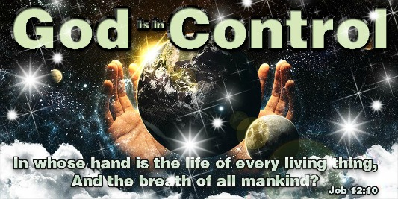

Slide 38
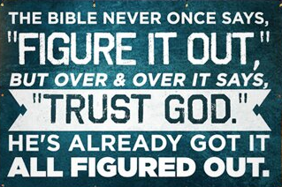

Slide 39
2
W
17
!

Slide 40
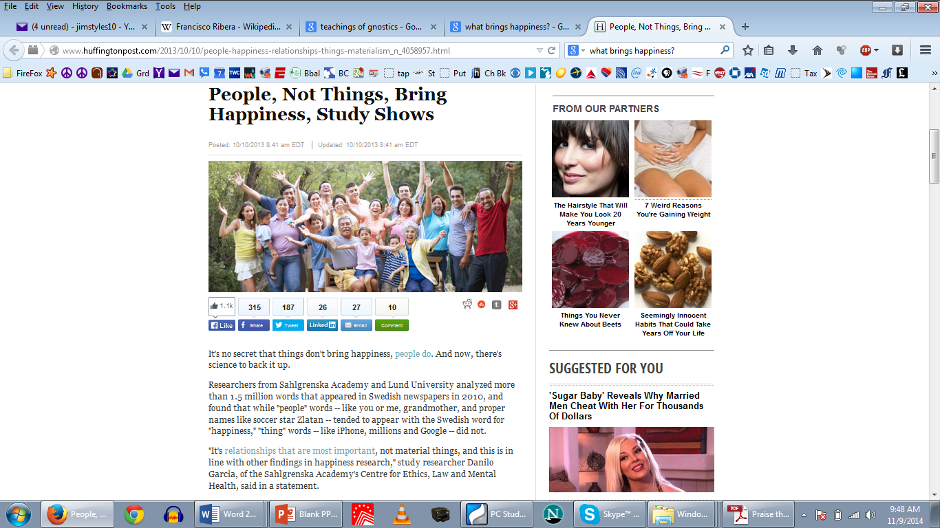
People, Not things, Bring Happiness, Study Shows

Slide 41
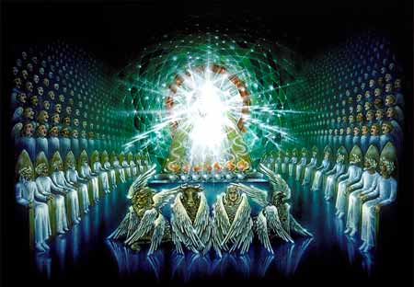
Visions of Rev 4-5
Living as a member of God’s Family
Class 1: What does God require of You?

Slide 42
2
S
G

Slide 43
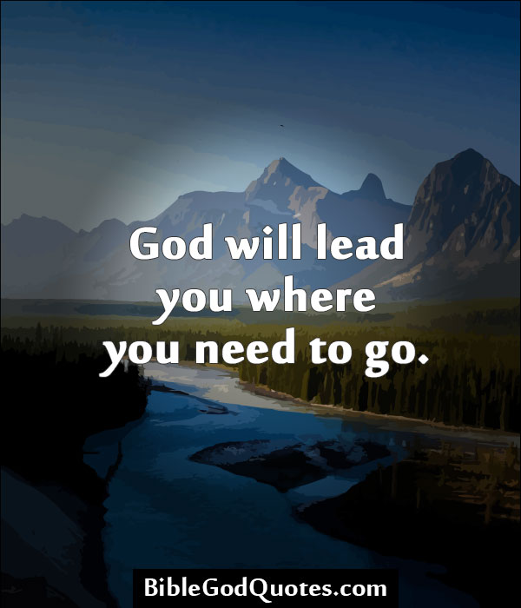

Slide 44
2
W
17
!

Slide 45
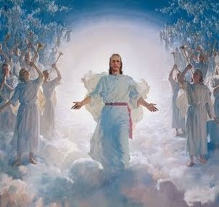

Slide 46
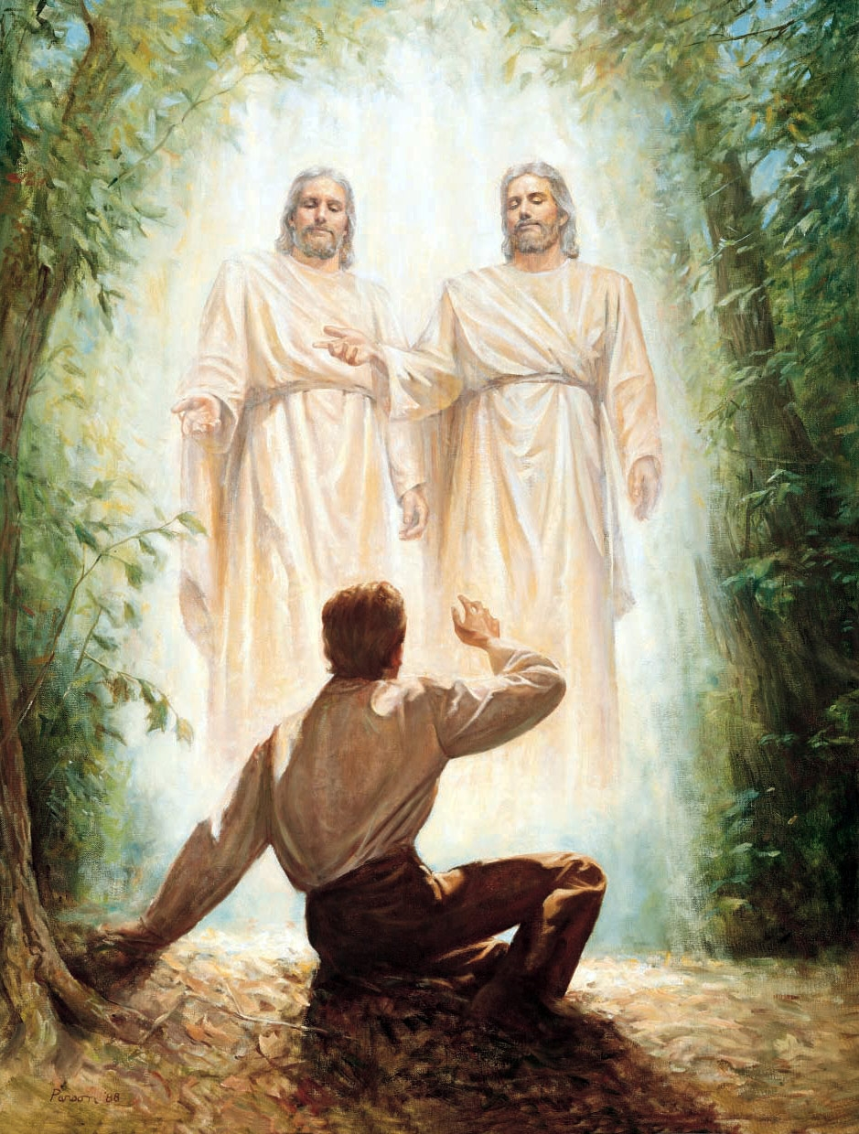
2
S
G

Slide 47
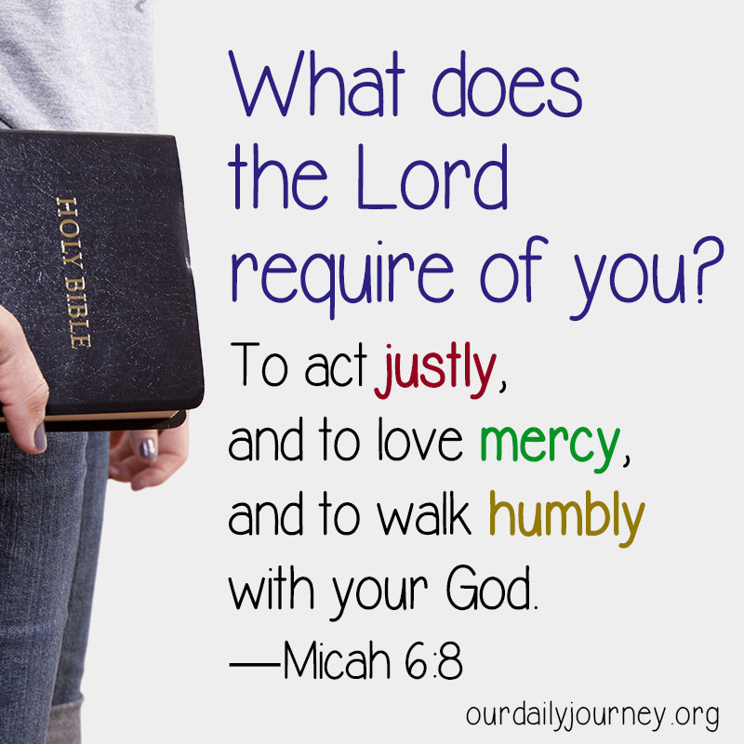
Isaiah’s Prophecies

Slide 48
2
W
17
!

Slide 49
2
S
G

Slide 50
2
W
17
!

Slide 51
2
S
G

Slide 52
2
W
17
!

Slide 53
2
S
G

Slide 54
2
W
17
!

Slide 55
2
S
G

Slide 56
2
W
17
!

Slide 57
2
S
G

Slide 58
2
W
17
!

Slide 59
2
S
G

Slide 60
2
W
17
!

Slide 61
2
S
G

Slide 62
2
W
17
!

Slide 63
2
S
G

Slide 64
2
W
17
!

Slide 65
2
S
G

Slide 66
2
W
17
!

Slide 67
2
S
G

Slide 68
2
W
17
!

Slide 69
2
S
G

Slide 70
2
W
17
!

Slide 71
2
S
G

Slide 72
2
W
17
!

Slide 73
2
S
G

Slide 74
2
W
17
!

Slide 75
2
S
G

Slide 76
2
W
17
!

Slide 77
2
S
G

Slide 80
2
S
G

Slide 81
2
W
17
!

Slide 82
2
S
G

Slide 83
2
W
17
!

Slide 84
Lessons from Today
Even

Slide 85

2
S
G

