Slide 1
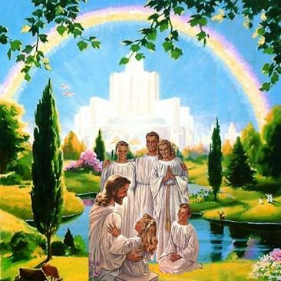
Living as a member of God’s Family
Class 2: Elevating your life to God’s moral code

Slide 2
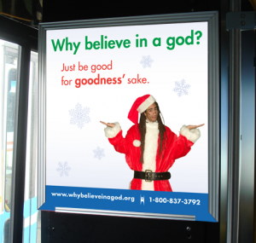

Slide 3
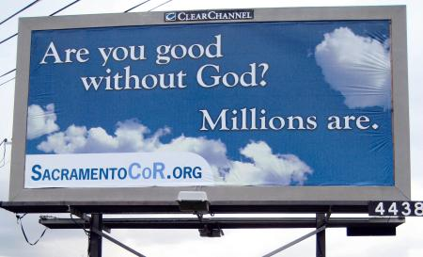
Sacramento Coalition of Reason

Slide 4
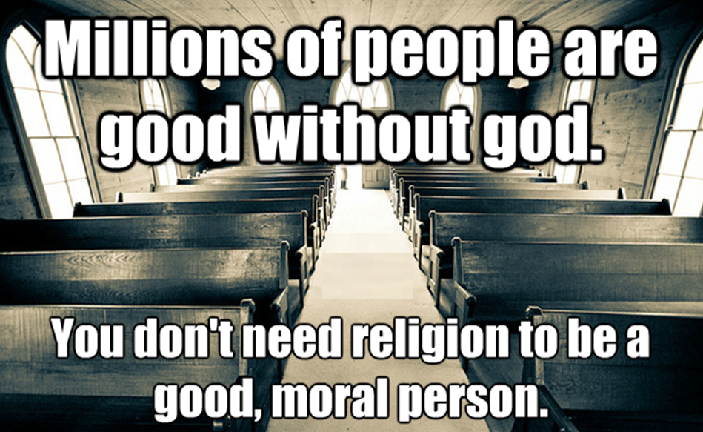

Slide 5
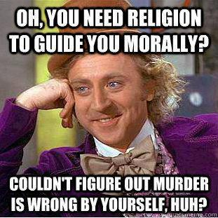

Slide 6


Slide 7

But what are Humanism’s answers for:
Paying taxes?
Divorce & remarriage? Gay marriage?
Pre-marital sex? Nudity? Polygamy?
War? ISIS? Vengeance?
Stealing from the rich?
Slavery? Abuse?
Someone has to define what is “good”

Slide 8


Slide 9

Humanism is designed for those who intend to only live once
It’s all about how you feel now and how you treat other people for this life only

Slide 10
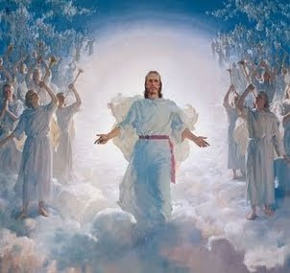
God’s morality is designed for a higher purpose…
Training us to join His family forever!

Slide 11
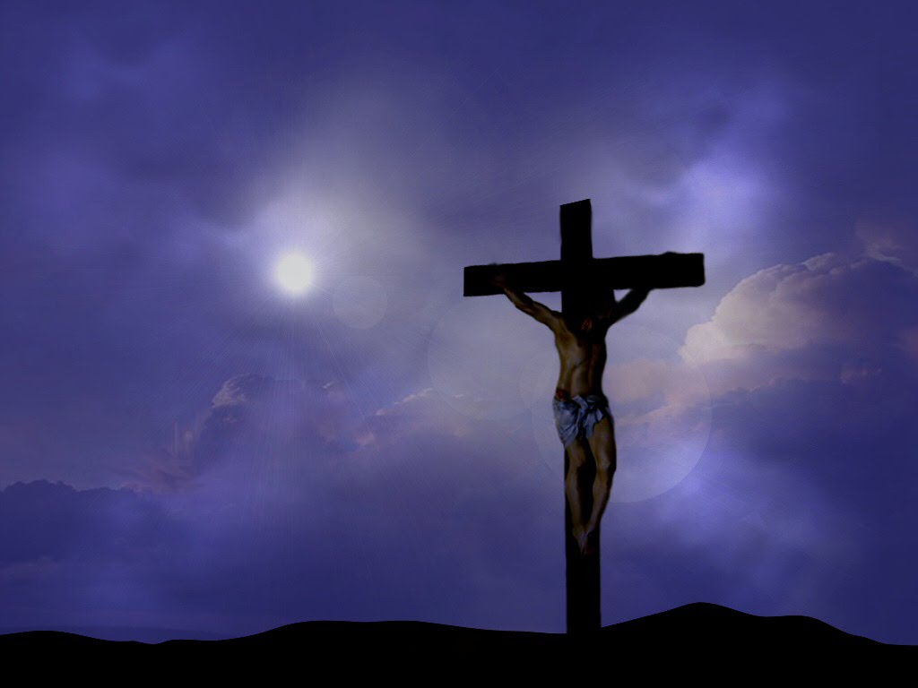
You can trust our Coach!
He loves us so much that He was willing to give His son to train us to join His family

Slide 12

God’s Morality has a higher purpose - training
Don’t steal – accept our situation & what God has given us is enough
No other gods before Him – only God’s morality will prepare us for immortality
Don’t divorce or commit adultery – practice faithfulness to God’s covenant
Submission – training us to be submissive to God
No vengeance – trust God to deal with these issues
No pride – God’s children will all acknowledge God’s hand in every aspect of life
Forgiveness & mercy – if we don’t practice them now we can’t expect to receive them from God
Humanism morality won’t prepare us for immortality

Slide 13

Colossians 3:1-4
Seeking God’s morality
1 If then you were raised with Christ, seek those things which are above, where Christ is, sitting at the right hand of God. 2 Set your mind on things above, not on things on the earth. 3 For you died, and your life is hidden with Christ in God. 4 When Christ who is our life appears, then you also will appear with Him in glory.
We must set our minds on God’s morality

Slide 14
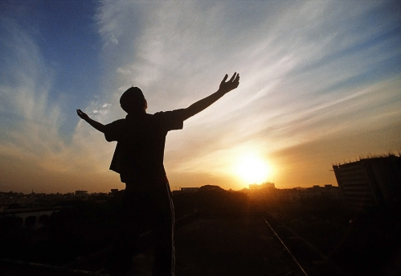
God & His angels designed our world in hope. They hoped that as we gaze into the sky:
We will realize that the true light that gives life to our world comes from above earth – from Him & we will look to Him & thank Him for life

Slide 15
Colossians 3:5-11
We all begin life satisfying our basic needs
5 Therefore put to death your members which are on the earth: fornication, uncleanness, passion, evil desire, and covetousness, which is idolatry. 6 Because of these things the wrath of God is coming upon the sons of disobedience, 7 in which you yourselves once walked when you lived in them.
8 But now you yourselves are to put off all these: anger, wrath, malice, blasphemy, filthy language out of your mouth. 9 Do not lie to one another, since you have put off the old man with his deeds, 10 and have put on the new man who is renewed in knowledge according to the image of Him who created him, 11 where there is neither Greek nor Jew, circumcised nor uncircumcised, barbarian, Scythian, slave nor free, but Christ is all and in all.
God is hoping to change us into different people who learn to live like God

Slide 16

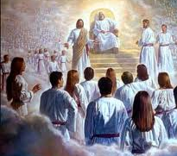
God’s Careful Design: He chose to Use Families
He could have chosen another way - communes, polygamy, divorce….
Gen 2:18 not good for man to be alone
Gen 18:19 I have known Abraham…that he might command his children
Eph 3:14-21 the Father of the Lord Jesus Christ…from whom the whole family in heaven and in earth is named
God allows us to experience His divine family and character through our families

Slide 17

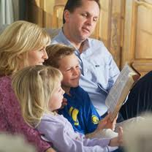
Marriage was designed by God
Mark 10:6-9
6 "But from the beginning of the creation, God 'made them male and female.‘ 7 'For this reason a man shall leave his father and mother and be joined to his wife, 8 'and the two shall become one flesh'; so then they are no longer two, but one flesh. 9 "Therefore what God has joined together, let not man separate.“
Malachi 2:15
And did not he make one (wife for Adam)? Yet had he the residue of the spirit. And wherefore one? That he might seek a godly seed. Therefore take heed to your spirit, and let none deal treacherously against the wife of his youth. [many people were breaking their covenants]
God designed marriage to be a one man - one woman relationship because He knows this is the best way to develop godly children!

Slide 18

Raising Godly Children is the Goal
We need someone at home instructing our children
The focus is on our children! When we get this right, many other problems dissolve.
What we do with our children is very similar to what the angels do with us – This is our practice time! We are learning to become angels in God’s kingdom
God designed families to help children grow up to become members of His family forever

Slide 19
2 Corinthians 6:14-18 (RSV)
Marriages should be “in the Lord”
14 Do not be mismated with unbelievers. For what partnership have righteousness and iniquity? Or what fellowship has light with darkness?
15 What accord has Christ with Be'lial? Or what has a believer in common with an unbeliever?
18 and I will be a father to you, and you shall be my sons and daughters, says the Lord Almighty."
God wants what’s best for US !

Slide 20
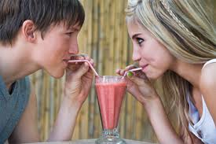

Then what does this mean about Dating?
God wants us to marry a believer
God expects us to date believers
Dating unbelievers is not Biblical.
It is playing with fire and dynamite, and then expecting God to save us out of the resulting explosion!
Dating is not a game! Your spiritual future is at stake. Pray for help & guidance!

Slide 21
Hebrews 12:3-11
There will be troubles & trials!
3 For consider Him (Jesus) who endured such hostility from sinners against Himself, lest you become weary and discouraged in your souls. 4 You have not yet resisted to bloodshed, striving against sin. 5 And you have forgotten the exhortation which speaks to you as to sons:
"My son, do not despise the chastening of the Lord, nor be discouraged when you are rebuked by Him; 6 For whom the Lord loves He chastens, and scourges every son whom He receives."
7 If you endure chastening, God deals with you as with sons; for what son is there whom a father does not chasten? 8 But if you are without chastening, of which all have become partakers, then you are illegitimate and not sons. 9 Furthermore, we have had human fathers who corrected us, and we paid them respect. Shall we not much more readily be in subjection to the Father of spirits and live? 10 For they indeed for a few days chastened us as seemed best to them, but He for our profit, that we may be partakers of His holiness. 11 Now no chastening seems to be joyful for the present, but painful; nevertheless, afterward it yields the peaceable fruit of righteousness to those who have been trained by it.
God uses our trials & troubles to train us to join His Family

Slide 22

God is attempting to reprogram our minds
By nature, we all try to satisfy ourselves – not others
Our minds are very good at deceiving ourselves and justifying our decisions
We tend to make decisions based on what gives us satisfaction & pleasure now – not about the future.
Reprogramming is a long, challenging project – thankfully God is willing to make the effort

Slide 23
I Corinthians 6:7-11
We all start out as ungodly people
7 Now therefore, it is already an utter failure for you that you go to law against one another. Why do you not rather accept wrong? Why do you not rather let yourselves be cheated? 8 No, you yourselves do wrong and cheat, and you do these things to your brethren! 9 Do you not know that the unrighteous will not inherit the kingdom of God? Do not be deceived. Neither fornicators, nor idolaters, nor adulterers, nor homosexuals, nor sodomites, 10 nor thieves, nor covetous, nor drunkards, nor revilers, nor extortioners will inherit the kingdom of God. 11 And such were some of you. But you were washed, but you were sanctified, but you were justified in the name of the Lord Jesus and by the Spirit of our God.
God changes our lives

Slide 24
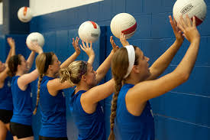
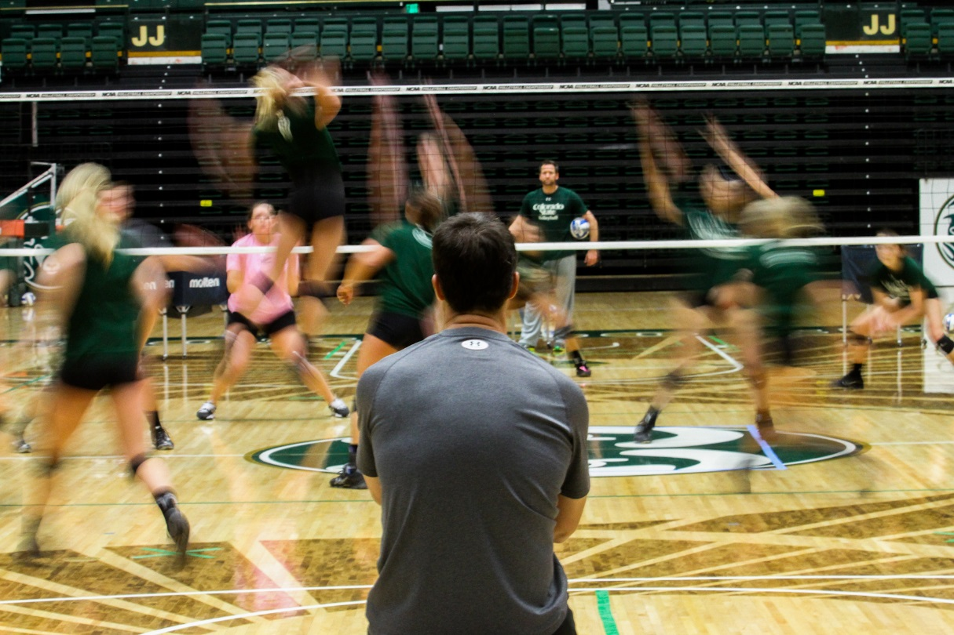
Our coach expects us to practice
So we will improve our game

Slide 25
1 John 3:7-12
We must practice living right
7 Little children, let no one deceive you. He who practices righteousness is righteous, just as He is righteous. 8 He who sins is of the devil, for the devil has sinned from the beginning. For this purpose the Son of God was manifested, that He might destroy the works of the devil. 9 Whoever has been born of God does not sin, for His seed remains in him; and he cannot sin, because he has been born of God.
10 In this the children of God and the children of the devil are manifest: Whoever does not practice righteousness is not of God, nor is he who does not love his brother. 11 For this is the message that you heard from the beginning, that we should love one another, 12 not as Cain who was of the wicked one and murdered his brother. And why did he murder him? Because his works were evil and his brother's righteous.
We will make mistakes, but we must practice living right daily!

Slide 26
Ephesians 6:1-4
Families become our training ground
1 Children, obey your parents in the Lord, for this is right. 2 "Honor your father and mother," which is the first commandment with promise: 3 "that it may be well with you and you may live long on the earth."
4 And you, fathers, do not provoke your children to wrath, but bring them up in the training and admonition of the Lord.
This becomes a basis for understanding God

Slide 27

God’s morality is helping you prepare for the future
Galatians 5:22-24
22 But the fruit of the Spirit is love, joy, peace, longsuffering, kindness, goodness, faithfulness, 23 gentleness, self-control. Against such there is no law. 24 And those who are Christ's have crucified the flesh with its passions and desires.
G
God’s training will change how we live

Slide 28


Slide 29


Waiting for God’s timetable
Abraham & Sarah waited till it was humanly impossible for them to have a child
Isaac & Rebekah waited 20 years for God to give them children
Job waited for God to finally send Elihu and speak to Job himself
David ran from Saul for years as he waited for God to make him king
Jacob waited years for God to change his children into spiritual sons of God
Joseph waited for over 20 years for God to reunite him with his family and his dreams to be fulfilled
Moses, Caleb & Joshua waited 40 years for God to lead Israel into the promised land
Abigail patiently waited years for God to remove Nabal and grant her a Godly husband
God does things at the right time, according to His purpose. He waited 4,000 years to send His son!

Slide 30

This is the piece we must provide!

Slide 31

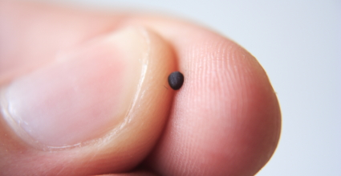

Our Faith must grow like a mustard seed
God directs the growth

Slide 32
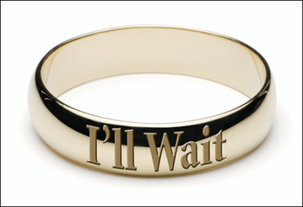


We practice righteousness daily so…
We won’t fall into sex before marriage
We won’t commit adultery
We won’t divorce our partner and split our family

Slide 33

Practicing Righteousness will help us in

Slide 34


Practicing Righteousness will help us:
Use the internet and cell phones for profitable activities

Slide 35
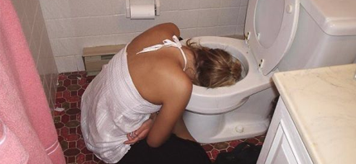
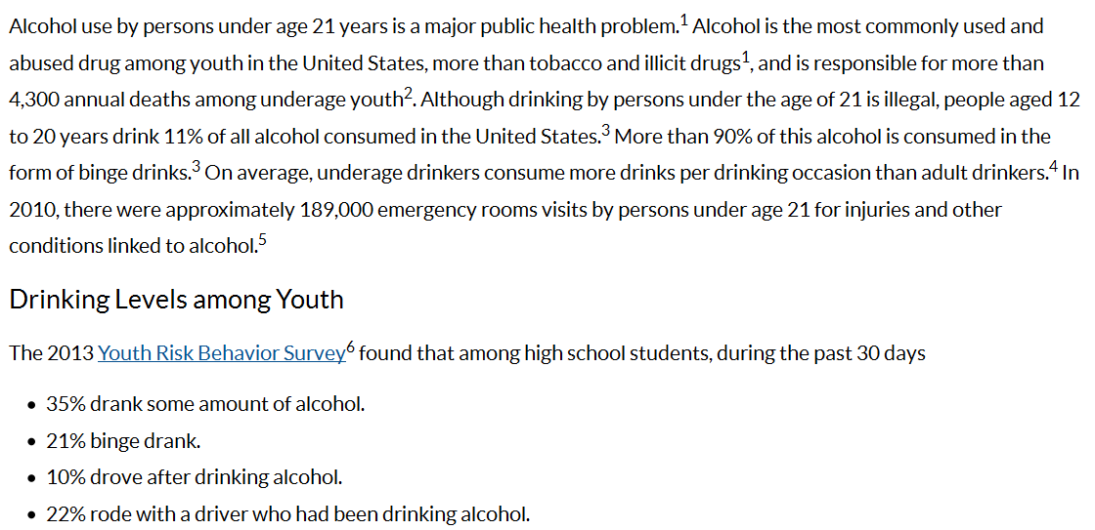
CDC fact sheet on Underage Drinking
God is planning something better for you!

Slide 36
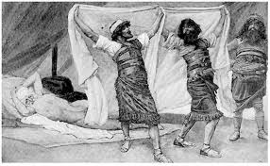
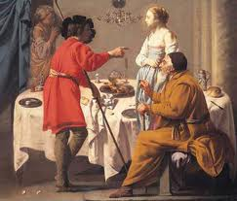

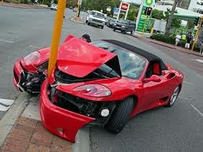
Alcohol in Genesis
It clouds judgment & removes inhibitions
Gen 9:21 Noah became drunk and Ham came in his tent
Gen 19:33 Lot’s daughters got him drunk and he fathered children by them
Gen 29:22 Probably involved in Jacob not realizing that he had gone in to Leah
God can forgive us of our mistakes, but we still live with the consequences of our actions when our judgment is clouded by alcohol

Slide 37

God is trying to elevate your game to His moral code

Slide 38

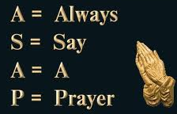
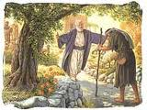
It’s hard to make Good Choices
Must overcome our embarrassment & pride – (like prodigal son)
  Like Naomi returning home (Ruth 1)
May need to pull out of depression, discouragement and despair from other bad choices
Turn to God – pray for His help!
Turn to your ecclesia – Ask for help!
True children in God’s family rejoice when struggling family members return. They are helpful, supportive and understanding. This is their opportunity to show God’s love!

Slide 39


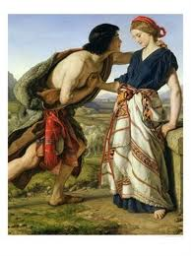
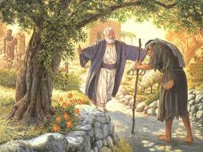
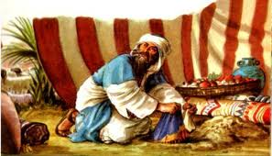
We live with the Consequences of bad choices – Like Lot
1) Lost his wife, most of his household
2) Lost his home and possessions
3) Lost touch with Abraham (the ecclesia)
4) Became depressed and wanted isolation
5) Impregnated his own two daughters
Dinah & Shechem
Prodigal Son
Achan

Slide 40

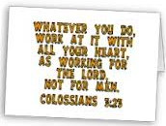

Go home & get involved in your CYC & Ecclesia! Support them
Show up to Bible classes & seminars
Volunteer to help with activities
Assist in Sunday School and CYC
  Create a project for Sunday School class teacher
  Help out at CYC activities and weekend trips
Don’t worry about prominent positions, do whatever needs to get done
Don’t take someone’s job, do something that isn’t getting done now
There’s no “I” in “team”

Slide 41

Lessons from this class
Don’t get caught up in humanism philosophy today – it’s for this life only
Learn to appreciate & trust God’s design for families and ecclesias – He’s using them to train us to join His family
Follow God’s game plan – practice righteousness daily – He knows what He’s doing and it will work.
Get involved in your CYC & ecclesia

Slide 42
2
S
G

Slide 43
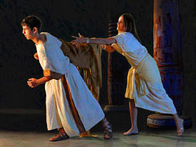
Joseph refuses Potiphar’s wife
No one in his family was watching

Slide 44
Be careful: the internet allows you to bring this world easily into your home!

Slide 45
Go home & get involved in your CYC & Ecclesia! Support them
Show up to Bible classes & seminars
Volunteer to help with activities
Assist in Sunday School and CYC
  Create a project for Sunday School class teacher
  Help out at CYC activities and weekend trips
Don’t worry about prominent positions, do whatever needs to get done
Don’t take someone’s job, do something that isn’t getting done now
There’s no “I” in “team”

Slide 46

Elevating your life to God’s moral code

Slide 47
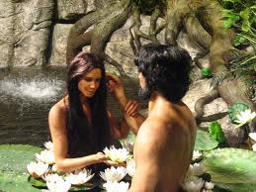
Genesis 2:18
And the LORD God said, "It is not good for the man to be alone; I will make him a helper suitable to him.“ (NASB)
God Designed Marriage
God didn’t intend us to be alone – like isolationists – He expects us to work with others.
In families, we help others and ourselves at the same time
Helper “comparable to him” (NKJ) or “suitable for him” (NASB) → we must look for spouses who will help our spiritual life!
Animals were formed from the ground, but Eve was formed out of Adam.

Slide 48
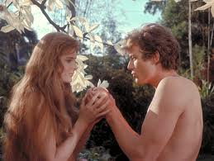
God Designed Roles
1 Timothy 2:11-15 (RSV)
11 Let a woman learn in silence with all submissiveness.
12 I permit no woman to teach or to have authority over men; she is to keep silent.
13 For Adam was formed first, then Eve;
14 and Adam was not deceived, but the woman was deceived and became a transgressor.
15 Yet woman will be saved through bearing children, if she continues in faith and love and holiness, with modesty.
Paul draws general conclusions from Adam & Eve
This is not cultural – it’s God’s view of how He wants His family to operate in the ecclesia – He knows best!
Not about who is greater or more important
Roles for men & women were established by God for our good, so we can be members of His family

Slide 49


Today’s society is confused about the roles of boys & girls
Some claim boys & girls are equal & demand the same roles
  Biology doesn’t support this
  Creates confused, over-worked & stressed people
Some women seem to be better leaders than their spouses
  “better” is not the issue
  God doesn’t need the “best”
    High priests, kings, etc show that!

Slide 50
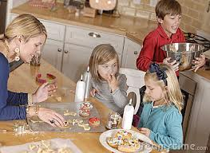

1 Timothy 5:14
Therefore I desire that the younger widows marry, bear children, manage the house, give no opportunity to the adversary to speak reproachfully.
“rule (oikodespoteo) the household” (RSV)
God wants a house that runs in peace, where everyone helps and encourages one another

Slide 51

The Bible is Clear:
Men are responsible to lead, provide, save, teach and give their lives for their spouses – show the life of Christ!
  Many families struggle when men don’t come through
  Men must read, study, pray & be involved in their families – all aspects!
Women should follow the spiritual lead of their husbands and focus on raising Godly children – they show the life of Christ’s bride
God wants husbands & wives who show their children how God’s family works – He wants to save their children!

Slide 52
1 Corinthians 11:7-11
7 For a man indeed ought not to cover his head, since he is the image and glory of God; but woman is the glory of man.
8 For man is not from woman, but woman from man.
9 Nor was man created for the woman, but woman for the man.
10 For this reason the woman ought to have a symbol of authority on her head, because of the angels. (the angels made the decision to create Eve out of Adam)
11 Nevertheless, neither is man independent of woman, nor woman independent of man, in the Lord.
12 For as woman came from man, even so man also comes through woman; but all things are from God.
The relationship of men and women, and their respective roles before God, were designed by God & His angels from the beginning of creation – for the spiritual development of His family

Slide 53
Trusting God’s morality impacts our lives
Colossians 3:17-22
17 And whatever you do in word or deed, do all in the name of the Lord Jesus, giving thanks to God the Father through Him.
18 Wives, submit to your own husbands, as is fitting in the Lord.
19 Husbands, love your wives and do not be bitter toward them.
20 Children, obey your parents in all things, for this is well pleasing to the Lord.
21 Fathers, do not provoke your children, lest they become discouraged.
22 Bondservants, obey in all things your masters according to the flesh, not with eyeservice, as men-pleasers, but in sincerity of heart, fearing God.
God is training us to live within His moral guidelines so we can live with Him forever!

Slide 54
2
W
17
!

Slide 55
2
W
17
!

Slide 56
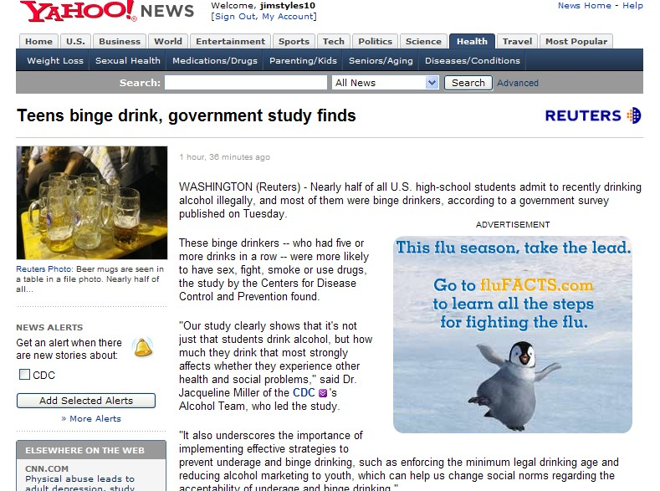
Points worth noting:
About half of high-schoolers drink illegally
How much you drink at one time matters
Binge drinkers more likely to lose inhibitions

Slide 57


Slide 58

Help your friends make good choices!

Slide 59
2
S
G

Slide 60
2
W
17
!

Slide 61
2
S
G

Slide 62
2
W
17
!

Slide 63
2
S
G

Slide 64
2
W
17
!

Slide 65
2
S
G

Slide 66
2
W
17
!

Slide 67
2
S
G

Slide 68
2
W
17
!

Slide 69
2
S
G

Slide 70
2
W
17
!

Slide 71
2
S
G

Slide 72
2
W
17
!

Slide 73
2
S
G

Slide 74
2
W
17
!

Slide 75
2
S
G

Slide 76
2
W
17
!

Slide 77
2
S
G

Slide 78
2
W
17
!

Slide 79
2
S
G

Slide 80
2
W
17
!

Slide 81
2
S
G

Slide 82
2
W
17
!

Slide 83
2
S
G

Slide 86
2
S
G

Slide 87
2
W
17
!

Slide 88
2
S
G

Slide 89
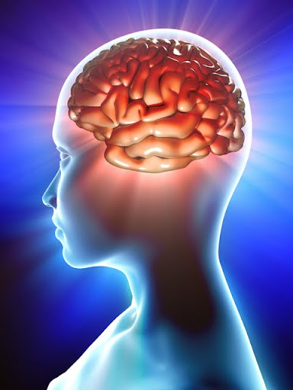

God is attempting to reprogram your mind
S
G

Slide 90
2
W
17
!

Slide 91
Lessons from Today
Even

Slide 92

2
S
G

