Slide 1
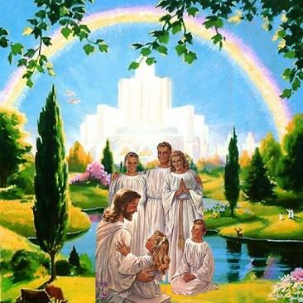
Living as a member of God’s Family
Class 3: Living by Love, not just by Law

Slide 2
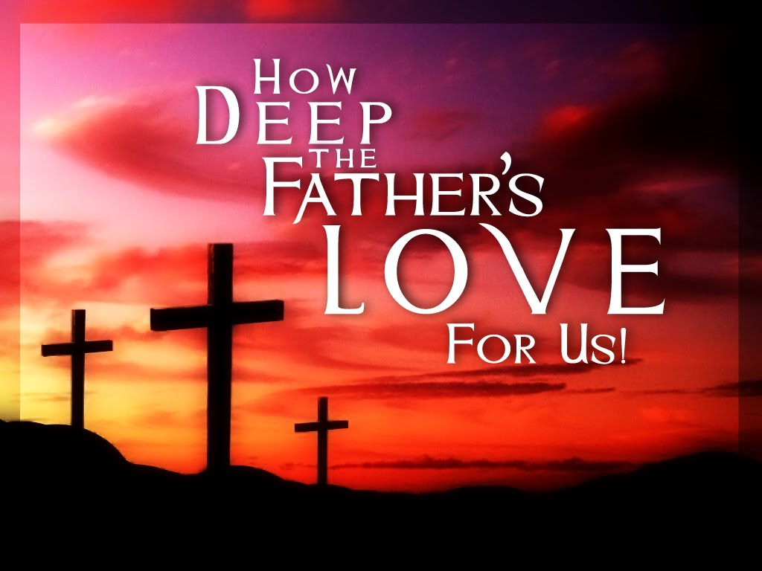
Greater love has no one than this, than to lay down one’s life for his friends (Jn 15:13)

Slide 3

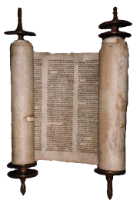

God does a perfect job of balancing
Because He implements His Law
Through Love
Law
Love

Slide 4
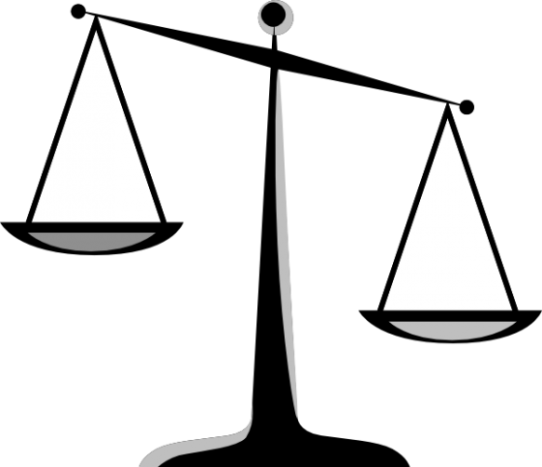
We tend to get out of balance
Some of us emphasize Love

Slide 5
We tend to get out of balance
Most of us emphasize Law

Slide 6

Romans 13:8-10
Love is a fulfillment of the law
8 Owe no one anything except to love one another, for he who loves another has fulfilled the law. 9 For the commandments, "You shall not commit adultery," "You shall not murder," "You shall not steal," "You shall not bear false witness," "You shall not covet," and if there is any other commandment, are all summed up in this saying, namely, "You shall love your neighbor as yourself." 10 Love does no harm to a neighbor; therefore love is the fulfillment of the law.
Love is an overriding principle that helps us understand how to implement the Law

Slide 7
Matthew 12:1-7
Love helps us rank the Laws
1 At that time Jesus went through the grainfields on the Sabbath. And His disciples were hungry, and began to pluck heads of grain and to eat. 2 And when the Pharisees saw it, they said to Him, "Look, Your disciples are doing what is not lawful to do on the Sabbath!"
3 But He said to them, "Have you not read what David did when he was hungry, he and those who were with him: 4 how he entered the house of God and ate the showbread which was not lawful for him to eat, nor for those who were with him, but only for the priests? 5 Or have you not read in the law that on the Sabbath the priests in the temple profane the Sabbath, and are blameless? 6 Yet I say to you that in this place there is One greater than the temple. 7 But if you had known what this means, 'I desire mercy and not sacrifice,' you would not have condemned the guiltless.
Mercy helps us rank God’s laws

Slide 8
Deuteronomy 25:1-4
Why mention muzzling a working ox in this context?
1 "If there is a dispute between men, and they come to court, that the judges may judge them, and they justify the righteous and condemn the wicked, 2 then it shall be, if the wicked man deserves to be beaten, that the judge will cause him to lie down and be beaten in his presence, according to his guilt, with a certain number of blows. 3 Forty blows he may give him and no more, lest he should exceed this and beat him with many blows above these, and your brother be humiliated in your sight.
4 "You shall not muzzle an ox while it treads out the grain.
It’s about how we treat people!

Slide 9
1 Corinthians 9:3-11
Paul explains a concept about reading the Law
3 My defense to those who examine me is this: 4 Do we have no right to eat and drink? 5 Do we have no right to take along a believing wife, as do also the other apostles, the brothers of the Lord, and Cephas? 6 Or is it only Barnabas and I who have no right to refrain from working? 7 Who ever goes to war at his own expense? Who plants a vineyard and does not eat of its fruit? Or who tends a flock and does not drink of the milk of the flock?
8 Do I say these things as a mere man? Or does not the law say the same also? 9 For it is written in the law of Moses, "You shall not muzzle an ox while it treads out the grain." Is it oxen God is concerned about? 10 Or does He say it altogether for our sakes? For our sakes, no doubt, this is written, that he who plows should plow in hope, and he who threshes in hope should be partaker of his hope.
Paul uses this again in 1Tim 5:17-18. This gives us a clue about how to read the Law

Slide 10
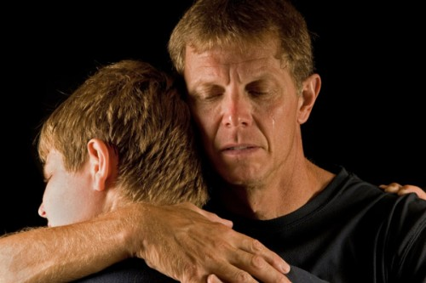
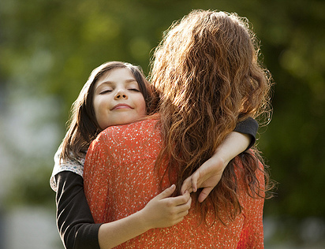
Families teach us how to show mercy to our loved ones who make mistakes
God hopes that experience will teach us how to show mercy to other families and ecclesial members who we may not be our loved ones

Slide 11
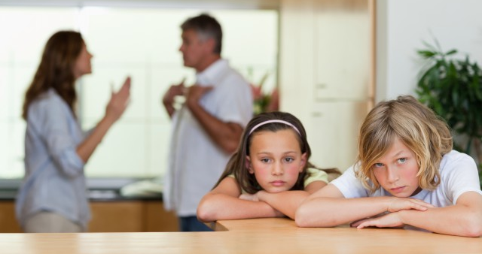
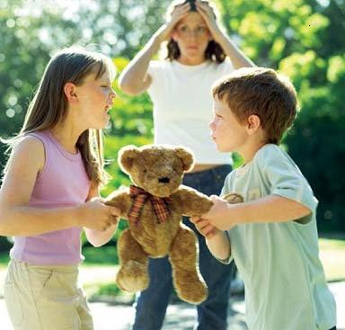
Family life & Ecclesial life will not be perfect!
Consider Jesus’ family & ecclesia
Think of David’s or Jonathan’s
Remember Joseph’s family
Then there’s Jeremiah, Samson, Abel, Elijah, Lot, etc.
God develops spiritual children in the most challenging situations
Don’t expect a perfect family or ecclesia – the Bible makes that very clear!

Slide 12
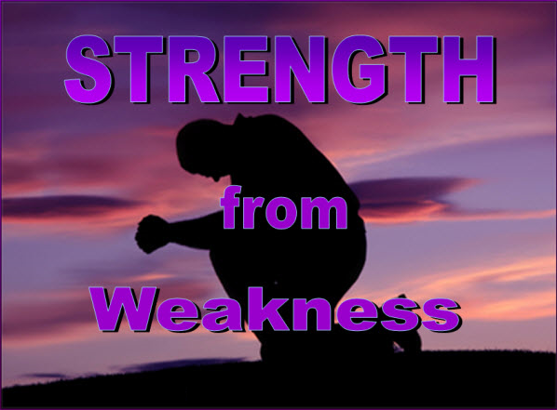
So all the glory goes to God

Slide 13
John 8:2-12
What about adultery, a major sin?
2 Now early in the morning He came again into the temple, and all the people came to Him; and He sat down and taught them. 3 Then the scribes and Pharisees brought to Him a woman caught in adultery. And when they had set her in the midst, 4 they said to Him, "Teacher, this woman was caught in adultery, in the very act. 5 Now Moses, in the law, commanded us that such should be stoned. But what do You say?" 6 This they said, testing Him, that they might have something of which to accuse Him. But Jesus stooped down and wrote on the ground with His finger, as though He did not hear.
Remember: Jesus kept the Law perfectly

Slide 14
John 8:2-12
How does Jesus handle it?
7 So when they continued asking Him, He raised Himself up and said to them, "He who is without sin among you, let him throw a stone at her first." 8 And again He stooped down and wrote on the ground. 9 Then those who heard it, being convicted by their conscience, went out one by one, beginning with the oldest even to the last. And Jesus was left alone, and the woman standing in the midst. 10 When Jesus had raised Himself up and saw no one but the woman, He said to her, "Woman, where are those accusers of yours? Has no one condemned you?"
11 She said, "No one, Lord.“ And Jesus said to her, "Neither do I condemn you; go and sin no more."
12 Then Jesus spoke to them again, saying, "I am the light of the world. He who follows Me shall not walk in darkness, but have the light of life."
Jesus is willing to forgive our past if we commit to walk in his light

Slide 15
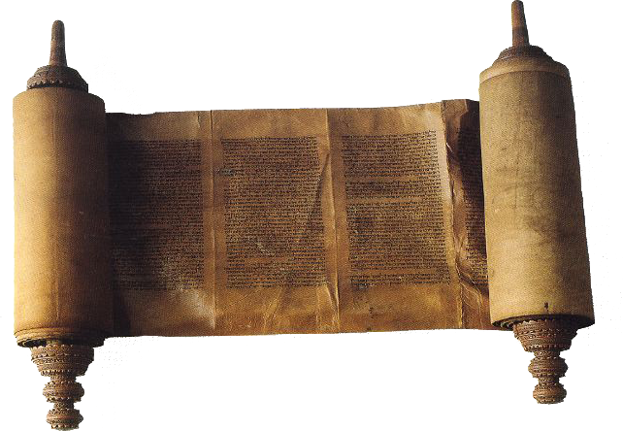
In the Law of Moses, God describes the punishments we deserve for crimes against God and people
God hoped we would learn to show mercy to other sinners who repent, as we hope for mercy from Him
“I desire mercy and not sacrifice”

Slide 16
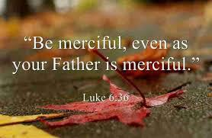

Slide 17
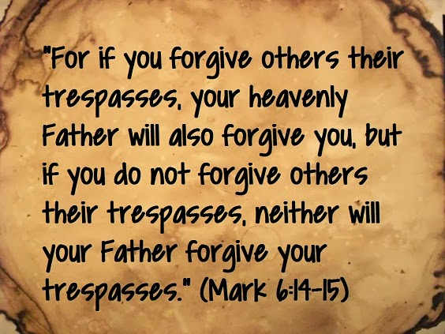

Slide 18

This is the piece we must provide!

Slide 19
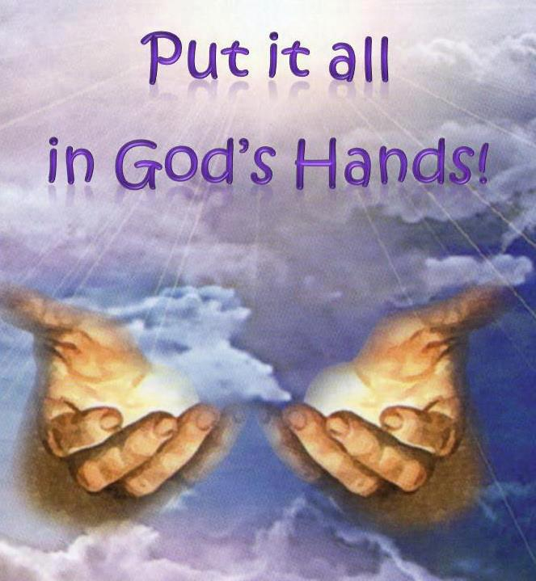
He will handle it best
Like He did with David

Slide 20
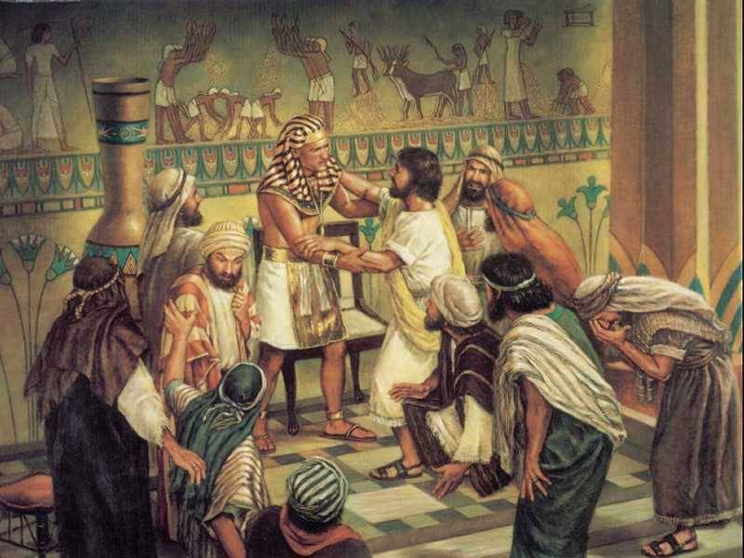

How did Joseph forgive his brothers?
Clearly saw the big picture – it’s more important where God brings us in the end, than how we got there.
Complete confidence that God is in control, no matter what anyone does to us
Love for his Father – knew that Jacob wanted all his children in God’s family
Love for the family – really did love each brother and sister
Hatred stirs up strife, but love covers all sins. (Proverbs 10:12)

Slide 21
Genesis 50:19-21
Joseph said to them, "Do not be afraid, for am I in the place of God? But as for you, you meant evil against me; but God meant it for good, in order to bring it about as it is this day, to save many people alive. Now therefore, do not be afraid; I will provide for you and your little ones." And he comforted them and spoke kindly to them.
This is how “faith in God” changes our lives
It motivates us to treat brothers & sisters with kindness & compassion – no matter how they have treated us.
Faith believes that God can bring good out of the worst situations, because He IS in control.

Slide 22
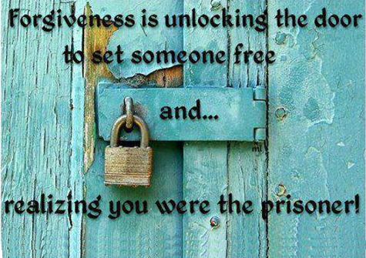

Slide 23

Forgiveness is not something we do for other people. We do it for ourselves - to get well and move on!
A different perspective…

Slide 24
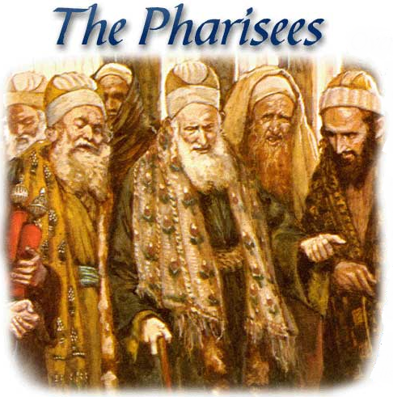
Jesus didn’t forgive the unrepentant
Unless you repent, you will all likewise perish! (Lk 13:3)
God expects us to repent of our mistakes

Slide 25
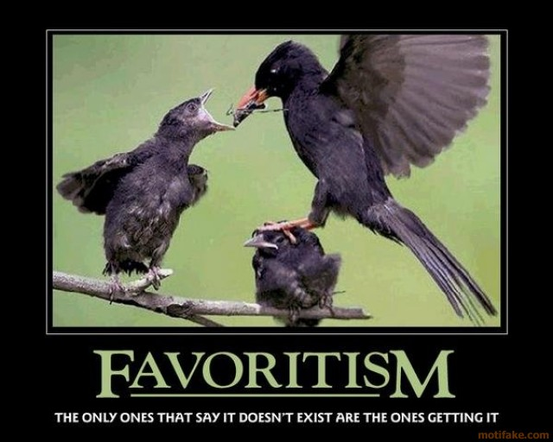
Emphasis on Law & lack of love leads to

Slide 26
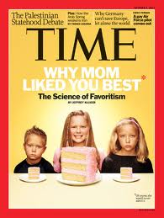
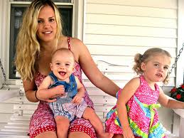
Favoritism is a common human trait
Genesis 25:28
And Isaac loved Esau because he ate of his game, but Rebekah loved Jacob.
Romans 9:12-13
it was said to her, "The older shall serve the younger.“ As it is written, "Jacob I have loved, but Esau I have hated."
Parents have a tendency to favor children who excel in things of this world!
  We might enjoy their success
  We might be reaching out to save them
Creates rivalries among children
Emphasizes the wrong goals

Slide 27
James 2:1-7 (NIV)
Favoritism in Ecclesial Life
1 My brothers, as believers in our glorious Lord Jesus Christ, don't show favoritism. 2 Suppose a man comes into your meeting wearing a gold ring and fine clothes, and a poor man in shabby clothes also comes in. 3 If you show special attention to the man wearing fine clothes and say, "Here's a good seat for you," but say to the poor man, "You stand there" or "Sit on the floor by my feet," 4 have you not discriminated among yourselves and become judges with evil thoughts?
5 Listen, my dear brothers: Has not God chosen those who are poor in the eyes of the world to be rich in faith and to inherit the kingdom he promised those who love him? 6 But you have insulted the poor.
Prejudice based on clothes!

Slide 28
James 2:8-13
Mercy triumphs over judgment
8 If you really fulfill the royal law according to the Scripture, "You shall love your neighbor as yourself," you do well; 9 but if you show partiality, you commit sin, and are convicted by the law as transgressors. 10 For whoever shall keep the whole law, and yet stumble in one point, he is guilty of all. 11 For He who said, "Do not commit adultery," also said, "Do not murder." Now if you do not commit adultery, but you do murder, you have become a transgressor of the law. 12 So speak and so do as those who will be judged by the law of liberty. 13 For judgment is without mercy to the one who has shown no mercy. Mercy triumphs over judgment.
God expects us to render our judgments with mercy

Slide 29
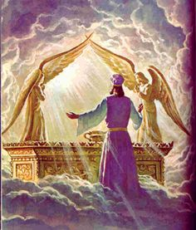
Mercy triumphs
over judgment

Slide 30
Luke 10:15-37
Legal Justification!
25 And behold, a certain lawyer stood up and tested Him, saying, "Teacher, what shall I do to inherit eternal life?"
26 He said to him, "What is written in the law? What is your reading of it?"
27 So he answered and said, "'You shall love the Lord your God with all your heart, with all your soul, with all your strength, and with all your mind,' and 'your neighbor as yourself.'"
28 And He said to him, "You have answered rightly; do this and you will live."
29 But he, wanting to justify himself, said to Jesus, "And who is my neighbor?"
Easy to recite Scripture, but hard to do it!

Slide 31
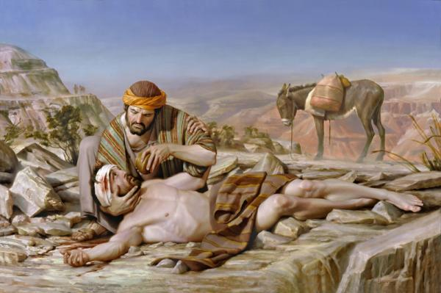
Loving your Neighbor as yourself
Showing Mercy without the blindness of Favoritism

Slide 32
Luke 10:15-37
Mercy without Prejudice
30 Then Jesus answered and said: "A certain man went down from Jerusalem to Jericho, and fell among thieves, who stripped him of his clothing, wounded him, and departed, leaving him half dead. 31 Now by chance a certain priest came down that road. And when he saw him, he passed by on the other side. 32 Likewise a Levite, when he arrived at the place, came and looked, and passed by on the other side. 33 But a certain Samaritan, as he journeyed, came where he was. And when he saw him, he had compassion. 34 So he went to him and bandaged his wounds, pouring on oil and wine; and he set him on his own animal, brought him to an inn, and took care of him. 35 On the next day, when he departed, he took out two denarii, gave them to the innkeeper, and said to him, 'Take care of him; and whatever more you spend, when I come again, I will repay you.' 36 So which of these three do you think was neighbor to him who fell among the thieves?"
37 And he said, "He who showed mercy on him.“ Then Jesus said to him, "Go and do likewise."
We need to work on showing mercy without prejudice!

Slide 33
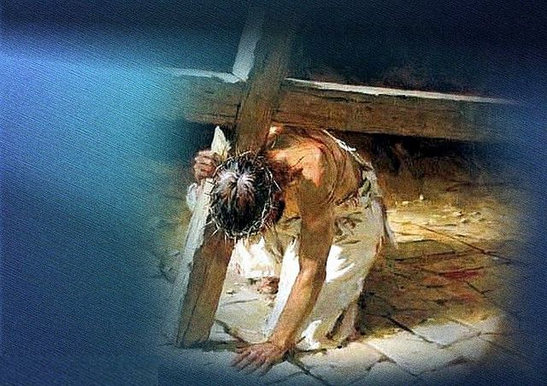
Living by Love also means…….
we will not let the law limit what we will do for God and others – this was a great weakness of the law

Slide 34
1 John 3:11-18 (ESV)
God taught us how to live by Love
11 For this is the message that you have heard from the beginning, that we should love one another. 12 We should not be like Cain, who was of the evil one and murdered his brother. And why did he murder him? Because his own deeds were evil and his brother's righteous. 13 Do not be surprised, brothers, that the world hates you. 14 We know that we have passed out of death into life, because we love the brothers. Whoever does not love abides in death. 15 Everyone who hates his brother is a murderer, and you know that no murderer has eternal life abiding in him.
16 By this we know love, that he laid down his life for us, and we ought to lay down our lives for the brothers. 17 But if anyone has the world's goods and sees his brother in need, yet closes his heart against him, how does God's love abide in him? 18 Little children, let us not love in word or talk but in deed and in truth.
Love motivates us to help the helpless

Slide 35
Greater love has no one than this, than to lay down one’s life for his friends (Jn 15:13)

Slide 36
Galatians 5:13-19 (ESV)
Love prevents us from becoming selfish Christians
13 For you were called to freedom, brothers. Only do not use your freedom as an opportunity for the flesh, but through love serve one another. 14 For the whole law is fulfilled in one word: "You shall love your neighbor as yourself."15 But if you bite and devour one another, watch out that you are not consumed by one another.
16 But I say, walk by the Spirit, and you will not gratify the desires of the flesh. 17 For the desires of the flesh are against the Spirit, and the desires of the Spirit are against the flesh, for these are opposed to each other, to keep you from doing the things you want to do. 18 But if you are led by the Spirit, you are not under the law.
Those led by the spirit will do far more for God than those living by Law

Slide 37
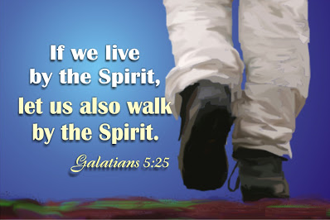

Slide 38

Lessons from this class
Let’s learn to show mercy to others the way we would like to show mercy to those we love
Make sure we are upholding God’s law in love – not just as a rigid law.
Learn to forgive others so we can let it go and then God can forgive us for our mistakes
Let God’s love motivate us so we will not be limited by laws

Slide 39
2
S
G

Slide 40
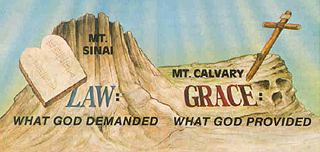

Slide 41
Galatians 5:16-26
W
16 I say then: Walk in the Spirit, and you shall not fulfill the lust of the flesh. 17 For the flesh lusts against the Spirit, and the Spirit against the flesh; and these are contrary to one another, so that you do not do the things that you wish. 18 But if you are led by the Spirit, you are not under the law.
19 Now the works of the flesh are evident, which are: adultery, fornication, uncleanness, lewdness, 20 idolatry, sorcery, hatred, contentions, jealousies, outbursts of wrath, selfish ambitions, dissensions, heresies, 21 envy, murders, drunkenness, revelries, and the like; of which I tell you beforehand, just as I also told you in time past, that those who practice such things will not inherit the kingdom of God.
22 But the fruit of the Spirit is love, joy, peace, longsuffering, kindness, goodness, faithfulness, 23 gentleness, self-control. Against such there is no law. 24 And those who are Christ's have crucified the flesh with its passions and desires. 25 If we live in the Spirit, let us also walk in the Spirit. 26 Let us not become conceited, provoking one another, envying one another.
!

Slide 42
Hebrews 11:1-3, (NIV)
W
1 Now faith is being sure of what we hope for and certain of what we do not see. 2 This is what the ancients were commended for.
3 By faith we understand that the universe was formed at God's command, so that what is seen was not made out of what was visible.
6 And without faith it is impossible to please God, because anyone who comes to him must believe that he exists and that he rewards those who earnestly seek him.
!

Slide 43
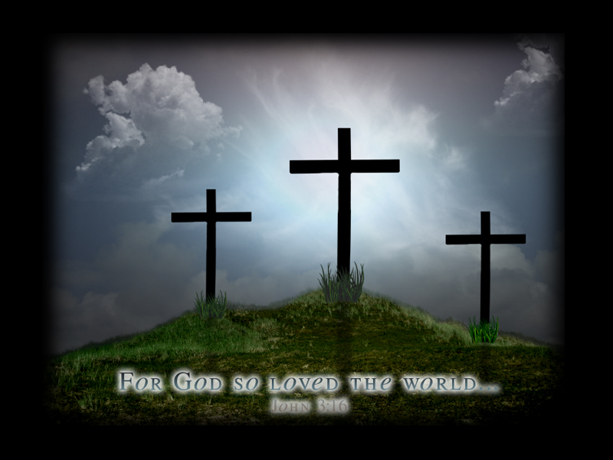
Greater love has no one than this, than to lay down one’s life for his friends (Jn 15:13)

Slide 44
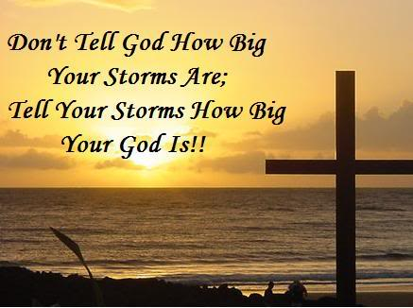
We have to have a good attitude!

Slide 45
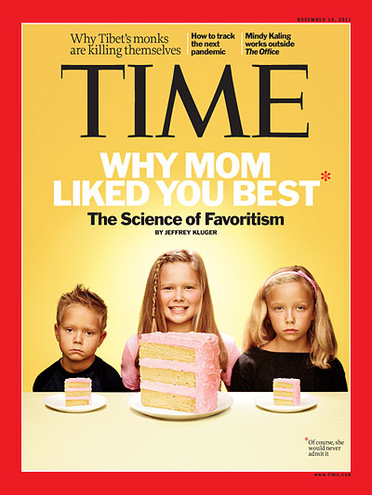
Nov 14, 2011

Slide 46
2
S
G

Slide 47
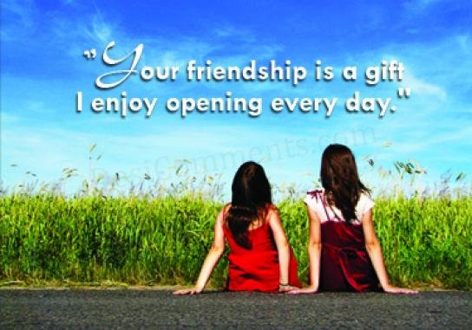
Help your friends make good choices!

Slide 48
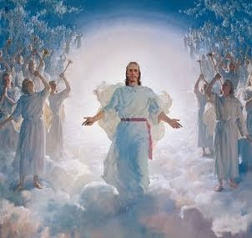

Slide 49
2
W
17
!

Slide 50
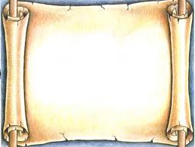
2
S
G

