Slide 1
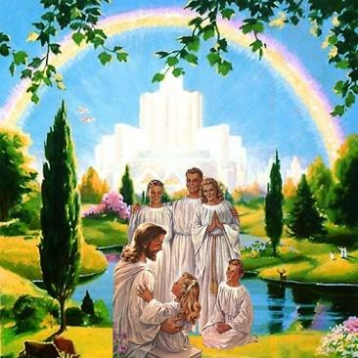
Living as a member of God’s Family
Class 4: You cannot serve God and Mammon

Slide 2


Matthew 6:24
Who do you serve?
24 "No one can serve two masters; for either he will hate the one and love the other, or else he will be loyal to the one and despise the other. You cannot serve God and mammon.
We have to make a choice! You can’t have it both ways

Slide 3
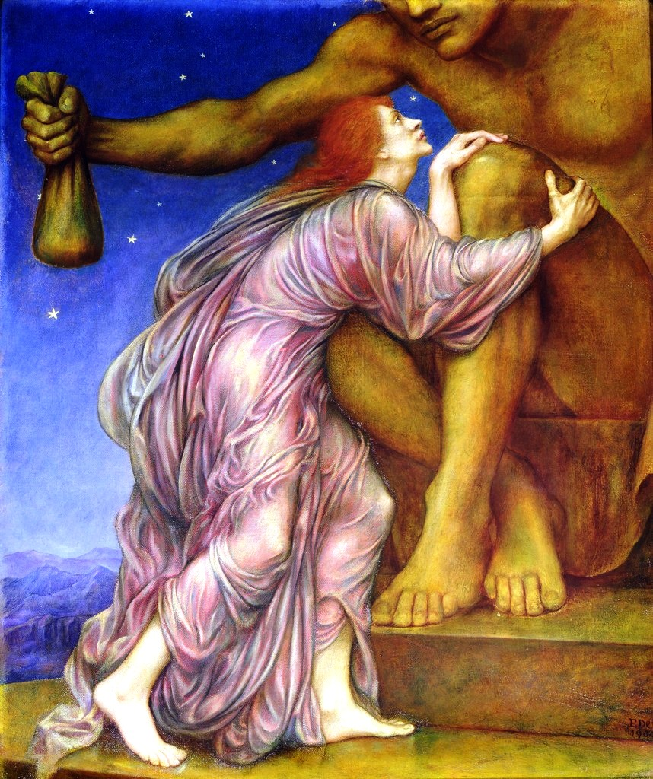
What is Mammon?
Mammon may have originated with the Aramaic word “mamon” which meant riches or money or a Hebrew word meaning “that which is to be trusted”

Slide 4



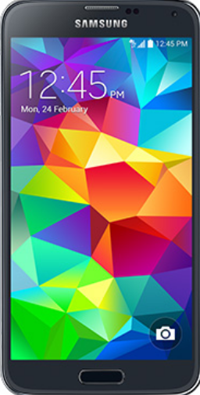

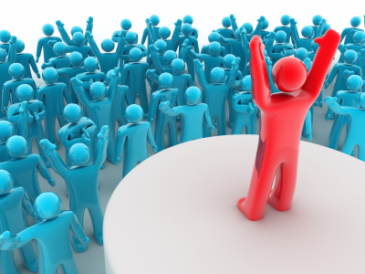
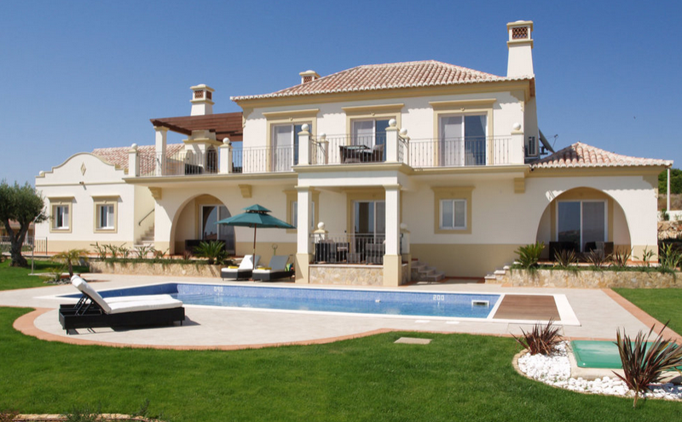
Mammon today

Slide 5
2 Kings 5:15-27
Naaman is cured of leprosy
15 And he (Naaman) returned to the man of God, he and all his aides, and came and stood before him; and he said, "Indeed, now I know that there is no God in all the earth, except in Israel; now therefore, please take a gift from your servant."
16 But he said, "As the Lord lives, before whom I stand, I will receive nothing." And he urged him to take it, but he refused.
17 So Naaman said, "Then, if not, please let your servant be given two mule-loads of earth; for your servant will no longer offer either burnt offering or sacrifice to other gods, but to the Lord. 18 Yet in this thing may the Lord pardon your servant: when my master goes into the temple of Rimmon to worship there, and he leans on my hand, and I bow down in the temple of Rimmon — when I bow down in the temple of Rimmon, may the Lord please pardon your servant in this thing."
19 Then he said to him, "Go in peace." So he departed from him a short distance.
Elisha understood God had healed Naaman

Slide 6
2 Kings 5:15-27
Gehazi bowed down to Mammon
20 But Gehazi, the servant of Elisha the man of God, said, "Look, my master has spared Naaman this Syrian, while not receiving from his hands what he brought; but as the Lord lives, I will run after him and take something from him." 21 So Gehazi pursued Naaman. When Naaman saw him running after him, he got down from the chariot to meet him, and said, "Is all well?"
22 And he said, "All is well. My master has sent me, saying, 'Indeed, just now two young men of the sons of the prophets have come to me from the mountains of Ephraim. Please give them a talent of silver and two changes of garments.'"
23 So Naaman said, "Please, take two talents." And he urged him, and bound two talents of silver in two bags, with two changes of garments, and handed them to two of his servants; and they carried them on ahead of him.
Bowing to Mammon leads to lies

Slide 7
2 Kings 5:15-27
God knows where our treasure is
24 When he came to the citadel, he took them from their hand, and stored them away in the house; then he let the men go, and they departed. 25 Now he went in and stood before his master. Elisha said to him, "Where did you go, Gehazi?"
And he said, "Your servant did not go anywhere."
26 Then he said to him, "Did not my heart go with you when the man turned back from his chariot to meet you? Is it time to receive money and to receive clothing, olive groves and vineyards, sheep and oxen, male and female servants? 27 Therefore the leprosy of Naaman shall cling to you and your descendants forever." And he went out from his presence leprous, as white as snow.
God uses events in our lives to reveal our weaknesses & attempt to change us

Slide 8
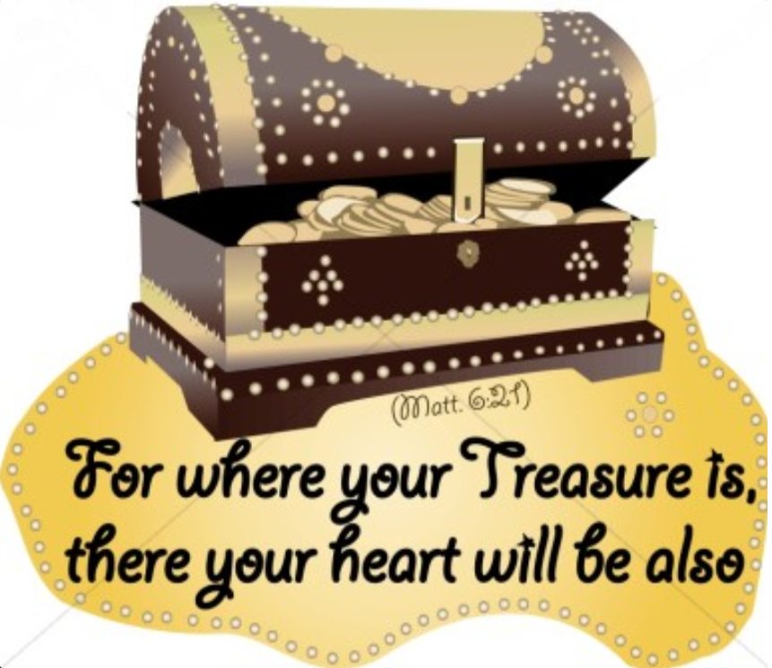
Our treasure reveals what we really want

Slide 9
1 Kings 21:1-5
Ahab covets Naboth’s vineyard
1 And it came to pass after these things that Naboth the Jezreelite had a vineyard which was in Jezreel, next to the palace of Ahab king of Samaria. 2 So Ahab spoke to Naboth, saying, "Give me your vineyard, that I may have it for a vegetable garden, because it is near, next to my house; and for it I will give you a vineyard better than it. Or, if it seems good to you, I will give you its worth in money."
3 But Naboth said to Ahab, "The Lord forbid that I should give the inheritance of my fathers to you!"
4 So Ahab went into his house sullen and displeased because of the word which Naboth the Jezreelite had spoken to him; for he had said, "I will not give you the inheritance of my fathers." And he lay down on his bed, and turned away his face, and would eat no food. 5 But Jezebel his wife came to him….. (you know the rest!)
King Ahab had almost anything he wanted

Slide 10

To serve his covetousness, Ahab had to throw his Bible away!

Slide 11
Mark 7:14-23
Covetousness defiles a person
14 When He had called all the multitude to Himself, He said to them, "Hear Me, everyone, and understand: 15 There is nothing that enters a man from outside which can defile him; but the things which come out of him, those are the things that defile a man. 16 If anyone has ears to hear, let him hear!"
17 When He had entered a house away from the crowd, His disciples asked Him concerning the parable. 18 So He said to them, "Are you thus without understanding also? Do you not perceive that whatever enters a man from outside cannot defile him, 19 because it does not enter his heart but his stomach, and is eliminated, thus purifying all foods?" 20 And He said, "What comes out of a man, that defiles a man. 21 For from within, out of the heart of men, proceed evil thoughts, adulteries, fornications, murders, 22 thefts, covetousness, wickedness, deceit, lewdness, an evil eye, blasphemy, pride, foolishness. 23 All these evil things come from within and defile a man."
It comes from within, but God can provide us with the solution to overcome it!

Slide 12
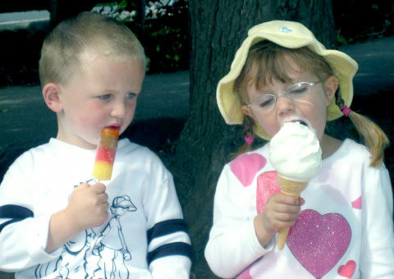
Covetousness involves wanting more than God has given us
It can eat away at us and turn us into selfish, unthankful, unhappy people

Slide 13
Colossians 3:5-7
Covetousness becomes Idolatry
5 Therefore put to death your members which are on the earth: fornication, uncleanness, passion, evil desire, and covetousness, which is idolatry. 6 Because of these things the wrath of God is coming upon the sons of disobedience, 7 in which you yourselves once walked when you lived in them.
God expects that our Faith & Trust in Him will force covetousness our of our lives

Slide 14
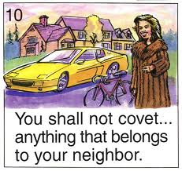
One of the top 10 commandments!

Slide 15
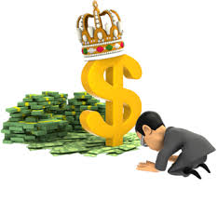
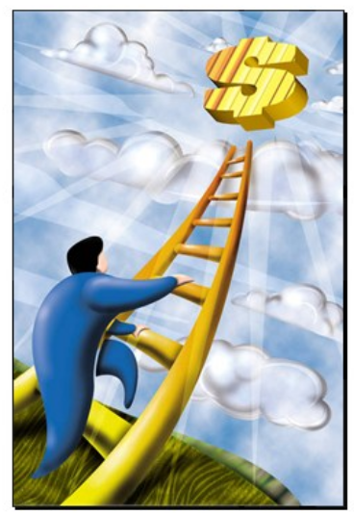
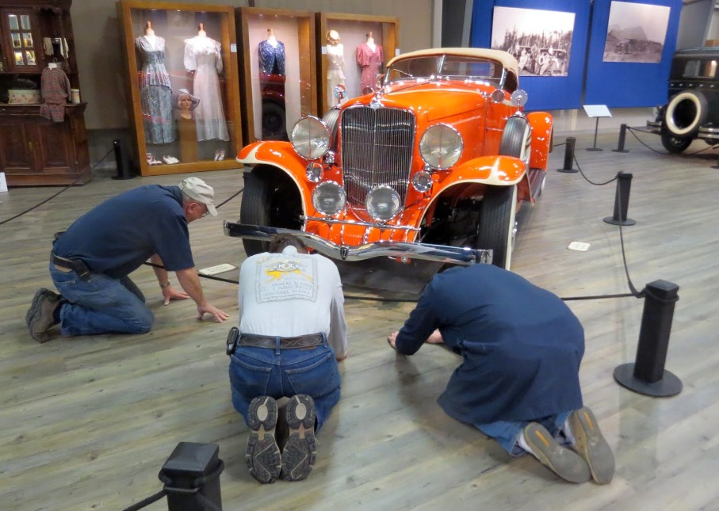
This way of life must be left behind

Slide 16
Ephesians 5:3-7
Covetous people cannot join God’s family
3 But fornication and all uncleanness or covetousness, let it not even be named among you, as is fitting for saints; 4 neither filthiness, nor foolish talking, nor coarse jesting, which are not fitting, but rather giving of thanks. 5 For this you know, that no fornicator, unclean person, nor covetous man, who is an idolater, has any inheritance in the kingdom of Christ and God. 6 Let no one deceive you with empty words, for because of these things the wrath of God comes upon the sons of disobedience.
Don’t be fooled!
God will not tolerate covetousness

Slide 17
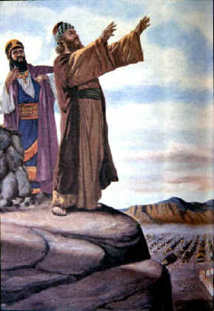
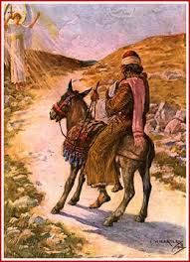
Balaam the Greedy Prophet
God tried to stop Balaam

Slide 18
Jude 4, 11-13 (NIV)
Balaam for hire
Numbers 22:7 (NIV)
7 The elders of Moab and Midian left, taking with them the fee for divination. When they came to Balaam, they told him what Balak had said.
4 For certain men whose condemnation was written about long ago have secretly slipped in among you. They are godless men, who change the grace of our God into a license for immorality and deny Jesus Christ our only Sovereign and Lord.
11 Woe to them! They have taken the way of Cain; they have rushed for profit into Balaam's error; they have been destroyed in Korah's rebellion.
12 These men are blemishes at your love feasts, eating with you without the slightest qualm — shepherds who feed only themselves.
Greed for profit creeps into ecclesial life

Slide 19

Godliness with contentment is great gain (1Tim 6:6)
It produces thankful, happy children of God

Slide 20
Philippians 4:11-13 (NIV)
Paul’s great secret of life….
for I have learned to be content whatever the circumstances. 12 I know what it is to be in need, and I know what it is to have plenty. I have learned the secret of being content in any and every situation, whether well fed or hungry, whether living in plenty or in want. 13 I can do everything through him who gives me strength.
Faith trusts whatever God gives us!

Slide 21
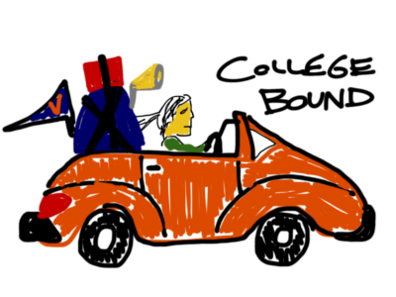

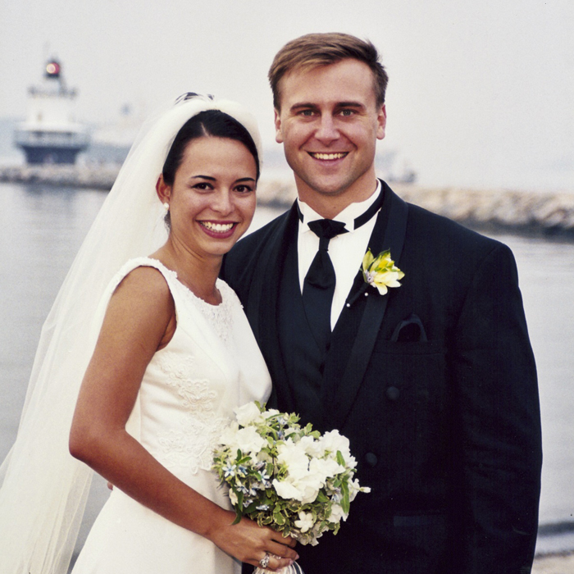


You have lots of choices ahead!

Slide 22

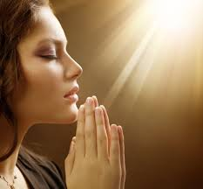
Don’t forget to pray!

Slide 23

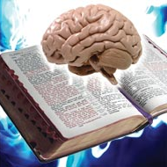
You have
Get as much of the Bible in your background as possible to help you make good choices

Slide 24

This is the piece we must provide!

Slide 25

Let’s work at making them the same!

Slide 26
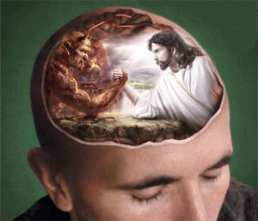
There’s a war going on in your head!
The mind of the spirit vs the mind of the flesh
Get God’s word into your mind

Slide 27
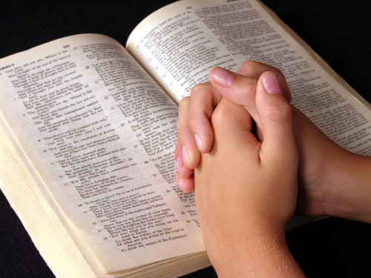
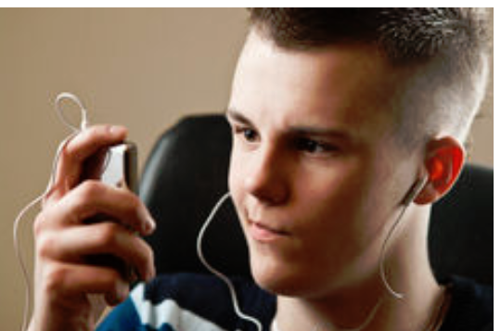
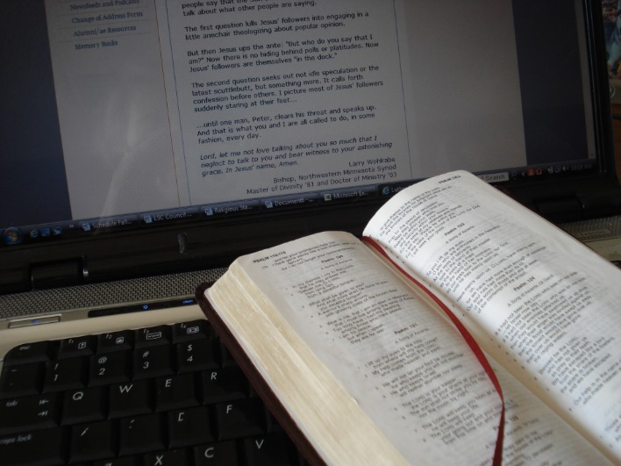


So many options today

Slide 28

So……think about it….

Slide 29
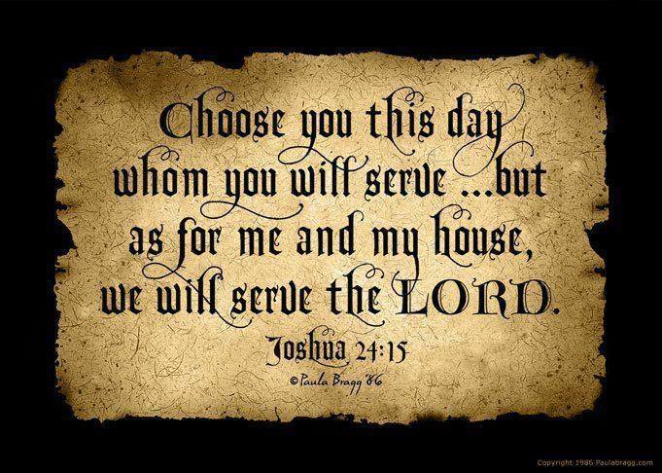
2
S
G

Slide 30

Where your treasure is… there will your heart be also (Mat 6:21)
God may give us what we REALLY want

Slide 31

Lessons from this class
It’s time to chose…..we can’t serve God and Mammon
God will help you if you choose to serve Him
Pray for God’s help with tough choices – He loves you and wants you in His family
God knows where our treasure is and He might have to help us see it too
The secret of life is to learn to be content with what God gives us – trust Him!

Slide 33
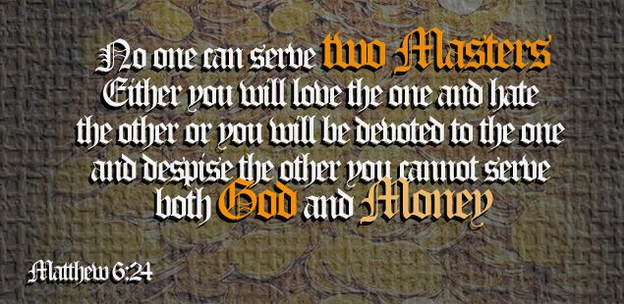

Slide 34


Slide 35
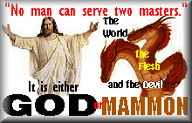

Slide 36


Slide 37
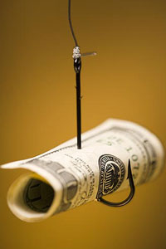
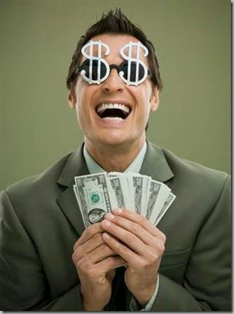
2
S
G

Slide 38
2
S
G

Slide 39
2
W
17
!

Slide 40
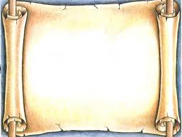
2
S
G

