Slide 1
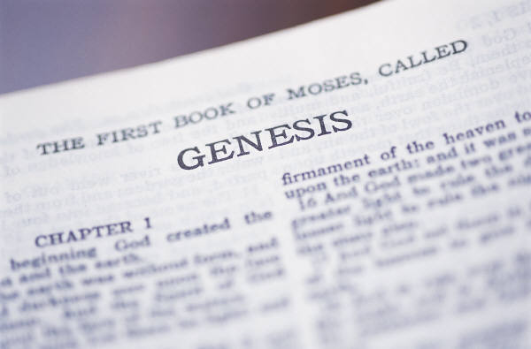

The Bible and
Science

Slide 2
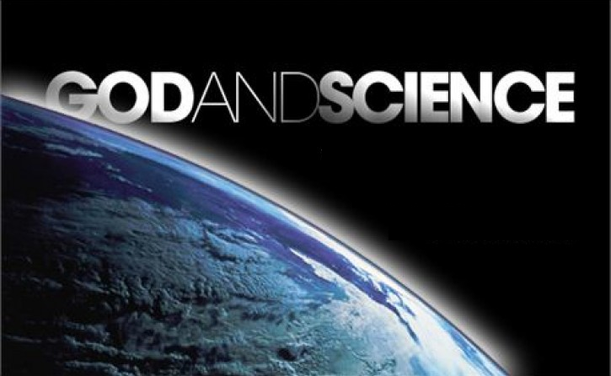
Good Science Supports the Bible
Bad science comes
from incorrect interpretations of data or lack of data

Slide 3
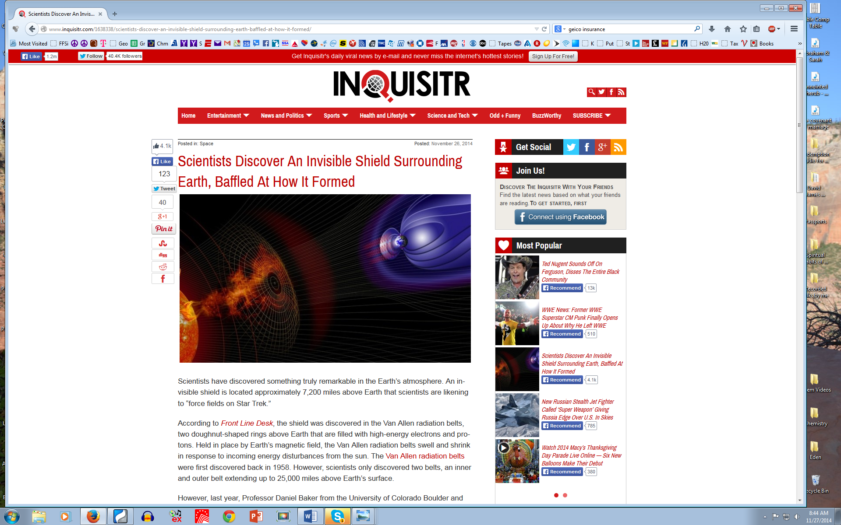
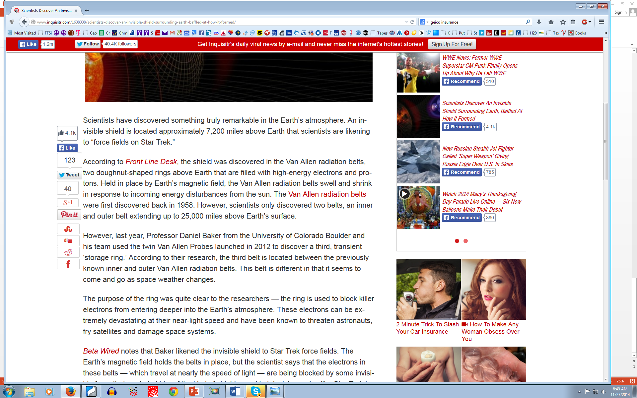
Original study is in Nature
Scientists Discover an Invisible Shield Surrounding Earth, Baffled at how it Formed (Nov 26, 2014)
Scientists continually discover essential components to life on Earth that we never knew existed

Slide 4
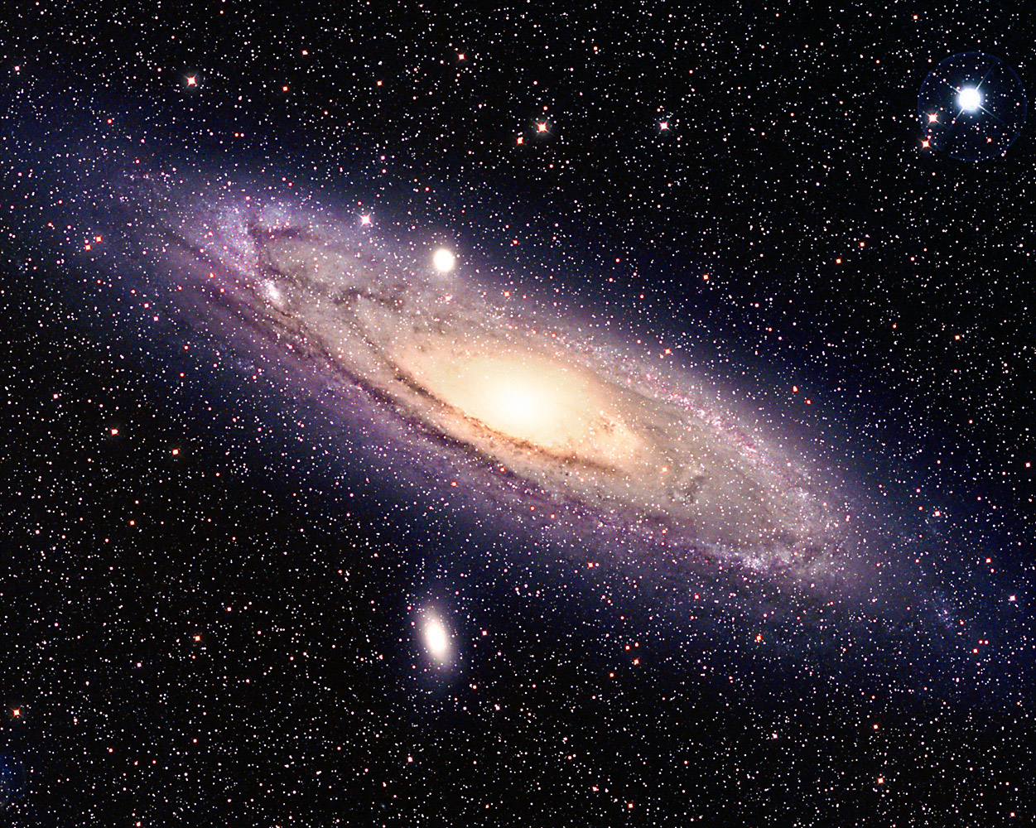
“When I see the glories of the cosmos, I can’t help but believe that there is a divine hand behind it all.”
Einstein

Slide 5
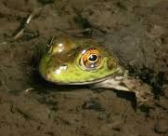
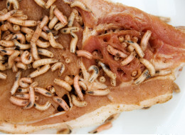
Scientific Theory Mistakes
Spontaneous Generation
Frogs from mud
Maggots from meat
Scientists mistakenly held onto this theory until the middle 1800’s

Slide 6
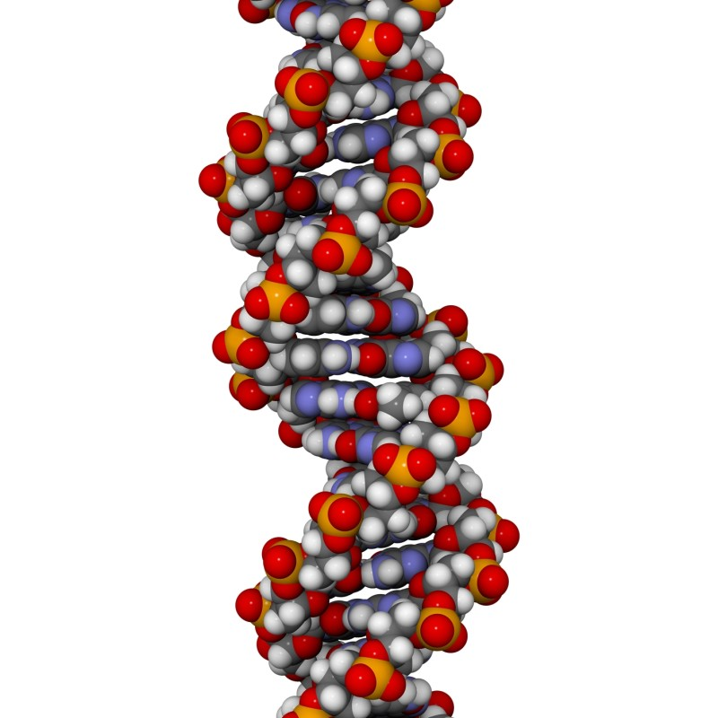
Scientific Theory Mistakes
Proteins determine Heredity
1944 Avery discovered only DNA could change one type of bacteria into another
1952 Hershey & Chase showed that when viruses take over cells, only the DNA of the virus goes into the cell.:
1953 Watson & Crick describes the structure of DNA
Scientists took years to accept the evidence that DNA determines Heredity

Slide 7
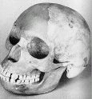
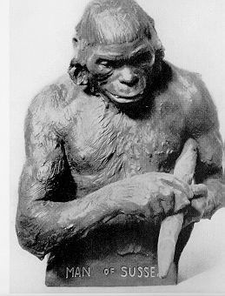
Flaws in Evolutionary Theory
Subject Interpretations of Fossils
Scientists “see” what they are looking for!
Piltdown Man:
Presented by Charles Dawson in 1912
Arthur Woodward reconstructed a skull
Finally a full size model was made
Skull was thoroughly examined for over
30 years before found to be a fake
Actually a very old human skull and
a recent orangutan jaw with canine
teeth that were filed down.

Slide 8
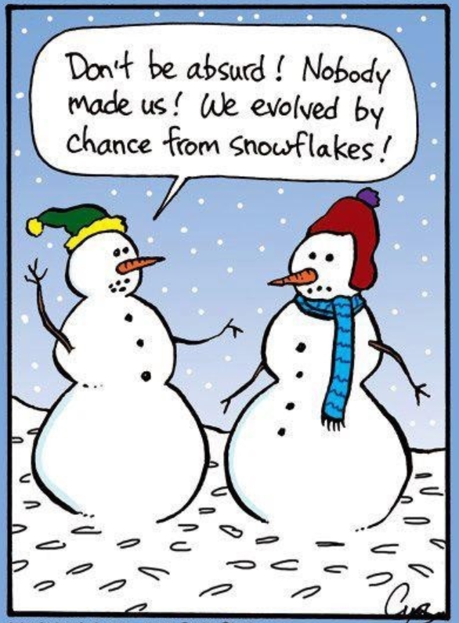
The evolution of life by random chance really is ridiculous!

Slide 9

Genesis 1:1
In the beginning God created the heavens and the earth

Slide 10
God’s Influence in Creation
There was a beginning!
Our universe continues to expand out from a beginning focal point. It is not static!
Like points on an enlarging balloon – all planets continue to get further away from each other.
No good scientific theories exist that explain how and why all the energy of the universe came to exist in one place and then exploded out from that one focal point.

Slide 11
Hebrews 11:3 (RSV)
By faith we understand that the world was created by the word of God, so that what is seen was made out of things which do not appear.

Slide 12
Matter made from invisible energy
(God’s energy)
Energy converted to matter in a way that scientists still don’t understand! (String theory tries to explain it!)
Energy transformed into quarks and leptons, and then compiled into protons, neutrons, and electrons to make atoms.
3-D substance of matter exists by electron force fields – electromagnetic force. Atoms are really full of empty space! If all empty space collapsed, whole earth would fit into a basketball!

Slide 13
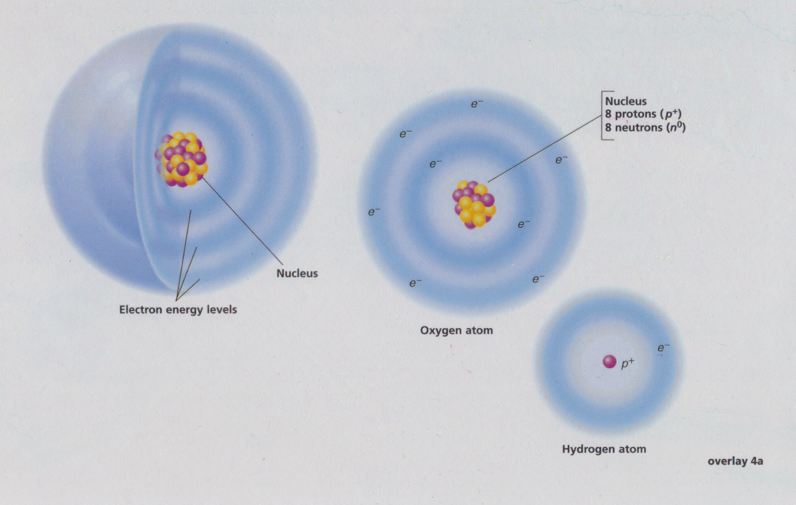
The Structure of Atoms
The particles in these diagrams are not in proportion

Slide 14
God’s Influence in Creation
Carbon-based life on Earth
All the molecules (organic compounds) put together by living cells are built on the base of carbon. (proteins, carbohydrates, fats, nucleic acids)
Carbon needs 4 electrons to be stable, so it bonds easily with other atoms.
Examples: CO₂ or CH₄ or C₆H₁₂O₆
Carbon has: 6 electrons, 6 protons, 6 neutrons (that’s 6-6-6). God made all the molecules of life on earth on the basis of an atom with 6-6-6

Slide 15
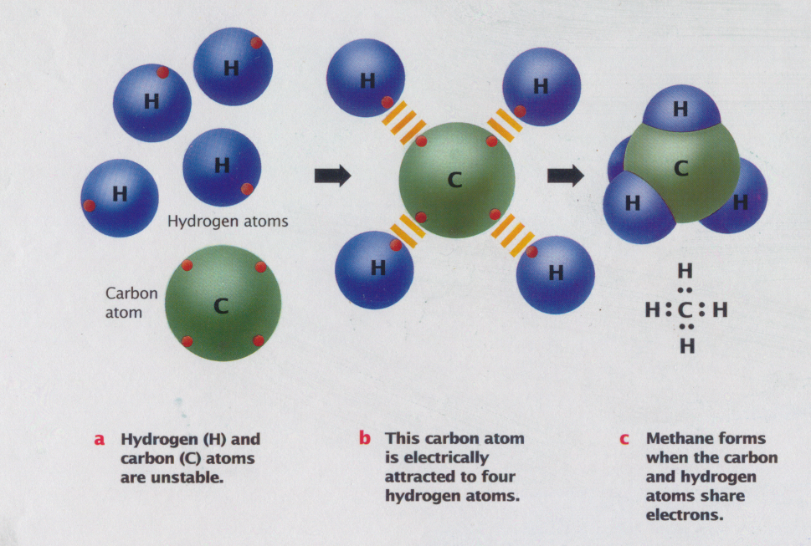
Carbon is the Basis of all Life on Earth

Slide 16
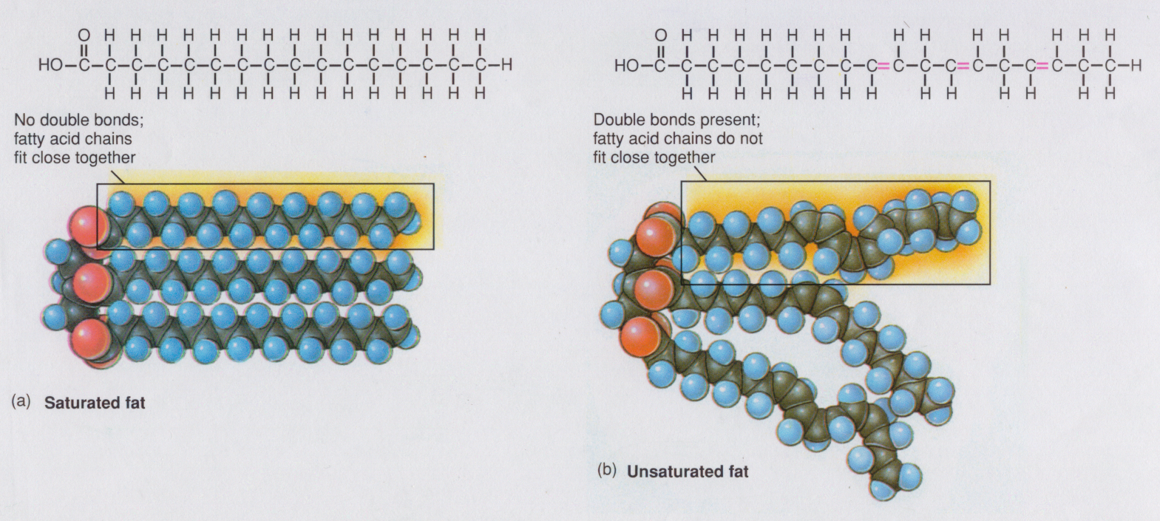
Saturated & Unsaturated Fats

Slide 17
God’s Influence in Creation
DNA implies there was a Creator
DNA’s code is very similar to computer code (developed by intelligent men before they knew about DNA!)
Code: computers are binary (0 and 1) DNA is based on 4 (A-T-G-C). DNA is universal.
Reader (processor): DNA is read in 3-letter words.
thebigredcatatethefatrat
Copy….verify: DNA uses enzymes to verify copies are exact, and fixes mistakes.

Slide 18
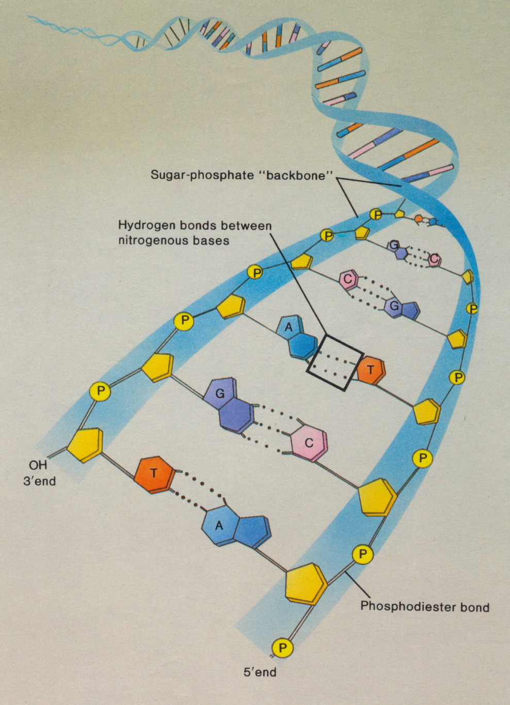
DNA is simple but very long!
Each human cell has over 3 billion DNA codes.
How many Bibles would it take to hold the codes in one human cell?
About 100

Slide 19
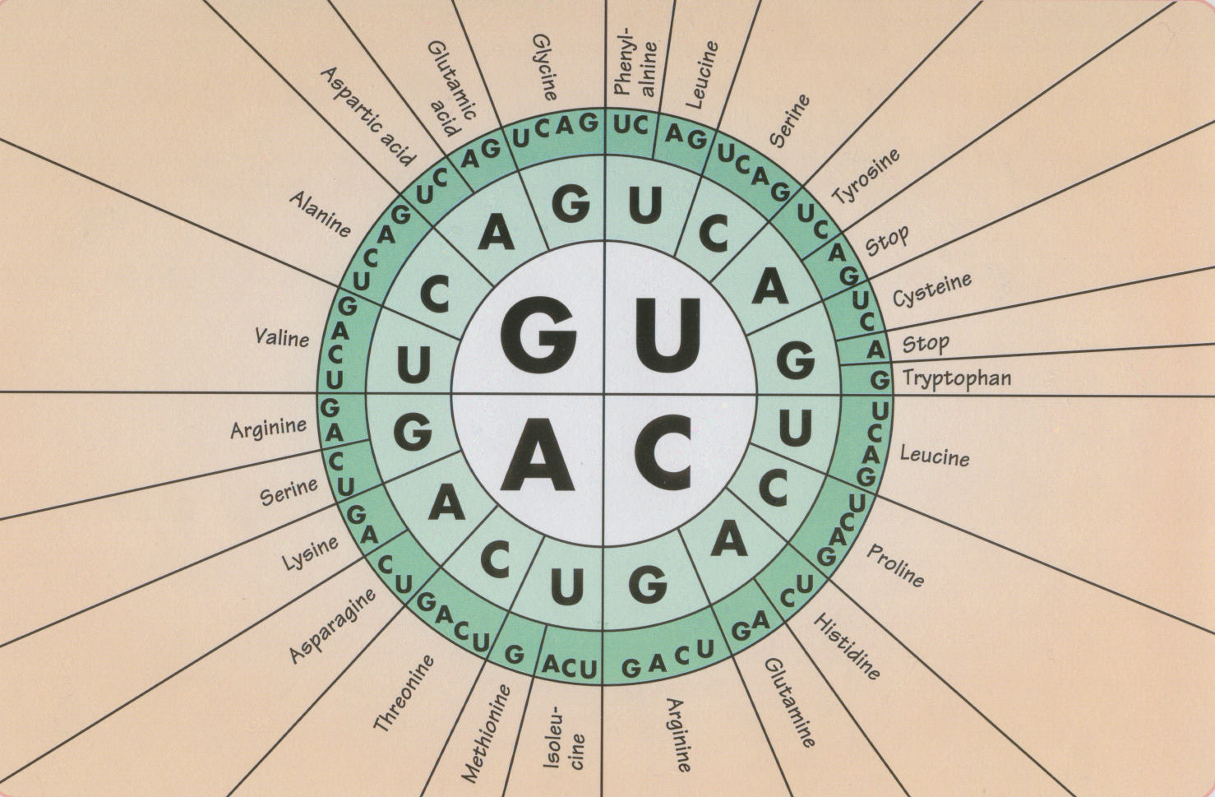
mRNA 3-Letter Code Book
AUGUGG
Methionine
Tryptophan

Slide 20
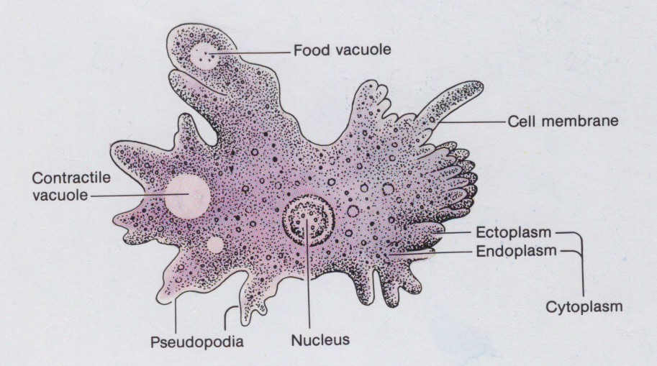
The “simple” Amoeba turned out to be not so “simple”
They have 96 chromosomes and 200 times more DNA than humans!

Slide 21
God’s Influence in Creation
Simple organisms turned out
to be very complex!
Single-celled organisms should have been very simple according to evolutionary theory and for years they were called “simple”. Now that DNA sequencing has been done, we found that most of the genes to operate a cell are very similar in most organisms (single-celled or multi-cellular). So we share a lot of genes in common with an Amoeba!
There really are no “simple” living cells on earth! Every living cell is extremely complex to run the biochemical processes required for life!

Slide 22
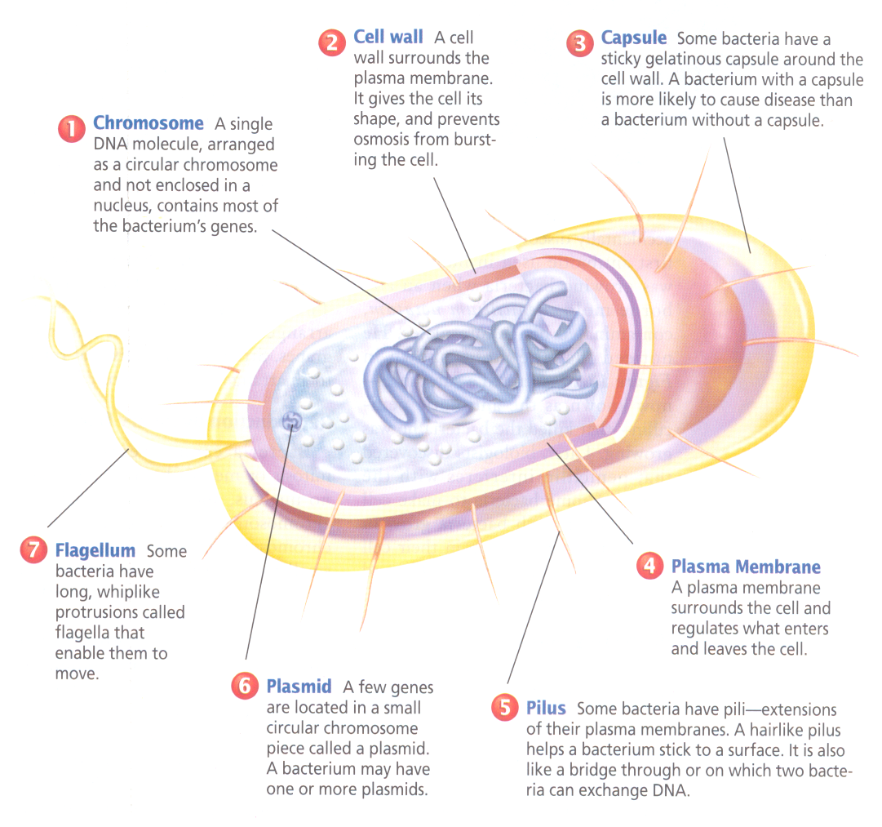
The “simple” Bacteria

Slide 23
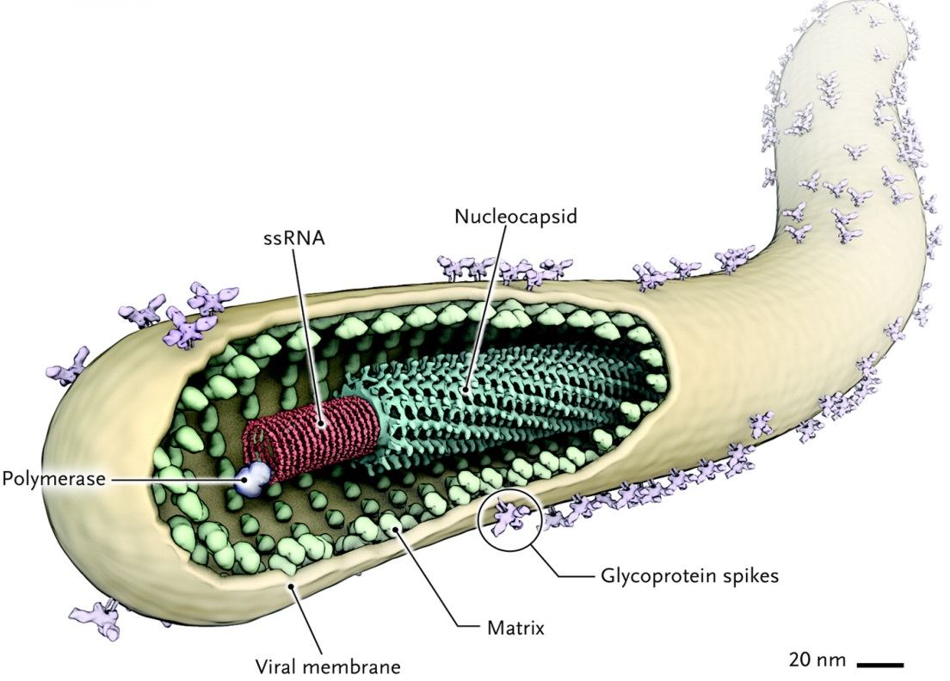
Viruses contain DNA or RNA, but are not considered “alive”
Ebola Virus

Slide 24
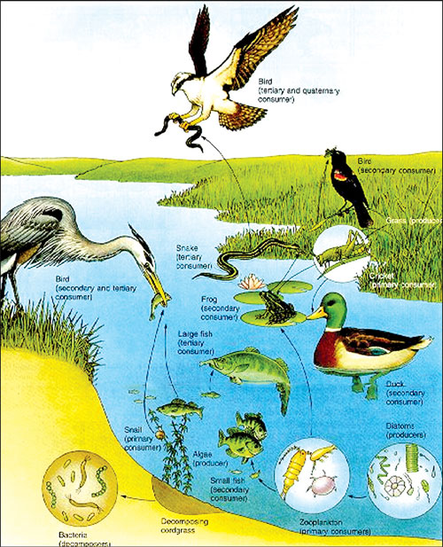
God’s Influence in Creation
Delicate Balance
in Ecosystems!
Ecosystems were made with producers (plants) and consumers (animals) – both are needed!
Every ecosystem must have decomposers (bacteria and fungi) to recycle the nutrients
Finding out today that when humans introduce pollutants or alien species into ecosystems we can upset the delicate balance God designed!
All the components in an ecosystem must be present at the same time for it to work

Slide 25
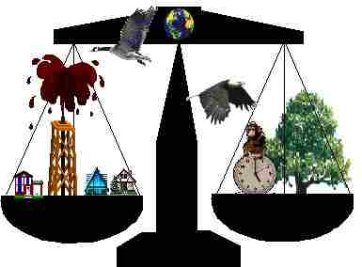
God’s Influence in Creation
Ecosystems are
amazingly resilient!
Ecosystems were designed to tolerate many different climatic changes, natural disasters, and even human mistakes!
Natural: Human:
Tornadoes Chemical pollutants
Hurricanes Oil spills
Volcanoes Over population
Floods Alien species
Forest fires

Slide 26
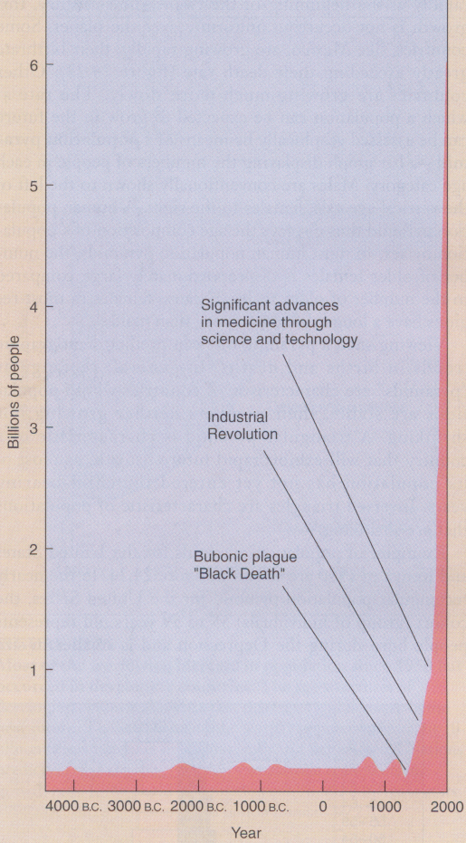
God designed an ecosystem that would fully recycle.
Human technology has led to a population explosion and polluted earth!

Slide 27
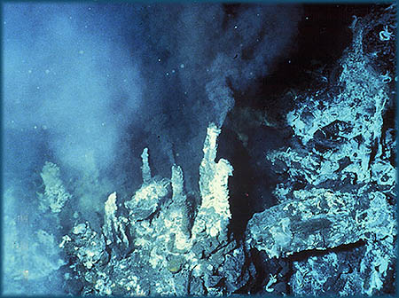
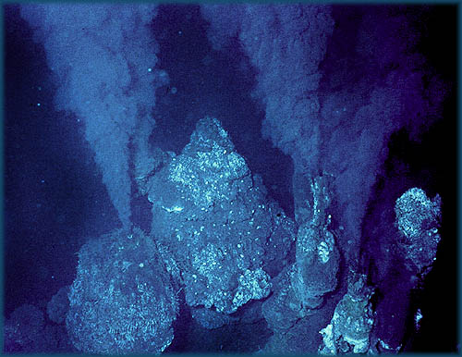
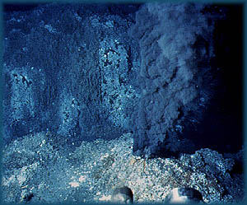
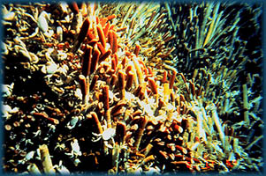


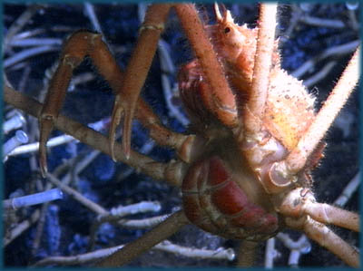
Black
Smokers
Average depth is 6300 feet

Slide 28
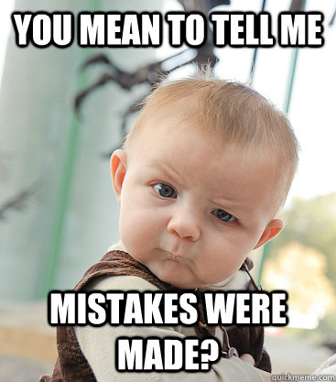
Flaws in the Theory of Evolution
Lack of experimental evidence that new species can be produced (macroevolution)
Ridiculous probabilities that random chance could produce so many positive mutations that could then be selected by Natural Selection to produce our world today
3) Look for issues that have a spiritual meaning designed by God (like sexual reproduction, helpless babies, families, weeds advantage over human food plants)

Slide 29
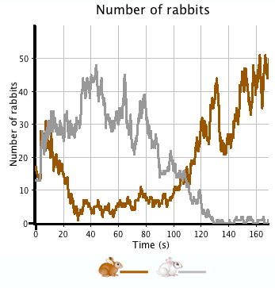
Definition of Evolution Today
Very broad now:
Any change in the genes or gene frequencies of a population
This definition makes it very difficult to argue against “evolution” as it is now defined, because changes to occur to genes & gene frequencies of species

Slide 30
Two areas of Evolution today
1) MicroEvolution: any changes in gene frequencies
This can be verified with experiments
and has meaning to our lives today!
2) MacroEvolution: development of new species
This has never been verified with
experiments!

Slide 31

Microevolution
This has lots of experimental evidence

Slide 32
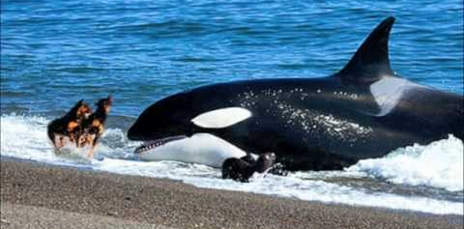
Macroevolution
This has NO experimental evidence

Slide 33
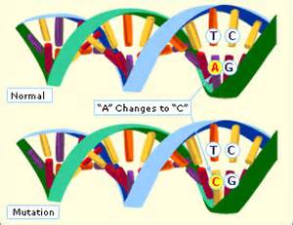
Mechanisms required for
Evolutionary Theory
Mutations: any changes in the DNA genetic code (like misspelled words in a newspaper)
  provide genetic diversity and variations in traits in species
  Some mutations (like antibiotic resistance) make an organism better able to survive in a select environment

Slide 34
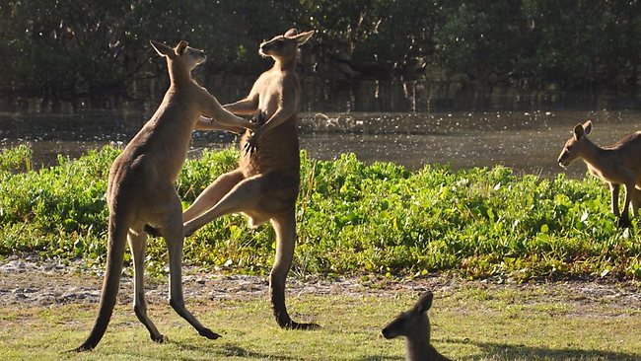
Mechanisms required for
Evolutionary Theory
Natural Selection: “survival of the fit”. Only the varieties of a species that are well suited to the environment will survive and reproduce.
  determines which variations survive
  survivors reproduce and pass on their genes

Slide 35
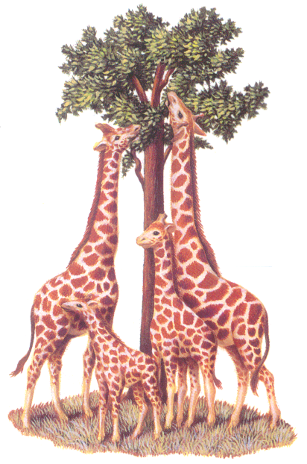
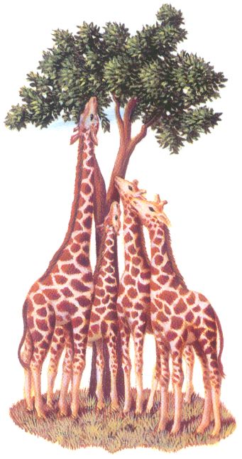
Natural Selection in action
Time

Slide 36
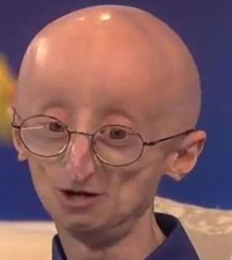
Flaws in Evolutionary Theory
Progeria
Mutations:
Harmful or Helpful?
Mutations are now claimed to be the major source of new variations in evolutionary theory. Without new mutations every species would now be limited to the variations that could be made by recombining their current genes. Millions of positive mutations are essential to the theory.
However, in experiments that have been run on fruit flies, fish, and worms, no known positive structural mutations have been created. Structural mutations are harmful or neutral. They don’t make the organism better.

Slide 37
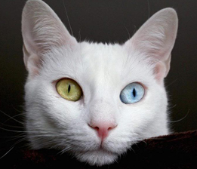
Mutations do not
create new species
1) It would take millions of micro-mutations to change from one species to another.
2) Mutations are random. They have no direction that would cause greater complexity or organization .
3) Fruit flies were purposely mutated for 30 years, but no new species (or structures) were produced.
4) 99.9% of observed mutations are harmful and usually kill the organism. (wait till you see the 0.1%)
5) The only mutations that even count are those in eggs or sperm. These can be passed to the next generation. If they did produce a new species, it could not sexually reproduce & would therefore die out

Slide 38
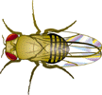
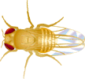




Drosophila (fruit fly)
Normal wild type

Slide 39
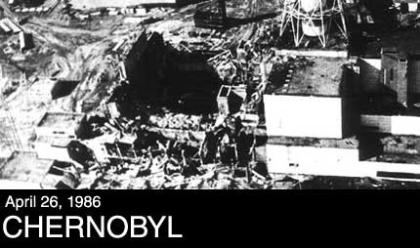
Where are any examples of positive mutations that resulted from the mutations at Chernobyl?

Slide 40

10 Myths about the Chernobyl Disaster
(taken from WorldNews.com)
Myth Two: The genetic consequences of the Chernobyl accident are horrific.
Facts: During 60 years of research, the global science has not registered any genetic mutations connected with radiation. Moreover, 20 years after the Chernobyl tragedy, the International Commission on Radiological Protection, seeing that there are no reasons to speak about potential genetic risks, downgraded the related risks by 90%. Therefore, all rumors about the genetic consequences of the Chernobyl disaster can be dismissed as a groundless fantasy or lies.

Slide 41
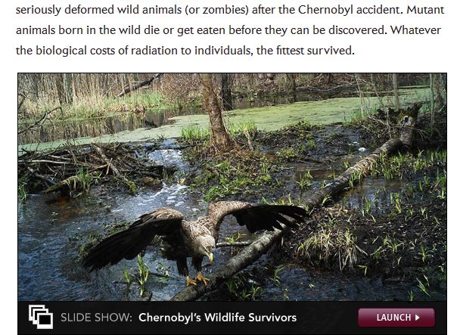
Are Chernobyl animals mutants or thriving?

Slide 42
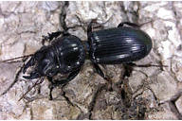
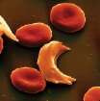
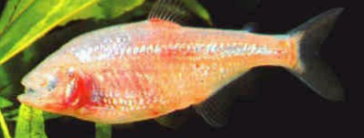
“Beneficial” Mutations
Wingless beetles
Blind Cave Fish
Sickled blood cells
What do they all have in common?

Slide 43
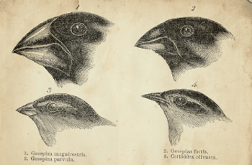
Flaws in Evolutionary Theory
Natural Selection does not create new species
1) It selects and then limits existing gene combinations within a species. This actually lowers the amount of variety within a species! Genetic information is actually lost as natural selection takes place!
(Like artificial selection of dogs, cows, pigs)
2) Natural selection does not create new structures, new organs or new species. It only selects which varieties are best fit to survive in the environment.
3) Natural selection has a limit to the extent that it can change a species.
(Like fastest horse, most milk-producing cow, best fruit)

Slide 44
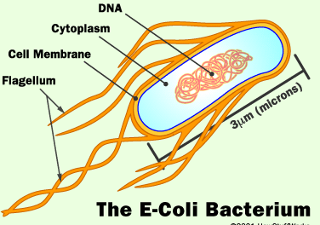
Flaws in Evolutionary Theory
Decoding of nuclear DNA has not changed
The entire field of Genetic Engineering is based on placing genes from one species into another. Genes from advanced mammals and plants can be put into simple bacteria, and the genes work fine! The Genetic Code is read the same way in all organisms.
During natural selection and mutation over millions of years, some changes should have occurred in the genetic code. Evolutionary scientists were shocked in the 1960’s to find out this had not happened!

Slide 45
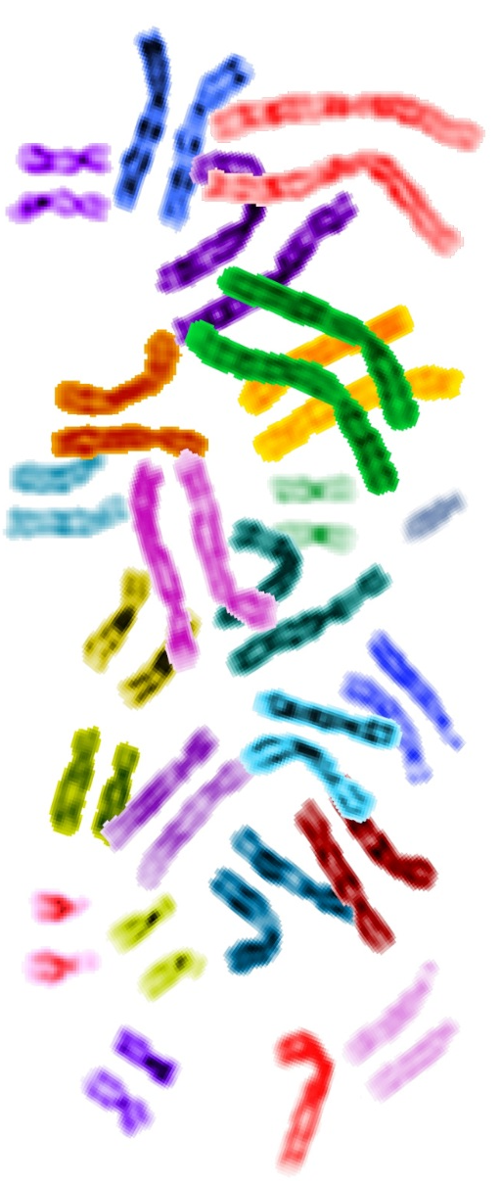
Flaws in Evolutionary Theory
Chromosome Number
Some organisms have as few as 1 or 2 chromosomes per cell, and others have over 1000! Humans have 46.
Evolutionary scientists expected a consistent pattern in the number of chromosomes as you move up the evolution tree, but the evidence proves contradictory!

Slide 46
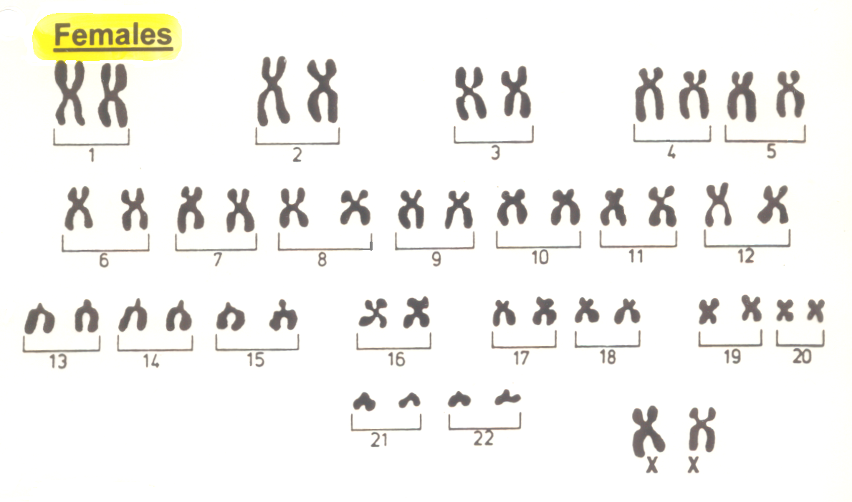
Human Chromosomes

Slide 47
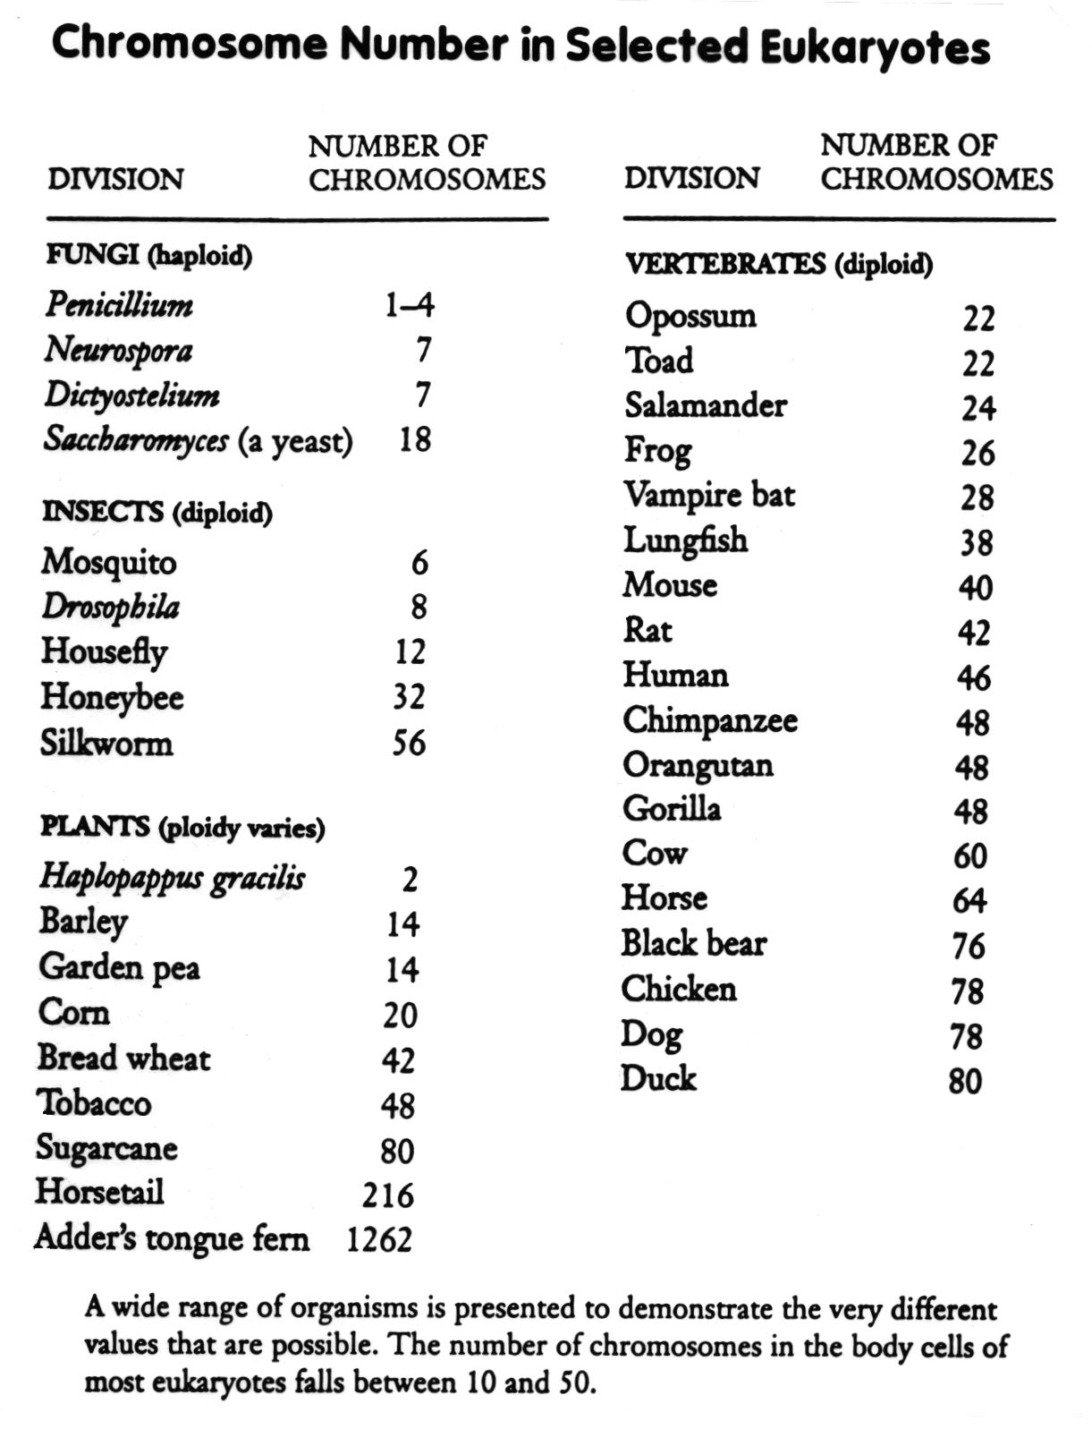

Slide 48
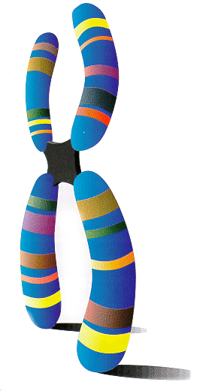
The Number of Genes
Each chromosome has many genes
It was once assumed that the more complex an organism is, the more genes it would need.
We now know that this it not true:
  Roundworm (C. elegans) – 19,500
  Small plant (Arabidopsis) – 27,000
  Humans – original estimate 100,000
now down to only 20,000-25,000

Slide 49
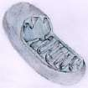

Mitochondrial DNA
DNA has been found in mitochondria!
Originally thought to be supportive of the Endosymbiotic Theory (bacteria took up residence in cells and became cell organelles)
Turned out that genes for reproducing mitochondria are in the cell nucleus!

Slide 50
Flaws in Evolutionary Theory
Subject Interpretations of Fossils
Scientists “see” what they are looking for!
Piltdown Man:
Presented by Charles Dawson in 1912
Arthur Woodward reconstructed a skull
Finally a full size model was made
Skull was thoroughly examined for over
30 years before found to be a fake
Actually a very old human skull and
a recent orangutan jaw with canine
teeth that were filed down.

Slide 51

US News & World Report Feb 14, 2000

Slide 52

National Geographic Magazine
11 page special
Nov 1999

Slide 53


Slide 54

Flaws in Evolution
Organs are fully
developed
If species were constantly changing and evolving to higher organisms, we should be able to find organisms today which have organs in the process of evolving.
Where are the new appendages, or additional sense organs, or new structures just beginning?
Everything in life points to the conclusion that all species today were created with complete, fully functioning organs

Slide 55
Flaws in Evolutionary Theory
Some species haven’t changed
from their fossil record!
Some species are supposedly millions of years old, but show no change from their fossil ancestors!
Mutations should have produced lots of varieties over millions of years and as the environment changed, natural selection should have selected varieties that were fittest to survive and produced some changes in the species.

Slide 56

Evolutionists’ Mistakes Revealed
in the Living Coelacanth
For nearly a century the Coelacanth had been considered an ideal intermediate between fish and terrestrial vertebrates based on its well-preserved skeletal fossil remains. This fish was thought to have gone extinct over 100 million years ago. But after one was discovered alive and well in 1938, analysis of the soft anatomy quickly revealed that it had all the characteristics of a fish, not the characteristics of an intermediate the evolutionists had predicted and hoped for.

Slide 57


Flaws in Evolutionary Theory
Prominent Evolutionists Admit Species are Not Slowly Changing
"The observation that species are amazingly conservative and static entities throughout long periods of time has all the qualities of the emperors' new clothes: everyone knew it but preferred to ignore it. Paleontologists, faced with a recalcitrant (inflexible) record obstinately refusing to yield Darwin's predicted pattern, simply looked the other way" – N. Eldredge and Tattersall, The Myths of Human Evolution, 1982, p 45-46.
"The overwhelming prevalence of stasis became an embarrassing feature of the fossil record" - S.J. Gould, ‘Cordelia's Dilemma', Natural History, Feb 1993, p 15.

Slide 58
Flaws in Evolutionary Theory
Fossil Record: Full of holes!
Over 100 years ago Charles Darwin expected scientists would find many intermediate fossils that would illustrate a slow, continuous change of species over time. After searching for these fossils for years, many scientists are now ready to admit they have not been found and do not exist!
Some of these scientists have refused to give up the theory of evolution in the face of the missing evidence, so they came up with the theory of punctuated equilibrium to explain the missing fossils!

Slide 59
Flaws in Evolutionary Theory
Punctuated Equilibrium
The theory of punctuated equilibrium gets around the missing link fossils by claiming that earth is usually in a state of equilibrium with no evolution taking place, and that evolution only occurs periodically and rapidly. So rapidly that fossils of the intermediate forms could not form.
This theory shows the desperate state of evolutionary theory. There is no experimental evidence that new species can form slowly, let alone rapidly! This theory also demands that cataclysmic events occurred throughout earth’s history periodically that caused rapid mutation.

Slide 60

Gradualism
verses
Punctuated Equilibrium
Cataclysmic Events

Slide 61


Published in 1996

Slide 62

Biochemical Pathways
Many molecules made by cells need to go through multiple processes (some over 10), each controlled by a different enzyme. The intermediate products are worthless until the final product is made.
If mutations had produced this complex system, all the required enzymes for one pathway would have had to evolve at the same time to complete the process!
Behe stated the obvious – this process could not have evolved!

Slide 63
Biochemical Pathway Analogy
It takes many steps and processes to make the head, shaft and rubber grip.
Each intermediate result is useless until the final product is assembled.

Slide 64

There is no point in the intermediate molecules unless the final product is produced!
Suggesting they evolved backwards doesn’t solve the problem!
Having endless time doesn’t solve the problem, it just makes it worse!

Slide 65

How could this intricate, complicated process possibly have evolved by random chance?

Slide 66

The weight of evidence is for creation!

Slide 67



Which Pathway will YOU choose?
Evolution by chance
Creation with purpose
God is hoping you will chose Him & He’s willing to help you daily to join His Family

Slide 69
God is not finished with His creation!
Romans 8:19-22
19 For the earnest expectation of the creation eagerly waits for the revealing of the sons of God.
20 For the creation was subjected to futility, not willingly, but because of Him who subjected it in hope;
21 because the creation itself also will be delivered from the bondage of corruption into the glorious liberty of the children of God.
22 For we know that the whole creation groans and labors with birth pangs together until now.
Those who are led by the Spirit are being fashioned into children of God

Slide 70
For more information…
Call:
Write:
Web:

Slide 71

Scientific Theory Mistakes
Circulatory System
Scientists mistakenly held onto this theory until the 1600’s

