Slide 1
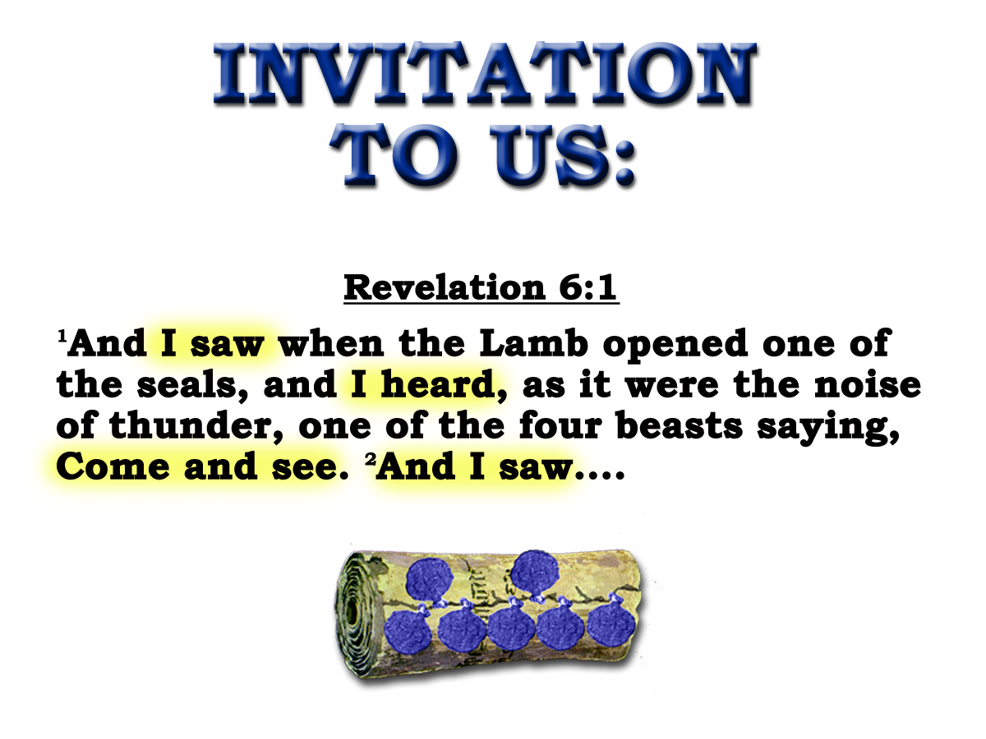
South West Bible School 2015

Slide 2
Unsealed! – ‘come and see!’
(Witnessing for Christ )
Study objectives:
Reinforce the continuous historical inter- pretation, by context and relevant verses:
Show vital need for saints to be informed of their historical circumstances.
To be inspired, reassured and convinced that God is in control of world and personal affairs.
Mid Atlantic Bible School 2015

Slide 3

Unsealed - “Come and See!”
Witnessing for Christ
7
Seals
7
1 2 3 4 5 6
Trumpets
7
1 2 3 4 5 6
Vials
Judgement - Pagan Rome
1 2 3 4 5 6
Judgement - Christian Rome
Rev.6
Judgement - Holy Roman Empire
Rev.8 & 9
AD 96 – AD 324
Rev.16
AD 395 – AD 1685
AD 1789 – AD 1820
South West Bible School 2015

Slide 4
1
"Come and see"
6:1
First
four
seals
2
"Come and see"
6:3
3
"Come and see"
6:5
4
"Come and see"
6:7

Slide 5
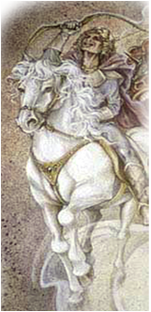
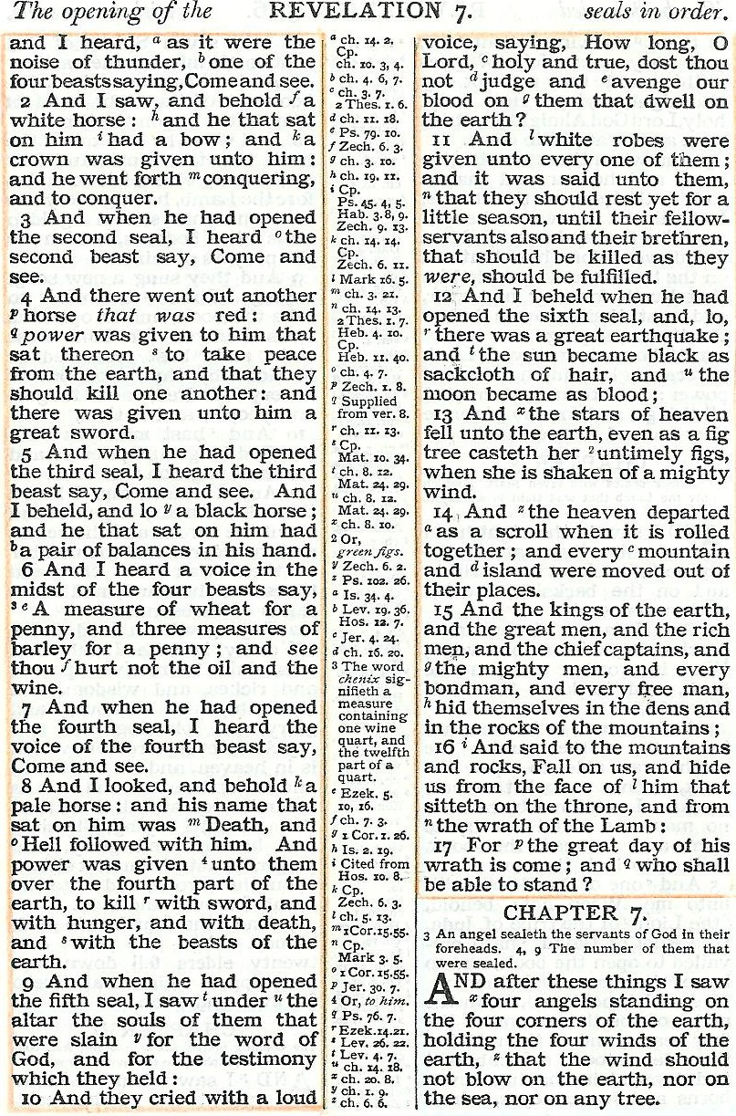
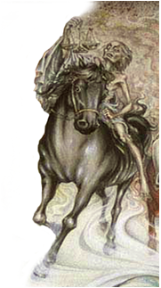
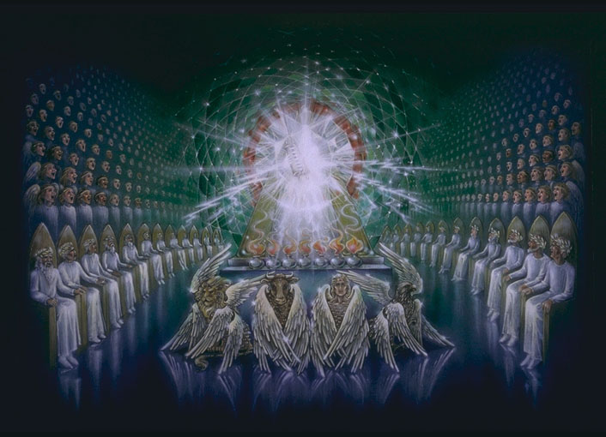
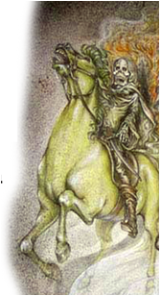
No ‘come and see’ !
No ‘living ones’ !
Revelation Ch.4:4-7
Four Beasts
Gk.=Zoa = Living Ones

Slide 6
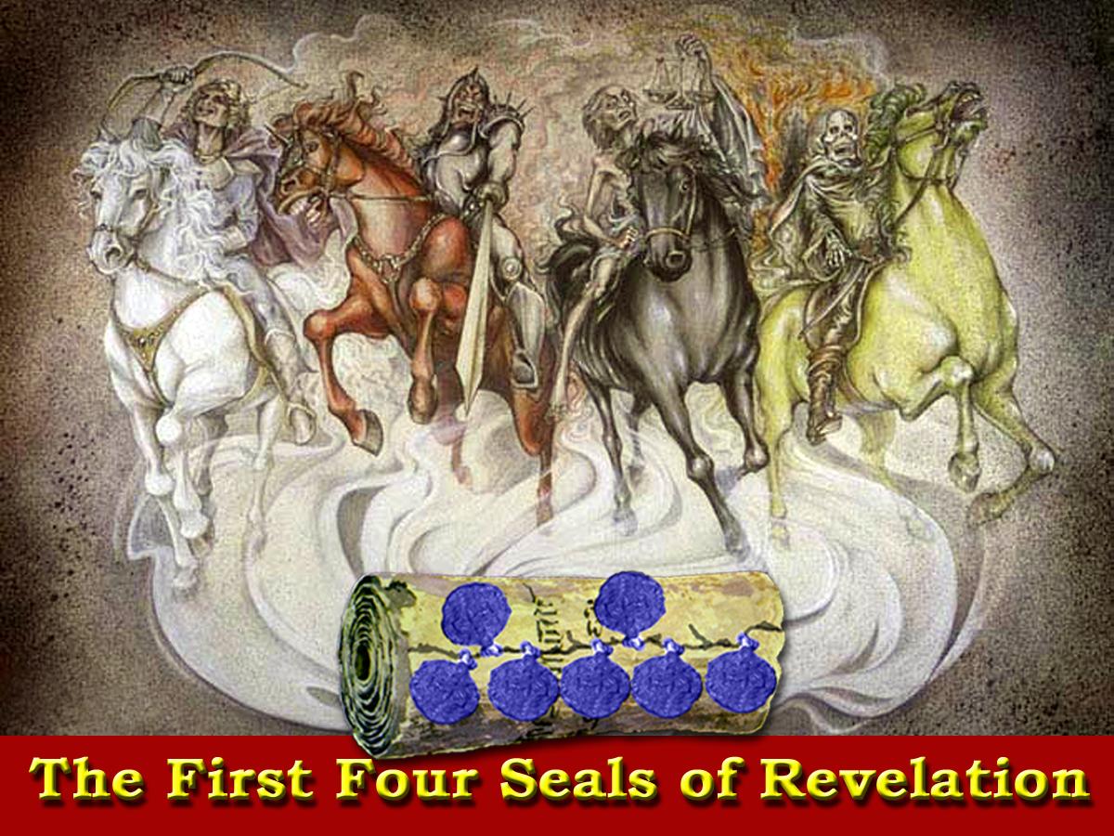
Blood
Death
Peace
Famine
The earth is the Empire
The horse its condition
The rider the reason

Slide 8
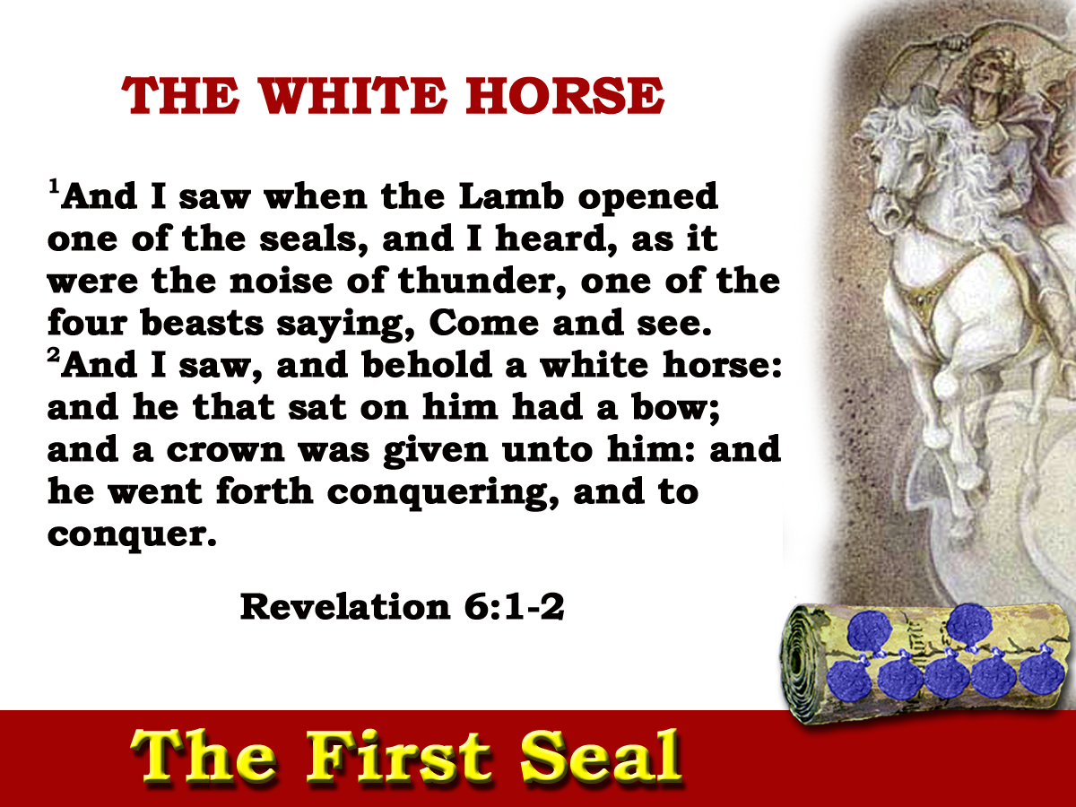
‘I will send those that escape of them, sounders of the truth, and they shall declare my glory among the nations.’ Isa.66
Zech. 9:13 Isa. 66:19 Psa. 64:3-4
Multitude
Proclaiming truth
Tongues bent - Words as arrows shot forth
Note V4
84yrs

Slide 9
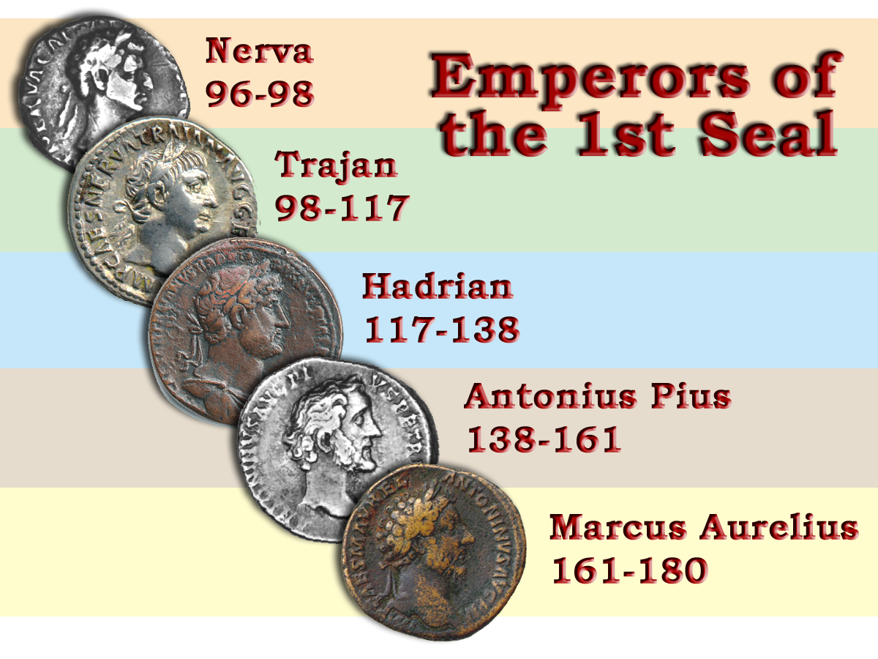
“To everyone the reign of Trajan seemed like the return to the golden age……It was during the reign of Antonius that the Roman Empire reached the zenith of its power and prosperity and for this reason his reign appears uninteresting and eventless…Marcus Aurelius had absolute need of domestic peace in order to carry out his foreign policy”
“If a man were called upon to fix a period in the history of the world, during which the condition of the human race was most happy and prosperous, he would, without hesitation, name that which elapsed from the death of Domitian to the accession of Commodus.” Gibbon Ch.3
Larousse History pp.208-209
84ys
Peace
Conquering the Roman world by the word of the covenant

Slide 10
“I am quite wearied with punishing and destroying the Galileans, or those of the sect called Christians according to your orders. Yet they never cease to profess voluntarily what they are, and to offer themselves to death. Wherefore I have laboured, by extortion and threatening, to discourage them from daring to confess to me that they are of that sect.”
Letter to Trajan from Tiberianus
G5115
G5088
The Empire prospered and was at peace but the dominate force governing the period was a warfare of faith against terrible odds.
2Cor 10:4-5
Notes:
'Bow' - only use of the word in the NT G5115
Note: Comes from base G5088
Total KJV Occurrences: 29 (always use in context of birth)
Not a warfare of death but of life!
Next time "white horse" appears is in Rev.19:11
This time it is Jewish in character. = zech 10:3
Conquering began in ch 6 but was not completed as horse turned red. but in ch19:11 the conquest of the world is fulfilled.

Slide 11
Blood
Peace
Nerva
Commodus
Trajan
Pertinax
Hadrian
Julian
Antonious Pious
Septimus Severus
Marcus Aurelius
Geta

Slide 12
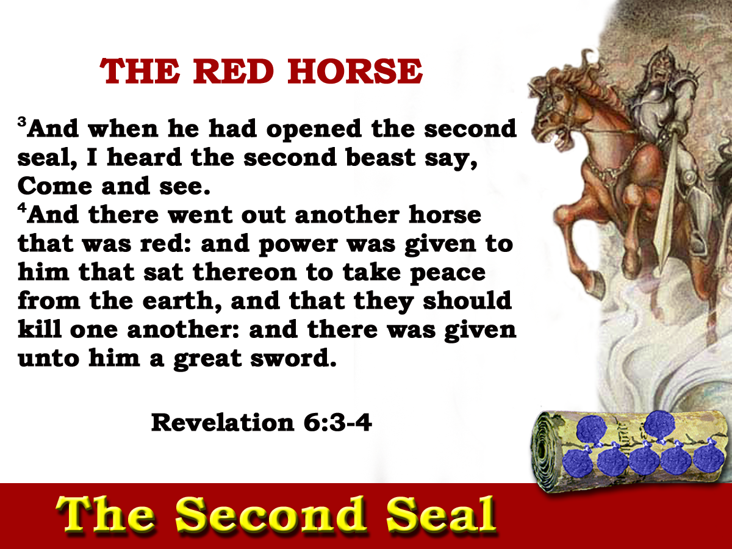
31yrs

Slide 13

Note contrast between v4 and v8

Slide 14
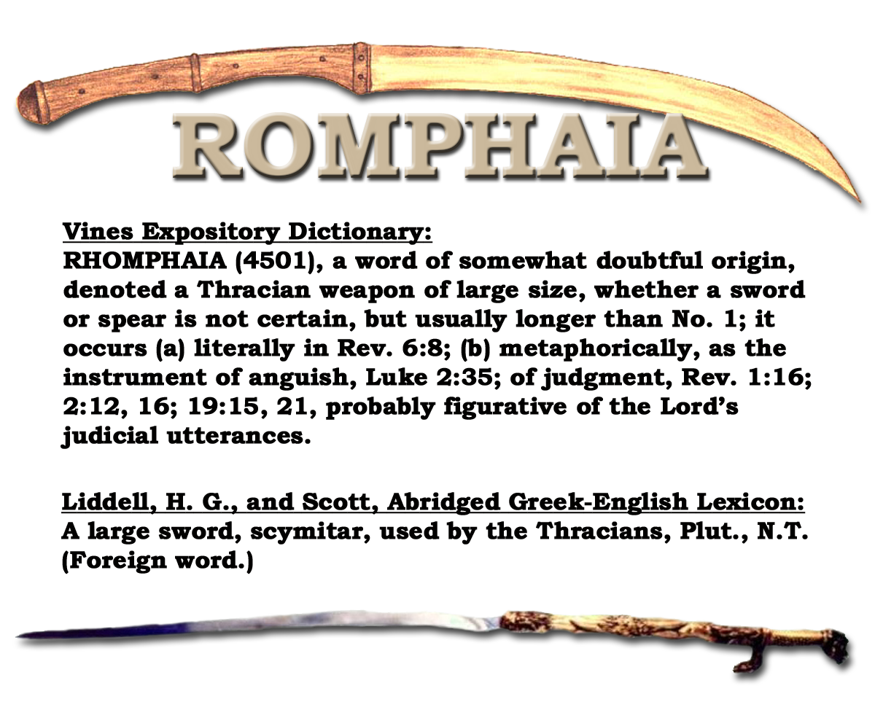
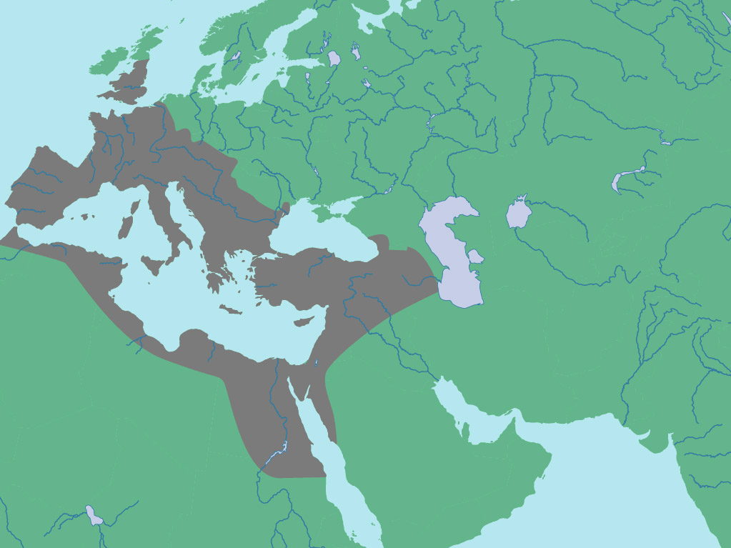
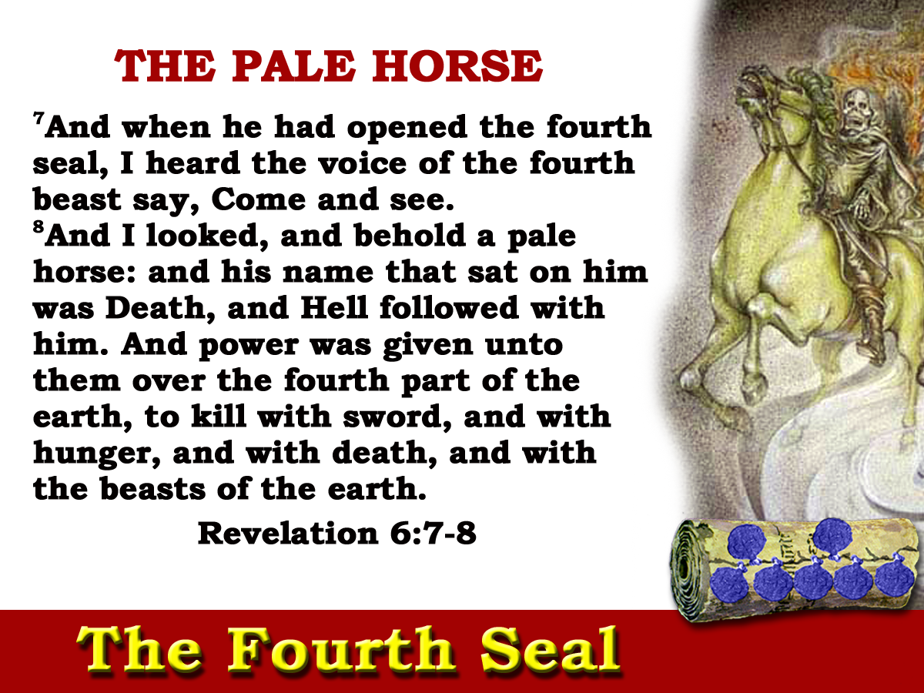
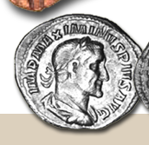
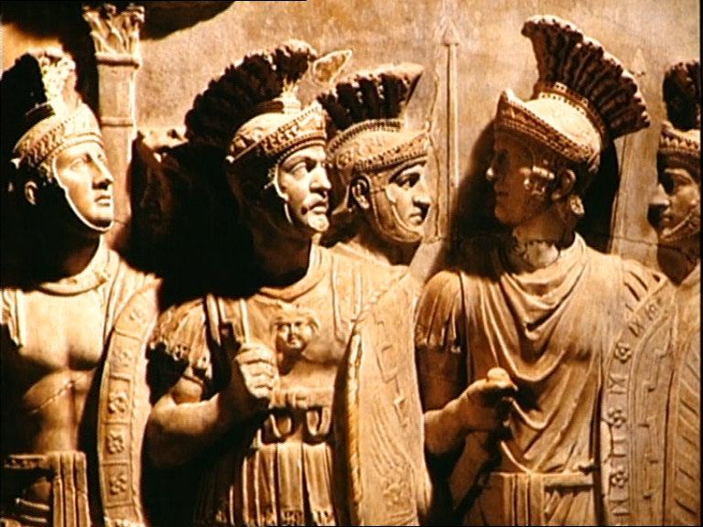

Slide 16
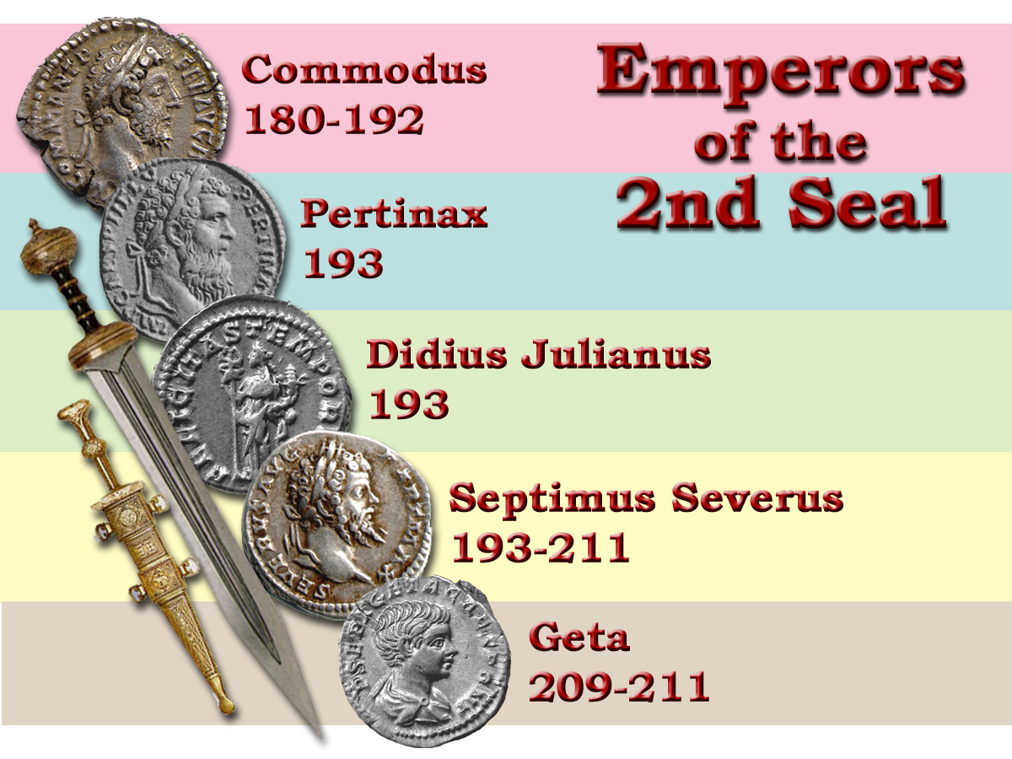
“Three years before his death, Marcus Aurelius had named as his successor his son Commodus.
Larousse History p.210
Blood
Empire descends into civil war
31ys
Notes:
The Second Seal lasted from Commodus until the emperor Geta.
It was a period characterized by assassination and civil unrest in the government while the MACHIRA did it’s work.

Slide 17
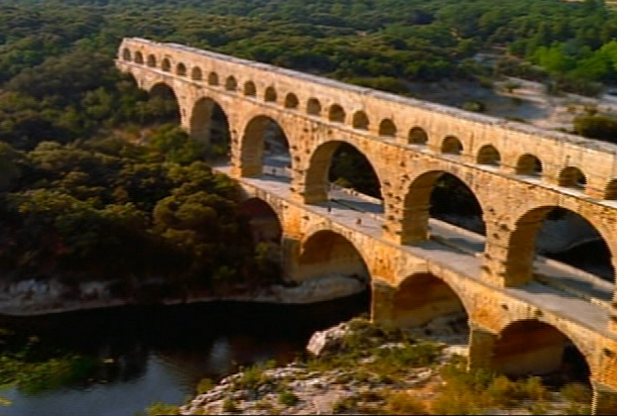

Slide 18
But he was incapable, a drunkard and a profligate.
Power at once went to his head and he demanded recognition and worship as a god. He abandoned the reigns of government to his licentious favorites and renounced the energetic defensive policy of his father.
He pillaged the treasury and persecuted the senate without mercy. Not unexpectedly, plots against his life were numerous.”
Larousse History p.210
Blood
Empire descends into civil war
“That they should kill one another”
31ys
Notes:
The Second Seal lasted from Commodus until the emperor Geta.
It was a period characterized by assassination and civil unrest in the government while the MACHIRA did it’s work.

Slide 19
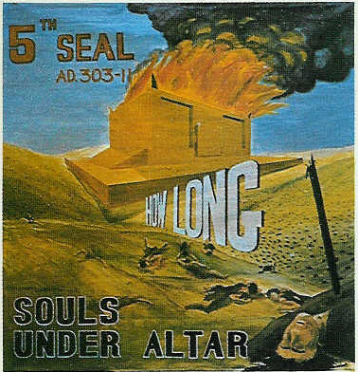
Blood
Peace
Nerva
Commodus
Trajan
Pertinax
Hadrian
Julian
Antonious Pious
Septimus Severus
Marcus Aurelius
Geta

Slide 20
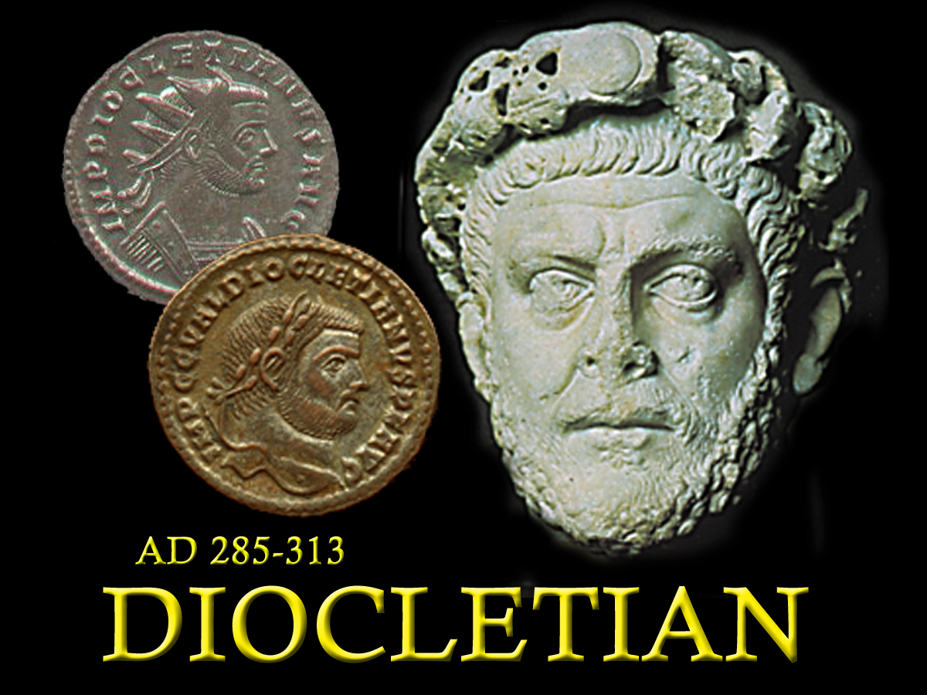
Next session – Seals 3-5.
Theme “How long, O Lord,”
Christ’s Brethren slain
285 - 305
Notes:
The Emperor Diocletian (who ruled the empire from 285-313) attempted to protect the interests of the Pagan empire
The Emperor was considered a “god”, and any religious system that would not recognize him was a threat to his power.
The pagan religion fed off the emperor who in turn fed off the pagan religion that legitimized him.
Diocletian issued a decree banning the Christian Religion and giving the different rulers throughout the empire the right to confiscate lands, monies and valuables from the church, to burn their buildings and kill the Christians.

Slide 22
‘and power was given unto them over the fourth part of the earth”
Four Prefectures
Gaul
Italy
Illyricum
East
Ch6:8

Slide 23
‘I heard one of the four living ones saying as with a voice of thunder.’ Diaglott
84yrs

