Slide 1
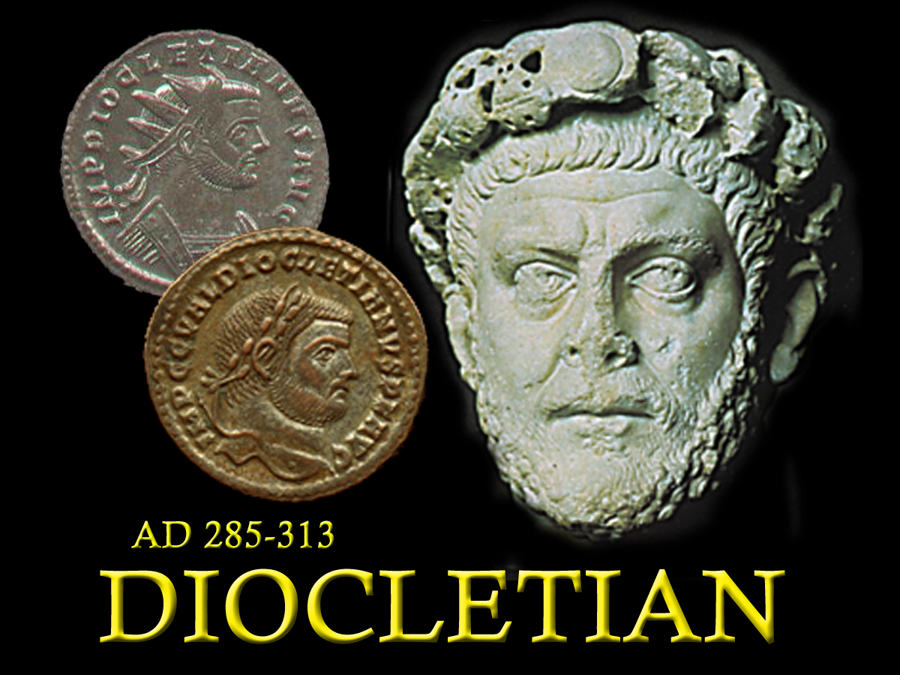
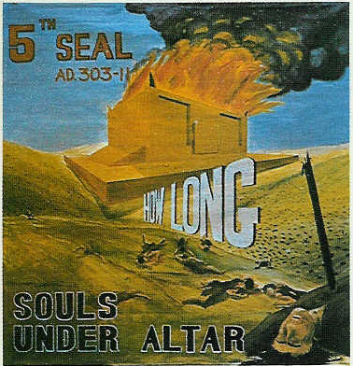
Seals 3-5.
Theme “How long, O Lord,”
Christ’s Brethren slain
285 - 305
Notes:
The Emperor Diocletian (who ruled the empire from 285-313) attempted to protect the interests of the Pagan empire
The Emperor was considered a “god”, and any religious system that would not recognize him was a threat to his power.
The pagan religion fed off the emperor who in turn fed off the pagan religion that legitimized him.
Diocletian issued a decree banning the Christian Religion and giving the different rulers throughout the empire the right to confiscate lands, monies and valuables from the church, to burn their buildings and kill the Christians.

Slide 2
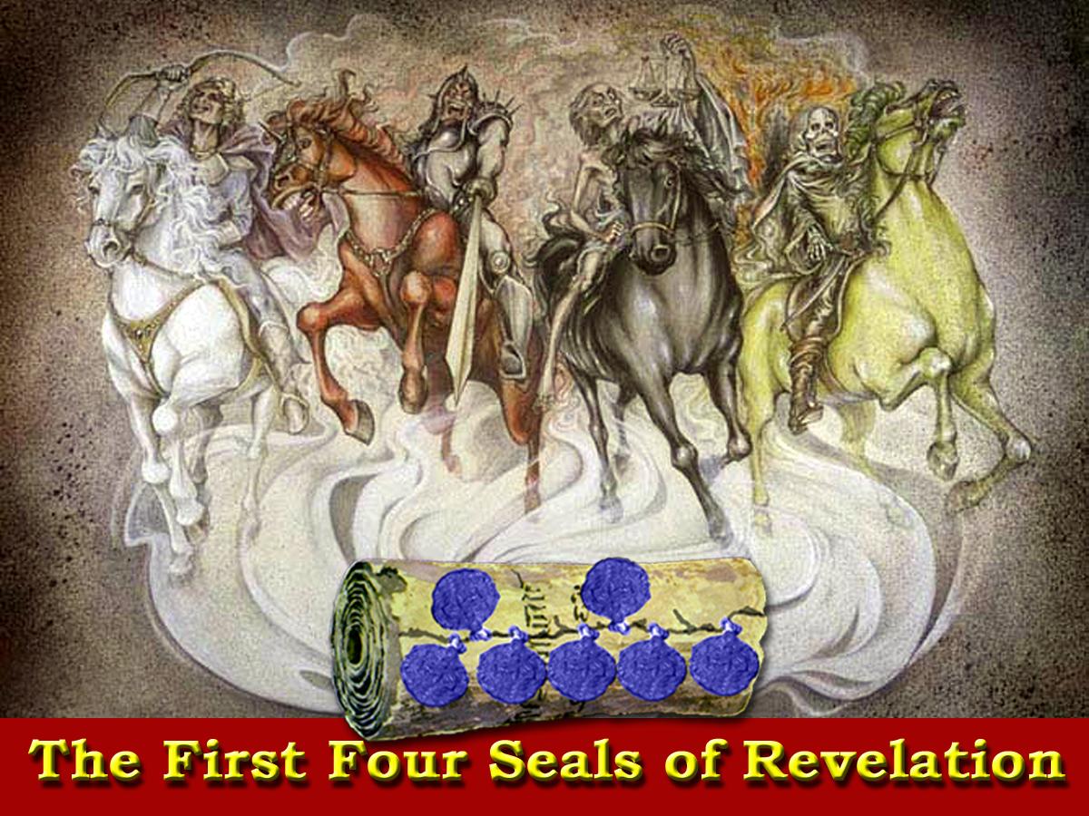
Peace
Blood
84 yrs
Injustice
31 yrs
Nerva
Caracalla
Trajan
Macrinus
Hadrian
Commodus
Pertinax
Elagabalas
Antonious Pious
Julian
Severus Alexander
Marcus Aurelius
Septimus Severus
Geta

Slide 3
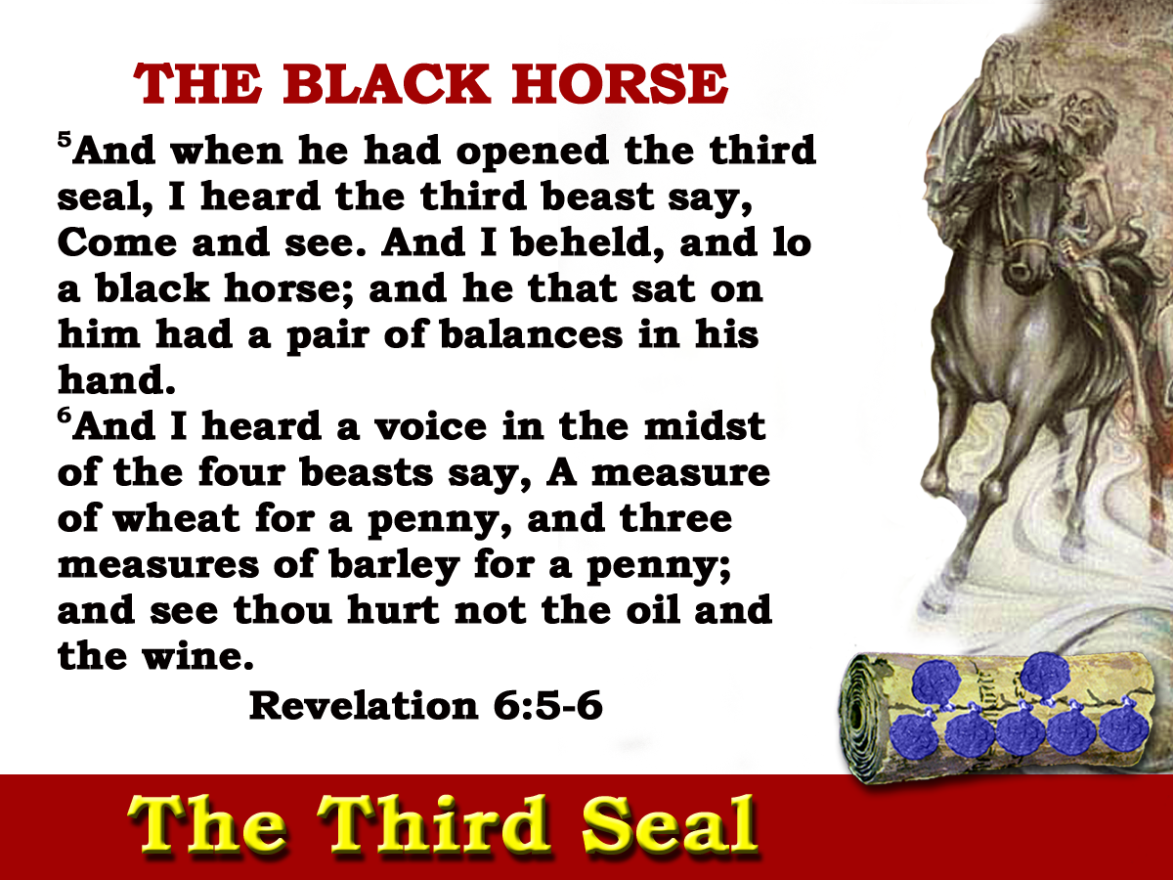
Justice!
JOB 30:26-31
Mourning
Distress
Intense depression of mind
211-235
24yrs
Notes:
The Third Seal brought the black horse whose rider carried the balances.

Slide 4
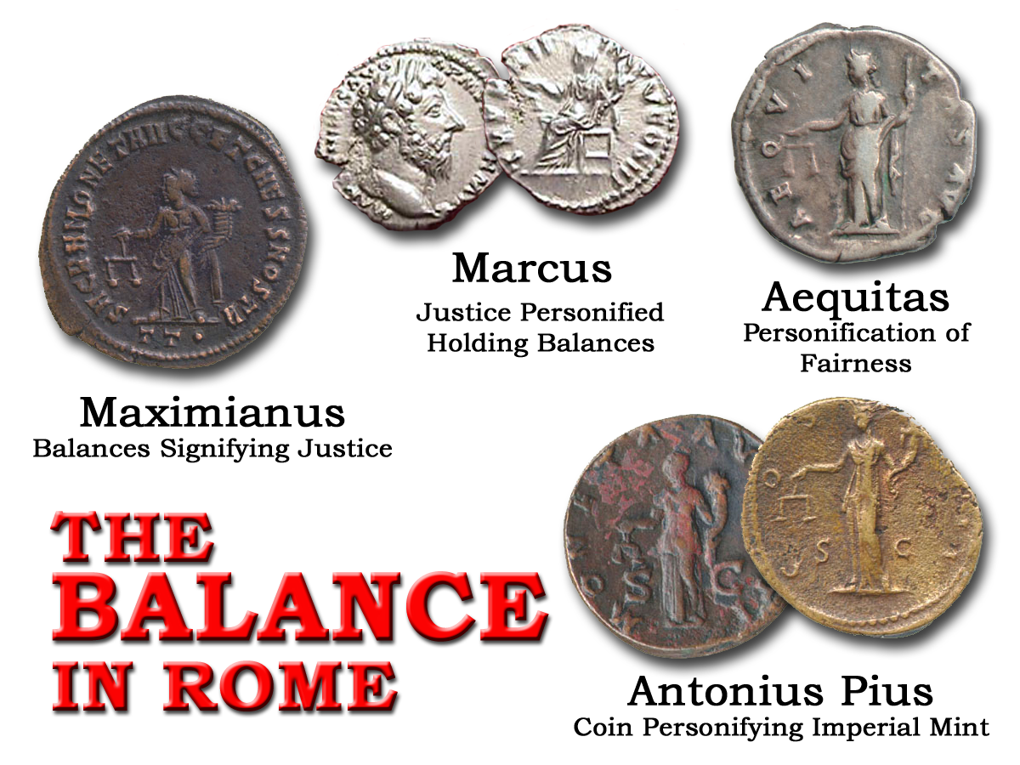
Notes:
The rider on the horse was to carry the balance – the symbol both then, and now (symbol used with blindfold to show fairness) of justice.
Injustice and greed would categorize this age – as evidenced by the inequitable pricing of food.

Slide 5
“Now in the first year of Cyrus king of Persia, that the word of the Lord by the mouth of Jeremiah might be fulfilled, the Lord stirred up the spirit of Cyrus king of Persia, that he made a proclamation throughout all his kingdom, and put it also in writing, saying,….”
(Mg. ‘caused a voice’)
Decrees and laws issued and carried out by those in authority
EZRA 1:1
?
EXOD. 4
211-235
24yrs
Notes:
The Third Seal brought the black horse whose rider carried the balances.

Slide 6
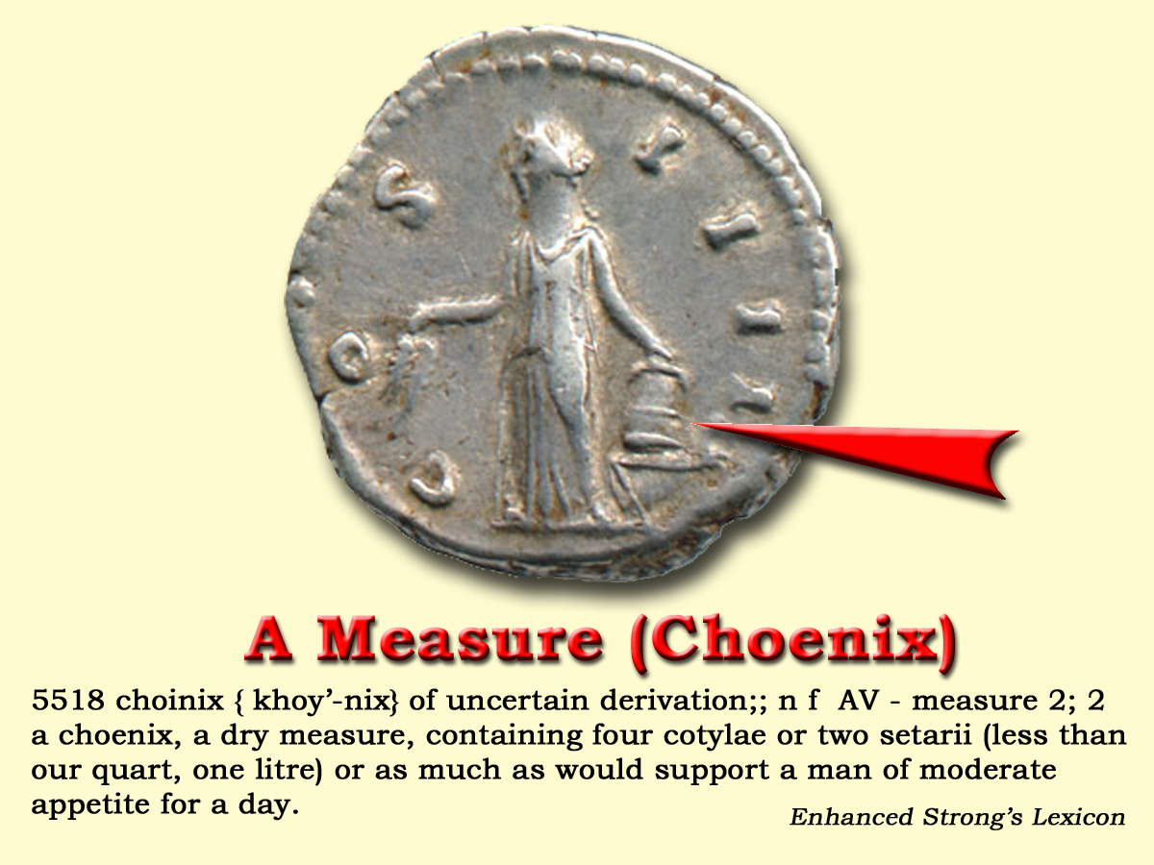
“a choinix of wheat a denarius: and three choinixes of barley a denarius; but the oil and the wine thou mayest not act unjustly by”
Taxation
Matt.20:2
Last crops
Relief
Last Emperor

Slide 7
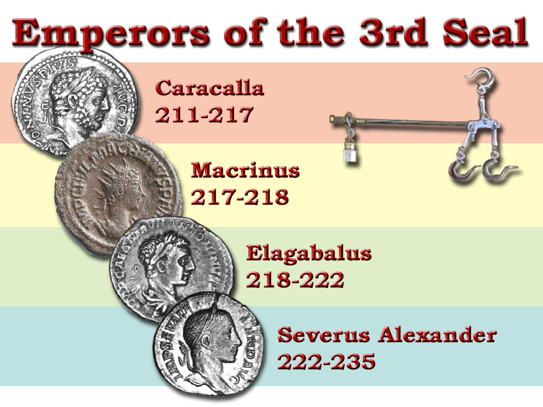
(The Savage Beast of Ausonia)
24ys
Famine
A period of heavy taxation
Notes:
The 3rd Seal was to last from Caracalla through Severus Alaxander and would bring the empire to its knees economically.

Slide 8
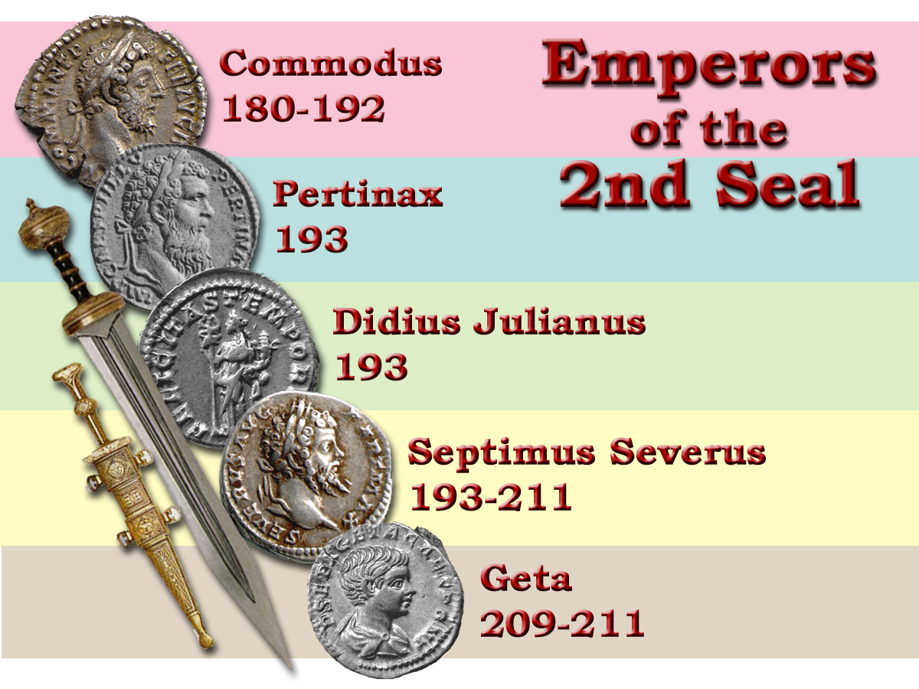

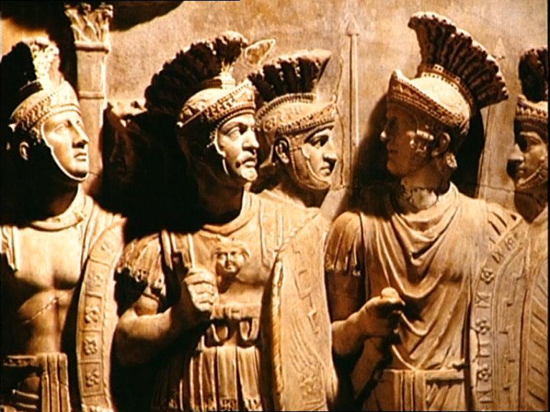
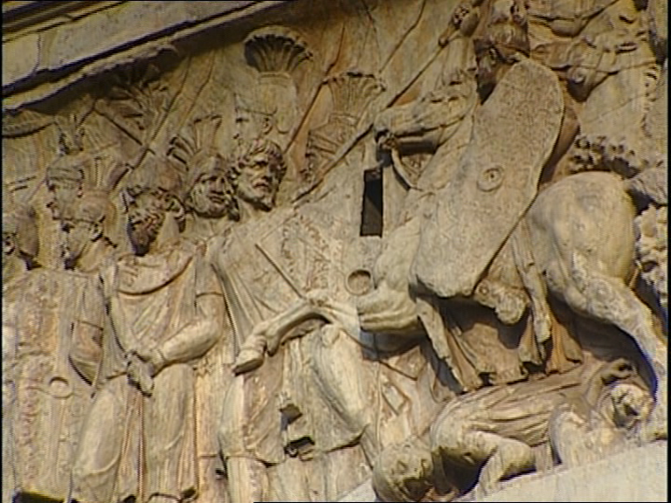

Slide 9
“The growing cost of the armed forces and the inflation which accompanied it compelled the emperors to increase existing taxes and to invent new ones. The spirit of the times was, moreover very susceptible to the message of Christianity, which made great advances.”
Larousse History p.217-218
24ys
Famine
A period of heavy taxation

Slide 10
Blood
Death
Peace
Injustice
Nerva
Caracalla
Trajan
Macrinus
Hadrian
Commodus
Maximin
Pertinax
Elagabalas
Antonious Pious
Julian
Severus Alexander
39
Marcus Aurelius
Septimus Severus
Geta
Diocletian

Slide 11
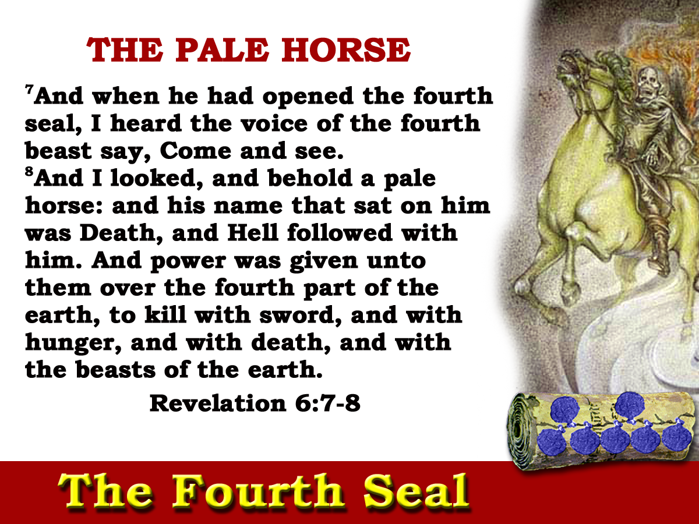
Gk.”Chloros”
“the animating health and vigour of the Empire were fled.”
Gibbon
235-303
68yrs

Slide 12
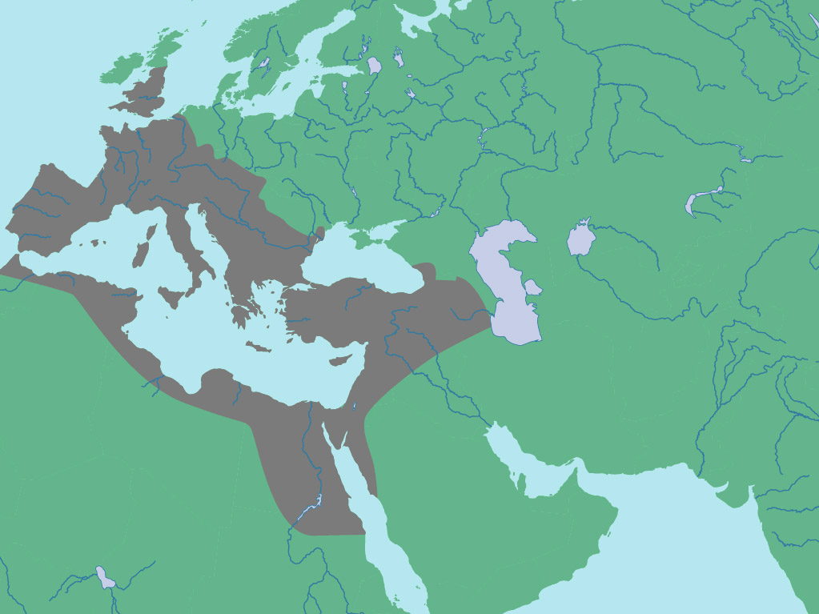
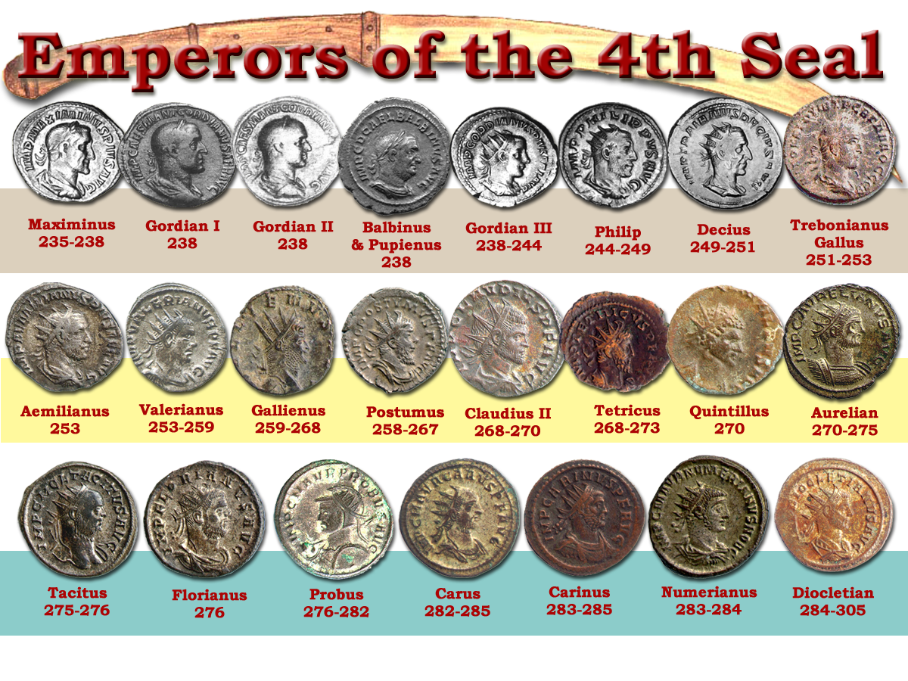
‘and power was given unto them over the fourth part of the earth”
Four Prefectures
Judgement brought home to the very heart and soul of the Empire in preparation for the final overthrow in the 6th Seal.
Gaul
Italy
Illyricum
“Famine is almost always followed by epidemic diseases, the effect of scanty and unwholesome food. Other causes must, however, have contributed to the furious plague which, from the year 250 to the year 265, raged without interruption in every province , every city, and almost every family of the Roman Empire .”
East
?
‘To kill with sword, and with hunger, and with death and with the beasts of the earth’.
Titus 1:12
Gibbon
Gibbon
Gibbon

Slide 13
68yrs
“For nearly half a century- since the death of Severus Alexander- the Roman world had been on the verge of chaos, and the consequences were incalculable. The Empire emerged from the period in a state of collapse. Wherever the barbarians had passed they left behind waste and ruin while the peasants whose fields and homes were ravaged, had fled.”
Death
A period of murder, disease & famine
Larousse History p.218-220
Notes:
The fourth seal lasted from Maximinus to Diocletian
a period of 70 years
During this time there were 23 emperors – each with a morbid tale of death to tell, except Diocletian.
The overall effect of the seals was the destruction of the PAGAN ROMAN WORLD.
This came to a head during the reign of Constantine under the 6th Seal.

Slide 14
285 - 305
Notes:
The Emperor Diocletian (who ruled the empire from 285-313) attempted to protect the interests of the Pagan empire
The Emperor was considered a “god”, and any religious system that would not recognize him was a threat to his power.
The pagan religion fed off the emperor who in turn fed off the pagan religion that legitimized him.
Diocletian issued a decree banning the Christian Religion and giving the different rulers throughout the empire the right to confiscate lands, monies and valuables from the church, to burn their buildings and kill the Christians.

Slide 15
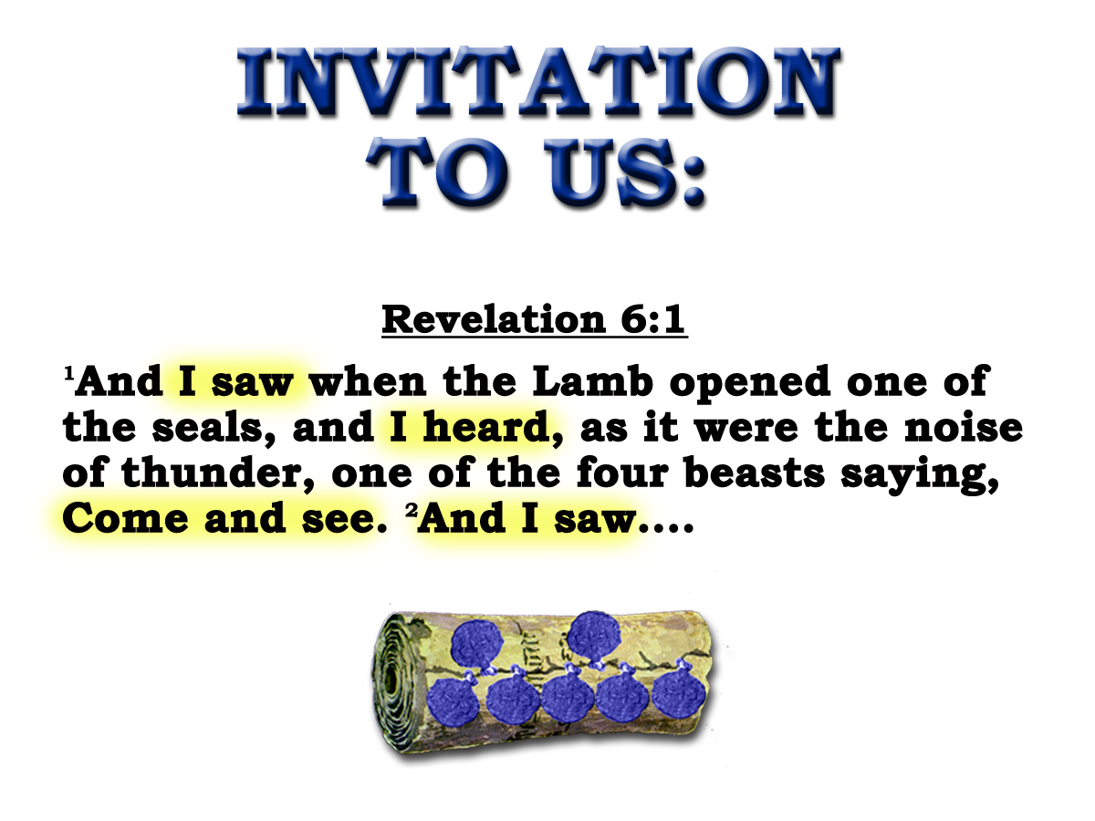
SOULS UNDER THE ALTAR
9
And when he had opened the fifth seal, I saw under the altar the souls of them that were slain for the word of God, and for the testimony which they held:
10
And they cried with a loud voice, saying, How long, O Lord, holy and true, dost thou not judge and avenge our blood on them that dwell on the earth?
No living ones!
Note: V 11
Note: Matt. 5:13
Revelation 6:9-11
The Fifth Seal
303-311
8yrs

Slide 16
SOULS UNDER THE ALTAR
9
And when he had opened the fifth seal, I saw under the altar the souls of them that were slain for the word of God, and for the testimony which they held:
Heb.13:10
Lev.4:7
Gal.3:26-29
“When the faithful in Christ Jesus (those within the Altar) die, and return to their parent earth without violence, they are underneath the altar, sleeping in Jesus ……. But if they are made to lie underneath the altar by the blood- shedding cruelty of the enemy, their souls are said, as in the language of the fifth seal, to cry with a great or loud voice for the judicial vengeance on the murderers who poured out their soul-blood unto death
Eureka Vol. 2 p238
The Fifth Seal
303-311
8yrs

Slide 17
SOULS UNDER THE ALTAR
10
And they cried with a loud voice, saying, How long, O Lord, holy and true, dost thou not judge and avenge our blood on them that dwell on the earth?
Revelation 6:9-11
The Fifth Seal
303-311
8yrs

Slide 18
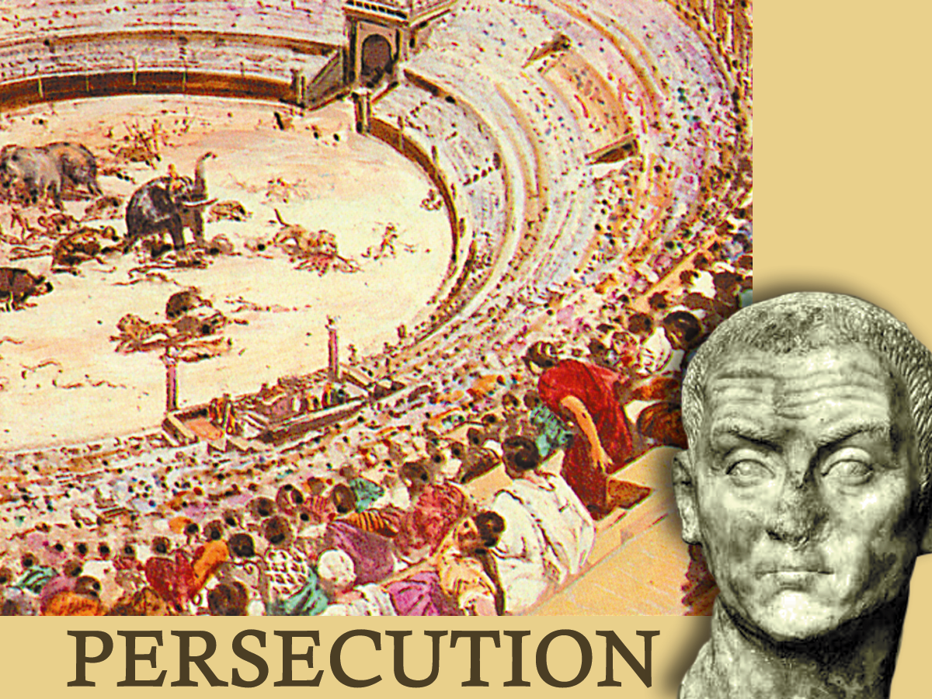
"THEY CRIED WITH A LOUD VOICE"
How would a man pray ?
How would a mother, a wife, pray ?

Slide 19
SOULS UNDER THE ALTAR
?
10
And they cried with a loud voice, saying, How long, O Lord, holy and true, dost thou not judge and avenge our blood on them that dwell on the earth?
Revelation 6:9-11
The Fifth Seal
303-311
8yrs

Slide 20
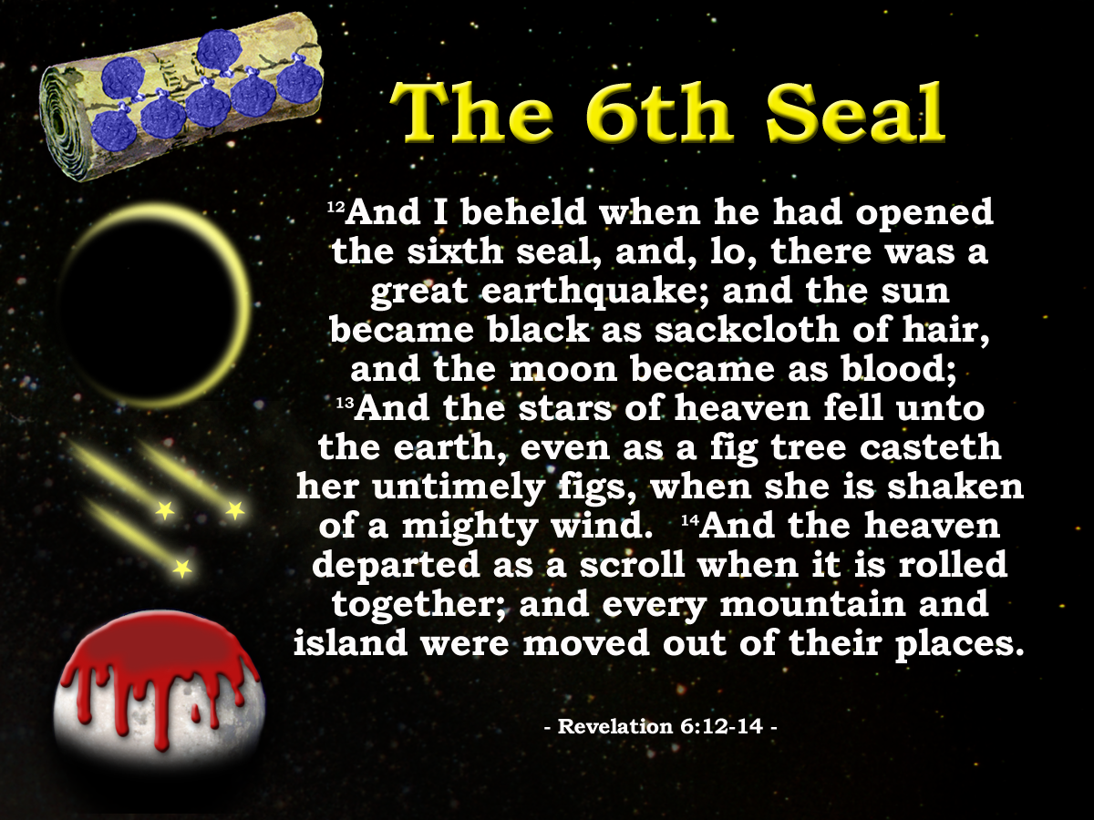
Next class : (God Willing)
Theme : God answers the prayers of the saints.
“And, lo, there was a great earthquake.”
Paganism cast out
Revelation 6:12-17

Slide 21
“Diocletian Jovian, Maximian, Herculaes, Caesares Augusti, for having extended the Roman empire in the East and West, and for having extinguished the name of Christians, who brought the Republic to ruin”
SOULS UNDER THE ALTAR
?
Gk. ”despot”
10
And they cried with a loud voice, saying, How long, O Lord, holy and true, dost thou not judge and avenge our blood on them that dwell on the earth?
“Diocletian &c, for having adopted Galerius in the East, for having everywhere abolished the superstition of Christ, for having extended the worship of the Gods.”
Revelation 6:9-11
The Fifth Seal
303-311
8yrs

Slide 22
SOULS UNDER THE ALTAR
9
“believe and live; even in the very exit of life pray for the remission of sins, and implore the only living and true God with confession and faith: pardon is granted to him who confesses his sin; and saving grace from the divine goodness is conferred on the believer; and thus may a man pass from death to immortality in his very last moments”
And when he had opened the fifth seal, I saw under the altar the souls of them that were slain for the word of God, and for the testimony which they held:
10
And they cried with a loud voice, saying, How long, O Lord, holy and true, dost thou not judge and avenge our blood on them that dwell on the earth?
No living ones!
Note: V 11
Note: Matt. 5:13
Extract of letter from Cyprian, to Demetrian.
Revelation 6:9-11
The Fifth Seal
303-311
8yrs

Slide 23
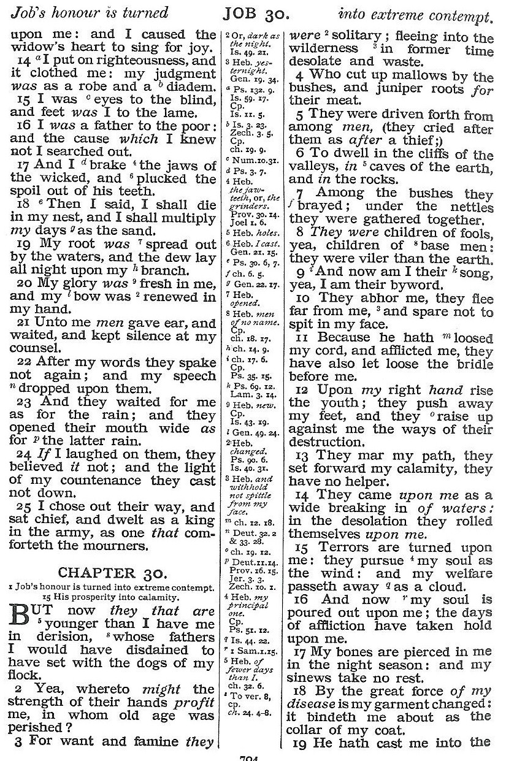
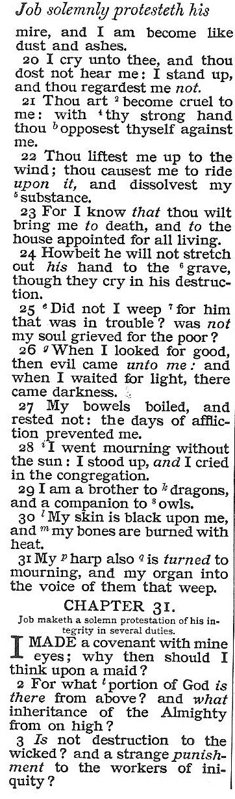
From God’s favour to God’s brutality
Respect to the object of a taunting song
evil
darkness
mourning
Security to un-certainty
black
mourning
weep
Honour to object of scorn
Robust health to door of death

