Slide 1
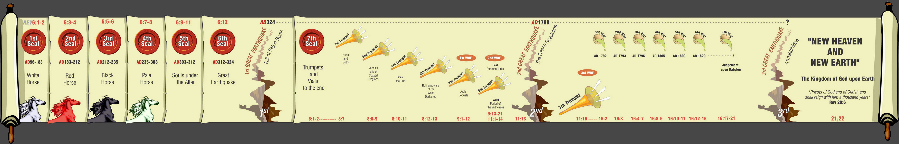
‘And the seven angels which had the seven trumpets prepared themselves to sound.’
South West Bible School 2015

Slide 2
‘And the seven angels which had the seven trumpets prepared themselves to sound.’
7
Seals
7
1 2 3 4 5 6
Trumpets
7
1 2 3 4 5 6
Vials
Judgement - Pagan Rome
1 2 3 4 5 6
Judgement - Christian Rome
Rev.6
Judgement - Holy Roman Empire
Rev.8 & 9
AD 96 – AD 324
Rev.16
AD 395 – AD 1685
AD 1789 – AD 1820
Contrasting Link

Slide 3
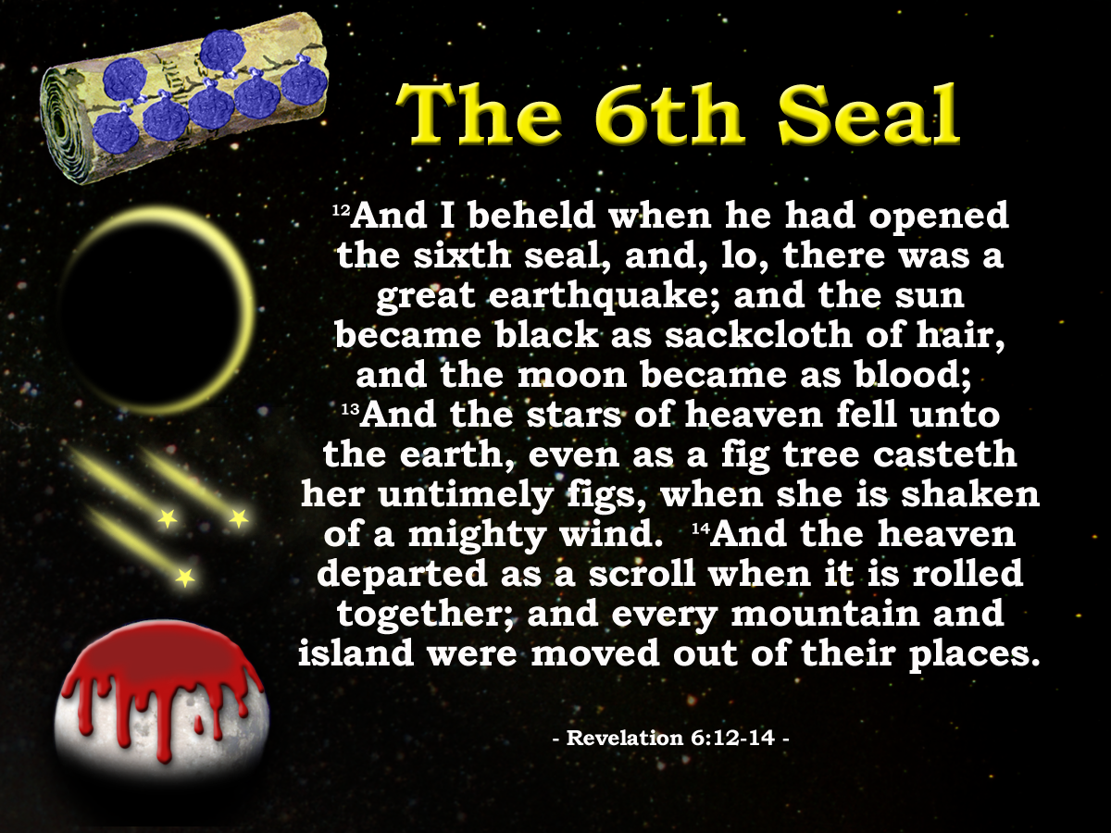
Constantine
312
313
324
330
337
Rev.12:12
Ruler in Rome
Constantinople
Ruler of whole Empire
Constantine dies
Edict of Milan
Chaos
Silence!
14yrs
Rev. 8:1

Slide 4
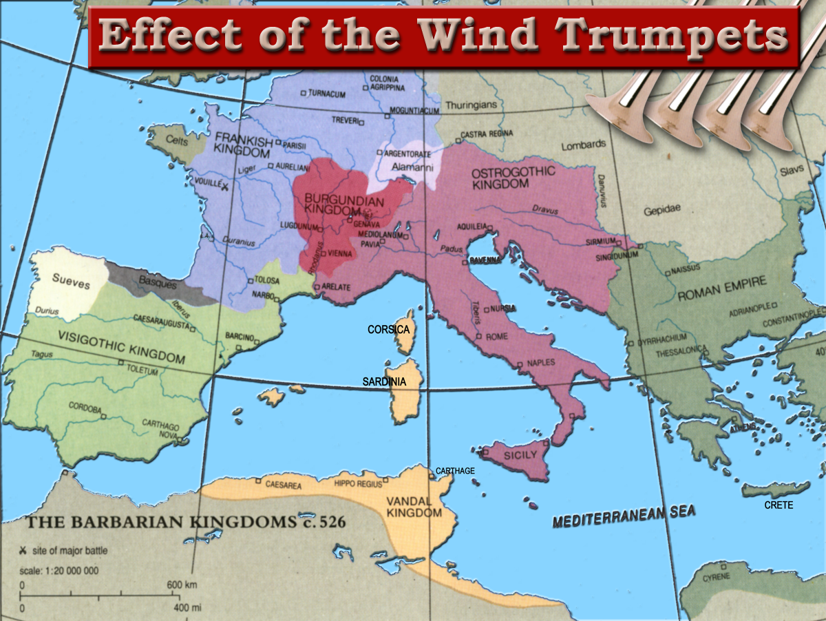
1453 AD
Western Empire ended 476 AD
Notes:
The result of the four Wind Trumpets had been the end of the Roman Empire in the West
The Remnants of the empire were carved up between the different barbarian hordes (10 toes) who had come and settled in the area.

Slide 5
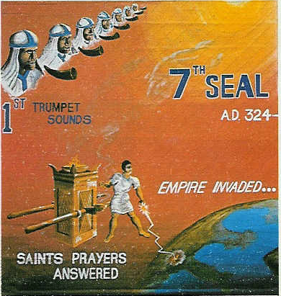
“there was silence in heaven about the space of half an hour”. Rev 8:1
Chapter 8 opens
John listens
Hears nothing
Silence for about ½ hour
Day for a Year. Gen.47:9, Num.14:34, Ezek. 4:4-6, Luke13:32
“Jesus answered, are there not twelve hours in the day?” John 11:9
12hrs in a Jewish day
1 hour = 1/12 of a day
½ hour = 1/24 of a day
Twelve hours in a Jewish Day
12 months in a year
1 month = 1/12 of a year or 30days
½ month = 1/24 of a year or 15days
“And it was about the sixth hour, and there was darkness over the earth until the ninth hour.” Luke 23:44
15 days = 15yrs
= 14yrs
AD 324 - 337
Peace as a result of Constantine’s victory over paganism

Slide 6
“..there was silence in heaven about the space of half an hour.”
Rev.8:1
Constantine
312
313
324
330
337
Rev.12:12
Ruler in Rome
Constantinople
Ruler of whole Empire
Constantine dies
Edict of Milan
Chaos
Silence!
Chaos
14yrs
8:5

Slide 7
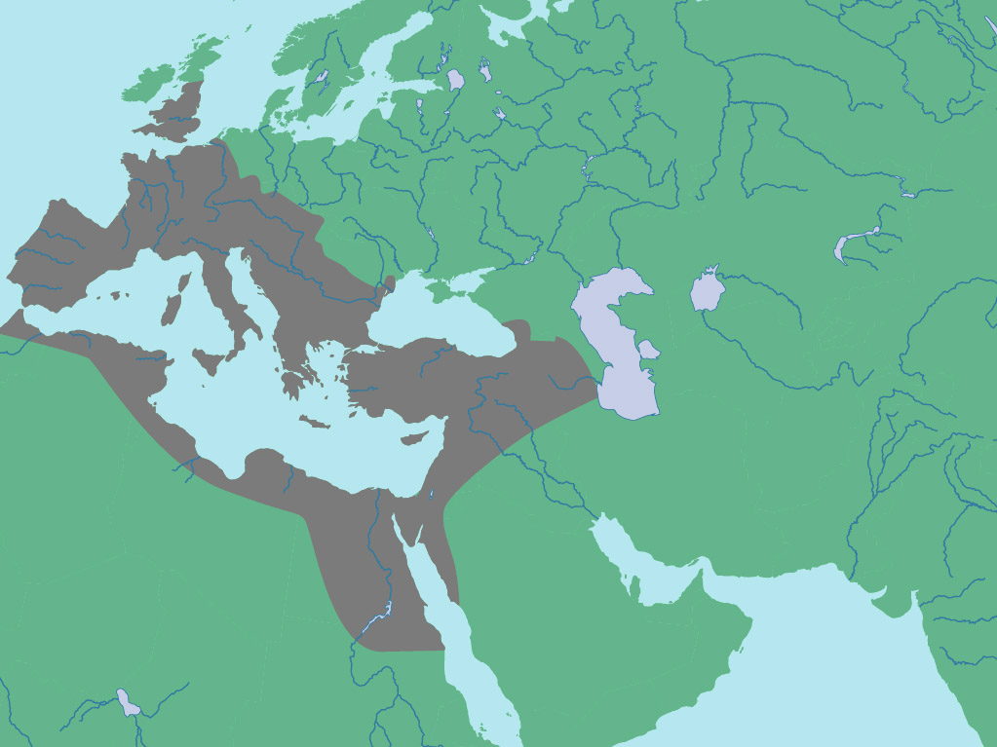
Revelation 8:7-12 “The third part”
9:1-19
7
Trumpets
1 2 3 4 5 6
Judgement on Christian Rome
Judgement on Christian Rome
LATIN WEST
Rev.8 & 9
HELLENIC EAST
AD 395 – AD 1685
HELLENIZED EAST
In AD326 Constantine moved the seat of his empire to Byzantium. From this time the Empire was divided into 3 parts.

Slide 8

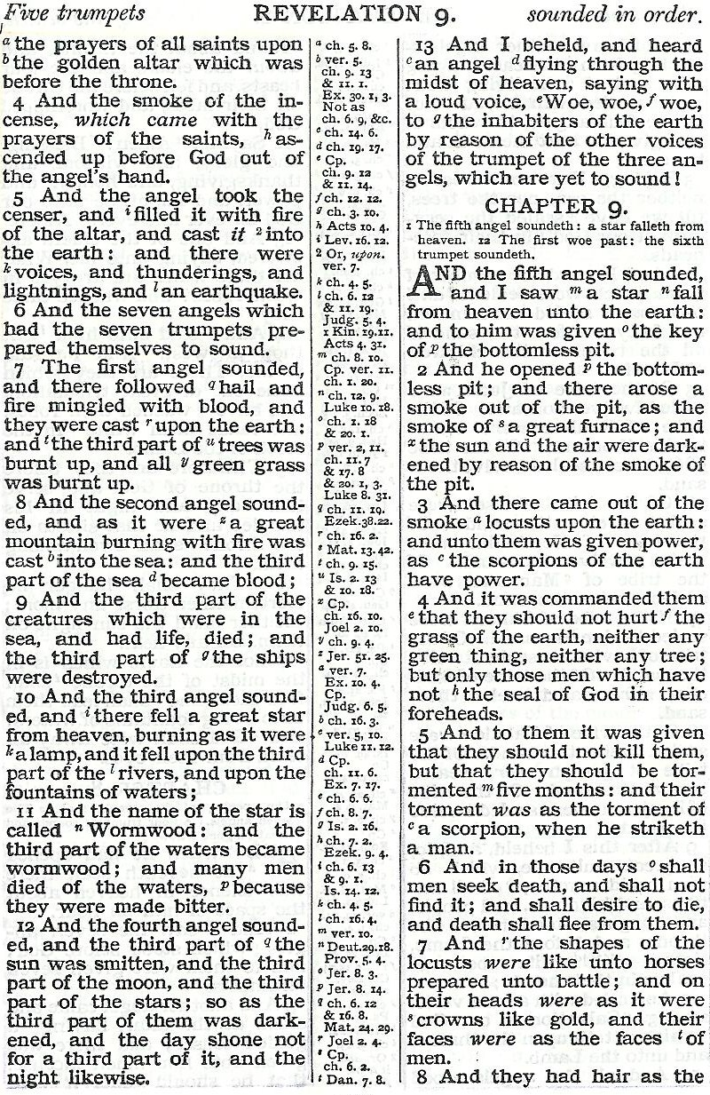
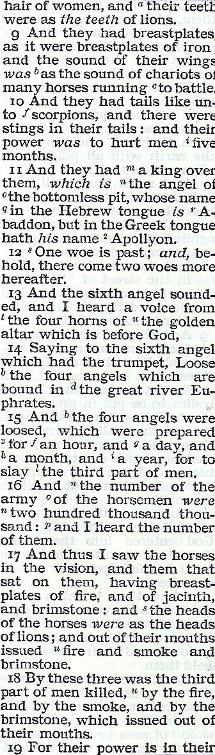
LATIN WEST
5
1
7
13
6
2
8
HELLENIZED EAST
3
10
HELLENIC EAST
4
12

Slide 9
And the seven angels which had the seven trumpets prepared themselves to sound.
Rev.8:6
Huns
“A wild Mongolian people riding on stout ponies out of central Asia in the latter part of the Fourth Century made its way over the steppes into south-eastern Europe. Slaying and plundering as they rode, these ugly merciless creatures, known as Huns, swept every obstacle before them like chaff before an eastern gale. Alans, Ostrogoths, and Visigoths felt successively the force of a thrust spreading tremors through the whole German world, and leading to those great, but obscurely chronicled movements of the German peoples, which for a time submerged Gaul and Britain, Spain, Africa and Italy.”
Fisher, A History of Europe, p. 111

Slide 10
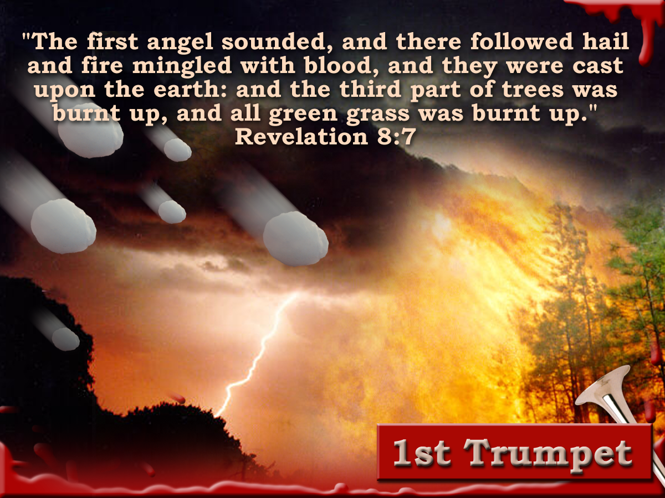
AD.395
Isaiah 28:2
Judges 9:8
Isaiah 28:17
Isaiah 61:3
Isaiah 30:30
Notes:
The 1st Trumpet was characterized by:
Hail mingled with blood being cast upon the earth
It resulted in a third part of the trees and grass being burnt up.

Slide 11
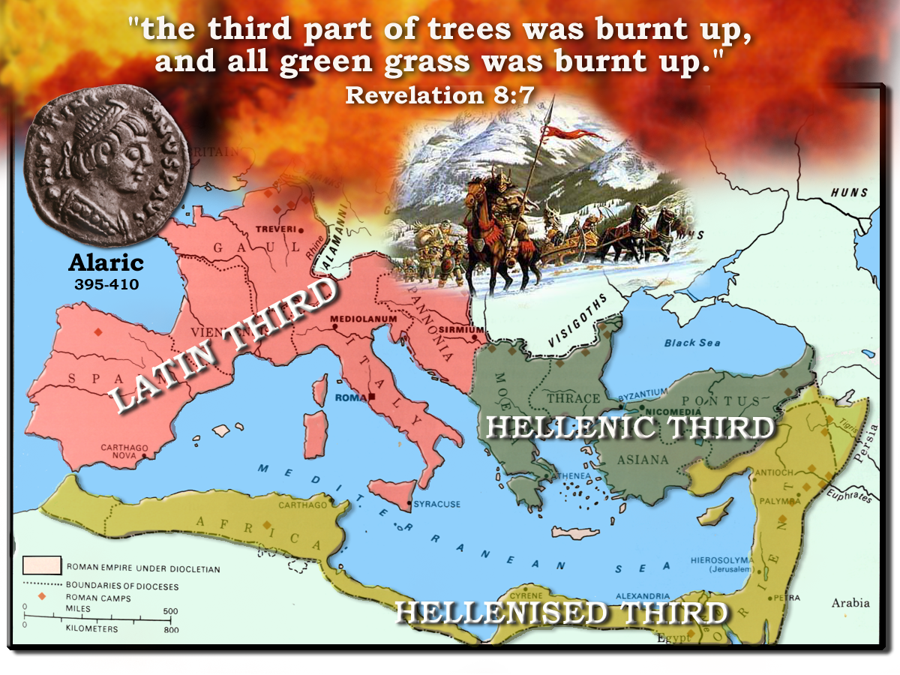
406
402
Honorius
408
Constantinople
Theodosius
Valens
Arcadius
409
395
410
Notes:
The first four trumpets would effect the LATIN THIRD of the Roman Empire
Constantine had divided the empire up under his three sons
The Latin Third was left vulnerable after he moved his capital to Constantinople
Aleric led the first wave of Barbarian Invasions
He crossed the Danube in 395
In 402 he crossed the Alps and marched in to Italy

Slide 12
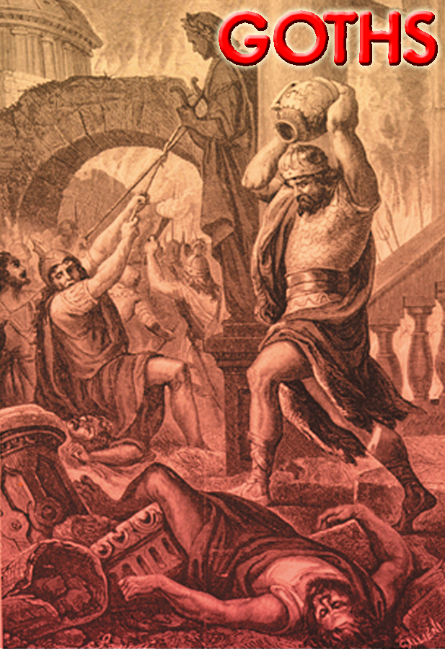
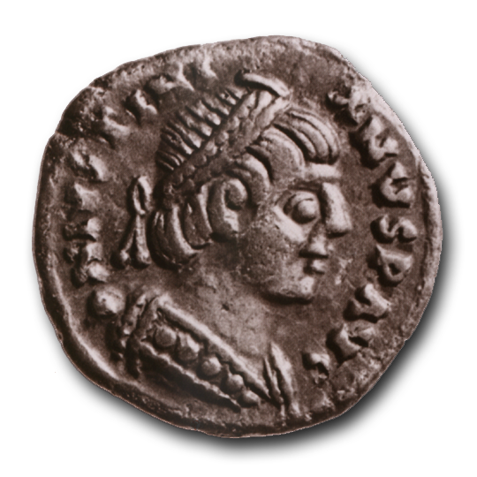
410 AD
“The bare fact that Rome itself, the Roma Eterna, the Roma Invicta of a thousand coins of a hundred emperors, Rome whose name for centuries on the shores of the Mediterranean had been synonymous with world wide dominion, should herself be taken, sacked, dishonoured by the presence of a flaxen-haired barbarian conqueror from the north, was one of those events apparently so contrary to the very course of nature itself, that the nations which heard the tidings, many of them old and bitter enemies of Rome, now her subjects and friends, held their breath with awe at the terrible recital.”
And the first angel sounded, and there followed hail and fire mingled in blood, and they were cast upon the earth: and the third part of trees was burnt up, and all green grass was burnt up.
“Alaric… marched to the gates of Rome… At the hour of midnight the Salarian gate was silently opened, and the inhabitants were awakened by the tremendous sound of the Gothic trumpet.”
– Gibbon’s Decline & Fall of the Roman Empire.
“It is not of my own will that I do this; there is One who forces me on and will not let me rest, bidding me spoil Rome.”
Hodgkin, Theodoric the Goth, pp 16-17
Notes:
In the year 410 he took the city of Rome
It had not seen the sight of a non-Roman invader for 618 years (since its foundation)
This was the first in a wave of Trumpet judgments that would ultimately result in the collapse of Rome
Gibbon records for us the “awakening of Rome by the Gothic Trumpet”

Slide 13
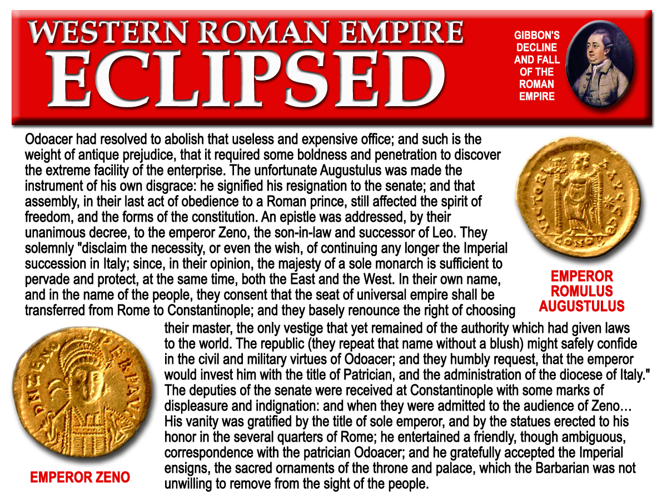

AD476
Next session God willing
Notes:
Rome was conquered by Odoacer, a Gothic king.
Odoacer forced the last Emperor Romulus Augustulus to resign
When he took the throne he sent the Imperial Ensigns back to Constantinople
The senate of Rome informed the Emperor Zeno in Byzantium they were no longer in need of them, and that he was now the sole Roman Emperor as the empire had ceased to exist in the Latin Third.
The Imperial Empire was eclipsed in 482.
Odoacer, was replaced by Theodoric who established the Kingdom of the Goths.

