Slide 1
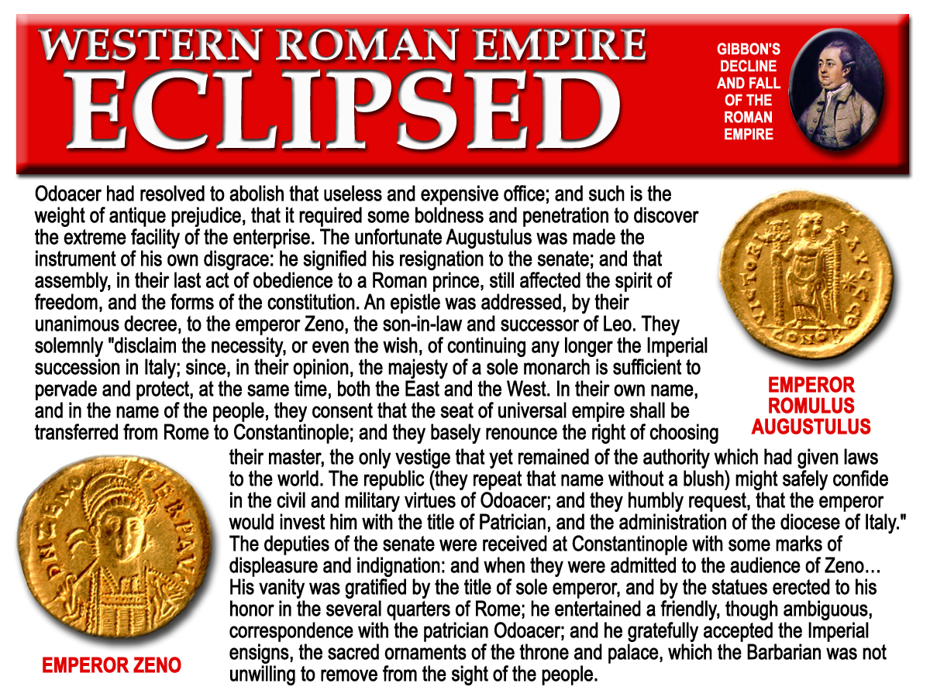
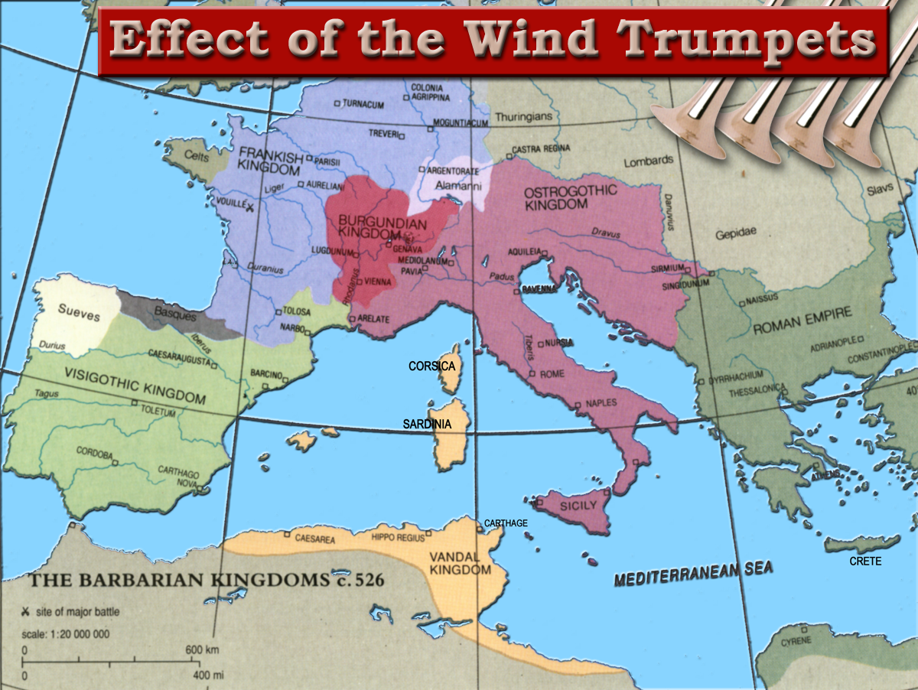

AD476
“… All the subjects of the Empire, were oppressed by the disgrace and calamities of foreign conquest; and the victorious nations of Germany established a new system of manners and government in the western countries of Europe.”
The Four Wind Trumpets
South West Bible School 2015
Notes:
Rome was conquered by Odoacer, a Gothic king.
Odoacer forced the last Emperor Romulus Augustulus to resign
When he took the throne he sent the Imperial Ensigns back to Constantinople
The senate of Rome informed the Emperor Zeno in Byzantium they were no longer in need of them, and that he was now the sole Roman Emperor as the empire had ceased to exist in the Latin Third.
The Imperial Empire was eclipsed in 482.
Odoacer, was replaced by Theodoric who established the Kingdom of the Goths.

Slide 2
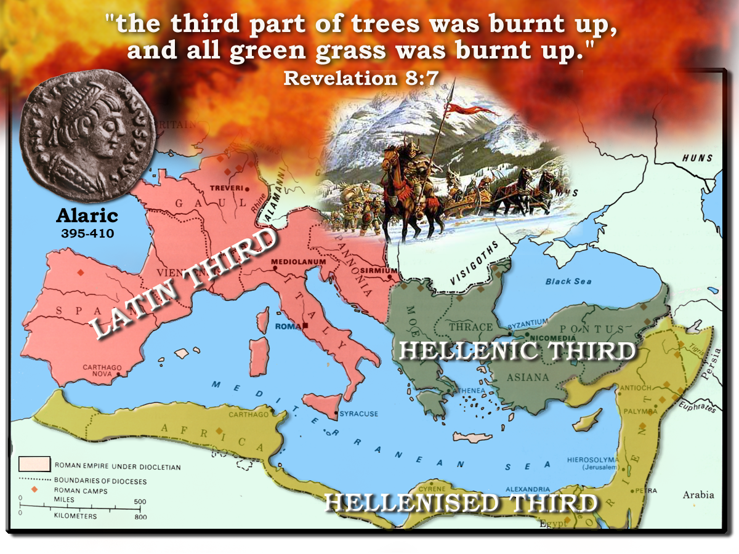
406
402
Honorius
408
Constantinople
Arcadius
409
395
410
Notes:
The first four trumpets would effect the LATIN THIRD of the Roman Empire
Constantine had divided the empire up under his three sons
The Latin Third was left vulnerable after he moved his capital to Constantinople
Aleric led the first wave of Barbarian Invasions
He crossed the Danube in 395
In 402 he crossed the Alps and marched in to Italy

Slide 3
‘And the second angel sounded’
395
410
429
1
2
Hail and fire mingled with blood Alaric (Goths)
Burning mountain cast into sea Genseric (Vandals)
Trumpets
Rev.8 & 9
Rev. 8:8-9
1 2 3 4 5 6
Judgement on Papal Rome
Judgement on Christian Rome
AD 395 – AD 1685

Slide 4
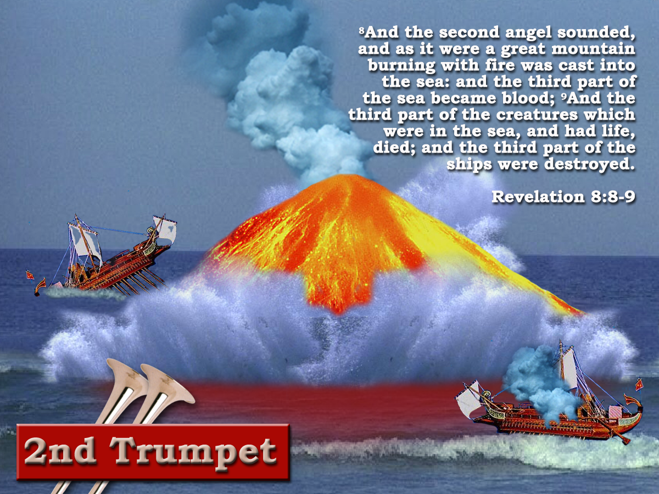
‘Behold I am against thee, O destroying mountain, saith the Lord, which destroyeth all the earth: and I will stretch out mine hand upon thee, and roll thee down from the rocks and make thee a burnt mountain.’
Jer.51:25
AD.429
Notes:
Following Aleric was the 2nd Trumpet
This judgment was characterized by a destroying mountain being cast into the sea
It’s effect would be to turn the sea into blood, destroying 1/3 part of the creatures and ships of the sea.7

Slide 5
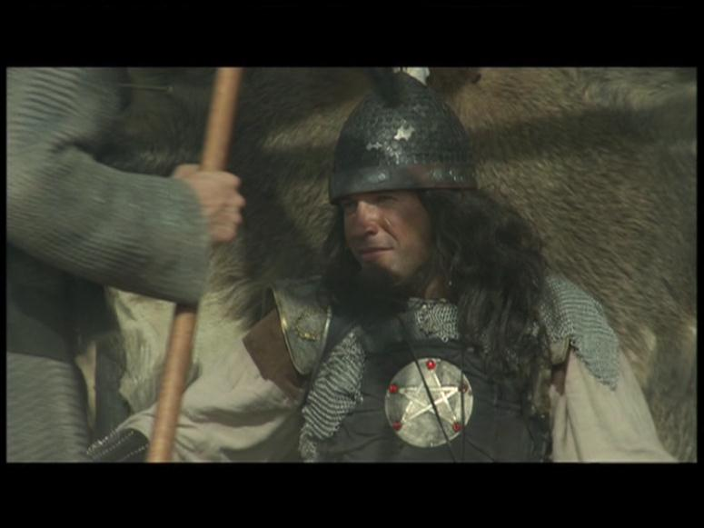
Vandals
2
AD 409
Invade Gaul and Spain
and the third part of the sea became blood. And the third part of the creatures which were in the sea, and had life died; and the third part of the ships were destroyed.
AD 429
Genseric made king
AD455
Boniface Governor of Africa
AD439 captured Carthage. Became base for 30yrs of piracy

Slide 6
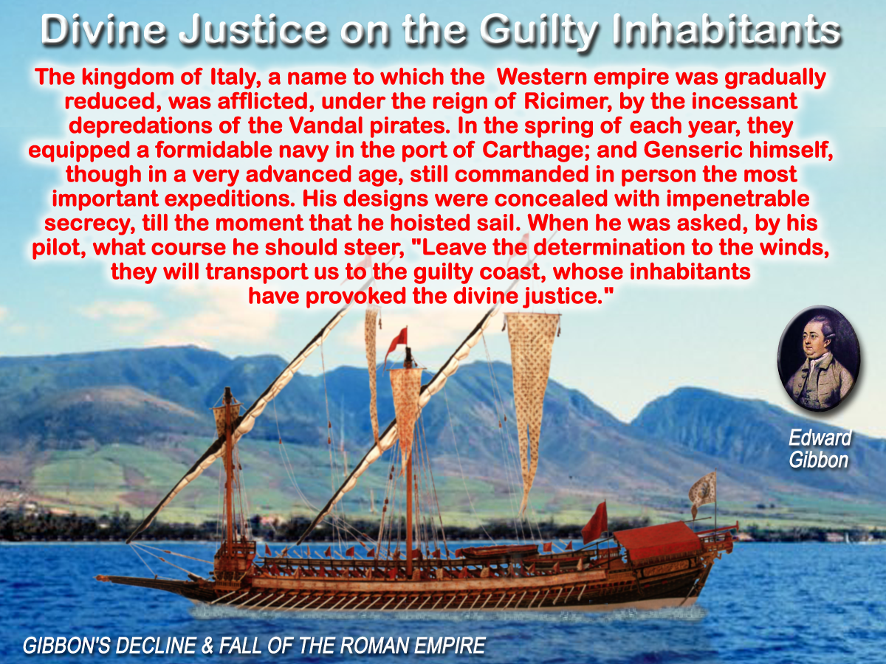
Notes:
Aleric took to the sea, and used maritime forces to attack the empire.
Genseric believed he was executing divine justice on the Empire – READ SLIDE
On June 15, 455 he took the city of Rome
The city was pillaged, and the candlestick and the table of shewbread were among the booty.
These were lost in the sea, on the return journey.
Following this invasion of Rome he torched the Roman fleet that came out to attack him, turning the sea into blood, and destroying 1/3 part of the ships.

Slide 7
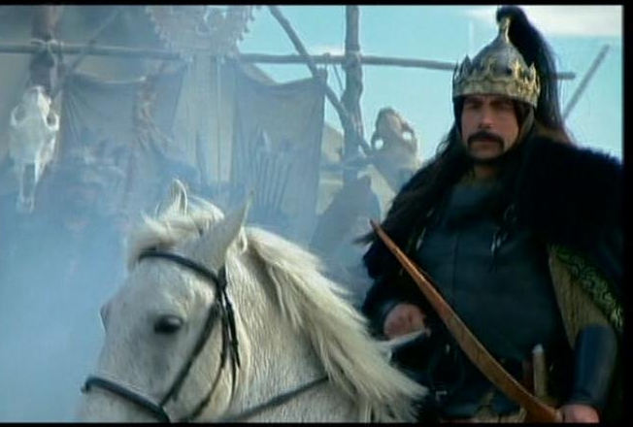
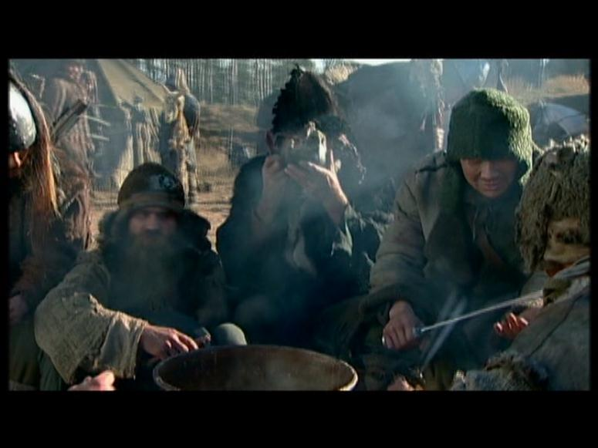
Star fell from heaven Attila (Huns)
433
453
395
410
429
3
1
2
Hail and fire mingled with blood Alaric (Goths)
Burning mountain cast into sea Genseric (Vandals)
Trumpets
Rev.8 & 9
Rev. 8:10-11
1 2 3 4 5 6
‘And the third angel sounded’
Judgement on Christian Rome
AD 395 – AD 1685

Slide 8
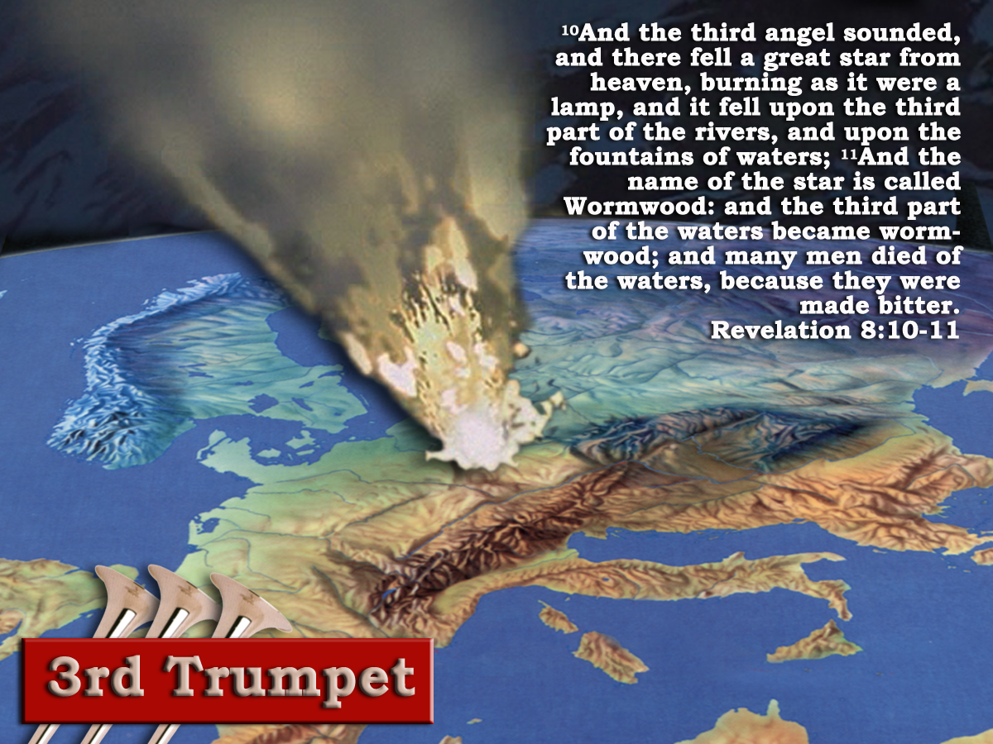
‘A great star burning as it were a torch’ Shooting Star-Meteor
‘A great star’
Num.24:17
‘I see one but not now: I observe one who is not near: there shall come a star out of Jacob, and a Sceptre shall arise out of Israel, and shall smite the corners of Moab, and destroy the children of Sheth’
Note: cp.
8:10, 9:1, 6:13
They are visible only while they fall.
The motion is rapid.
The duration brief.
The brightness, while it lasts, intense.
The extinction instantaneous.
When the light is extinguished, nothing remains: the body which emitted the light is nowhere to be found.
Attila!
Attila’s conquests and depredations were not carried on for the purpose of founding a nation or empire. It started suddenly, it fell in the west, in a place of rivers and fountains of waters (northern Italy and the surrounding countries), it caused intense bitterness to the peoples, and it ceased as suddenly as it had commenced.
Eureka vol.3 p.59
Apocalypse and History p.56

Slide 9
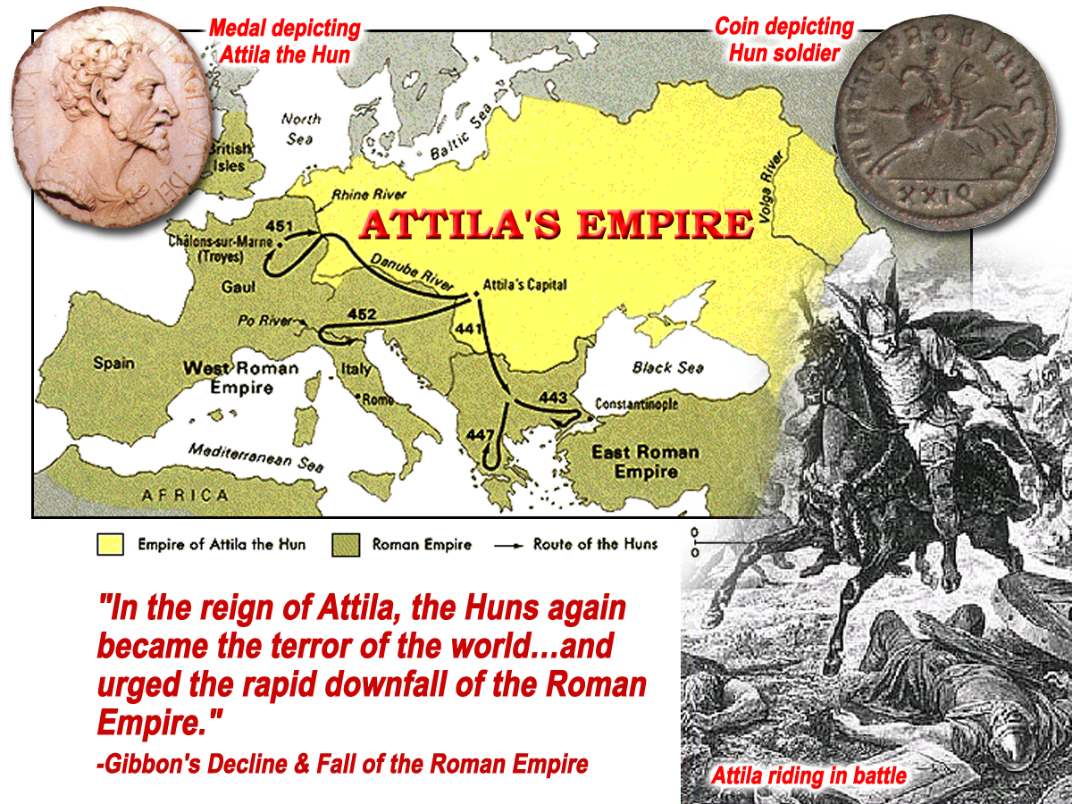
There fell a great star
River Absinthos
“Aspinthii – a people of Thrace. They received their name from a small river called Apsinthus, which flowed through their territory. Lemprieres Classical Dictionary p.70
Gk.= ‘Absinthos’ = Undrinkable
10
And it fell upon the third part of the rivers, and upon the fountains of waters
11
French word for wormwood is ‘Absinthe’
And the name of the star is called wormwood: and the third part of the waters became wormwood; and many men died of the waters, because they were made bitter.
‘the Absinthian’

Slide 10
‘And the fourth angel sounded’
Star fell from heaven Attila (Huns)
Heavens eclipsed Odoacer
433
453
476
395
410
429
3
4
490
1
2
Hail and fire mingled with blood Alaric (Goths)
Burning mountain cast into sea Genseric (Vandals)
Rev. 8:12
Trumpets
Rev.8 & 9
End of the Western Empire
1 2 3 4 5 6
Judgement on Papal Rome
Theodoric (Ostrogoth) having unseated Odoacer in Italy reigns as king
AD 395 – AD 1685

Slide 11
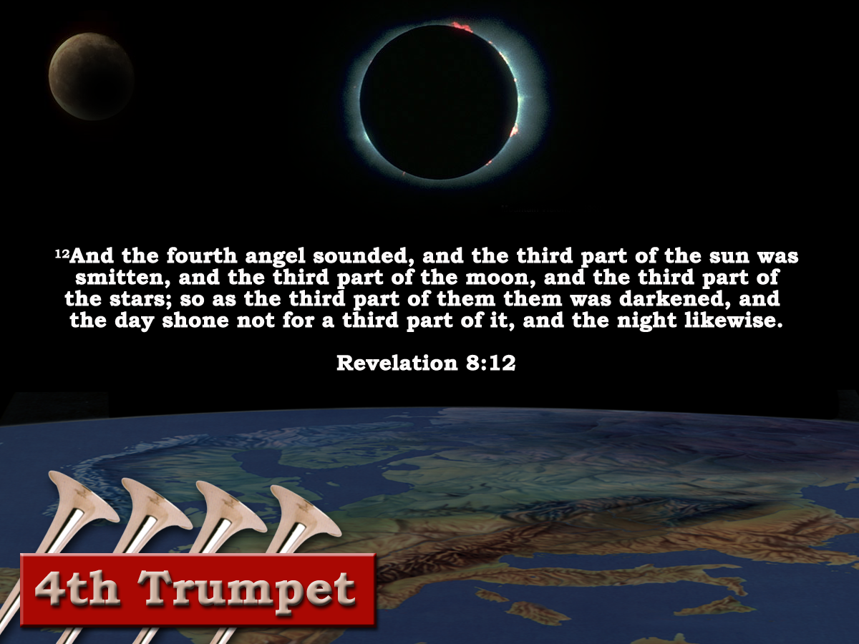
Thus, by the judgements of the first, second, and third, trumpets, the final catastrophe was preparing by which the emperors of the west and their dominions were to be extinguished. Rome’s glory had long departed; its provinces severally and successively separated from it; the territory still remaining to it had become like a desert; and its maritime dependencies, and its fleets and commerce, been annihilated. Little remained to it but the vain titles and insignia of sovereignty; and now the time was come that, by smiting of the fourth trumpet, these too were to be withdrawn; and that the imperial, or Sixth Head of the Roman Dragon should be “as it were slain to death,” and give place to the Seventh Head, which had not yet come, and which, “when he cometh, must continue a short space” Rev13:3, 17:10
‘And the fourth angel sounded, and the third part of the sun was smitten, and the third part of the moon, and the third part of the stars; so as the third part of them was darkened, and the day shone not for a third part of it, and the night likewise.’
Revelation 8:12
Eureka vol.3 p.59
The land had been hailed on
The seas had been turned to blood
The rivers and fountains of waters desolated
Notes:
The Fourth trumpet was characterized by the eclipse of the sun, moon and stars that shone over the Latin 1/3 of the empire.

Slide 12

Unsealed - “Come and See!”
7
Seals
7
1 2 3 4 5 6
Trumpets
7
1 2 3 4 5 6
Vials
Judgement - Pagan Rome
1 2 3 4 5 6
Judgement - Christian Rome
Rev.6
Judgement - Holy Roman Empire
Rev.8 & 9
AD 96 – AD 324
Rev.16
AD 395 – AD 1685
AD 1789 – AD 1820
Armageddon

Slide 13
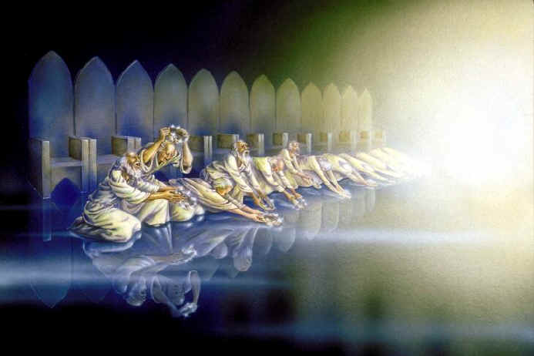
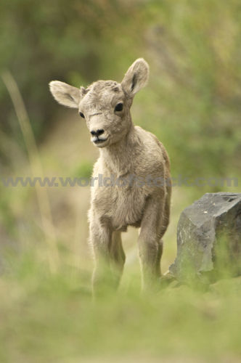
Humanism in the Churches
“ Among the many types of humanism that I have met in human history, I have found that of Jesus of Nazareth particularly attractive, although remote in time and open to completion by many more recent cultural elements. It is a humanism of universal, unselfish, brotherly love.”
J. Gomez Caffarena - Jesuit Priest.
Humanism in the Churches
Increasing tolerance of feminism, political activism and homosexuality have made the Anglican Church a spearhead in humanism.
Character of the
Redeemed
Revelation 14:1-5
Who are the women?
The Argument!
The values of the 1st Century Christians , and of the Israelites before them, were relative values.
It is argued that if something becomes culturally acceptable, it becomes morally acceptable.
Rev.17:1-2, 5
4
These are they which were not defiled with women; for they are virgins. These are they which follow the lamb withersoever he goeth. These were redeemed from among men, being the firstfruits unto God and to the lamb.
“ Humanism has come to mean a reverence for man and a concern for his dignity, morality and happiness, linked with a belief that these ends are best served by the advance of scientific outlook”
Archbishop of Canterbury
Humanism affects Moral Behaviour!
The Seventh Vial
40yrs prior to Millennium
17

Slide 14

..The kingdoms of this world are become the kingdoms of our Lord and of his Christ: and he shall reign for ever and ever.”
Revelation11:14-15

Slide 16
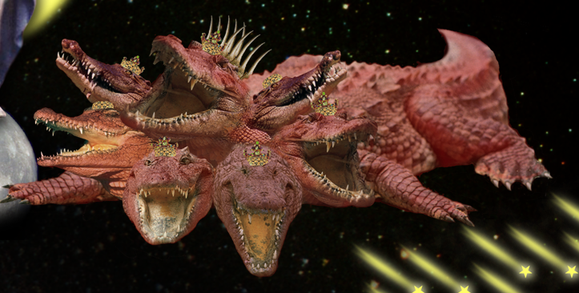
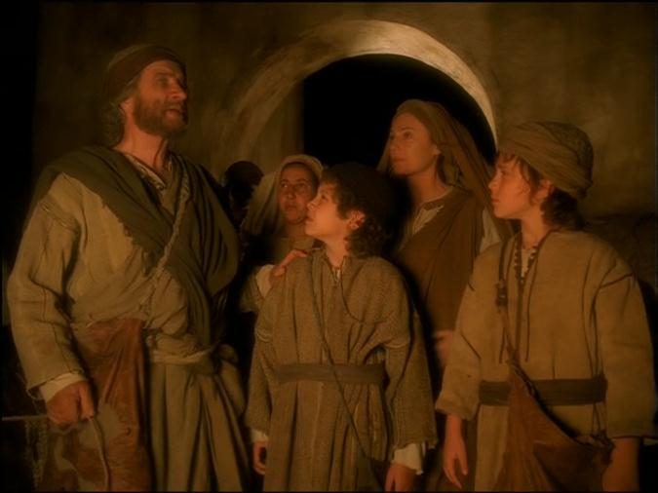
Revelation 17
v10 “and there are seven kings:” = 7 forms of Government
“.. not yet come, when he comes he must continue a short space”
“five are fallen”
“one is”
8th Head
“The one that was and is not”
Rev. 13:3

Slide 17
Romulus Augustus
Theodoric
Zeno
Odoacer
Theodoric
AD476
“Our royalty is an imitation of yours, a copy of the only Empire on earth.”
Notes:
Rome was conquered by Odoacer, a Gothic king.
Odoacer forced the last Emperor Romulus Augustulus to resign
When he took the throne he sent the Imperial Ensigns back to Constantinople
The senate of Rome informed the Emperor Zeno in Byzantium they were no longer in need of them, and that he was now the sole Roman Emperor as the empire had ceased to exist in the Latin Third.
The Imperial Empire was eclipsed in 482.
Odoacer, was replaced by Theodoric who established the Kingdom of the Goths.

Slide 18
Star fell from heaven Attila (Huns)
Heavens eclipsed Odoacer
433
453
476
395
410
429
3
4
493
Goths continue to reign for next 60 yrs.
Rev.17:10
1
2
Hail and fire mingled with blood Alaric (Goths)
Burning mountain cast into sea Genseric (Vandals)
553
Trumpets
Rev.8 & 9
End of the Western Empire
1 2 3 4 5 6
Judgement on Christian Rome
Theodoric (Ostrogoth) having unseated Odoacer in Italy reigns as king
AD 395 – AD 1685

Slide 19
1hour =1month or 30days
1/3 of day =4hrs
4 X 30 =120days or 120yrs
1/3 of night =4hrs
4 X 30 =120days or 120yrs
240yrs of total eclipse
560 AD - 800 AD
‘And the fourth angel sounded, and the third part of the sun was smitten, and the third part of the moon, and the third part of the stars; so as the third part of them was darkened,
Justinian's ‘Pragmatic Sanction’ – Rome degraded to second rate city. – Italy becomes province of Byzantium Empire.
“Charlemagne – The restorer of the empire”
Gibbon
and the day shone not for a third part of it, and the night likewise.’ Revelation 8:12
Notes:
The Fourth trumpet was characterized by the eclipse of the sun, moon and stars that shone over the Latin 1/3 of the empire.

Slide 20

Genseric (Gaiseric) and the Vandals

