Slide 1
Events surrounding
the return of Christ
Study 1
The return of Christ and the 10 years to Armageddon
Rogue River Bible School 2015

Slide 2
Knowing the times!
When David was made king there was a class of people “that had under-standing of the times, to know what Israel ought to do” (1 Chron. 12:32).
Will it be so just before Christ comes to be made king?
A special appeal! Time is clearly short.
All the signs are converging – the world moves inexorably towards a massive economic collapse. Christ warned we would be taken from a time of prosperity.
Preparing for the Return of Christ

Slide 3
The importance of a vision
Heb. chazown – mental sight; root chazah – to gaze at; mentally to perceive, contemplate (with pleasure); to have a vision.
Proverbs 29:18
18 Where there is no vision, the people perish: but he that keepeth the law, happy is he.
Heb. para – to loosen; to expose, dismiss.
Roth. – “a people is let loose.”
Young’s Lit. – “without a vision is a people made naked.”
Events surrounding the return of Christ

Slide 4
The Ages of Human History
0 1656 AD 70 6000 7000
Ante-
diluvian
Jewish
Gentile
Millennium
Flood
Christ
Creation
2nd Advent
God all in all
Events surrounding the return of Christ

Slide 5
The Millennium
The Jubilee Period
Mortal flesh eradicated
The
Little
Season
1000 year reign of Christ
50 yrs
Flesh bound
Rev.
20:3
Flesh subdued
Flesh unleashed
Events surrounding the return of Christ

Slide 6
The Jubilee period
50 yrs
30 yrs
20 yrs
Jehoahaz 3 months
Jehoiachin 3 months
Fall of Jerusalem
5 yrs
Josiah – last 13 yrs
Jehoiakim
11 years
Zedekiah 11 years
14 years
18th Josiah
Great Passover
Ezek. 40:1
Ezek. 1:1-2
Jehoiachin’s captivity
Destinies determined
Temple opened
Jubilee

Slide 7
40 years preparation for Kingdom
“…a period of forty years …in which some of the most important events of the Apocalypse are to be transacted.”
  Bro. Thomas, Eureka Vol. 1 pg. 187
  “A scroll extended gives us the idea of length; and this is representative of time. A little scroll is a short time in which things written therein are to be accomplished—a period, say of forty years, according to the testimony of Micah 7:14–17.” (Eureka)
Events surrounding the return of Christ

Slide 8
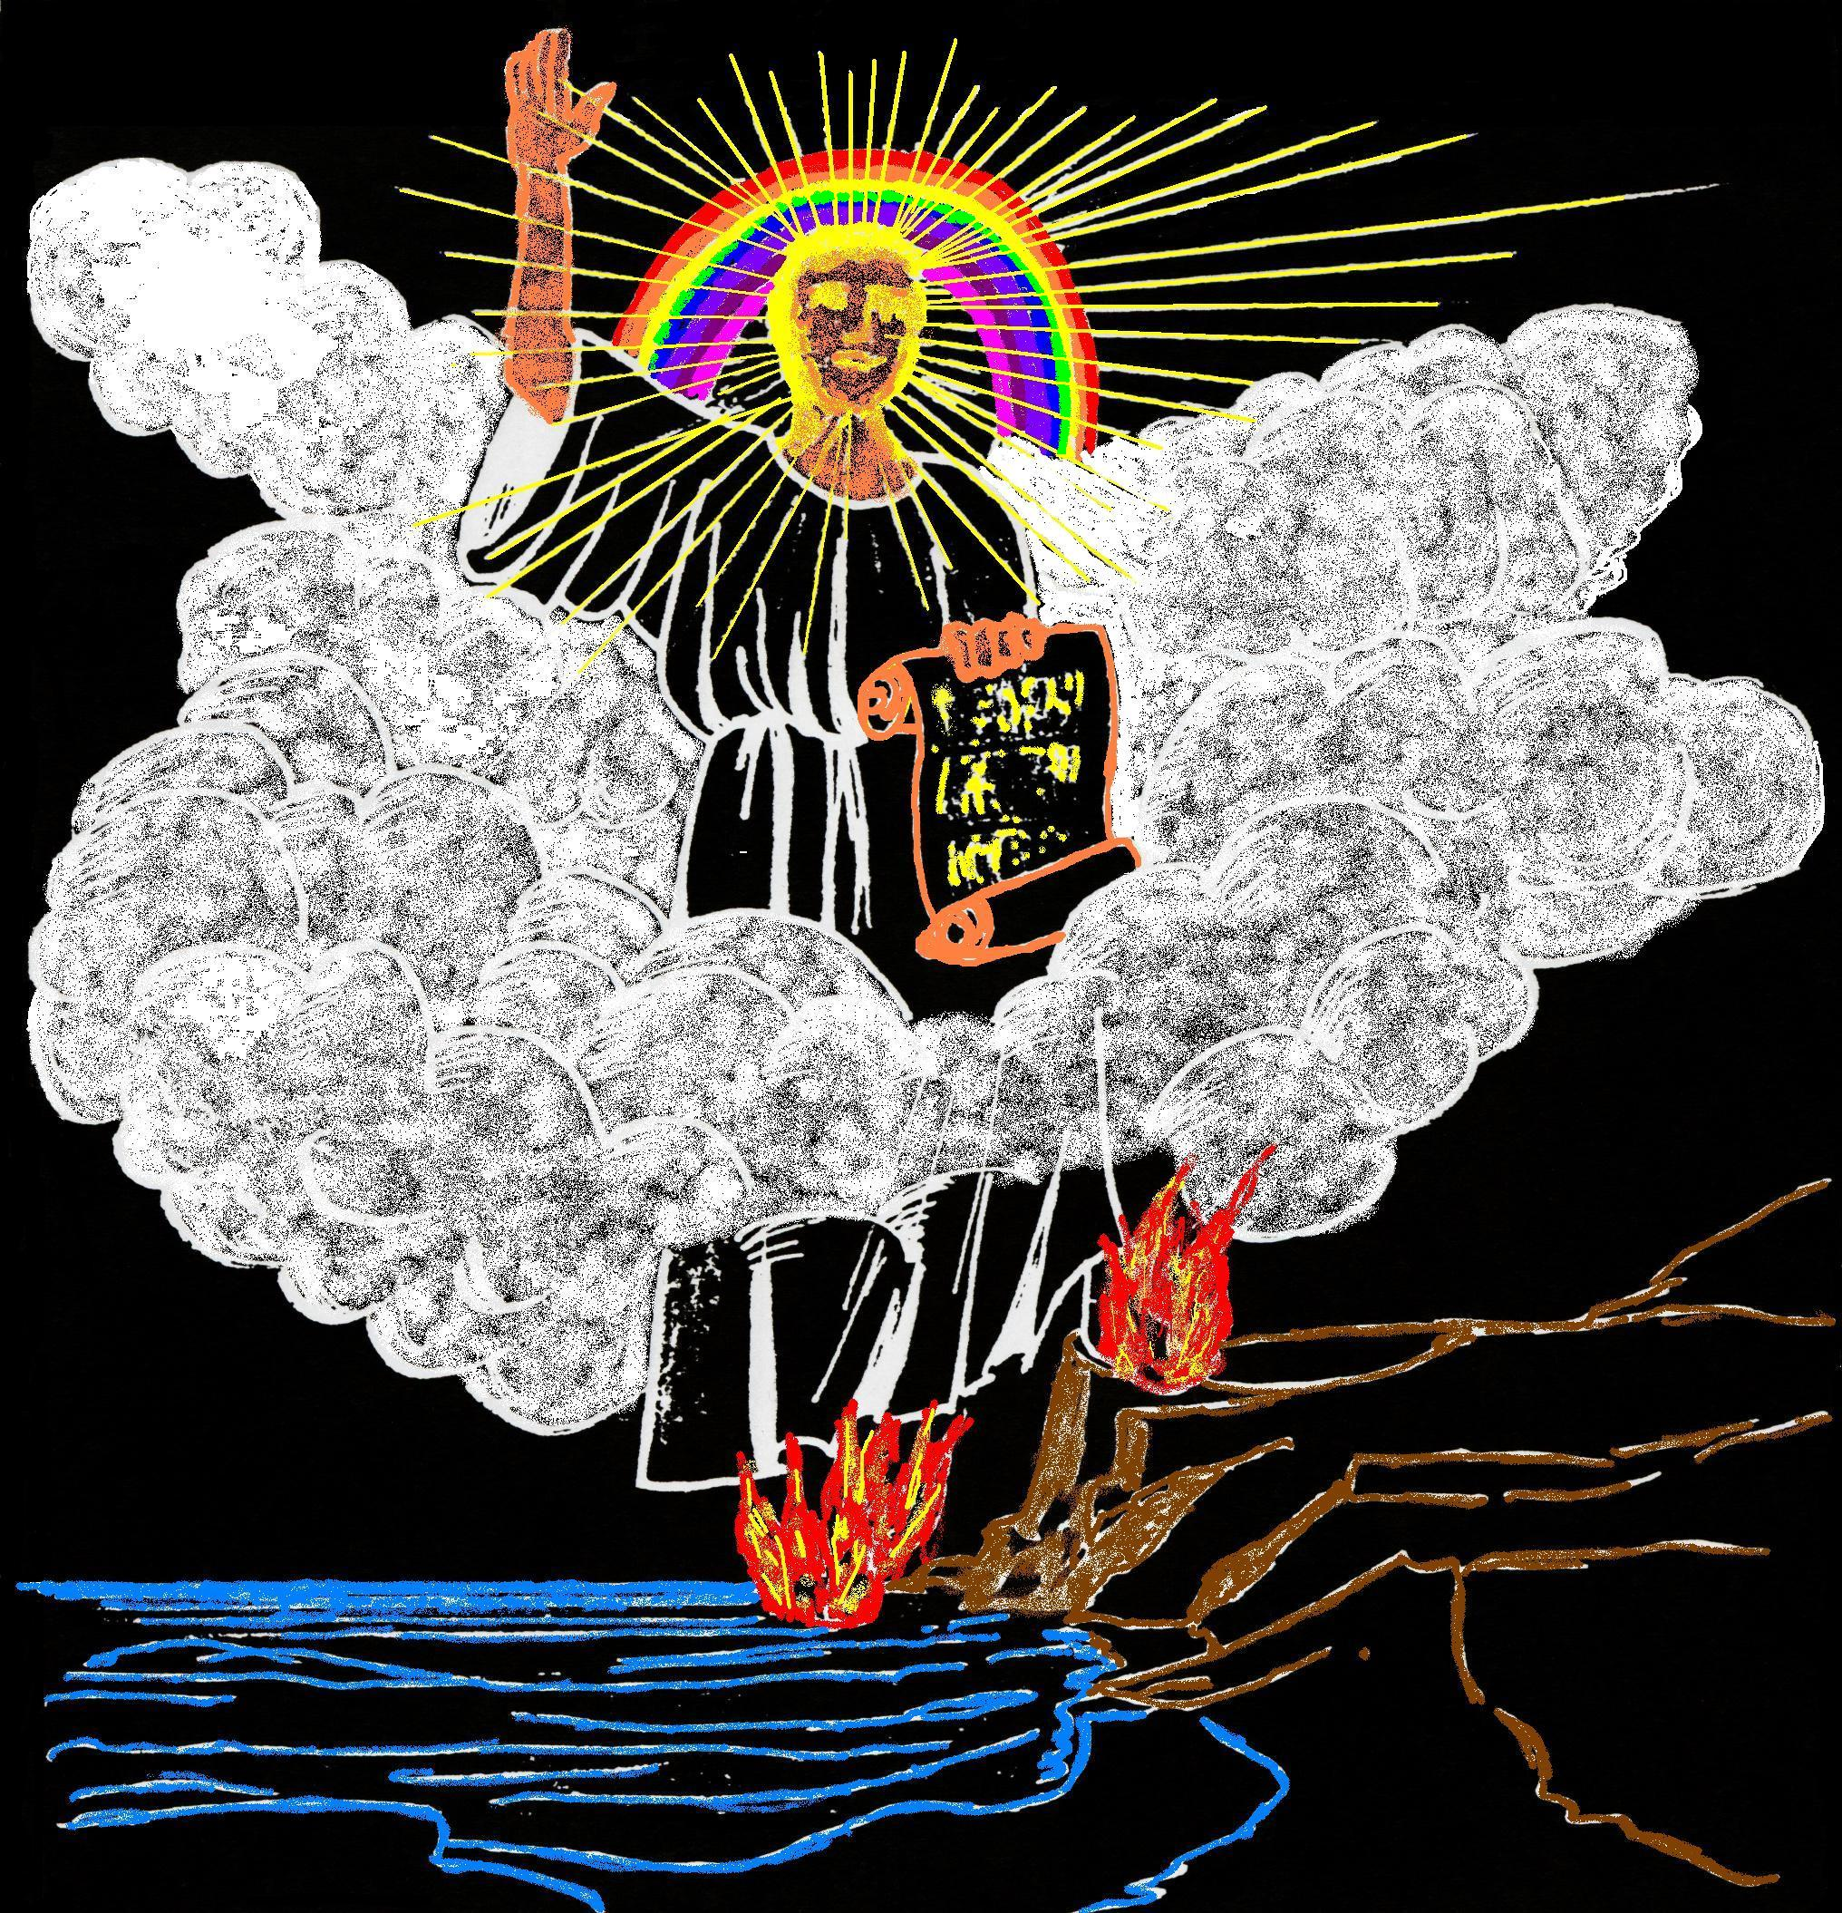
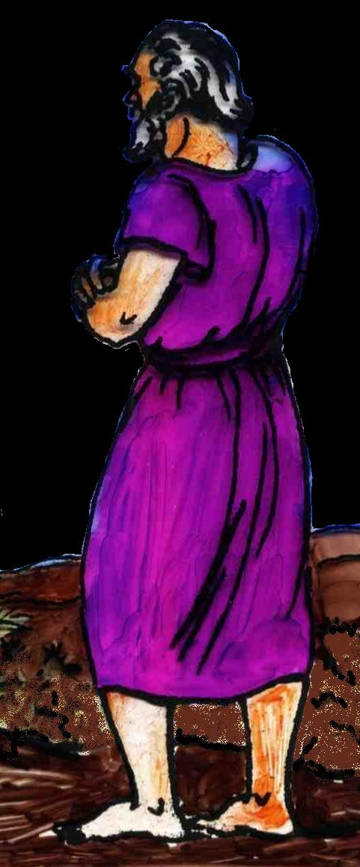
“Go and take the little scroll which is open in the hand of the angel”
“This ‘little scroll’ is the most important fragment of the Apocalypse. It contains the catastrophe of the plot without which all the rest would be of little interest to the believer.”
Bro. Thomas, Eureka Vol. 3 pg. 178
John as representative of all the saints.
Events surrounding the return of Christ

Slide 9
The secret code of Rev. 14
144,000 (v.1) is based on Rev. 7:4-9 – 12 tribes of Israel each with 12,000 sealed. To Jews a thousand represented a ‘family’ (see Roth. Jud. 6:15) and 12 is the number of Israel – hence using the square root principle 144,000 represents the perfected family of Israel (an innumerable multitude of Jew and Gentile (Rev. 7:9).
1,600 furlongs in v.20 is not a lineal measurement but the length or period of the bloodshed involved in treading the winepress. Using the square root principle of v.1 - 1,600 is 40 x 40 – hence, represents a period of 40 years.

Slide 10
Events of the Jubilee Period
50 years
Marriage
of Lamb
Yahweh Sabaoth manifested in power
for 40 years but glory unseen by the world
Elijah’s mission to scattered Jewry
THE SECOND EXODUS OF ISRAEL
Return of Christ - Resurrection
Judgement Seat
Arabs subdued
The smiting and healing of Egypt
Christ’s universal rule over all nations
Judah saved and settled in Land
10 years
Gog buried – Land cleansed & divided
40 years
ARMAGEDDON
Rome destroyed
Mid-heaven
Proclamation
10 years
Catholic Europe destroyed – 30 years
Marriage
Supper
Events surrounding the return of Christ
Britain submits
All nations submit to Christ
Temple built

Slide 11
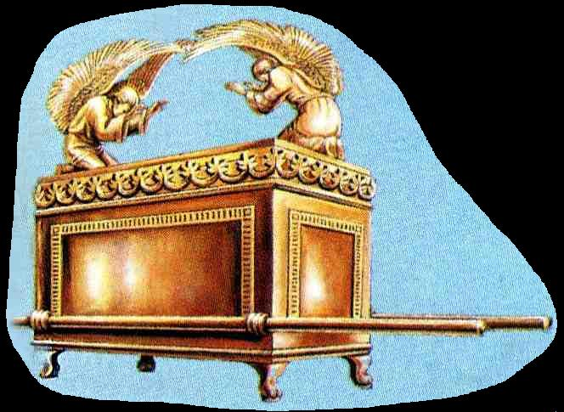
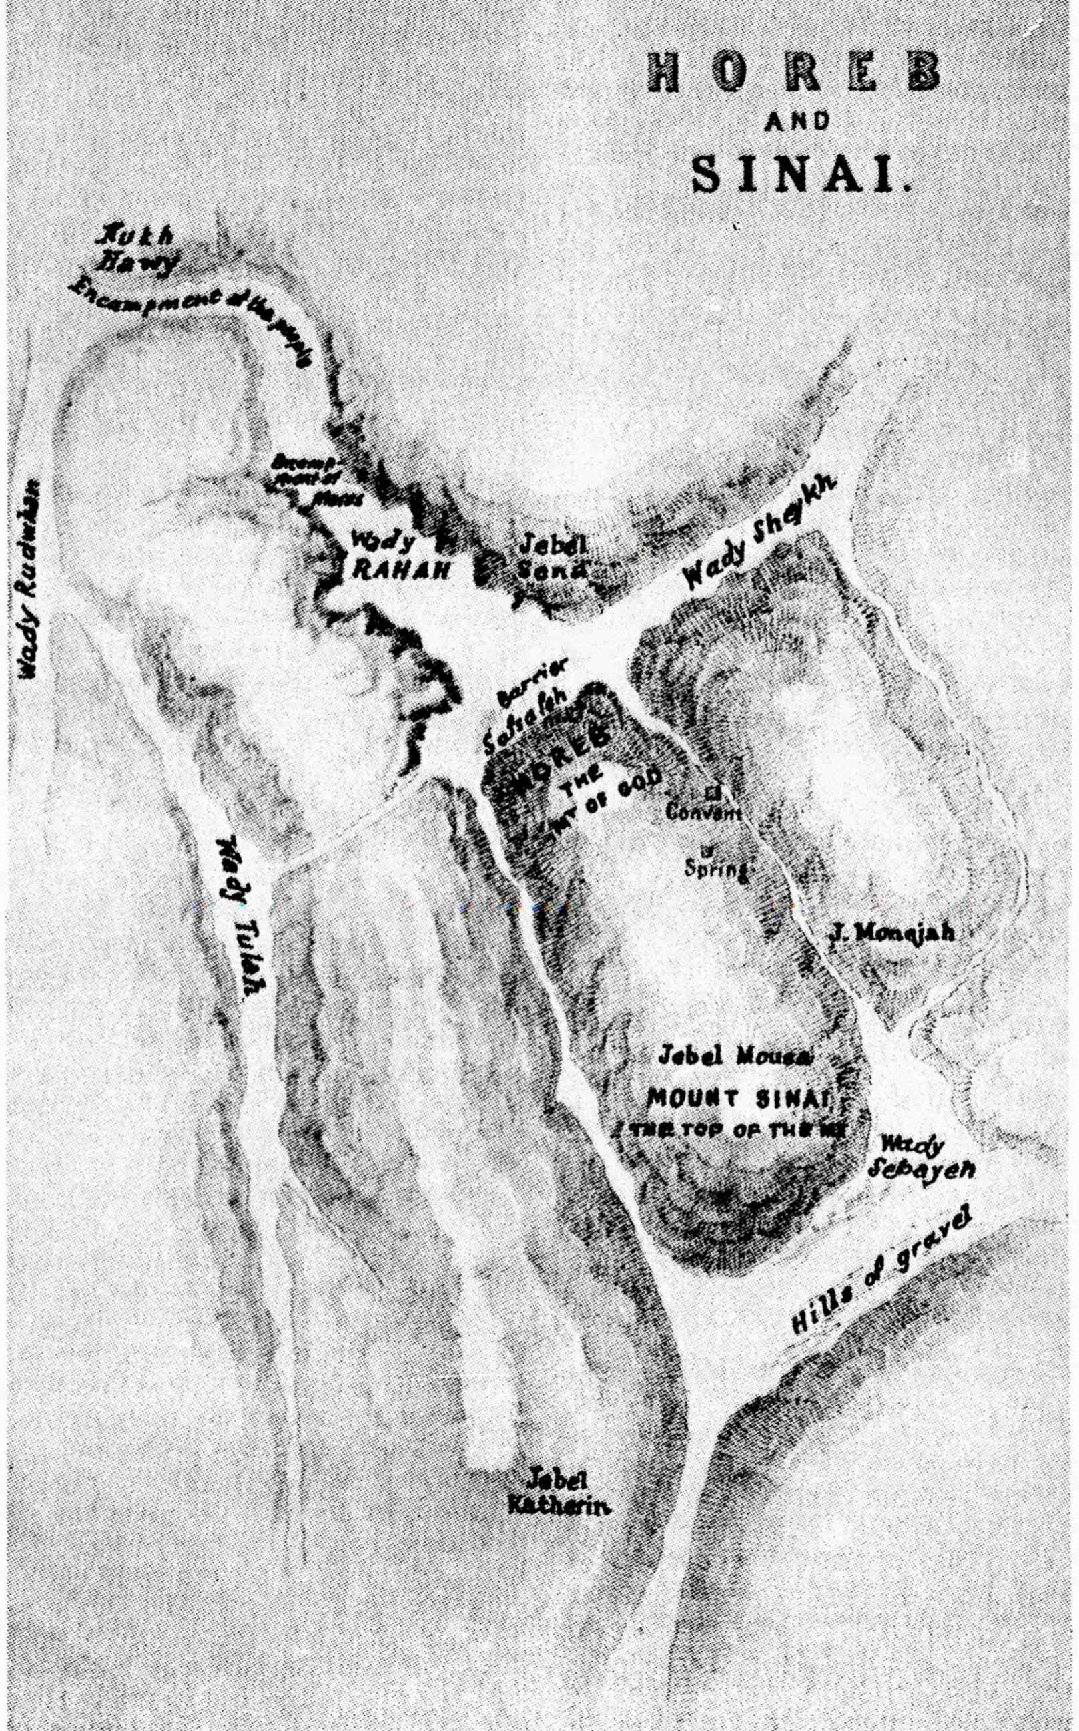
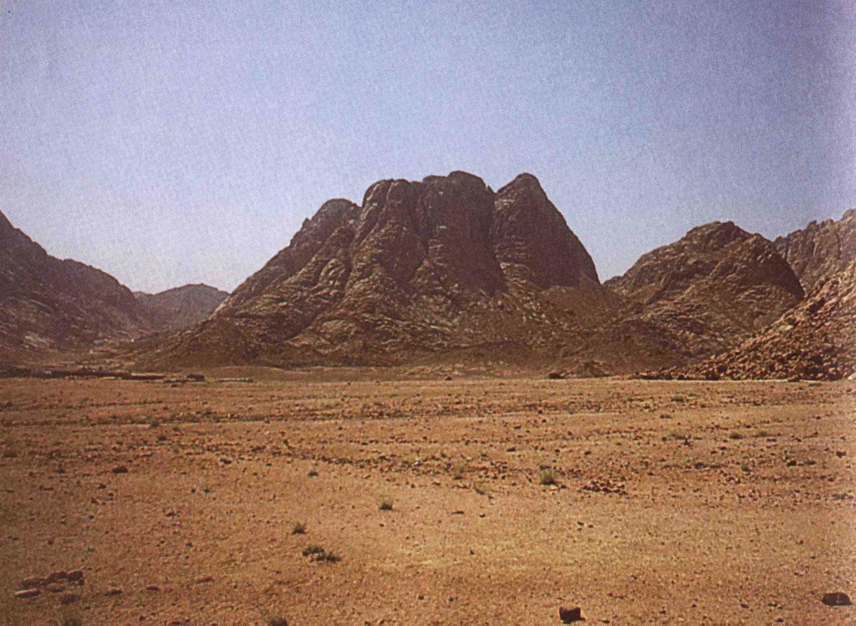
Sinai – Our home for how long?
The plain in front of Mount Horeb is quite large, for Israel a nation of about 2 million people camped before it for 11 months, and they were not permitted to camp near the mount!
Our photo is taken from this position
Israel camped here, were organised into an army, and built the Tabernacle, including the Ark which began its journey to Zion from this place.
N
Events surrounding the return of Christ

Slide 12
Timeline for Isa. 26:20
Refers to the privacy and security of the marriage chamber – Christ takes his bride.
Deut. 24:5 – No war or external activity for one year – Christ rejoices with his bride.
Mal. 4:5-6 (Luke 1:13-17) – Elijah sent as a forerunner to Jews outside the Land – Possible 3.5 year ministry.
Hab. 3:7-8; Isa. 19 – Sinai Arabs and Egypt dealt with prior to Armageddon.
Resurrection
Armageddon
Judgement
Marriage
Preparation for work
Elijah & pre-Arm.
1 year 1 year 4-5 years 3.5 years

Slide 13
1 Thessalonians 4:14-15
Gr. ago – to lead , lead along (as a General), take with one.
14 For if we believe that Jesus died and rose again, even so them also which sleep in Jesus will God bring with him.
15 For this we say unto you by the word of the Lord, that we which are alive and remain unto the coming of the Lord shall not prevent them which are asleep.
Gr. phthano – to come before. Diaglott – “precede”.
Events surrounding the return of Christ

Slide 14
Christ returns as Judge
Gr. keleusma – (from keleuo – to put in motion by word or command) a call, summons, a shout or command which assembles all at once.
Gr. autos – very self; he and no other
16 For the Lord himself shall descend from heaven with a shout, with the voice of the archangel, and with the trump of God: and the dead in Christ shall rise first:
Michael (Jude 9) – “Who is like El” – Ex. 23:20-21; Isa. 63:9; Dan. 10:21; 12:1. Yahweh’s name-bearer with power to forgive or condemn.
Lit. “a trump” – Jubilee trumpet Lev. 25:8-10 – once every 50 years on Day of Atonement (coverings).
Events surrounding the return of Christ

Slide 15
Reward in the Aerial – 1 Thess. 4:17-18
Gr. harpazo – to snatch, to seize, to take hold of forcibly.
Gr. perileipo – to leave over, to be left remaining, to survive.
17 Then we which are alive and remain shall be caught up together with them in the clouds, to meet the Lord in the air: and so shall we ever be with the Lord.
18 Wherefore comfort one another with these words.
Symbol of a multitude – Heb. 12:1
The Aerial or governing region – Eph. 2:2; Rev. 9:2.
Gr. apantesis – with a view to a meeting (to welcome a newly arrived dignitary).
Events surrounding the return of Christ

Slide 16
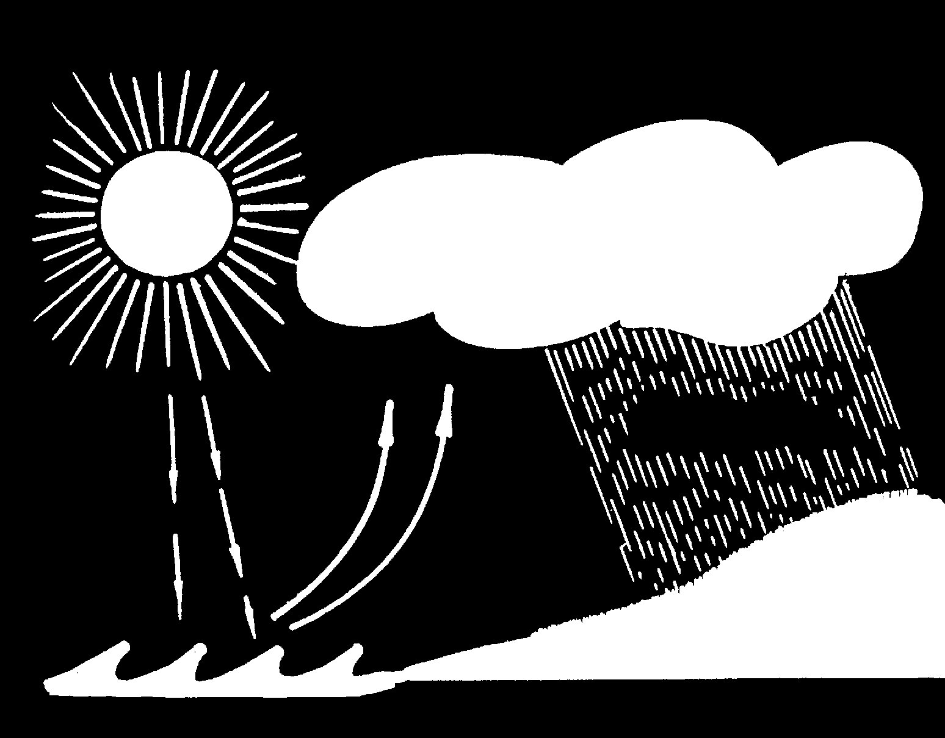
Clouds in the Aerial
Christ as Sun of Righteous-ness draws some from the Sea of Nations as Clouds of Witnesses and they will drop Yahweh’s Rain on the mown grass of mankind after Armageddon.
Mal. 4:2
Heb. 12:1
Deut. 32:2
Ps. 72:6
Isa. 57:20

Slide 17
The return of Christ – Order of events
The living saints will not precede the dead;
Christ will return with a shout or command that will awaken the dead;
He will come with the authority of the Archangel to forgive or condemn, to invite in participation or banish;
The dead raised, he will gather the living with them into a place of judgement;
Christ will grant a reward to the faithful – rulership in the Kingdom at his side.
"So shall we ever be with the Lord"
Events surrounding the return of Christ

Slide 18
Hierarchy of the Kingdom Age
“For unto the angels hath he not put in subjection the world to come, whereof we speak.” - Heb. 2:5
YAHWEH
CHRIST
Christ’s Immortalised Brethren
The Restored Tribes of Israel
Mortal Population of
the Nations
Angels
Angels
Mortality
Mortality
Events surrounding the return of Christ

Slide 19
Next study (God willing)
“Gather My Saints unto Me” - Resurrection
Events surrounding
the return of Christ
Events surrounding the return of Christ

Slide 20
Events unknown to the world
Christ returns to raise the dead and gather the living for judgement
Elijah is sent to Jews living outside the Land of Israel
Elijah sent to Jews
outside the Land
2
1
Events surrounding the return of Christ

Slide 21
Events leading to Armageddon
Russia invades Turkey and plunges down into Egypt
Christ and saints begin the subjugation of the Sinai Arab peoples
3
3
4
Events surrounding the return of Christ

Slide 22
Gog victorious
Western nations fortify Jerusalem
Russia advances main force to Jerusalem
Christ and saints begin to smite and heal Egypt
Jews defeated, flee or are taken into captivity
8
Ships of
Tarshish
Gog
conquers
Egypt
Tarshish
powers
5
Gog a cruel lord in Egpyt
6
Gog rules Egypt
8
Christ and
saints advance
into Egypt
7
Events surrounding the return of Christ

Slide 23
Armageddon and aftermath
Christ and the saints advance from Sinai to Jerusalem
Fleeing Jews return to the Land to meet their Messiah
Proclamation to the nations to submit to Christ’s rule
11
Proclamation to all nations
Armageddon
Throne of
David
established
10
Jews
“And his feet shall stand in that day upon the mount of Olives, which is before Jerusalem on the east, and the mount of Olives shall cleave in the midst thereof” – Zech. 14:4
9
Events surrounding the return of Christ

Slide 24
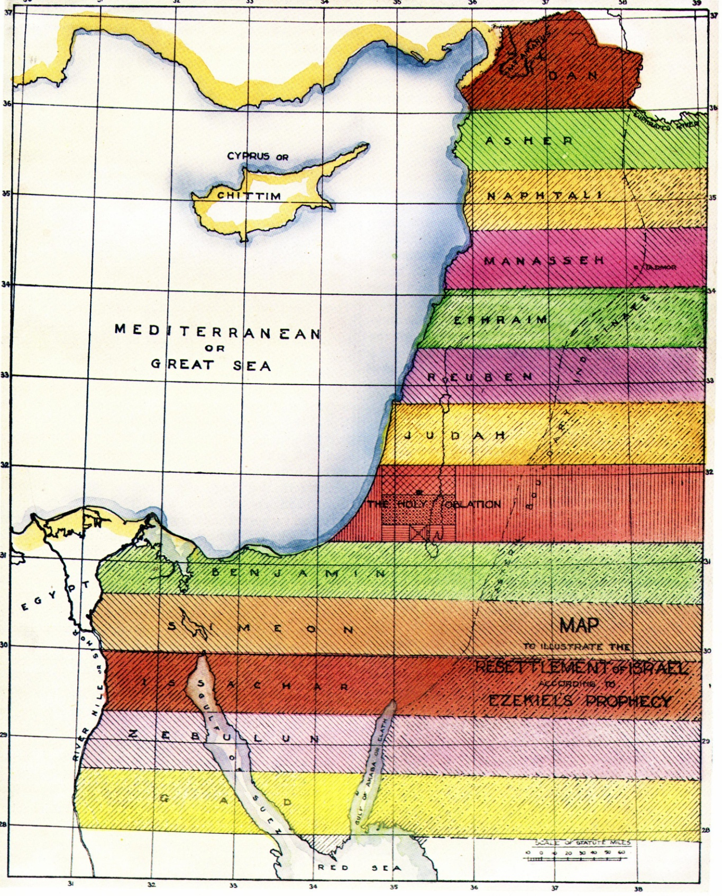
Subjugation of the Nations
13
Britain and other nations submit to Christ’s rule
Catholic Europe and allies destroyed in 30 years of conflict after Rome is destroyed
Catholic Europe
destroyed
Britain submits
The 40 years after Armageddon will see intense activity in the Land:
The Land cleansed and divided into Cantons for the 12 tribes
Inheritance for mortal Christadelphian children – Ezek. 47:22-23
The Temple built and prepared for worship
Events surrounding the return of Christ

Slide 25
The Second Exodus of Israel
Elijah returns with the purified remnant of scattered Jewry
All nations submit to Christ’s rule
Across 'the River'
All nations submit
to Christ’s rule
15
14
Across tongue of the Egyptian Sea
“He shall have dominion also from
sea to sea, and from the river unto
the ends of the earth.” Ps.72:8
Events surrounding the return of Christ

