Slide 1
Events surrounding
the return of Christ
Study 2
“Gather My Saints unto Me” - Resurrection
Rogue River Bible School 2015

Slide 2
Reward in the Aerial – 1 Thess. 4:17-18
Gr. harpazo – to snatch, to seize, to take hold of forcibly.
Gr. perileipo – to leave over, to be left remaining, to survive.
17 Then we which are alive and remain shall be caught up together with them in the clouds, to meet the Lord in the air: and so shall we ever be with the Lord.
18 Wherefore comfort one another with these words.
Symbol of a multitude – Heb. 12:1
The Aerial or governing region – Eph. 2:2; Rev. 9:2.
Gr. apantesis – with a view to a meeting (to welcome a newly arrived dignitary).
Events surrounding the return of Christ

Slide 3
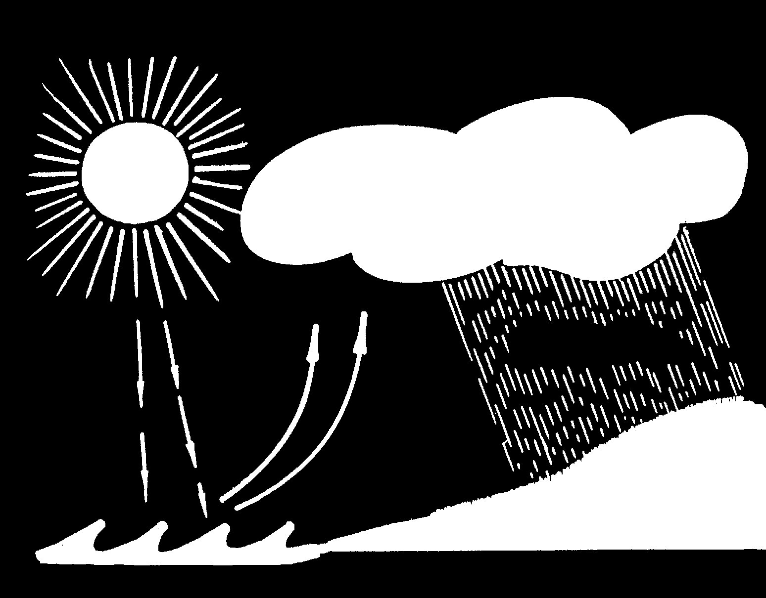
Clouds in the Aerial
Christ as Sun of Righteous-ness draws some from the Sea of Nations as Clouds of Witnesses and they will drop Yahweh’s Rain on the mown grass of mankind after Armageddon.
Mal. 4:2
Heb. 12:1
Deut. 32:2
Ps. 72:6
Isa. 57:20

Slide 4
The return of Christ – Order of events
The living saints will not precede the dead;
Christ will return with a shout or command that will awaken the dead;
He will come with the authority of the Archangel to forgive or condemn, to invite in participation or banish;
The dead raised, he will gather the living with them into a place of judgement;
Christ will grant a reward to the faithful – rulership in the Kingdom at his side.
"So shall we ever be with the Lord"
Events surrounding the return of Christ

Slide 5
Hierarchy of the Kingdom Age
“For unto the angels hath he not put in subjection the world to come, whereof we speak.” - Heb. 2:5
YAHWEH
CHRIST
Christ’s Immortalised Brethren
The Restored Tribes of Israel
Mortal Population of
the Nations
Angels
Angels
Mortality
Mortality
Events surrounding the return of Christ

Slide 6
Examples of mortal transfer
Acts 8:39-40 - “caught away” is harpazo - used 1 Thess. 4:17.
V.26 - Directed to Gaza to meet Ethiopian eunuch.
V.40 - Transported 25 miles (32 kms) to Ashdod.
Consider also Enoch and Elijah.

Slide 7
Examples of mortal transfer
John 6:16-21
Disciples in boat some distance from Capernaum.
Immediately at land!
15 km
Events surrounding the return of Christ

Slide 8
Saints Sinners
Righteous Enlightened
Accountable
Responsible
Ungodly Unenlightened
Not accountable
Not in covenant relationship – accountable for refusal
In covenant relationship – responsible for outcomes
In ignorance – the vast majority of mankind
Responsibility to Divine Judgement
1 Peter 4:17-18

Slide 9
What is Anastasis?
A rising up, a standing up (from the root ANISTEMI, to stand up, to cause to rise) is used 42 times in the N.T. and is translated 39 times ‘resurrection’, once ‘rising again’, once ‘raised to life again’, and once ‘that should rise’.
Resurrection is therefore the standing up of dead ones. The resurrection will be a virtual recreation of former beings into exactly the same mental, moral and physical state that they possessed prior to their death – 1 Pet. 4:19.
Events surrounding the return of Christ

Slide 10
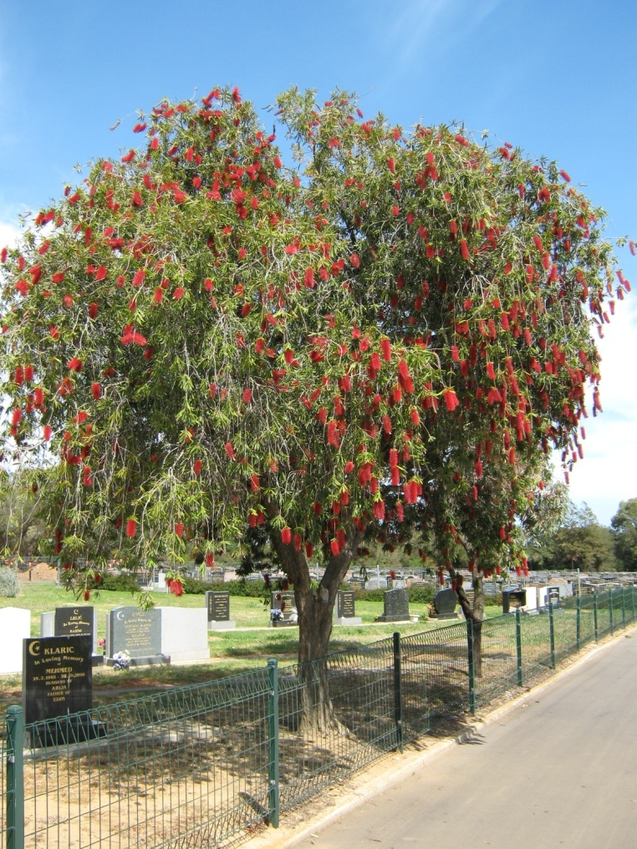
“…the hour is coming, in the which all that are in the graves shall hear his voice, and shall come forth…” – John 5:28-29
Centenial Park Cemetry in Adelaide, S.A.
Phil King and Ian Robinson – killed in a road accident 13 May 1967 on the way to Bible School

Slide 11
3 views on “sown” in 1 Cor. 15
That we are sown:
When we are born into a state and an environment related to corruption, dishonour, weakness, and to things natural.
When the dead body is buried in the ground.
When we are called forth from the grave at the resurrection.
Events surrounding the return of Christ

Slide 12
“Sowest” in 1 Cor. 15:35-38
Gr. egeiro – to rebuild, cause to exist
Bro. Thomas trans-
lates, “for what body”.
35 But some man will say, How are the dead raised up? and with what body do they come?
36 Thou fool, that which thou sowest is not quickened, except it die:
Gr. speiro (Active voice) – to scatter seed, sow
37 And that which thou sowest, thou sowest not that body that shall be, but bare grain, it may chance of wheat, or of some other grain:
38 But God giveth it a body as it hath pleased him, and to every seed his own body.
Gen. 1:11-12

Slide 13
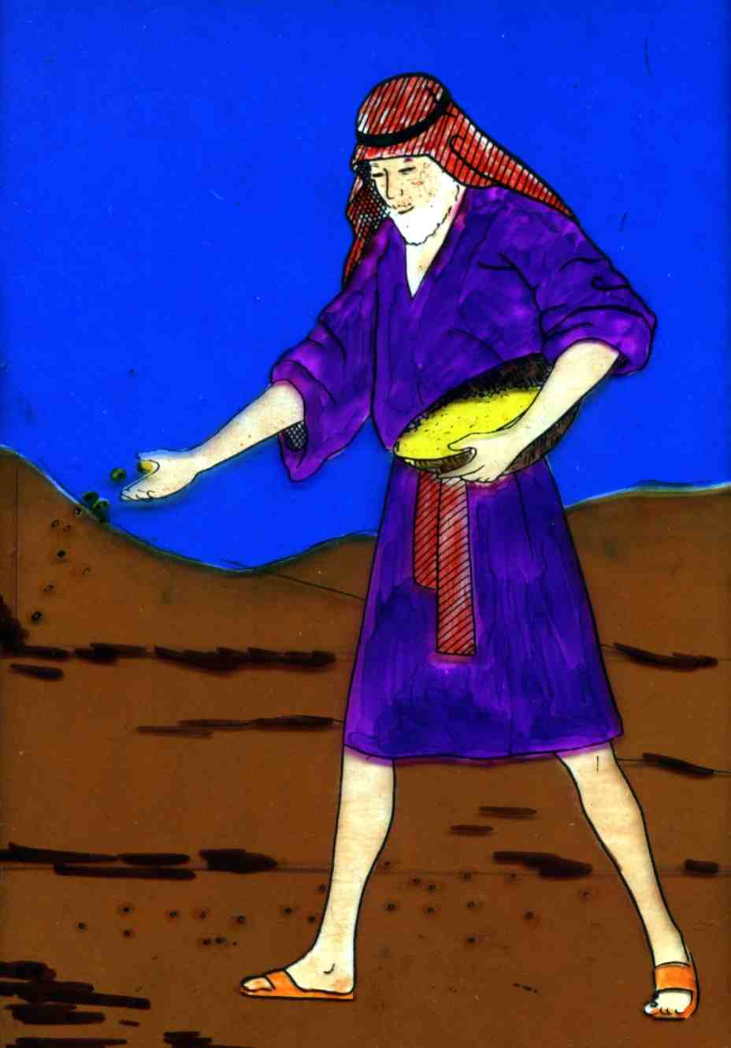
“Sown” in 1 Cor. 15:36-37
The Greek word speiro occurs 3 times in Vv. 36 and 37, all in the Active voice.
SPEIRO (Active voice) – to scatter seed, to sow seed (Liddell and Scott Greek Lexicon)
Represents the burial of the dead body
Events Subsequent to the Return of Christ

Slide 14
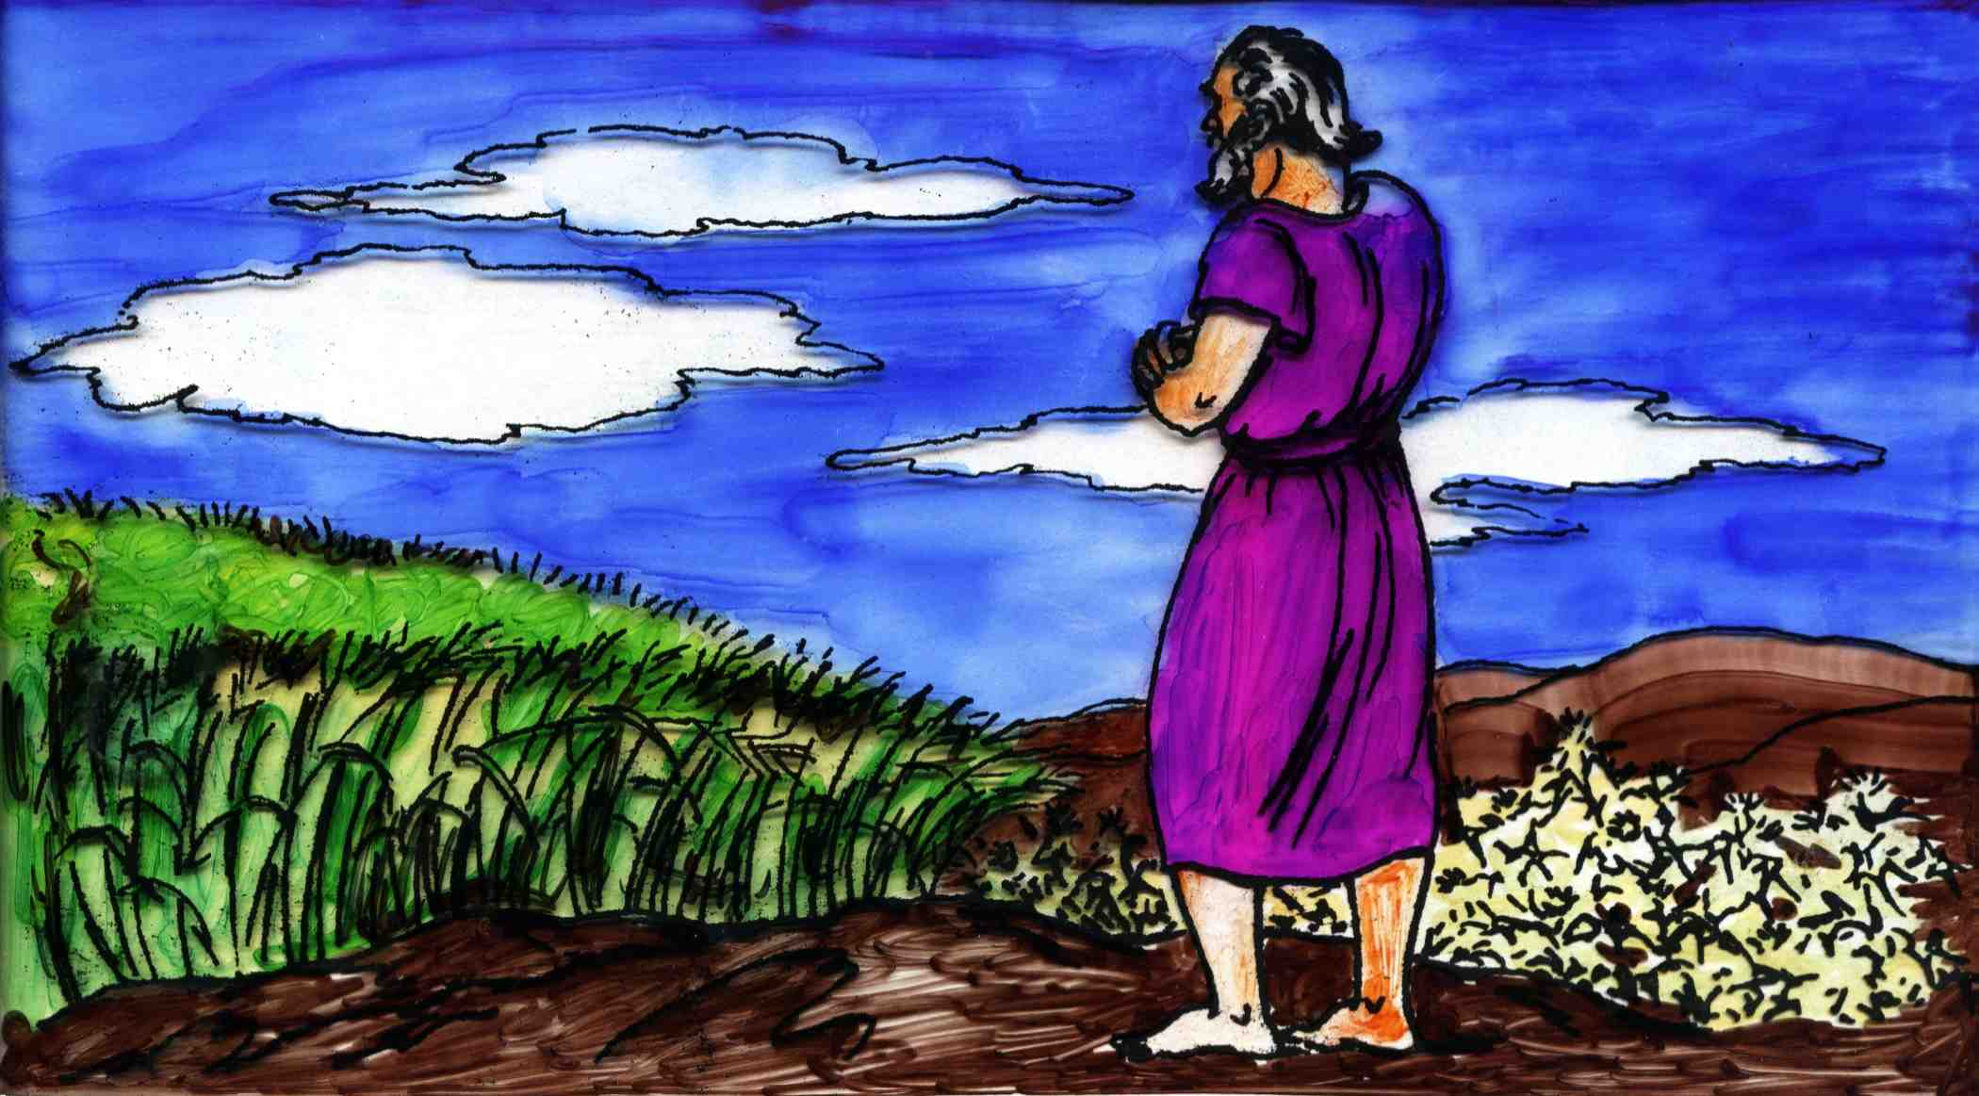
“Sown” in 1 Cor. 15:42-44
The word speiro occurs 4 times in Vv. 42-44 but is in the passive voice where it speaks of the results of sowing.
The word in the Greek is SPEIRETIA (Passive voice) – to spring or be born (Liddell and Scott Greek Lexicon).
The resurrection of the body
Events Subsequent to the Return of Christ

Slide 15
1 Cor. 15:42-45
Bro. Thomas – “It is sprouted”
ANASTASIS – standing up
42 So also is the resurrection of the dead. It is sown in corruption; it is raised in incorruption:
43 It is sown in dishonour; it is raised in glory: it is sown in weakness; it is raised in power:
44 It is sown a natural body; it is raised a spiritual body. There is a natural body, and there is a spiritual body.
45 And so it is written, The first man Adam was made a living soul; the last Adam was made a quickening spirit.
Egerthesontai – to raise up, rebuild, cause to exist
Speiretai (Passive voice) – to spring or be born

Slide 16
The pattern of contrasts in Vv. 42-44
“sown” | “raised”
“it springs forth in…” | “it is caused to exist in…”
Corruption | Incorruption
Dishonour | Glory
Weakness | Power
Natural Body | Spiritual Body
Events surrounding the return of Christ

Slide 17
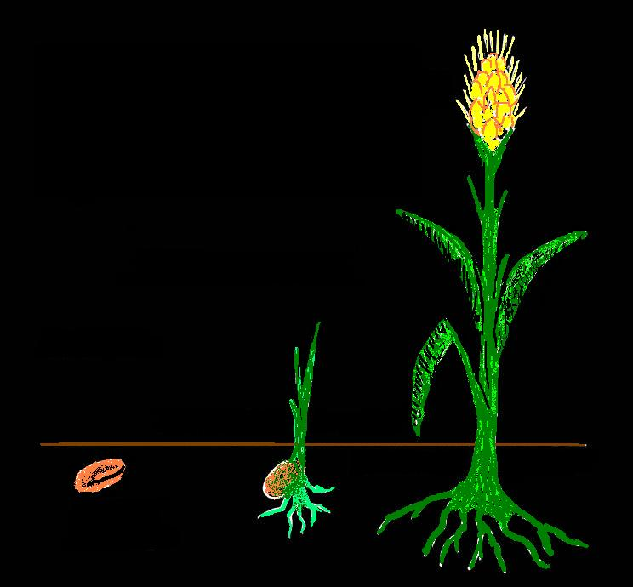
3 stages of resurrection
1 Cor. 15:35-45
3. Glorification
Corruption
Dishonour
Weakness
Natural
Judgement
2. Resurrection
“Gather my saints unto me…”
1.Death
Raised Body
1.
Seed
Body
Sprout
Body
3.
2.
“naked kernel”

Slide 18
Daniel’s typical death, resurrection and glorification
Daniel’s death – Dan. 10:8-9
3 stages of Daniel’s resurrection
Reformed and given life, but is enfeebled – Dan. 10:10-11,15
Strengthened and stands up for judgement – Dan. 10:16-17
Accepted and immortalised – “strong” – Dan. 10:18-19; 12:13
Events surrounding the return of Christ

Slide 19
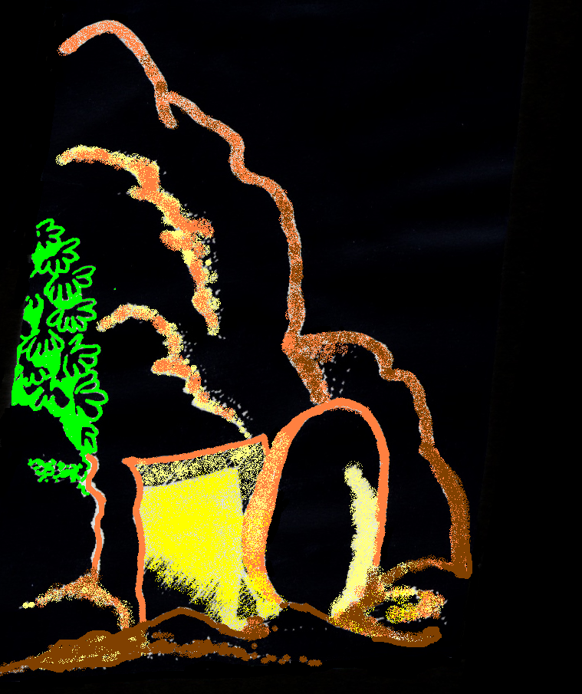
The certainty of the Resurrection
Acts 24:15 - And have hope toward God, which they themselves also allow, that there shall be a resurrection of the dead, both of the just and unjust.
John 5:28-29 - Marvel not at this: for the hour is coming, in the which all that are in the graves shall hear his voice,
And shall come forth; they that have done good, unto the resurrection of life; and they that have done evil, unto the resurrection of damnation.
Events surrounding the return of Christ

Slide 20
Next study (God willing)
“At the judgement seat of Christ”
Events surrounding
the return of Christ
Events surrounding the return of Christ

