Slide 1
Events surrounding
the return of Christ
Study 3
“At the Judgement Seat of Christ”
Rogue River Bible School 2015

Slide 2
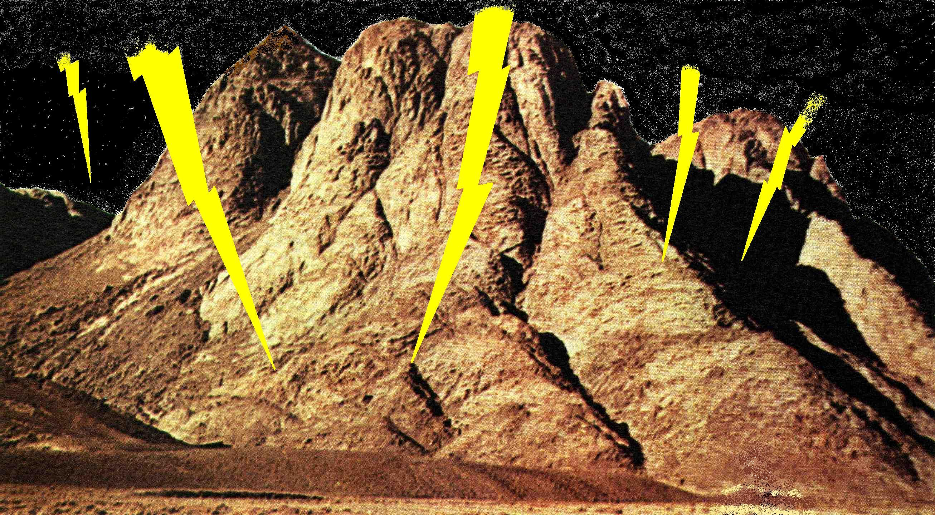
Sinai – Mountain of Judgement
“…the mount that might be touched, and that burned with fire, …unto blackness, and darkness, and tempest” – Heb. 12:18
Heb. 12:28-29 – “Wherefore we receiving a kingdom which cannot be moved, let us have (hold fast to) grace, whereby we may serve God acceptably with reverence and godly fear: For our God is a consuming fire.”
1 John 4:17-18 – “Herein is our love made perfect, that we may have boldness in the day of judgment: because as he is, so are we in this world. There is no fear (dread) in love; but perfect love casteth out fear: because fear hath torment. He that feareth is not made perfect in love.”
Events surrounding the return of Christ

Slide 3
Deut. 33:2
i.e. Israel
Heb. zarach – to irradiate (or shoot forth beams), i.e. to rise (as the sun)
From Sinai to the Sanctuary
Bro. Thomas – “Yahweh came in from Sinai”
2 And he said, The LORD came from Sinai, and rose up from Seir unto them; he shined forth from mount Paran, and he came with ten thousands of saints: from his right hand went a fiery law for them.
Heb. rebabah – abundance; i.e. a myriad. Refers to an innumerable multitude – 1 Cor. 4:15; 14:19; Jude 14
Heb. eshdath – a fire law. Bro. Thomas – “a fiery mandate”. Roth. – “fire to guide them”.
Events surrounding the return of Christ
Heb. athah –to arrive, to appear speedily, suddenly and unexpectedly

Slide 4
Psalm 68:1-4
Heb. elohim – “mighty ones”
1 Let God arise, let his enemies be scattered: let them also that hate him flee before him.
2 As smoke is driven away, so drive them away: as wax melteth before the fire, so let the wicked perish at the presence of God.
3 But let the righteous be glad; let them rejoice before God: yea, let them exceedingly rejoice.
4 Sing unto God, sing praises to his name: extol him that rideth upon the heavens by his name JAH, and rejoice before him.
Cited from Num. 10:33-36 (with one important change – “Yahweh” becomes “Elohim”; i.e. “He who will become” has now become “mighty ones”) – “Rise up, Yahweh and let thine enemies be scattered”.
Events surrounding the return of Christ
Heb. arabah – Lit. through the deserts. Roth. – “that rideth through the waste plains”.

Slide 5
Psalm 68:17
Heb. shinan – to change, reiterate, a repeating; thousands of repetitions, i.e. myriads. Roth. – “the chariots of God are two myriads, thousands repeated”. Alternative – “the changed ones”.
17 The chariots of God are twenty thousand, even thousands of angels: the Lord is among them, as in Sinai, in the holy place
Ginsburg – “the Lord hath come from Sinai into the Sanctuary”. Comp. Bible – “Yahweh among them hath come from Sinai into His Sanctuary”. Jerusalem Bible – “The Lord has left Sinai for His Sanctuary”.
Events surrounding the return of Christ

Slide 6
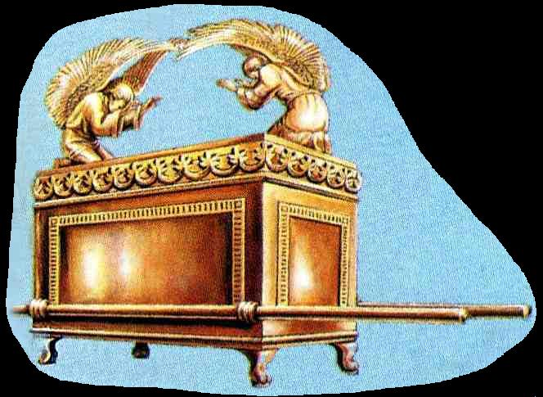
The path taken by Yahweh Sabaoth as seen by Moses, David and Habakkuk
The Sanctuary
Arabah
Egypt
Arabs
Sinai
Events surrounding the return of Christ

Slide 7
The process of Judgement
Angels raise the dead and transport to Sinai – 1 Thess. 4:16.
Angels collect the responsible living and transport to Sinai – 1 Thess. 4:17.
Angels interview each responsible person – Rom. 14:10-12.
Angels bring contemporary groups before Christ’s judgement throne beginning with the final generation and working back to Adam – Matt. 20:1-16.
The righteousness of God will be upheld
Events surrounding the return of Christ

Slide 8
The process of judgement
Calculate time if Christ interviews each responsible person individually.
Say, 20 million responsible, given 1 minute per interview = 38 years required (24 hr day).
Say, 10 mill. @ 1 hour interview = 1,142 years (24 hr day).
Hence, Rom. 14:10-12 achieves at least two things:
Speeds the process up considerably;
Vindicates God’s righteousness.
Events surrounding the return of Christ

Slide 9
A verbal account to the Angels
Romans 14:10-12
10 But why dost thou judge thy brother? or why dost thou set at nought thy brother? for we shall all stand before the judgment seat of Christ.
11 For it is written, As I live, saith the Lord, every knee shall bow to me, and every tongue shall confess to God. – Cited from
12 So then every one of us shall give account of himself to God.
Should be “God” (Gr. Theos)
Isa. 45:23
Gr. logos – the word spoken; an expression of the thoughts of the mind; an account or exposition.
Gr. exomologeomai – to speak out and confess fully.
Events surrounding the return of Christ

Slide 10
The length of the Judgement
The Ark began its journey to Zion about 13 months after Israel left Egypt – Num. 10:11.
The Ark and Tabernacle were constructed from materials brought out of Egypt.
The process leading to manifestation of the glory of God in the Tabernacle (Ex. 40:34) took a little under 12 months.
Conclusion – From the time the responsible are gathered from the nations (Egypt) to their glorification will be about 12 months.
Events surrounding the return of Christ

Slide 11
The righteousness of God vindicated at the Judgement Seat
Isa. 45:23 is quoted in Phil. 2:10-11 – Christ is charged with vindicating his Father’s righteousness in the future.
More time is likely to be spent with the rejected by the angels for this purpose.
Even the righteous will be greatly humbled by the experience – remembered only for good – Neh. 13:14,22,31.
No flesh will glory in God’s presence – His righteousness will be seen to be upheld.
Events surrounding the return of Christ

Slide 12
God’s righteousness seen in the fate of rejected
Shame (Dan.12:2), tribulation, anguish and wrath (Rom. 2:8-9), weeping and gnashing of teeth (Matt. 8:12).
Punishment meted out by degrees – Luke 12:47-48.
Shame revealed before brethren – Rev. 16:15; Luke 12:3.
Depart from Christ in fearful expectation of inevitable destruction – Heb. 10:27.
Cast into “outer darkness” to suffer with the nations – Matt. 22:13.
Read Nazareth Revisited pgs. 393-394
Events surrounding the return of Christ

Slide 13
The Judgement Seat – A shepherd dividing sheep from goats Matt. 25:31-32
³¹ When the Son of man shall come in his glory, and all the holy angels with him, then shall he sit upon the throne of his glory: – i.e. Christ’s judgement throne – Luke 9:26
³² And before him shall be gathered all nations: and he shall separate them one from another, as a shepherd divideth his sheep from the goats:
People of all nations – Acts 15:14; Rev. 5:9
Suggests goats more numerous
Events surrounding the return of Christ

Slide 14
Reward of the Right Hand
Matthew 25
33 And he shall set the sheep on his right hand, but the goats on the left.
34 Then shall the King say unto them on his right hand, Come, ye blessed of my Father, inherit the kingdom prepared for you from the foundation of the world.
“Thou wilt shew me the path of life: in thy presence is fulness of joy; at thy right hand there are pleasures for evermore.” - Ps. 16:11
Events surrounding the return of Christ

Slide 15
The Angels at the Judgement
Accompany Christ when he returns as judge of the household – Matt. 16:27; 25:31; Mark. 8:38
The results of judgement are to be declared in their presence – Luke 12:8-9; Rev. 3:5
They will remove and punish the rejected – Matt. 13:49-50
Events surrounding the return of Christ

Slide 16
Role of the Angels – Hebrews 1:14
Gr. apostello – to send
forth, equip and
despatch on a mission
Gr. litourgikos – public service; esp. in the Temple
14 Are they not all ministering spirits, sent forth to minister for them who shall be heirs of salvation?
Gr. eis diakonia –
Lit. with a view
to service
Events surrounding the return of Christ

Slide 17
The books of Judgement
A book of the Life – An individual account of our daily lives
The Book of Life – A record of the names of all the Redeemed
The Book of Life
Moses Abraham
David Enoch
Christ Jesus
Jacob Uriah
Bathsheba David
Events surrounding the return of Christ

Slide 18
Are the books literal or figurative?
Heb. caphar – to score with a mark as a tally or record, i.e. to inscribe
Psalm 56:8
⁸ Thou tellest my wanderings: put thou my tears into thy bottle: are they not in thy book?
Heb. ciphrah from caphar – a writing or record
An individual account of David’s life
Events surrounding the return of Christ

Slide 19
Records taken - Malachi 3:16
16 Then they that feared the LORD spake often one to another: and the LORD hearkened, and heard it, and a book of remembrance was written before him for them that feared the LORD, and that thought upon his name.
Heb. kathab – to grave, write.
Heb. zikrown – a memento; rt. zakar –to mark, i.e. to remember
Heb. chashab – to plait, weave; to compute by mental effort.
Events surrounding the return of Christ

Slide 20
The Second Judgement at the end of the Millennium will follow the pattern of our judgement!
Revelation 20:12
12 And I saw the dead, small and great, stand before God; and the books were opened: and another book was opened, which is the book of life: and the dead were judged out of those things which were written in the books, according to their works.
Individual records of the life of mortals
Who opens these books?
Events surrounding the return of Christ

Slide 21
What is not found in the books!
Isa. 43:25 – “I, even I, am he that blotteth out thy transgressions for mine own sake, and will not remember thy sins.”
Prov. 28:13-14 – He that covereth his sins shall not prosper: but whoso confesseth and forsaketh them shall have mercy. Happy is the man that feareth alway: but he that hardeneth his heart shall fall into mischief.
Ps. 51:9 – “Hide thy face from my sins, and blot out all mine iniquities.”
Ps. 103:12 – “As far as the east is from the west, so far hath he removed our transgressions from us.”
An intriguing fact – At the Judgement Seat, not one word about David’s sin with Bathsheba and the murder of Uriah will be mentioned to him – but the historical record will remain forever in the Scripture for all to read! – Ezek. 18:21-22

Slide 22
Blameless at the Judgement Seat
1 Cor. 1:8 – “Who shall also confirm you unto the end, that ye may be blameless in the day of our Lord Jesus Christ.”
2 Peter 3:14 – “Wherefore, beloved, seeing that ye look for such things, be diligent that ye may be found of him in peace, without spot, and blameless.”
Jude 24 – “Now unto him that is able to keep you from falling, and to present you faultless before the presence of his glory with exceeding joy.”

Slide 23
Next study (God willing)
“Come, my people, hide thyself for a moment”
Events surrounding
the return of Christ
Events surrounding the return of Christ

