Slide 1
Events surrounding
the return of Christ
Study 4
“Come, my people, hide thyself for a moment”
Rogue River Bible School 2015

Slide 2
The process of Judgement
Christ simply separates sheep from goats and waves to right and left respectively – Matt. 25:32.
Some object and claim better treatment. A one line answer is given by Christ – Matt. 7:22-23.
When all have appeared, Christ glorifies the righteous simultaneously – Matt. 25:34; 1 Cor. 15:51-53.
Christ then dismisses the rejected and the angels herd them away – Lk. 13:28.
Events surrounding the return of Christ

Slide 3
Made apparent at the Judgement
Gr. phaneroo – to make apparent, show forth
2 Cor. 5:10-11
10 For we must all appear before the judgment seat of Christ; that every one may receive the things done in his body, according to that he hath done, whether it be good or bad.
11 Knowing therefore the terror of the Lord, we persuade men; but we are made manifest unto God; and I trust also are made manifest in your consciences.
Gr. phobos - terror
“Reaping what we sow”
Gr. dia - through
Events surrounding the return of Christ

Slide 4
The context of the parables
Matt. 24 and 25 constitute one complete address – Matt. 26:1.
The 3 parables expand Matt. 24:45 –
“wise servant” – 10 virgins (4 times)
“faithful” – Talents (4 times – V.21,23)
Reward of stewardship – Sheep & goats
Matt. 25:31-46 – Primarily Judgement Seat.
Bro. Thomas recognises this in Eureka – Vol. 5 pgs. 43, 82; Vol. 1 pg. 219; Vol. 2 pg. 254. He does also use it of the national judgement of the nations – Dan. 7:9-12.
Events surrounding the return of Christ

Slide 5
The Judgement Seat – A shepherd dividing sheep from goats Matt. 25:31-32
³¹ When the Son of man shall come in his glory, and all the holy angels with him, then shall he sit upon the throne of his glory: – i.e. Christ’s judgement throne – Luke 9:26
³² And before him shall be gathered all nations: and he shall separate them one from another, as a shepherd divideth his sheep from the goats:
People of all nations – Acts 15:14; Rev. 5:9
Suggests goats more numerous
Events surrounding the return of Christ

Slide 6
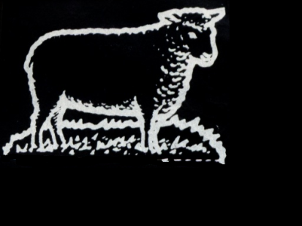
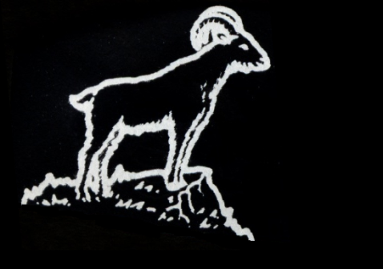
Two classes at the Judgement
SHEEP
Dependent
Submissive
Willing
Obedient
Gregarious
White
Selective eaters
GOATS
Independent
Rebellious
Callous
Disobedient
Solitary
Black
Eat anything
?
Events surrounding the return of Christ

Slide 7
The characteristics of sheep
Attentive - John 10:27 – “My sheep hear my voice, and I know them, and they follow me.”
Willingly led - Ps. 23:2 – “He maketh me to lie down in green pastures: he leadeth me beside the still waters.”
Submissive - Isa. 53:7 – “…he is brought as a lamb to the slaughter, and as a sheep before her shearers is dumb, so he openeth not his mouth.”
Occasionally stray - Isa. 53:6 – “All we like sheep have gone astray; we have turned every one to his own way.”
Events surrounding the return of Christ

Slide 8
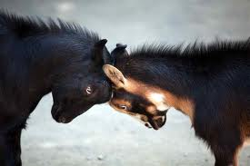
The characteristics of goats
Unlike sheep, who graze, goats feed on the leaves and shoots of shrubs, a habit that enables them to thrive in semi-arid scrublands and mountains.
Goats are capricious. They are impulsive and unpredictable, devious and contrary. If they are not poking their heads through fences, they may be standing on their hind legs, stretching for those tender leaves just out of reach. Goats are never content with what they have.
Encarta
Events surrounding the return of Christ

Slide 9
Goats - Violence and herd order
From a long time goat farmer
No matter how you want them to always get along, there will be occasions where your goats fight and take “pot shots” at each other.
The best thing to do is let them fight it out. It’s brutal, but it is the way of goats. It is their nature.
You may also see other goats get involved, and take sides in a fight.
Goats will ram “lesser” goats for no other reason than to just to make sure they know their place.
“Get out of my way!”
Events surrounding the return of Christ

Slide 10
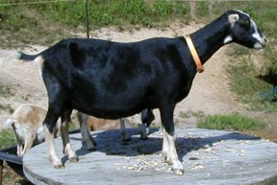
Goats hate restriction!
Goats are intelligent and playful but impulsive, unpredictable, and devious.
They are experts in opening gates and squeezing through small gaps because they hate to be confined. Fences that will handle sheep, cattle, and horses will not hold goats. They will work tirelessly to spring themselves from any situation they deem inhibiting.
Goats do not push well. If you push them to get them out of your way, they will lean into the push.
Events surrounding the return of Christ

Slide 11
Goats not good followers!
Consequently, goats are not very good followers. “Gregarious behavior” is a term that refers to the flocking or herding instinct which is found strongly in sheep, cattle, and horses. Again, this quality is rather weak in goats; they prefer leading or going off on their own.
Meat packers use this instinct in sheep and goats to their advantage. They will train an old goat, appropriately called a “Judas”, to lead sheep to the pens for slaughter. A well-trained Judas will lead group after group of sheep to the slaughter all day long.
Events surrounding the return of Christ

Slide 12
“Ye have done it unto me” Matt. 25:34-46
1 John 4:17 - “…because as he is, so are we in this world.”
V.35-36 – The kindnesses are only those the Lord could fittingly identify with.
Bro. Carter – “To feed a sick soul may have greater value than feeding a hungry body; to help the spiritually weary may fill a greater need than restoring physical vigour.”
V.40 & 45 – Contrast – “...these my brethren” and “these” (what happened?).
Events surrounding the return of Christ

Slide 13
The purpose of judgement is to determine motivation
1 Cor. 4:5
5 Therefore judge nothing before the time, until the Lord come, who both will bring to light the hidden things of darkness, and will make manifest the counsels of the hearts: and then shall every man have praise of God.
Gr. boule – will, determination, propensity; purpose, design, plan.
Weymouth – “and will disclose the motives”
Gr. phaneroo – to make apparent, show openly
Events surrounding the return of Christ

Slide 14
Isa. 26:19-21 (Rotherham)
¹⁹ Thy dead, shall come to life again, My dead body, they shall arise,—Awake and shout for joy, ye that dwell in the dust For, a dew of light, is thy dew, And, earth, to the shades shall give birth.
²⁰ Come my people, enter into thy chambers, And shut thy doors behind thee,—Hide thee as it were a little moment Till the indignation pass over.
²¹ For lo! Yahweh, is coming forth out of his place, To visit the iniquity of earths inhabitant upon him,—Therefore shall the earth unveil her shed-blood, And throw a covering, no longer over her slain.
Events Surrounding the Return of Christ

Slide 15
Timeline for Isa. 26:20
Refers to the privacy and security of the marriage chamber – Christ takes his bride.
Deut. 24:5 – No war or external activity for one year – Christ rejoices with his bride.
Mal. 4:5-6 (Luke 1:13-17) – Elijah sent as a forerunner to Jews outside the Land – Possible 3.5 year ministry.
Hab. 3:7-8; Isa. 19 – Sinai Arabs and Egypt dealt with prior to Armageddon.
Resurrection
Armageddon
Judgement
Marriage
Preparation for work
Elijah & pre-Arm.
1 year 1 year 4-5 years 3.5 years

Slide 16
The Bridal Chamber
Isa. 26:20 – “chamber” – cheder - chamber, room, parlour, innermost or inward part, within. 38 occs. O.T. – often used of a bed-chamber.
“moment” – rega - a wink (of the eyes), that is, a very short space of time.
1 Cor. 15:50-52 - Now this I say, brethren, that flesh and blood cannot inherit the kingdom of God; neither doth corruption inherit incorruption.
Behold, I shew you a mystery; We shall not all sleep, but we shall all be changed,
In a moment, in the twinkling of an eye, at the last trump: for the trumpet shall sound, and the dead shall be raised incorruptible, and we shall be changed.
Events Surrounding the Return of Christ

Slide 17
The immortal being
1 Cor. 15:50 – The basic rule – “flesh and blood cannot inherit the kingdom of God”.
Luke 24:39 – Different constitution - “for a spirit hath not flesh and bones, as ye see me have”.
Rev. 21:3-4 - Spirit nature excludes corruption in any form - sin, disease, sickness, sorrow and physical decline completely absent.
John 20:19-29 – Identity retained.
Lev. 21:17-23 – Physical abnormality absent.

Slide 18
Male or Female?
Male and female identity continue.
Luke 20:36 - As angels – no marriage.
Reproductive organs – now redundant will disappear.
1 John 3:1-2 – Share God’s nature and character.
Gen. 17:1 – El Shaddai – Nourisher of family.
Num. 11:12 – Delegated to Moses (Acts 13:18).
Isa. 49:15,22-23 – Yahweh operates as father and mother.
Gen. 2:21-24 – Law of sympathy designed to produce Yahweh’s character.

Slide 19
Next study (God willing)
“This honour have all His saints”
Events surrounding
the return of Christ
Events surrounding the return of Christ

