Slide 1
Events surrounding
the return of Christ
Study 5
“This honour have all His saints”
Rogue River Bible School 2015

Slide 2
Isa. 26:20-21 – “indignation” “A time of trouble” – When?
Dan. 12:1-2 – Note “at that time”. Namely, Armageddon – Dan. 11:40-45 – “the time of the end”.
Christ (“Michael” = “who is like El”) appears to raise the dead.
The Judgement Seat follows – V.2-3 (10 years prior to Armageddon).
The resurrection era is the period when “the time of trouble begins”.

Slide 3
The time of trouble looming
H.P. Mansfield – Expositor - Daniel
Dan. 12:1 – “trouble” — The Hebrew word for “trouble” (tsarah) indicates “intense turmoil” (Ps. 25:17), comparable to the pain endured by a woman bearing her first child (Jer. 4:31). It describes the terror of a people who cowered in fear before a merciless, rapacious army (Jer. 6:24). Note the usage of the word in Hab. 3:16; Zeph. 1:15 and Zech. 10:11. The same word appears in Jer. 30:7, “the time of Jacob's trouble.”

Slide 4
The time of trouble looming
Thus, the Lord will return at a time of unparalleled chaos involving both Israel and the Gentiles (Jer. 25:30-33; Zech. 14; Mal. 4; Luke 21:25-26; 2 Thess. 1:7-10). It will be an age of spiritual and moral gloom, with mankind in a state of "gross darkness" (Isa. 60:2). The trouble will be so intense that there will seem to be "no way out“ (as the word “perplexity" in Luke 21:25 signifies), with men's hearts failing them for fear as they contemplate the catastrophe that faces them.

Slide 5
The time of trouble looming
The saints, however, have already been removed from this scene of chaos, for the time of trouble will erupt as the Judgment Seat is in progress (Isa. 26:20-21; Luke 21:25-27; 2 Pet.3:12).
The Christadelphian Expositor
Bro. H.P. Mansfield
So, what precedes this time of trouble?

Slide 6
What will conditions in the world be like just before the return of Christ to raise the dead?
Will there be poverty and hard times or general prosperity?
Luke 17:26-30; 21:34 & Rev. 3:14:22 suggest the answer.

Slide 7
Prosperity at return of Christ!
Luke 17:26-30
Eating and drinking – gluttony and excessive drinking – culture of enjoyment and revelry.
Marrying and being given in marriage – implies multiple marriages – culture of pleasure.
Buying and selling – pre-occupation with acquisition – never satisfied = materialism.
Planting – business pursuits - culture of increase and gain.
Building – continual upgrading to improve status – culture of luxury and comfort.
...and then all their prosperity collapsed in a day when the saints were taken away
The days of Noah and Lot!

Slide 8
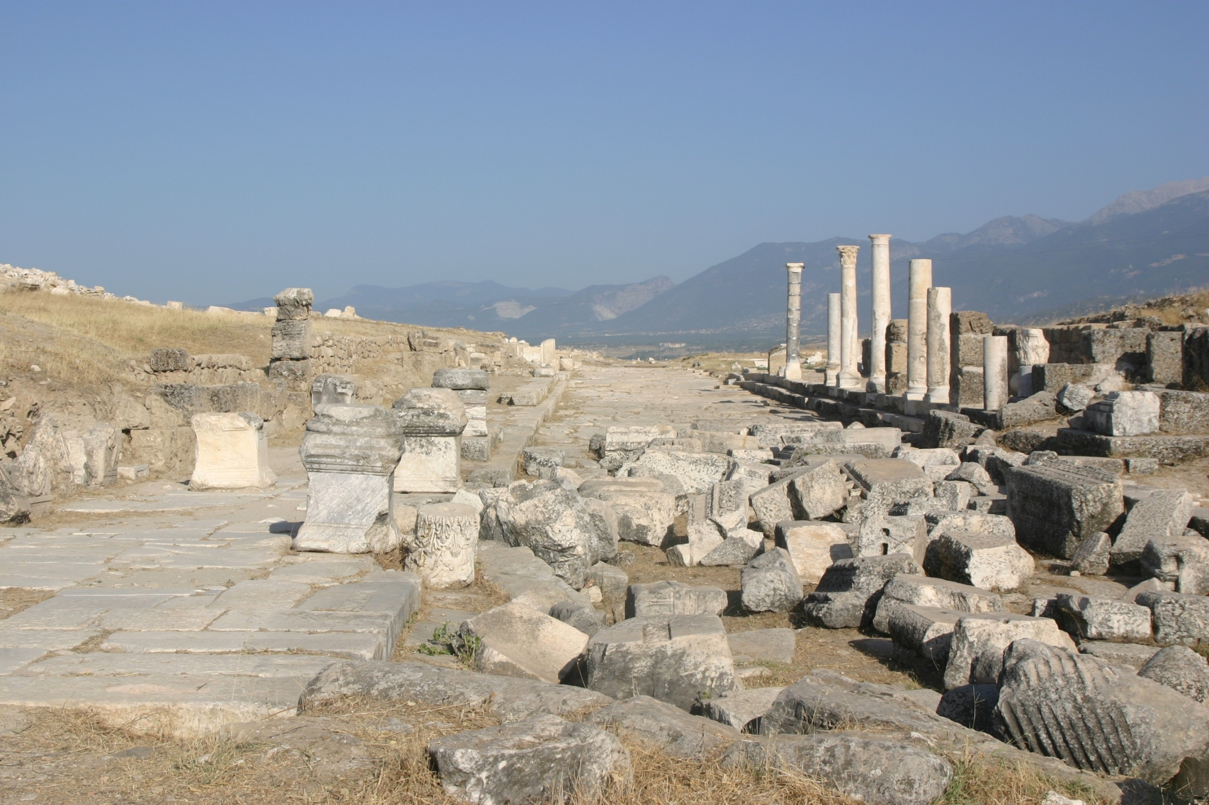
Ruins of ancient Laodicea
.
“Because thou sayest, I am rich, and increased with goods, and have need of nothing; and knowest not that thou art wretched, and miserable, and poor, and blind, and naked.” – Rev. 3:17
We are in the Laodicean era of Ecclesial history – A time of unparalleled prosperity!
“Behold, I stand at the door, and knock…”

Slide 9
A great depression looms
Soaring US debt, political grid-lock, ‘Quantitative Easing’ and rising interest rates guarantee collapse in the US.
Numerous European states are on the verge of bankruptcy, e.g. Greece, Cyprus, Spain, Italy, France....
The European Central Bank is in panic mode turning to Quantitative Easing.
China and Russia have signed financial, oil and gas and military deals that cut the US dollar out of their international trade.
The Greek crisis simmers. ECB quivers!

Slide 10
Timeline of Depressions
World War 2
1929
10 years
1939
War
Times of prosperity become times of poverty and unemployment
1930
This is the last cycle because of the events of 2,060
201?
10 years
Times of prosperity become….
A huge
financial crisis
is long overdue!
A time of trouble such as never was – Dan. 12:1-2
Armageddon

Slide 11
Dan. 12:4 –
“many shall run to and fro”
Gesenius says the word shut is used metaphorically to run through a book; i.e. to examine thoroughly.
It is nevertheless true, also, that the Scriptures have been opened up to a greater extent than formerly; printed expositions and commentaries abound, and the passage of history has verified most prophetic details. Yet there is a lack of true understanding.
Bro. H.P. Mansfield – Expositor - Daniel

Slide 12
The Saints’ role not passive
Mal. 4:1 - For, behold, the day cometh, that shall burn as an oven; and all the proud, yea, and all that do wickedly, shall be stubble: and the day that cometh shall burn them up, saith the LORD of hosts, that it shall leave them neither root nor branch.
Mal. 4:3 - And ye shall tread down the wicked; for they shall be ashes under the soles of your feet in the day that I shall do this, saith the LORD of hosts.
Rom. 16:20 - And the God of peace shall bruise Satan under your feet shortly.

Slide 13
“My servants would fight…” John 18:36
“Jesus answered, My kingdom is not of this world: if my kingdom were of this world, then would my servants fight, that I should not be delivered to the Jews: but now is my kingdom not from hence.”
Events Surrounding the Return of Christ

Slide 14
Singing a New Song Ps. 149:1-3
V.1 - “new song” – 9 occs. in Scripture. Indicates a song that can only be sung with full meaning by immortals.
“congregation” – qahal – O.T. equivalent for ecclesia.
“saints” – chasiyd - faithful, kind, godly, holy one, saint. Roth. – “men of loving-kindness”.
V.3 - “dance” – machol – round dance; root chul – twist, whirl about.

Slide 15
The meek beautified with salvation Ps. 149:4
V.4 - “beautify” – pa’ar - to glorify, beautify, adorn.
“meek” – anayv - depressed (figuratively), in mind (gentle); hence humble, lowly, meek.
21 occs. in O.T. – First Num. 12:3 (Moses). Significant occs. – Ps. 37:11; 76:9; Isa. 11:4; Zeph. 2:3.

Slide 16
“This honour have all His saints” Ps. 149:5-9
V.5 - “joyful” – alaz – jump for joy; exult.
“beds” – mishkab – couch, recliner.
V.6 - “high” – romam – praise, exaltation.
“mouth” – garon – neck or throat. Roth. – “The high songs of GOD be in their throat”.
“two-edged” – piyphiyah - tooth, edge, mouth. Only other occ. Isa. 41:15 (“teeth”).
V.9 - “honour” – hadar - honour, glory.

Slide 17
The relation of young people to judgement
What will happen to young people too young to be baptised when Christ returns?
What about babies and the unborn?
What is the age of responsibility and what will happen to those who have reached it but have not been baptised at Christ’s return?
What of children whose parents are both rejected at the judgement seat?

Slide 18
The fate of children whose parents are rejected at the Judgement Seat
Outcome will be right – Gen. 18:25.
Where children are embraced by, and/or follow parents ungodly example – destruction awaits – Deut. 20:16-18.
Where children stand for God despite the parent’s faulty leadership they will be preserved and given an opportunity – Num. 26:9-11.

Slide 19
The care of the Judge
In the act of judgement, Yahweh cares for the fatherless and widow - Ps. 68:5-10.
Christ will shepherd the young and mothers with babies (born or unborn) - Isa. 40:9-11.
Inheritance prepared and given to children thus preserved – Ezek. 47:22-23.

Slide 20
The inheritance of our children Ezek. 47:22-23
22 And it shall come to pass, that ye shall divide it by lot for an inheritance unto you, and to the strangers that sojourn among you, which shall beget children among you: and they shall be unto you as born in the country among the children of Israel; they shall have inheritance with you among the tribes of Israel.
23 And it shall come to pass, that in what tribe the stranger sojourneth, there shall ye give him his inheritance, saith the Lord GOD.
These are Gentiles – they are also mortal because they marry and have children – and though they sojourn in the Land, they are counted as Israelites.

Slide 21
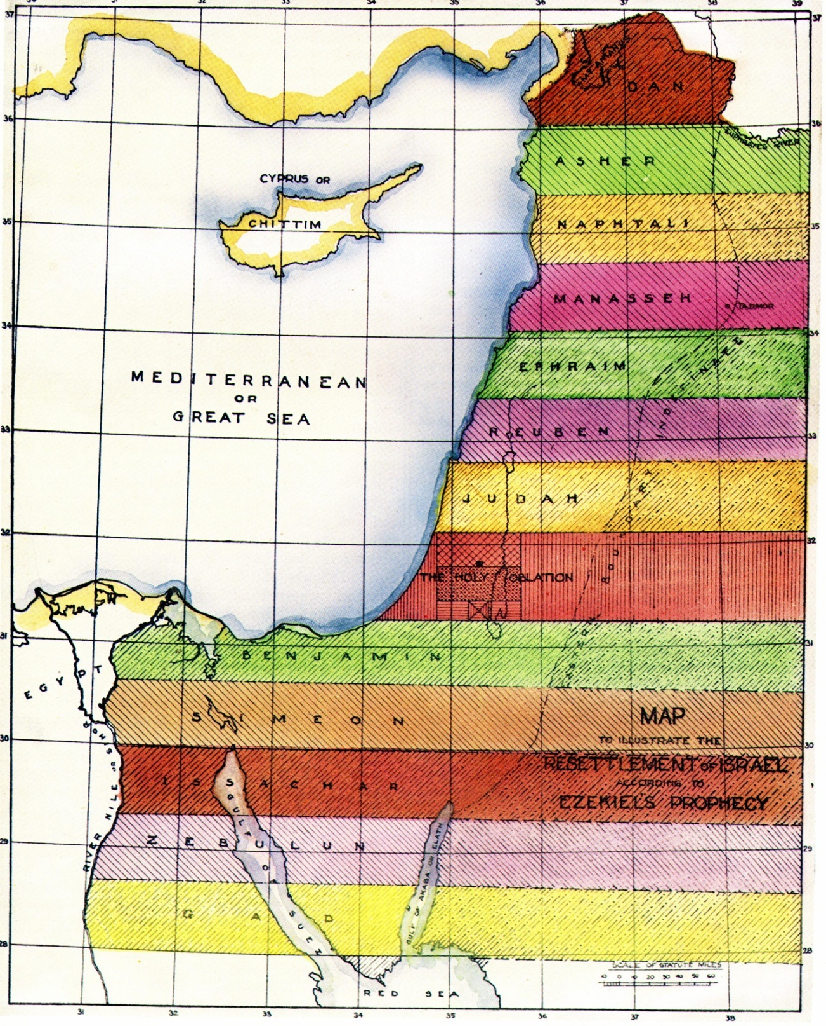
The Tribal Cantons
A privileged class of mortals
Ezek. 47:23
Unique among the mortal inhabitants of the Land, the children of Saints can choose where they inherit among the tribes of Israel.

Slide 22
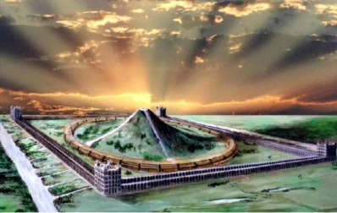
Timeline for Christadelphian children
Let us say Christ comes in late 2015 and a baby is born to a Christadelphian family in early 2015.
That child will be nearly 2 years old when its parent/s are immortalised; aged 10 at Armageddon; aged 50 at opening of the Temple for worship.
10
About here they will marry and start their own family
50
Resurrection
Armageddon
10 years
40 years

Slide 23
Events surrounding
the return of Christ
2 Pet. 3:11 - Seeing that these things are thus all to be dissolved, what manner of persons ought ye to be in all holy living and godliness.
Events surrounding the return of Christ

Slide 24
The final urgent warning
Revelation 22:11-12
¹¹ He that is unjust, let him be unjust still: and he which is filthy, let him be filthy still: and he that is righteous, let him be righteous still: and he that is holy, let him be holy still.
¹² And, behold, I come quickly; and my reward is with me, to give every man according as his work shall be.
Soon there will be no opportunity to make any necessary changes to our life
Events surrounding the return of Christ

Slide 25
...
!
Preparing for the Return of Christ

Slide 26
Bro. Robert Roberts Ambassador Vol. 3 page 185
“As to children who may be alive when the Lord returns and sends for the members of his household......the question is, will not provision be made for the household of the faithful? If we are to judge from the Deity's operations in the past, we are justified in expecting that this will be so. Respect has always been shewn to the kindred of those who have been the objects of divine regard. Noah's family is one instance; Lot's family another.

Slide 27
His sons-in-law were, by command of the angels, invited to escape the impending judgement, but laughed the invitation to scorn. Rahab's family were spared from the destruction that befell Jericho. Is it not possible that similar favour will be shewn when the greatest judgement of all arrives? Is it not possible that households may be invited to accompany the saints eastward? As a matter of course, the saints alone are called to judgement, and they alone enter the Kingdom of God, in the sense of obtaining the life, honour, and glory of it; but mortal subjects will have to be provided for as well as kings and priests; ……

Slide 28
…and is it not possible the saints may have a commission to secure among these a place for such of their kindred as shall have to leave home and country for the seat of the New Power, there to shelter in the King's refuge until the judgement is overpast, and afterwards to settle among the tribes of Israel as strangers sojourning in the Land, to whom a portion will be divided? (Ezek.47:22). If so all difficulty about the children would be at an end.”
Bro. Robert Roberts Ambassador Vol. 3 page 185

