Slide 1
“The Sabbath – Its Prophecies, Principles and Prospects”
Study 1
“Let them have dominion”

Slide 2
“Sabbath” in Scripture
shah-vath - to sit down, to rest, to be still. 70 occs. – “cease”, “rest”, “keep sabbath”.
shab-bahth – intermission. 111 occs. – “sabbath” 110, “another” once.
shab-bah-thon – a sabbatism - 11 occs. – “sabbath” 3, “rest” 8.
In the N.T. three words are used:
sabbatismos
sabbaton/prosabbaton
sabbata
70 occs. in total = the nations

Slide 3
The Feast of Tabernacles - The ingathering of all nations – Zech. 14:16
Seven days - 15th to 21st day of Tishri (7th month)
Day 1 - (Num. 29:13) 13 bullocks offered
Day 2 - (v.17) 12
Day 3 - (v.20) 11
Day 4 - (v.23) 10
Day 5 - (v.26) 9
Day 6 - (v.29) 8
Day 7 - (v.32) 7 = Total 70 (The Nations)
8th Day - One bullock offered (Num.29:35-36) – “That great day of the feast” – John 7:37.
Begins with 13 – No. of rebellion
Ends with 7 – Covenant & Sabbath rest
The Sabbath

Slide 4
The foundations of the Sabbath
Gen. 1:26-28 – Exercising dominion on the Sabbath – Key to understanding.
Prophecy of the end of the 6th millennium – Marriage to come before the 7th day.
“them” – Masculine Plural – multitude in “the Man” – Christ and his bride.
Gen. 2:1-3 – God rested but “the man” worked (V.15) – not the toil of mortality.
Need for divinely appointed labour on the Sabbath – Sabbath every day.

Slide 5
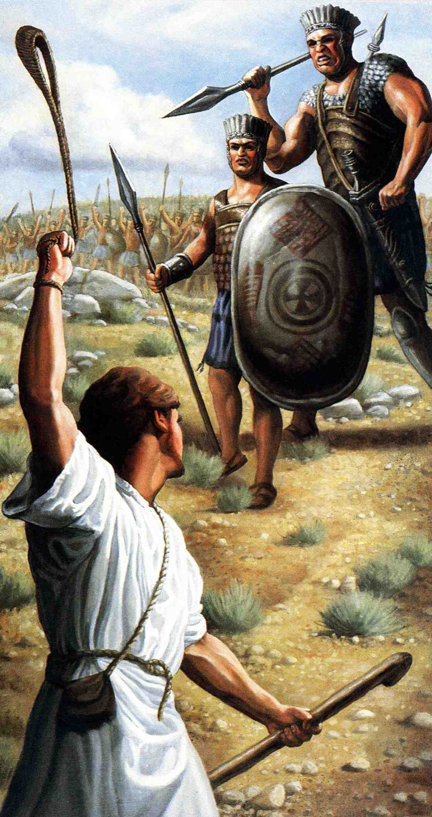
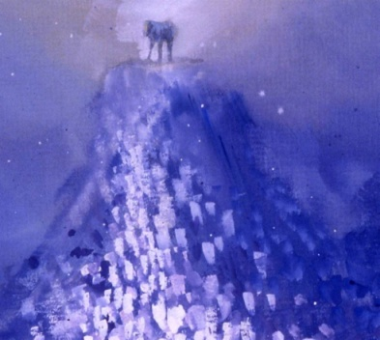
David’s exposition of Gen. 1 & 2 Psalm 8
Ps. 8:2 – “still” - shabath
Dominion exercised
David saw the death of Goliath as a type of the restoration of dominion over all carnal things by Christ through the work of Atonement
“Let them have dominion”
The Lamb upon Mt Zion
Sabbath
Sin
“The Son
of man”
Millennium
Dominion lost
Dominion restored

Slide 6
The background to Ps. 8
The subscription (appended to superscription of Psalm 9) – “To the chief Musician upon Muthlabben” indicates “On the death of the champion”.
David wrote the psalm after he had slain Goliath and brought his head to Jerusalem.
Hence, there are several allusions to 1 Sam. 17.

Slide 7
Psalm 8:1 & 9
“O Yahweh our Lord, how excellent is thy name in all the earth!”
“Lord” is the Hebrew adon with a suffix - adonynuw (first person plural). It indicates “rulers” and refers to Christ and the saints manifesting the rulership of Yahweh in the earth.
A literal translation of the opening and closing statement of the psalm would read: “O, He who will become rulers, how majestic is thy name in all the earth.”
Proof – Heb. 2:6-8 and 1 Cor. 15:24-28.

Slide 8
“Son of man” Hebrew - ben-a-adam
A title referring to divinely delegated authority to exercise dominion over carnal things.
Drawn from Ps.8:4 and Ps.80:17 - Roots of the phrase are in Gen.1:26,28.
“Son of man” is used 92 times of Ezekiel the prophet as a type of Christ (never “the Son of man”). The theme of Ezekiel is exercising dominion.

Slide 9
Visitation – Ps. 8:4 & 80:14
“visit” – paqad (Qal in both) – to pay attention to, observe, to attend to, to seek, look about for, to visit.
First occ. Gen. 21:1 – Yahweh “visited” Sarah and Isaac was conceived.
Gen. 50:24 – Joseph assured his brothers that “God would surely visit” them. In the Hebrew paqad occurs twice for emphasis.
The idea is of God giving special attention to His son to ensure dominion over carnality.

Slide 10
The Son of man
The title “the Son of man” occurs 89 times in the N.T. - 85 of those in the Gospel records.
It is used of Christ exercising dominion as the faithful and obedient “last Adam” in overpowering sin and death.
No. Notable occurrences
Matthew (32) Matt.9:5-8; 16:13-16; 26:63-64
Mark (15) Mark 2:28
Luke (26) Luke 5:24
John (12) John 5:17-27

Slide 11
The Sabbath and the Son of man
Sabbath - Prefigures the Millennium during which Divine dominion will be exercised in the earth.
The Son of man - A title of Christ (“last Adam”) - delegated to exercise dominion over all carnal things on earth.
He deliberately taught and healed on the Sabbath day exercising dominion over sin, disease and death.
There are seven Sabbath days on which Christ healed in the Gospels.

Slide 12
Dominion over all things
Ps. 8:6 – “dominion” – mashal – to rule. See occ. 2 Sam. 23:3; Zech. 6:13; Ps. 22:28; Mic. 5:2.
Based on Gen. 1:26,28 but a different word is used there. It is radah – to tread down; i.e. subjugate.
Mashal speaks of the end attained – radah of the process to achieve it.
For the kingdom is Yahweh’s: and he is the governor among the nations.
The “last Adam” will share this dominion with his bride on the ‘Seventh Day’

Slide 13
Dominion exercised in 1 Sam. 17
David exercised dominion over the beasts of the earth by divine power – vv.34-37.
His mind taken back to Gen. 1:26-28 by Goliath – vv.43-47.
David’s amazing understanding of Gen. 3:15 and Gen. 22 is seen in v.54.

Slide 14
A taste of dominion over all things
Luke 10:17-22
Context – Preaching the Kingdom – “come nigh” v.9,11.
Six titles for sin and its effects – cp. Goliath v.17-20. (2 Sam. 21:20)
Disciples given delegated authority to exercise dominion – foretaste of the Kingdom.
Clear allusions to Ps. 8 – v.21-22.
“Father” used 5 times as key to victory – cp. David’s 5 smooth stones (by grace).
devils
Satan
serpents
scorpions
enemy
spirits

Slide 15
The End - 1 Cor. 15:24-28
Then cometh the end, when he shall have delivered up the kingdom to God, even the Father; when he shall have put down all rule and all authority and power.
For he must reign, till he hath put all enemies under his feet.
The last enemy that shall be destroyed is death.
For he hath put all things under his feet. But when he saith all things are put under him, it is manifest that he is excepted, which did put all things under him.
And when all things shall be subdued unto him, then shall the Son also himself be subject unto him that put all things under him, that God may be all in all.
The Greek word pas occurs 10 times in this bracket of verses.

Slide 16
The fulfilment of Psalm 8
The Greek word pas (all) is used 10 times in 1 Cor. 15:24-28 (a context of its own). 10 is the ordinal number for “all”.
The Greek word hupo (“under”) occurs 8 times in the passage – twice by itself and 6 times as part of the word hupotasso.
8 is the number of a new beginning and immortality.
10 is the number for all.
Hence, dominion over all things!
“O ‘He who will become’ our Rulers, how excellent is thy name in all the earth!”

Slide 17
Next Study
(God willing)
Study 2
“They shall not enter into my rest”

Slide 18
… ….
...

