Slide 1
“The Sabbath – Its Prophecies, Principles and Prospects”
Study 2
“They shall not enter into my rest”

Slide 2
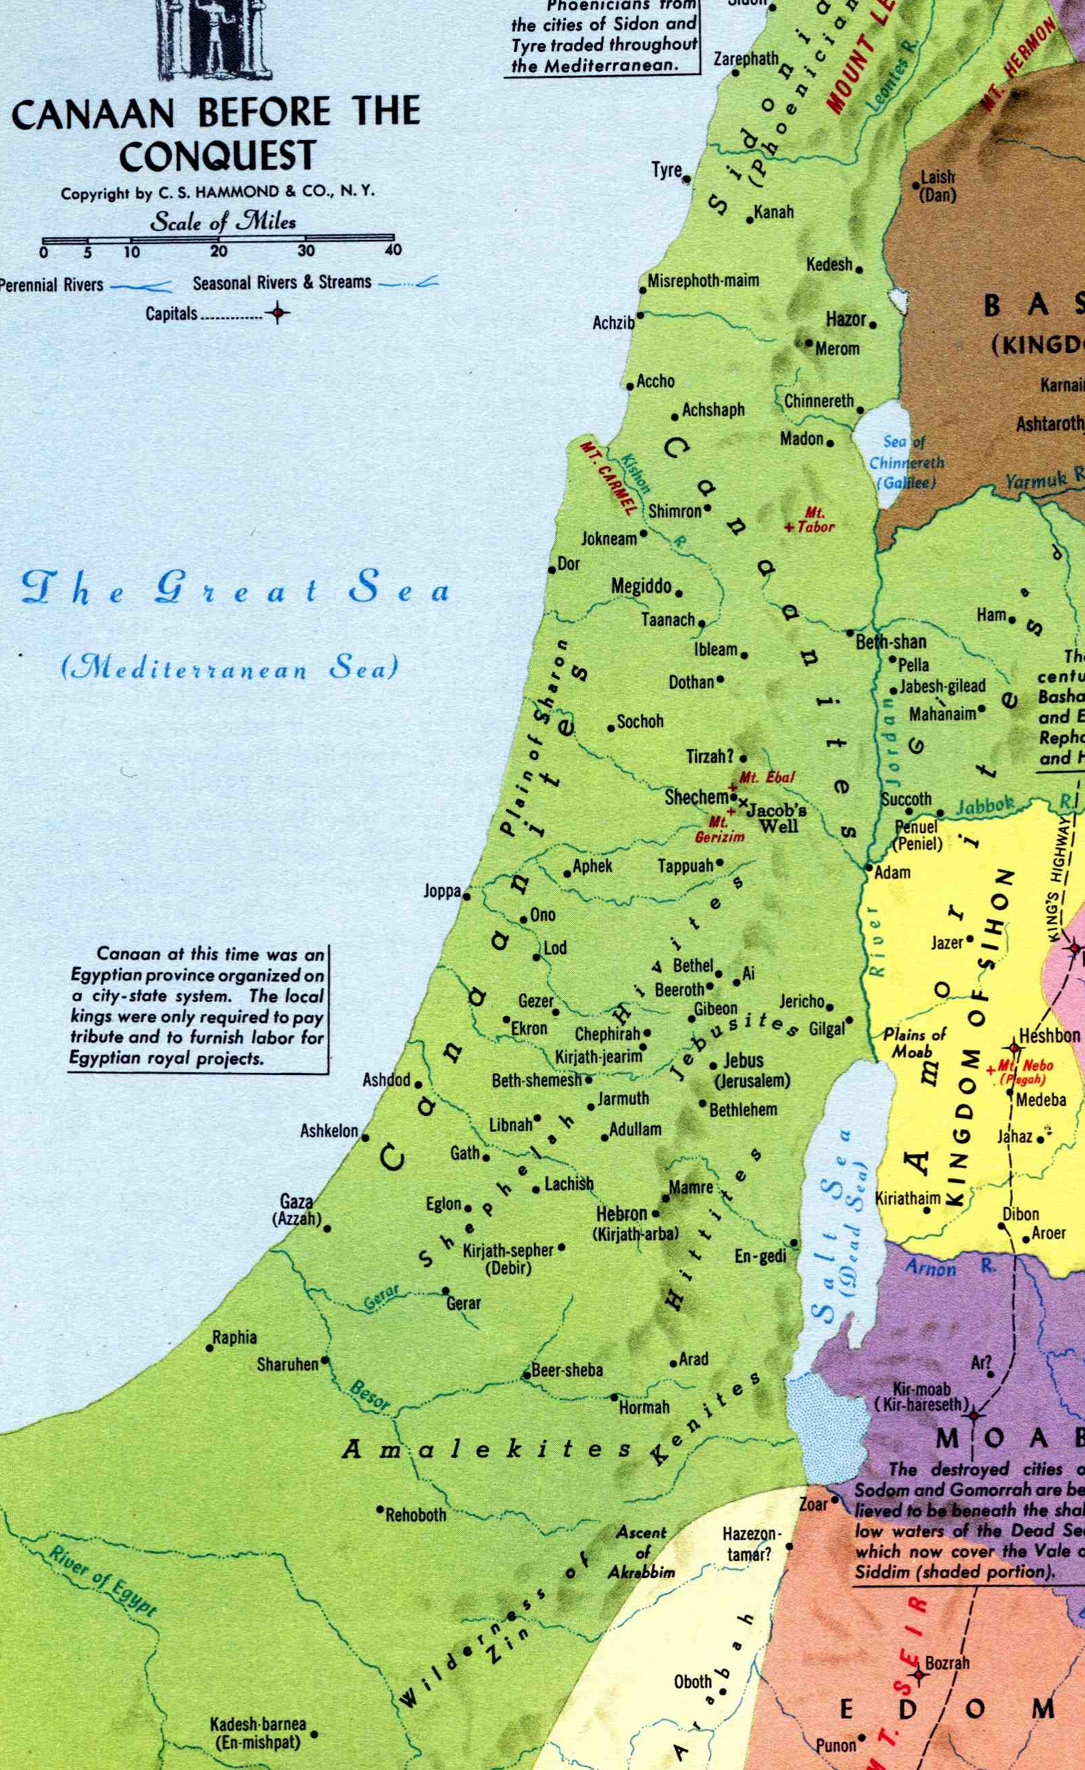
Israel and God’s rest – Ps. 95
Theme - Israel’s relationship to the Sabbath – There is much to learn.
The real meaning of the Sabbath was never obvious to God’s people – They missed the point and so can we!
Israel saw the Sabbath as an imposition - not an opportunity.
“They shall not enter into my rest”

Slide 3
The Sabbath – A holy day!
The day was of such outstanding importance because it so concisely symbolised both the character and the ultimate end of God’s purpose with Israel. It bore expressive witness as “the sabbath of rest” that He had redeemed them with the aim of giving them rest from sin’s bondage, repose after the toil of mortality.
Law and Grace pg. 135

Slide 4
The Sabbath
To act as though the day was not holy to them would be to do despite to their calling - would be equivalent to a repudiation both of the privilege of membership of the covenant people and the unparalleled responsibility which went with it.
As men treated God, so He would treat them. Those who by their attitude and actions treated their covenant status as of little worth would forfeit it by death.
Law and Grace pg. 135

Slide 5
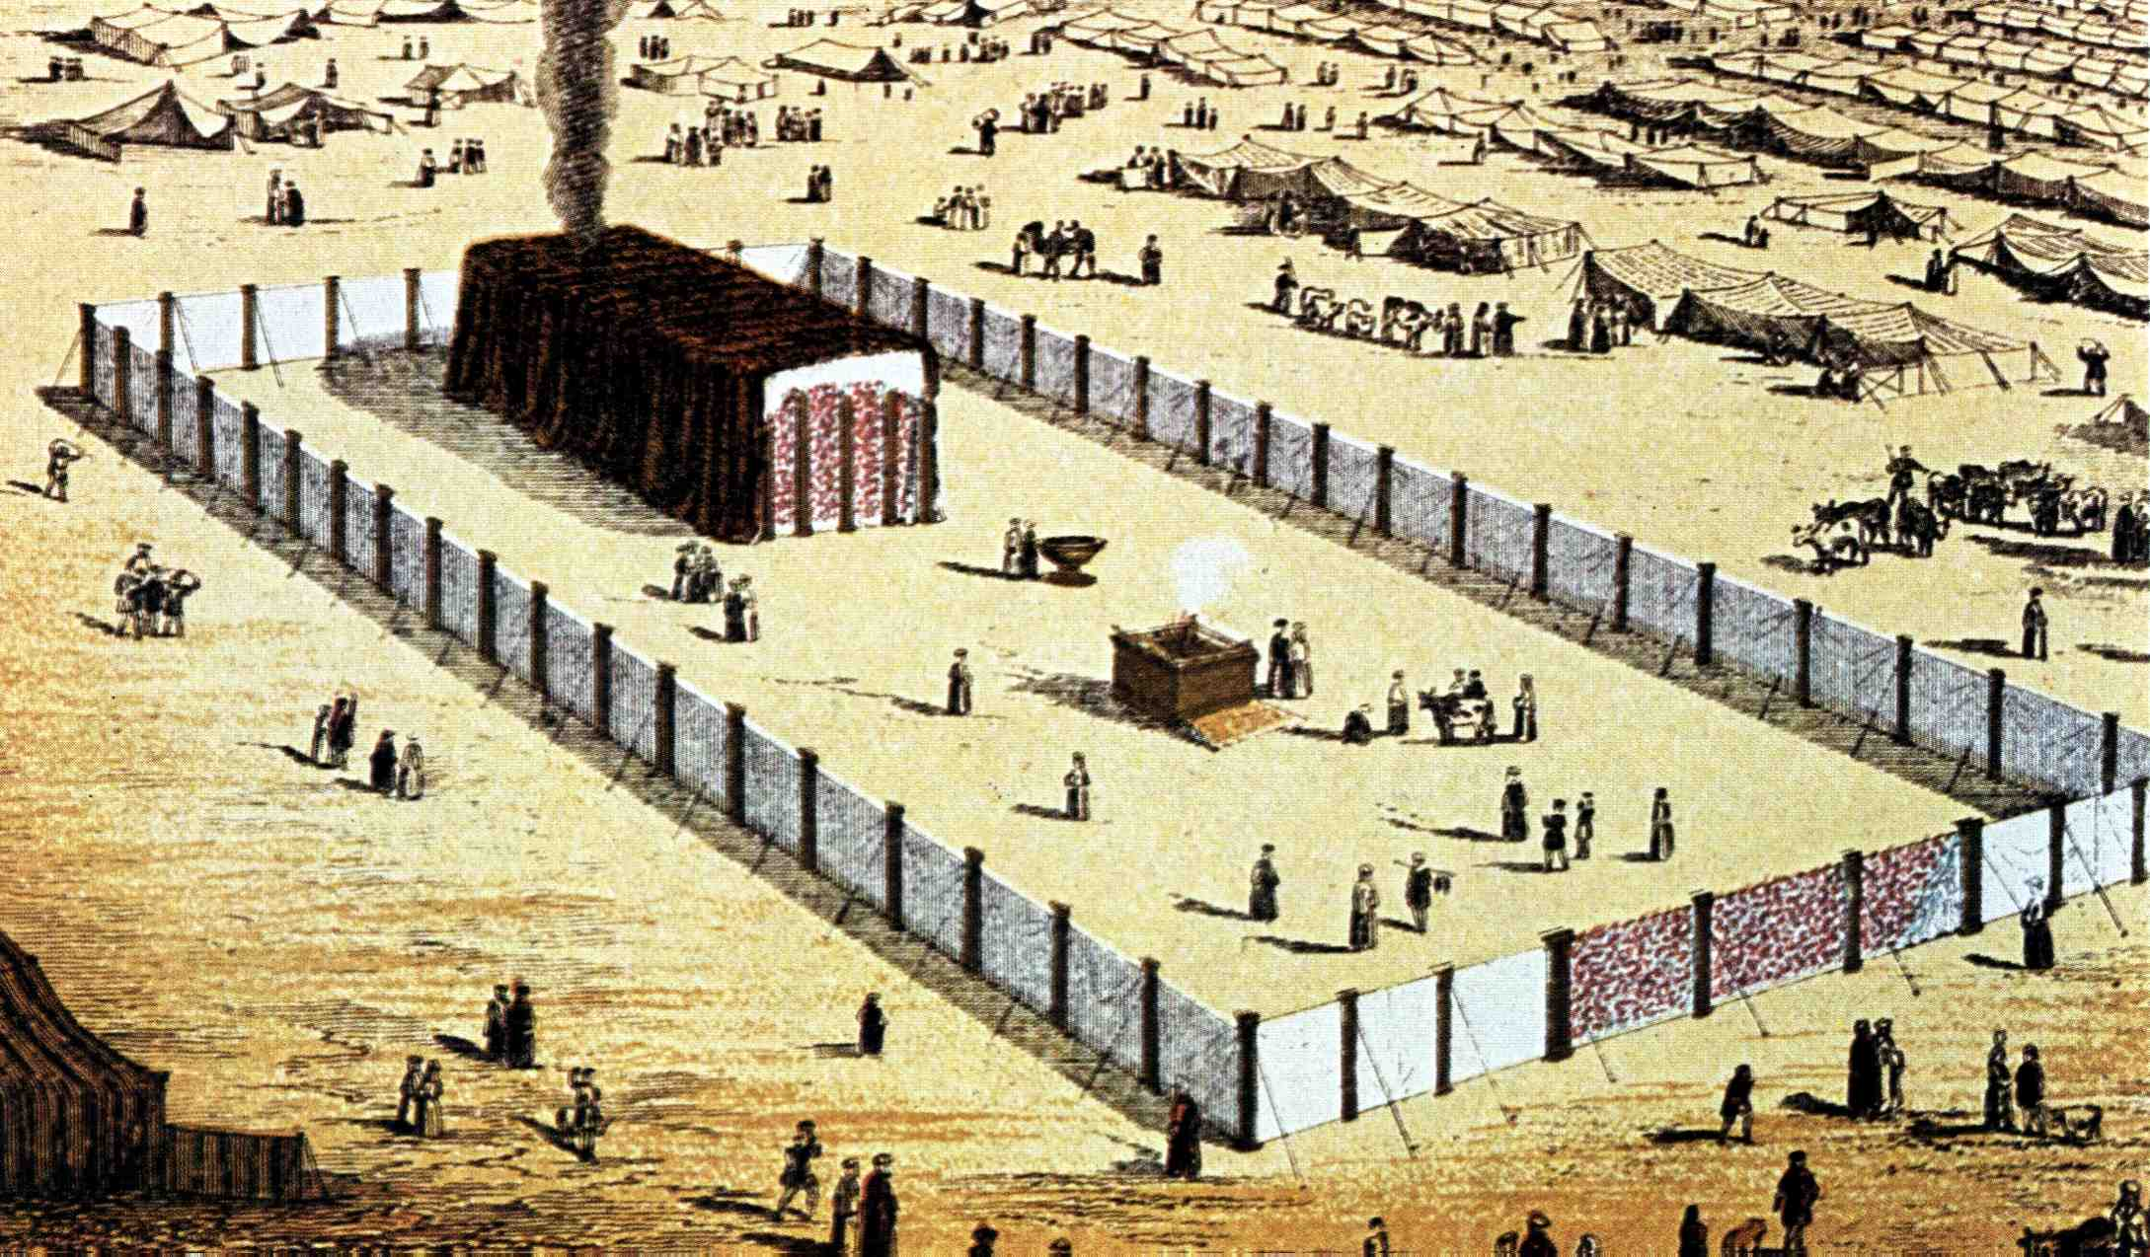
The dominant position of the Sabbath in Israel’s life
Ex. 31:12-17 – The law of the Sabbath – Related to the name of Yahweh.
Deut. 5:12-15 – Key to the Sabbath was “to do” God’s will on that day – activity!
V.15 – “keep” - asah – to do, work, act, make.
Ezek. 20:10-26 – Keep the Sabbath – Live in the commandments.

Slide 6
The principle of the Sabbath
Luke 11:21-26 – Context shown by V.20 – cites Ex. 8:19 – Wilderness wandering.
Christ paraphrases the experience of Israel’s exodus from Egypt.
Israel never filled the vacuum of life in Egypt with positive activity for God.
Principle – Rom. 12:21 – “Be not overcome of evil, but overcome evil with good.”
V.26 - “seven other spirits” – Implies the principles of the Sabbath ignored.

Slide 7
Two-fold purpose of the Sabbath
Ex. 12:14-20 – Passover followed by the Feast of Unleavened Bread – Corruption free.
Note use of seven – Total rest from sin to the Kingdom.
Ex. 16:22-30 – Manna of Sabbath did not corrupt – Principle established.
Lev. 23:39-43 – Labour permitted to enable rejoicing.
Deny corruption every day
Live in hope
Rejoice doing God’s work
Deut. 28:47

Slide 8
Why Israel could not enter into God’s rest
Num. 14 – Condemned by Yahweh’s oath – Life and death sharply contrasted.
Ps. 95:8-11 – 40 years “kept feeling a loathing” – No menuchah for them.
Num. 15:32-36 – The tragedy revealed in the man gathering sticks on the Sabbath.
Microcosm of the condemned generation – one of few recorded incidents in 40 years.
Context V.1-2 – Appeal to new generation to match profession with performance.

Slide 9
A sweet savour unto Yahweh Num. 15
The phrase occurs 6 times in the chapter (v.3,7,10,13,14,24).
“sweet” - reyach - odour (as if blown); fragrance.
“savour” - niychoach - restful, i.e. pleasant. First occ. is Gen. 8:21 and last Ezek. 20:41. See also use in Num. 28:2.
Lit. - “a fragrance of rest”. The meaning is that when men serve God faithfully He can be at rest (cp. our children!).
Note Gen. 6:3-7

Slide 10
A sweet savour unto Yahweh Num. 15
niychoach is from the root nuwach - to rest, settle down. Used of attaining rest in the Land - Josh.21:44; 22:4; 23:1; Ex.33:14; Deut.12:10, and of God's rest on the Sabbath - Ex.20:11. Other sig. occs. Ex.17:11; Ezek.40:2.
A cognate word menuchah is used Ps.95:11; 132:8,14; Num.10:33; Isa.11:10; 32:18.

Slide 11
Final redemption for Israel in Sabbath – John 5:1-18
Third Sign of John’s Gospel – The impotent man healed at Bethesda on the Sabbath – V.9-10.
“Bethesda” – from Hebrew bayith chesed – “house of loving-kindness” (Ex. 34:6) with 5 porches = grace.
Jesus came looking for just one man – deliberately healed then escaped – V.13.
38 years – vital clue – represented Israel languishing in the wilderness – V.5.

Slide 12
Final redemption for Israel in Sabbath – John 5:1-18
V.3 - “waiting for the moving of the water” – Israel on the border of the Land ready to cross Jordan.
V.6 – “Wilt thou” – Lit. – “Are you willing?” This is the key issue of the Sabbath.
“whole” – hugies – sound, healthy, whole (6 occs. in context; 7 in book, all of this sign).
V.17 – Weymouth – “My Father works unceasingly, and so do I.”

Slide 13
The sequel
John 7:21-24 – Israel’s misunderstanding of the Sabbath law.
V.21 – “I have done one work” – Refers to John 5:1-18.
V.22 – “ye on the sabbath day circumcise a man” – i.e. cut off flesh to keep law.
V.23 – “every whit whole” – holos hugies – Lit. “all whole”; i.e. fully restore.
The principle of the Sabbath is to be positive; to seek to restore and build up – to do God’s work.

Slide 14
Next Study
(God willing)
Study 3
“Call the Sabbath a delight”

Slide 15
… ….
...

