Slide 1
“The Sabbath – Its Prophecies, Principles and Prospects”
Study 3
“Call the Sabbath a delight”

Slide 2
Delighting in the Sabbath Isa. 58:13-14
Attitude to the Sabbath principle will ultimately determine our destiny.
Is it an “exquisite delight” or a nuisance?
V.13 – “turn away thy foot” – i.e. refrain from going one’s own way. This whole context revolves around the hand!
“delight” – oneg – exquisite delight (Roth.).
“him” – Roth. & Ygs. Lit. – “it”.
V.14 – Roth. – “Then, shall then rest thine own exquisite delight upon Yahweh…”

Slide 3
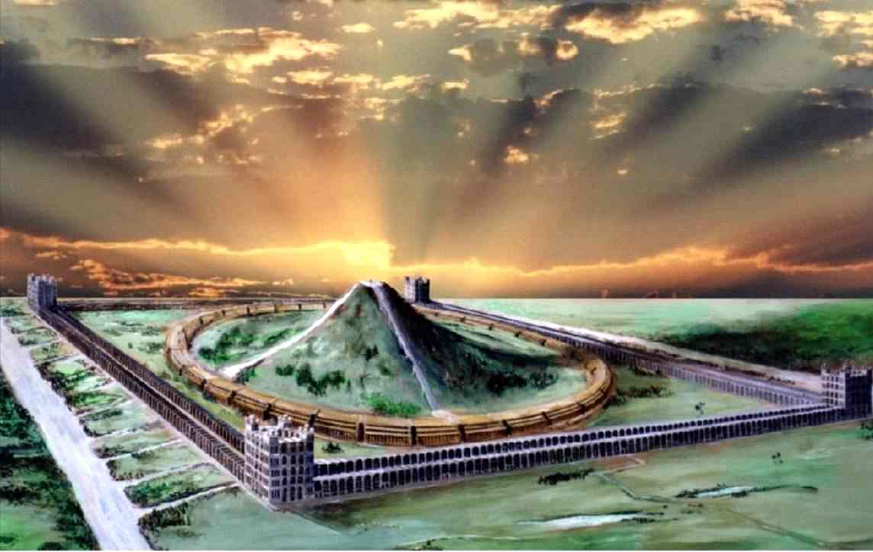
The Sabbath and the hand Isa. 56:1-8
V.2-3 – The words of Ps. 8 used – “the son of man” – laying hold – keeping hand.
V.4-6 – Outcasts and Gentiles choose the things of God and seize covenant.
V.7-8 – The reward – a place in God’s house of prayer in the Sabbath rest.

Slide 4
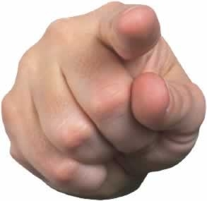

True fasting and Sabbath keeping Isa. 58:1-12
V.1-2 – Unsparing exposure of hypocrisy – appearances can be deceiving.
V.3-4 – Fist or fast – the figure of the hand emerges – note V.9 “finger”.
Cruel, mean-spirited, and lawless attitude represented by closed hand.
The accusing finger
“…to smite with the fist of wickedness”

Slide 5
A fist or a fast – Isa. 58:3-5
Self-centred worship and oppression replaced ‘rest’ to do good.
V.3 – Roth. – “Lo! in the day of your fast, ye take pleasure, But all your toilers, ye drive on!”
Luke 18:12 – Ludicrous scenario! (“one day”). Pharisees fasted twice a week – Monday and Thursday. These were occasions for sanctimonious display and public piety.
V.5-7 – The acceptable fast (7 occs.) – use the open hands for good and positive things.

Slide 6
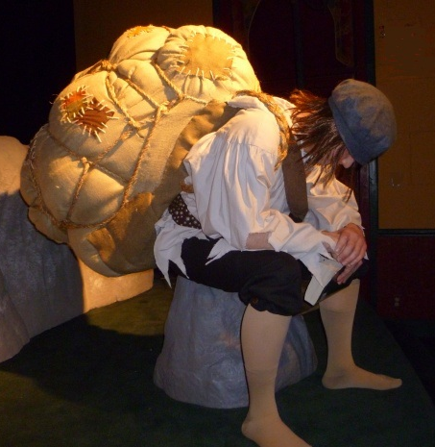

True fasting and Sabbath keeping Isa. 58:6-7
Exercising dominion over these evils impossible with clenched fist.
V.6 - “loose” – pathach – to open wide. Used Deut. 15:8,11 four times.
“undo” – nathar – to leap up to unloose.
“heavy” – motah – pole; bar of the yoke. 1st occ. Lev. 26:13 “bands”; Ezek.
30:18.

Slide 7
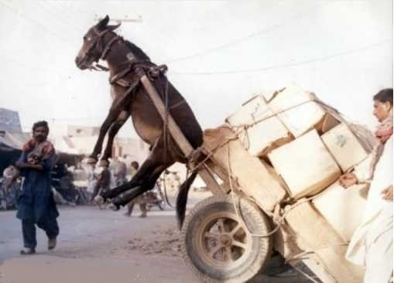
Things impossible with fist or finger
nathar – to leap up to unloose.
“break every yoke”
“undo the heavy burdens”
“let the oppressed go free”

Slide 8
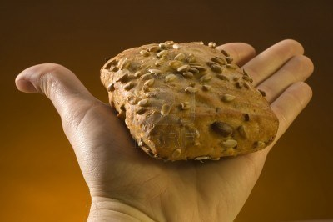
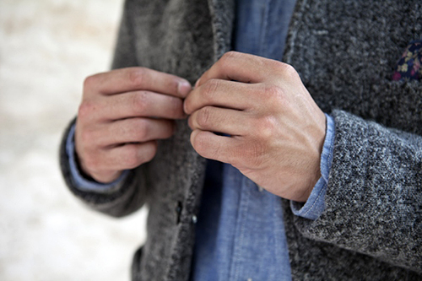
Acts of the open hand – Isa. 58
V.7 – “deal” – paras – to divide, break in two. Cp. Mark 14:22.
“cast out” - marud – straying, wanderers, refugees.
“hide” – alam – to veil from sight; conceal.
“...deal thy bread to the hungry”
How can clothing be removed with a clenched fist or pointing finger?

Slide 9
The Sabbath character – Isa. 58
V.8-12 – Rewarded in kind – Positive, effusive, dynamic superlatives.
Double epithet for the positive and selfless builders of the house:
Repairer of the breach
Restorer of paths to dwell in.
“repairer” – gadar – build a wall; to wall in. See use Ezek. 13:5 (“made up’); 22:30 (“make up”).
Roth. – “A Repairer of broken walls, A Restorer of paths leading home.”

Slide 10
Christ’s teaching about the blessedness of giving Acts 20:35
“I have shewed you all things, how that so labouring ye ought to support the weak, and to remember the words of the Lord Jesus, how he said, It is more blessed to give than to receive.”

Slide 11
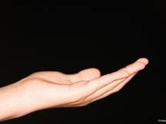

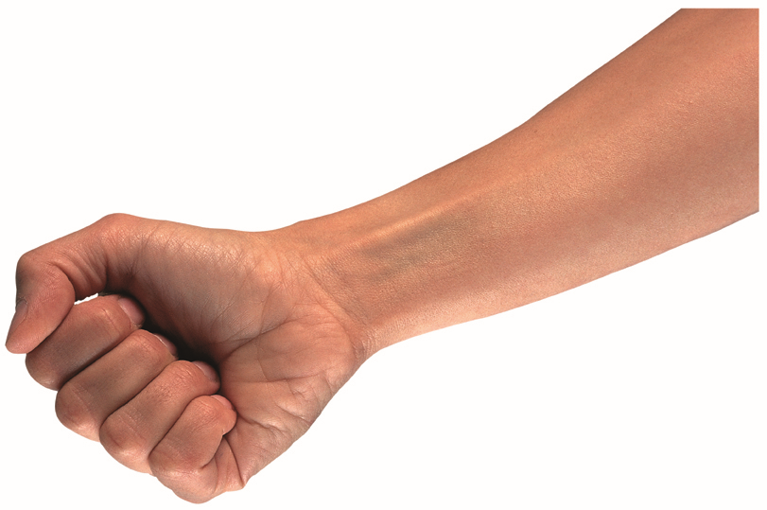
Yahweh’s hand is not shortened Isa. 59
Yahweh’s opened hand (v.1) contrasted with Israel’s hands (V.3-6) – clenched fist.
V.16 – Yahweh’s open hand on his outstretched arm represents Christ.
Shortened hand
“...the act of violence is in their hands”

Slide 12
The open hand in the Sabbath year Deut. 15
The use of words six times in chapter – “release” (6 occs. of verb and noun); “poor”, “hand” (yad), and “bless” (barak).
V.1 & 12 - Required to open wide the hand in the Sabbath year – servant entering seventh year of service – Ex. 21:2.
The Sabbath had to be lived – not just kept!

Slide 13
Open wide thine hand - Deut. 15
V.8 & 11 – “open...wide” – pathach – to open wide; let loose. The word occurs twice in the text in both verses. ISA – Lit. “to open, you shall open...”
The roots of James found here:
V.5 – Basis of James 1:23 (“doers of word”);
V.9 – Allusion – James 5:4 (wages kept back);
V.13 – Allusion – James 2:14-16 (things needful);
V.14 – “liberally” – James 1:5.
V.19-21 – Interesting juxtaposition of ideas – withered and blemished refused.

Slide 14
Warning for the final generation Matt. 24:45-51
V.45 – Wise and faithful shown by open hand to feed and provide ‘therapy’.
“household” – therapeia - service rendered by one to another, including medical assistance (4 occs. 2 x “healing”).
Cited from Ps. 145:15-16.
V.48-51 – Danger of latter days - reversing our attitude to clench the fist to deny and bruise others.

Slide 15
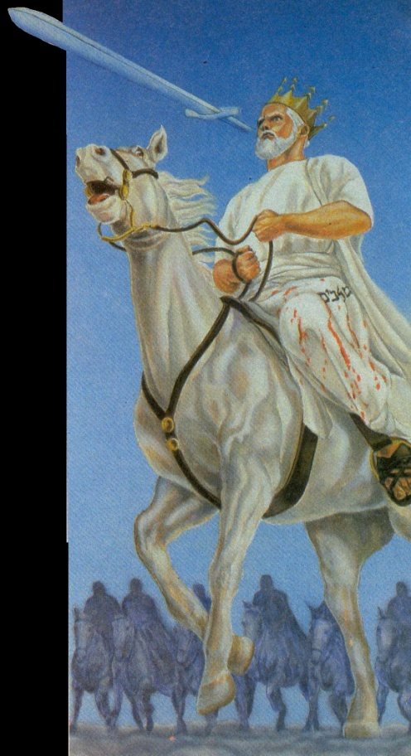
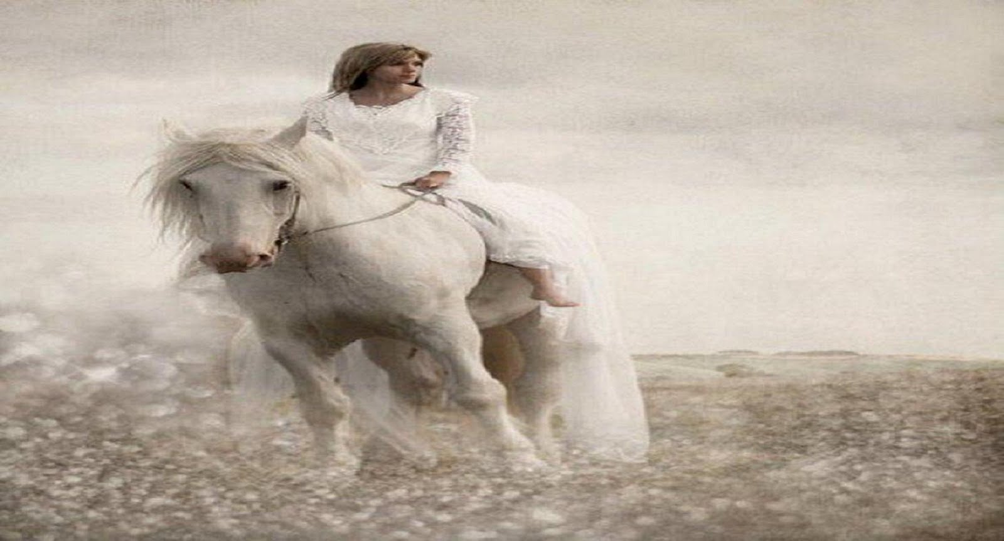
Reward to exercise dominion in Sabbath - Isa. 58:14
Riding the high places – Deut. 32:13; 33:26-29; Hab. 3:19; Rev. 19:11-16 – context is Armageddon.
“…and he will make me to walk upon mine high places.” – Hab. 3:19

Slide 16
Open wide your hand!

Slide 17
Next Study
(God willing)
Study 4
“The Son of man is Lord of the Sabbath”

Slide 18
… ….
...

