Slide 1
“The Sabbath – Its Prophecies, Principles and Prospects”
Study 4
“The Son of man is Lord of the Sabbath”

Slide 2
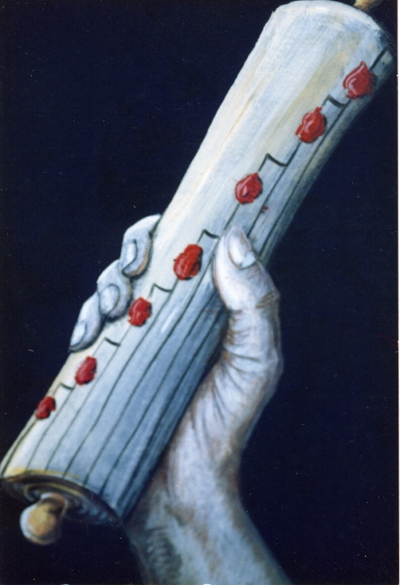
The Lord’s course set at Nazareth - Luke 4:16-19;29-31
Mind in Isaiah on the Sabbath day – Quotes Isa. 61:1-2 but with echoes of Isa. 58, 59 – releasing captives, etc.
Allusion also to Isa 29:11-12 – “And the vision of all is become unto you as the words of a book that is sealed, which men deliver to one that
is learned, saying, Read this, I pray thee: and he saith, I cannot; for it is sealed: And the book is delivered to him that is not learned, saying, Read this, I pray thee: and he saith, I am not learned.”
Exercises dominion V.30 – Word was with power on Sabbath.

Slide 3
The context of Matt. 12:1-13
Context 3 Sabbaths – Luke 6:1 – Subject is the Sabbath – Matt. 11:25-30.
V.3-5 - David exercised dominion on the Sabbath like priests.
V.6-8 - Hos. 6:6 – “For I desired mercy, and not sacrifice; and the knowledge of God more than burnt offerings.” – Knowledge of God (Jer. 22:15-16) – Mercy = Positives (Sabbath) – Sacrifice = Negatives.
V.9 - “Their synagogue” – Their attitude represented by man with withered hand.

Slide 4
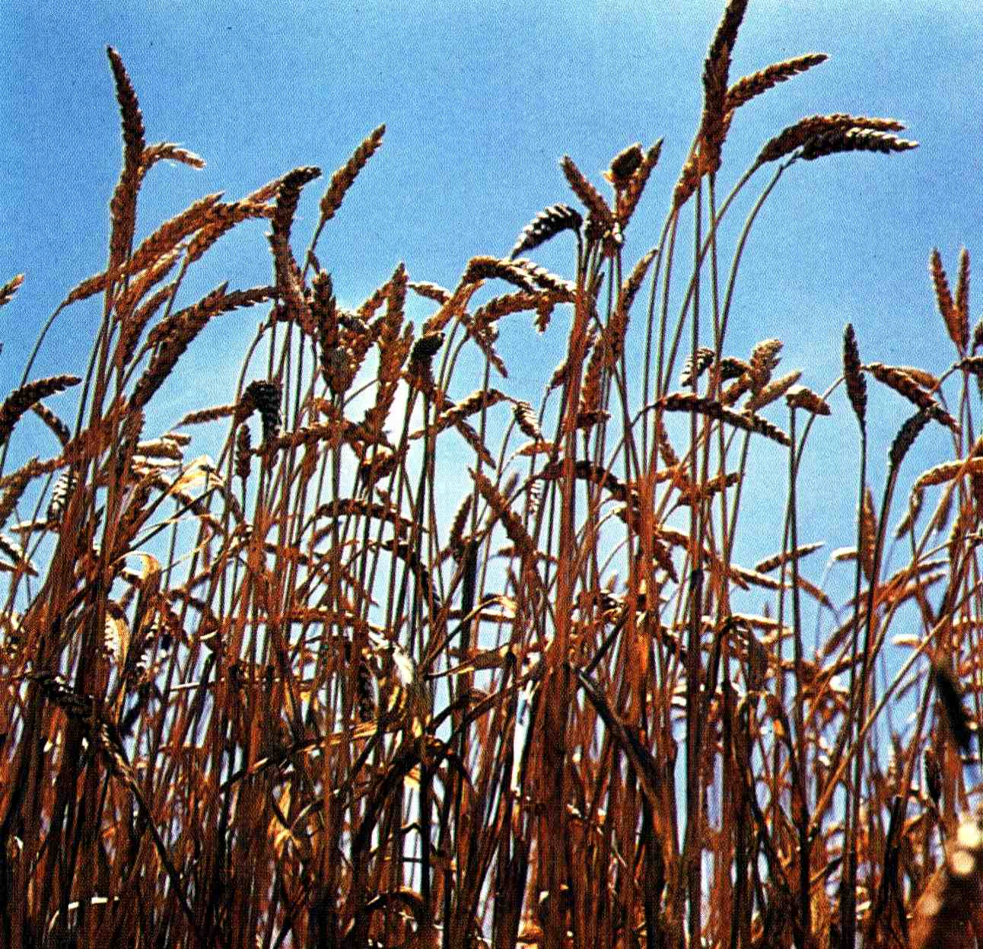
The Sabbath and Jewish law
Rabbinical law stated – “He that reaps (on the Sabbath day) ever so little, is guilty (of stoning), and plucking of ears of corn is a derivative of reaping.”
Jewish law prohibits doing any form of “work” (melakhah = “deliberate activity”). The 39 categories of work include plowing earth, sowing, reaping, binding sheaves, threshing, winnowing, selecting, grinding, sifting, etc.

Slide 5
David exercised dominion
Mark 2:26 – “How he went into the house of God” – On a Sabbath – 1 Sam. 21:4-6 (Mgn.); Lev. 24:8; 1 Chron. 9:32.
“not lawful to eat” – Ex. 29:32-33.
“for the priests” – Lev. 24:5-9.
David had been anointed king of Israel – 1 Sam. 16:1,13. His understanding of the role of the Melchizedek order was unique – 2 Sam. 6:12-19.
With an eye on the future David exercised dominion on the Sabbath day.
“over the shewbread, to prepare it every sabbath”

Slide 6
The Son of man is Lord of the Sabbath – Mark 2:27-28
V.27 – Diag. – “The sabbath because of the man was made, not the man because of the sabbath.” Based on Gen. 1:26,28 – Christ the “last Adam”.
“for” – dia – through. IB – “on account of”.
The Sabbath ruled Jewish life and exercised dominion over them.
Pointed to the Kingdom and triumph over carnality – “Therefore” V.28. Imperative that ‘the last Adam’ be supreme in authority (kurios) over the Sabbath.

Slide 7
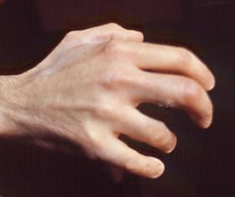
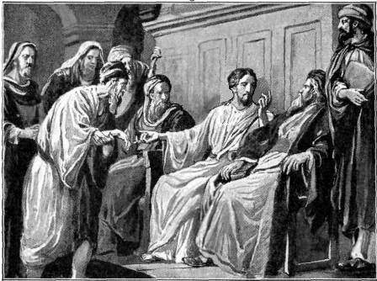
Exercising dominion on the Sabbath day – Matt. 12:10-13
Luke 6:8 – “stand forth in the midst” – See also Mark 3:3 – A microcosm of all present with their withered minds.
Jeroboam – “...and his hand, which he put forth against him, dried up, so that he could not pull it in again to him.”
Ps. 137:5 - If I forget thee, O Jerusalem, let my right hand forget her cunning.

Slide 8
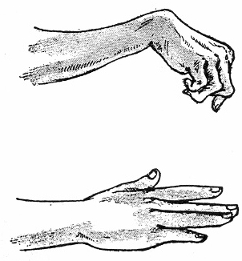
Exercising dominion on the Sabbath day – Matt. 12:10-13
Appropriateness of man unable to work or help others restored on Sabbath.
Moral imperative to heal on Sabbath – exercise dominion – Ps. 8 (11:25-27).
V.13 – “Stretch forth thine hand” – Diag. – “Stretch out the hand.” The ‘clenched fist’ becomes an ‘open hand’.
Isa. 58 illustrated

Slide 9
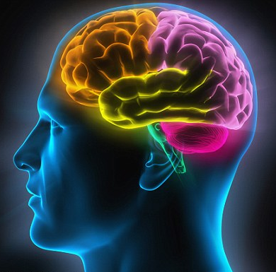

The Pharisee’s mind! – Matt. 12:14
Matt. 12:14 – “Then the Pharisees went out, and held a council against him, how they might destroy him.”

Slide 10
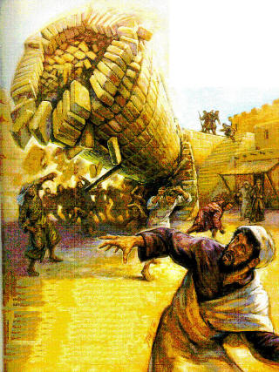
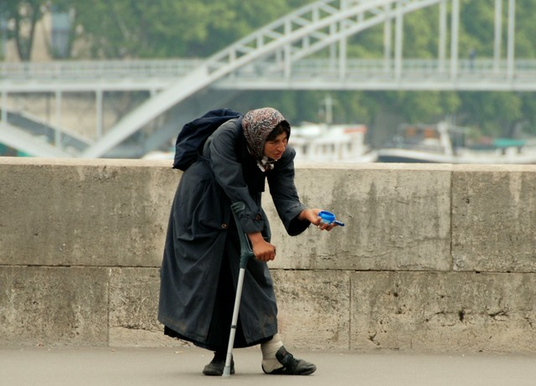
The crippled woman loosed on the Sabbath – Luke 13:11-17
“Infirmity” = weakness of flesh. 18 is the vital link with V.4 – shared same destiny.
18 victims of Tower of Siloam died instantly thrust to the ground – the woman glacially heading the same way.
Osteoporosis – Not uncommon among aged women

Slide 11
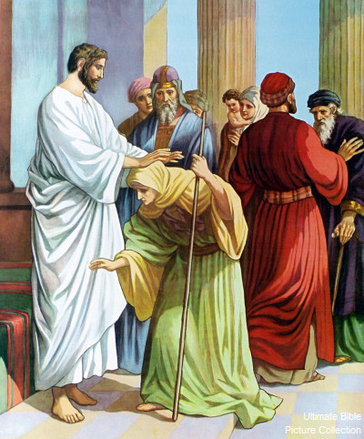
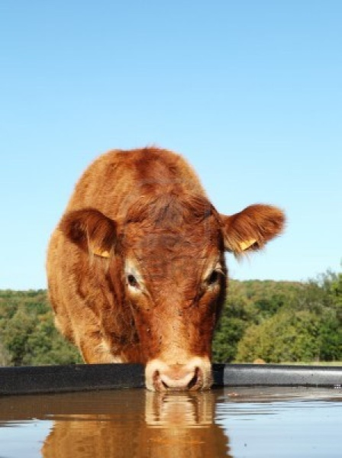
The crippled woman loosed on the Sabbath – Luke 13:11-17
V.13 - Jesus uses his hands to straighten her and unloose the heavy burden.
V.15 - They exercised dominion over animals (Israel) on Sabbath out of self-interest.

Slide 12
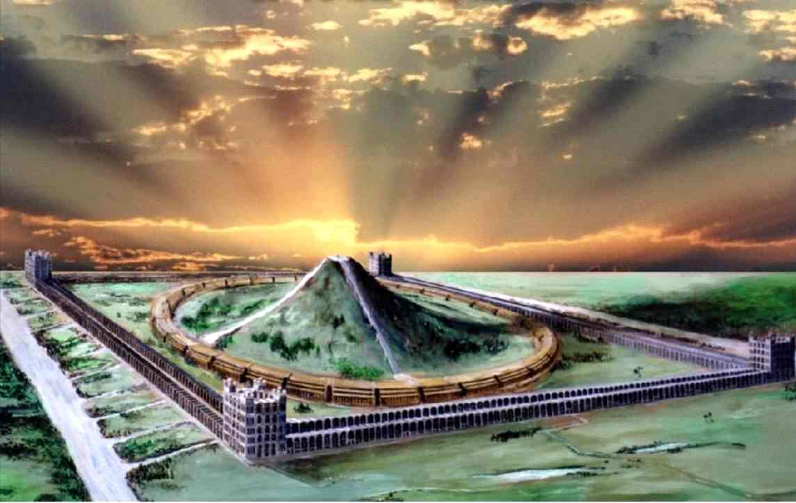
The crippled woman loosed on the Sabbath – Luke 13:11-17
Imperative to loose this woman on the Sabbath – she was a microcosm of the whole race, all of whom are inexorably descending to the grave.
Context the Kingdom V.18 – Quotes Ps. 118:24 in V.35 (refers to the Millennium – the Sabbath Day).

Slide 13
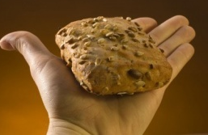
The exhortation for us
Isa. 58:6 - “Is not this the fast that I have chosen? to loose the bands of wickedness, to undo the heavy burdens, and to let the oppressed go free, and that ye break every yoke?”
Let us exercise dominion over carnality now in prospect of the Sabbath day.
Let us use the ‘open hand’ to assist our brethren and sisters to bear their burdens.
It’s all in the mind!

Slide 14
Next Study
(God willing)
Study 5
“The Sabbath was made for man”

Slide 15
… ….
...

Slide 16
The title “The Son of man”
Refers to delegated divine authority – not primarily to his humanity – Ps. 8:4; 80:17.
John 5:17-30 – Delegated to exercise dominion over sin – Luke 5:24.
85 occs. N.T. (32 Matt., 15 Mark, 26 Luke, 12 John) – 92 “son of man” in Ezekiel.
Based on assumption by last Adam of dominion lost by first Adam to sin.
Additional proof – Matt. 9:5-8; 16:13-16; 26:63-64.

