Slide 1
“The Sabbath – Its Prophecies, Principles and Prospects”
Study 5
“The Sabbath was made for man”

Slide 2
The aims of this study
Focus now on prophecies and prospects – we have established the principles.
But first a look at the final disputes over the Sabbath – it is illuminating.
We will consider how the Sabbath was on the mind of Christ as he entered Jerusalem for the last time.
Finally, we will reflect on the exhortations for the final generation of believers.

Slide 3
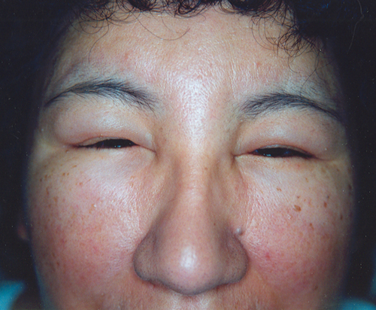
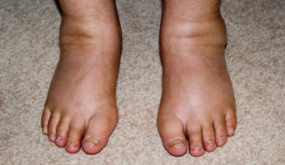
The dropsical man healed on the Sabbath – Luke 14:1-6
V.1-2 – Confronted by a deliberate plant – The disease of Dropsy – typical of man.
“dropsy” – hudropikos – dropsical (as if looking watery).
The ugly manifestation reveals a deeper sickness in heart, liver, and kidneys.
Dropsy

Slide 4
The dropsical man healed and released – Luke 14:3-4
V.3 – The crux of the issue – heal or refrain – They “rested” Luke 23:56.
V.4 – “took” – epilambanomai - to lay hold of or to seize upon anything with the hands.
“let him go” – apoluo – to free fully; release.
Jesus used his hands to fully release him - in two ways – from them and the effects of mortality.

Slide 5
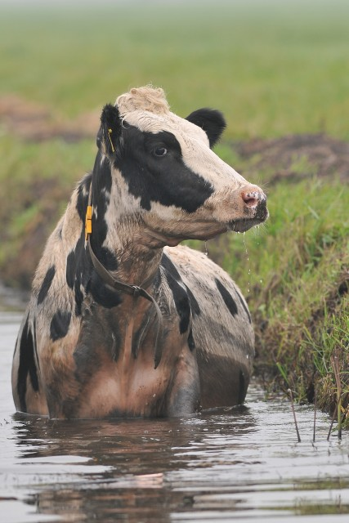
The hypocritical Pharisees silenced– Luke 14:5-6
The enemy silenced but not transformed – “again” Cp. Luke 13:17.
“ass or an ox” – Symbols of Israel.
V.5 – “fallen” – empipto – fallen into; be entrapped by.
“straightway” – eutheos – directly; at once. Out of self-interest.
“answer” – antapokrinomai - to contradict in reply.

Slide 6
The man born blind healed on the Sabbath – John 9:1-7
The broad issues of the Sabbath – Its prospects for the whole race – 6th sign.
Man is a microcosm of the race – cured of blindness on the 7th Day – V.14.
V.3-4 - “Works” of God on the Sabbath – To bring ‘light’ to mankind by Word – Isa. 8:6.
V.6 – New creation – resumes the work of the angels – clay washed away by Word.

Slide 7
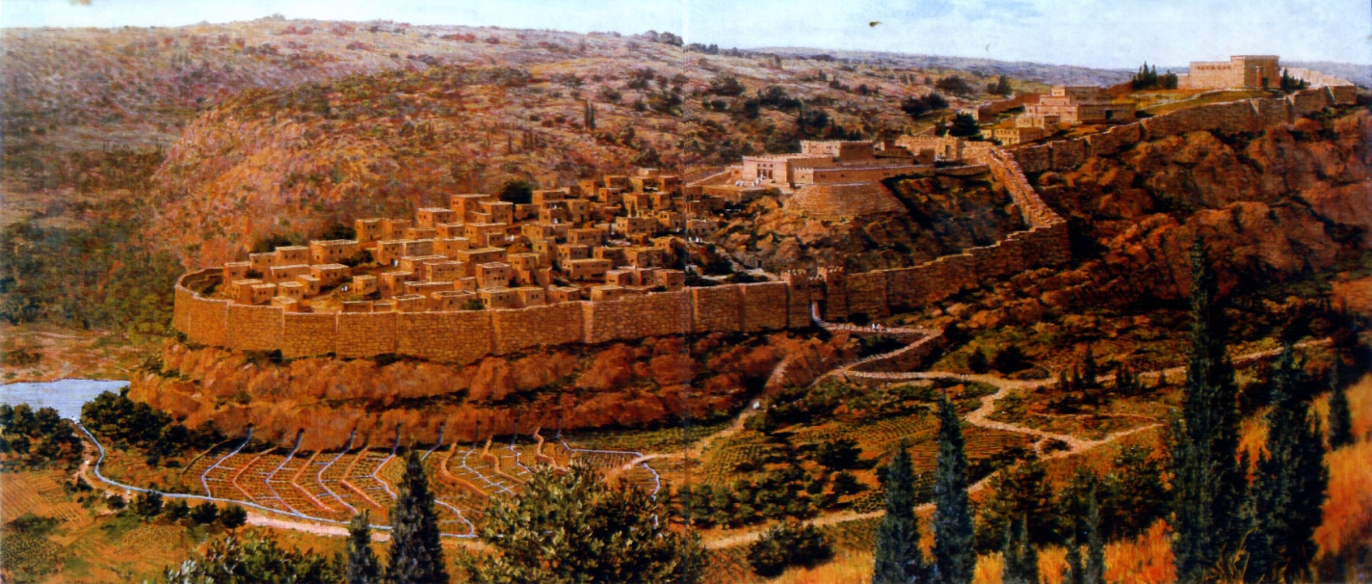
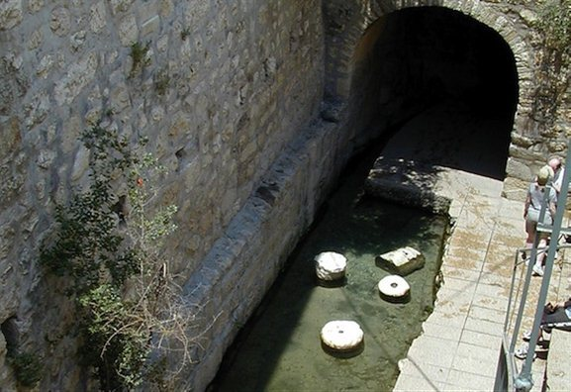
The pool of Siloam
V.7 – “Siloam” – “Sent”. The N.T. name for Shiloah (Isa. 8:6).
Isa. 8:6 – “refuseth” – ma’as - reject, spurn, despise.

Slide 8
This is the day which Yahweh hath made - Ps. 118:19-29
Context Armageddon – V.10-16, 21, 28 quotes from Ex. 15:2, 6 (Rev. 15:3).
V.19-20 – The saints enter gates to exercise dominion in government.
V.21-22 – Salvation for spiritual Israel in the Kingdom – note citations (Mark 12:10).
V.23-24 – The righteous to see the Day – Sabbath of rest for rejoicing.

Slide 9
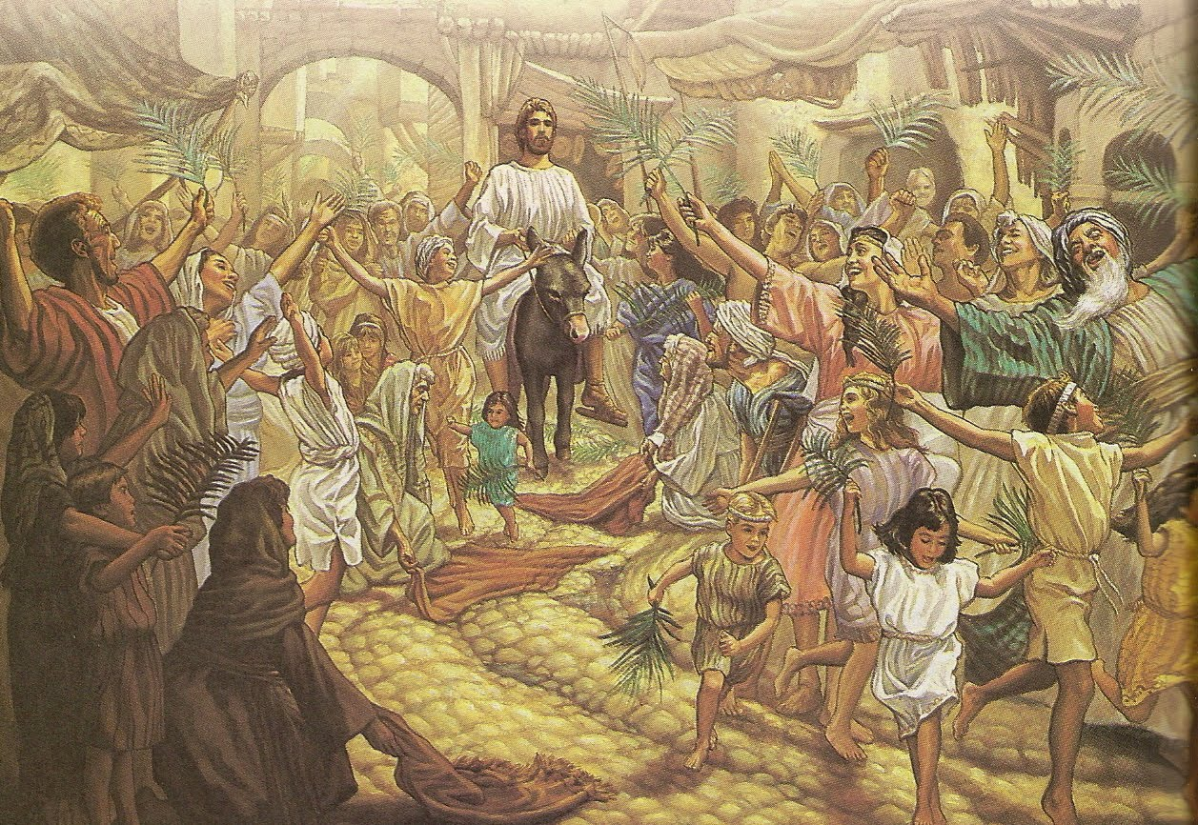
This is the day which Yahweh hath made - Ps. 118:19-29
V.25-26 – Hosanna – Mark 11:9-10 – Triumphant entry into Jerusalem – Matt. 23:39.
Christ rides into Jerusalem on the colt the foal of an ass on the 10th of Abib (a Sabbath) to be inspected as “the Passover lamb”.
10 Sabbath 11 Sunday 12 Mon 13 Tues 14 Wednesday 15 Thu 16 Fri 17 Sat

Slide 10
The Sabbath on the Lord’s mind in last week – Luke 19:41-46
V.46 – Quotes from Isa. 56:7 and Jer. 7:11 – Why? Study the contexts = Sabbath.
V.41-44 – The Lord’s mind in Jeremiah – “peace” – Leprous house – Visitation.
Lev. 14:33-45 – Leprous house removed after 3 visitations – V.36,39,44.
Cp. Jer. 6:6,11-16; 17:11, 14-15, 29; 8:10-12; 9:1,9,25; 10:15; 11:22-23.

Slide 11
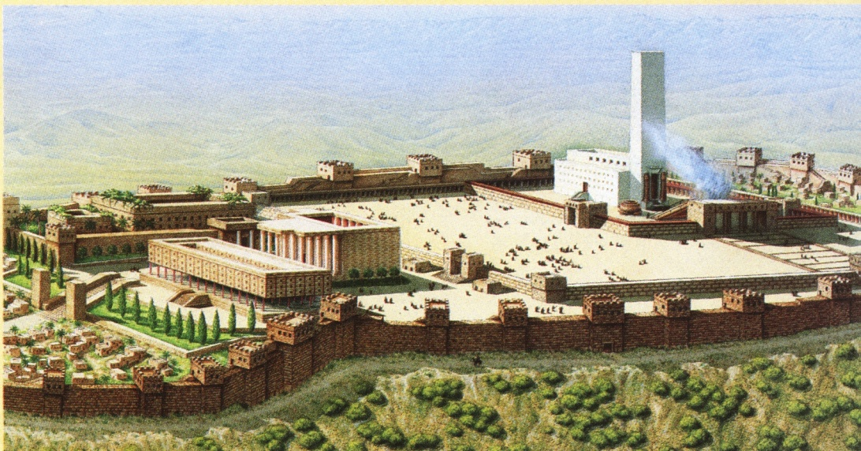
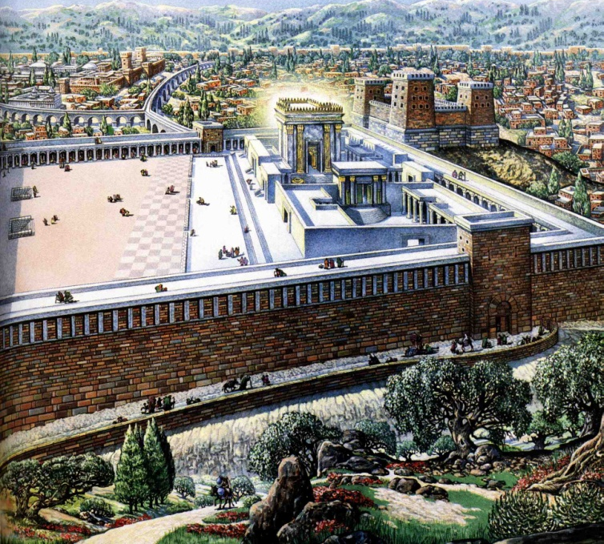
The Sabbath on the Lord’s mind in last week – Luke 19:41-46
Jer. 17:19-27 – Entry by gates (8 occs. – dominion) by true Sabbath keeping – 7 occs.
See the warnings of Neh. 13:15-22 (type of Second Advent) and Amos 8:5.

Slide 12
The promise of his coming 2 Pet. 3:3-14
“Creation” the context – V.4-5,13 – Key found in V.8 – Millennial days prefigured.
V.9,13 – The promise is in the days of creation – 6 ‘days’ given to man, then comes the Sabbath rest.
There must be a marriage of Christ to his bride before end of the 6th day – Gen. 1&2.
V.11-14 – What manner of persons ought we to be – urge on, use speed earnestly.

Slide 13
Let us labour to enter that rest - Heb. 4:1-11
Context Heb. 3 dominated by Ps. 95 – Entering rest – “Today” (5 occs.) time of grace.
V.4 – Sabbath Day – Some must enter V.6,8-9 to keep a Sabbath.
V.10-11 – Principles of the Sabbath – negative and positive.
Forsake own works to do God’s with diligence, haste and zeal.

Slide 14
“Diligent service with positive objectives is the only acceptable way of observing the Sabbath principle.”

Slide 15
“Call the Sabbath a delight”

Slide 16
… ….
...

