Slide 1
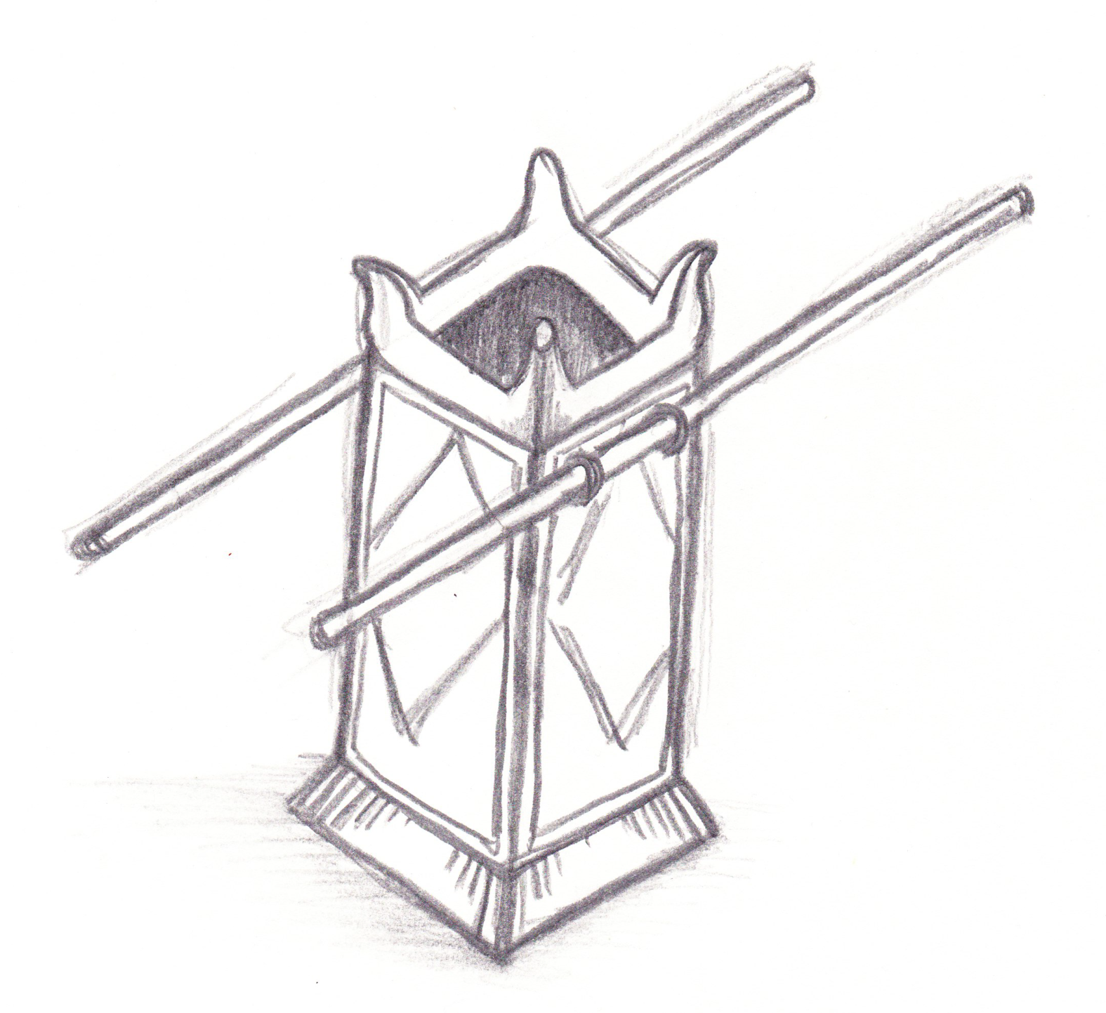
Two Men Went up into the Temple to Pray
Rogue River Bible School 2013
Isaiah Chapter 6

Slide 2
Two Men Went up into the Temple to Pray
Class 1 The Death of a Proud King
Class 2 The Song of a Humble Prophet
Class 3 The Purpose of Speaking Parables
Class 4 The Longsuffering of our Lord
Class 5 The Hope of the Holy Seed
Isaiah 6

Slide 4
The Death of a Proud King
Two Men Went up into the Temple to Pray
“In the year that king Uzziah died”

Slide 7
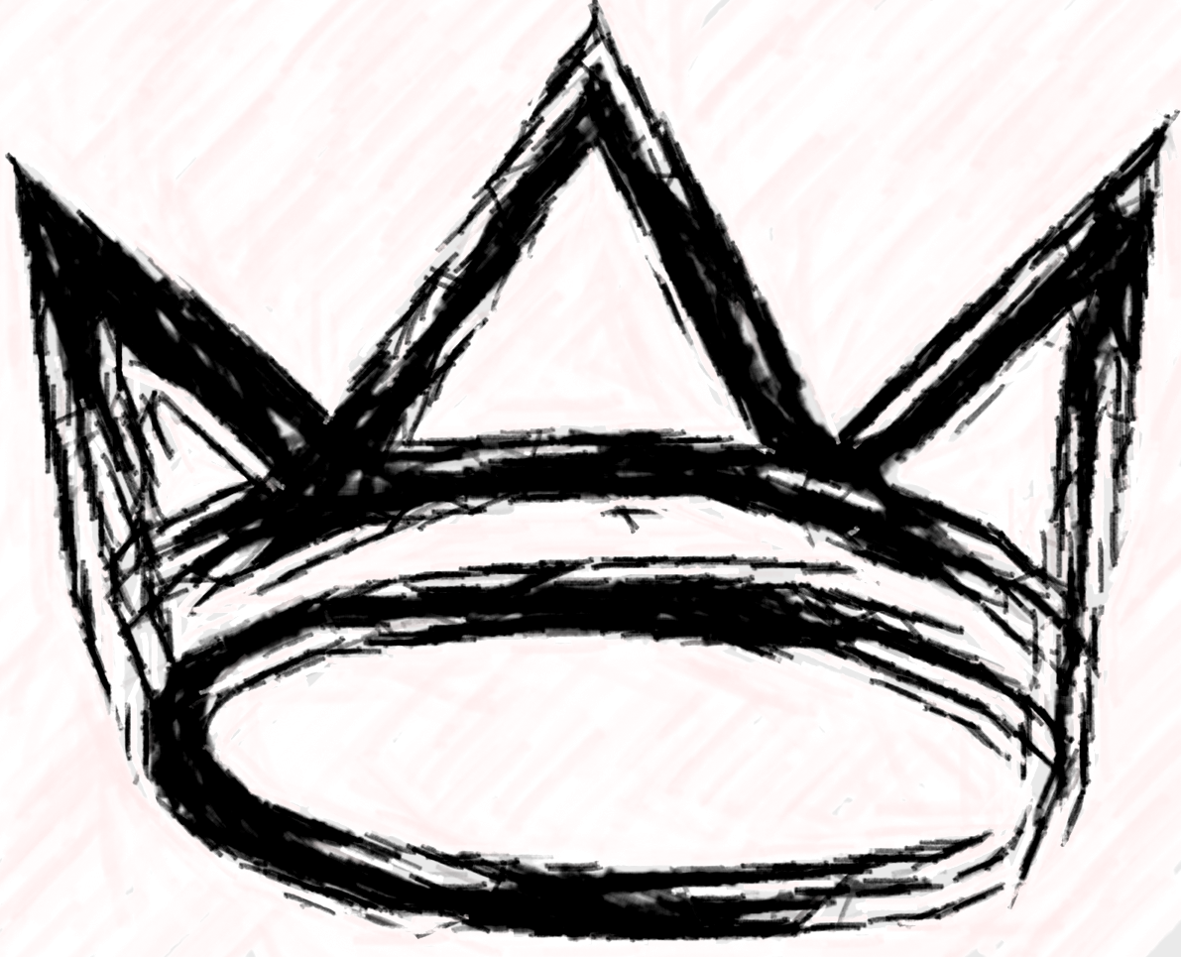
2 Chronicles 26
1-5 Uzziah’s Reign: Divine Summary
6-8 Breaking Down
the Walls of the Enemies
9-10 Building Up
the Land of Judah
11-15 Judah’s Military Strength
16-21 Uzziah’s Arrogance & Punishment
22-23 Uzziah’s Death & Burial
The Death of a Proud king

Slide 8
In the year King Uzziah died…
The King on his Throne
2 Ch. 26:1
The Priest after Melchizedek’s Order
2 Ch. 26:16
High and Lifted Up
2 Ch. 26:16,19
In the Temple
2 Ch. 26:16,21
The Death of a Proud King

Slide 9
In the year King Uzziah died…
With his Attendants
2 Ch. 26:17
Full of his Glory
2 Ch. 26:8,15
A Great Shaking
2 Ch. 26:20; Am. 1:1; Ze. 14:5
The Death of a Proud King

Slide 10
In the year King Uzziah died…
Approaching before Yahweh
2 Ch. 26:16
Burning Incense
2 Ch. 26:16-19
Answering Prayers
2 Ch. 26:19,21
Judgment on the People
2 Ki. 15:37; ct.
2 Ch. 26:6-15
The Death of a Proud King

Slide 11

Yahweh Sitting on His Throne…
The King on His Throne
2 Ch. 26:1 cp. Is. 6:1,5
The Priest after Melchizedek’s Order
2 Ch. 26:16 cp. Is. 6:1
High and Lifted Up
2 Ch. 26:16,19 cp. Is. 6:1
In the Temple
2 Ch. 26:16,21 cp. Is. 6:1
The Death of a Proud King

Slide 12
Yahweh Sitting on His Throne…
With His Attendants
2 Ch. 26:17 cp. Is. 6:2
Full of His Glory
2 Ch. 26:8,15 cp. Is. 6:3
A Great Shaking
2 Ch. 26:20; Am. 1:1; Ze. 14:5 cp. Is. 6:4
The Death of a Proud King

Slide 13
Yahweh Sitting on His Throne…
Approaching before Yahweh
2 Ch. 26:16 cp. Is. 6:5
Burning Incense
2 Ch. 26:16-19 cp. Is. 6:6
Answering Prayers
2 Ch. 26:19,21 cp. Is. 6:7
Judgment on the People
2 Ki. 15:37; ct. 2 Ch. 26:6-15 cp. Is. 6:9-13
The Death of a Proud King

Slide 15
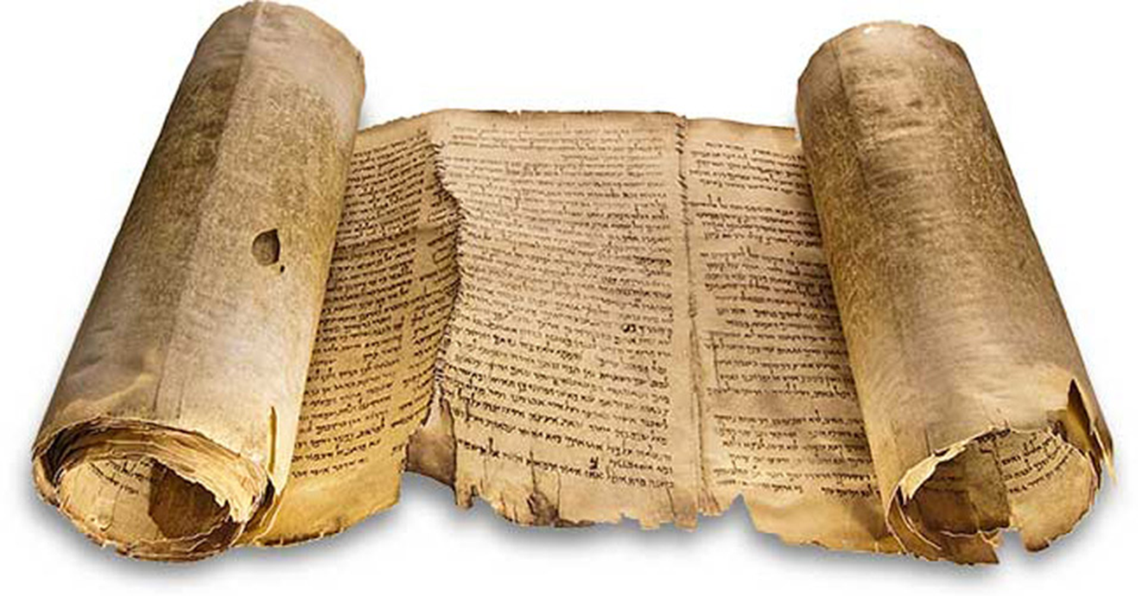
PRIDE
Proverbs
18:12
KJV
“Before destruction the heart of man is haughty, and before honour is humility.”

Slide 16
PATIENCE
Ecclesiastes
7:8
KJV
“…the patient in spirit is better than the proud in spirit.”

Slide 17
SELF-CONTROL
Proverbs
16:32
KJV
“He that is slow to anger is better than the mighty; and he that ruleth his spirit than he that taketh a city.”

Slide 18
see also
Ps. 119:133
Ps. 19:13
SELF-CONTROL
Romans
6:12
KJV
“Let not sin therefore reign in your mortal body, that ye should obey it in the lusts thereof.”

Slide 20
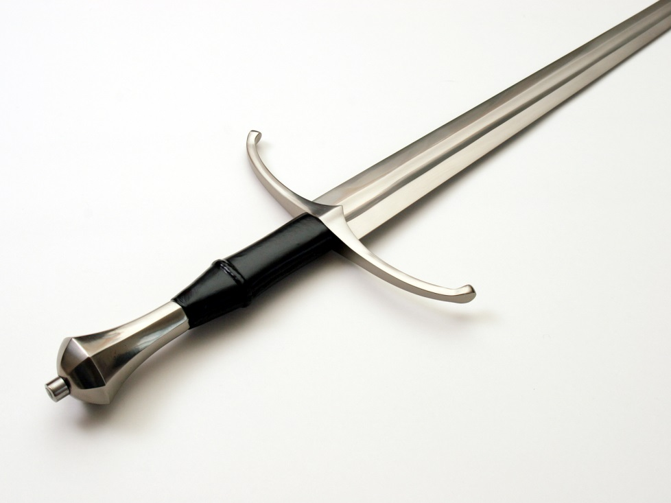

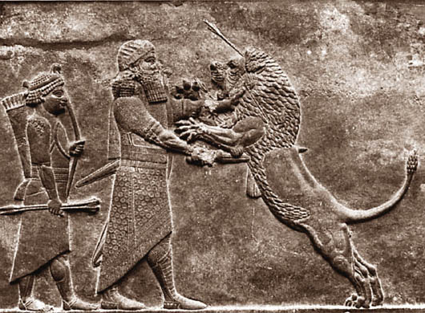
Uzziah
Hezekiah
Trusted in his own strength 2CH 26:8,12,13,15,16
Trusted in his own righteousness 2CH 26:18
Trusted in his God like no one else 2KI 18:5,20-22,24,30
2KI 19:10
IS 7:9
Ahaz
Hezekiah was tested in the same way at the same place by the same nation as his father Ahaz. 2KI 18:17
IS 7:3
Trusted in the strength of his enemies 2CH 28:16,20
IS 7:9

Slide 22
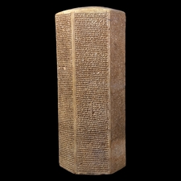
Evidence
for historical accuracy
Sennacherib’s Prism:
Assyrian king’s account of invasion
Mentions Hezekiah by name
c701 BC
“I laid siege to 46 of his strong cities”
The Death of a Proud King
Notes:
22

Slide 23
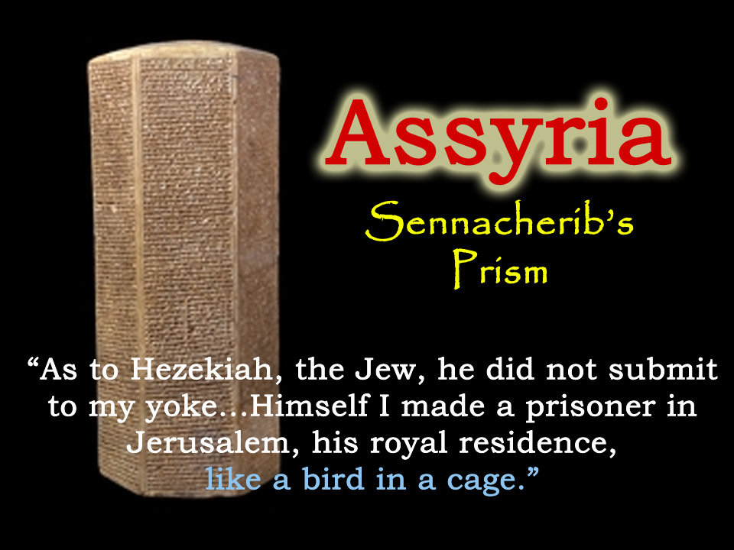
The Death of a Proud King

Slide 24
Who do you
trust?

Slide 26
Summary
Learning from Israel
The burning bush is a symbol of Yahweh’s preservation of the nation of Israel, through the covenants of promise made to Abraham, Isaac, and Jacob.
The Death of a Proud King

Slide 27
Summary
Learning from Israel
God’s word is heard in the wilderness, and not in the crush of the world’s concerns.
The re-establishment of the nation of Israel must never cease to sustain our faith in the covenants of promise.
Our Heavenly Father has not called us for who we are, but for who He is able to create for His glory.
The Death of a Proud King

Slide 28
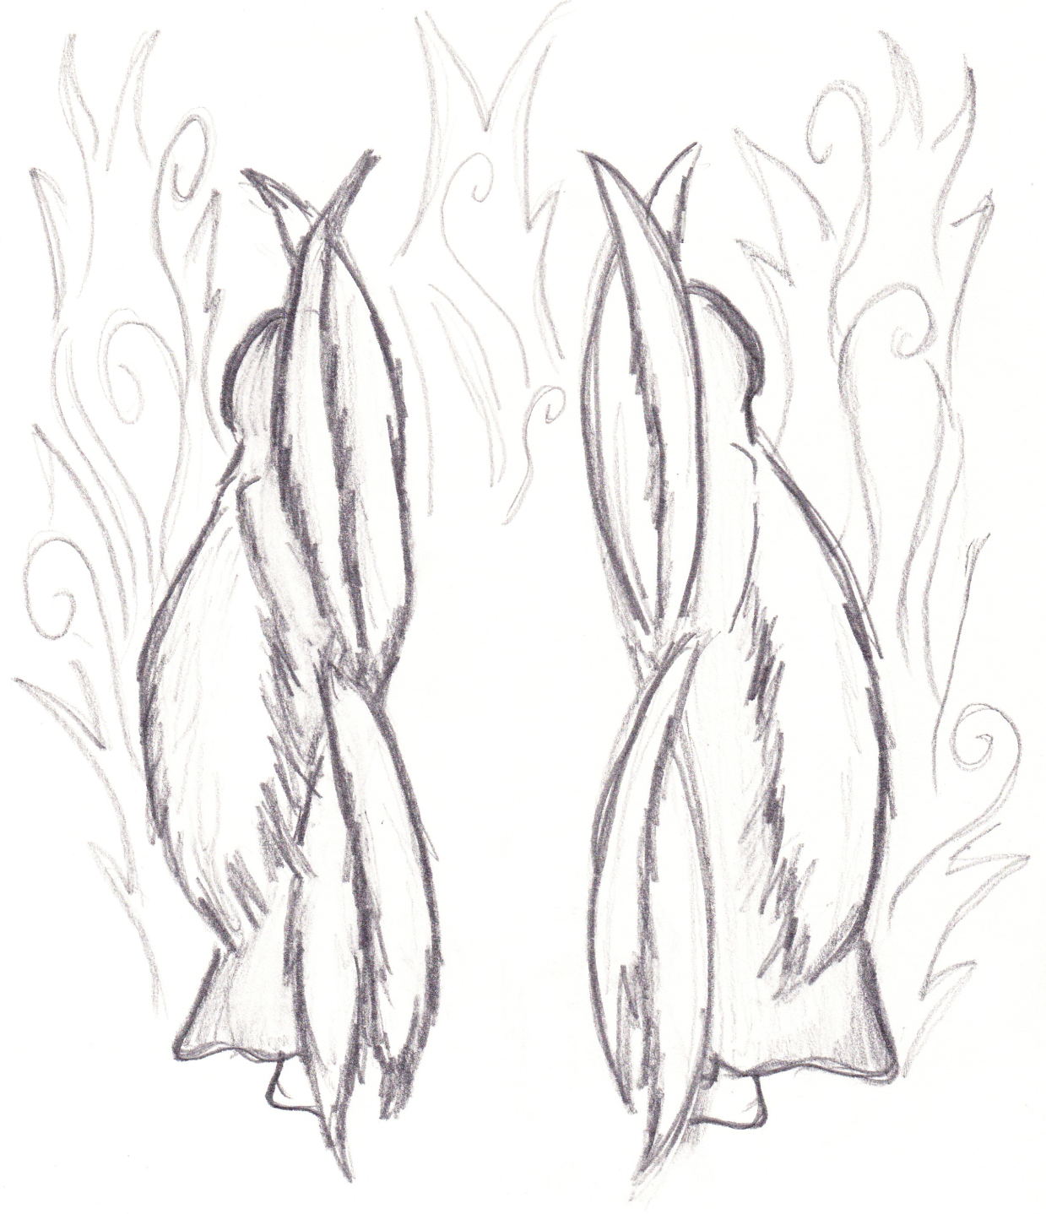
The Song of a Humble Prophet
Two Men Went up into the Temple to Pray
“I am a man of unclean lips”

Slide 31
Isaiah (A Prophet of Song)
Moses’ Song of Witness 1:2
Song of the Vineyard 5:1-2
Song of the Seraphim 6:3
Song of Salvation 12:1-6
Song of Exaltation 25:1-5
Song of the Strong City 26:1-
Song of the Vineyard of Desire 27:2-5
Song of Hezekiah 38:9-20
New Song of Praise 42:10-
Songs of the Servant 40-66
The Song of a Humble Prophet

Slide 32
What are the seraphim?
‘seraph’
Psalm 104:4
Strong 8314 from 8313 ‘burning’
TWOT 2292 not derived from ‘serpent’ but from the root of both words – ‘fire’
Gesenius ‘the verb has the sense of burning, not of shining’
BDB also trans. serpent (from ‘fiery’ poison)
ISBE probably derived from burning
The Song of a Humble Prophet

Slide 34
Our God is a Consuming Fire
destroys by consuming
preserves by purifying
Maher-shalal-hash-baz
Isaiah 22:14; Ek. 10:2
Shear-jashub
Isaiah 33:14-15; 6:6-7
Psalm 145:20
DEATH
LIFE
The Song of a Humble Prophet

Slide 35
What’s the
context?

Slide 36
HOLINESS
Leviticus
10:3
KJV
“…I will be sanctified in them that come nigh me, and before all the people I will be glorified.”

Slide 38
see also
Ps. 141:2
Re. 8:3-4
INCENSE
Revelation
5:8
KJV
“…the four beasts and four and twenty elders fell down before the Lamb, having every one of them harps, and golden vials full of odours, which are the prayers of saints.”

Slide 39
see also
Ex. 30:34-38
Je. 1:9
Ek. 1:14
Da. 10:6
ANGELS
Isaiah
6:6
KJV
“Then flew one of the seraphim unto me, having a live coal in his hand.”

Slide 40
see also
8:13
30:29-32
33:14-
35:10
57:15
66:2
THE HOLY ONE
Isaiah
6:3
KJV
“And one cried unto another, and said, Holy, holy, holy, is Yahweh of hosts: the whole earth is full of his glory.”

Slide 41
HYPOCRISY
Isaiah
29:13
KJV
“…this people draw near me with their mouth, and with their lips do honour me, but have removed their heart far from me...”

Slide 42
1 Kings 22:19-23
Ezekiel 1:4-5:17
Psalm 18:6-24
Daniel 7:9-14
Isaiah 6:1-13
Revelation 4:1-5:14

Slide 43
Royal Council
1 Kings 22:19-23
Ezekiel 1:4-5:17
Psalm 18:6-24
Daniel 7:9-14
Isaiah 6:1-13
Revelation 4:1-5:14

Slide 44
Royal Council
Cherubic Chariot
1 Kings 22:19-23
Ezekiel 1:4-5:17
Psalm 18:6-24
Daniel 7:9-14
Isaiah 6:1-13
Revelation 4:1-5:14

Slide 45
Royal Council
Cherubic Chariot
1 Kings 22:19-23
Ezekiel 1:4-5:17
Flying Cherub
Psalm 18:6-24
Daniel 7:9-14
Isaiah 6:1-13
Revelation 4:1-5:14

Slide 46
Royal Council
Cherubic Chariot
1 Kings 22:19-23
Ezekiel 1:4-5:17
Flying Cherub
Ancient of Days
Psalm 18:6-24
Daniel 7:9-14
Isaiah 6:1-13
Revelation 4:1-5:14

Slide 47
Royal Council
Cherubic Chariot
1 Kings 22:19-23
Ezekiel 1:4-5:17
Flying Cherub
Ancient of Days
Psalm 18:6-24
Daniel 7:9-14
Flying Seraphim
Isaiah 6:1-13
Revelation 4:1-5:14

Slide 48
Royal Council
Cherubic Chariot
1 Kings 22:19-23
Ezekiel 1:4-5:17
Flying Cherub
Ancient of Days
Psalm 18:6-24
Daniel 7:9-14
Flying Seraphim
Living Creatures
Isaiah 6:1-13
Revelation 4:1-5:14

Slide 50
Summary
Learning from Israel
The burning bush is a symbol of Yahweh’s preservation of the nation of Israel, through the covenants of promise made to Abraham, Isaac, and Jacob.
The Song of a Humble Prophet

Slide 51
Summary
Learning from Israel
God’s word is heard in the wilderness, and not in the crush of the world’s concerns.
The re-establishment of the nation of Israel must never cease to sustain our faith in the covenants of promise.
Our Heavenly Father has not called us for who we are, but for who He is able to create for His glory.
The Song of a Humble Prophet

Slide 52
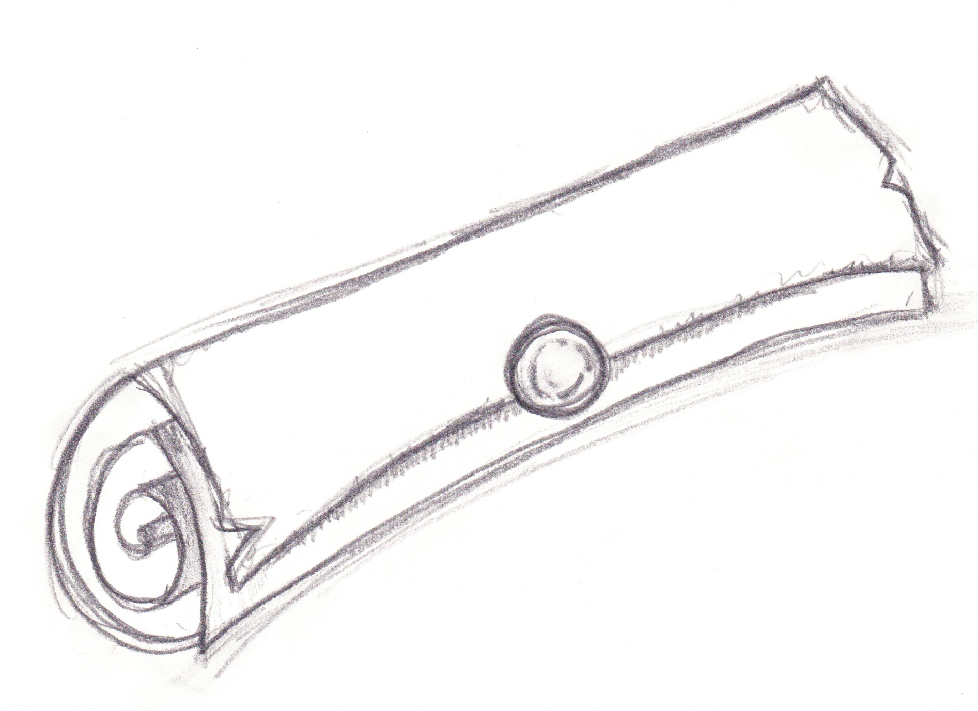
The Purpose of Speaking Parables
Two Men Went up into the Temple to Pray
“Hear ye indeed, but understand not”

Slide 55
see also
1 Ki. 8:51
Je. 11:4
PARABLES
Isaiah
29:11
KJV
“And the vision of all is become unto you as the words of a book that is sealed, which men deliver to one that is learned, saying, Read this, I pray thee: and he saith, I cannot; for it is sealed…”

Slide 57
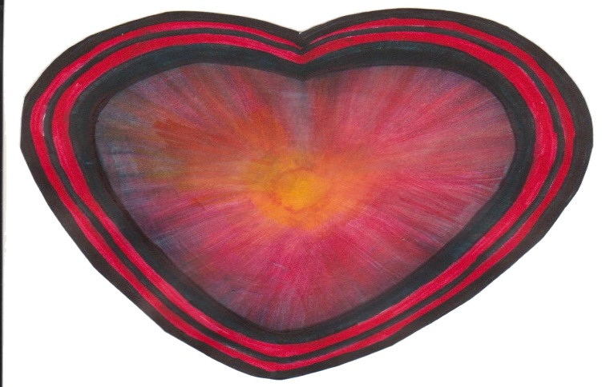
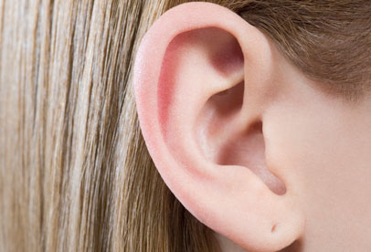
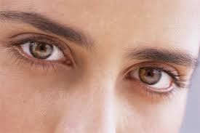
Heart
…make the heart of this people fat…lest they… understand with their heart
Ears
…make their ears heavy… lest they…
hear with their ears
…shut their eyes…
lest they…
See with their eyes
Eyes

Slide 58
Heart
Hardness
Isaiah 6:9-10 1:5-6
Remedy
Isaiah 32:4, 33:18, 35:4, Luke 4:18
Ears
…make their ears heavy… lest they…
hear with their ears
…shut their eyes…
lest they…
See with their eyes
Eyes

Slide 59
Heart
Hardness
Isaiah 6:9-10 1:5-6
Remedy
Isaiah 32:4, 33:18, 35:4, Luke 4:18
Ears
Deafness
Isaiah 6:9-10 1:5-6
Remedy
Isaiah 32:3, 33:15-24, 35:5, Luke 4:18
…shut their eyes…
lest they…
See with their eyes
Eyes

Slide 60
Heart
Hardness
Isaiah 6:9-10 1:5-6
Remedy
Isaiah 32:4, 33:18, 35:4, Luke 4:18
Ears
Deafness
Isaiah 6:9-10 1:5-6
Remedy
Isaiah 32:3, 33:15-24, 35:5, Luke 4:18
Blindness
Isaiah 6:9-10 1:5-6 29:20
Remedy
Isaiah 32:3, 33:15-24, 35:5, Luke 4:18
Eyes

Slide 62
HEARING
Acts 9:7
cp.
Acts 22:9
KJV
“And the men which journeyed with him stood speechless, hearing a voice, but seeing no man.”
“And they that were with me saw indeed the light, and were afraid; but they heard not the voice of him that spake to me.”

Slide 63
Heart
…that thou shouldest know his will
Ears
…and shouldest
hear the voice of his mouth
Eyes
…and see that Just One
Acts 22:14

Slide 65
Is. 6
Mt. 13
Mk. 4
Lk. 8
Jh. 12
Ac. 28
Ro. 11
FAITH
Deuteronomy
29:4
KJV
“Yet the LORD hath not given you an heart to perceive, and eyes to see, and ears to hear, unto this day.”

Slide 67
Summary
Learning from Israel
The burning bush is a symbol of Yahweh’s preservation of the nation of Israel, through the covenants of promise made to Abraham, Isaac, and Jacob.
The Purpose of Speaking Parables

Slide 68
Summary
Learning from Israel
God’s word is heard in the wilderness, and not in the crush of the world’s concerns.
The re-establishment of the nation of Israel must never cease to sustain our faith in the covenants of promise.
Our Heavenly Father has not called us for who we are, but for who He is able to create for His glory.
The Purpose of Speaking Parables

Slide 69
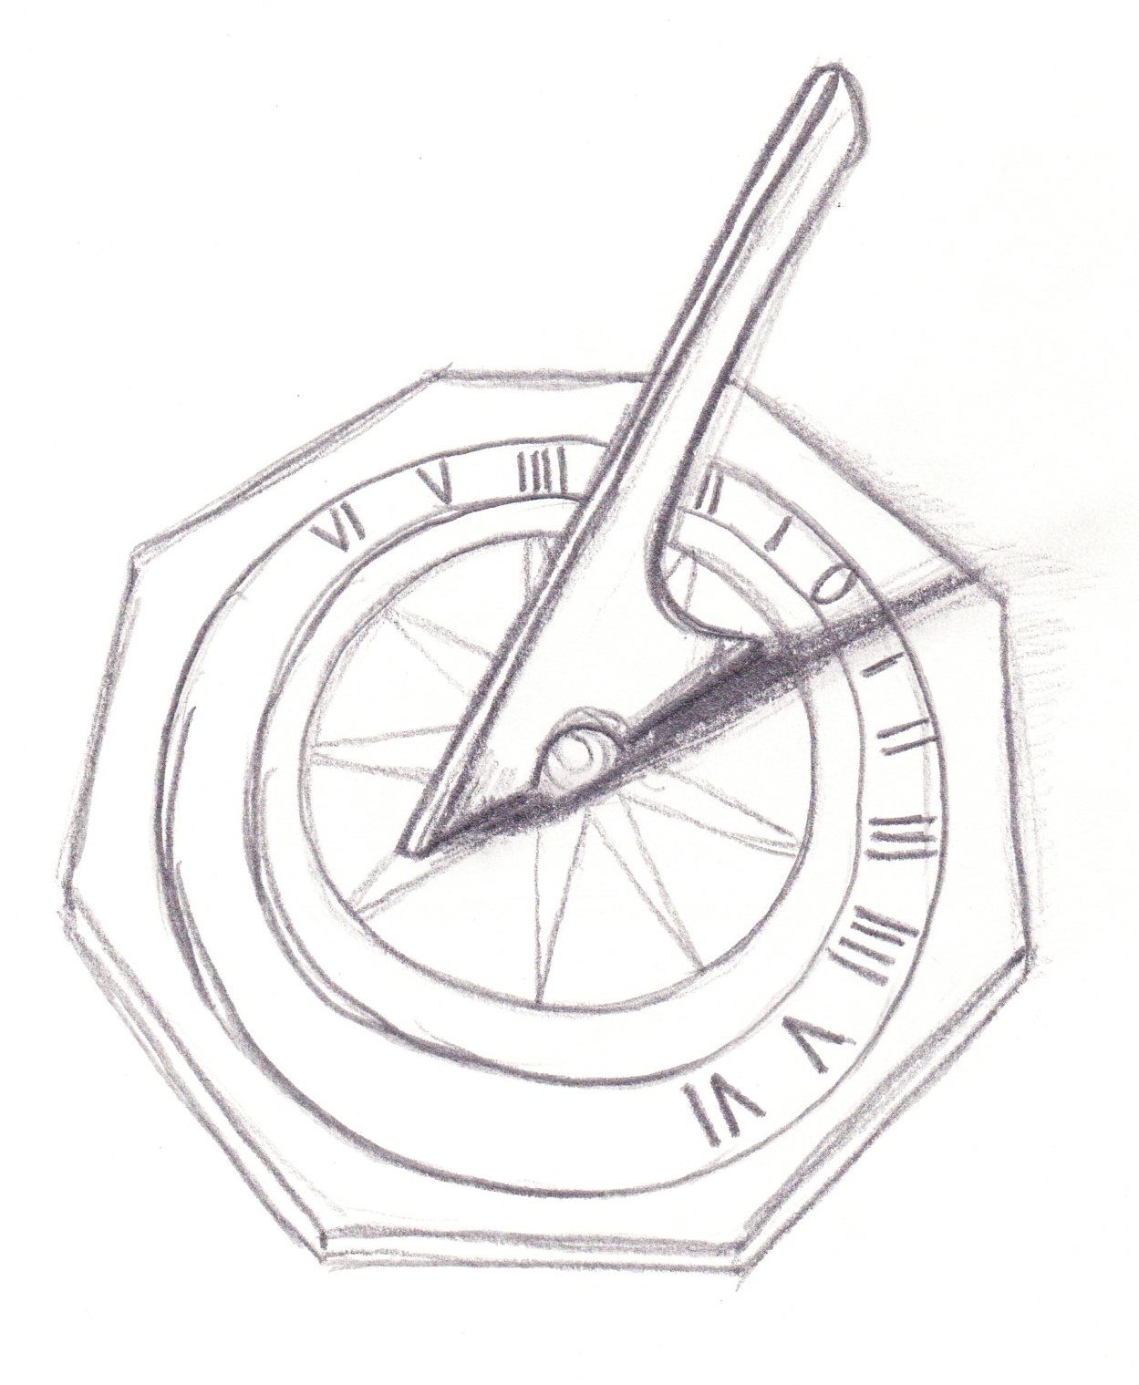
The Longsuffering of our Lord
Two Men Went up into the Temple to Pray
“Then said I, Lord, how long?”

Slide 72
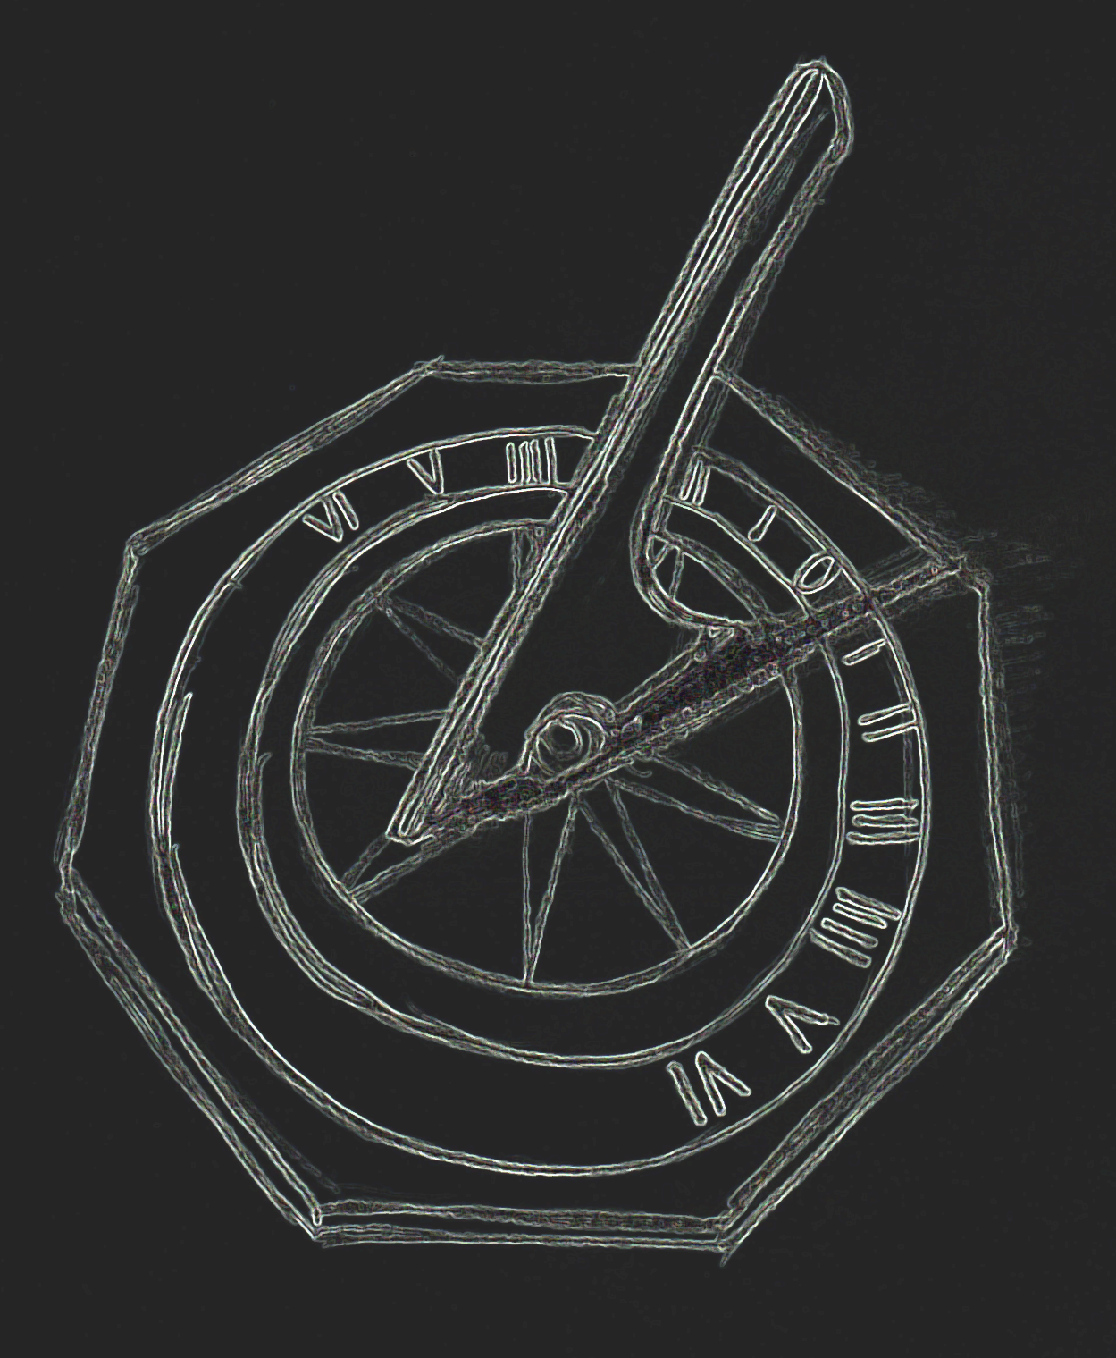
How
long?

Slide 74
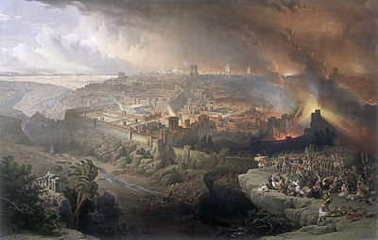
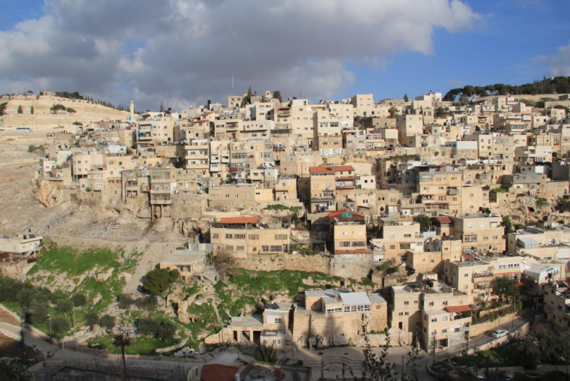
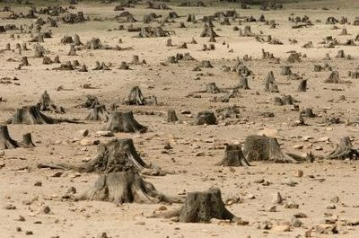
…until the cities be wasted without inhabitant
…and the houses
without man
…and the land be
utterly desolate.

Slide 75
Fulfillment
Isaiah 1:7-8 32:14 36:1
Restoration
Isaiah 4:5 44:26 54:3 61:4
Cities
…and the houses
without man
…and the land be
utterly desolate.

Slide 76
Fulfillment
Isaiah 1:7-8 32:14 36:1
Restoration
Isaiah 4:5 44:26 54:3 61:4
Cities
Fulfillment
Isaiah 3:14 5:8-9 32:13
Restoration
Isaiah 4:5 44:26 54:3 65:21
Houses
…and the land be
utterly desolate.

Slide 77
Fulfillment
Isaiah 1:7-8 32:14 36:1
Restoration
Isaiah 4:5 44:26 54:3 61:4
Cities
Fulfillment
Isaiah 3:14 5:8-9 32:13
Restoration
Isaiah 4:5 44:26 54:3 65:21
Houses
Fulfillment
Isaiah 1:7 5:6 7:23 32:13
Restoration
Isaiah 35:1,7 37:30 65:21
Land

Slide 79
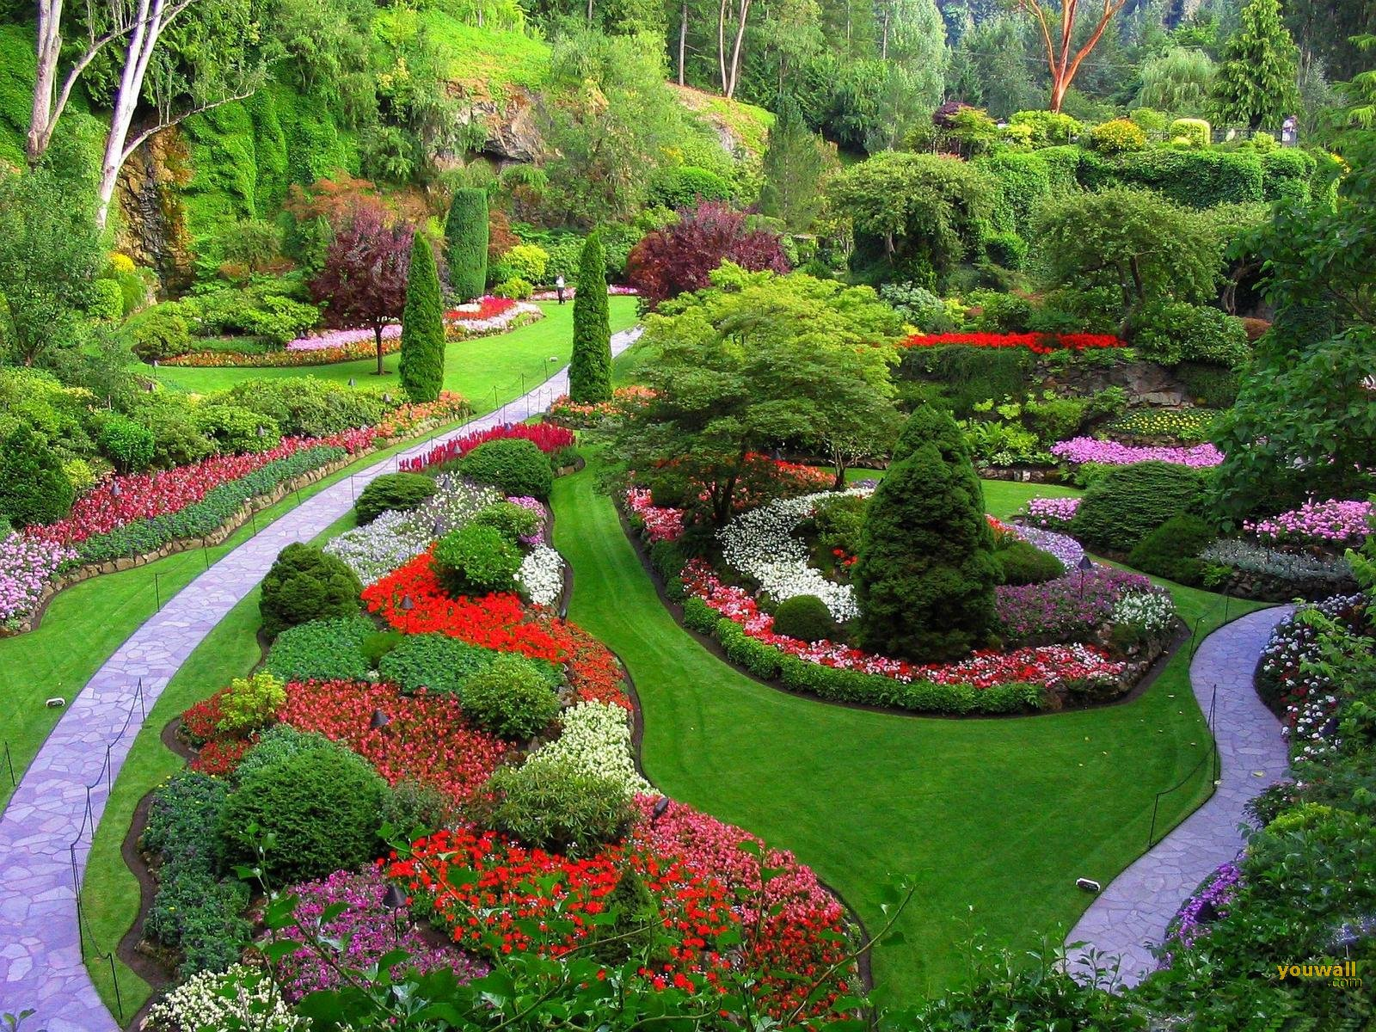

Slide 80
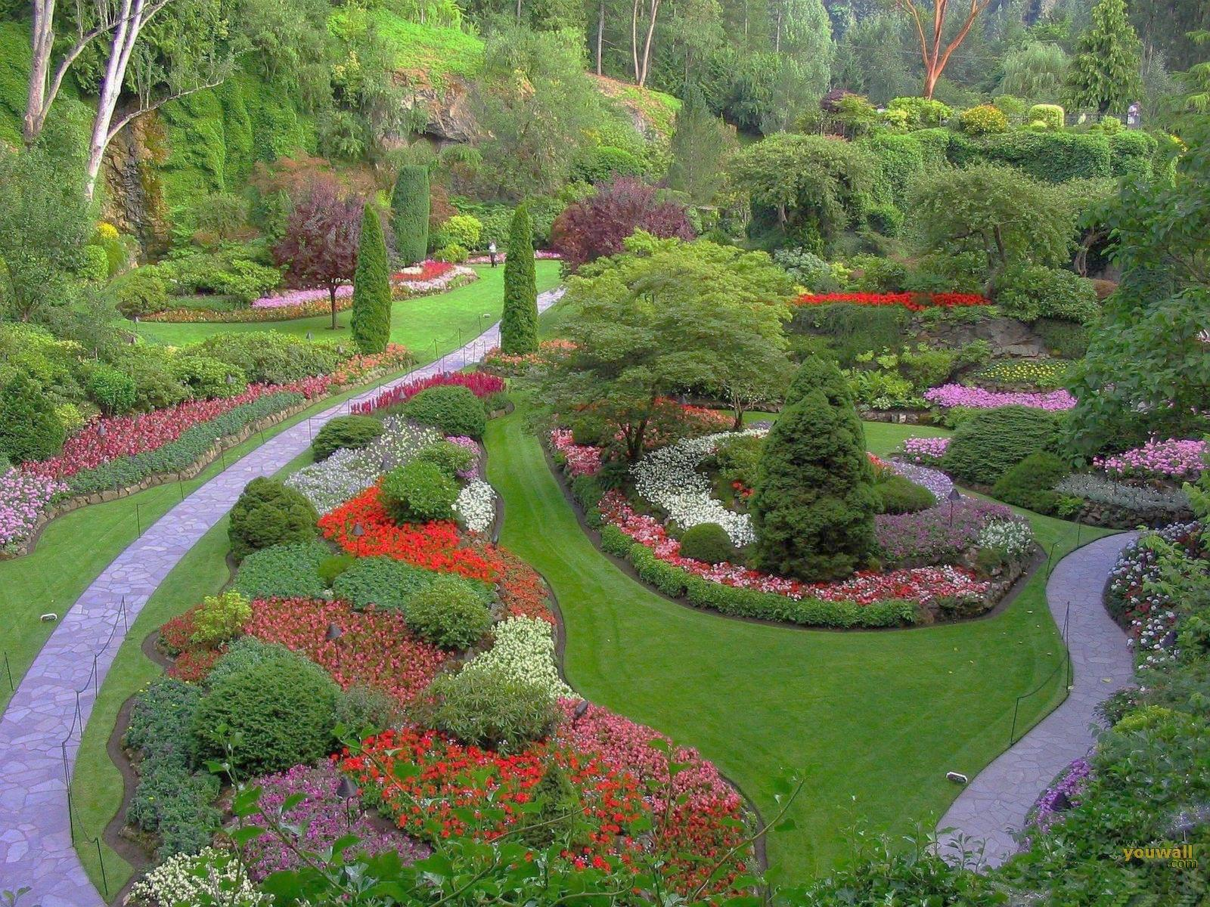
Isaiah 1:29
For they shall be ashamed of the oaks
which ye have desired,
and ye shall be confounded for the gardens
that ye have chosen.

Slide 81
TREES
Hosea
4:13
ESV
“They sacrifice on the tops of the mountains and burn offerings on the hills, under oak, poplar, and terebinth, because their shade is good. Therefore your daughters play the whore, and your brides commit adultery.”

Slide 82
TREES
Hosea
4:14
ESV
“I will not punish your daughters when they play the whore, nor your brides when they commit adultery; for the men themselves go aside with prostitutes and sacrifice with cult prostitutes, and a people without understanding will come to ruin.”

Slide 84
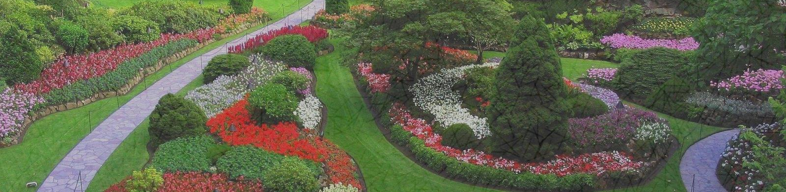
Gardens & Trees
The places of
the names of gods
for
utter destruction
The place of
the name of Yahweh
for
national devotion
Deuteronomy 12:1-3
Isaiah 1:30, 57:3-9, 65:2-7, 66:17
Ezekiel 6:13
Hosea 4:12-14
Deuteronomy 12:4-7
Isaiah 41:18-19, 51:1-3
Luke 23:43
Revelation 2:7

Slide 86
Summary
Learning from Israel
The burning bush is a symbol of Yahweh’s preservation of the nation of Israel, through the covenants of promise made to Abraham, Isaac, and Jacob.
The Longsuffering of our Lord

Slide 87
Summary
Learning from Israel
God’s word is heard in the wilderness, and not in the crush of the world’s concerns.
The re-establishment of the nation of Israel must never cease to sustain our faith in the covenants of promise.
Our Heavenly Father has not called us for who we are, but for who He is able to create for His glory.
The Longsuffering of our Lord

Slide 88
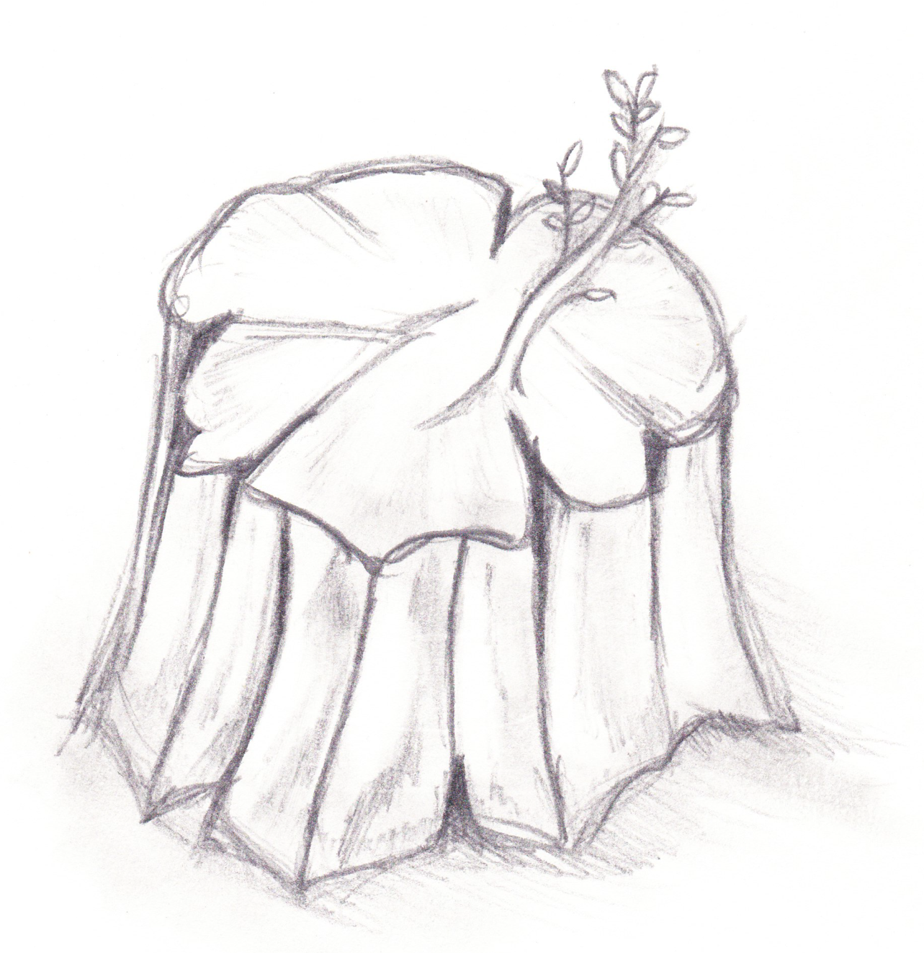
The Hope of the Holy Seed
Two Men Went up into the Temple to Pray
“The holy seed shall be the substance thereof”

Slide 90
Isaiah 6:13 ESV
“And though a tenth remain in it,
it will be burned again,
like a terebinth or an oak,
whose stump remains
when it is felled.
The holy seed is its stump.”
The Hope of the Holy Seed

Slide 91
see also
Lev. 27:32
Amos 5:3
THE TITHE
Ezra
9:2
KJV
“…they have taken of their daughters for themselves, and for their sons: so that the holy seed have mingled themselves with the people of those lands…”

Slide 93
Shall Return
Isaiah 10:20-22
Preserved by Yahweh
Isaiah 1:8
Shear-jashub
Isaiah 7:3
Blessings for Gentiles
Romans 9:21-33
Called Holy
Isaiah 4:3
The
Remnant
Eats Butter and Honey
Isaiah 7:22
Encouraged to Repent
2 Chronicles 30:6-10

Slide 95

The
Nation
Restored to ultimate glory after judgment Ezra 9:2
Isaiah 2:13
Isaiah 10:33-34
Isaiah 61:9
…whose stump remains when it is felled…
Isaiah 6:13 ESV

Slide 96
The
Nation
The
Messiah
Restored to ultimate glory after judgment Ezra 9:2
Isaiah 2:13
Isaiah 10:33-34
Isaiah 61:9
Raised up
by the
Spirit of God
Isaiah 4:2, 11:1, 53:2
Jeremiah 23:5
Zechariah 3:8, 6:12
Revelation 5:5, 22:16
…whose stump remains when it is felled…
Isaiah 6:13 ESV

Slide 97
The
Nation
The
Messiah
The
Prophet
Restored to ultimate glory after judgment Ezra 9:2
Isaiah 2:13
Isaiah 10:33-34
Isaiah 61:9
Raised up
by the
Spirit of God
Isaiah 4:2, 11:1, 53:2
Jeremiah 23:5
Zechariah 3:8, 6:12
Revelation 5:5, 22:16
Sawn asunder by Manasseh to obtain a better resurrection Hebrews 11:37
…whose stump remains when it is felled…
Isaiah 6:13 ESV

Slide 99
Summary
Learning from Israel
The burning bush is a symbol of Yahweh’s preservation of the nation of Israel, through the covenants of promise made to Abraham, Isaac, and Jacob.
The Hope of the Holy Seed

Slide 100
Summary
Learning from Israel
God’s word is heard in the wilderness, and not in the crush of the world’s concerns.
The re-establishment of the nation of Israel must never cease to sustain our faith in the covenants of promise.
Our Heavenly Father has not called us for who we are, but for who He is able to create for His glory.
The Hope of the Holy Seed

