Slide 1
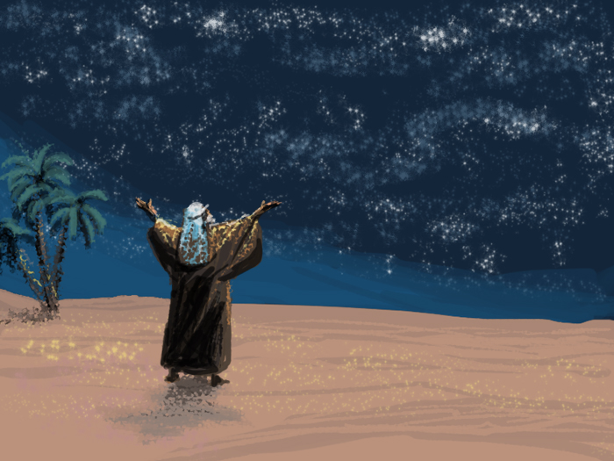
The Prayer of Jabez
“According to His Will”
1 Chronicles 4:9-10
London Fraternal Gathering 2011

Slide 2
The Prayer of Jabez
“According to His Will”
1 Chronicles 4:9-10
Rogue River Bible School 2013

Slide 3
The Prayer of Jabez
Class 1 His Sorrow “I bare him with sorrow”
Class 2 His God “Jabez called on the God of Israel”
Class 3 His Tribe “If Thou wilt bless me”
Exhort. His Joy “God granted his request”
I Chronicles 4:9-10

Slide 4
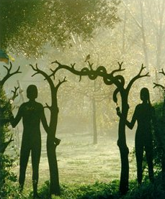
The Prayer of Jabez
Class 1
His Sorrow:
“I bare him with sorrow”

Slide 5
Defining “Jabez”
‘yabets’
Strong 3258 probably from an unused root meaning ‘to grieve’ – or ‘sorrowful’
K&D his name is a play on words with the word sorrow
ISBE ‘sorrow’
Gesenius ‘he causes pain’
BDB ‘sorrow’
His Sorrow

Slide 7
Summary
Learning from his sorrow
There was sorrow in the family of Jabez. His sorrowing mother named him after it. While his brothers did nothing, Jabez was more honourable, and called on the God of Israel to deliver him from his sorrow. And God granted his request.
His Sorrow

Slide 8
Summary
Learning from his Sorrow
In the wisdom of our Heavenly Father, creation has been designed to experience sorrow and feel emptiness that we might hope for something more.
Faithful families will experience sorrow and suffer trial. Remember the patriarchs.
Yahweh is able to use the sorrowful trials in our lives to strengthen us, that we might be able to comfort each other.
His Sorrow

Slide 9
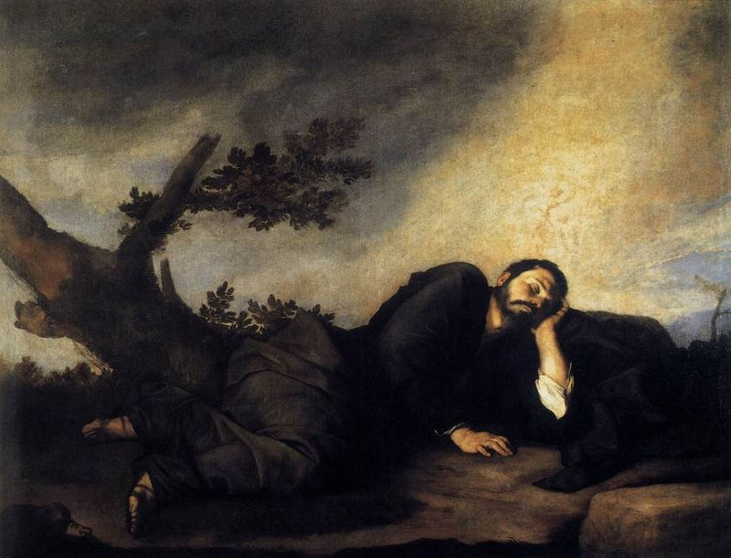
The Prayer of Jabez
Class 2
His God:
“Jabez called on the God of Israel”
Notes:
Ted Larsen

Slide 10
The Prayers of Jacob & Jabez
Living more honourably than their brethren
1Ch. 4:9 cp. Mal. 1:2
Sorrowing in motherhood
1Ch. 4:9 cp. Ge. 27:46; 26:35
Blessing to the faithful brother
1Ch. 4:10 cp. Ge. 28:3-4,13-15; 32:26,29
Praying for Providence
1Ch. 4:10 cp. Ge. 28:20-22
His God

Slide 11
The Prayers of Jacob & Jabez
Vowing to serve
1Ch. 4:10 cp. Ge. 28:20-22
Calling on the God of Israel
1Ch. 4:10 cp. Ge. 28:21; 32:28
Rising above their given names
1Ch. 4:10 cp. Ge. 32:28
Kept from evil
1Ch. 4:10 cp. Ge. 31:29; 48:16
Enlarging the borders
1Ch. 4:10 cp. Ge. 28:13-14
His God

Slide 13
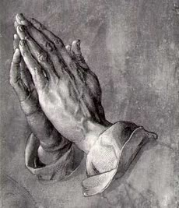
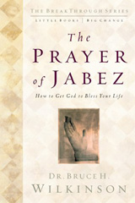
The Prosperity Gospel
Inspired by
Jacob
or Esau?
His God
Notes:
The Septuagint with Apocrypha: Greek and English, Sir Lancelot C.L. Brenton, Hendrickson Publishers

Slide 15
Summary
Learning from his God
There was faith in the heart of Jabez. His plea to the God of Israel proclaims his identification with Jacob’s spirit. Jabez treasured Jacob’s heritage, experienced great anxiety like Jacob, and received a blessing like Jacob did, from the God of his fathers.
His God

Slide 16
Summary
Learning from his God
Jacob asked only for enough to sustain him, not for extravagant blessings of the flesh. So Jesus instructs us to only ask for our basic needs, while we focus on the righteousness of God’s kingdom.
Spiritual men and women understand the deceptiveness of the world’s riches.
We must learn to implicitly trust our Heavenly Father, especially in the most confusing and hopeless situations.
His God

Slide 17
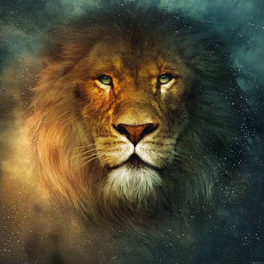
The Prayer of Jabez
Class 3
His Tribe:
“If Thou wilt bless me”
Notes:
Ted Larsen

Slide 19
Judah’s Prophetic Blessings
Divine blessings for the tribe of Judah
1Ch. 4:9 cp. Ge. 49:28 cp. De. 33:1,7
Spiritual qualities of his brethren
1Ch. 4:9 cp. Ge. 49:8
Providential victory over his enemies
1Ch. 4:10 cp. Ge. 49:9,11-12 cp. De. 33:7
The omnipotent hand of his God
1Ch. 4:10 cp. Ge. 49:8 cp. De. 33:2-3,7
His Tribe

Slide 20
Judah’s Prophetic Blessings
Divine protection from evil
1Ch. 4:10 cp. Ge. 49:9,11-12 cp. De. 33:7
Divine comfort in sorrow
1Ch. 4:10 cp. Ge. 49:8 cp. De. 33:7
A desired answer from God
1Ch. 4:10 cp. De. 33:1,7
His Tribe

Slide 22
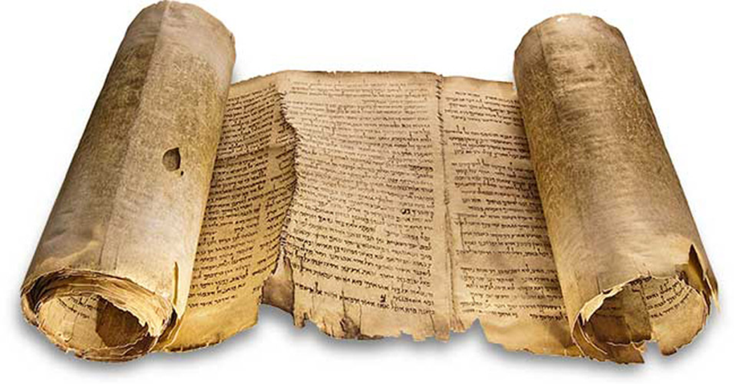
‘landmark’
Heb.
gebul
Deuteronomy
27:17
KJV
“Cursed by he that removeth his neighbour’s landmark. And all the people shall say, Amen.”
His Tribe

Slide 23
‘bound’
Heb.
gebul
Hosea
5:10
KJV
“The princes of Judah were like them that remove the bound: therefore I will pour out my wrath upon them like water.”
His Tribe

Slide 24
‘border’
Heb.
gebul
Amos
1:13
KJV
“…I will not turn away the punishment thereof; because they have ripped up the women with child of Gilead, that they might enlarge their border”
His Tribe

Slide 25
‘enlarge my coast’
Revealing the borders
Ge. 13:14-17
Enlarging the borders by casting out the nations
Ex. 34:24
Enlarging the borders as God promised
De. 12:20
Enlarging the borders as God swore to the fathers, conditional upon keeping the commandments, and teaching their children, just like their fathers did De. 11:18-25
His Tribe

Slide 27
Summary
Learning from his Tribe
There was zeal in the works of Jabez. He firmly believed in God’s promises, and deeply desired to see them fulfilled. Jabez treasured his fathers’ heritage, (the special promises given to his tribe), and experienced the wonder of God working in His life. He prayed and acted according to His will.
His Tribe

Slide 28
Summary
Learning from his Tribe
Jabez had an honourable faith in the revealed will of God found in His word.
We need to develop a firm faith in God’s promises, with the fervent desire to participate in their fulfillment in our own lives.
For our prayers to be answered, they must be offered in humility, and according to the will of God. In order to pray according to His will, we must learn what His will is.
His Tribe

Slide 29
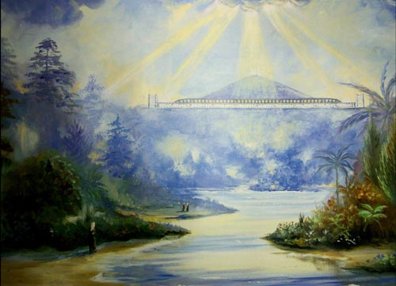
The Prayer of Jabez
Class 4
His Joy: “God granted his request”
Notes:
Ted Larsen

Slide 31
Men of Sorrow and Joy
Sorrow in her childbirth
1Ch. 4:9 cp. Mat. 1:18 cp. Lu. 2:3-7
Honour above his brethren
1Ch. 4:9 cp. Jn. 7:3-5; Mk. 3:31 ct. Ac. 1:14
Prayer in his sorrow
1Ch. 4:10 cp. Lu. 22:42
Protection of God`s hand
1Ch. 4:10 cp. Isa. 49:2
Deliverance from evil
1Ch. 4:10 cp. Mat. 6:13
His Joy

Slide 32
Men of Sorrow and Joy
Man of sorrows
1Ch. 4:9-10 cp. Is. 53:3-4 cp. Mat 26:36-37
Granting of his request
1Ch. 4:10 cp. Heb. 5:7
Blessings of his tribe
1Ch. 4:1,10 cp. Ge. 49:9 cp. Rev. 5:5
Reward of his inheritance
1Ch. 4:10 cp. Isa. 53:12 cp. Isa. 54:2-3
His Joy

