Slide 1
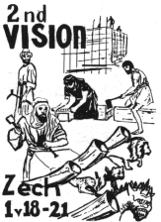
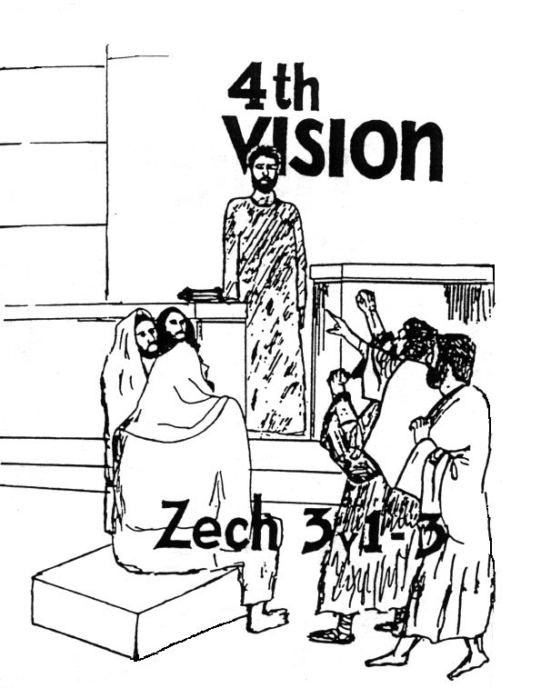
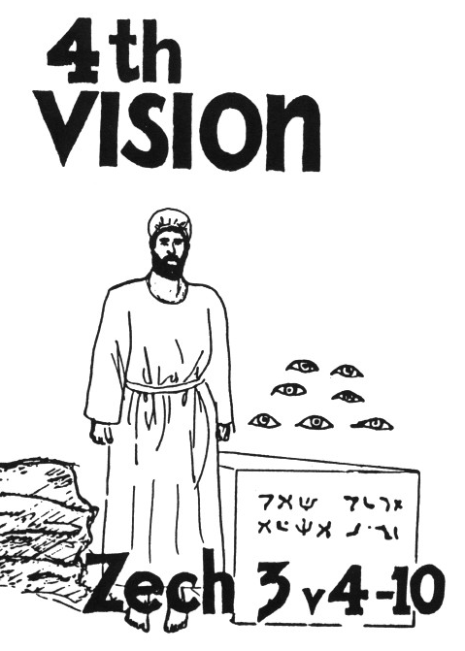
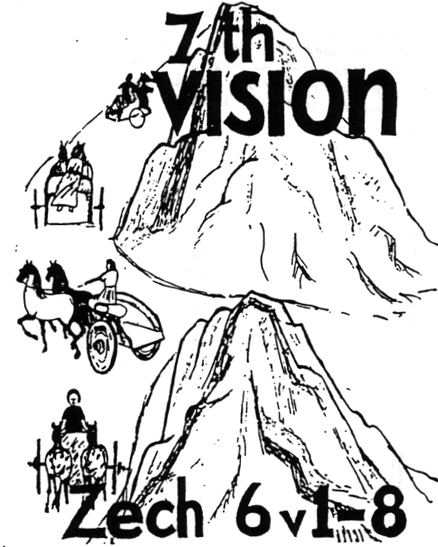
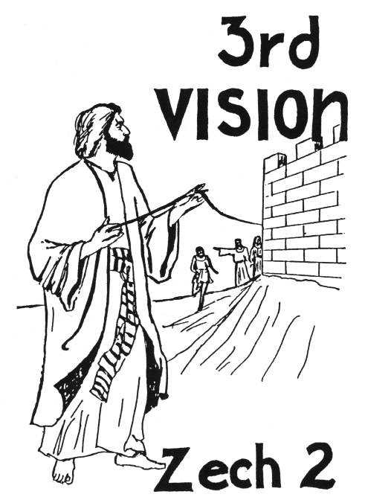
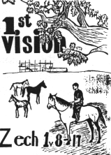
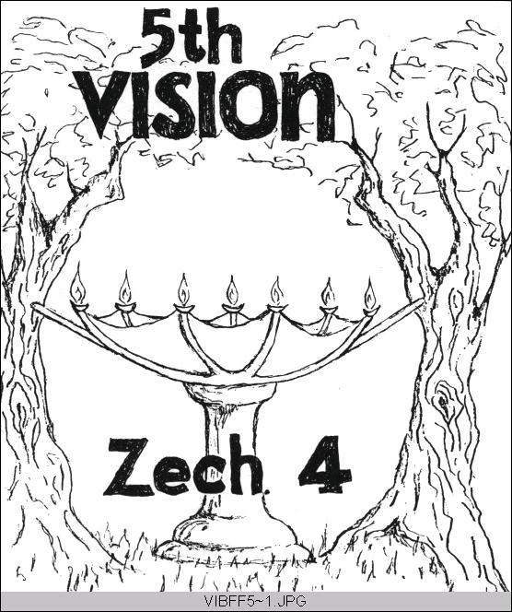
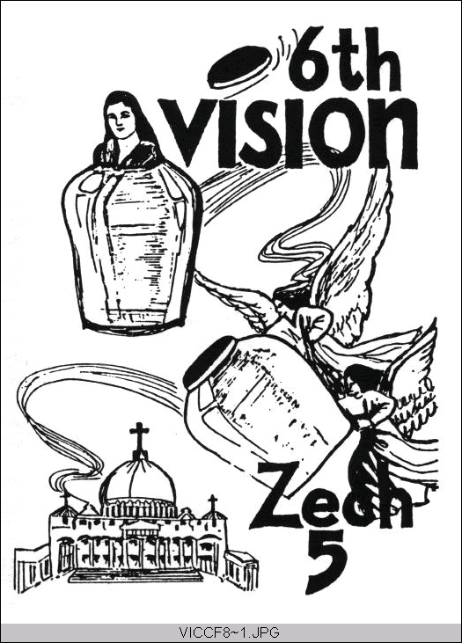
Zechariah’s
Night Visions
(Zech. 1-6)
Class 2:
God’s Angels Prepare the Way

Slide 2
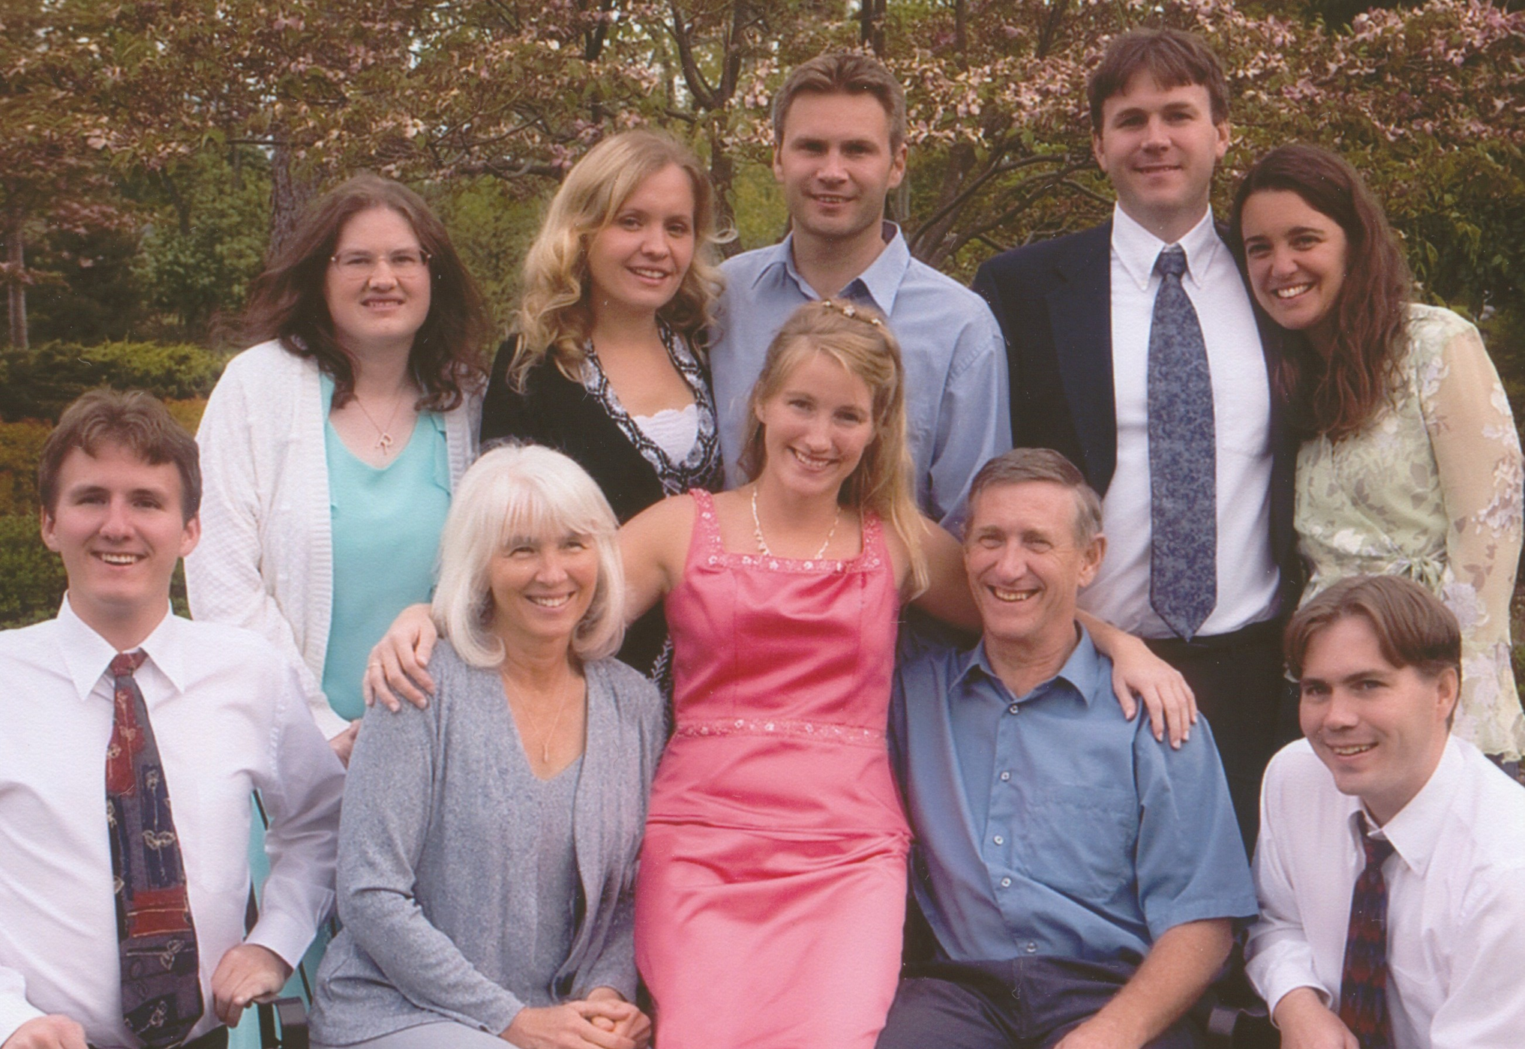
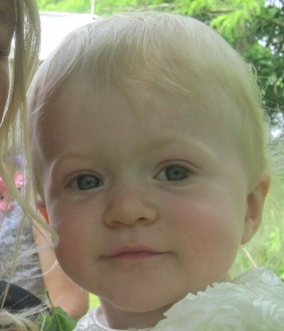
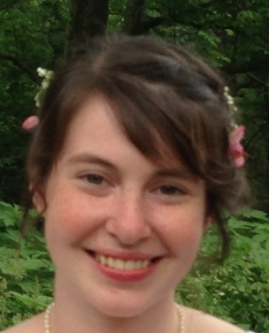

Slide 3
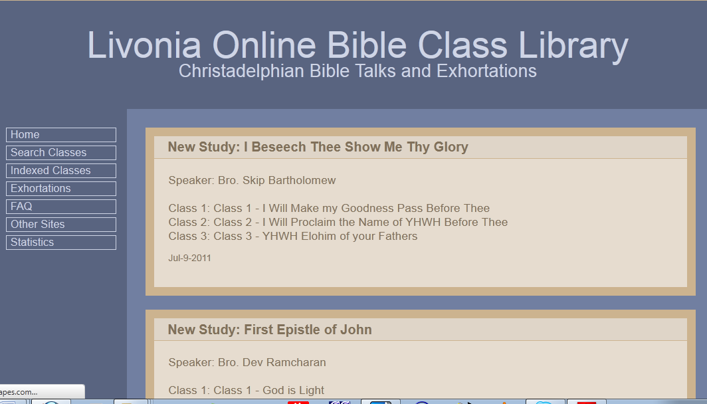
www.livoniatapes.com

Slide 4
Time to Review!

Slide 5
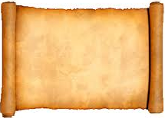
Zechariah 1:18-21
2nd Vision
18 Then I raised my eyes and looked, and there were four horns. 19 And I said to the angel who talked with me, "What are these?"
So he answered me, "These are the horns that have scattered Judah, Israel, and Jerusalem."
20 Then the Lord showed me four craftsmen [carpenters]. 21 And I said, "What are these coming to do?"
So he said, "These are the horns that scattered Judah, so that no one could lift up his head; but the craftsmen are coming to terrify them, to cast out the horns of the nations that lifted up their horn against the land of Judah to scatter it."
God will use these temple craftsmen!

Slide 6
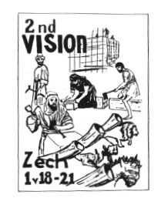
The 2nd Vision
What Zechariah saw:
4 horns
4 craftsmen or carpenters
What happened?
The horns scattered and
humiliated Israel
The carpenters will terrify
and cast out the horns

Slide 7
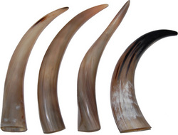
4 Horns of Zech 1:18-10
Horns = Kings (Dan 7:24; 8:21)
4 Kings responsible for scattering Israel:
Shalmaneser – 2 Kgs 18:9-12
Sennacherib – 2 Kgs 18:13-16
Pharaoh Necho – 2 Kgs 23:31-34
Nebuchadnezzar – 2 Kgs 24:10–25:11
Or the 4 horns may refer to the adversaries all around Israel that had bothered them until now

Slide 8
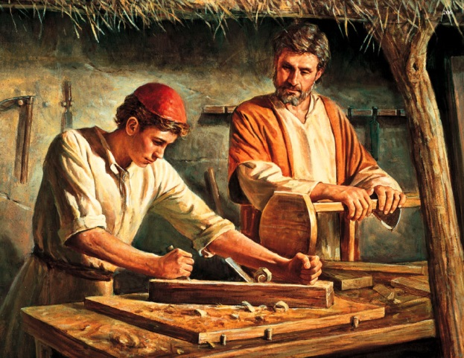
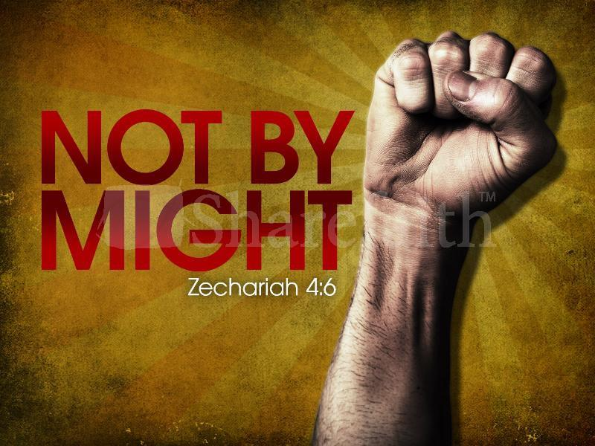
4 Carpenters (KJV)
“craftsmen” (NKJ, NIV, NASB)
1 Sam 13:19 Now there was no blacksmith to be found throughout all the land of Israel, for the Philistines said, “Lest the Hebrews make swords or spears.”
Ezra 3:7 They also gave money to the masons and the carpenters…
God will empower His temple builders to overcome their adversaries so they can finish the temple

Slide 9
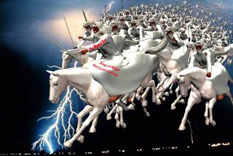
Use of “Lord of hosts”
Isaiah – about 60 times
Jeremiah – about 80 times
Zechariah – about 50 times
in only 14 chapters!
The people were scared and needed assurance that Yahweh of armies would be there to save and protect His people!

Slide 10
Nations learned to fear Jews
Deut 2:25 `This day I will begin to put the dread and fear of you upon the nations under the whole heaven, who shall hear the report of you, and shall tremble and be in anguish because of you.'
Deut 11:25 "No man shall be able to stand against you; the LORD your God will put the dread of you and the fear of you upon all the land where you tread, just as He has said to you.
Josh 2:9-11 Rahab: "I know that the LORD has given you the land, that the terror of you has fallen on us, and that all the inhabitants of the land are fainthearted because of you.
Esther 6:13 When Haman told his wife Zeresh and all his friends everything that had happened to him, his wise men and his wife Zeresh said to him, "If Mordecai, before whom you have begun to fall, is of Jewish descent, you will not prevail against him but will surely fall before him."

Slide 11
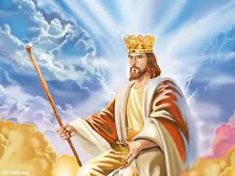
The Long-term Fulfillment
Christ will again use the Jews as his battle axe to conquer the Gentile nations and establish his kingdom (Zech 9:13; Jer 51:19-24)
The nations will fear & respect the Jews because Christ will be their king

Slide 12
Zechariah 2:1-5
3rd Vision
Then I raised my eyes and looked, and behold, a man with a measuring line in his hand. 2 So I said, "Where are you going?"
And he said to me, "To measure Jerusalem, to see what is its width and what is its length."
3 And there was the angel who talked with me, going out; and another angel was coming out to meet him, 4 who said to him, "Run, speak to this young man, saying: 'Jerusalem shall be inhabited as towns without walls, because of the multitude of men and livestock in it. 5 For I,' says the Lord, 'will be a wall of fire all around her, and I will be the glory in her midst.'"
God will protect Jerusalem!

Slide 13
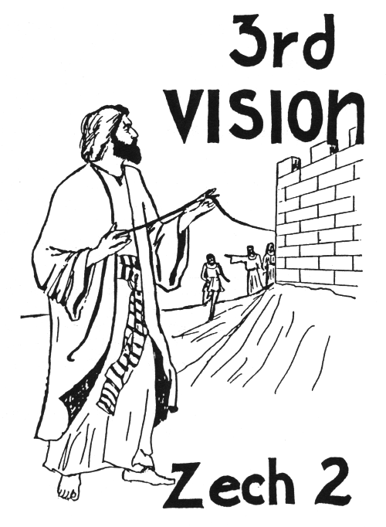
The 3rd Vision
What Zechariah saw:
A man with a measuring line
Man intends to measure Jerusalem
Another angel comes out
This angel says to tell the young
man Jerusalem will not need walls
Jerusalem will be overflowing with
people and livestock
God will her wall of fire and glory

Slide 14
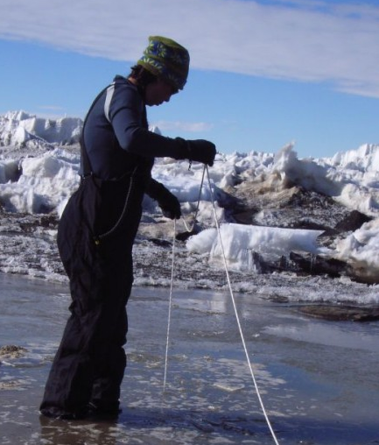
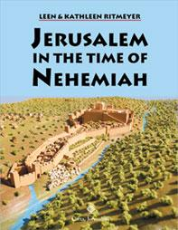
Vision of the Measuring Line
Consider the situation:
1) Only about 40,000 Jews back in the land
2) Adversaries discouraged, troubled and hired counselors against them
3) Persian King demanded the work stop
Most people would have been thinking about security and protection – walls!

Slide 15
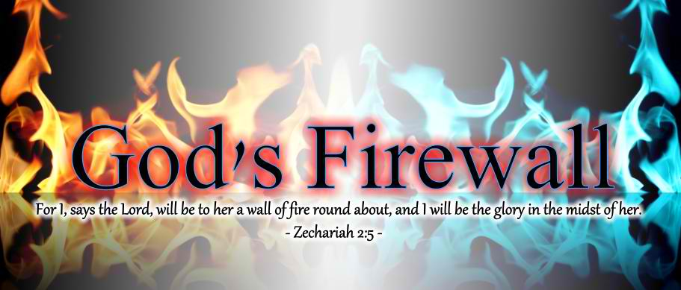
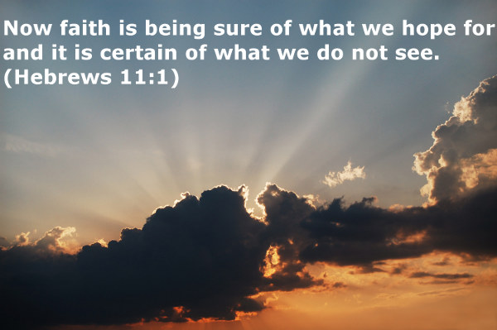
Why Jerusalem doesn’t need walls
Because God will bless the city with many people and animals (2:4)
Because God will be a wall of fire to protect the city (2:5)
This vision required the people have faith that God would accomplish his promise!

Slide 16
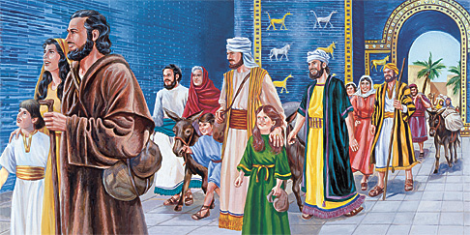
Get out of Babylon!
Return to Israel!
“Flee” (v.6) and “escape” (v.7). Get out of the places you were held captive!
God will shake His hand against the nations
Many nations will be joined to the Lord
God will dwell in your midst in Jerusalem
"Come out of her, my people, lest you share in her sins, and lest you receive of her plagues. Rev 18:4-5

Slide 17
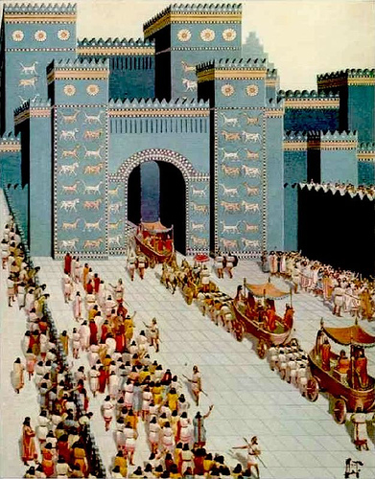
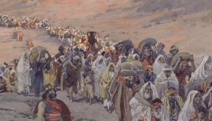
Convincing the Jews to Return
Only about 42,000 returned with Jeshua and Zerubbabel (Ezra 2), and only 74 of those were Levites!
Ezra brought more people back (Ezra 8), but he had trouble convincing any Levites to return (8:15)

Slide 18
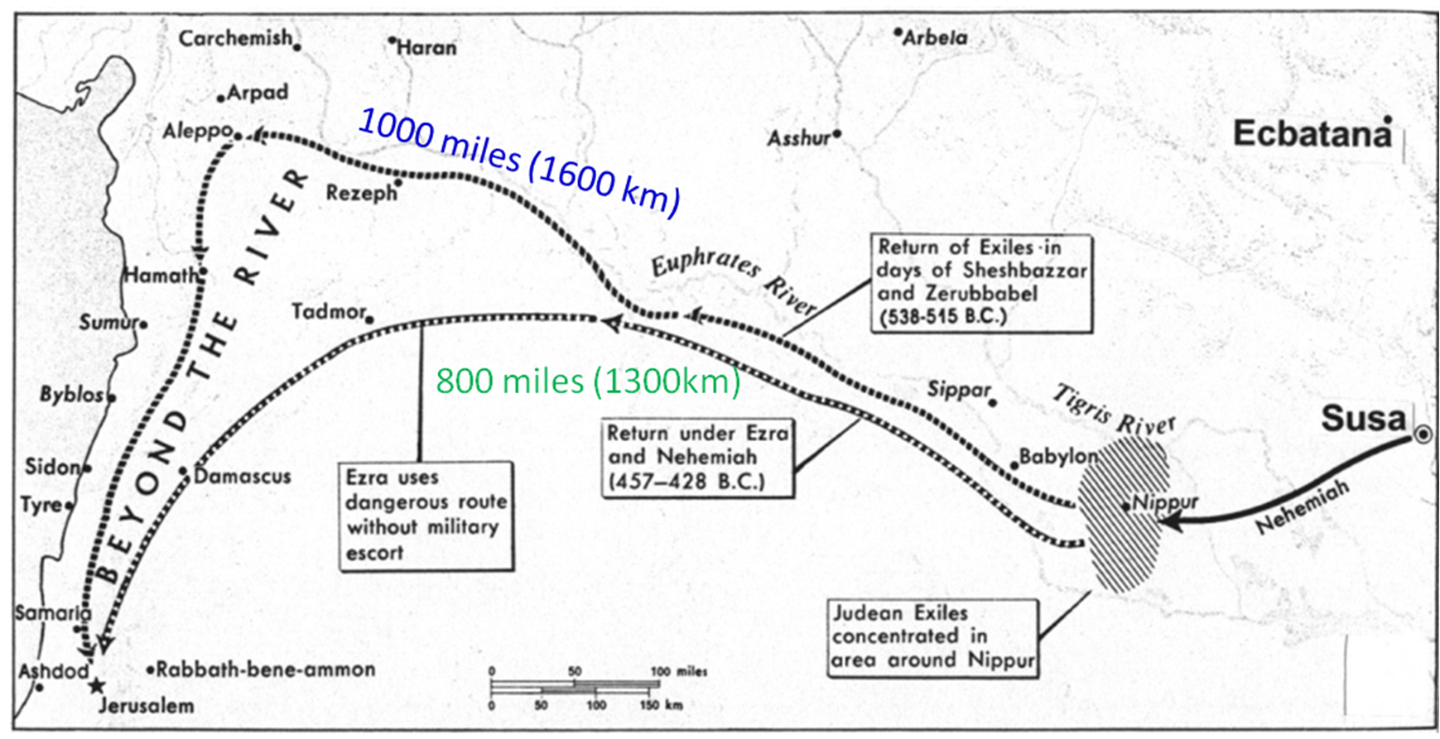
The long Return to Israel
This required Faith!

Slide 19

Why didn’t the Jews want to return?
Easier to stay in Persia!
Long journey (400-600 miles) to Israel
The land was a mess (run down for 70 years and lots of rubble)
God had sent drought, famine and economic trouble on the land (Hag 1)
The Levites didn’t trust the people to support them with tithes
Required Faith to make the move!

Slide 20
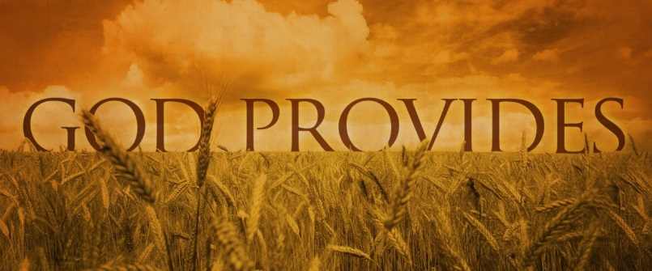
God’s Motivation to Return
He promised to bless their economy and food (Hag 2:19)
He promised to protect their cities (Zech 2:1-5)
He promised to dwell in their midst (Zech 2:11)
He raised up Haman to make them face the reality of destruction in a foreign land (Esther 3) God’s gentle push!

Slide 21

Many Nations (Gentiles!)
Gentiles
Ezra 6:21-22
21 Then the children of Israel who had returned from the captivity ate together with all who had separated themselves from the filth of the nations of the land in order to seek the LORD God of Israel.
22 And they kept the Feast of Unleavened Bread seven days with joy; for the LORD made them joyful, and turned the heart of the king of Assyria toward them, to strengthen their hands in the work of the house of God, the God of Israel.

Slide 22
Many Nations (Gentiles!)
Gentiles
Zech 8:20-23 (4th of Darius)
20 "Thus says the LORD of hosts: 'Peoples shall yet come, inhabitants of many cities;
21 The inhabitants of one city shall go to another, saying, "Let us continue to go and pray before the LORD, and seek the LORD of hosts. I myself will go also."
22 Yes, many peoples and strong nations shall come to seek the LORD of hosts in Jerusalem, and to pray before the LORD.'
23 "Thus says the LORD of hosts: 'In those days ten men from every language of the nations shall grasp the sleeve of a Jewish man, saying, "Let us go with you, for we have heard that God is with you."'"
The building of God’s house became a powerful witnessing project

Slide 23
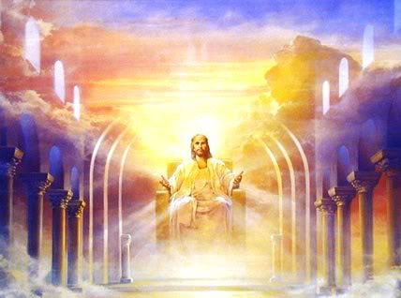
The Long-term Fulfillment
Christ will again be a wall of fire around Jerusalem to protect it
Jews will again be called to Israel from the four corners of the earth
Jerusalem will be blessed with people and animals
Gentile nations will be encouraged to submit to Christ their king because of what he has done for the Jews

Slide 24
Zechariah 3:1-5
4th Vision
Then he showed me Joshua the high priest standing before the Angel of the Lord, and Satan standing at his right hand to oppose him. 2 And the Lord said to Satan, "The Lord rebuke you, Satan! The Lord who has chosen Jerusalem rebuke you! Is this not a brand plucked from the fire?"
3 Now Joshua was clothed with filthy garments, and was standing before the Angel.
continued

Slide 25
Zechariah 3:1-5
4th Vision
4 Then He answered and spoke to those who stood before Him, saying, "Take away the filthy garments from him." And to him He said, "See, I have removed your iniquity from you, and I will clothe you with rich robes."
5 And I said, "Let them put a clean turban on his head.“ So they put a clean turban on his head, and they put the clothes on him. And the Angel of the Lord stood by.
Joshua will be High Priest!

Slide 26
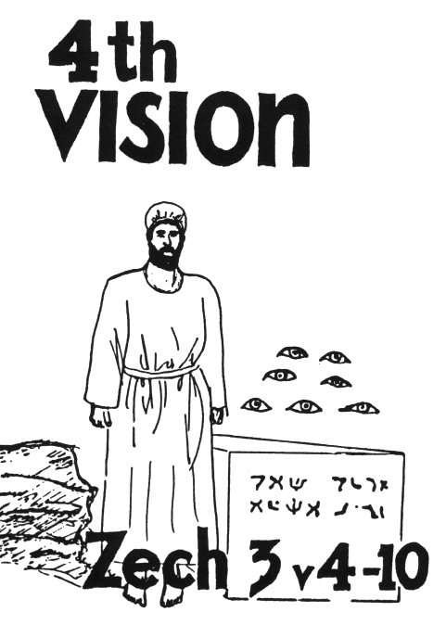
The 4th Vision:
What Zechariah saw:
Joshua & Satan standing before the
Angel of the Lord
Angel tells Satan “the Lord rebuke you”
Angel tells other angels to change
Joshua’s dirty clothes & put a clean
turban on him
Joshua and his companions are a
wondrous sign
God will bring forth His servant, the
Branch, the stone
7 eyes are looking at the stone
God will remove the iniquity of the land

Slide 27
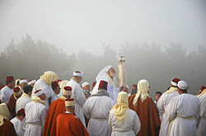
Who is Satan in Zechariah 3?
Satan represents the Samaritans who were moved into Israel by Esarhaddon, and the local authorities who opposed the temple
Ezra 4:1-5 They discouraged the Jews and troubled their building, and hired counselors against them to frustrate their purpose
Ezra 5:3-4 They collected the names of the leading Jews and wrote a letter to Darius
They tried to stop the building of God’s house

Slide 28
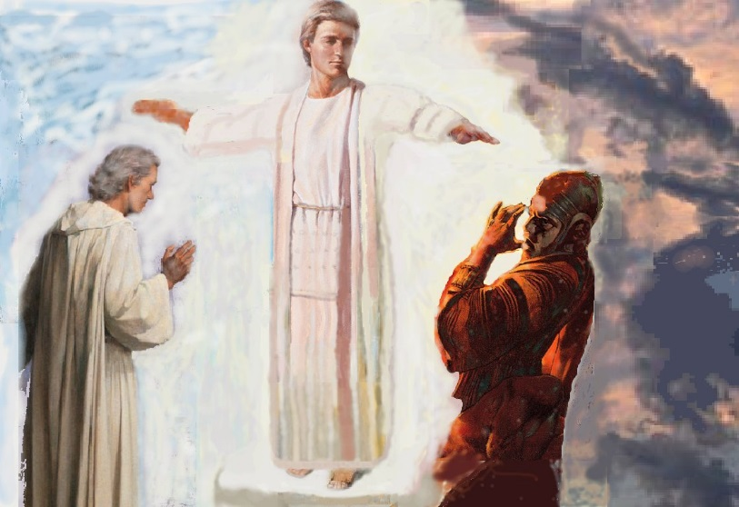
Vision of the High Priest
Zechariah 3
Appears like a court scene
The Angel of the Lord is the judge
Joshua and Satan stand before him
Other angels stand before him too (v.4)
Verdict: The Lord rebuke you!

Slide 29

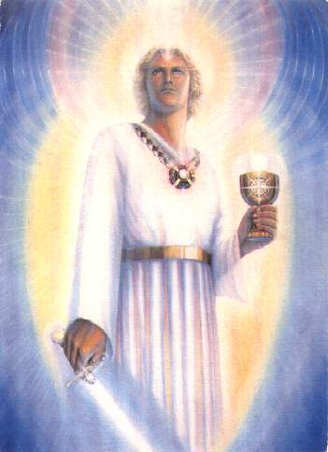
Who is the Angel of Zechariah 3?
Jude 1:9
Yet Michael the archangel, in contending with the devil, when he disputed about the body of Moses, dared not bring against him a reviling accusation, but said, "The Lord rebuke you!"
This may mean that the Angel of the Lord
throughout Zechariah is Michael
Note the reference to the brand plucked from the fire in Jude 1:23: ”but others save with fear, pulling them out of the fire, hating even the garment defiled by the flesh.”

Slide 30
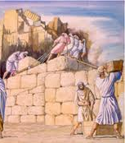
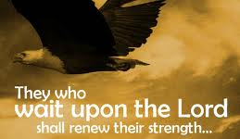
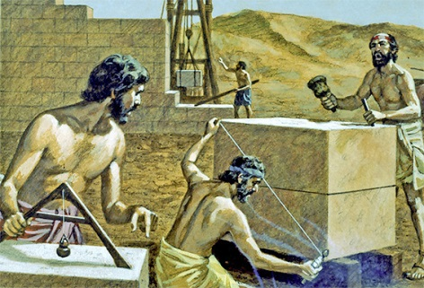
Joshua’s Sad State
Joshua was the High Priest of Israel (Hag 1:12; Ezra 5:2)
He had no temple to work in
He was filthy from working on the temple
He did not have the holy garments that were for glory and beauty (Ex 28:2)
The adversaries were committed to make him fail

Slide 31
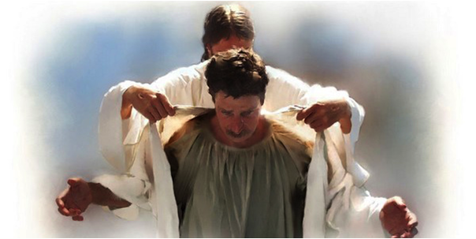
God Encourages Joshua (vs 2-5)
God has chosen Jerusalem & plucked it from the fire (v.2) [Note Jude 23]
The Angel of the Lord is on your side (v.2)
The Lord will rebuke the adversaries (v.2)
Joshua’s iniquity will be removed (v.4)
Joshua will be clothed in rich robes (v.4) and a clean turban (v.5) – Indicates he will operate as High Priest again!

Slide 32
Zechariah 3:6-7
Angel admonished Joshua
6 Then the Angel of the Lord admonished Joshua, saying, 7 "Thus says the Lord of hosts:
'If you will walk in My ways,
And if you will keep My command,
Then you shall also judge My house,
And likewise have charge of My courts;
I will give you places to walk
Among these who stand here.

Slide 33
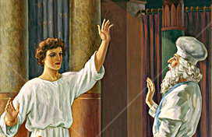
Angel’s charge to Joshua (6-7)
Walk in My ways
Keep My command
Then you will also judge My house
Then you will have charge of My courts
You will have “right of access” (RSV) among those (angels v.4) who stand by
God promised to bless Joshua as High Priest & grant him access to God’s house among the angels!

Slide 34
Zechariah 3:8-10
8 'Hear, O Joshua, the high priest, you and your companions who sit before you, for they are a wondrous sign; For behold, I am bringing forth My Servant the BRANCH.
9 For behold, the stone that I have laid before Joshua: Upon the stone are seven eyes. Behold, I will engrave its inscription,‘ Says the Lord of hosts, 'And I will remove the iniquity of that land in one day.
10 In that day,' says the Lord of hosts, 'Everyone will invite his neighbor under his vine and under his fig tree.'"

Slide 35

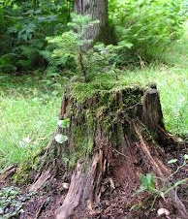
My Servant, the Branch (v.8)
Used in Jer 23:5 and 33:15 of someone who would be raised up in the line of David (a King)
Hag 2:23 – God says he will take “Zerubbabel My servant” make him as a signet ring, because He has chosen him.
Here applies to Zerubabbel, the governor, in the line of the King, whose hands will finish the temple! (4:9) – God’s promise!
Joshua & companions were men of sign

Slide 36
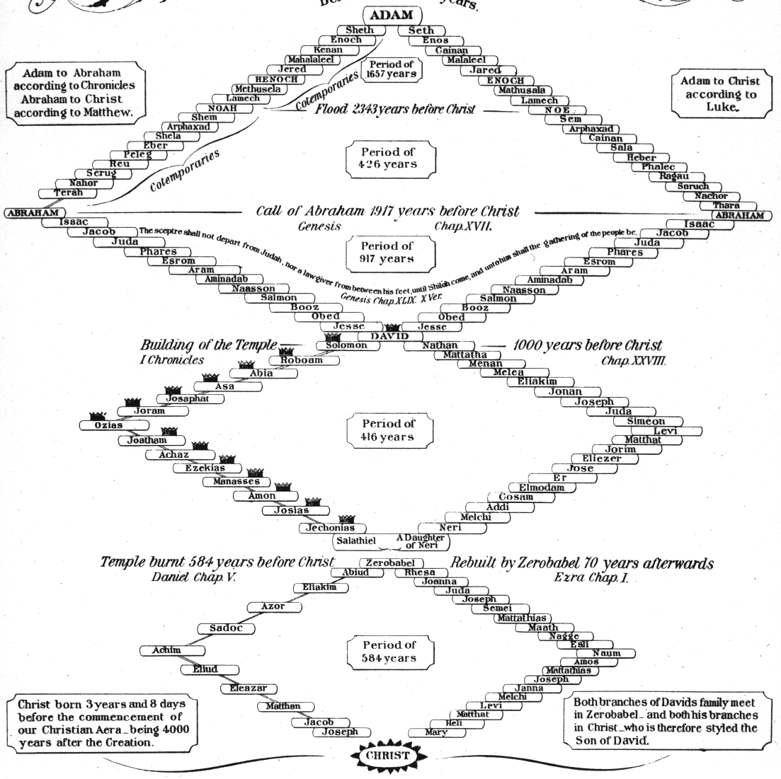

Slide 37
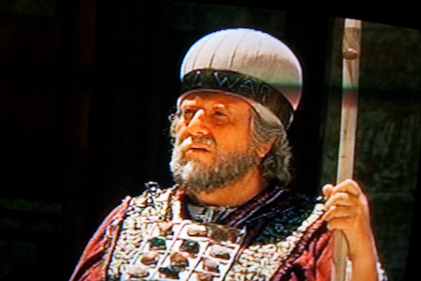
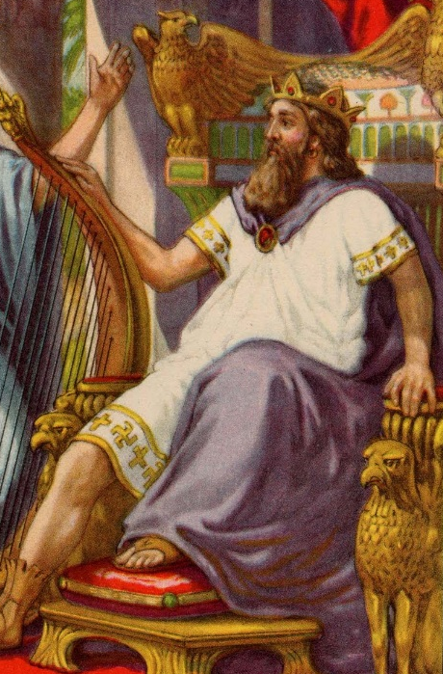
My Servant, the Branch
Used again in 6:11-13 and clearly applies to Joshua
The “Branch” prophecies ultimately predict a Messiah to come who will unite the offices of priest and king, as he will sit on his throne as priest and king (6:13)
Neither Joshua nor Zerubabbel could individually depict what Messiah would do, but together they predicted what God would do through His Son

Slide 38
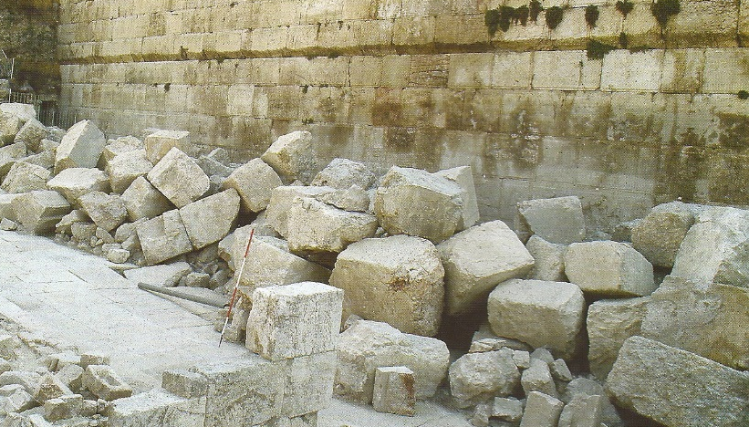
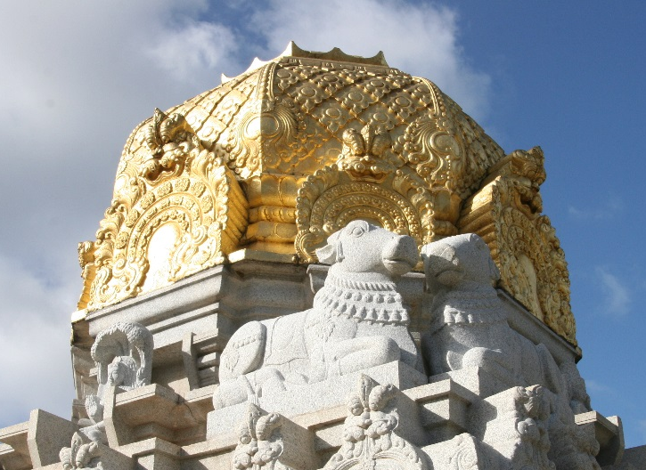
The Stone (3:9)
Not the cornerstone of the temple foundation because it was laid 16 years earlier in Ezra 3:8-13
This stone is the capstone (Zech 4:7), the final stone of the temple
Inscription was probably “Grace” as this was shouted in 4:7

Slide 39

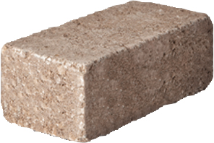
Upon the stone are 7 eyes (v.9)
Grace
Grace
Grace
Iniquity
removed!
“upon the stone” means the eyes are fixed, looking upon the stone. They are not in the stone, because the inscription is engraved in the stone
“7 eyes” are the angels (4:10) who will make sure the last stone (capstone) is placed into the temple

Slide 40
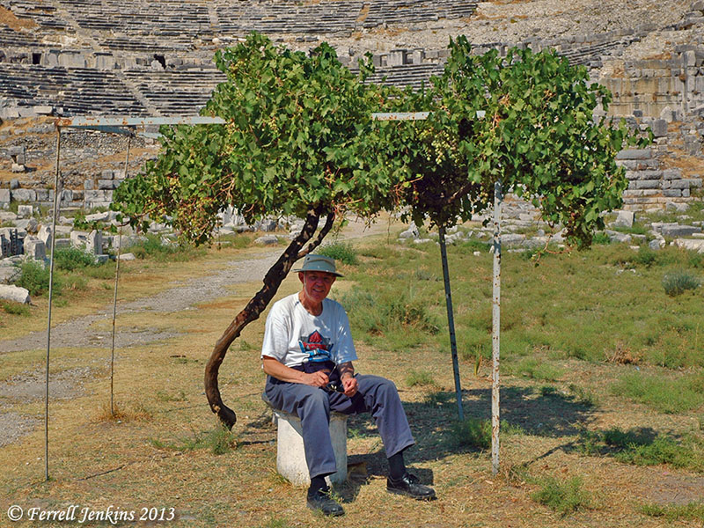
Under His Vine & His Fig Tree
Taken from Micah 4:4 indicating peace and prosperity
“invite his neighbor” implies a time of wonderful peace between people who get along and work together
If this is what the kingdom will be like, we should try to make it happen today!

Slide 41
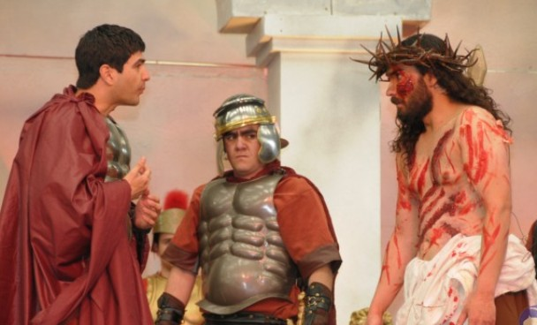
The Long-term Fulfillment
Jesus had to come in our nature & work in the filthy arena of sinful flesh to build God’s house (cross before the crown!)
Although Jesus’ adversaries accused him, God ultimately rebuked them and raised Jesus from the dead
God changed his clothes to immortality so as our immortal high priest he can save those who become part of God’s house

Slide 42

Lessons from Today
God will protect His ecclesias, if we are working on His house
Flee out of Babylon while we can, before the great and terrible Day of the Lord
Our God will rebuke our adversaries and bless our work today
The angels are watching over our ecclesial work and will make sure God’s house is assembled in the kingdom

Slide 44
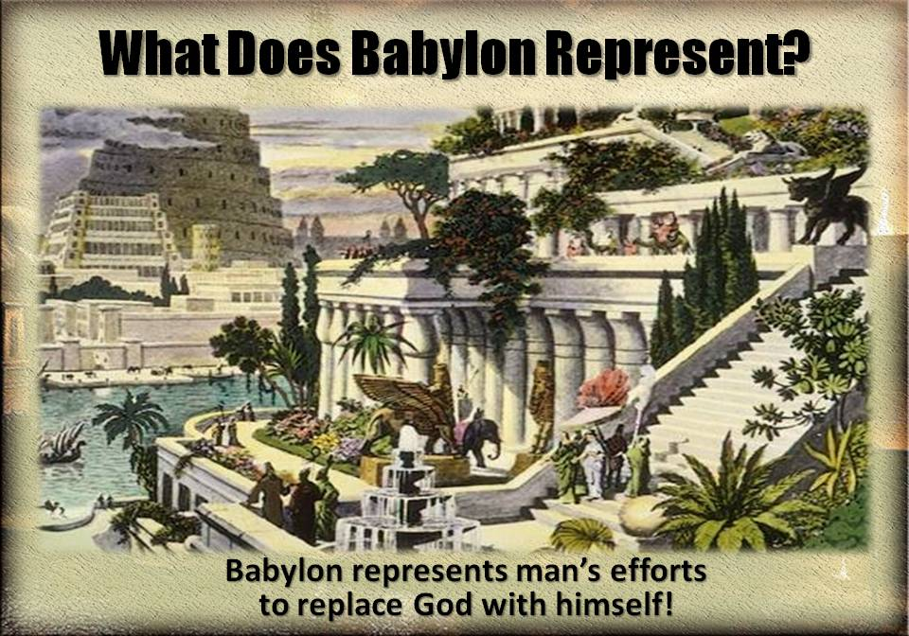

Slide 45
L
S
H
d

