Slide 1
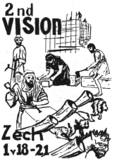
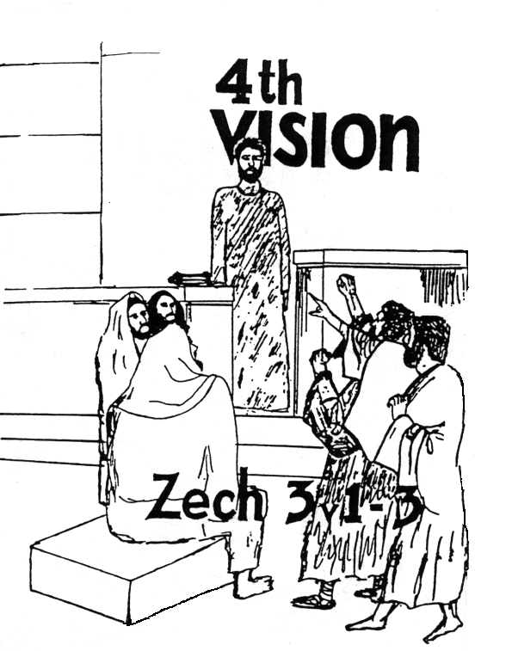
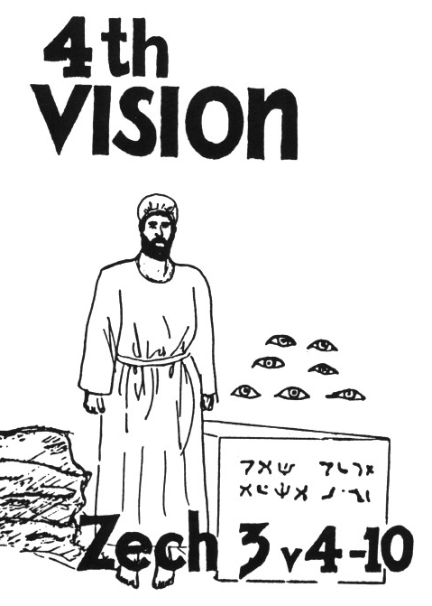

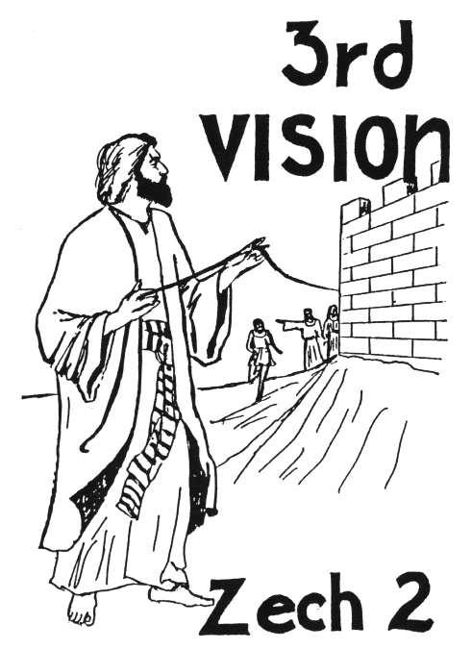



Zechariah’s
Night Visions
(Zech. 1-6)
Class 3:
Not by Might, nor by Power, but by God’s Spirit

Slide 2

Christadelphian writers who cover the historical application
Edward Whittaker in Testimony Magazine (June 1985)
W. H. Boulton in the 1907 Christadelphian Magazine
C.C. Walker in Theophany
Geoff & Ray Walker in The Second Exodus

Slide 3

Christadelphian writers who cover the historical application
Edward Whittaker in Testimony Magazine articles (June 1985)
W. H. Boulton in the 1907 Christadelphian Magazine
C.C. Walker in Theophany
Geoff & Ray Walker in The Second Exodus

Slide 4

The 5th Vision
What Zechariah saw:
Lampstand with a bowl on top
7 lamps and 7 pipes
2 olive trees dripping oil through 2 pipes into the bowl

Slide 5
What’s missing in this vision as compared to the tabernacle?
We have….
Lampstand
Lamps
Oil
What’s missing?
No human effort to supply the oil!

Slide 6
The Components of the vision
Lampstand = one community of believers
7 Lamps = individual ecclesias or pockets of believers (Rev 1:20)
Lights = revealing of God’s character and purpose to unbelievers & believers (Mat 5:14-15)
Oil = God’s spirit at work in our lives

Slide 7
The 2 Olive Trees?
Zerubabbel & Joshua (like the 2 witnesses of Rev 11:3-4)
The 2 Olive Branches (v.12)?
The “two anointed ones” (Sons of oil)
Haggai & Zechariah

Slide 8
What was the mountain (v.7) that Zerubabbel faced at that time?
Ezra 4:23-24
23 Now when the copy of King Artaxerxes' letter was read before Rehum, Shimshai the scribe, and their companions, they went up in haste to Jerusalem against the Jews, and by force of arms made them cease.
24 Thus the work of the house of God which is at Jerusalem ceased, and it was discontinued until the second year of the reign of Darius king of Persia.

Slide 9
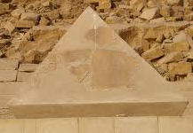

The capstone (v.7)
Grace
Last stone lifted into place
It’s force was felt by every stone in the building and held everything in place
Shouts of “grace, grace to it!”
God’s grace was all over this last stone because there was nothing the people could have done to deserve God’s kindness to them in letting them finish this house!

Slide 10
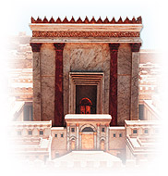
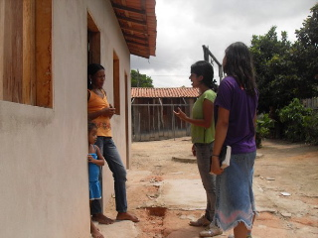
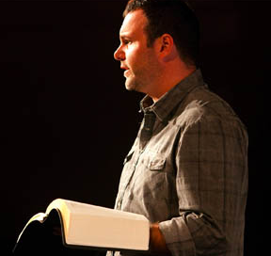
God’s House will be Finished!
Not by might, nor by power, but by God’s spirit (v.6)
Soon! Zerubabbel’s hands will finish it (v.9)
The angels (7 eyes) rejoice to see the work continuing (v.10)
Beware lest we despise the day of small things!

Slide 11

Haggai 2:2-4
The day of small things
2 "Speak now to Zerubbabel the son of Shealtiel, governor of Judah, and to Joshua the son of Jehozadak, the high priest, and to the remnant of the people, saying:
3 'Who is left among you who saw this temple in its former glory? And how do you see it now? In comparison with it, is this not in your eyes as nothing?
4 'Yet now be strong, Zerubbabel,' says the LORD; 'and be strong, Joshua, son of Jehozadak, the high priest; and be strong, all you people of the land,' says the LORD, 'and work; for I am with you,' says the LORD of hosts.
Never despise God’s work. The angels are always excited!

Slide 12
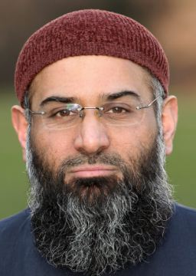
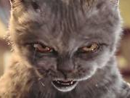
Who has despised the day of small things?
Most ecclesias today are small
Many have simple buildings, rent, or use homes
Witnessing projects may appear simple and small
Services: we try to use everyone
Warning: Don’t despise what God has given us and He is using to build His house! Get involved and appreciate what He has provided!

Slide 13

Look at the Angels in Zechariah
“Angel of the Lord” (Michael)
“Angel who talked with me” (possibly Gabriel)
“those who stood before him” (3:4)
Note the teamwork of the angels all throughout Zechariah!

Slide 14
Involvement of the Angels
Zech 1: Angels working with angels to provide political environment to finish building. An angel pleading with God for His mercy on the people.
Zech 2: Angels involved in the security of Jerusalem and assisting Jews who want to return to the land.
Zech 3: An angel stands up for the Jews and rebukes the adversaries. Assisting angels change Joshua’s clothes. Angels watching over the capstone.
Zech 4: Angels involved in removing the mountain and rejoicing in the temple work!

Slide 15
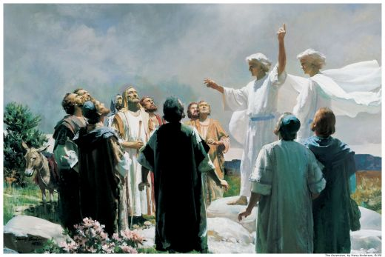
Angels throughout the Bible
2 Chron 16:9 The eyes of the Lord run to and fro throughout the whole earth
Dan 4:17 'This decision is by the decree of the watchers, and the sentence by the word of the holy ones…
Heb 1:14 Are they not all ministering spirits sent forth to minister for those who will inherit salvation.

Slide 16
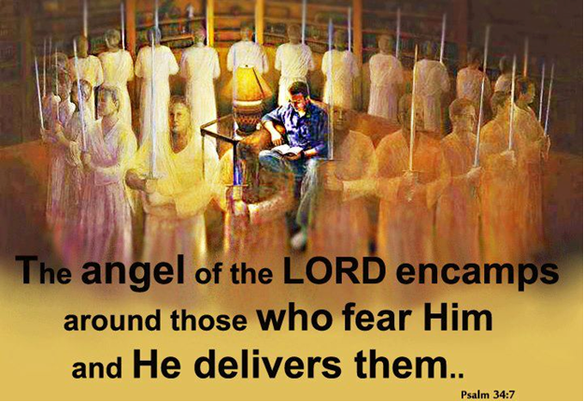
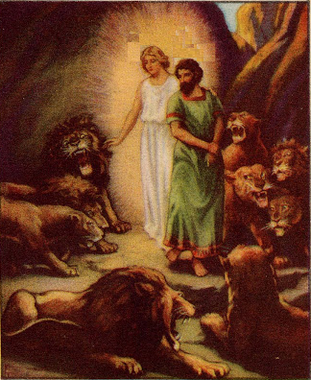
No different today!
Angels involved in the political events
Angels protecting God’s family: in our homes and when we travel
Angels pleading to God on our behalf
Angels guide us in our walk to the Kingdom

Slide 17
Luke 20:35-36
We hope to be equal to Angels
35 "But those who are counted worthy to attain that age, and the resurrection from the dead, neither marry nor are given in marriage;
36 "nor can they die anymore, for they are equal to the angels and are sons of God, being sons of the resurrection.
We will behave like angels. Now is our practice time!

Slide 18
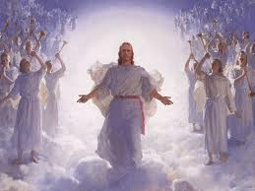
What Angels do now, we hope to do in the Kingdom!
Psa 103:20-22 God’s ministers who excel in strength and do God’s word and do His pleasure.
Heb 1:14 Ministering spirits sent forth to minister for those who will inherit salvation.
This is our practice time!

Slide 19
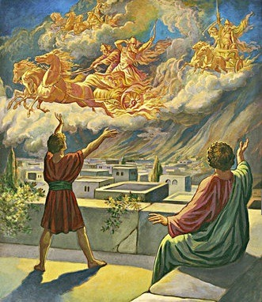
Angels are here right now!
They hear what we say and think (Gen 18:12-13; 1 Pet 3:6; Lk 24:6-7)
They rejoice when we make good choices (Luke 15:10), disappointed when we don’t
They watch the way we treat each other
They know what we do in our homes
Don’t disappoint them!

Slide 20
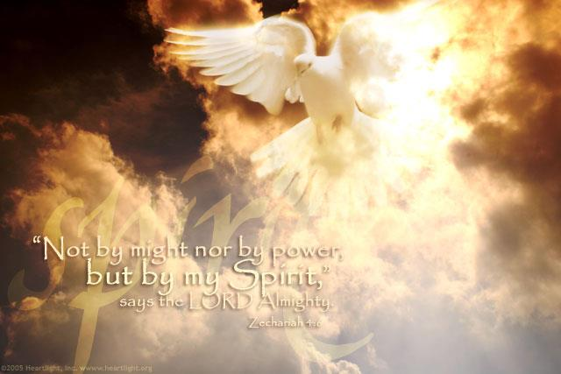
The Long-term Fulfillment
The Jews today will not succeed by their own might & power, but God’s spirit will deliver them again & build Ezekiel’s temple in the land
The mountain of Muslim opposition will be removed & Abraham’s descendants will inherit the land
The Angels will bring about these events today, just as they did years ago

Slide 21

Lessons from Today
Our God will rebuke our adversaries and bless our work today
The angels are watching over our ecclesial work and will make sure God’s house is assembled in the kingdom
Remember…it’s God’s spirit, not our might, that keeps our ecclesial lights shining
It is only by God’s grace that we will fit into His spiritual house
The Angels work for us 24 – 7 – 365. They want us to make it. Don’t let them down!

Slide 23
Lessons from Today
God

Slide 24
2
W
17
!

Slide 25
2
W
17
!

Slide 26
2
W
17
!

Slide 27
Lessons for Us
Remember…it’s God’s spirit, not our might, that keeps our ecclesial lights shining
It is only by God’s grace that we will fit into His spiritual house
The Angels work for us 24 – 7 – 365. They want us to make it. Don’t let them down!

