Slide 1
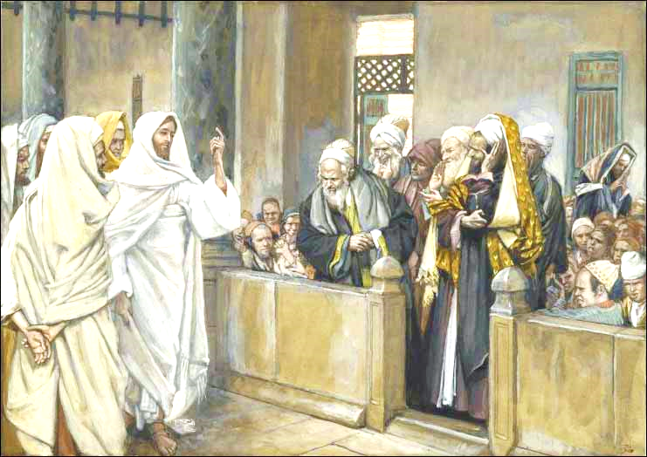
Delegation from Bethel
Zech 7

Slide 2

Zechariah 7:1-3
Should we keep weeping & fasting?
1 Now in the fourth year of King Darius it came to pass that the word of the Lord came to Zechariah, on the fourth day of the ninth month, Chislev, 2 when the people sent Sherezer, with Regem-Melech and his men, to the house of God, to pray before the Lord, 3 and to ask the priests who were in the house of the Lord of hosts, and the prophets, saying, "Should I weep in the fifth month and fast as I have done for so many years?"
They did this for almost 50 years!

Slide 3

Where are we in Zechariah 7?
4
You are here!

Slide 4
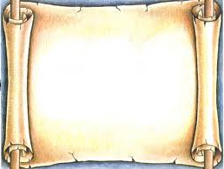
House of God OR Bethel
New King James (NKJV & KJV)
2 when the people sent Sherezer, with Regem-Melech and his men, to the house of God, to pray before the LORD,
New American Standard (NASB)
2 Now the town of Bethel had sent Sharezer and Regemmelech and their men to seek the favor of the LORD,
Revised Standard Version (RSV)
2 Now the people of Bethel had sent Share'zer and Reg'em-mel'ech and their men, to entreat the favor of the LORD,

Slide 5

☺ Contextual Scholars Only ☺
How can you tell from the context of 6:14 - 7:3 that the “house of God” (KJV and NKJV) is not the temple???
Temple is referred to as “house of the Lord of hosts” (v.3)

Slide 6
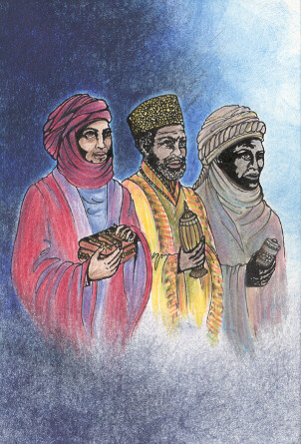
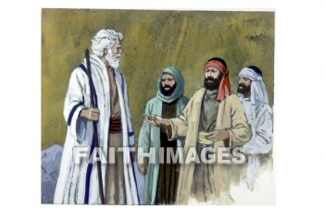
Contrast the two Delegations of Zechariah 6 & 7
Zech 6:10 The gifts from the captives – from Heldai, Tobijah and Jedaiah
Zech 7:2 The question from Bethel – from Sherezer, Regem-Melech, and his men
What differences do you notice???

Slide 7
Contrast the two groups
Zechariah 6
From Babylon
Jewish names
Give gifts
Focused on temple
Operate on faith
Zechariah 7
From Bethel
Babylonian names
Ask questions
Focused on themselves
Concerned about works

Slide 8

Delegation from Bethel
Some of Bethel did return (Ezra 2:20) 223 of Bethel and Ai.
Sent official delegation to ask about information that temple builders would have discussed while on the job!
Should have helped build the temple, but seems they were out of touch.
Probably stayed in Bethel & kept the rituals going.
Uninvolved in ecclesial life. Worried about formal rituals that take away personal time!

Slide 9
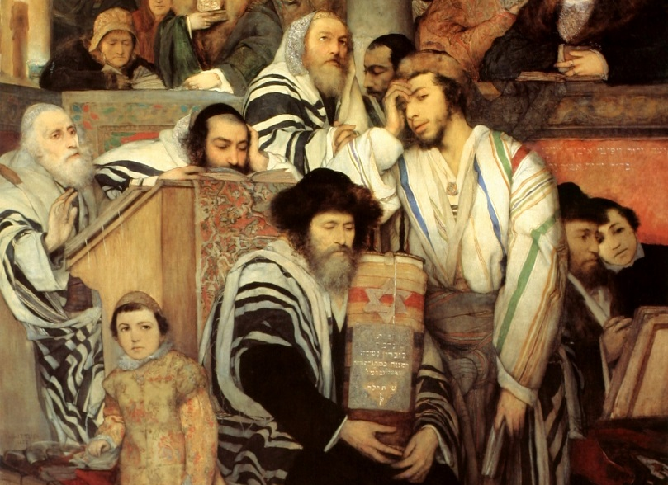
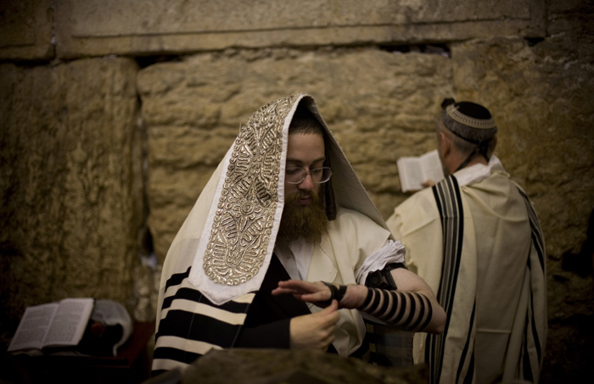
The Question about Fasting
The people only ask about the 5th month fast
God’s response covers all their ritualistic fasts – 7th month, 4th month, 10th month (see 7:5; 8:19)

Slide 10
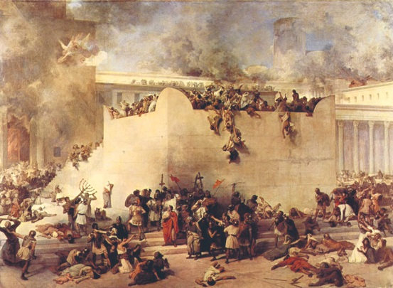
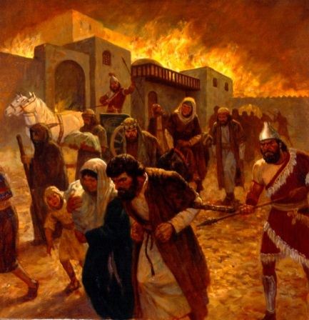
Jewish fasts to remember
Jerusalem’s downfall (7:5; 8:19)
5th Month: Jer 1:3 Judah taken captive
7th Day – 2 Kgs 25:8-9 Nebuzaradan burned temple,
broke wall of city
10th Day – Jer 52:12-15 Nebuzaradan burned
temple, burned king’s house, broke wall of city
7th Month:
2 Kgs 25:25 Ishmael rebelled, killed Gedaliah & Jews at Mizpeh, escaped to Egypt
Jer 41:1-3, 10 Ishmael rebelled, killed Gedaliah, carried some Jews from Mizpeh away captive

Slide 11
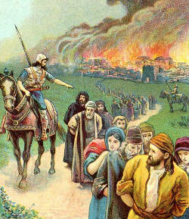
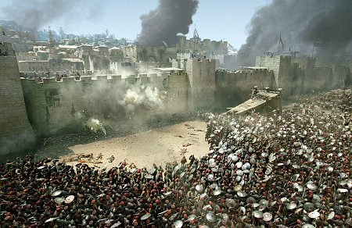
Jewish fasts to remember
Jerusalem’s downfall (8:19)
4th Month: Probably 9th day
Jer 52:6-8 Zedekiah broke thru wall, tried to escape, but was captured
Jer 39:1-2 Nebuchadnezzar penetrated wall of Jerusalem
10th Month: Prob 10th day
2 Kgs 25:1; Jer 39:1; 52:4 Nebuchadnezzar besieged Jerusalem in Zedekiah’s 9th year

Slide 12
Zechariah 7:4-7
God’s response!
4 Then the word of the Lord of hosts came to me, saying, 5 "Say to all the people of the land, and to the priests: 'When you fasted and mourned in the fifth and seventh months during those seventy years, did you really fast for Me — for Me? 6 When you eat and when you drink, do you not eat and drink for yourselves? 7 Should you not have obeyed the words which the Lord proclaimed through the former prophets when Jerusalem and the cities around it were inhabited and prosperous, and the South and the Lowland were inhabited?'"
God wanted obedience, not ritual observance!

Slide 13
2
W
17
!

Slide 14

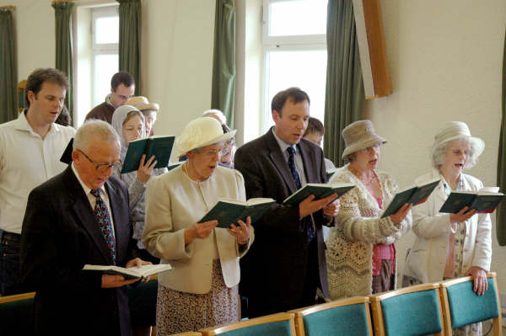
God’s Response:
to “all the people of the land” (v.5)
Did you really fast for Me – for Me???
You really do what pleases you!
You should have obeyed the message given to you from the prophets years ago
God cares about our motives, not our motions!

Slide 15
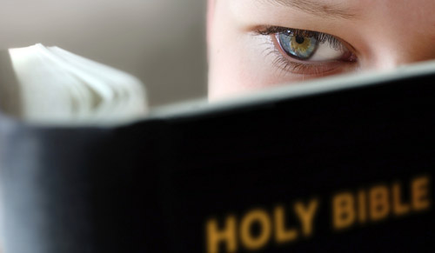
God cares about our Motives!
Why do you read the Bible?
Their motives for fasts:
  self pity – they mourned their suffering, not their sins!
  Looked righteous – but no real caring for others
Their motives for feasts
  Pleasure for themselves – not for God or others!
  Social gatherings and parties
God’s intent – 8:19-23
  Joyful feasts
  Love truth and peace
  Invite others to join in worshipping Him!
“having a form of godliness, but denying its power” 2 Tim 3:5

Slide 16
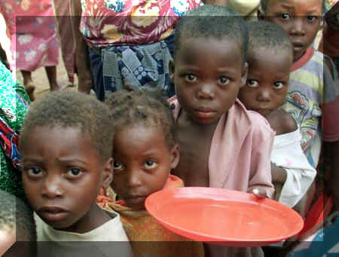

God’s intent for fasts (Isa 58)
Loose the bonds of wickedness & let the oppressed go free (v.6)
Feed the hungry, give shelter to the homeless, clothe the naked (v.7)
Not a time for putting yokes on others, pointing fingers or speaking wickedness (v.9)
Do God’s work instead of our own
v.14 - I will cause you to ride on the high hills of the earth, and feed you with the heritage of Jacob your father. Taken from Deut 32:13,9 when Moses tried to get Israel to see beyond the letter of the Law!

Slide 17
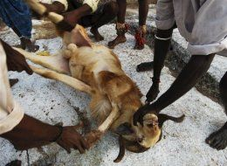
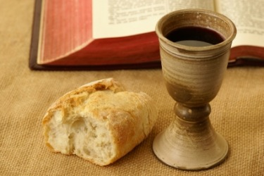
Who are the rituals for?
Amos 4:4-5
4 "Come to Bethel and transgress, at Gilgal multiply transgression; bring your sacrifices every morning, your tithes every three days.
5 Offer a sacrifice of thanksgiving with leaven, proclaim and announce the freewill offerings; for this you love, you children of Israel!" Says the Lord GOD.
Amos 5:25-26
25 "Did you offer Me sacrifices and offerings in the wilderness forty years, O house of Israel?
26 You also carried Sikkuth your king and Chiun, your idols, the star of your gods, which you made for yourselves. (used by Stephen in Acts 7:42-43)

Slide 18
Zechariah 7:8-10
What God really wants
8 Then the word of the Lord came to Zechariah, saying, 9 "Thus says the Lord of hosts:
'Execute true justice,
Show mercy and compassion
Everyone to his brother.
10 Do not oppress the widow or the fatherless,
The alien or the poor.
Let none of you plan evil in his heart
Against his brother.'
God expects us to live like Him!

Slide 19

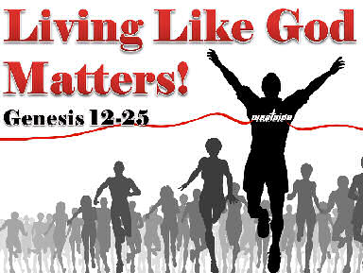
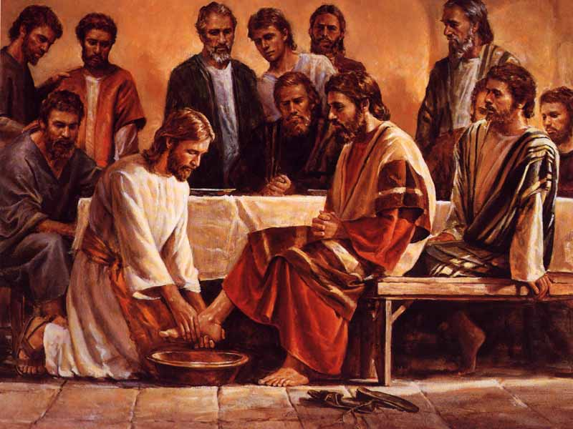
Live the Truth! (vs 9-10) Don’t just act it out!
Execute true justice (in our decisions)
Show mercy & compassion
Don’t oppress the poor, fatherless, widows
Don’t plan evil in our hearts against a brother or sister!
I am the Way, and the Truth, and the Life
The Truth is a way of life, not a club or church!

Slide 20
Micah 6:6-8
What does God really want?
6 With what shall I come before the LORD, and bow myself before the High God? Shall I come before Him with burnt offerings, with calves a year old?
7 Will the LORD be pleased with thousands of rams, ten thousand rivers of oil? Shall I give my firstborn for my transgression, the fruit of my body for the sin of my soul?
8 He has shown you, O man, what is good; and what does the LORD require of you but to do justly, to love mercy, and to walk humbly with your God?
God wants Godly behavior, not rituals

Slide 21
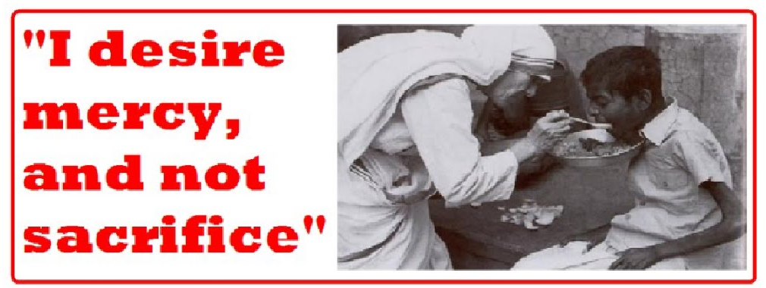
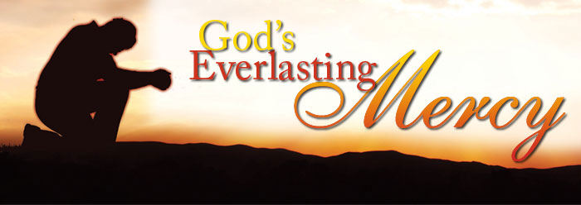
God didn’t really want sacrifices!
Ex 19:5 Obey My voice, keep covenant
Jer 7:21-23 Obey My voice!
Amos 5:21-25 I will not accept them!
Hos 6:6 Mercy…not sacrifice!
Note Christ’s use in Mat 9:13; 12:7
Compare the fasts
of Zech 7

Slide 22
Zechariah 8:14-17
Same message in Zechariah 8
14 "For thus says the Lord of hosts: 'Just as I determined to punish you When your fathers provoked Me to wrath,‘ Says the Lord of hosts, 'And I would not relent, 15 So again in these days I am determined to do good To Jerusalem and to the house of Judah. Do not fear.
16 These are the things you shall do:
Speak each man the truth to his neighbor; Give judgment in your gates for truth, justice, and peace; 17 Let none of you think evil in your heart against your neighbor; And do not love a false oath. For all these are things that I hate,‘ Says the Lord."
When God does us good, He expects good behavior from us!

Slide 23
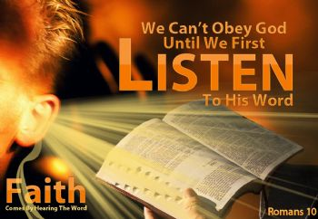

Listen to the Bible and respond! (vs 7 and 12)
Listen to the prophets when we read our Bibles in our homes
  Don’t just read and walk away!
  Read…think….consider how to put it into practice today
  How can I live more like God?
  What can I do today to help God’s family?

Slide 24
Zechariah 7:13
God’s Warning!
'When I called, they did not listen; so when they called, I would not listen,' says the LORD Almighty. (NIV cp RSV, NASB)
The way we respond to God now may be the way He responds to us in the days to come
Don’t wait until a tragedy occurs, to listen to God speaking to us today thru His word, and events He brings into our lives

Slide 25
Zechariah 7:14
God warns the Nation
"But I scattered them with a whirlwind among all the nations which they had not known. Thus the land became desolate after them, so that no one passed through or returned; for they made the pleasant land desolate."
He did it before and He will do it again!

Slide 26

Lessons from Zechariah 7
Don’t let your worship deteriorate into ritual worship – let it affect how you live!
God cares about our motives – make sure we are serving Him for the right reasons
Work on justice & mercy, and walk humbly before God
Listen to the warnings in God’s word
Don’t be an actor – live God’s way all the time

Slide 27

Let’s leave camp, thankful we have a loving Heavenly Father, and His son who showed us how to live, and His angels that work for us everyday, all the time
And we know that God causes all things to work together for good to those who love God, to those who are called according to His purpose. (Rom 8:28)

Slide 29
2
W
17
!

Slide 30
2
S
G

