Slide 1
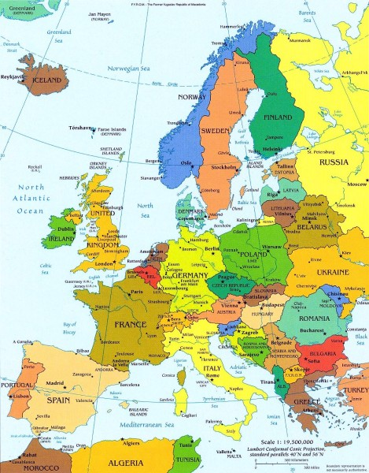
Why Russia and Europe will Combine!
Perth
2015 Prophecy Day

Slide 2
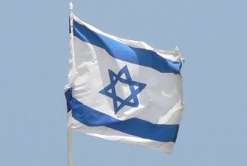
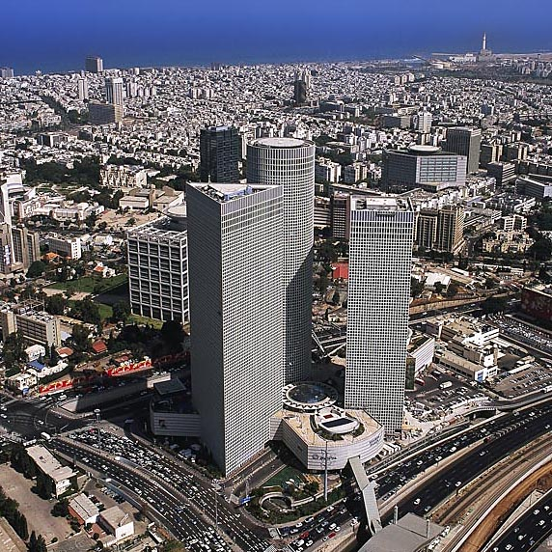
In those days …
Joel 3:1-2 KJV
1 For, behold, in those days, and in that time, when I shall bring again the captivity of Judah and Jerusalem,
2 I will also gather all nations, and will bring them down into the valley of Jehoshaphat, and will plead with them there for my people and for my heritage Israel, whom they have scattered among the nations, and parted my land.
Tel Aviv – From sand dunes to a major city in a 100 years

Slide 3
“latter years” – Our Time!
Ezekiel 38:8 KJV
8 After many days thou shalt be visited: in the latter years thou shalt come into the land that is brought back from the sword, and is gathered out of many people, against the mountains of Israel, which have been always waste: but it is brought forth out of the nations, and they shall dwell safely all of them.

Slide 4
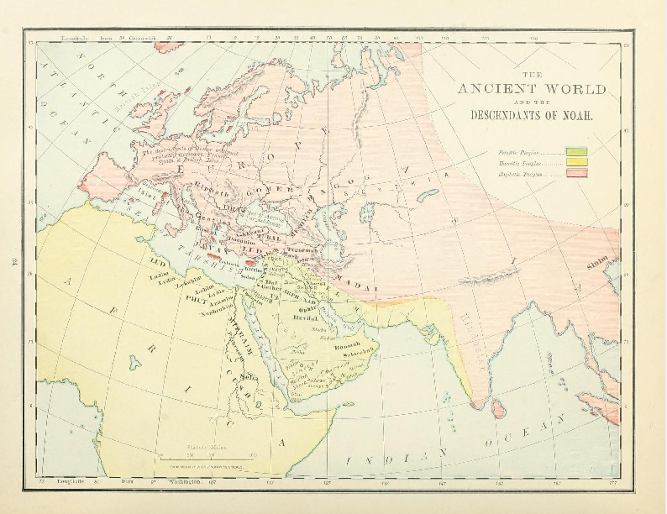
The Ancient World
The Nations of Genesis 10
Genesis 10:2-5 KJV
2 The sons of Japheth; Gomer, and Magog, and Madai, and Javan, and Tubal, and Meshech, and Tiras.
3 And the sons of Gomer; Ashkenaz, and Riphath, and Togarmah.
4 And the sons of Javan; Elishah, and Tarshish, Kittim, and Dodanim.
5 By these were the isles of the Gentiles divided in their lands; every one after his tongue, after their families, in their nations.

Slide 5
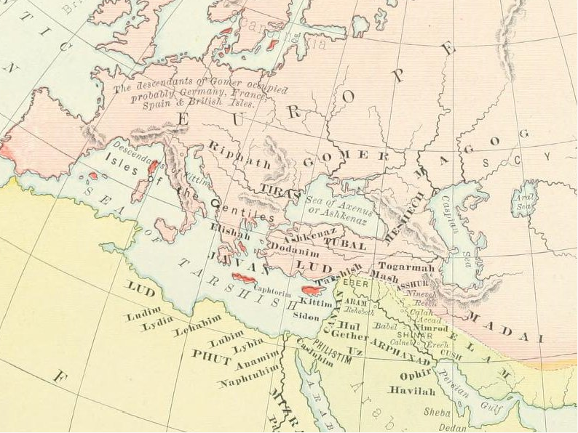
The Descendants of Noah (Rand-McNally)

Slide 6
“I will” – A work of God
Ezekiel 38:4 KJV
4 And I will turn thee back, and put hooks into thy jaws, and I will bring thee forth, and all thine army, horses and horsemen, all of them clothed with all sorts of armour, even a great company with bucklers and shields, all of them handling swords:
Ezekiel 38:4-5 ESV
4 And I will turn you about and put hooks into your jaws, and I will bring you out, and all your army, horses and horsemen, all of them clothed in full armor, a great host, all of them with buckler and shield, wielding swords.

Slide 7
The God of Heaven shall …
Daniel 2:44 KJV
44 And in the days of these kings shall the God of heaven set up a kingdom, which shall never be destroyed: and the kingdom shall not be left to other people, but it shall break in pieces and consume all these kingdoms, and it shall stand for ever.

Slide 8
Yahweh will gather the nations
Zechariah 14:1-3 KJV
1 Behold, the day of the LORD cometh, and thy spoil shall be divided in the midst of thee.
2 For I will gather all nations against Jerusalem to battle; and the city shall be taken, and the houses rifled, and the women ravished; and half of the city shall go forth into captivity, and the residue of the people shall not be cut off from the city.
3 Then shall the LORD go forth, and fight against those nations, as when he fought in the day of battle.

Slide 9
When Yahweh restores Judah …
Joel 3:1-2 KJV
1 For, behold, in those days, and in that time, when I shall bring again the captivity of Judah and Jerusalem,
2 I will also gather all nations, and will bring them down into the valley of Jehoshaphat, and will plead with them there for my people and for my heritage Israel, whom they have scattered among the nations, and parted my land.

Slide 10
Chief; Rosh; Russia
Ezekiel 38:1-3 KJV
1 And the word of the LORD came unto me, saying,
2 Son of man, set thy face against Gog, the land of Magog, the chief prince of Meshech and Tubal, and prophesy against him,
3 And say, Thus saith the Lord GOD; Behold, I am against thee, O Gog, the chief prince of Meshech and Tubal:
Ezekiel 38:1-3 RV
1 And the word of the LORD came unto me, saying,
2 Son of man, set thy face toward Gog, of the land of Magog, the prince of Rosh, Meshech, and Tubal, and prophesy against him,
3 and say, Thus saith the Lord GOD: Behold, I am against thee, O Gog, prince of Rosh, Meshech, and Tubal:

Slide 11
Gog of the land of Magog (Elpis Israel pg. 429)
“Gogue of the land Ma-gogue”, that is, styling the ruler of Magogue by the latter syllable of the name of the country over which he rules. We have seen that Magogue is the region extending from the Ros, or Russia, to the Rhine, comprehending Wallachia, Transylvania, Hungary, and Germany. Of course, the prophecy must be future, because the Prince of the Ros is the Gogue of Magogue ; and as yet no Emperor of Russia has been alse Emperor of Germany, etc.”

Slide 12
Many Peoples of Europe with Russia
Ezekiel 38:6 KJV
6 Gomer, and all his bands; the house of Togarmah of the north quarters, and all his bands: and many people with thee.

Slide 13
John Thomas’ Paraphrase of Ezekiel 38:2-7
(Elpis Israel) Pg. 432
“Son of Man, set thy face against Gogue, the Emperor of Germany, Hungary, etc., and Autocrat of Russia, Moscovy, and Tobolskoi, and prophesy against him, and say, Thus saith the Lord God: Behold I am against thee, O Gogue, Autocrat of Russia, Moscovy, and Tobolskoi: and I will turn thee about, and put a bit into thy jaws, and I will bring thee forth from the north parts, and all thine army, horses, and horsemen, all of them accoutred with all sorts of armour, even a great company with bucklers and shields, all of them handling swords: among whom shall be Persians, Ethiopians, and Libyans,; all of them with shields and helmet: French and Italians, etc., Circassians, Cossacks, and the Tartar hordes of Usbeck, etc. : and many people not particularly named besides. Be thou prepared; prepare thyself, thou, and all thy company that are assembled with thee; and be thou Imperial Chief to them.”

Slide 14
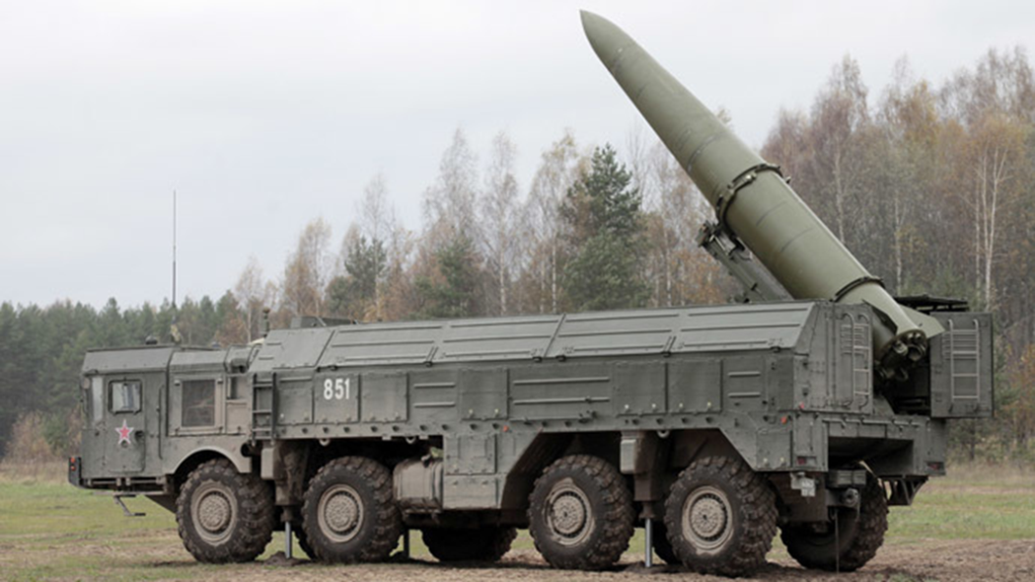
Gog “Guards” the Others
Ezekiel 38:7 KJV
7 Be thou prepared, and prepare for thyself, thou, and all thy company that are assembled unto thee, and be thou a guard unto them.

Slide 15
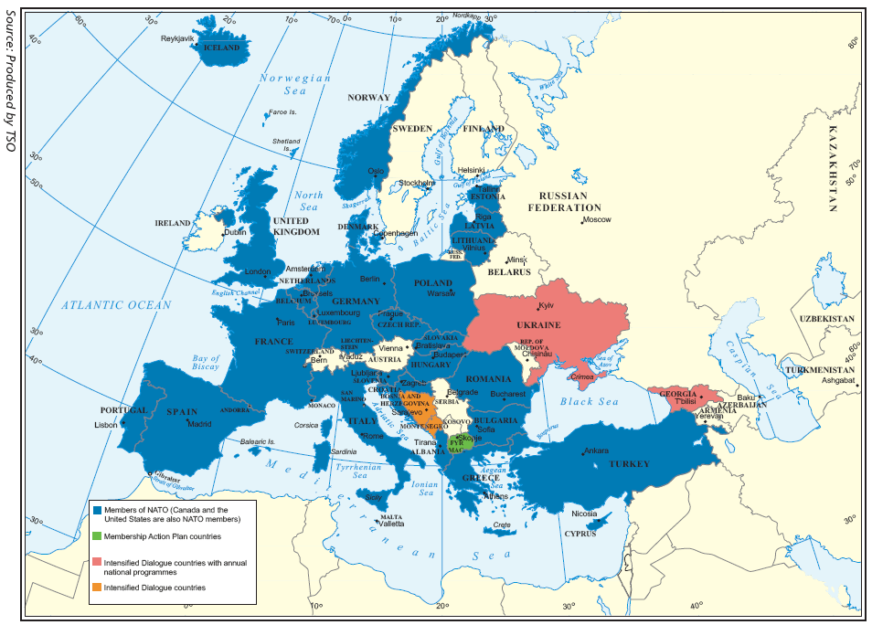
NATO and EUROPE

Slide 16
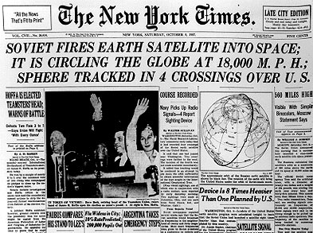
October 8, 1957

Slide 17
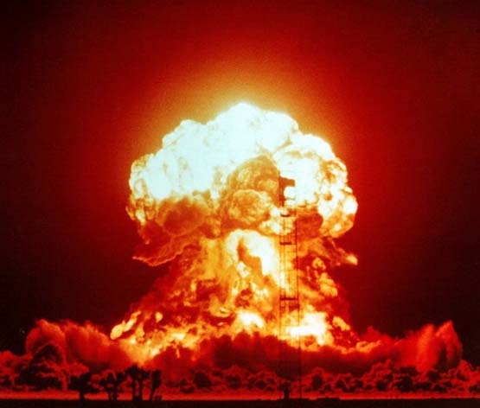
5 Megaton Nuclear Bombs?

Slide 18
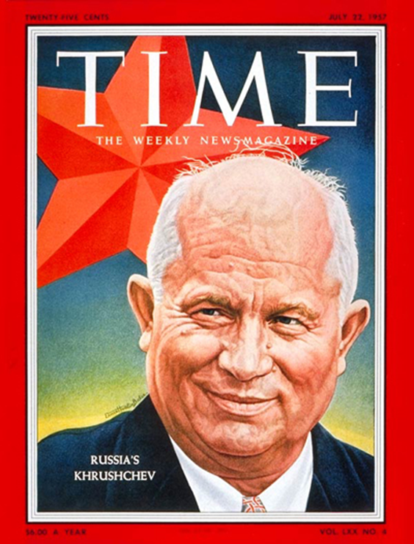
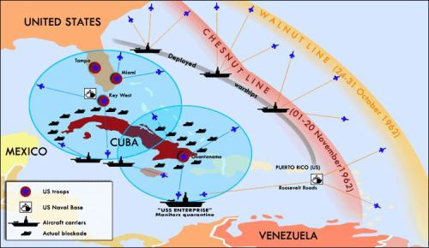
Cuban Missile Crisis - 1962

Slide 19
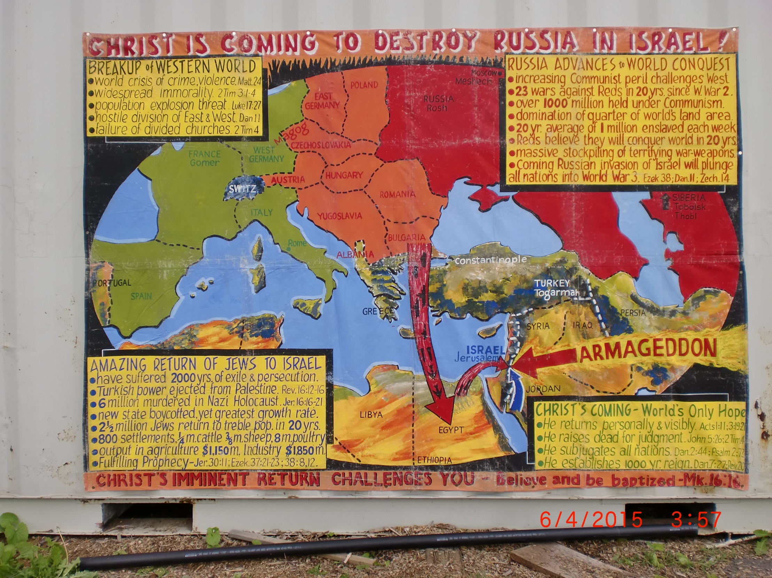
OUR PROPHETIC MESSAGE IN THE 60’S

Slide 20
OUR PROPHETIC MESSAGE IN THE 60’S

Slide 21
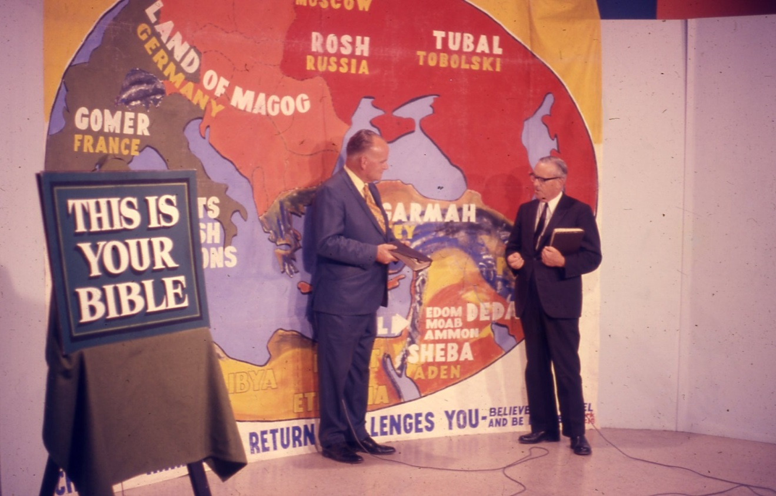
OUR PROPHETIC MESSAGE IN THE 70’S

Slide 22
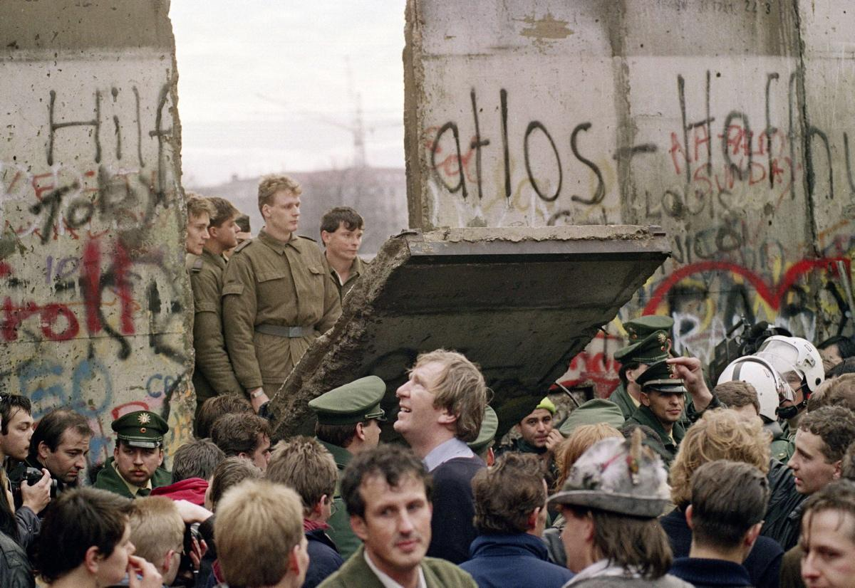
Then the Berlin Wall Came Down
(1989)

Slide 23
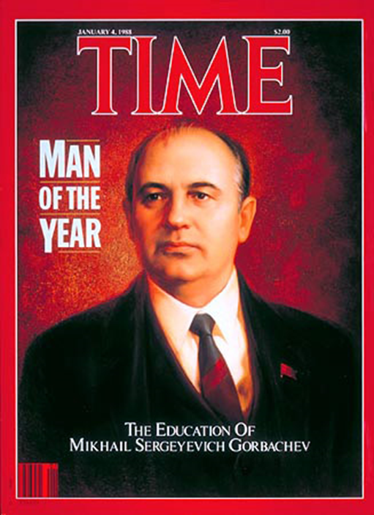
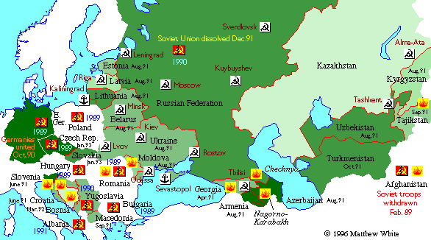
Then the Soviet Union collapsed - 1990

Slide 24
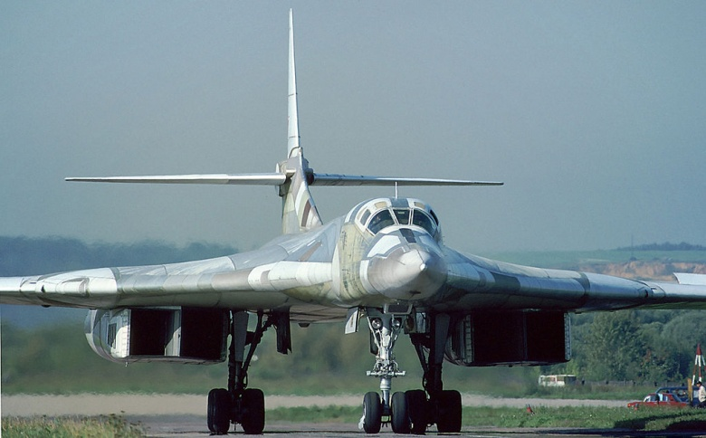
But Now Russia Rises Again (1990 – 2015)

Slide 25
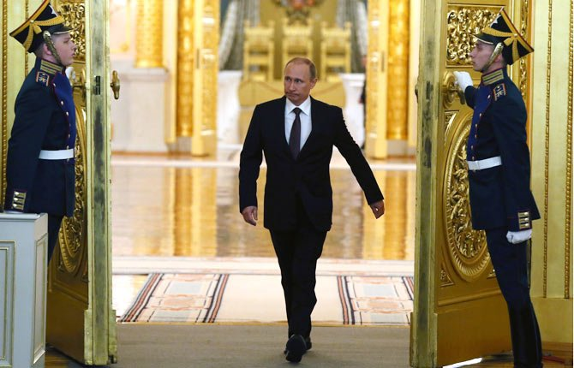
A New Prince of Rosh, Meshech, Tubal
Vladimir Putin
President of Russia

Slide 26
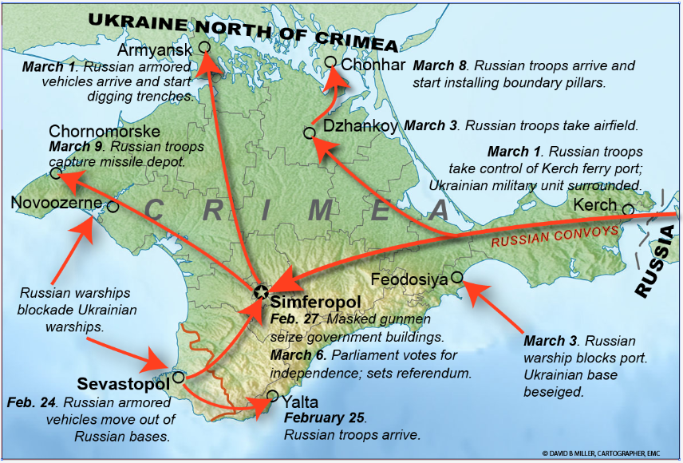
The Invasion and Takeover of Crimea

Slide 27
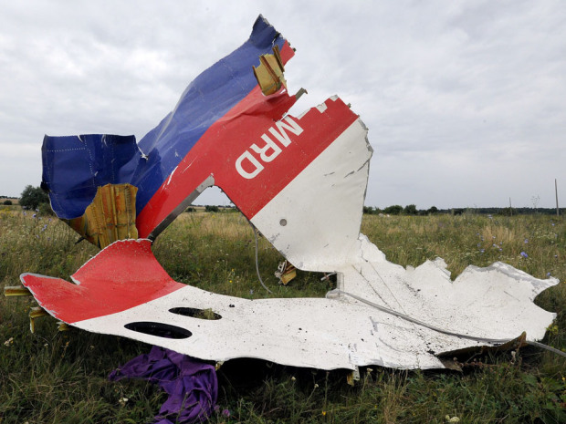
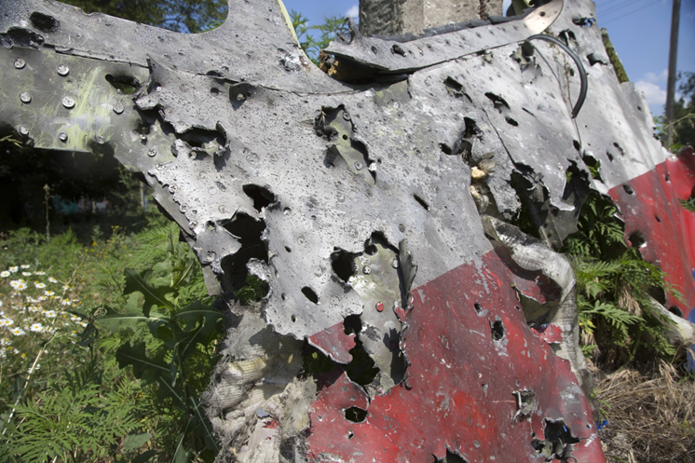
MH-17 Blasted out of the Sky!

Slide 28
Russia Files Bid At UN For Vast Arctic Territory
“Russia says it has submitted to the United Nations a bid for vast territories in the Arctic Ocean. The Foreign Ministry said on August 4 that Moscow is claiming 1.2 million square kilometers of the Arctic sea shelf. Russia, the United States, Norway, Denmark, and Canada have all attempted to assert their jurisdiction over parts of the Arctic Ocean, which is thought to hold much of the Earth's undiscovered energy resources. Russia first submitted such a claim in 2002, but the UN returned it due to a lack of evidence. Moscow's latest bid reportedly contains much more data. Russia made a symbolic claim to the Arctic seabed in 2007 when one of its submarines dropped a canister containing a Russian flag onto the ocean floor near the North Pole.”
-- Based on reporting by AP and Interfax. Radio Free Europe/Radio Liberty © 2015 RFE/RL, Inc. All Rights Reserved. http://www.rferl.org/content/russia-un-arctic-territory/

Slide 29
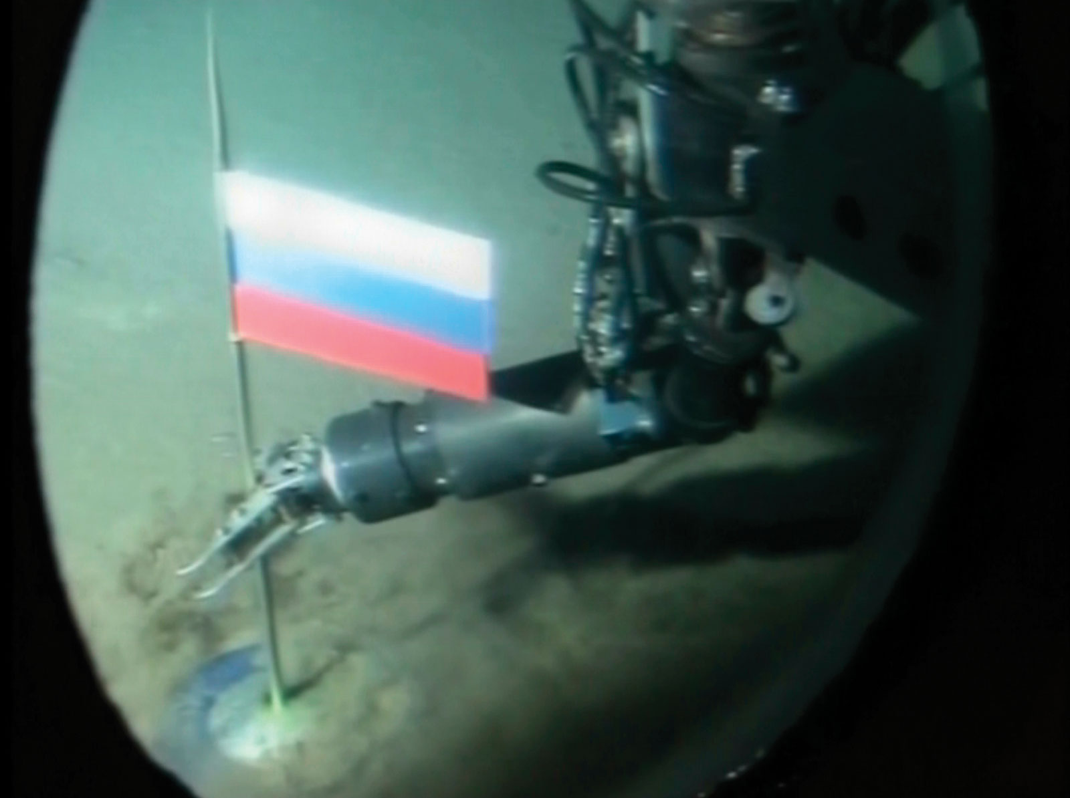
A Russian Robotic Submarine placed a Russian flag under the sea at North Pole (2007)

Slide 30
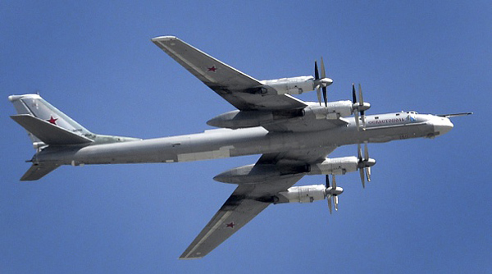
Russian TU195 Bombers test the Airspace of Western Nations
Four such aircraft probed Californian airspace on July 4th, this month!

Slide 31
Against Jerusalem to battle …
Zechariah 14:1-3 KJV
1 Behold, the day of the LORD cometh, and thy spoil shall be divided in the midst of thee.
2 For I will gather all nations against Jerusalem to battle; and the city shall be taken, and the houses rifled, and the women ravished; and half of the city shall go forth into captivity, and the residue of the people shall not be cut off from the city.
3 Then shall the LORD go forth, and fight against those nations, as when he fought in the day of battle.

Slide 32
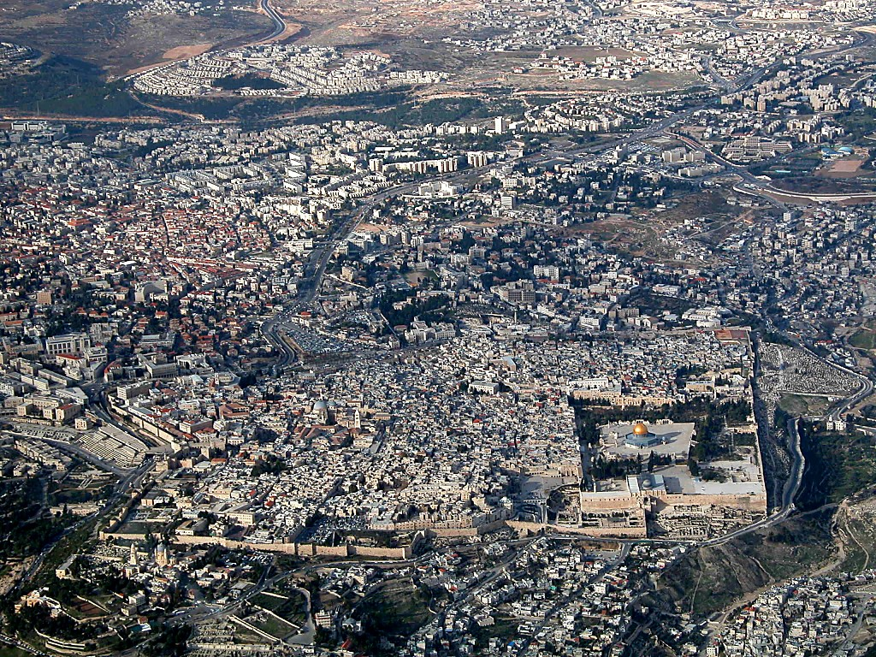
Stakeholders in the City of Jerusalem
THE ARAB QUARTER
THE ‘LATIN’ QUARTER
THE JEWISH QUARTER
THE ‘GREEK’ QUARTER

Slide 33
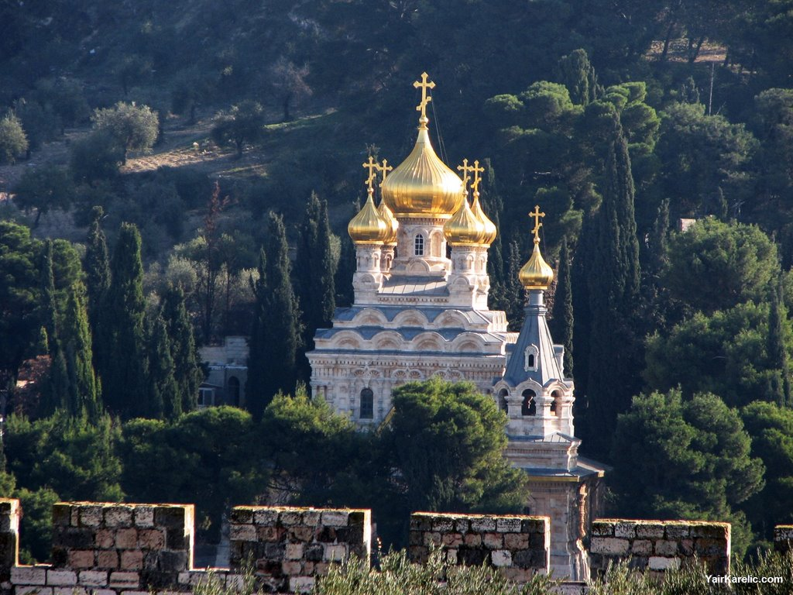
Russian Real Estate in Jerusalem
(The Church of Mary Magdalene)

Slide 34
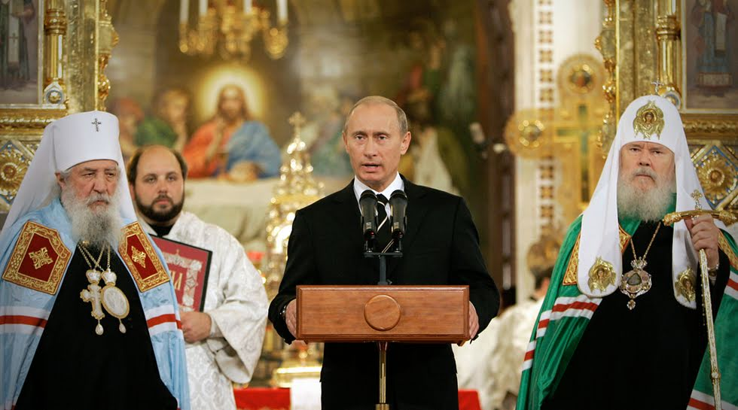
President Putin’s Religious Links

Slide 35
SNIPPETS CR-RU:150521: (21-May-15)
(Un) Holy Alliance: Vladimir Putin, The Russian Orthodox Church and Russian Exceptionalism – Forbes 21-May-15
When Putin came to power he shrewdly noted the ROC’s useful role in boosting nationalism and the fact that it shared his view of Russia’s role in the world, and began to work toward strengthening the Church’s role in Russian society. Early in his presidency the Russian Duma passed a law returning all church property seized during the Soviet era (which alone made the ROC one the largest landholders in Russia). Over the past decade and a half, Putin has ordered state-owned energy firms to contribute billions to the rebuilding of thousands of churches destroyed under the Soviets, and many of those rich oligarchs surrounding him are dedicated supporters of the ROC who have contributed to the growing influence of the church in myriad ways. Around 25,000 ROC churches have been built or rebuilt since the early 1990’s, the vast majority of which have been built during Putin’s rule and largely due to his backing and that of those in his close circle of supporters.

Slide 36
Snippets: CR-RU:150605:(08-JUN-15):
Putin's Holy War And The Disintegration Of The 'Russian World' – Forbes 05-Jun-15
Vladimir Putin and Alexander Dugin’s vision of “Holy Russia,” which is shared with the Russian Orthodox Church, sees Russia’s mission as being to expand its influence and authority until it dominates the Eurasian landmass by means of a strong, centralized Russian state aligned with the Russian Orthodox Church, championing “traditional” social values over against the cultural corruption of a libertine West. The partnership between the Kremlin and the Russian Orthodox Church (ROC) has been aimed not only at articulating this sacralized view of Russian national identity to the domestic audience, but also in advancing the mission of the Russian nation abroad. The manner in which the Russian state and the Church has been cooperating, however, is undermining their jointly-stated goal of building a “Russian world” that dominates Eurasia under Moscow’s benign imperial oversight.

Slide 37
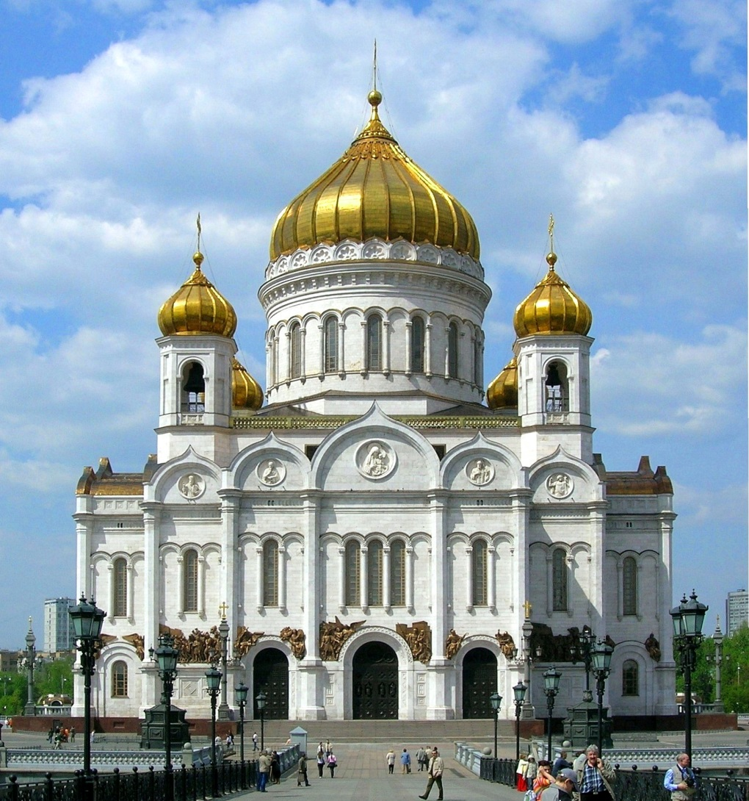
The Revival of Religion in Russia
Christ the Saviour Cathedral - Moscow

Slide 38
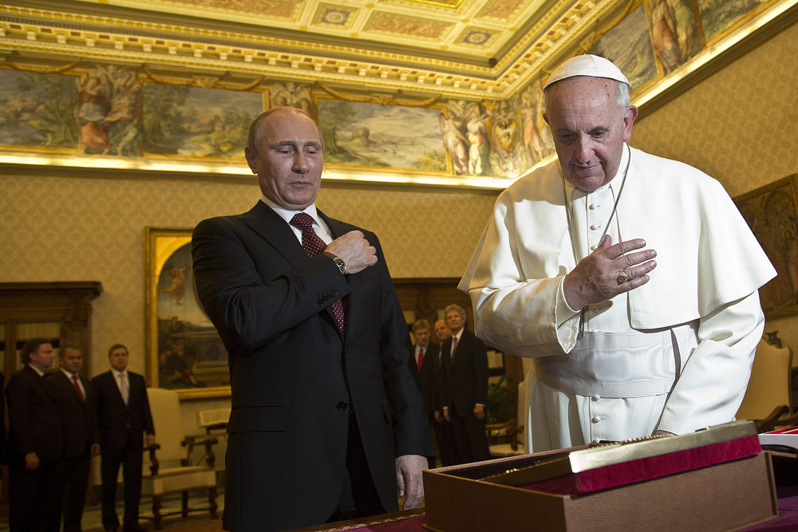
Who would have expected this 20 years ago?

Slide 39
Snippets: RU-CR:150105:(05-JAN-15):
Putin's Christian Faith Is Central to His Policies
RussiaInsider 05-Jan-15; Boyd D. Cathey (The Unz Review)
“And Putin gained firm support and endorsement from that inveterate and most intransigent anti-Communist, Aleksandr Solzhenitsyn. Before his death in 2008, Solzhenitsyn praised Putin and stated that he believed Putin’s personal acceptance of Christian faith to be genuine.
American ambassador William Burns visited Solzhenitsyn (April 2008) shortly prior to his death and quoted him as stating that under Putin, the nation was rediscovering what it was to be Russian and Christian. [See article at guardian.co.uk, Thursday, December 2, 2010] The great Russian anti-Communist also gave a long 2007 interview with the German magazine, Der Spiegel, saying the same thing.

Slide 40
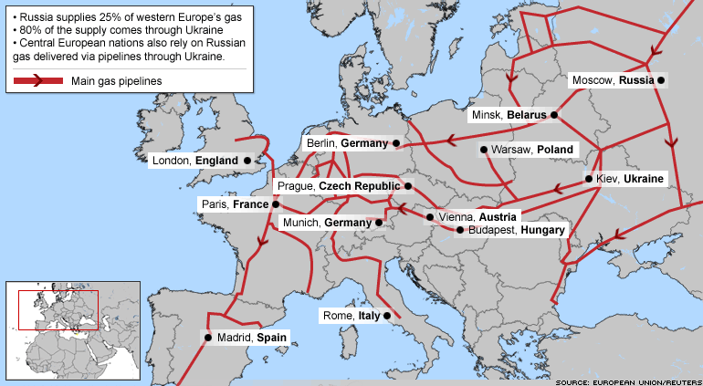
European Dependence on Russian Energy

Slide 41
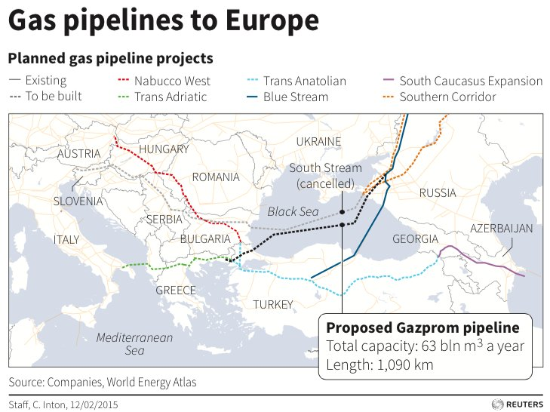
The Latest Planned Gas Link to Europe

Slide 42
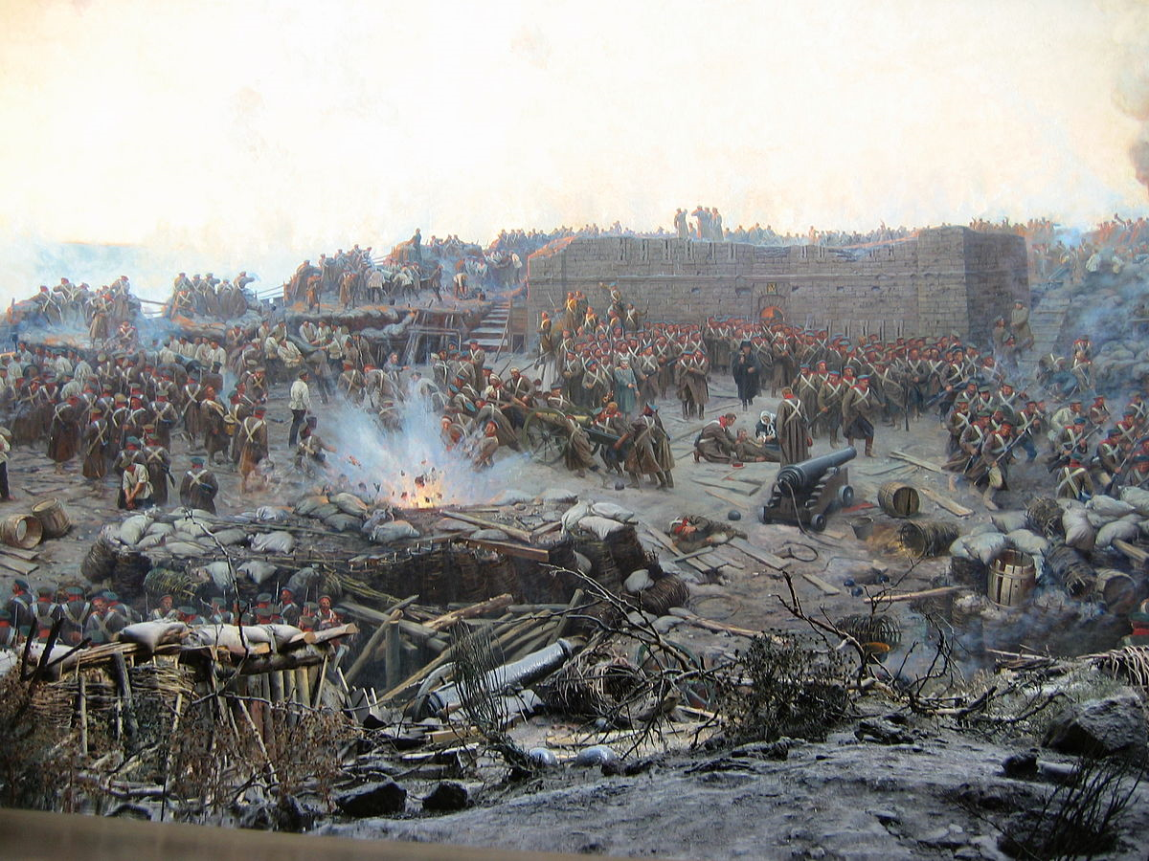
What was the Cause of the Crimean War? October 1853 – February 1856
https://en.wikipedia.org/wiki/Crimean_War
The immediate issue involved the rights of Christians in the Holy Land, which was controlled by the Ottoman Empire. It involved the control of the holy sites in and around Jerusalem. The French promoted the rights of Catholics, while Russia promoted those of the Orthodox. The longer-term causes involved the decline of the Ottoman Empire, and the unwillingness of Britain and France to allow Russia to gain territory and power at Ottoman expense. Russia lost and the Ottomans gained a twenty-year respite from Russian pressure. The Christians were granted a degree of official equality and the Orthodox gained control of the Christian churches in dispute. Russia survived, gained a new appreciation for its religious diversity, and launched a reform program with far-reaching consequences.

Slide 43
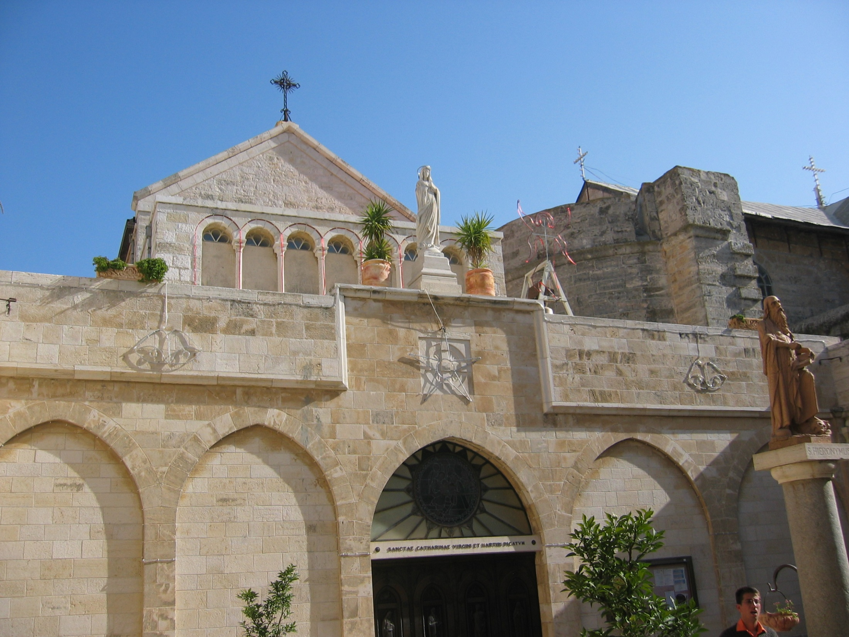
The Church of Nativity – Bethlehem

Slide 44
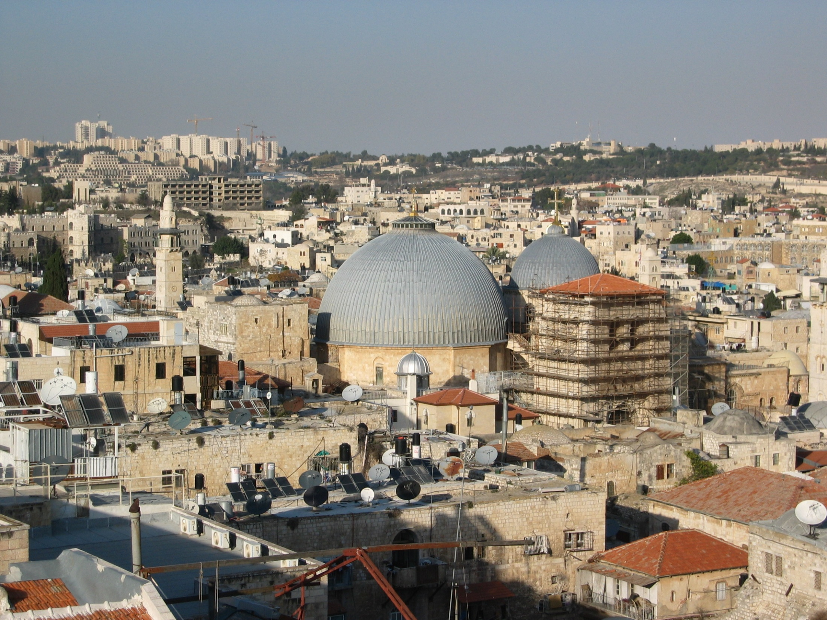
The Church of the Holy Sepulcher - Jersusalem
ROME’S FALSE PROPHET

Slide 45
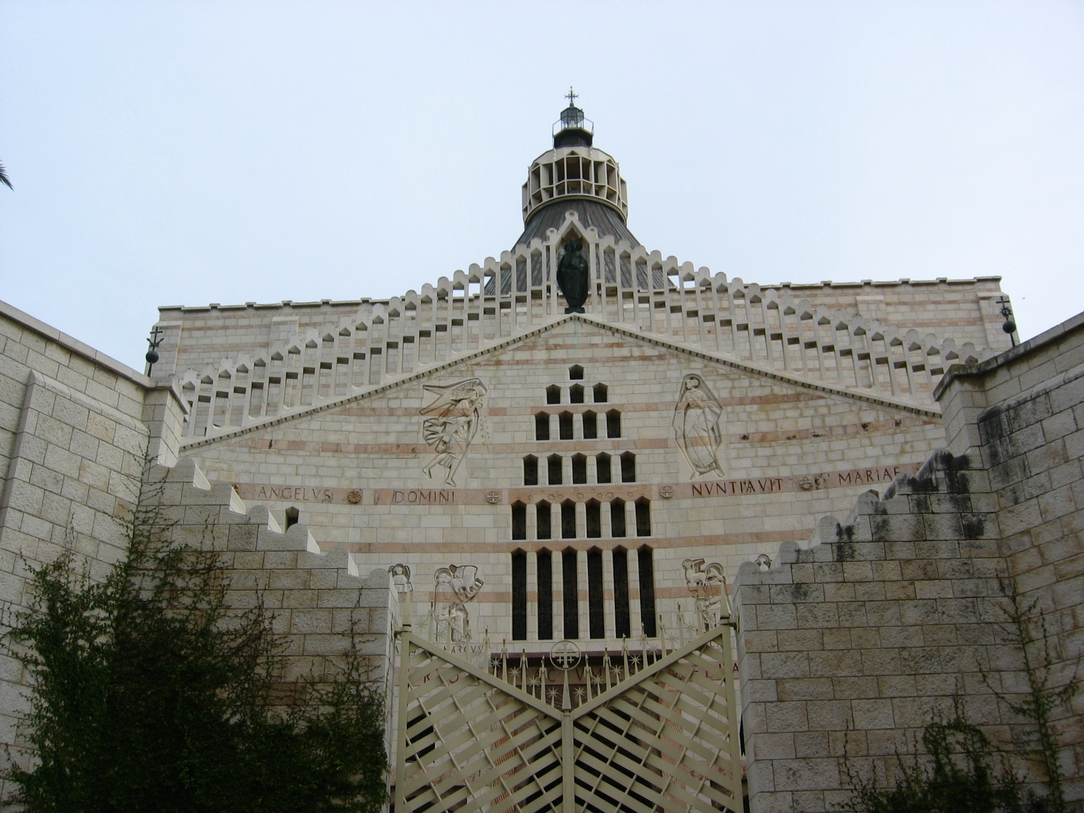
The Church of the Annunciation - Nazareth

Slide 46
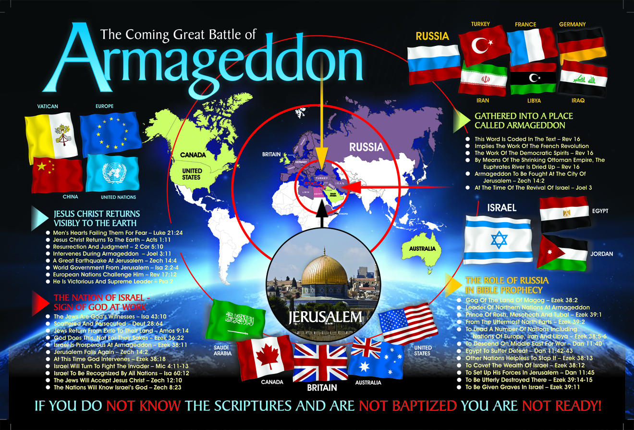

Slide 47
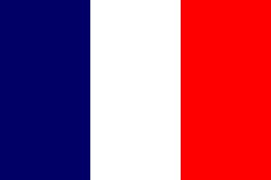
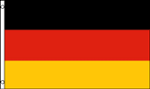
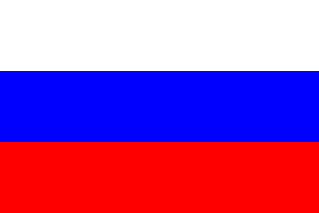
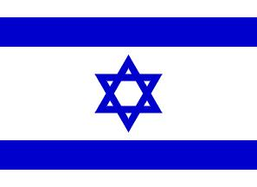
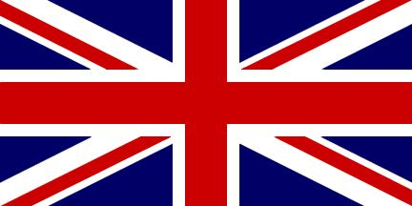
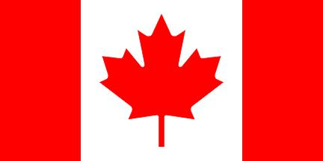
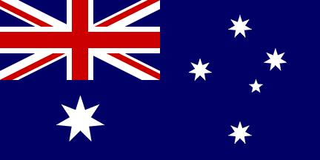
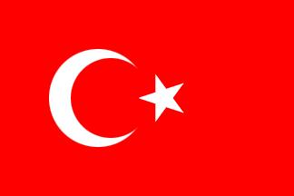
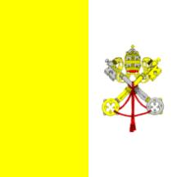
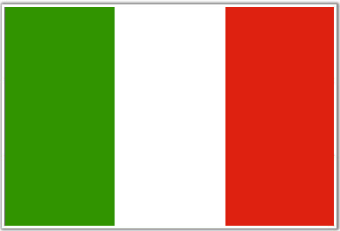
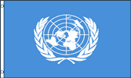
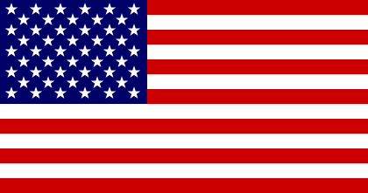
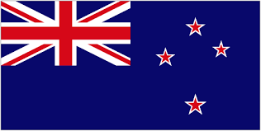
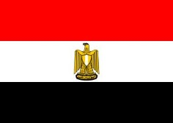
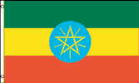













The Evidence: of Bible Prophecy
Prophecies written 2500 years ago, but speaking of these modern Nations
FRANCE
GERMANY
RUSSIA
ISRAEL
UNITED KINGDOM
CANADA
AUSTRALIA
TURKEY
VATICAN
ITALY
UNITED NATIONS
U.S.A.
NEW ZEALAND
EGYPT
ETHIOPIA
SUDAN
SPAIN
EUROPE
BELGIUM
U.A.E.
SAUDI ARABIA
IRAN
IRAQ
GREECE
LEBANON
LIBYA
POLAND
JORDAN

Slide 48

Bible Prophecy: A Means of Reaching Out!

Slide 49
Gog and his Hordes will be Disarmed and Destroyed!
Ezekiel 39:3-4 KJV
“And I will smite thy bow out of thy left hand, and will cause thine arrows to fall out of thy right hand. Thou shalt fall upon the mountains of Israel, thou, and all thy bands, and the people that is with thee: I will give thee unto the ravenous birds of every sort, and to the beasts of the field to be devoured. Thou shalt fall upon the open field: for I have spoken it, saith the Lord GOD. And I will send a fire on Magog, and among them that dwell carelessly in the isles: and they shall know that I am the LORD.

Slide 50
Why will Russia and Europe come together?
Their coming together is certain because the author of the Bible who knows the future states that it will happen. (Ezek 38; Zech 14; Dan 2; Joel 3)
To accomplish HIS purpose with HIS people of Israel, HE will bring them together.
Europe will have reason to invade the Middle East under Russian leadership.
At some stage they will be attracted to Jerusalem to attempt to take control and divide the spoil … but all nations will find Jerusalem to be a “burdensome stone” especially those who rise up against her.

