Slide 1
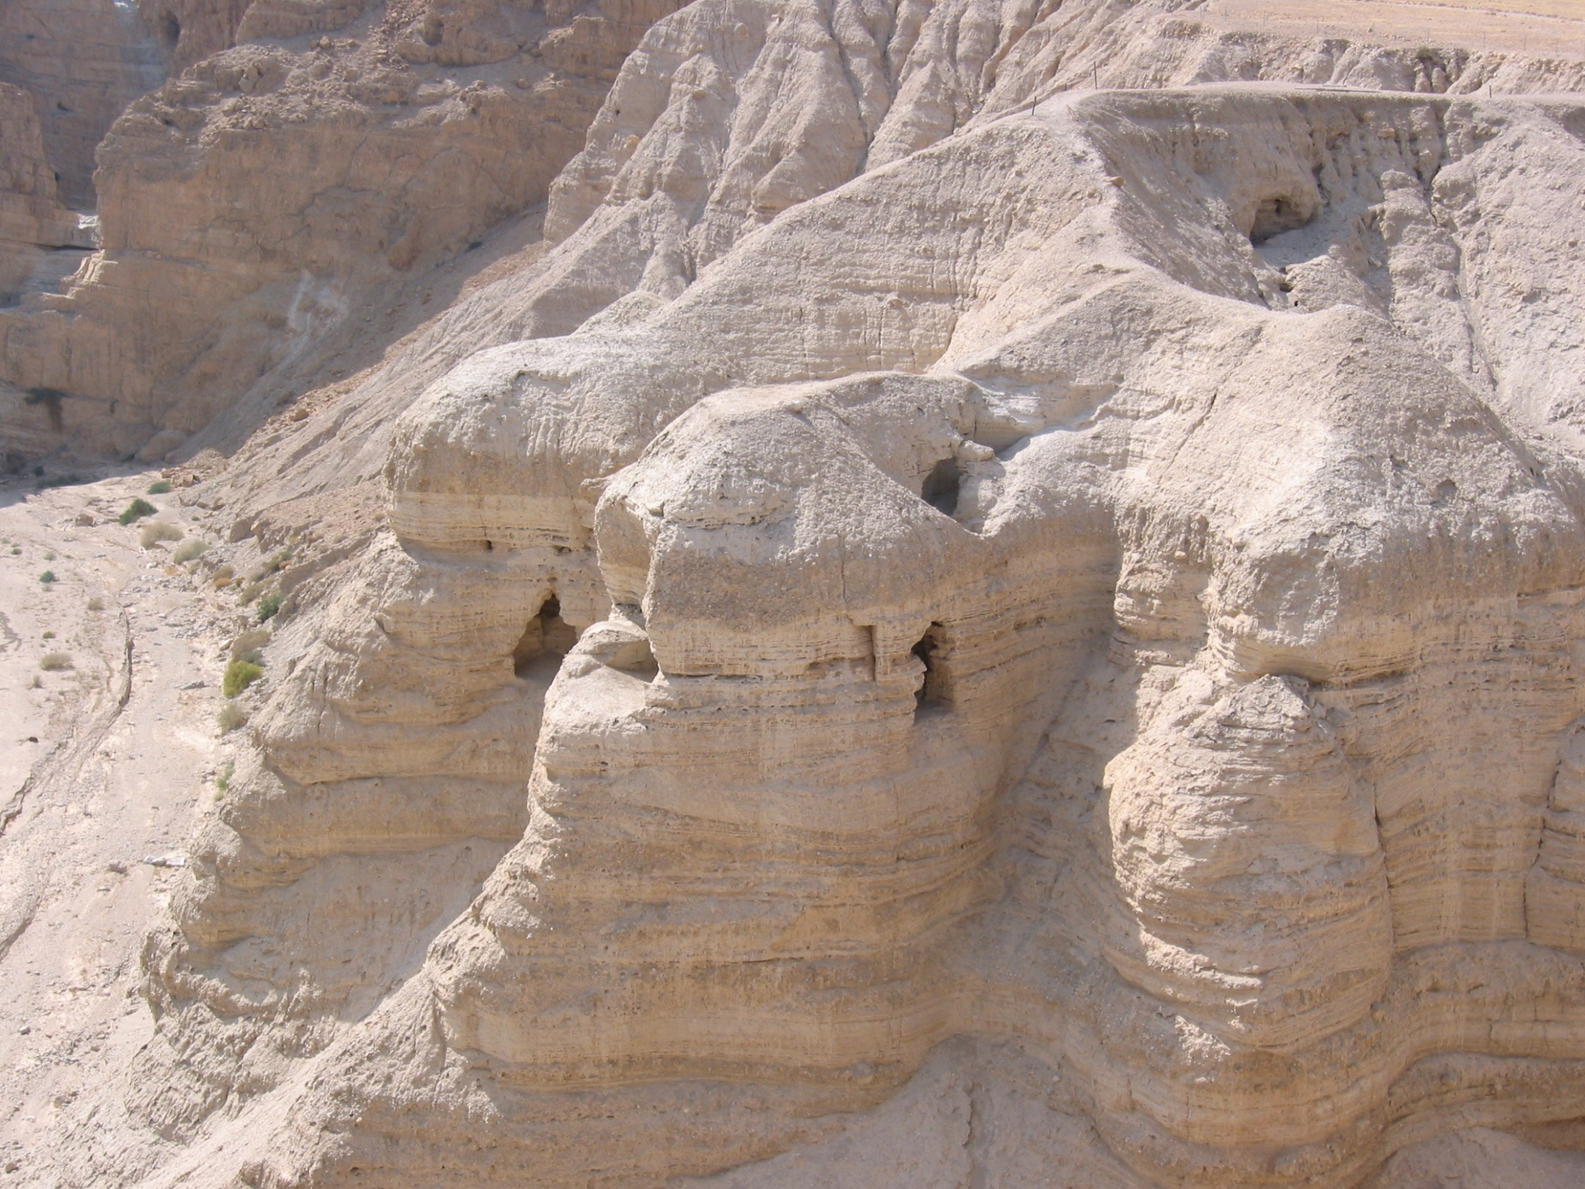
THE DEAD SEA SCROLLS: The Greatest Archaeological Discovery of all time.
11 Caves
19000 Fragments
800 Scrolls: 200 of which were Biblical
4 Materials: skin, papyrus, copper, lead
Ancient Hebrew, Hebrew, Aramaic, Greek
Discovered between 1947 and 1956
Dated as between 1900 and 2200 years old.

Slide 2
Isaiah 43:9-10
Let all the nations be gathered together, and let the people be assembled: who among them can declare this, and shew us former things? let them bring forth their witnesses, that they may be justified: or let them hear, and say, It is truth.
Ye are my witnesses, saith YHWH, and my servant whom I have chosen: that ye may know and believe me, and understand that I am he: before me there was no God formed, neither shall there be after me.

Slide 3
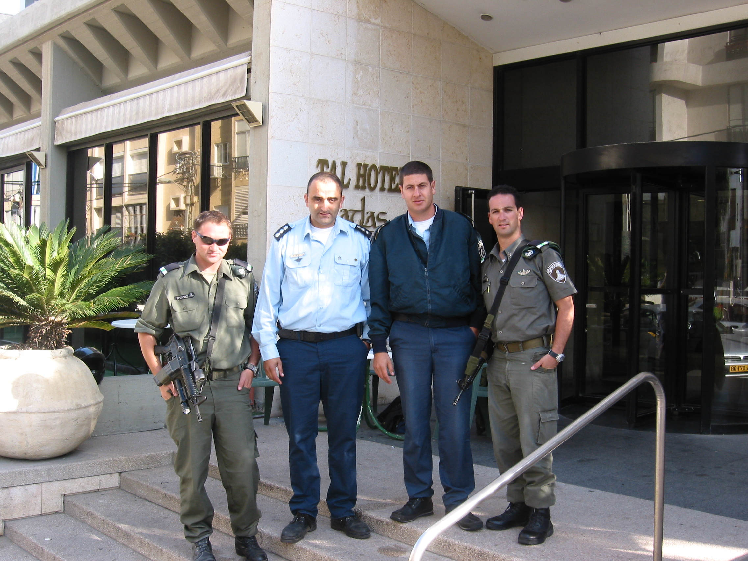
OUR WELCOMING CREW, TEL AVIV, 2004

Slide 4
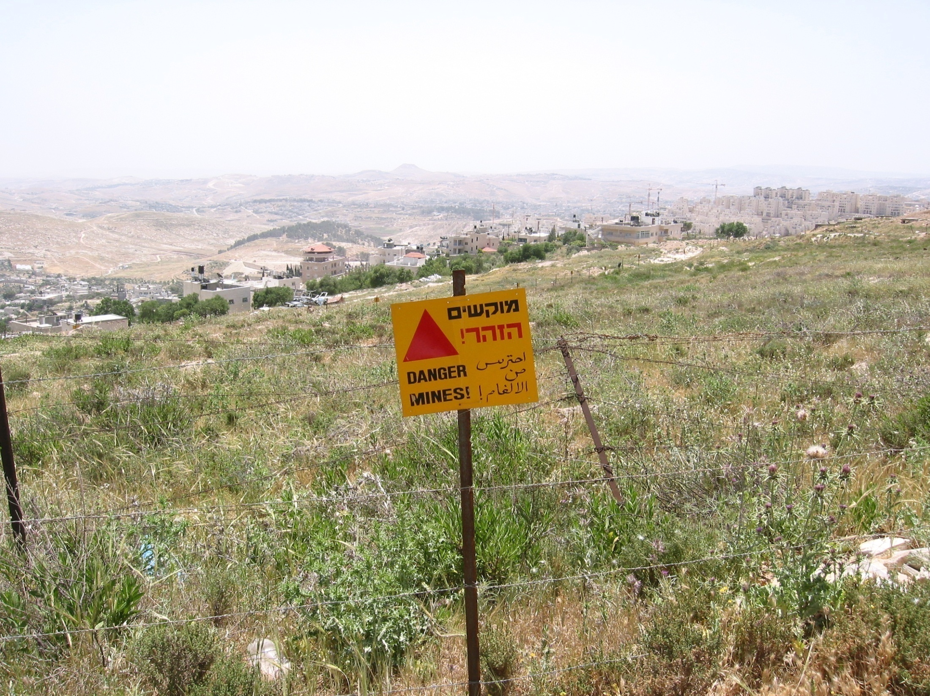
BETHLEHEM

Slide 5
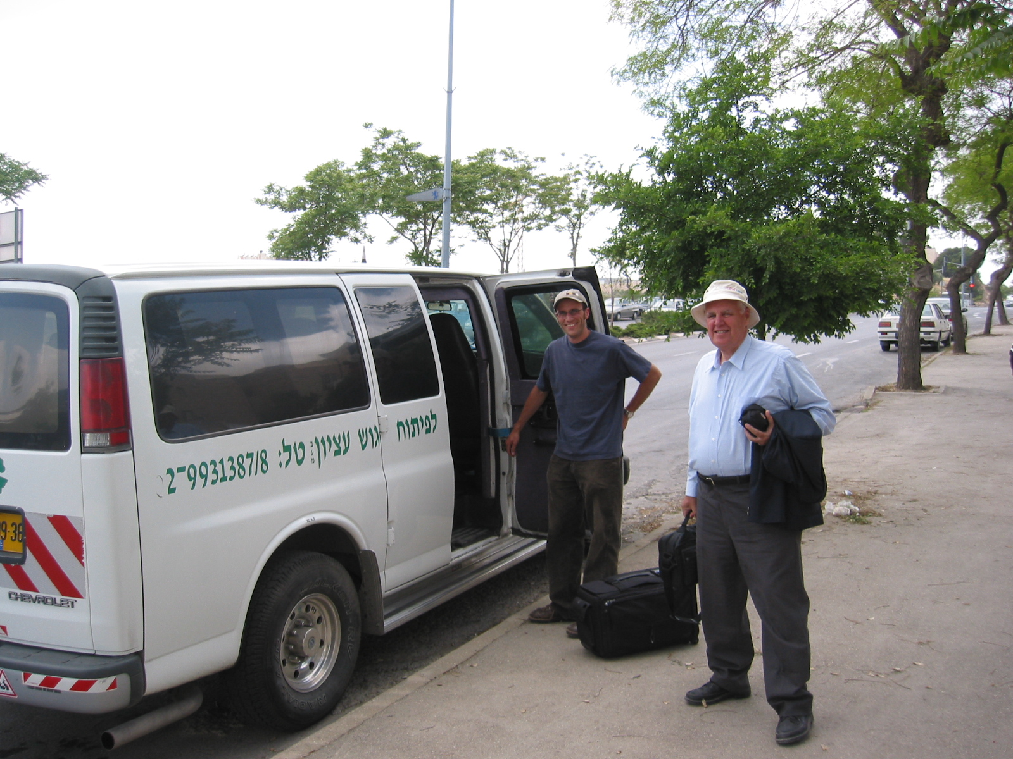
ARMOURED VEHICLE – THE BUS TO HEBRON

Slide 6
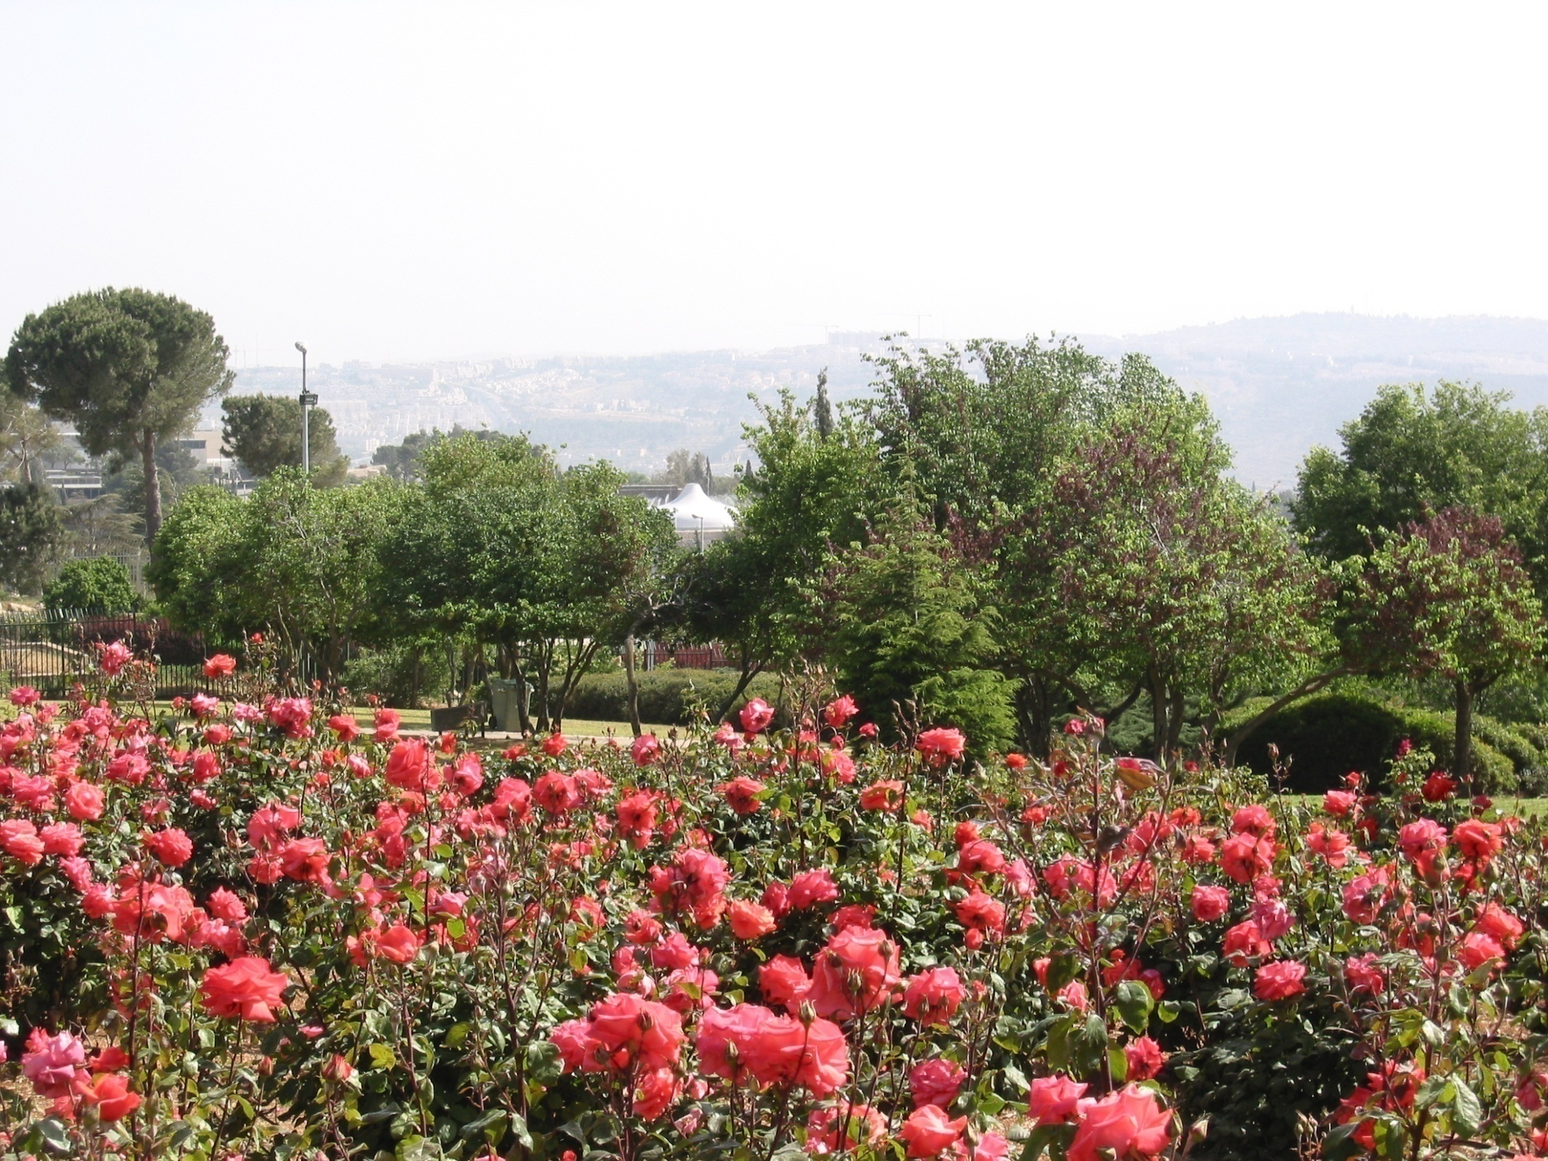
JERUSALEM AND THE SHRINE OF THE BOOK

Slide 7
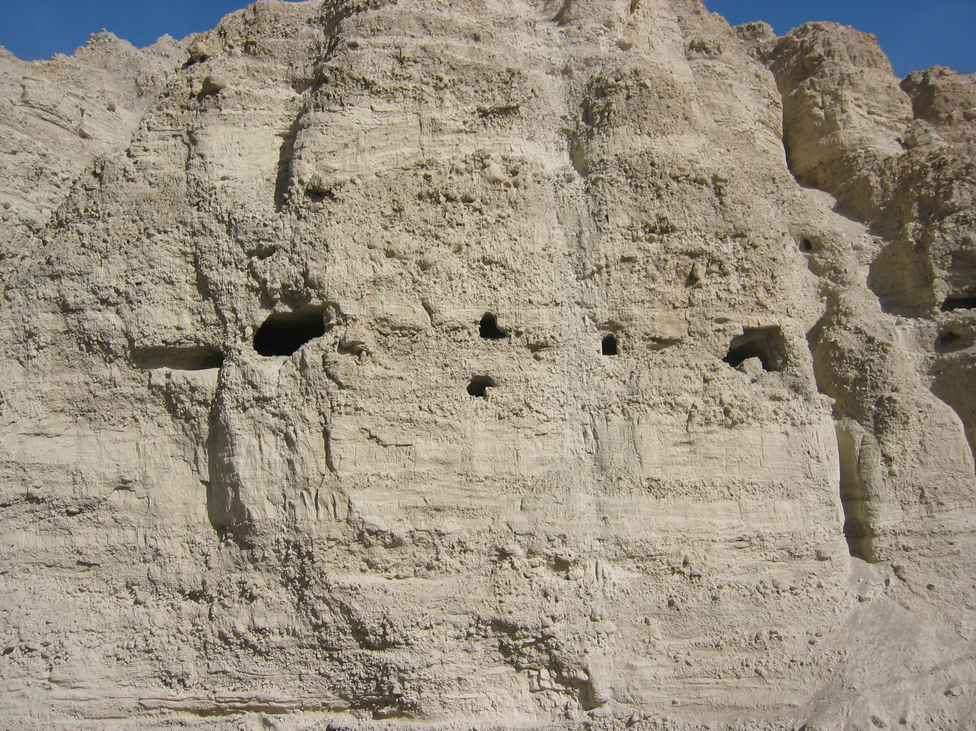
ISRAEL: A LAND OF CAVES!

Slide 8
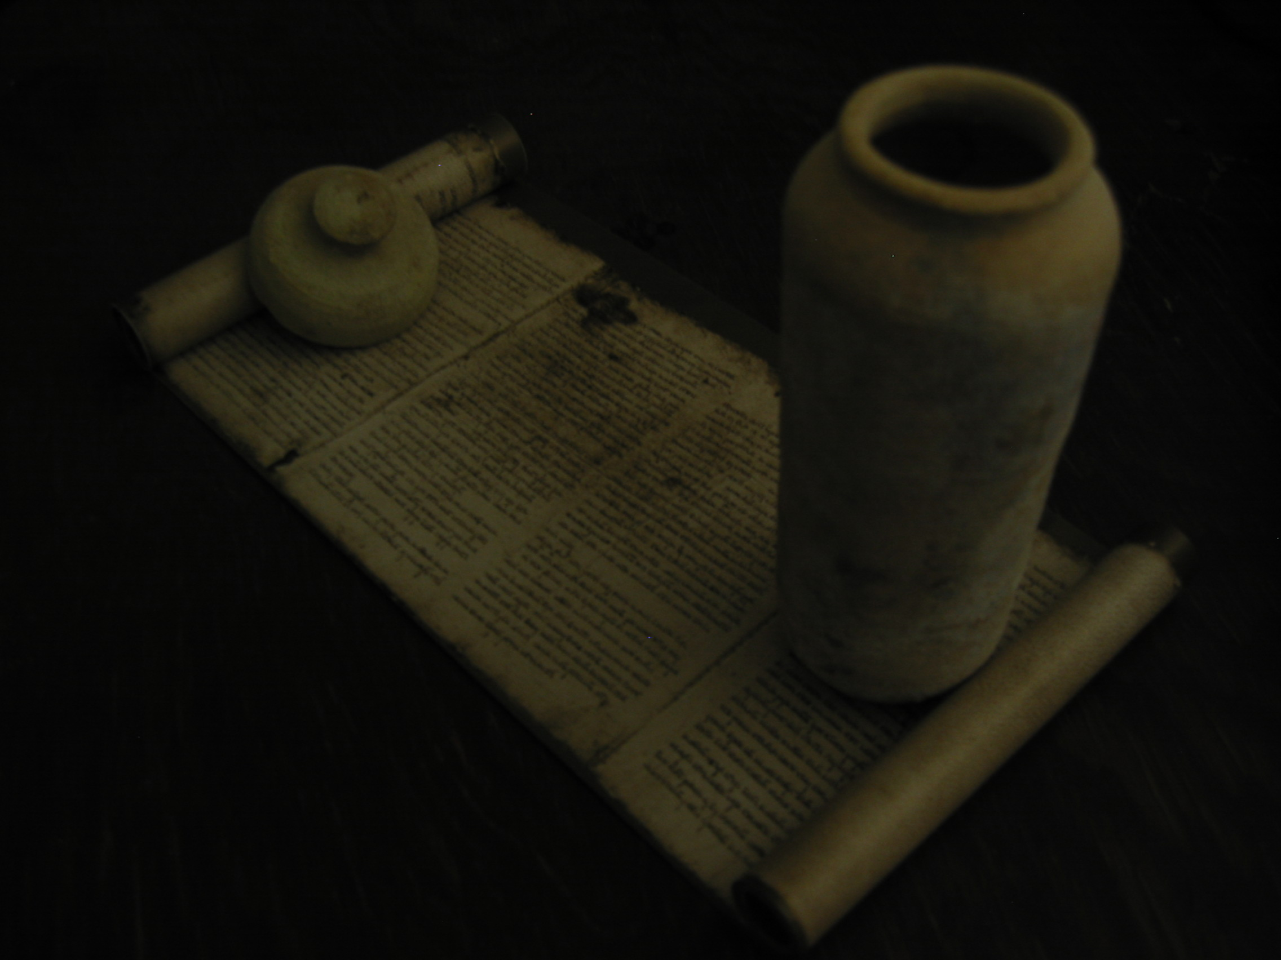
Even in 100 BCE Hiding Scrolls in Jars was not a New Idea
Jeremiah 32:13-14
“And I charged Baruch before them, saying, Thus saith the LORD of hosts, the God of Israel; Take these evidences, this evidence of the purchase, both which is sealed, and this evidence which is open; and put them in an earthen vessel, that they may continue many days.”

Slide 9
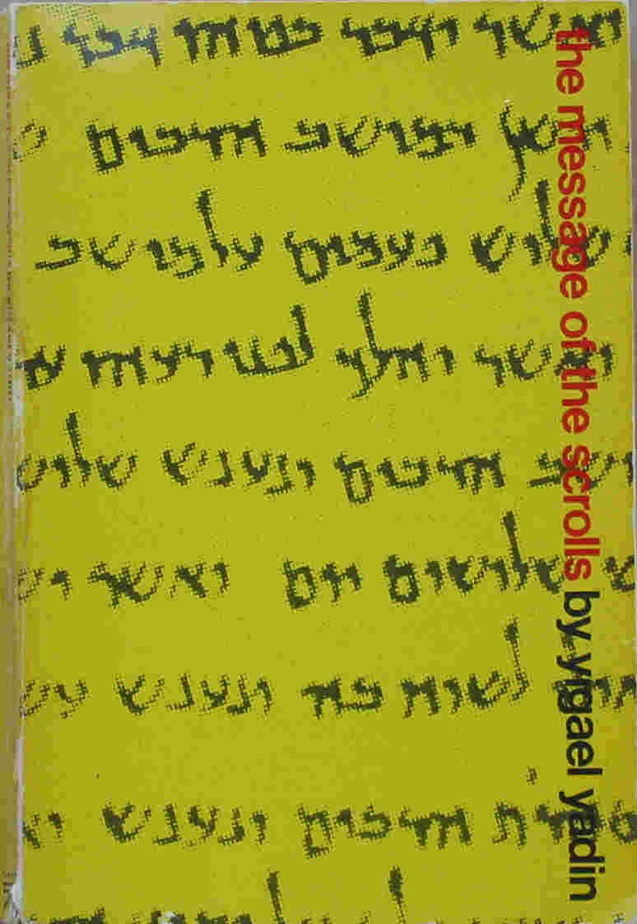
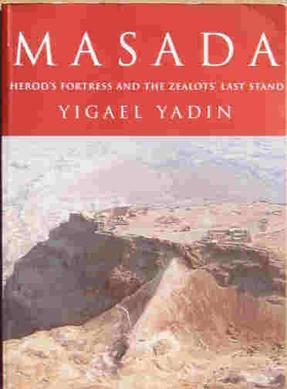
BOOKS SUPPORTING
THE SUBJECT MATTER

Slide 10
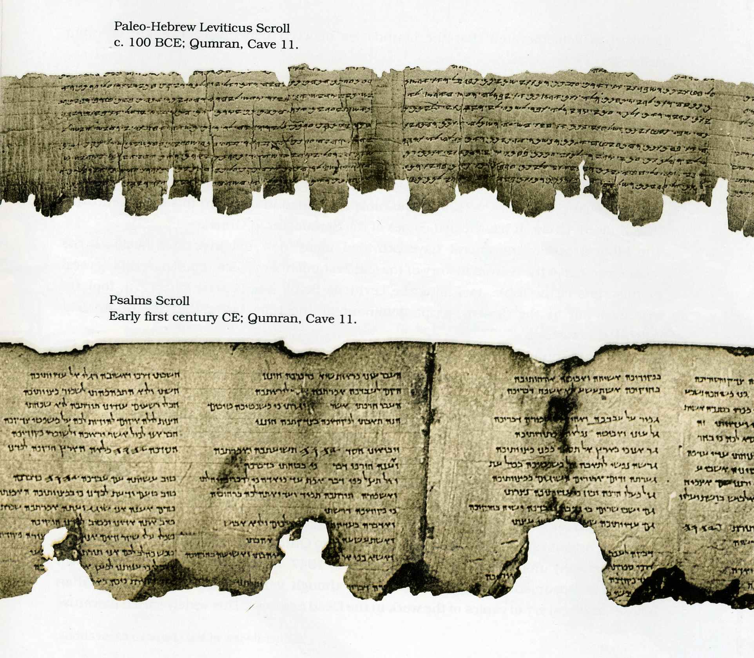
EXAMPLES OF THE CONDITION OF THE SCROLLS

Slide 11
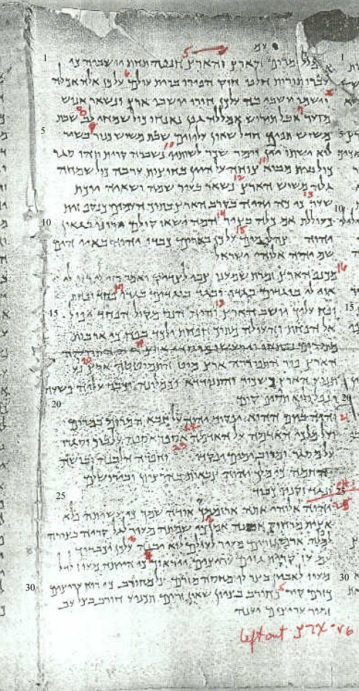
THE CONDITION OF THE ISAIAH SCROLL

Slide 12
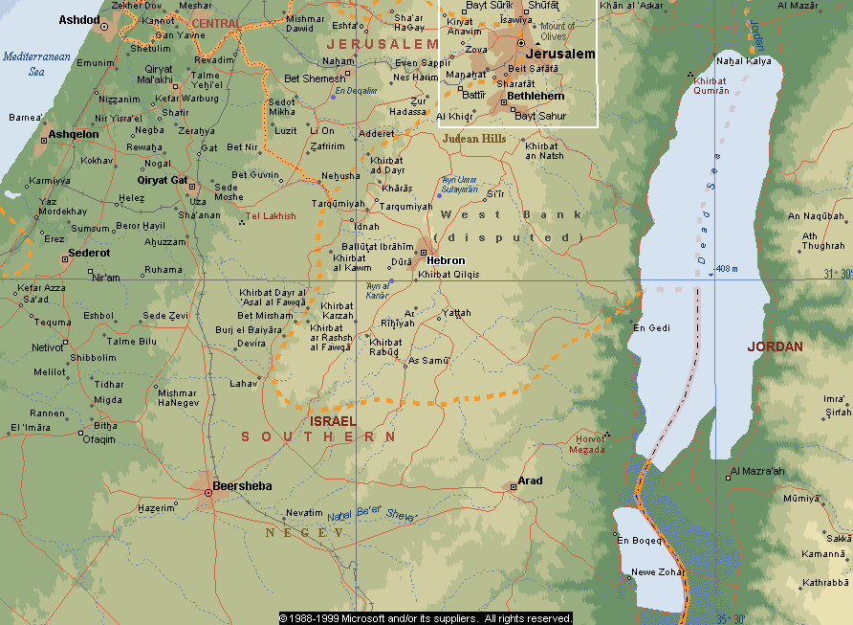
OUR AREAS OF INTEREST NEAR THE SHORE OF THE DEAD SEA

Slide 13
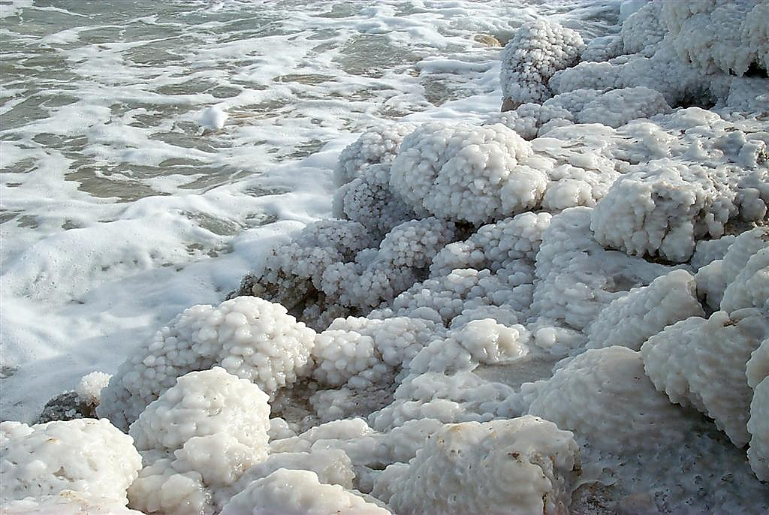
Dead Sea shoreline

Slide 14
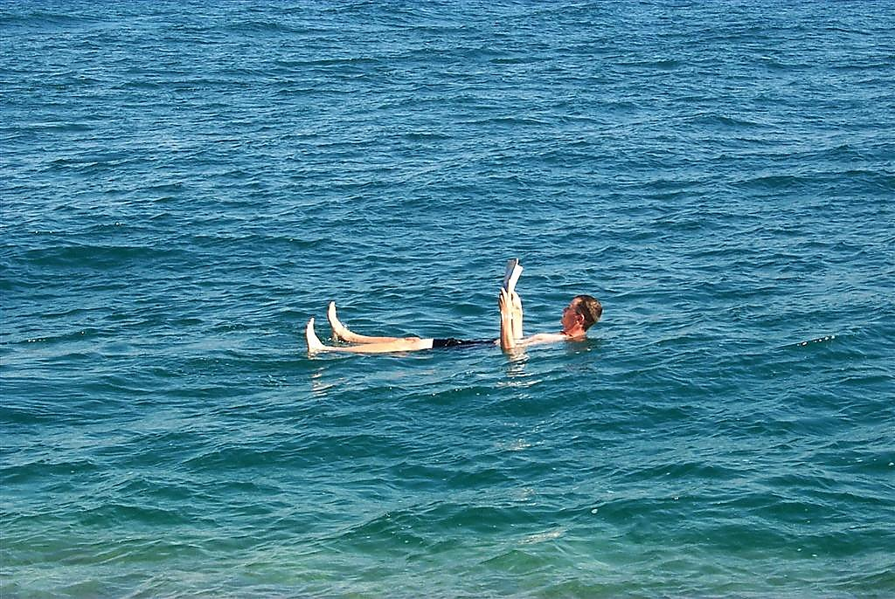
Dead Sea man floating

Slide 15
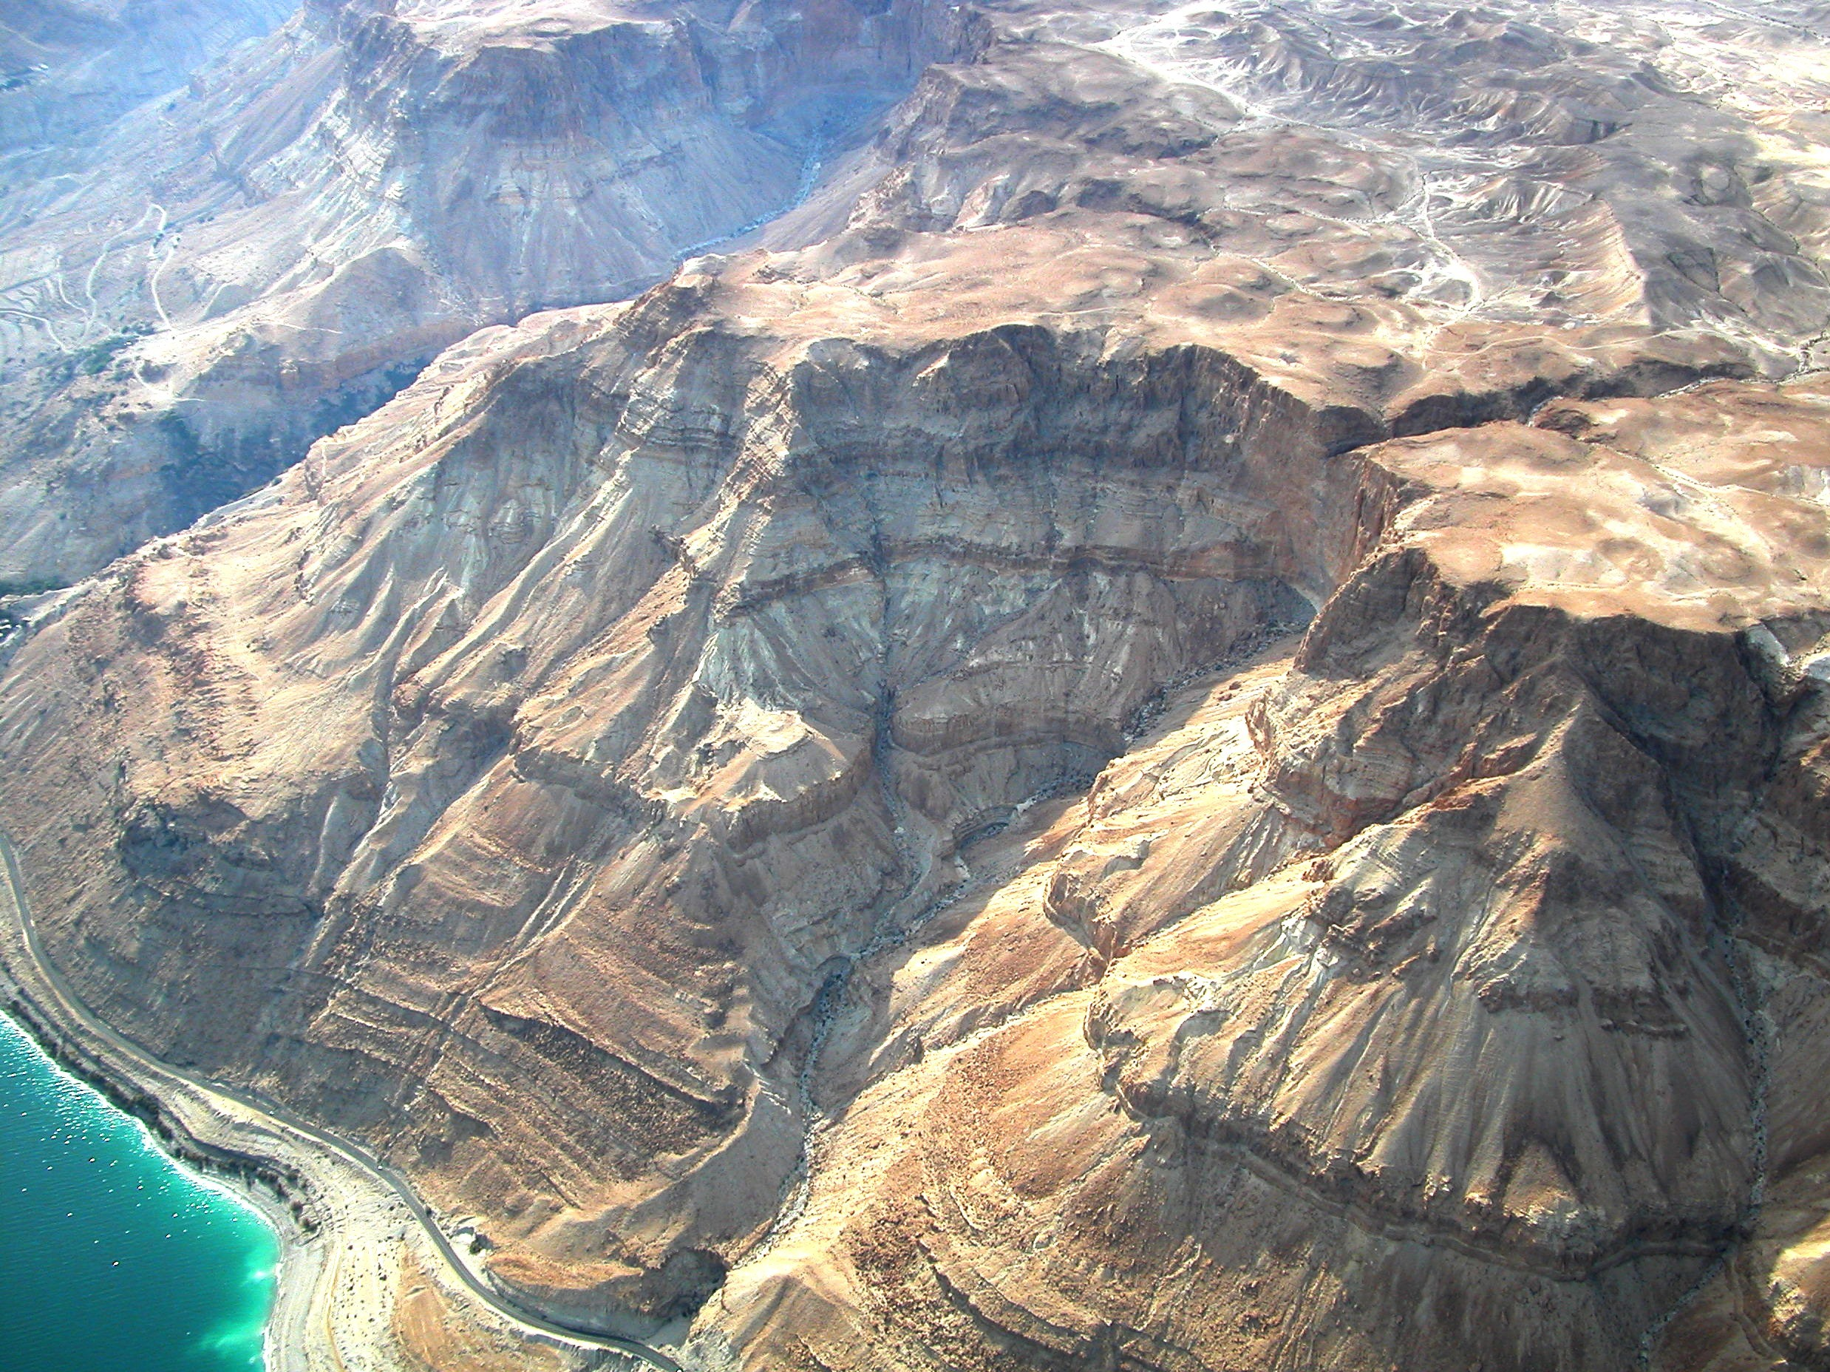
THE NORTH-WEST SHORE LINE OF THE DEAD SEA

Slide 16
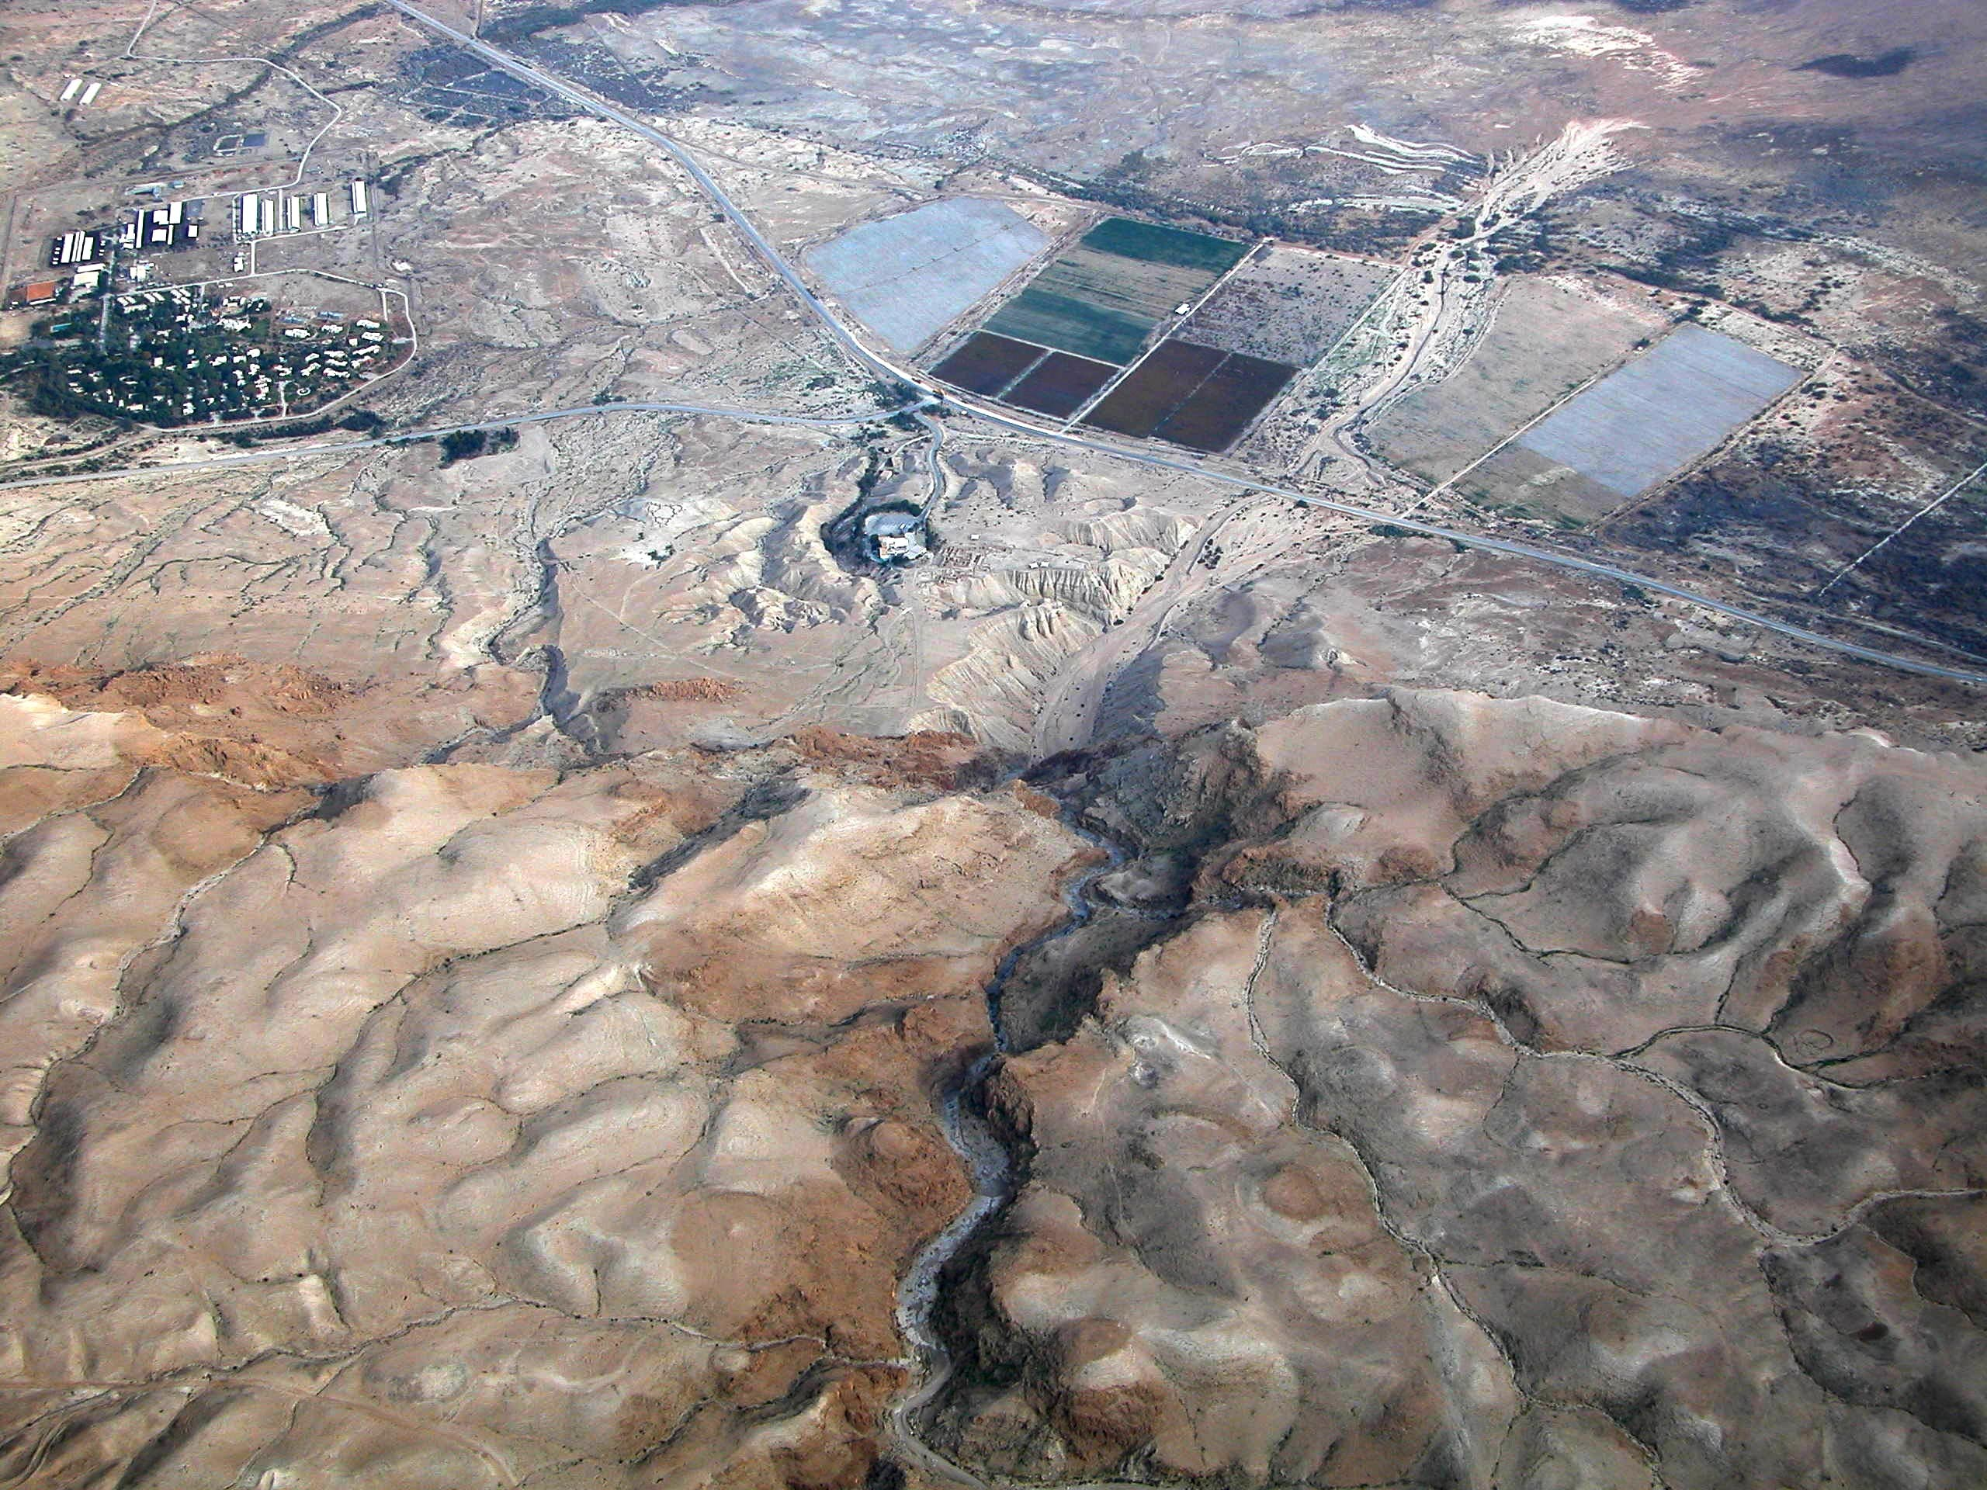
QUMRAN: LOCATION OF THE ANCIENT CIVILIZATION

Slide 17
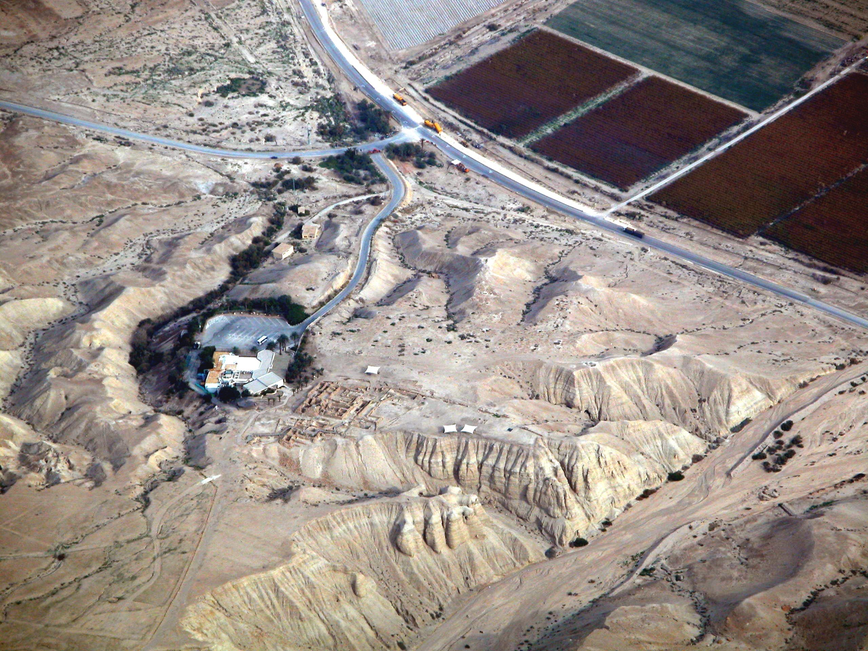
Khirbet Qumran

Slide 18
Cave 4 – Site of 15,000 fragments originating from many hundreds of composite texts.

Slide 19
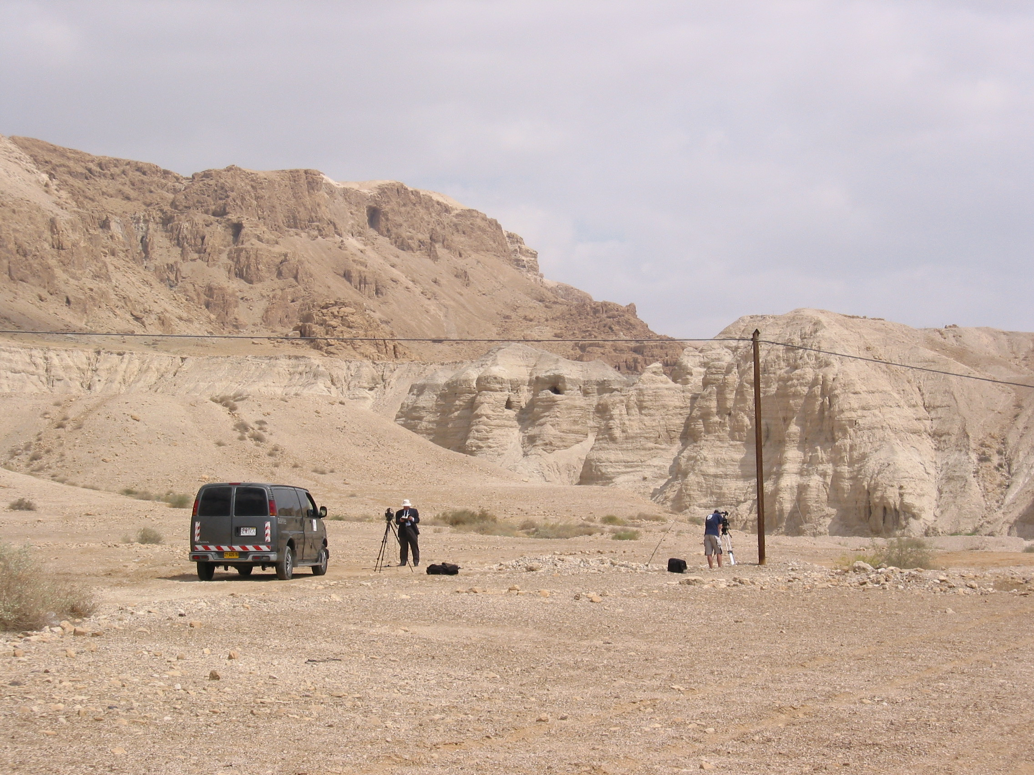
FILMING AT THE SITE OF THE CAVES AT QUMRAN

Slide 20
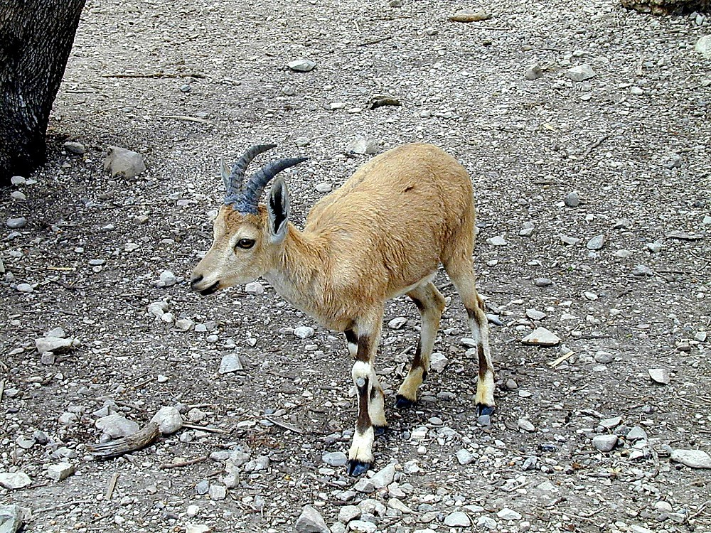
Ibex at En Gedi

Slide 21
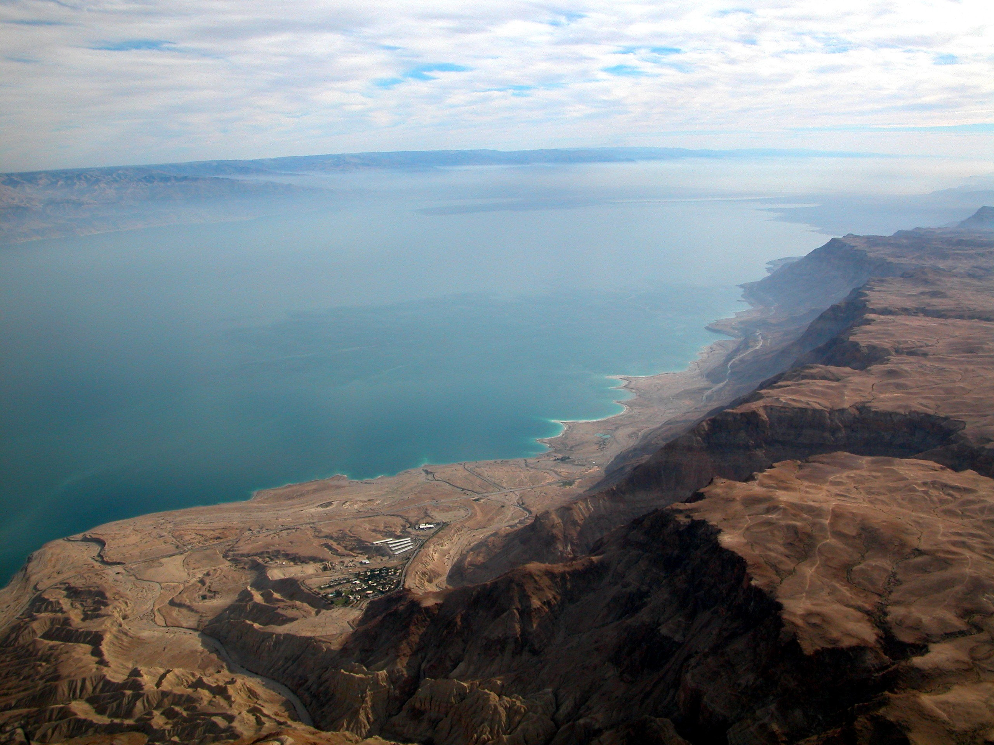
THE NORTH-WEST SHORE LINE OF THE DEAD SEA

Slide 22
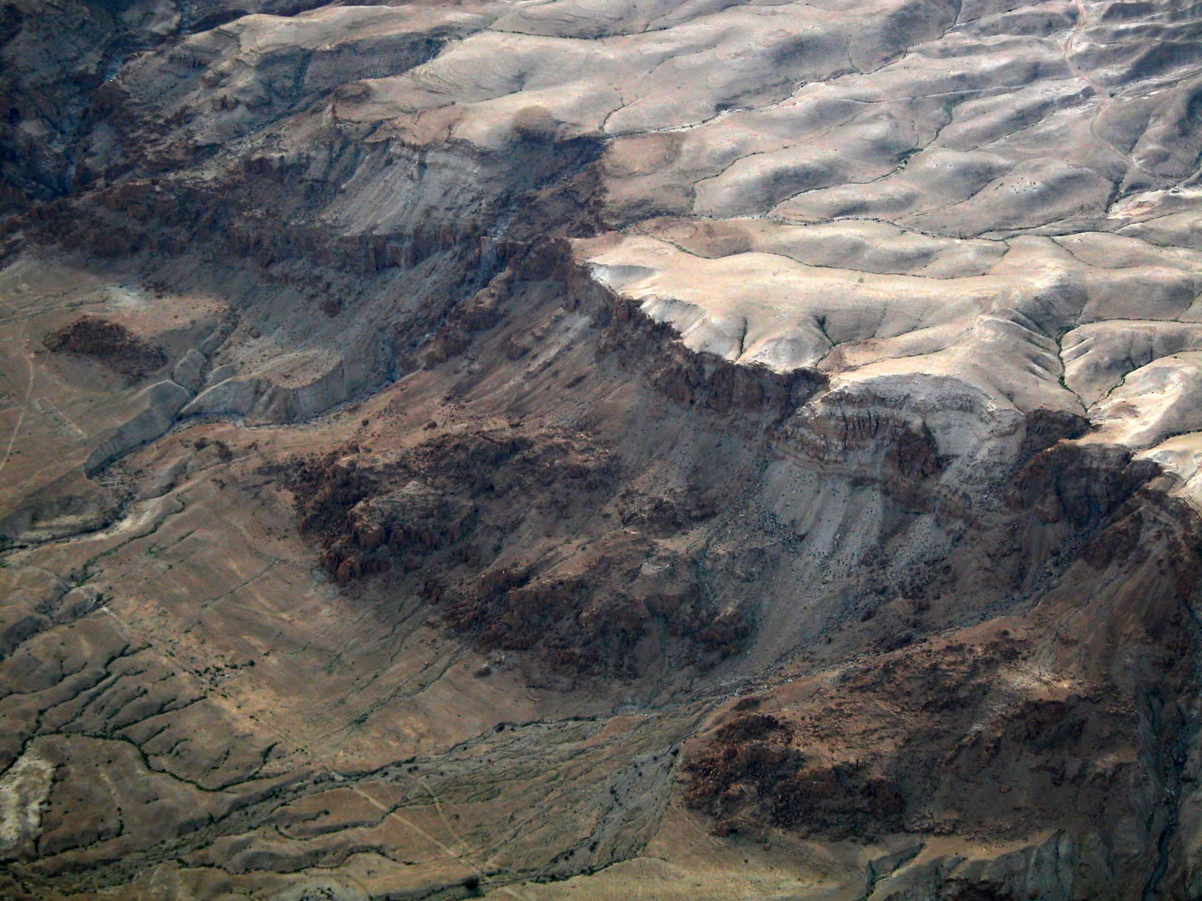
LOCATION OF CAVE 1 - THIS MADE THE AREA FAMOUS

Slide 23
Cave 1 – Site of Seven Scrolls
  Isaiah A
  Isaiah B
  The Habakkuk Commentary
  The Thanksgiving Scroll
  The Manual of Discipline
  The War Rule
  The Genesis Apocryphon
Isa 43:10
10 Ye are my witnesses, saith the LORD, and my servant whom I have chosen: that ye may know and believe me, and understand that I am he: before me there was no God formed, neither shall there be after me.
KJV

Slide 24
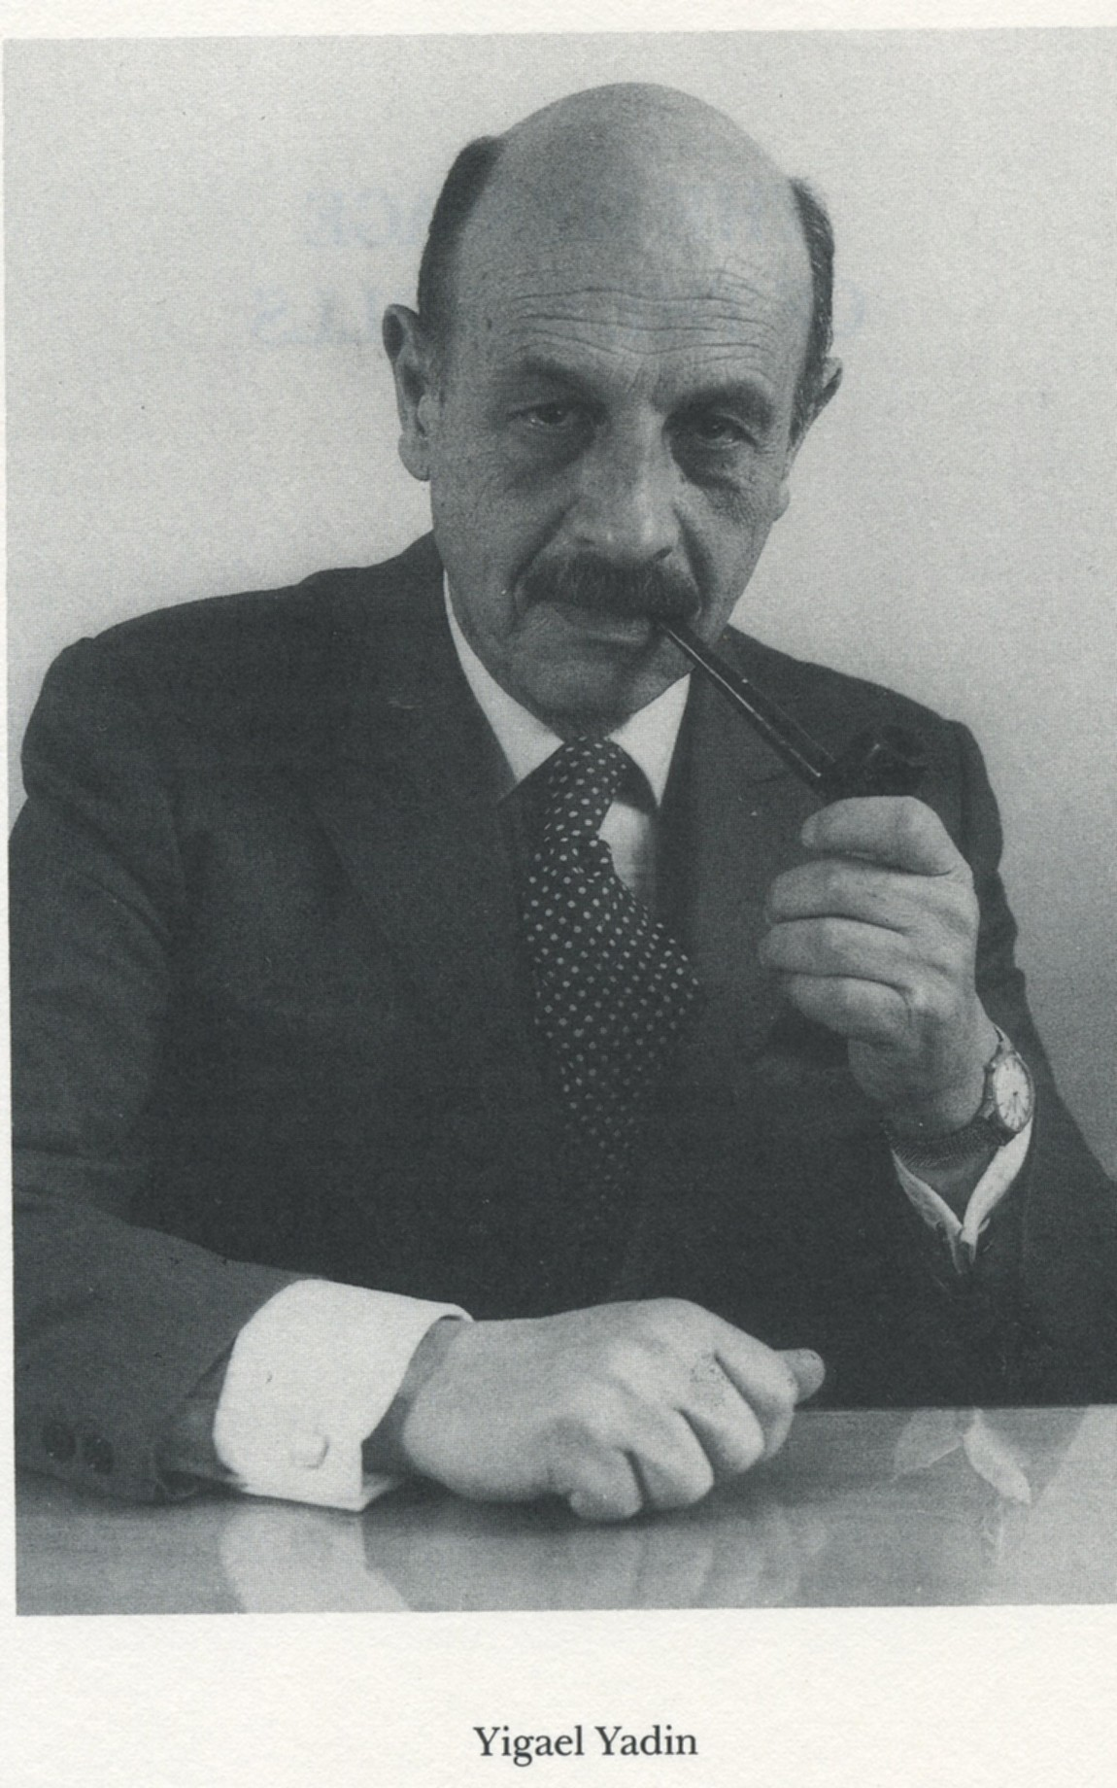

Slide 25
The Testimony of Professor Yigael Yadin
“I cannot avoid the feeling that there is SOMETHING SYMBOLIC in the discovery of the scrolls and their acquisition at the moment of the creation of the State of Israel. It is as if these manuscripts had been waiting in caves for two thousand years, ever since the destruction of Israel’s independence, until the people of Israel had returned to their home and regained their freedom. This symbolism is heightened by the fact that the first three scrolls were bought by my father for Israel on 29th November, 1947, the very day on which the United Nations voted for the re-creation of the Jewish state in Israel after two thousand years.”
Pg. 14; THE MESSAGE OF THE SCROLLS; Yigael Yadin; 1957

Slide 26
The Way the God of the Bible Works
Exodus 12:40-41
“Now the sojourning of the children of Israel, who dwelt in Egypt, was four hundred and thirty years. And it came to pass at the end of the four hundred and thirty years, even the selfsame day it came to pass, that all the hosts of the LORD went out from the land of Egypt.”

Slide 27
COINCIDENCE OR PROPHECY BEING FULFILLED?
    A scroll of Isaiah was placed in a jar in this cave sometime while the land of Israel was being destroyed by the Roman armies.
    About 2000 years passed without the scroll being discovered or disturbed.
    Then, while one of the main prophecies in the scroll was being fulfilled, it was rediscovered in 1947.
    This is evidence of the touch of the Divine hand.

Slide 28
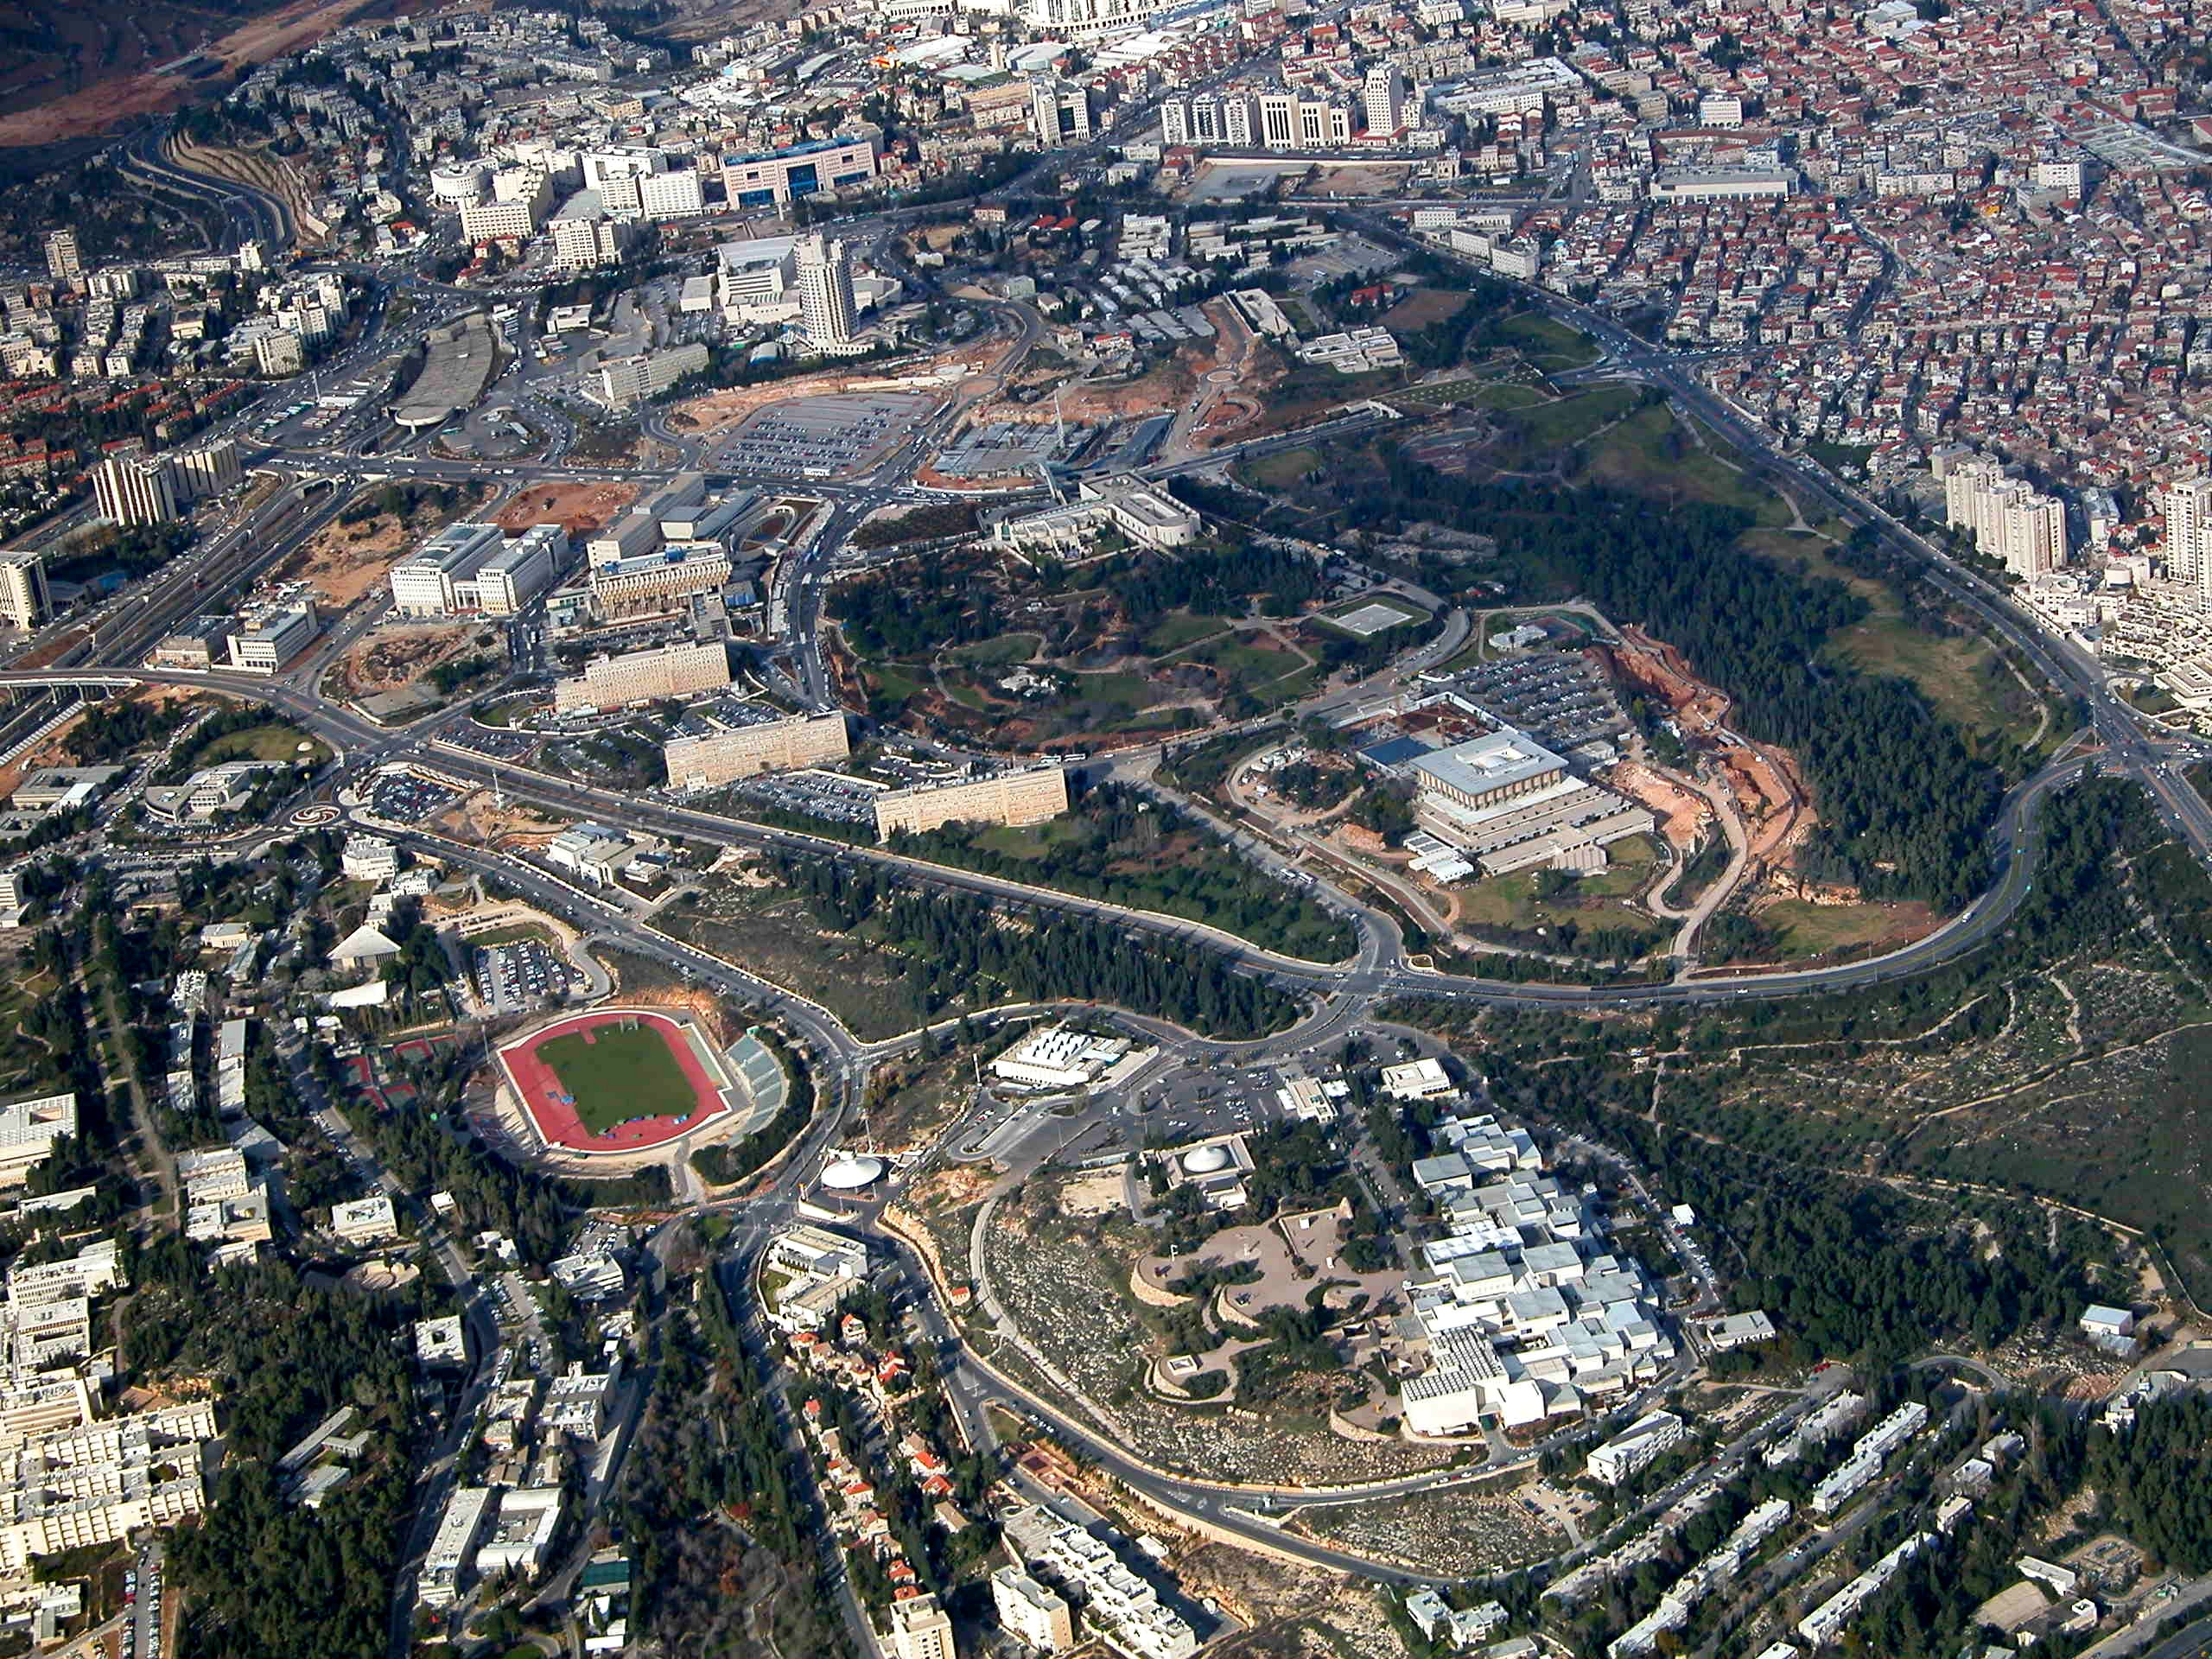
The Shrine of the Book

Slide 29
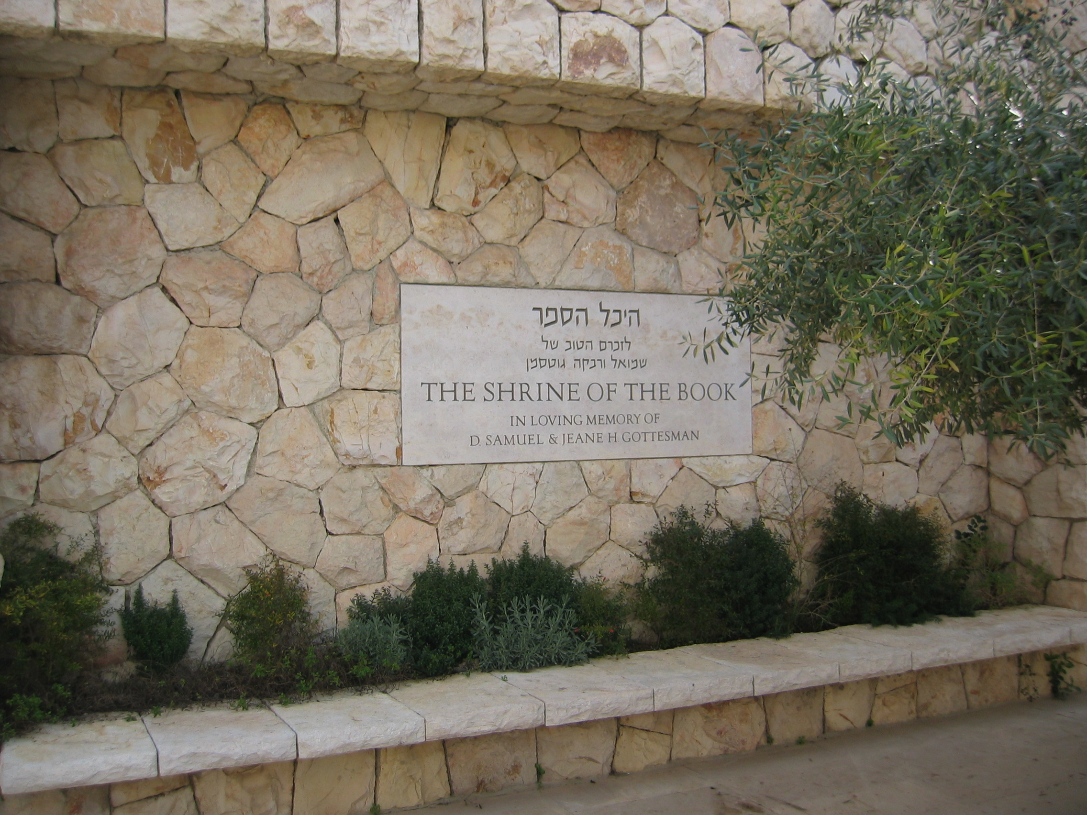
ISRAEL: THE LAND OF THE SCROLLS!

Slide 30
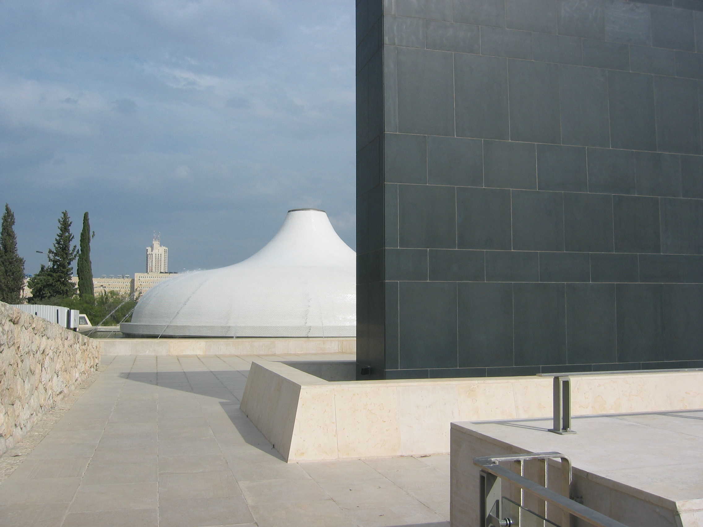
THE SHRINE OF THE BOOK CLOSEUP

Slide 31
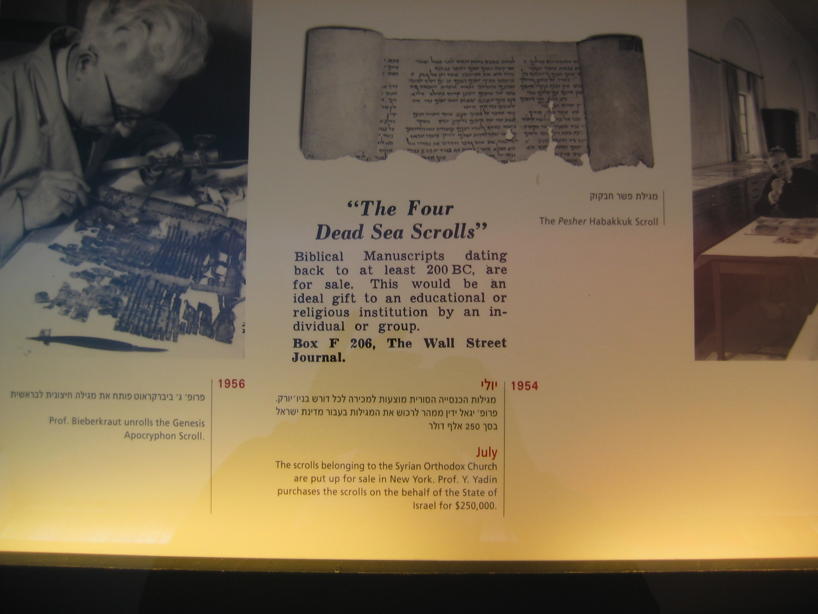

Slide 32
The Great Antiquity of the Dead Sea Scrolls
“Thus we know that even from this second source – Septuagint – we have not full texts of the Bible earlier than the fourth century AD. In the light of that fact, it is easy to appreciate the great importance of two Isaiah texts discovered among the Qumran Scrolls. These texts are about a thousand years older than the oldest Hebrew text known to us and about five hundred years older than the earliest Greek version of the Septuagint.”
The Isaiah Scrolls; The Message of the Scrolls; Yigael Yadin; 1992; Pg.83

Slide 33
The Reliability of the Biblical Text
“What is astonishing is that despite their antiquity and the fact that the scrolls belong to this pre-standardization period, they are on the whole almost identical with the Masoretic text known to us. This establishes a basic principle for all future research on texts of the Bible. Not even the hundreds of slight variations established in the texts, affecting mainly spelling and occasional word-substitution, can alter that fact.”
The Isaiah Scrolls; The Message of the Scrolls; Yigael Yadin; 1992; Pg.83

Slide 34
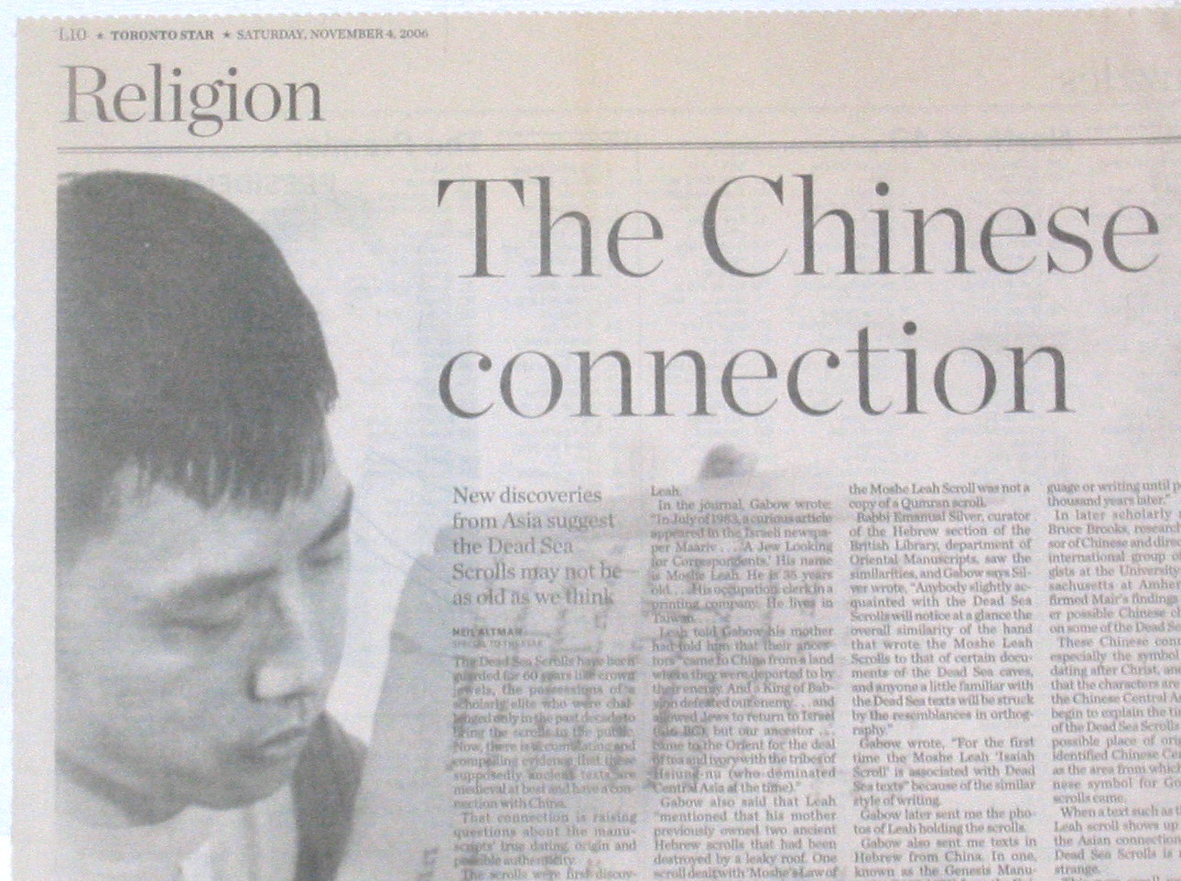
Even in 100 BCE Hiding Scrolls in Jars was not a New Idea
November 4, 2006
Jeremiah 32:13-14
“And I charged Baruch before them, saying, Thus saith the LORD of hosts, the God of Israel; Take these evidences, this evidence of the purchase, both which is sealed, and this evidence which is open; and put them in an earthen vessel, that they may continue many days.”

Slide 35
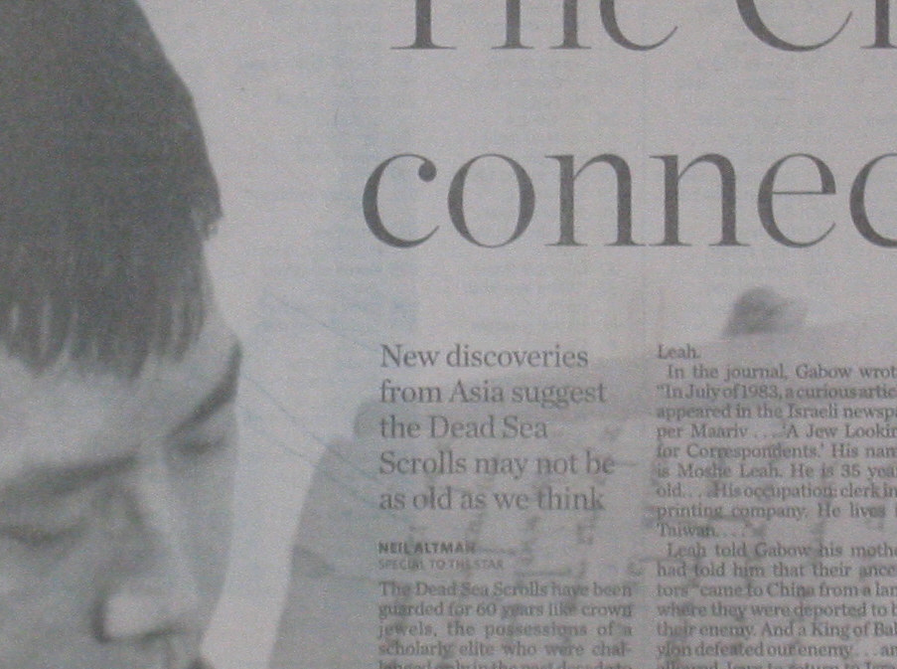
Even in 100 BCE Hiding Scrolls in Jars was not a New Idea
“Beloved, believe not every spirit, but try the spirits whether they are of God: because many false prophets are gone out into the world.” - 1John 4:1
Jeremiah 32:13-14
“And I charged Baruch before them, saying, Thus saith the LORD of hosts, the God of Israel; Take these evidences, this evidence of the purchase, both which is sealed, and this evidence which is open; and put them in an earthen vessel, that they may continue many days.”

Slide 36
THE DATING OF THE SCROLLS
“Today scholarly opinion regarding the time span and background of the Dead Sea Scrolls is anchored in historical, paleographic, and linguistic evidence, corroborated firmly by carbon-14 datings. Some manuscripts were written and copied in the third century BCE, but the bulk of material, particularly the texts that reflect on a sectarian community, are originals or copies from the first century BCE.”

Slide 37
THREE TECHNOLOGIES needed to develop (1980’s) and be available to assist in the analysis of the scrolls:
INFRARED technology permitted the reading and copying of the scroll content.
DNA analysis permitted scientists to piece together which fragment came from which scroll.
CARBON 14 DATING provided proof of the age of the scrolls.

Slide 38
The Scrolls Found at Masada
MASADA

Slide 39
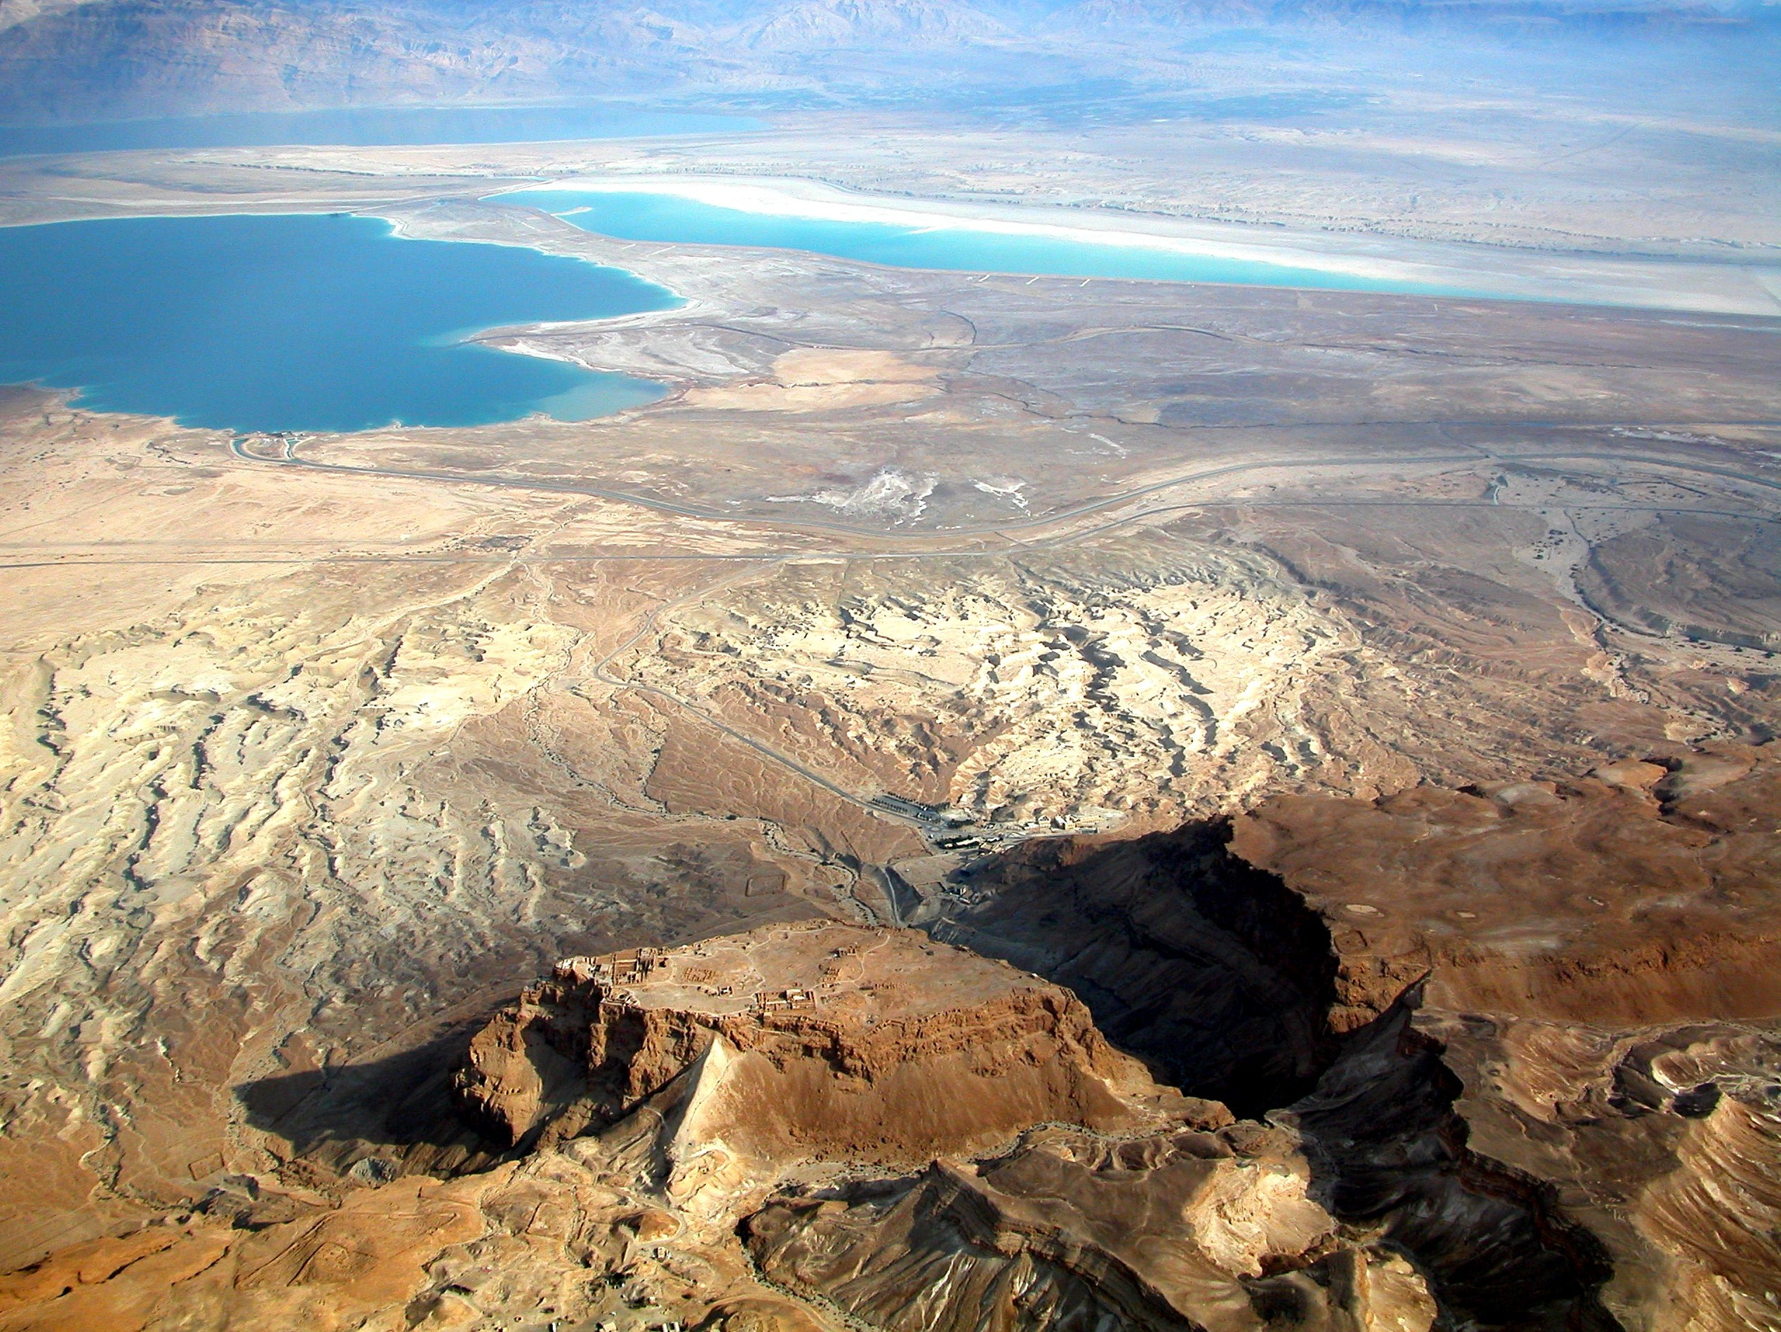
MASADA

Slide 40
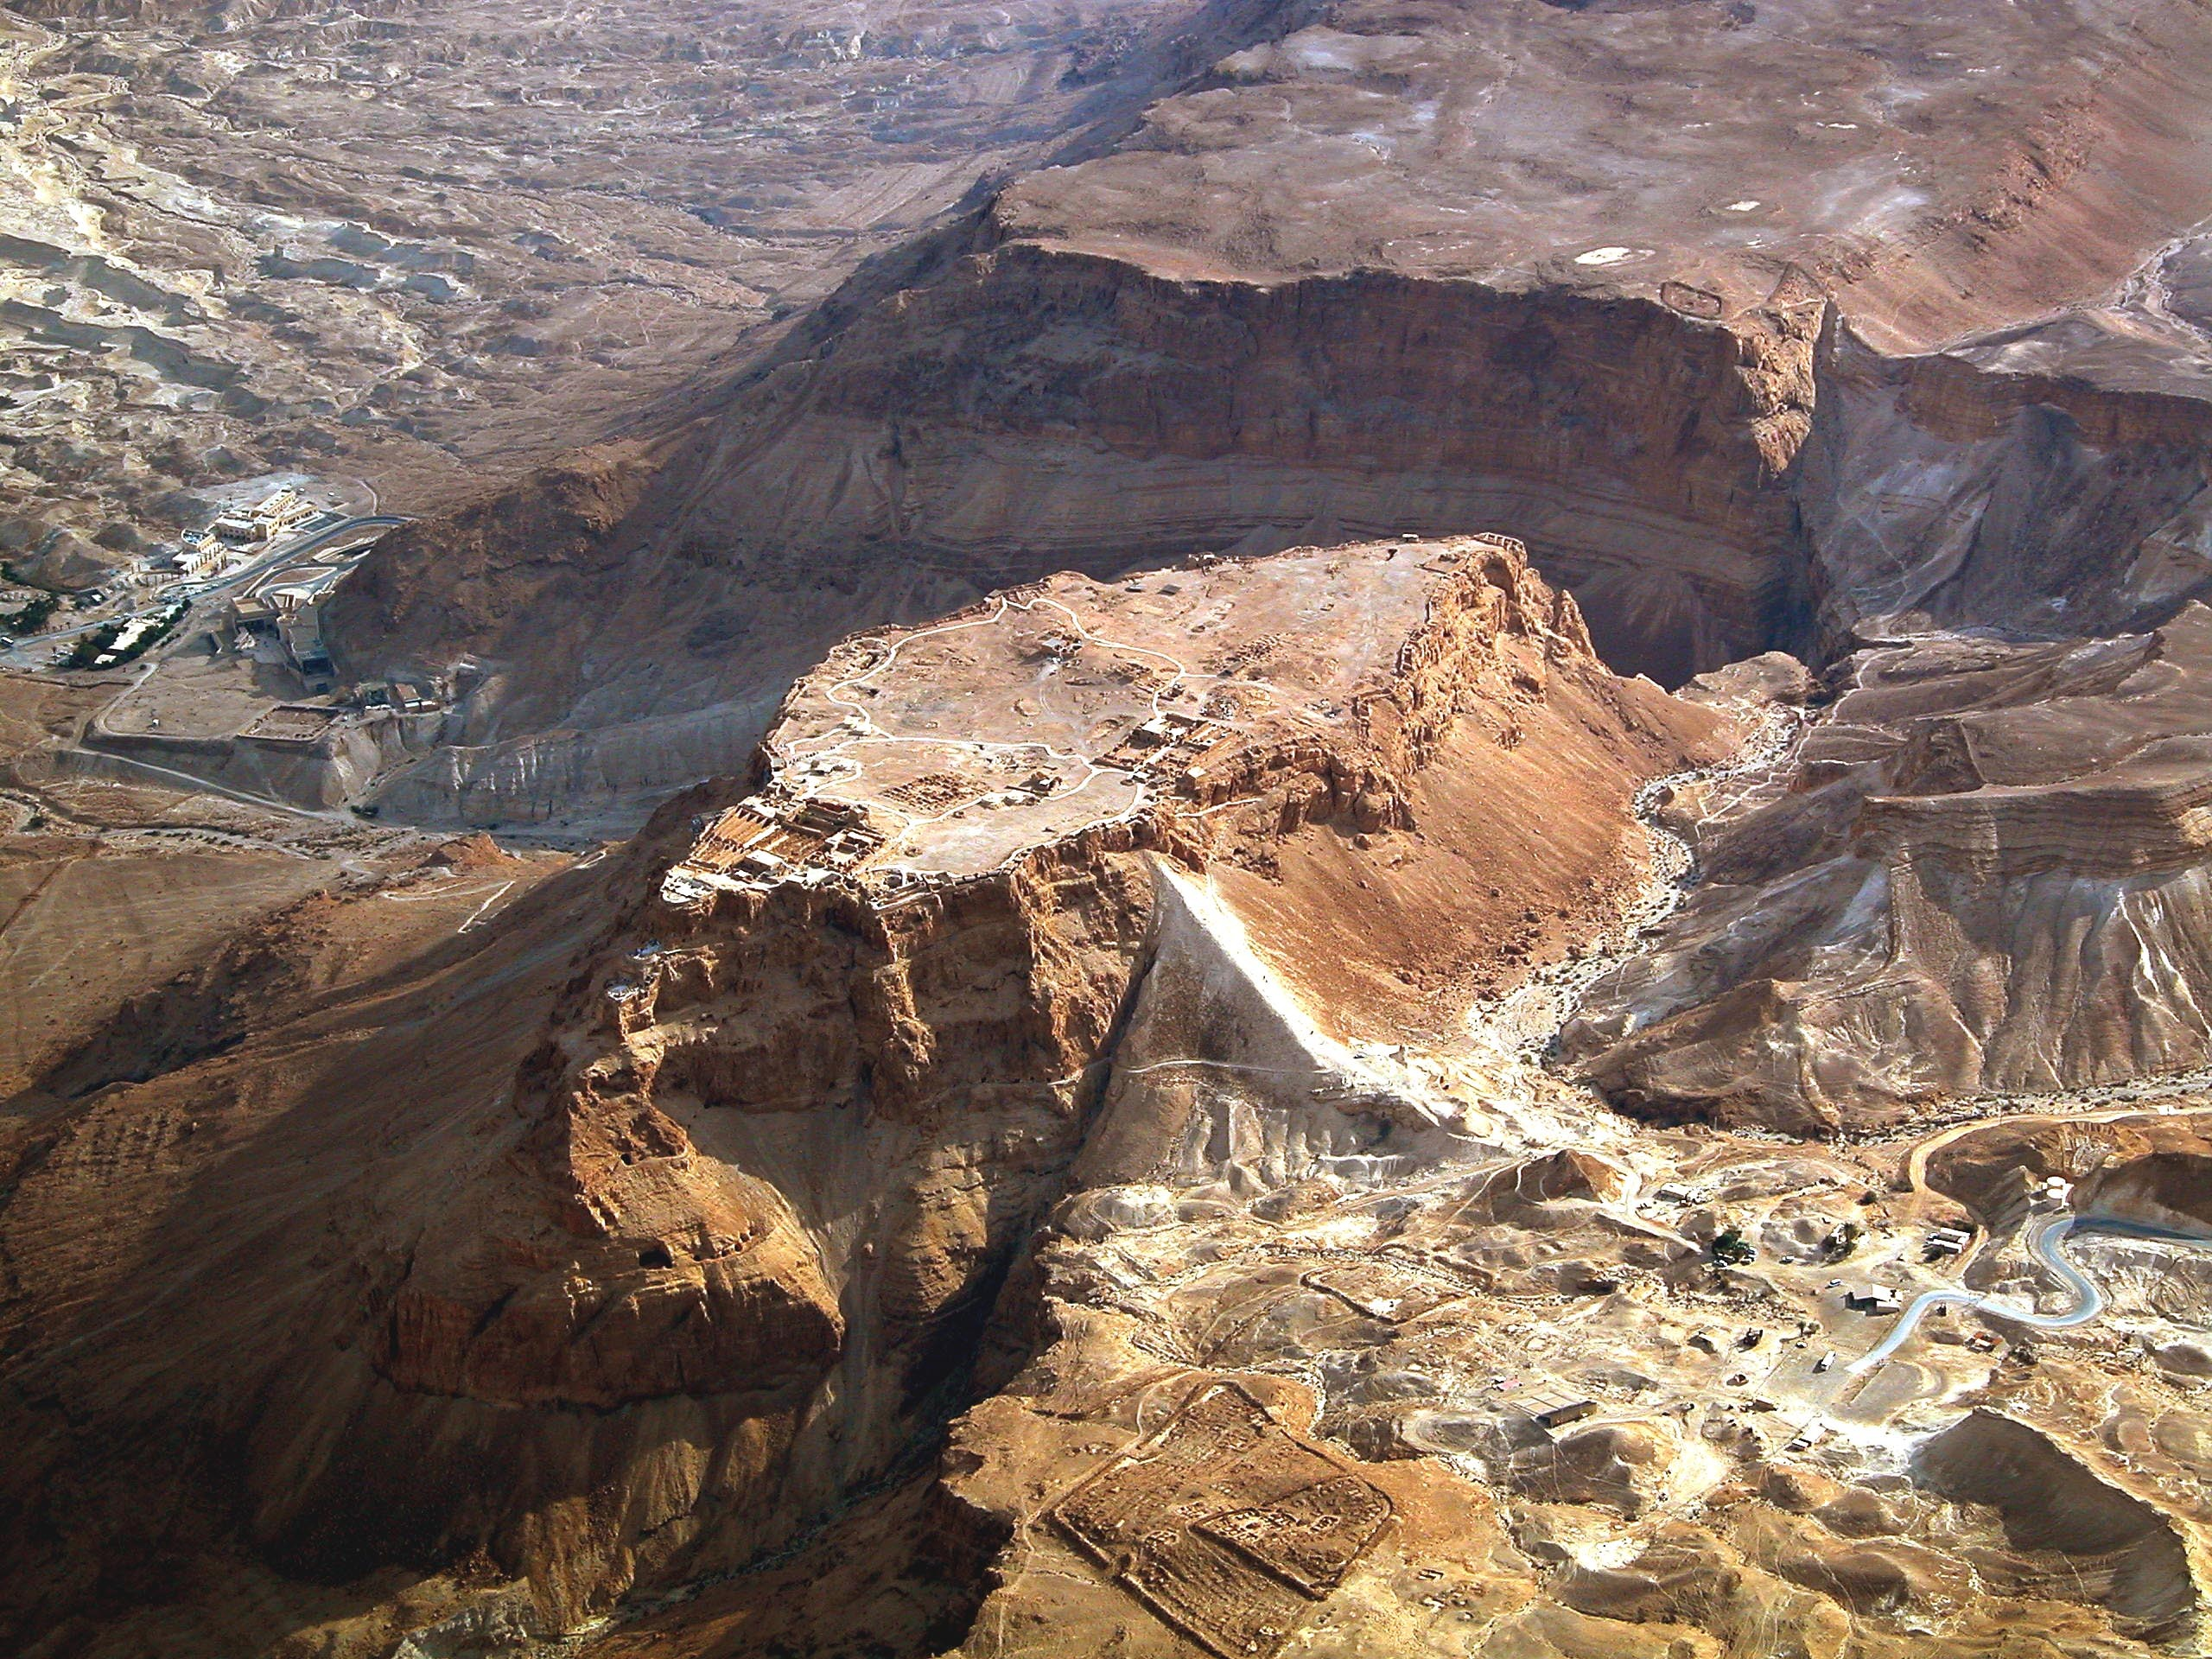
THE ROMAN ENCAMPMENTS

Slide 41
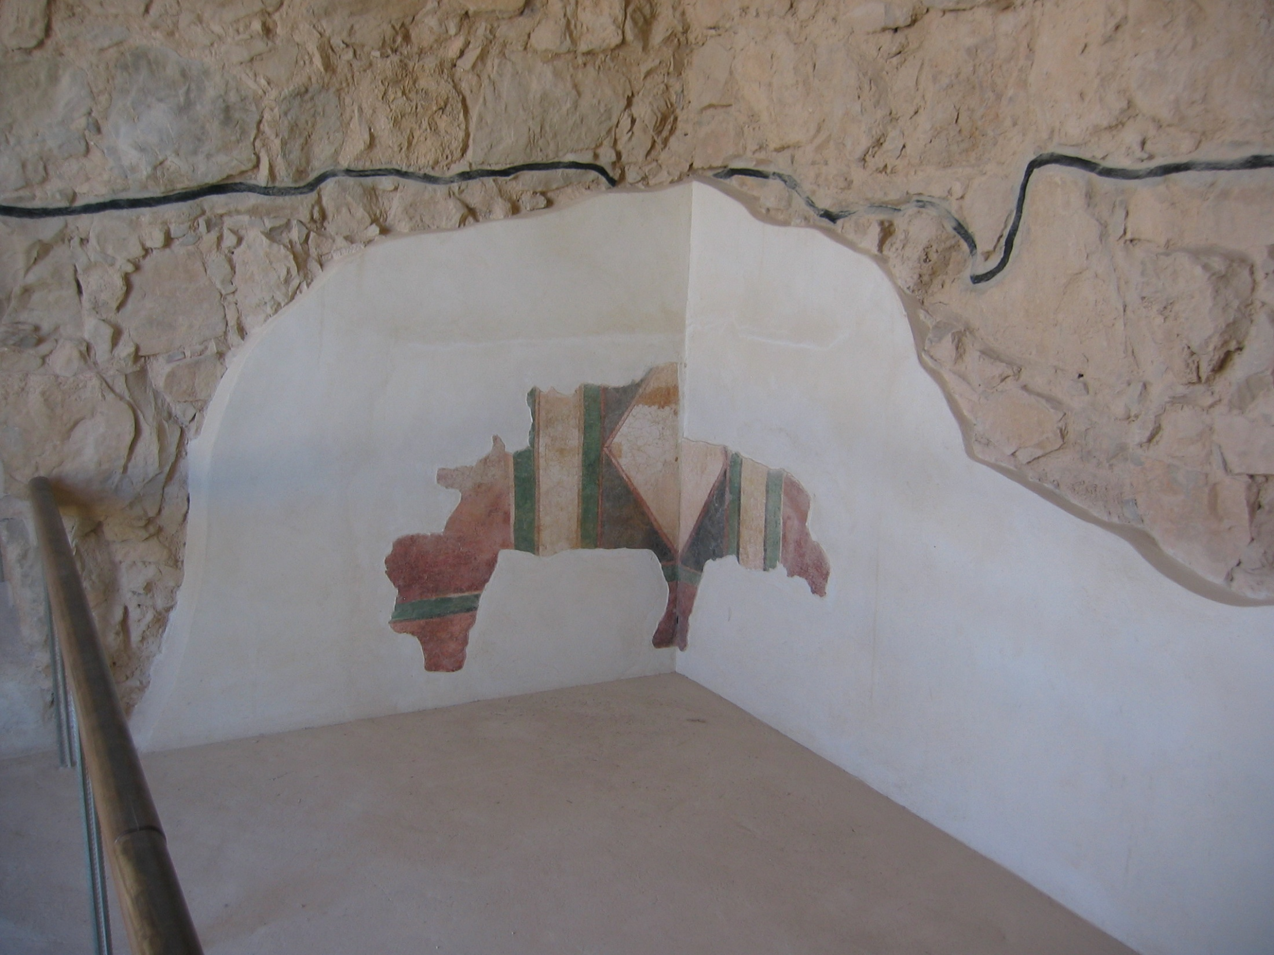
RESTORATION OF DECORATED WALLS

Slide 42
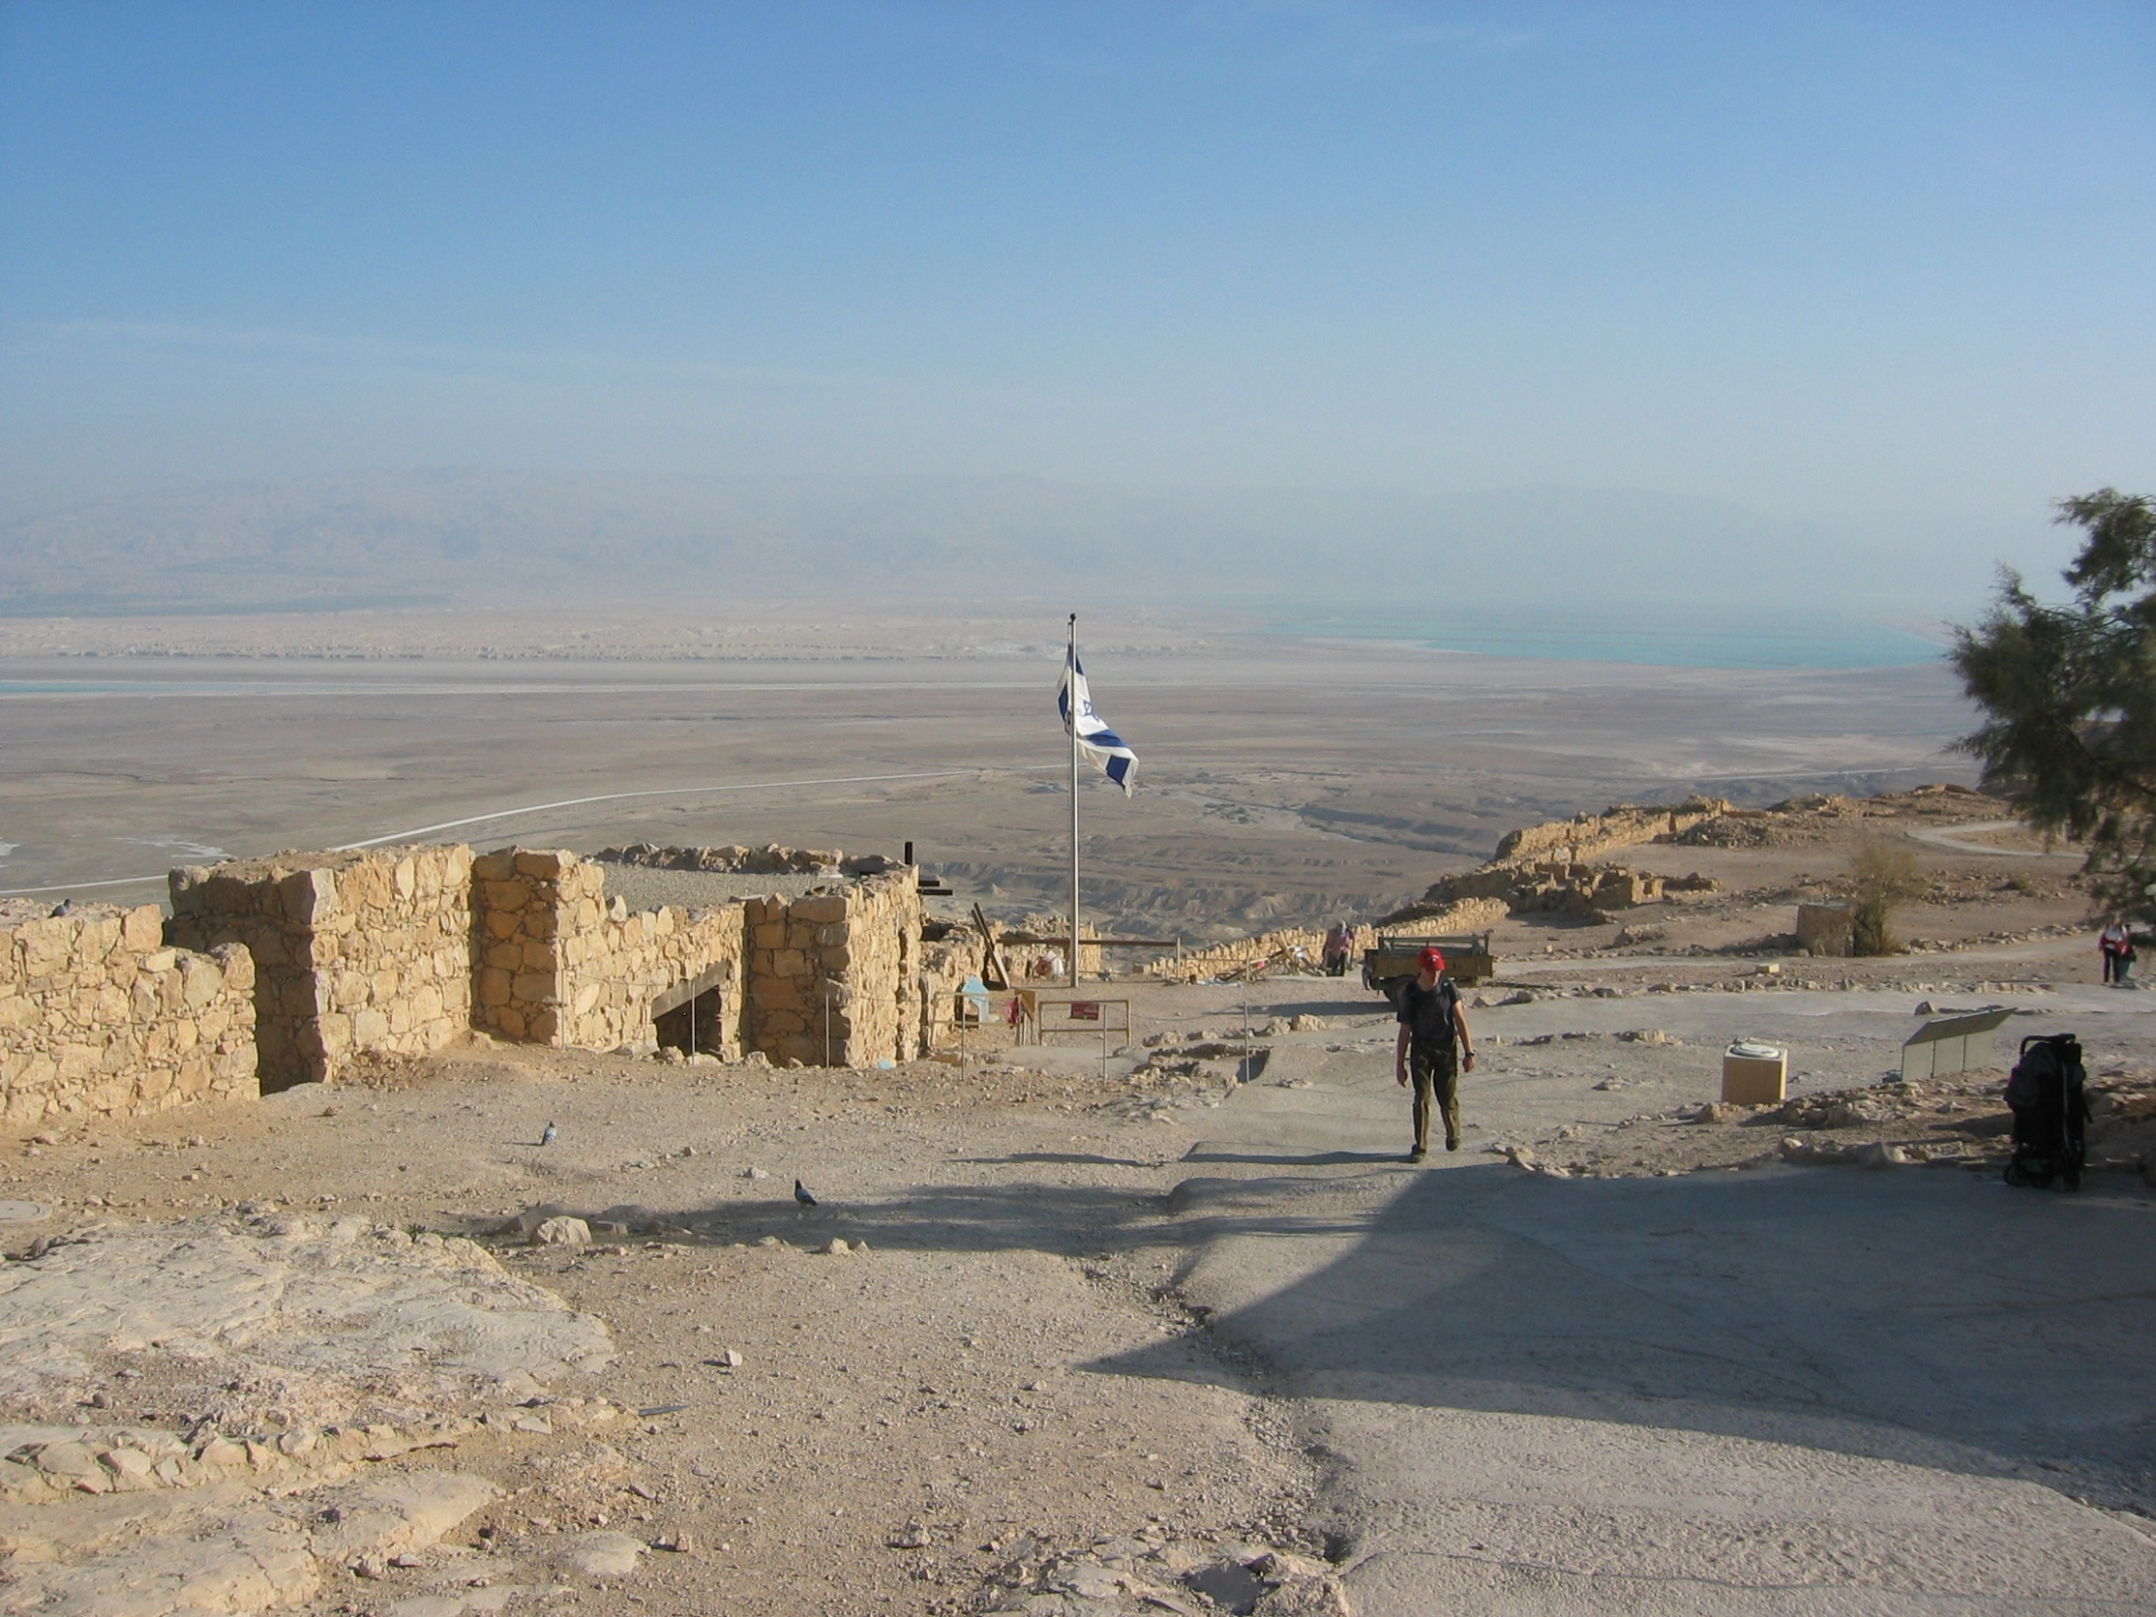
VIEW FROM TOP OF MASADA LOOKING SOUTH-EAST

Slide 43
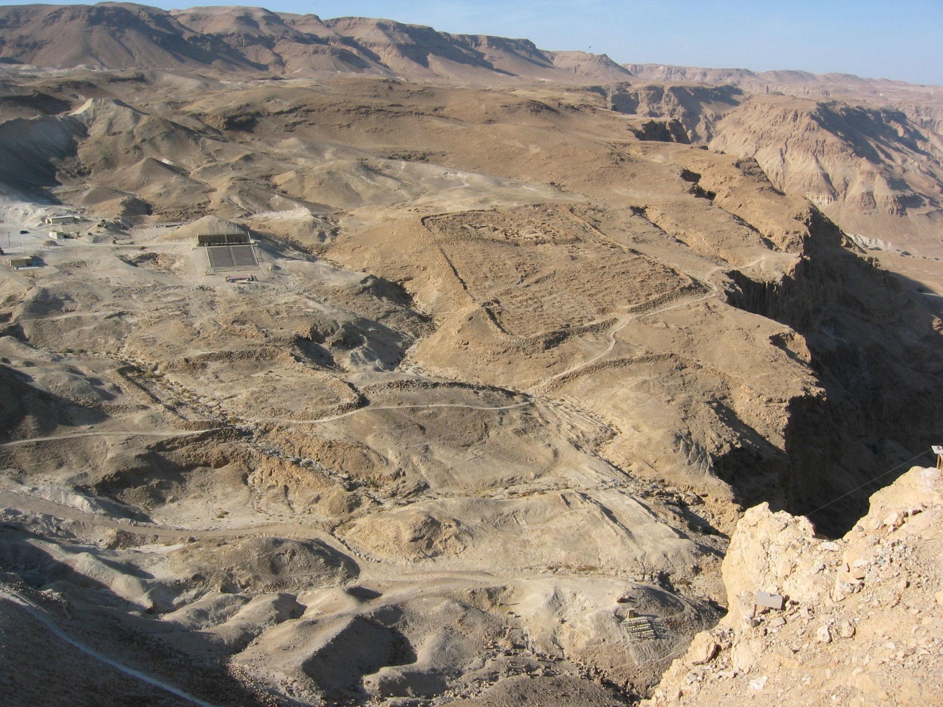
ROMAN ENCAMPMENTS VIEWED FROM THE WALL

Slide 44
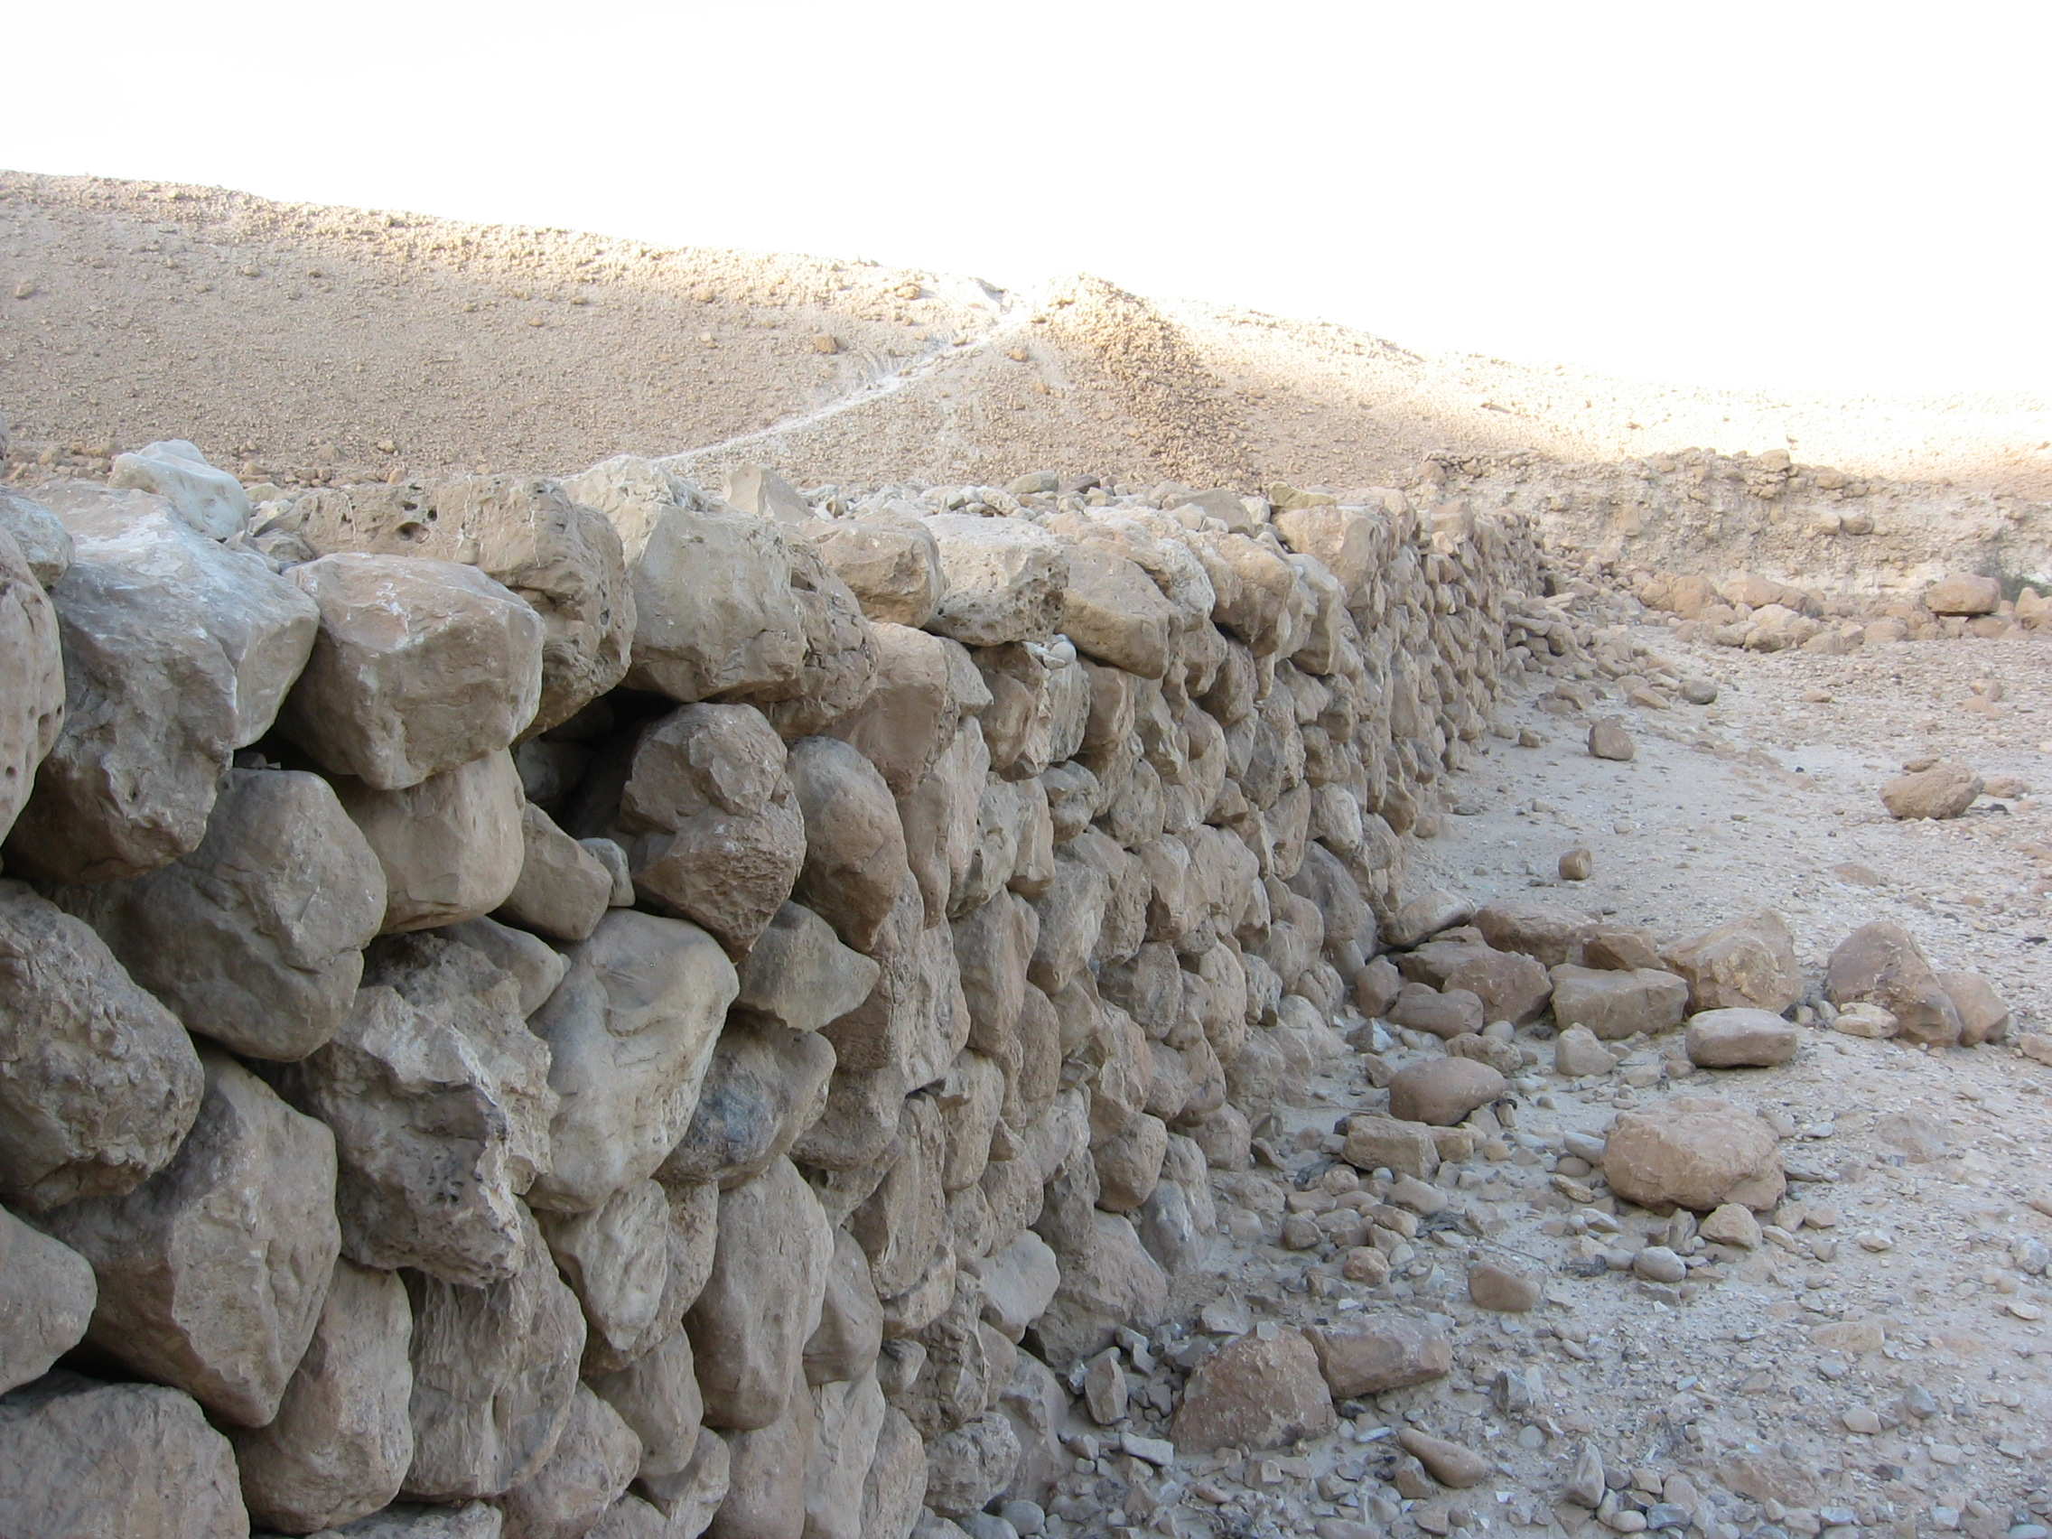
STONE WALLS AROUND THE ROMAN ENCAMPMENTS

Slide 45
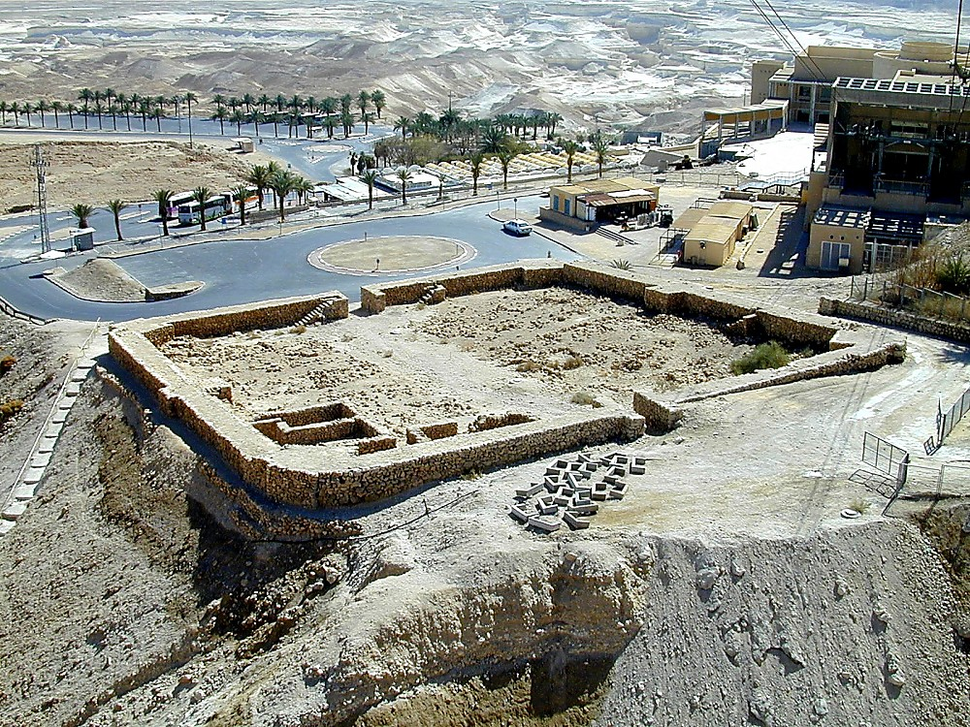
Masada siege camp reconstructed

Slide 46
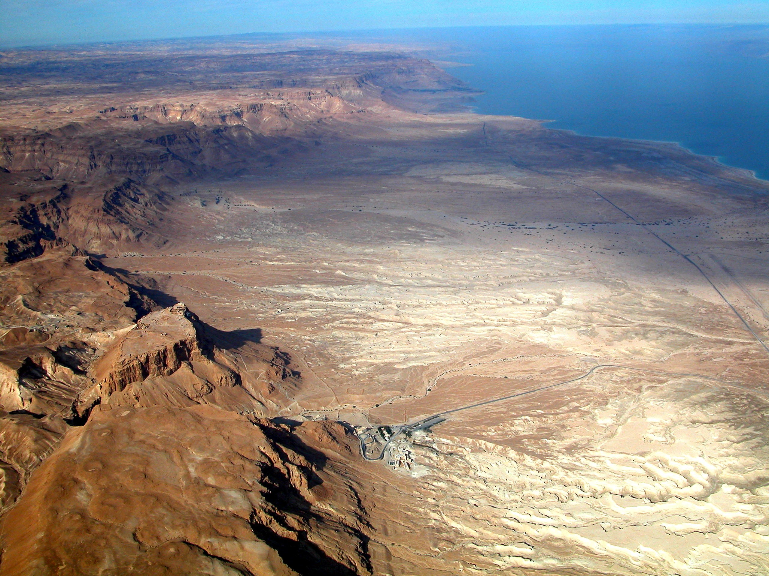
“MASADA SHALL NOT FALL AGAIN”
“It is thanks to Ben Ya’ir and his comrades, to their heroic stand, to their choice of death over slavery, and to the burning of their humble chattels as a final act of defiance to the enemy, that they elevated Masada to an undying symbol of desperate courage, a symbol which has stirred hearts throughout the last nineteen centuries. It is this which moved scholars and laymen to make the ascent to Masada. It is this which moved the modern Hebrew poet to cry: ‘Masada shall not fall again!” It is this which has drawn the Jewish youth of our generation in their thousands to climb to its summit in a solemn pilgrimage. And it is this which brings the recruits of the armoured units of the Defence Forces of modern Israel to swear the oath of allegiance on Masada’s heights: ‘Masada shall not fall again!”
Pg. 201; Masada: Herod’s Fortress and the Zealot’s Last Stand:
Yigael Yadin, Orion Publishing Group

Slide 47
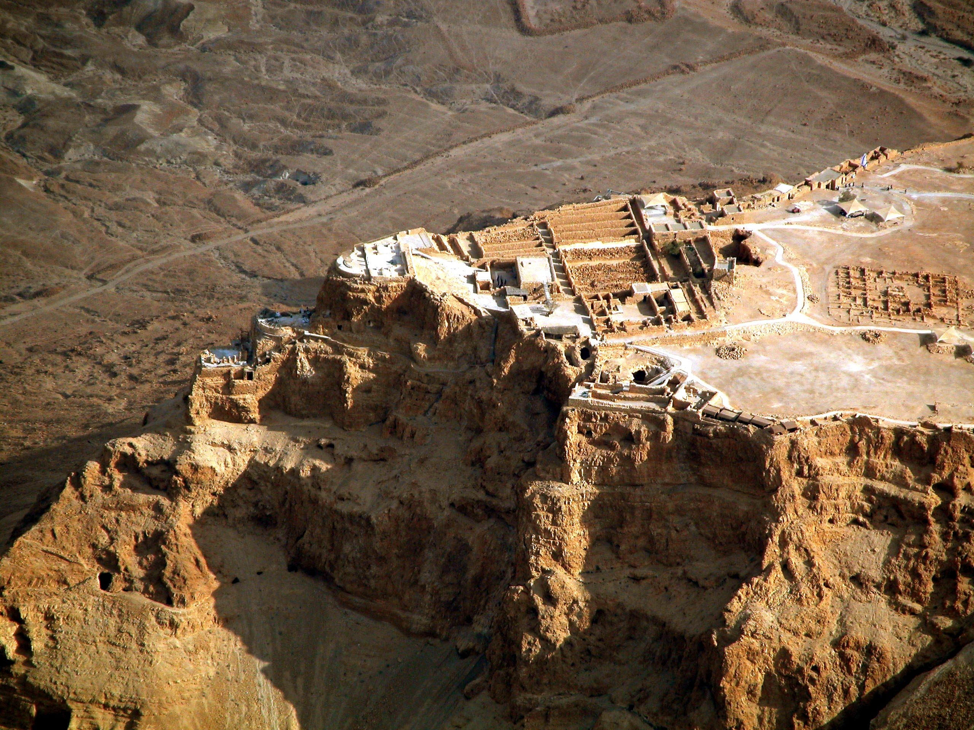
HEROD’S THREE-TIERED PALACE

Slide 48
The Synagogue facing Jerusalem

Slide 49
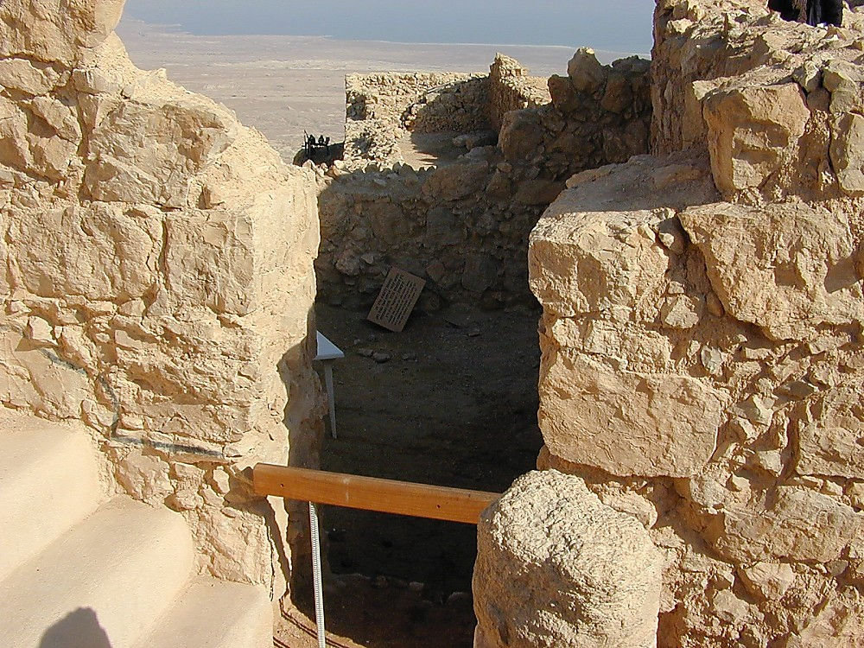
THE GENIZA AT MASADA

Slide 50
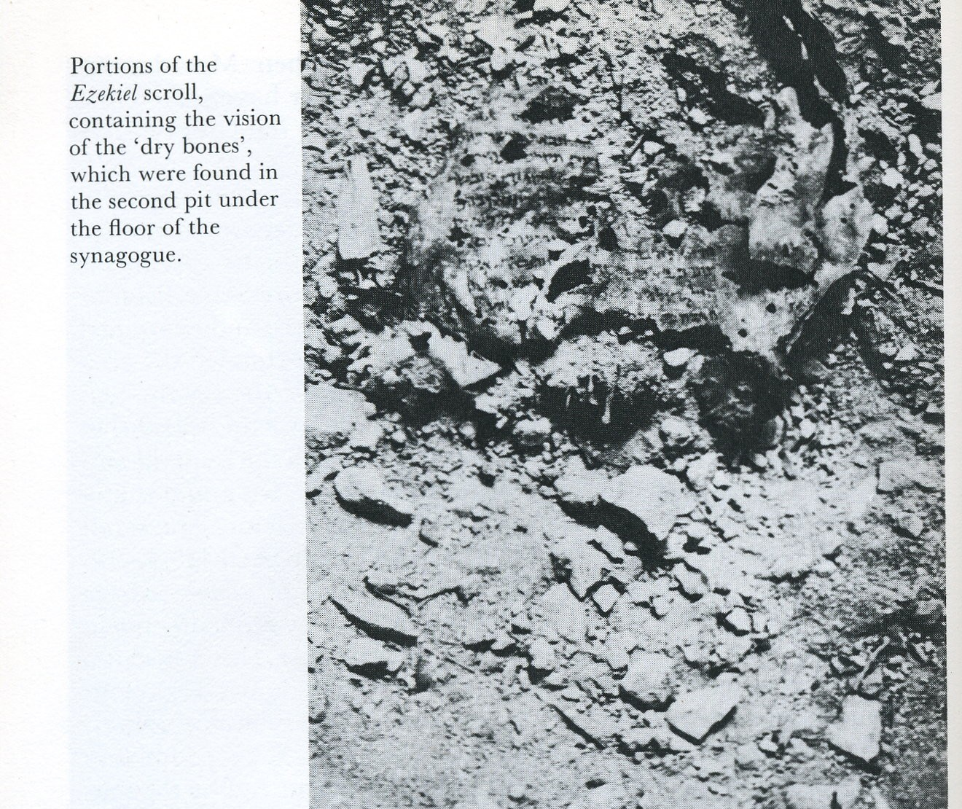

Slide 51
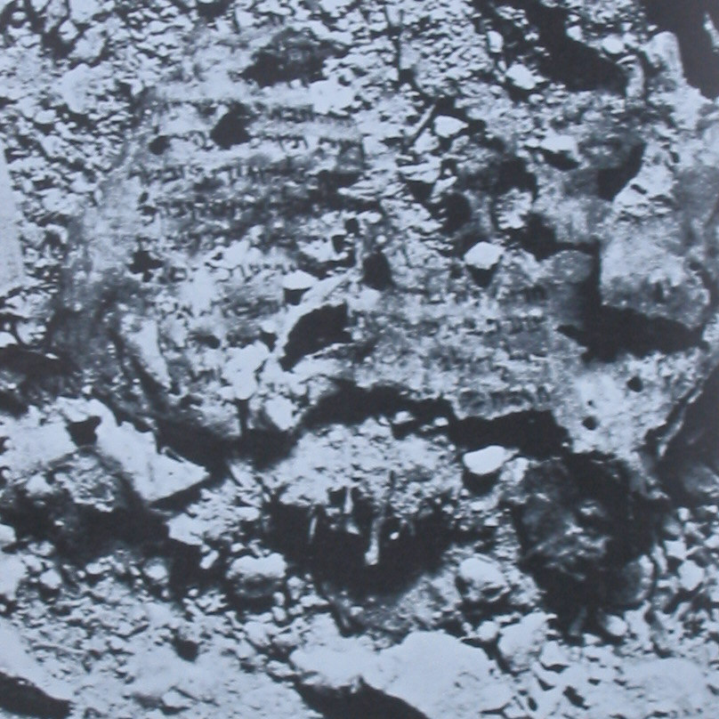
EZEKIEL 37:11-14 (6th Century B.C.)
“Then he said unto me, Son of man, these bones are the whole house of Israel: behold, they say, Our bones are dried, and our hope is lost: we are cut off for our parts. Therefore prophesy and say unto them, Thus saith the Lord GOD; Behold, O my people, I will open your graves, and cause you to come up out of your graves, and bring you into the land of Israel. And ye shall know that I am the LORD, when I have opened your graves, O my people, and brought you up out of your graves, And shall put my spirit in you, and ye shall live, and I shall place you in your own land: then shall ye know that I the LORD have spoken it, and performed it, saith the LORD.”

Slide 52
THE DEAD SEA SCROLLS AND THEIR SIGNIFICANCE TO BIBLE STUDENTS
  Illustrate the Reliability of the Biblical record.
  Underscore where we are in time according to God’s plan.
  A message of hope to Biblical students.
  Gives assurance that the other promises made in God’s word will surely come to pass.

