Slide 1
I Corinthians
Let him glory in the Lord
I Corinthians 1

Slide 2
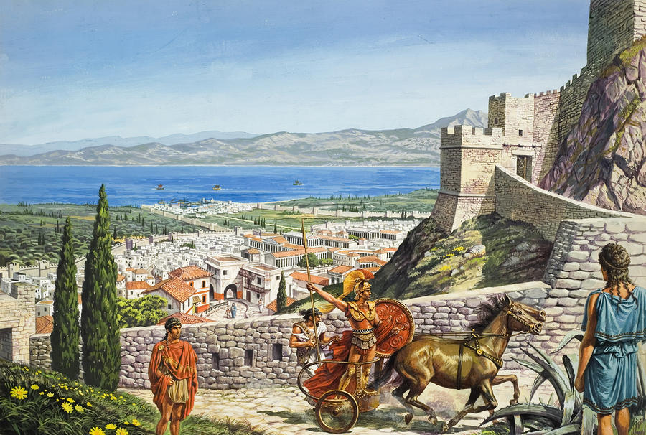
I Corinthians

Slide 3
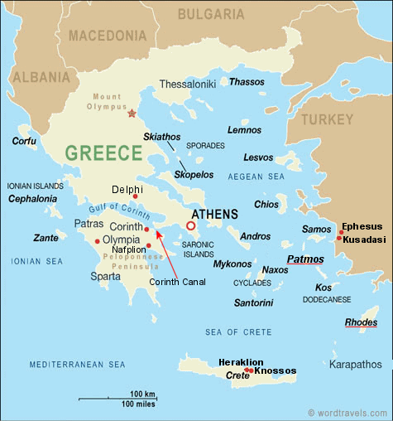

Slide 4
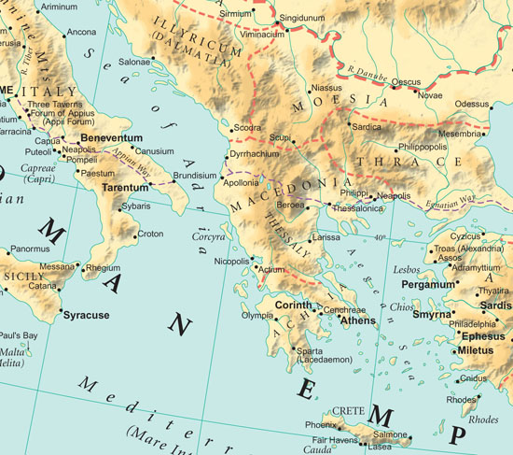

Slide 5
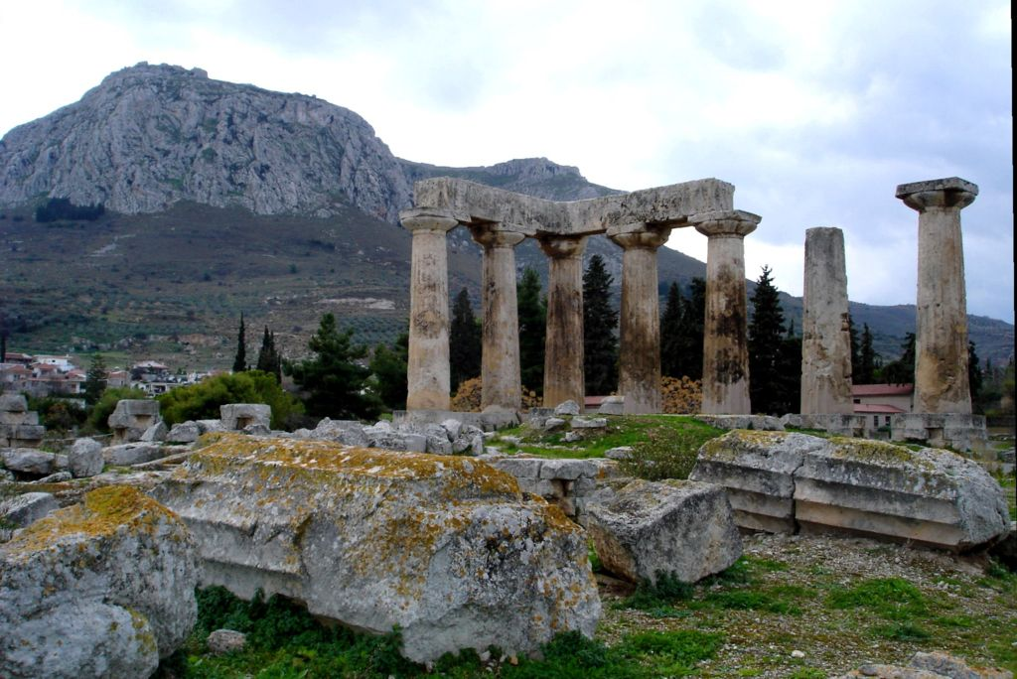

Slide 6


Slide 7
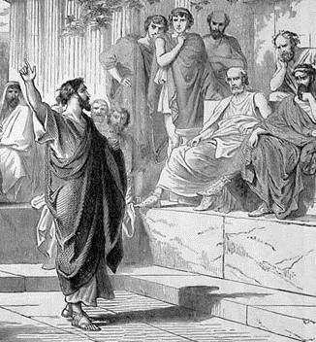

Slide 8
Immediate focus on unity in the Lord Jesus Christ

Slide 9
Fulfil ye my joy, that ye be likeminded, having the same love, being of one accord, of one mind.
Philippians 2:2

Slide 10
Nevertheless, whereto we have already attained, let us walk by the same rule, let us mind the same thing.
Philippians 3:16

Slide 11
I beseech Euodias, and beseech Syntyche, that they be of the same mind in the Lord.
Philippians 4:2

Slide 12
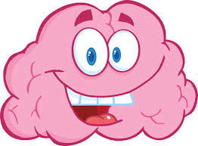
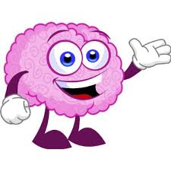


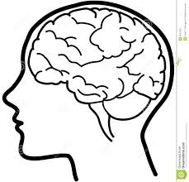



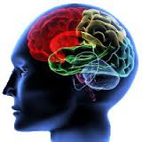


Be perfectly joined together in the same mind

Slide 13
The burden of the Corinthian Ecclesia: The “I” Brigade

Slide 14
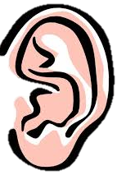
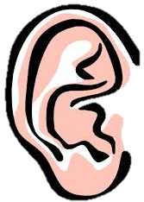
Perish
Saved
The Power of God
Foolishness
Not many wise,
not many mighty,
not many noble
The wise, the scribe
The disputers of
this world
Preaching – The Gospel
of Salvation

Slide 15
No flesh will glory in His presence

Slide 16
Let him glory in the Lord

Slide 17
Jeremiah 9 v 23-24 | 1 Corinthians 1 v 26 | 1 Corinthians v 27-31
Thus saith the LORD, let not the wise man glory in his wisdom, | ….not many wise men after the flesh, | But God hath chosen the foolish things of the world to confound the wise; v27
neither let the mighty man glory in his might, | not many mighty, | And God hath chosen the weak things of the world to confound the things which are mighty; v27
let not the rich man glory in his riches: | not many noble, are called… | and the base things of the world… v28
But let him that glorieth glory in this, that he understandeth and knoweth me, that I am the LORD which exercise lovingkindness, judgment, and righteousness, in the earth: for in these things I delight, saith the LORD. |  | That, according as it is written, He that glorieth, let him glory in the Lord. v31

