Slide 1
I Corinthians
Ye are not your own… ye are bought with a price
I Corinthians 5 – 7

Slide 2
Now some are puffed up

Slide 3
Deliver such an one to Satan
Disfellowship
Sending back to the Jewish Synagogue
Deliver to the Roman authorities

Slide 4
Of whom is Hymenaeus and Alexander; whom I have delivered unto Satan, that they may learn not to blaspheme.
I Timothy 1:20

Slide 5
Deliver such an one to Satan
Disfellowship
Sending back to the Jewish Synagogue
Deliver to the Roman authorities

Slide 6
But rise, and stand upon thy feet: for I have appeared unto thee for this purpose, to make thee a minister and a witness both of these things which thou hast seen, and of those things in the which I will appear unto thee; Delivering thee from the people, and from the Gentiles, unto whom now I send thee,
To open their eyes, and to turn them from darkness to light, and from the power of Satan unto God, that they may receive forgiveness of sins, and inheritance among them which are sanctified by faith that is in me.
Acts 26:16-18

Slide 7
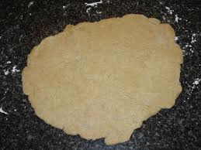
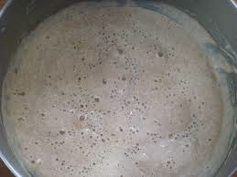
Leaven and the Passover

Slide 8
Ecclesial Elders
For this cause left I thee in Crete, that thou shouldest set in order the things that are wanting, and ordain elders in every city, as I had appointed thee:
If any be blameless, the husband of one wife, having faithful children not accused of riot or unruly. For a bishop must be blameless, as the steward of God; not selfwilled, not soon angry, not given to wine, no striker, not given to filthy lucre;
But a lover of hospitality, a lover of good men, sober, just, holy, temperate; Holding fast the faithful word as he hath been taught, that he may be able by sound doctrine both to exhort and to convince the gainsayers.
For there are many unruly and vain talkers and deceivers, specially they of the circumcision:Whose mouths must be stopped, who subvert whole houses, teaching things which they ought not, for filthy lucre's sake.
Titus 1:5-11

Slide 9
Ecclesial Elders
This is a true saying, If a man desire the office of a bishop, he desireth a good work.
A bishop then must be blameless, the husband of one wife, vigilant, sober, of good behaviour, given to hospitality, apt to teach;
Not given to wine, no striker, not greedy of filthy lucre; but patient, not a brawler, not covetous;
One that ruleth well his own house, having his children in subjection with all gravity;
(For if a man know not how to rule his own house, how shall he take care of the ecclesia of God?)
1 Timothy 3:1-5

Slide 10
Ye are not
your own

Slide 11
Basis of Ecclesial Life
Not about our self or our right
We do not even own ourselves – we belong to God
Do all for the body of Christ

Slide 12
All things are lawful – but not not all things are expedient

Slide 13
“Expedient”
Expedient – Greek – sumpherō
To bear together, to contribute – conducive – advantage.

Slide 14
The Temple
of the
Living God

Slide 15
