Slide 1
I Corinthians
All things are lawful unto me but not all things are expedient
I Corinthians 8 – 11

Slide 2
The danger of self imposed justification

Slide 3
Idol is Nothing

Slide 4
“Commended” idol to God
Idol is Nothing

Slide 5
Eat meat offered to idol
“Commended” idol to God
Idol is Nothing

Slide 6
Destroy not thy brother for whom Christ died

Slide 7
In the idol’s temple
Eat meat offered to idol
“Commended” idol to God
Idol is Nothing

Slide 8
Cause the loss of a brother
In the idol’s temple
Eat meat offered to idol
“Commended” idol to God
Idol is Nothing

Slide 9
Principle:
What will edify (build up) my brother or sister rather then what can I justify getting away with

Slide 10
The example of the Apostles

Slide 11
Examples of Israel in the Wilderness

Slide 13
1 Cor 10 | Israel | Eating/ Drinking | Anti-manna | Idols | Immoral-ity
V6 As they also lusted | Graves of the Greedy Num 11:4-6, 33-34
V7 Idolaters as were some of them | Golden Calf Ex 32:6
V8 Fornication as some of them committed | Baal-Peor Num 25:1-3
V9 Some of them tempted | Fiery Serpents Num 21:5-6
V10 Some of them murmured | Marah, Elim, Rephidim Ex 15:24; Ex 16:2-4; Ex 17:3

Slide 14
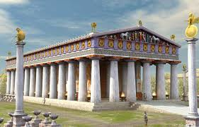
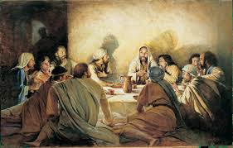
The Communion of the Body and Blood of the Lord

Slide 15
Fellowship with devils
Cause the loss of a brother
In the idol’s temple
Eat meat offered to idol
“Commended” idol to God
Idol is Nothing

Slide 16
Make the Memorial Meeting like idol worship
Fellowship with devils
Cause the loss of a brother
In the idol’s temple
Eat meat offered to idol
“Commended” idol to God
Idol is Nothing

Slide 17
All things are lawful – but not all things are expedient

Slide 18
God’s Salvation

Slide 19
“Whether therefore ye eat or drink, or whatsoever ye do – do all to the glory of God.”

