Slide 1
I Corinthians
Yet show I unto you a more excellent way
I Corinthians 12 – 14

Slide 2
The Exodus | Moses/Paul | Israel/Corinth | Corinthians
Ex 4:10-12 | I am not eloquent/came not with excellency of speech |  | I Cor 2:1-4
Num 12:7 | Faithful in all my house/ Stewards - a man be found faithful |  | I Cor 4:2
Num 5:18 |  | Unfaithful woman’s head uncovered | I Cor 13:12
Num 12:8 | God to Moses – speak mouth to mouth | /then face to face | I Cor 13:12
Num 11:29 |  | Would God all…were prophets/I would ye all spake with tongues | I Cor 14:5

Slide 3
The Exodus | Moses/ Paul | Israel/Corinth | Corinthians
Num 10:1-9 |  | If the trumpet gives an uncertain sound who shall prepare…. | I Cor 14:8
Ex 13, Ex 16, Ex 17, |  | The Blessings from God - Baptism (Red Sea), Manna, Living Water | I Cor 10:1-4
Num 11, Ex 32, Num 25, Num 21, Num 14, Ex 15, Ex 16, Ex 17 |  | The failings (associated with eating and drinking) – Graves of greedy, golden calf, joined to idols temple, rejected spiritual meat, murmured. | I Cor 10:5-10
 |  | God not well pleased, overthrown in the wilderness, lusted, fell, destroyed, | I Cor 10:5-10

Slide 4
The issues of the congregation in the wilderness
Challenge against the authority of Moses
Individuals create issues that spread to the whole congregation
God’s glory revealed in judgement and evidence of God’s support of Moses
Every person, including Moses and Aaron learning that they did nothing in their own strength but as instruments of God

Slide 5
I Corinthians 10:6
Now these things were our examples, to the intent we should not lust after evil things, as they also lusted

Slide 6
I Corinthians 10:11
Now all these things happened unto them for ensamples: and they are written for our admonition, upon whom the ends of the world are come.

Slide 7
I Corinthians 10:12
Wherefore let him that thinketh he standeth take heed lest he fall.

Slide 8
I Corinthians 10:13
There hath no temptation taken you but such as is common to man: but God is faithful, who will not suffer you to be tempted above that ye are able; but will with the temptation also make a way to escape, that ye may be able to bear it.

Slide 9
Spirit Gifts: Contribution vs
Ambition

Slide 10
Different Gifts – the same spirit

Slide 11
All in All! God’s Glory

Slide 12

Yahweh’s Glory
Man’s Wisdom

Slide 13
Yahweh’s Glory
Man’s Wisdom

Slide 14
Yahweh’s Glory
Man’s Wisdom

Slide 15
Yahweh’s Glory
Man’s Wisdom

Slide 16
Yahweh’s Glory

Slide 17
Yahweh’s Glory

Slide 18
The
Ecclesial
Body

Slide 19
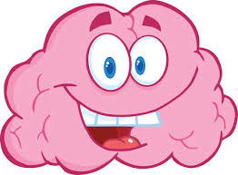


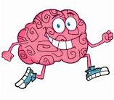
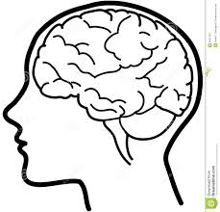



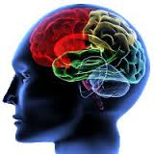


Be perfectly joined together in the same mind

Slide 20
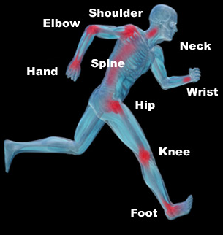

Slide 21
The Importance of Diversity

Slide 22
a more excellent way
Gk – Huperbolē (Hoop-er-bol-ay) = a throwing beyond others, supereminence, far more exceeding.

Slide 23
A more excellent
way - Love

