Slide 1
I Corinthians
Thanks be to God which giveth us the victory
I Corinthians 15

Slide 2
Death then Resurrection

Slide 3
For if, when we were enemies, we were reconciled to God by the death of his Son, much more, being reconciled, we shall be saved by his life.
Romans 5:10

Slide 4
Eye witness evidence

Slide 5
Resurrection: a foundation hope

Slide 6
… of all men most miserable

Slide 7
Three resurrections

Slide 8
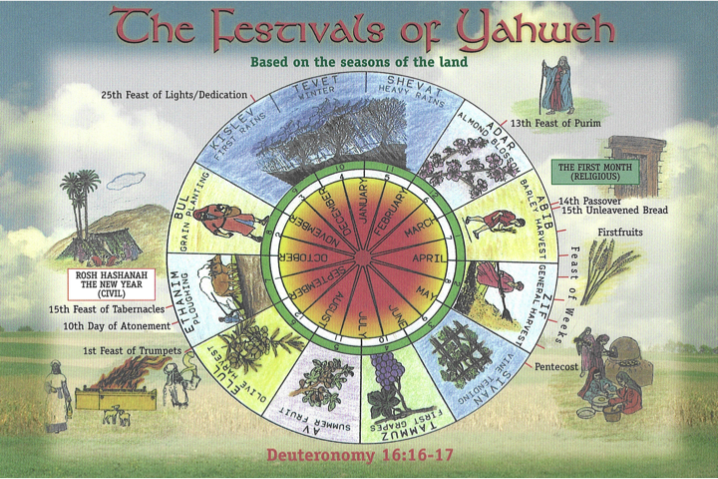

Slide 9
Three Resurrections
Christ the firstfruits
They that are Christ’s at his coming
Then cometh the end – end of the millenium

Slide 10
It will thus be seen that the kingdom of the thousand years is but a transitional period between the purely animal and purely spiritual ages. It will blend the elements of both.
It will exhibit the perfection of the eternal ages in the Lord Jesus and the saints who will be immortal and incorruptible, and the imperfection of the human age in the mortal population who will constitute the subjects of their rule.

Slide 11
Both will co-exist for a thousand years, and will constitute a state of things as superior to the present dispensation as it will be inferior to the glory ages beyond.
The Kingdom of God will lead us by a bridge of a thousand years from the age of sin and death defection to the age of restoration in the bosom of the Deity, in righteousness and life eternal.
Brother Roberts – Christendom Astray, Lecture 10

Slide 12
All things under His feet

Slide 13
Put down all rule, all authority, all power
Rule = archē = a commencement (ie first), a chief
Authority = exousia = privilege, force, capacity
Power = dunamis = force; specifically miraculous power

Slide 14
The Power
of Death

Slide 15
I will ransom them from the power of the grave; I will redeem them from death: O death, I will be thy plagues; O grave, I will be thy destruction: repentance shall be hid from mine eyes.
Hosea 13:14

Slide 16
Forasmuch then as the children are partakers of flesh and blood, he also himself likewise took part of the same; that through death he might destroy him that had the power of death, that is, the devil; And deliver them who through fear of death were all their lifetime subject to bondage.
Hebrews 2:14-15

Slide 17
That God
may be
All in All

Slide 18
And God blessed them, and God said unto them, Be fruitful, and multiply, and replenish the earth, and subdue it: and have dominion over the fish of the sea, and over the fowl of the air, and over every living thing that moveth upon the earth.
Genesis 1:28

Slide 19

Yahweh’s Glory

Slide 20
Christ
All in All

Slide 21
This passage then in I Corinthians 15:42...should be read,
“the resurrection-body, springs, is sprouted or born in corruption; it is built, reared up or raised , in incorruption – it is sprouted in dishonour; it is reared up in glory – it is sprouted in weakness; it is built up in power – it is born (of the earth) a natural body; it is reared up (or transformed by the Spirit into) a spiritual body”.
Anastasis – Bro Thomas (page 40)

Slide 22
Thanks be to God which giveth us the victory

Slide 23
But thanks be to God, which giveth us the victory through our Lord Jesus Christ!
Therefore
my beloved brethren,
be ye steadfast, unmoveable, always abounding in the work of the Lord, forasmuch as ye know that your labour is not in vain in the Lord.
I Corinthians 15:57-58

