Slide 1
“Blessed with faithful Abraham”
Study 1 – “Exceeding great and precious promises”

Slide 2
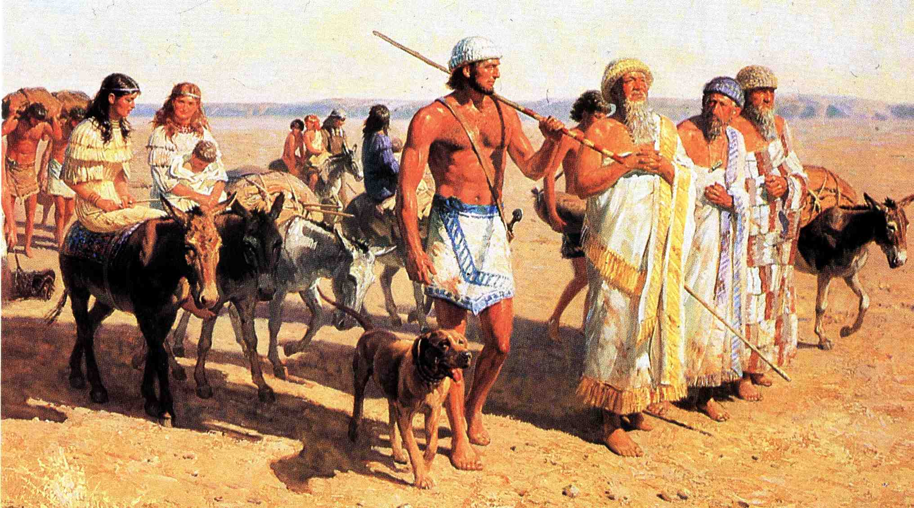
Abraham leaves Ur of the Chaldees for Haran and 5 years later, the Land of Promise

Slide 3
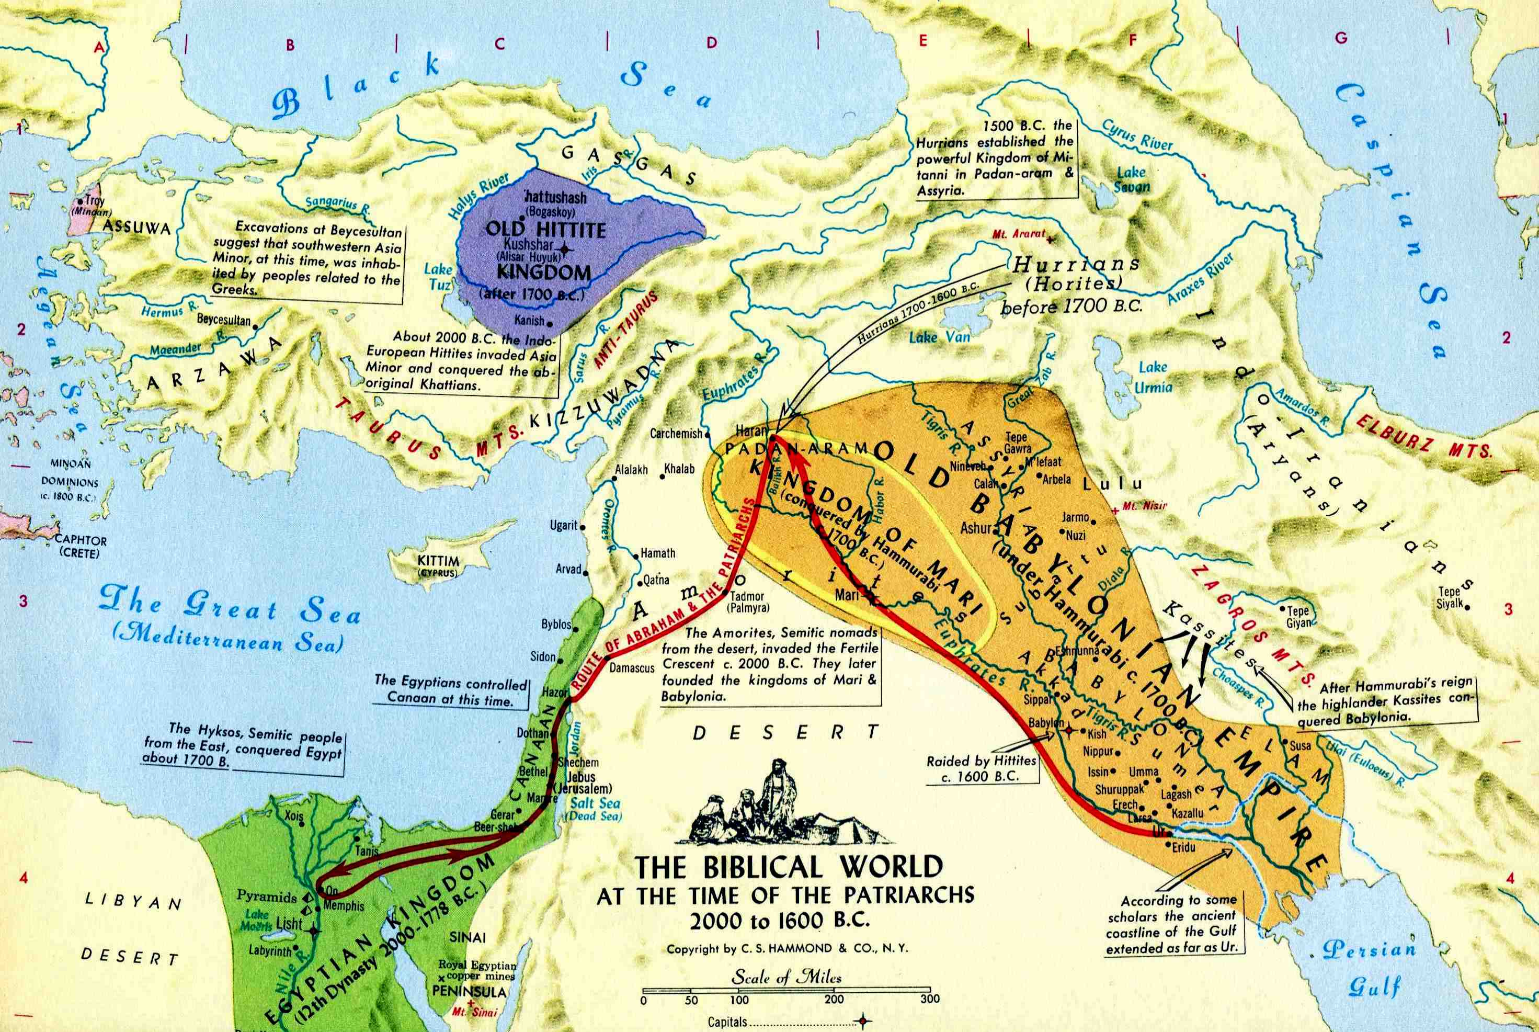
Abraham’s journeys
Heb. 11:8 - By faith Abraham, when he was called to go out into a place which he should after receive for an inheritance, obeyed; and he went out, not knowing whither he went.
Haran was the second most important place of the worship of Sin the moon god
Ur of the Chaldees was the centre of the worship of Sin

Slide 4
The Abrahamic Covenant
God made seven promises to Abraham between Gen. 12 and 22.
Gen. 12:1-3 - The first of seven promises to Abraham has seven clauses – the first points to the culmination of God’s purpose – “I will make of thee a great nation”.
Gen. 12:7 – The Land promised first to Abram’s seed – Christ (Gal. 3:16).
Gen. 13:14-17 – The Land promised to Abram once 3 conditions of 1st met.

Slide 5
The Abrahamic Covenant
Gen. 15:13-21 – The captivity and redemption of Abram’s people and the cutting of a covenant – Abram’s seed (Christ – Gal. 3:16) guaranteed possession of the Land from Euphrates to Nile.
Gen. 17:4-8 – Yahweh’s fatherhood delegated to Abraham and promise of the Divine family.
Gen. 17:15-16; 18:10,14 – The promised seed – Isaac, to be born in 12 months.

Slide 6
The Abrahamic Covenant
Gen. 22:16-18 – The promises made unconditional (Heb. 6:13-18) to Abraham.
Preceded by covenant with Gentiles – 7 ewe lambs offered – Gen. 21:22-32; hence “Beer-sheba” (“Well of the seven” (shaba/sheba – 7 times).
Culminates with Gen. 22:18 – “And in thy seed shall all the nations of the earth be blessed.”

Slide 7
The first promise to Abraham
Gen. 12:1-3
Get thee out of thy country, and from thy kindred, and from thy father's house, unto a land that I will shew thee:
And I will make of thee a great nation, and I will bless thee, and make thy name great; and thou shalt be a blessing:
And I will bless them that bless thee, and curse him that curseth thee: and in thee shall all families of the earth be blessed.
1
2
3
3 primary conditions to be met
1
2
3
4
5
6
7
7 clauses

Slide 8
Abraham promised a Great Nation Gen. 12:2-3
And I will make of thee a great nation¹/, and I will bless thee²/, and make thy name great³/; and thou shalt be a blessing⁴/:
And I will bless them that bless thee⁵/, and curse him that curseth thee⁶/: and in thee shall all families of the earth be blessed⁷/.
1 Kings 3:8 – “And thy servant is in the midst of thy people which thou hast chosen, a great people, that cannot be numbered nor counted for multitude.”

Slide 9
What is this ‘great nation’?
“nation/s” – goy / goyim - nation, people (noun masculine).
First occs. Gen. 10:5 - “Gentiles” and “nations”.
Next 4 occs. rendered “nations” – Gen. 10:20, 31, 32 (twice).
The 7th occ. is in Gen. 12:2 – “I will make of thee a great nation.”
The word “great” is gadol – this is also the 7th occ. in the O.T.

Slide 10
Who are the families?
“families” - mishpachah - clan, family, tribe, kind; hence people or nation.
First occ. – Gen. 8:19 – “kinds”.
Next 5 occs. rendered “families” – Gen. 10:5,18, 20,31,32.
7th occ. – Gen. 12:3 – “…in thee shall all families of the earth be blessed.”
“blessed” – barak – The 7th occ. in O.T. is Gen. 12:2 – “I will bless thee” – The 10th (= all) is…
The Abrahamic Covenant will ultimately bring a blessing to people of all nations.

Slide 11
What does it mean to be blessed with faithful Abraham?
Gen. 12:2-3 – “blessed” – barak – occurs 4 times in this promise. 4 is the number of ‘righteousness’.
Acts 3:25-26 – “...to bless you, when ye are turning away, each one, from your wickednesses.” (poneria – 7 occs. N.T.)
“iniquities” – poneria - depravity, iniquity, wickedness, evil purposes and desires.
Gal. 3:8 – “justify” – dikaioo – to declare or render righteous.

Slide 12
Justified by faith Hebrews 11:1
“substance” – hupostasis - a setting under, support, foundation, confidence. Bro. Thomas translates – “Faith is the confident anticipation of things hoped for, a full persuasion of things not seen”. R.V. – “giving of substance to things hoped for”.
“evidence” – elegchos - logical proof, evidence, demonstration, convincing argument.
Faith is reality and proof. The person who has it, embraces certain things promised as realities, and certain transactions as things proved. (Bro. Thomas)

Slide 13
The Canaanite in the Land Gen. 12:5-6
“Canaan/ite” – from the root kana – to bend the knee; hence to humiliate, vanquish; hence to be humble, be humbled, be subdued, be brought down, be low, be under, be brought into subjection.
Phil. 3:21 - “who shall transform the body of our humiliation to its becoming conformed to the body of his glory” (Young’s Literal).

Slide 14
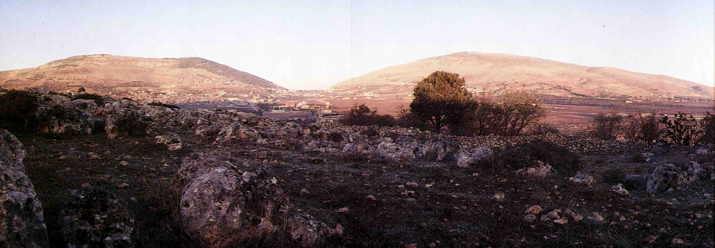
Shechem – Place of choice
The name signifies the back or shoulder; the place of burdens; hence to shoulder a burden.
Gerizim means “cuttings off”
Ebal means “bare” or “bald”
Mount of Blessing – Deut. 11:29
Mount of Cursing – Josh. 8:33-34
Shechem
North

Slide 15
The Land promised to Christ Gen. 12:7
Before it is promised to Abram! – the 3 conditions have yet to be fully met.
Gal. 3:16 – “Now to Abraham and his seed were the promises made. He saith not, And to seeds, as of many; but as of one, And to thy seed, which is Christ.”
Paul cites Gen. 13:15 which in turn is a repetition of Gen. 12:7.
Christ already had a title to the Land!

Slide 16
The challenge for Abraham Gen. 12:8
V.1-3 – The primary conditions must be met before the promise can be fulfilled.
“Get thee out of thy country...”
“...and from thy kindred...”
“...and from thy father’s house...”
Gen. 13:14-17 – The third condition met.
V.8 – Choosing the “house of God” and turning the back on “ruin” critical.
Requires sacrifice and commitment.

Slide 17
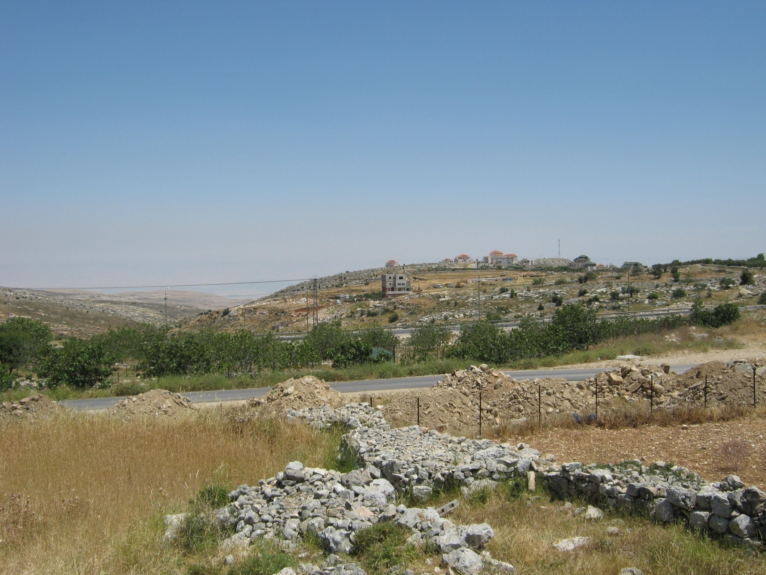
Choosing a way – Bethel or Hai
Ur is towards the east
Hai = ruin
We stand at Bethel (“House of God”) looking eastwards

Slide 18

The challenge of leadership Gen. 12:9
V.9 – “south” – negeb – parched; the south. The challenges still come!
V.10 – Why did not the Canaanites flee the famine? Without God’s help!!!
V.11-13 – A decision taken that will shape the family’s future for two generations.
V.14-15 – Abram’s worst fears realised.
“And there was a famine in the land”

Slide 19
Recovering from a mistake Gen. 13:1-4
Gen. 12:10 – “went down” – yarad - to go down, descend, decline, sink down.
Gen. 13:1 – “went up” – alah – to ascend.
V.2 – “very rich” – Cp. 12:16 – the seeds of future trouble sown – Gen. 13:1,10,12.
V.3 – “at the beginning” – techillah – beginning, first – Gen. 12:8.
V.4 – “first” – rishon - first, primary, former. Recommitment to fundamental principles and sacrifice.

Slide 20
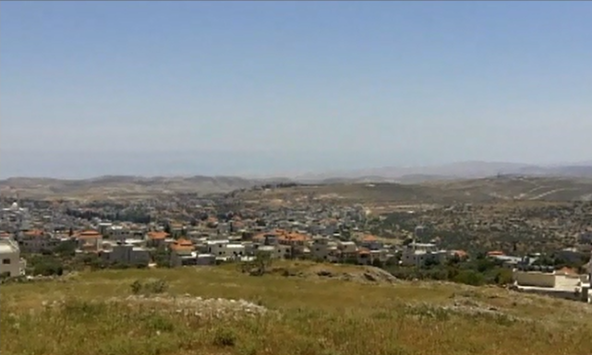
The Land promised to Abraham Gen. 13:14-17
The third promise made when the third condition fulfilled.
The plain of Jordan

Slide 21
Next study…God willing
Blessed with faithful Abraham
Study 2 - “He counted it to him for righteousness"
Blessed with faithful Abraham

Slide 22
…
...

