Slide 1
“Blessed with faithful Abraham”
Study 2 – “He counted it to him for righteousness”

Slide 2
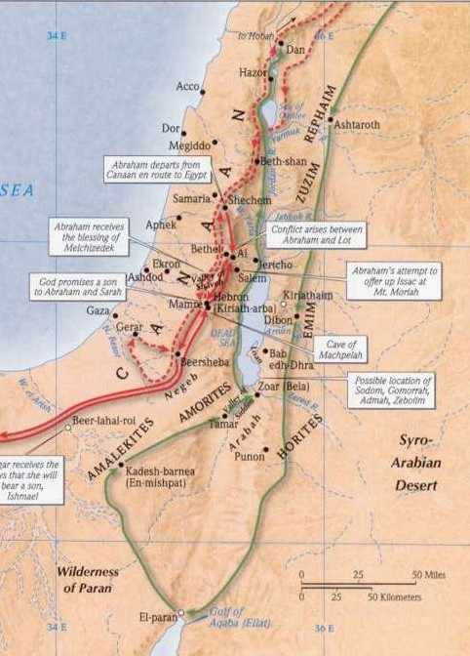
Cameo of Armageddon Gen. 14
Invasion by a northern confed-eracy on a southern confederacy. Abraham delivers his natural brethren,
and makes a solemn (and dangerous) oath – Gen. 14:22-24.

Slide 3
Abraham’s oath in the presence of Melchizedek
It is clear from Abraham’s words that in the worship of God in company with Melchizedek Abraham had made a solemn dedication of service to God. Some intimate words had passed between priest and worshipper, and some great resolve registered. The meeting had set Abraham’s course and had given him the moral earnestness to follow it, though it meant refusing the overtures of the King of Sodom and offering a repulse to him that could make him an embittered enemy.
Bro. John Carter – The Letter to the Hebrews

Slide 4
The 4th Promise – Gen. 15
Four is the scriptural number of righteousness - The subject of Gen.15 is justification (being imputed righteous) by faith.
Romans 4 is Paul’s exposition of the subject. “Righteousness” occurs 8 times (2x4) in Rom. 4; 36 times (9x4) in the book of Romans.
The O.T. word “righteousness” - tsedaqah occurs 156 times (39x4) in the singular.

Slide 5
The 4th Promise – Gen. 15
The 4th promise has three parts/elements.
Vv.1-5 - Yahweh a “shield” - Promise of protection for his seed; and “great reward” - Promise of an heir, a multitudinous seed and redemption.
Vv.13-16 – (Shield) The position of Abram and his natural seed in relation to the Land of Promise – Israel redeemed.
Vv.18-21 – (Great reward) The certainty of Abram’s seed/heir Christ (incorporating the saints) inheriting the Land for ever.

Slide 6
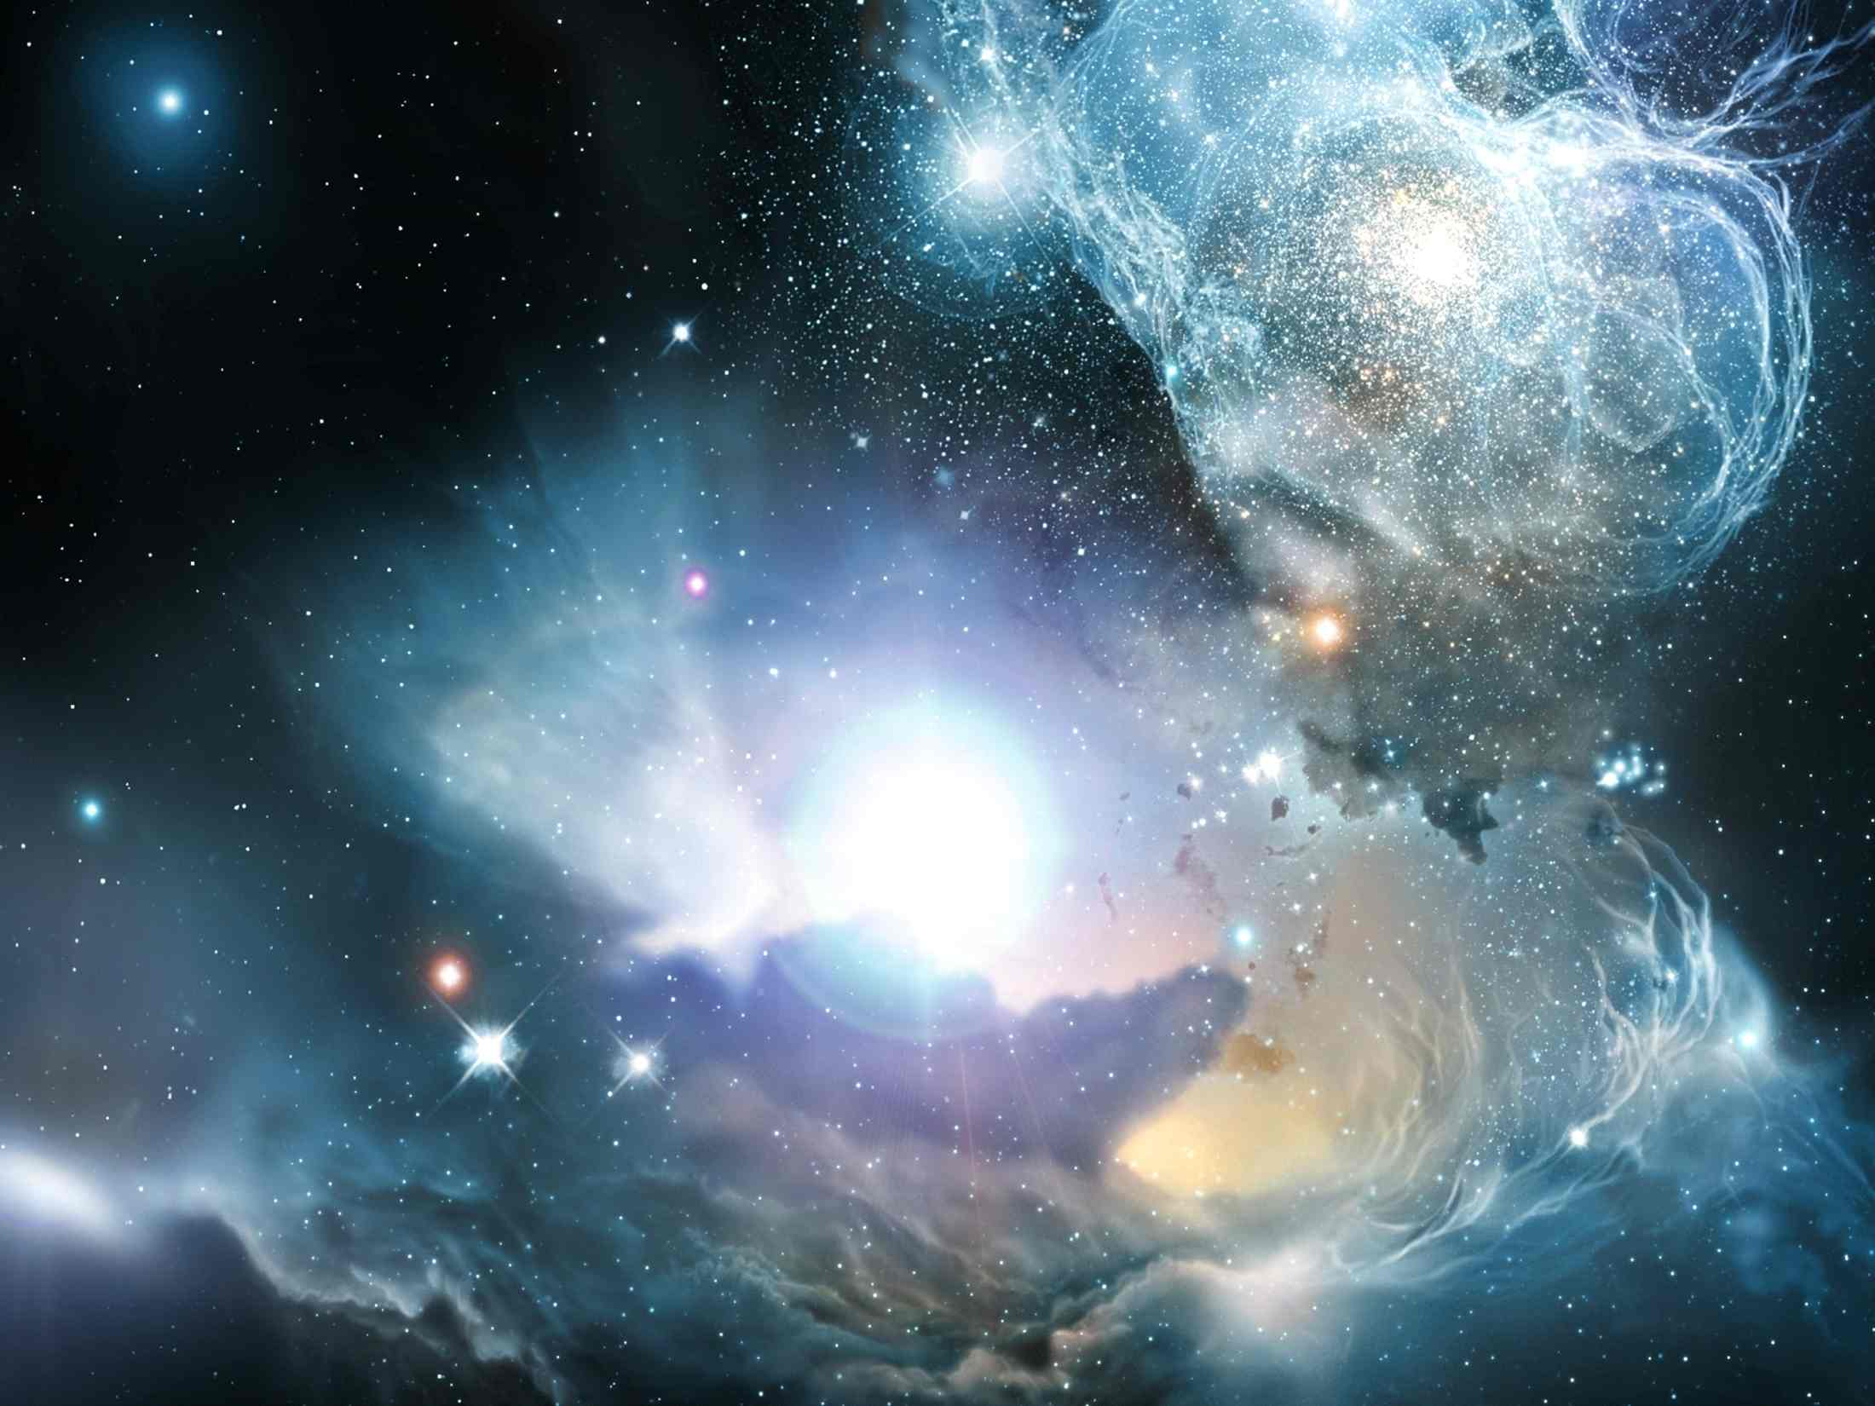
… - …
…..
Look now toward heaven, and tell the stars, if thou be able to number them: and he said unto him, So shall thy seed be.

Slide 7
Faith counted for righteousness
Gen. 15:6 is cited in Romans 4:18.
“counted” – chashab – to think, regard, compute. The Greek equivalent is logizomai - to reckon, count, compute, calculate, count over; hence metaphorically to pass to one’s account, to impute. Occurs 19 times in Romans and variously translated, “thinkest”, “counted”, “conclude”, “reckoned”, “imputeth”, “impute/d”, “accounted”, “esteemeth”.

Slide 8
The Atonement – Gen. 15:7
“I am Yahweh that brought…”
The 10 commandments (words) are introduced - Ex. 20:2 – “I am Yahweh the God, which have brought thee out of the land of Egypt, out of the house of bondage.” The fulfilment of Gen. 15:13-16.
The Atonement is the basis of the Law. So Gen. 15:7 reminds Abram of God’s redemptive work with him.

Slide 9
Abram’s redemption to inherit
Gen. 15:8 – Roth. – “And he said, My Lord Yahweh, whereby, can I know that I shall inherit it?”
Abram asks by what means God will be able to redeem both him and his multitudinous seed.
The response – By the sacrifice of Christ!

Slide 10
“Take for Me…” – Gen. 15:9-10
Roth. – “Take for me”. This was Yahweh’s sacrifice, but Abraham would provide the flesh – Matt. 1:1; Acts 2:30.
“heifer” – eglah (fem.) – a calf, nearly grown; a heifer mature but not yet exposed to the yoke.
“three years old” – Each of the animals was to be mature, but not forced into servitude – Isa. 15:5; Jer. 48:34. 3 is the number of fruit, result; hence maturity.

Slide 11
“Take for Me…” – Gen. 15:9-10
“she goat” – gehz (fem.) – a she-goat (as strong). Principle of Gen. 3:15. Used Lev. 4:28; 5:6 (sin offering); Num. 15:27 (ignorance); Lev. 3:6,12 (peace).
“ram” – ayil – strength; a chief; ram as head of the flock. Used consecration of Aaron and sons Ex. 29:15; Lev. 5:15-18; 6:6 (trespass); Num. 6:14-17 (Nazarite).
Gen. 22:13 - And Abraham lifted up his eyes, and looked, and behold behind him a ram caught in a thicket by his horns: and Abraham went and took the ram, and offered him up for a burnt offering in the stead of his son.

Slide 12
Three animals and one bird
V.9 – “turtledove” – tor – a ring dove. Used Lev. 1:4 (burnt); Lev. 5:7 (sin for poor); Lev. 12:6,8 (childbirth); Lev. 14:22 (leper). Always offered by poor – Luke 2:23-24.
“and a young pigeon” – gozal – nestling. Only other occ. Deut. 32:11 (“young”). I.S.A. – “fledgling”. I.B. – “even a nestling”.
These 4 cover the whole range of Mosaic sacrifices and embrace every class of offerer = Christ’s sacrifice.

Slide 13
The sacrifice of Christ
“This sacrifice was representative of the qualities of the Christ, concerning whom confirmation was about to be made, attestive of Abram’s and his Seed’s possession of the land in the fullness of the times afterwards to be arranged.”
Elpis Israel pg. 231

Slide 14
Cutting a Covenant - Gen. 15:10
LITV – “Take for Me a heifer three years old, and a she-goat three years old, and a ram three years old, and a turtledove, even a nestling. And he took all these for Him, and he divided them in the middle; and he laid each piece against one another, but he did not divide the bird.”
“but the birds divided he not” – Young’s Lit. – “but the bird he hath not divided”. Interlinear Scriptural Analyzer – “and the bird not he sundered”.
There is only one bird – its age is qualified as for the 3 animals.

Slide 15

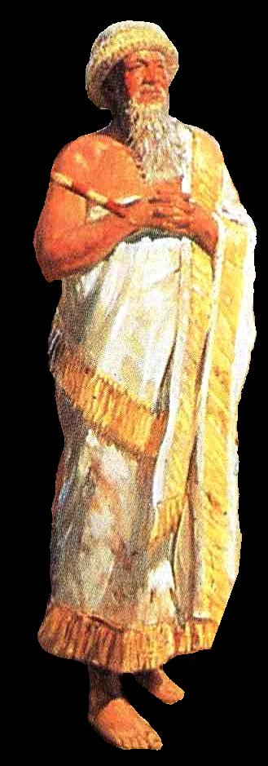
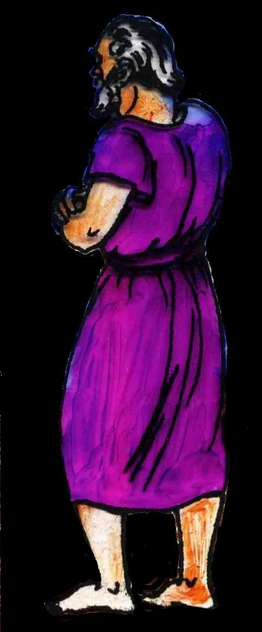
Cutting a Covenant
The parts were laid opposite each other, a passage being left between them.
The contracting parties entered this passage at each end, met in the middle, and there took the covenant oath; adjudging themselves to death should they break this covenant.
Then they both feasted on the victim.
A calf was divided from the nose to the rump in the most careful manner.

Slide 16
7 pieces = Abrahamic Covenant
3 is the number of fruit; hence result or outcome.
4
3
4 is the number of righteousness; new creation; God manifestation.

Slide 17
The Type - Gen. 15:11-12
“fowls” – ayit – a bird of prey; a swooper.
“came down upon the carcases” – As in V.13 – “they shall afflict them”.
“Abram drove them away” – Before the confirming of the covenant by the sacrifice of Christ, his “seed” were protected by God’s promise to him – until Jer. 12:9; 34:18-20.
“sun was going down” – See V.17 – i.e. between the two evenings – cp. V.5.

Slide 18
The Type - Gen. 15:12,17
“a deep sleep” – Abram would be dead when covenant confirmed.
“an horror of great darkness” – Typical of the darkness over the land at the time of Christ’s crucifixion – Luke 23:44.
V.17 – “when the sun went down” – At the time Judah’s Commonwealth neared its end the sacrifice would be accepted.
“it was dark” – AD 30 to 70.

Slide 19
Elpis Israel pg. 234
“The sun having gone down entirely, which was figurative of the setting of ‘the sun of righteousness’ below the horizon of life, Abram beheld ‘a smoking furnace, and a flame of fire pass between the pieces’. This was a sign which could not be mistaken. The animals he had slain, and watched, and defended so long from the birds of prey, were consumed by fire from heaven. By this he knew, and was assured, that he and his seed, the Christ, should inherit the land for ever.”

Slide 20
Yahweh passes between the pieces Gen. 15:17
“furnace” – tannuwr – firepot; oven or furnace.
“burning lamp” – esh lappid – Roth. – “torch of fire”.
Lappid occurs 14 times in O.T. – In Ezek. 1:13, Dan. 10:6 used of Divine light of cherubim and “man of the one”.
“passed between those pieces” – God alone makes this covenant – It will not fail! Abram might yet fail.

Slide 21
Yahweh’s Covenant - Gen. 15:18
“made” – karath – to cut, cut off.
“covenant” – berith – covenant, alliance, pledge (by cutting).
Frequently used together and often rendered “make a covenant”. Gen. 15:18 is the first.
“thy seed” – Masculine singular = Christ – Gal. 3:16.
“have I given this land” – Past Tense – Guaranteed by Yahweh’s karath-berith.

Slide 22
Spiritual counting – Gen. 15:13-16
There are 9 clauses in the prophecy and promise concerning Abraham’s seed.
The subject of each clause matches the spiritual meaning of its number.
1 = God, certainty, surety – Clause 1 – “Know of a surety that thy seed shall be a stranger in a land that is not their’s.”
2 = Division, separation – Clause 2 – “and shall serve them”. No man/nation can serve two masters – Matt. 6:24.

Slide 23
Spiritual counting – Gen. 15:13-16
3 = Fruit, result – Clause 3 - “and they shall afflict them 400 years.” Lam. 3:33 – “For he doth not afflict willingly…”
4 = Righteousness – Clause 4 – “And also that nation, whom they serve, will I judge.” (i.e. righteously).
5 = Grace – Clause 5 – “and afterward shall they come out with great substance” – by God’s grace.
6 = Man – Clause 6 – “And thou shalt go to thy fathers in peace.” “In Adam all die.”

Slide 24
Spiritual counting – Gen. 15:13-16
7 = Completion (inter-alia) – Clause 7 – “thou shalt be buried in a good old age.” Abraham completes the cycle.
8 = New beginning (inter-alia) – Clause 8 – “But in the 4th generation they shall come hither again” = new start.
9 = Finality, fullness – Clause 9 – “for the iniquity of the Amorites is not yet full.”
10 = All (ordinal perfection) – There are 10 nations listed in Vv.19-21 = All nations.

Slide 25
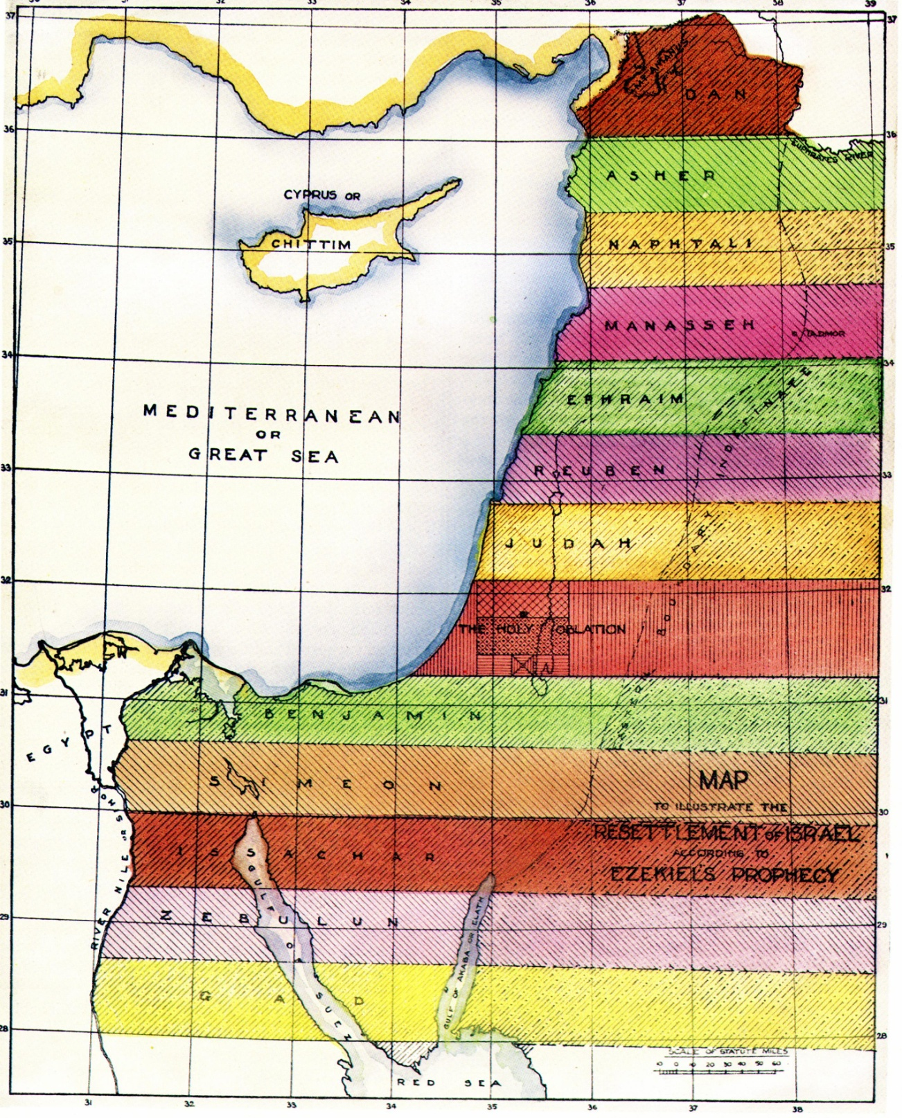
The Tribal Cantons
Inheritance of Abraham’s seed
Bounded north and south by Euphrates and Nile (Gen.15:18), and from “sea to sea” – Mediterranean to Persian Gulf (Ps.72:8)
When Abraham inherits this land he will share it with Kenites and Kenezites!
Resettlement of the 12 Tribes

Slide 26
Next study…God willing
Blessed with faithful Abraham
Study 3 - “A father of many nations have I made thee"
Blessed with faithful Abraham

Slide 27
…
...

