Slide 1
“Blessed with faithful Abraham”
Study 3 – “A father of many nations have I made thee”

Slide 2
The times of Abraham
Ishmael
Born
Gen. 16
Leaves
Haran
Gen.
15
Gen.
17
Gen.
21
At Hebron
75
85
86
99
100
4th
Promise
5th
Promise
Isaac
born
Gen. 17:21 – “But my covenant will I establish with Isaac, which Sarah shall bear unto thee at this set time in the next year.” Exactly 12 months from Gen. 17 to 21.

Slide 3
The 5th promise to Abraham
Gen. 17:1 – Abram 99 = fullness/finality.
“Yahweh appeared” – 5th appearance, probably via Michael (Isa. 63:9).
“the Almighty God” – El shaddai – the 1st of 48 occurrences of this Divine title in O.T. Refers here to the builder of a family – final occ. Joel 1:15 of destroyer.
“walk before me” – halak paniym – Lit. “walk as though in my presence”.
“perfect” – tamiym – entire, complete. After 24 years in the Truth!

Slide 4
El Shaddai
Gen. 17:1 – 1st occ. links with Abrahamic Covenant and Yahweh’s delegated Fatherhood – Rom. 4:17.
Shaddai derived from shad – the breast (as nourishing); and shadad – burly; i.e. powerful; hence to devastate, destroy.
The primary meaning of El Shaddai – the strength of the nourishers = building the Divine family.
Both aspects revealed Gen. 17 to 19 with one aim – to build the Divine family.

Slide 5
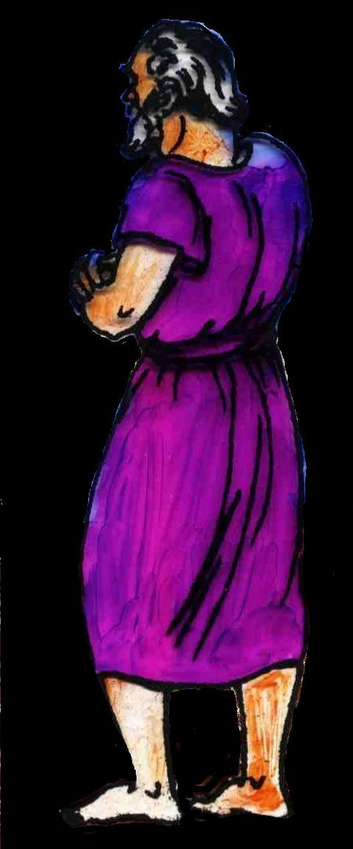
Abraham’s delegated fatherhood Rom. 4:17
“before him” – katenanti – down over against; i.e. in the sight and estimation of. Hence, he was “like unto” God – allowed to stand in His presence as father of the Divine family.
For this reason, God handed Abraham a knife and commanded him to ‘cut off ‘ his flesh – circumcision.

Slide 6
Our father and mother Isa. 51:2-3
Abraham – the father of the faithful – Rom. 4:12,16. Cp. Christ – Isa. 53:10-11.
Sarah – the mother of us all – Isa. 54:1,5; Gal. 4:22-26.
V.3 – “For Yahweh shall comfort Zion...”
Abraham
Sarah
Yahweh
Zion

Slide 7
The Divine Allegory
Gal. 4:22-31 – Paul uses Gen. 16 and 17 as the basis of an allegory.
Hagar
= Mosaic Covenant
Ishmael
= Israel under Law (circumcised in flesh but not in heart – Gen. 17:25)
Sarah
= Abrahamic Covenant
Isaac
= Spiritual Israel under grace (circumcised in heart – Jews inwardly – Rom. 2:29)
Ishmael was the result of human failure
– “Is anything too hard for Yahweh?”

Slide 8
“As for me...”
Gen. 17:4 – El Shaddai guarantees His involvement in the desired outcome – the completed Divine family – V.4-8. “I will be their God and they shall be my people” – occs. 7 times in the prophets.
V.9 – Roth. – “But, as for thee, my covenant, must thou keep”.
V.14 – Roth. – “But, as for the un-circumcised male.”
V.15 – “As for Sarai...” – She must have Abraham’s faith – V.16.
V.20 – “As for Ishmael...” = Israel (flesh).

Slide 9
The covenant of circumcision
Introduced to demonstrate the method of participation in the Abrahamic promise.
Preceded the Law of Moses – John 7:22.
Seal of imputed righteousness by faith – Rom. 4:9-11.
Typically foreshadowed baptism into Christ and that translated into a way of life – Col. 2:11-13.
Intended to be an outward sign of an inward change – Rom. 2:25-29.

Slide 10
The structure of Romans 4
Gen.15:6 14 years Gen.17:5
“Abraham” - 7 times (9 in Book).
“father” - 7 times (12 in Book).
“circumcision” (6); “circumcised” (1) - total 7 times.
“uncircumcised” (2); “uncircumcision” (3) - total 5 times.
V.16 - Lit. “Wherefore out of faith, that according to grace it might be.”
5 is the No. of grace (5 x 14 = 70 = “all nations”).

Slide 11
Father of the faithful Gen. 17:4-8
Abram’s name changed – Responsibility of a delegated father.
V.5 - Yahweh added the 5th letter of the Hebrew alphabet with a numerical value of 5 to the 5th position of Abram’s name.
Abram – N.V. 243
Abraham – N.V. 248
The name Abraham occurs 248 times in Scripture
Abram
Has 5 letters – 4 consonants (1 vowel)
Abraham
Has 7 letters – 5 consonants (2 vowels)

Slide 12
“As for Sarai” ...and Mary
The promised seed could not be conceived without faith in the humanly impossible – Rom. 4:18-22 (Gen. 17).
Luke 1:34-38,45 – The Divine pattern demanded Sarah acquire Abraham’s faith concerning the promised seed.
Forming Christ in Sarah – Gen. 18 (Gal. 4:19 – “My little children, of whom I travail in birth again until Christ be formed in you.”).
The events of Gen. 18 to 21 are designed to accomplish this in just 2^{1/2} months.
Sarah’s submission memorialised.

Slide 13
Heirs together of the grace of life – Gen. 17 (1 Pet. 3:7)
5 is the Biblical number of grace.
V.15 - Yahweh replaced the 5th letter of Sarai’s name with a numerical value of 10 with the 5th letter of the Hebrew alphabet with a numerical value of 5.
Sarai – N.V. 510
Has 5 letters – 3 consonants (2 vowels)
Sarah – N.V. 505
Has 5 letters – 3 consonants (2 vowels)
Net result = 10 - Sarah is reduced by 5 – Abraham increased by 5. 10 = all; hence Sarah is in complete submission to Abraham.

Slide 14
The set time - Gen.17:21; 21:2
Gen. 17:1, 24 – Abraham 99
Gen. 21:5 - Abraham 100
Normal gestation period - 9 months 10 days - leaves just over 2^{1/2} months for events of Gen.17 to 20:
Abraham circumcised - 17:24
Visit by 3 angels - 18:1-15
Sodom destroyed - Lot delivered - Gen.19
Move from Hebron to Gerar - 20:1
Sarah in Abimelech's house - 20:2-16
Prays for Abimelech's house - 20:17-18
One year

Slide 15
Next study…God willing
Blessed with faithful Abraham
Study 4 - “Is anything too hard for Yahweh"
Blessed with faithful Abraham

Slide 16
…
...

