Slide 1



Ezra: Working together in God’s service
Class 1: God set us Free to work in His Service!

Slide 2
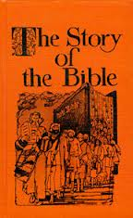

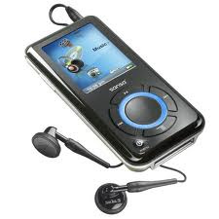
Christadelphian Resources on Ezra
Story of the Bible (vol 4) by H.P. Mansfield
The Exiles Return by Michael Ashton
Haggai, Zechariah, Malachi (Expositor) by H. P. Mansfield
The Prophets after the Exile by John Carter
For the audio learners:
Audio – 8 classes by Jim Cowie
Audio – 6 classes by Jim Styles

Slide 3
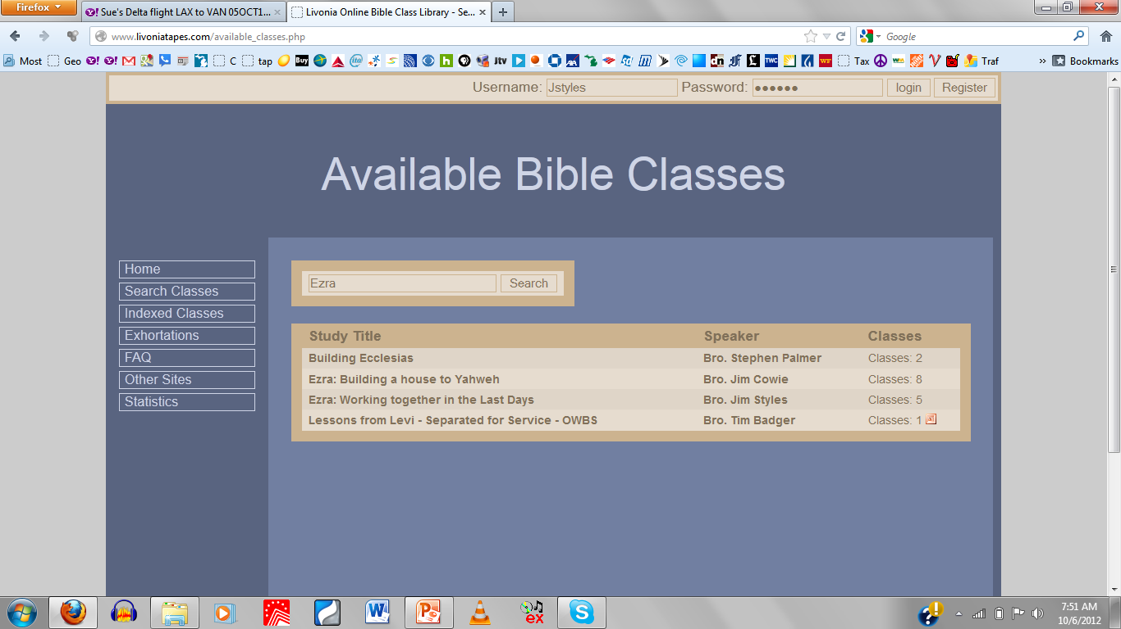
www.livoniatapes.com

Slide 4

An Exciting Study for Today!
Study Ezra!
Experience brothers & sisters working together through troubles in ecclesial life
Practical lessons in family life & ecclesial life
Parallels to Christ’s soon return to restore & build the everlasting household of God
Confidence & peace that grows as we watch the unseen angels working behind the scenes to carry out God’s plan
Everyone will find practical lessons in this study!

Slide 5
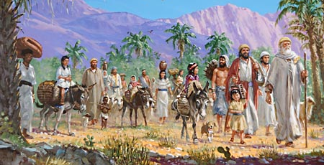
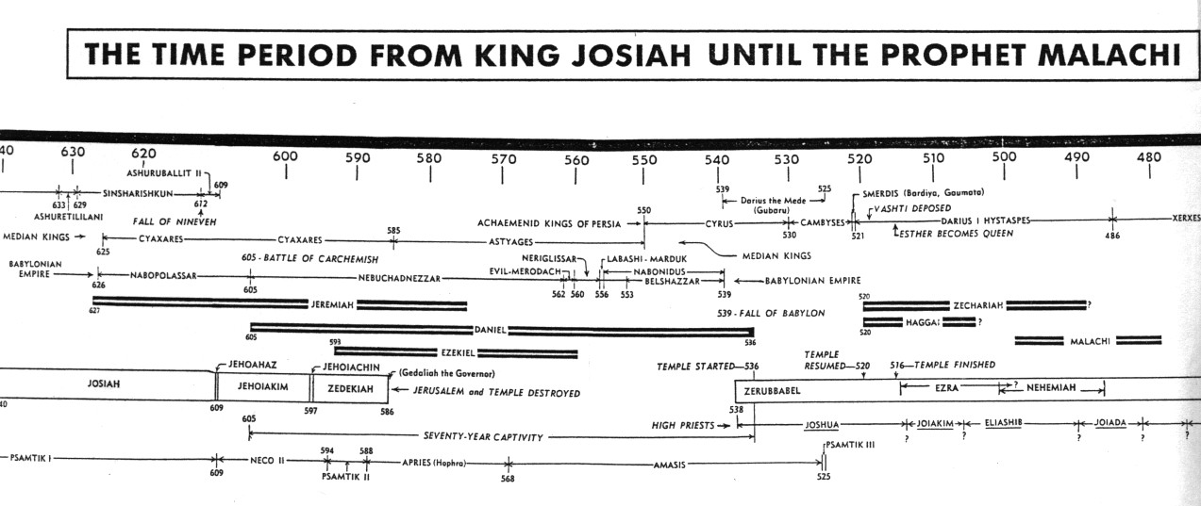
Sequence of Events
1) Some return with Jeshua & Zerubbabel (Ezra 1-2)
2) Rebuilding the temple (Ezra 3-4)
3) Zechariah & Haggai motivate the finishing of the temple (Ezra 5-6)
4) Ezra Returns with more exiles (Ezra 7-10)
5) God uses Haman to convince the Jews to return home (Esther)
6) Nehemiah builds the walls of Jerusalem
7) Malachi, then time between the Testaments

Slide 6
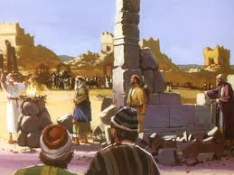
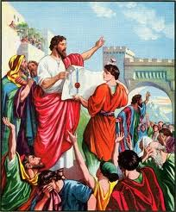
2 Sections in the Book of Ezra
Chapters 1-6 Don’t involve Ezra himself
Continue 2 Chronicles 36:23
initial return from captivity
rebuilding of the temple
Don’t involve Ezra himself
Chapters 7-10 involve Ezra himself
Ezra returns to work in the temple
Solving the mixed marriages problem
Ezra probably returned as soon as the temple was finished

Slide 7
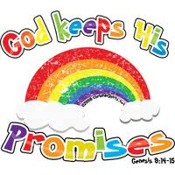
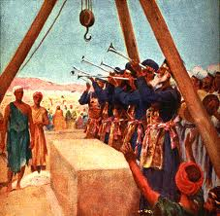

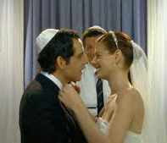
Purpose of the Book of Ezra
1) God is faithful – He will restore Israel
2) God will build His house (both physical & spiritual)
4) Warnings about mixed marriages
3) Illustrates the cost of Unity

Slide 8
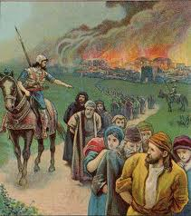

Reasons for the 70-year Captivity
1) Idol worship was so integrated in the people’s minds (Ezekiel 14:1-5) (God’s plan worked! Idolatry was abolished)
2) God wanted to save a remnant (He had promised Abraham)
3) United Judah & Israel again (the power of adversity!) Sad it takes this to bring unity ☹
4) So the land could enjoy its Sabbaths (Lev 26:43; 2 Chron 36:21)
1 Now some of the elders of Israel came to me and sat before me.
2 And the word of the LORD came to me, saying,
3 "Son of man, these men have set up their idols in their hearts, and put before them that which causes them to stumble into iniquity. Should I let Myself be inquired of at all by them?
4 "Therefore speak to them, and say to them, 'Thus says the Lord GOD: "Everyone of the house of Israel who sets up his idols in his heart, and puts before him what causes him to stumble into iniquity, and then comes to the prophet, I the LORD will answer him who comes, according to the multitude of his idols,
5 "that I may seize the house of Israel by their heart, because they are all estranged from Me by their idols.“’
Captivity accomplished God’s plan

Slide 9
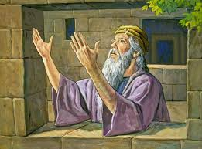
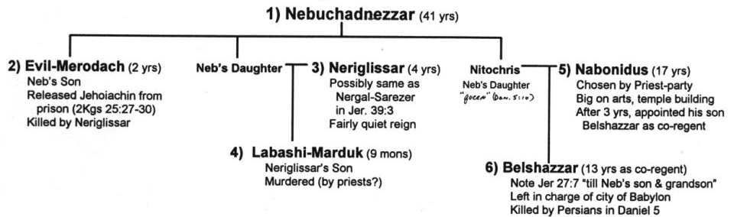
Political Situation: Looked Hopeless for Jews to Return
Nabonidus king of Babylon – very religious – built temples for gods of other nations
Belshazzar (Nabonidus’ son) left in charge (Dan 5)
Nabonidus brought foreign gods to Babylon to protect it.
This really upset the Babylonian priests and people!

Slide 10
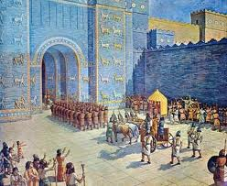
Political Situation: Looked Hopeless for Jews to Return
Cyrus entered Babylon without a battle & liberated city
Different Strategies: Babylonians exiled people. Persians left people and incorporated existing governments & people.
Similar situation to our day: No angelic visits, No spirit gifts – Yet God still working in the nations for His people!

Slide 11

The Lesson for Us!
You must be ready!
Events of the last days can change and happen fast!
We need to watch always, and be ready at all times “for the son of man is coming at an hour you do not expect” (Mat 24:44)
The angels are working tirelessly today to prepare for the Day of the Lord – they will get it done on time!
But you, brethren, are not in darkness, so that this Day should overtake you as a thief. You are all sons of light and sons of the day. We are not of the night nor of darkness. Therefore let us not sleep, as others do, but let us watch and be sober. (1 Thes 5:4-6)

Slide 12
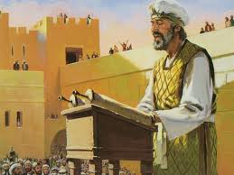
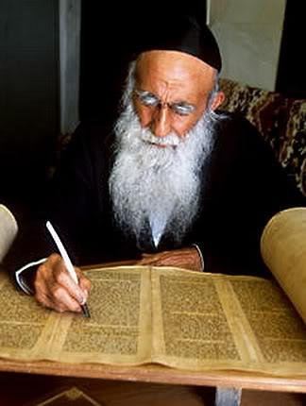
Author of the Book of Ezra
Ezra: note his use of “I”, “me” (8:15, etc.)
Earlier information was probably compiled later by Ezra
Clear sections of Hebrew & Aramaic:
Hebrew: 1:1 – 4:7
Aramaic: 4:8 – 6:18
Hebrew: 6:19 – 7:11
Aramaic: 7:12-26
Hebrew: 7:27 – end
Probably switches because book was compiled by Ezra

Slide 13
Time Line for Ezra
S
Ezra returns here
G
Book of Ezra starts here

Slide 14
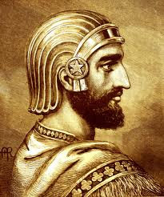
The First Year of Cyrus (1:1)
The 1st year Persia took over Babylon and Cyrus ruled over Babylon
Cyrus actually became a Persian ruler about 10 years earlier
G

Slide 15

Isaiah 44:28 – 45:2 (NKJV)
28 Who says of Cyrus, 'He is My shepherd, And he shall perform all My pleasure, Saying to Jerusalem, "You shall be built,“ And to the temple, "Your foundation shall be laid."‘
1 "Thus says the Lord to His anointed, To Cyrus, whose right hand I have held — To subdue nations before him And loose the armor of kings, To open before him the double doors, So that the gates will not be shut: 2 'I will go before you And make the crooked places straight; I will break in pieces the gates of bronze And cut the bars of iron.

Slide 16
Isaiah 45:3-6
3 I will give you the treasures of darkness And hidden riches of secret places, That you may know that I, the Lord, Who call you by your name, Am the God of Israel. 4 For Jacob My servant's sake, And Israel My elect, I have even called you by your name; I have named you, though you have not known Me. 5 I am the Lord, and there is no other; There is no God besides Me. I will gird you, though you have not known Me, 6 That they may know from the rising of the sun to its setting That there is none besides Me. I am the Lord, and there is no other.

Slide 17
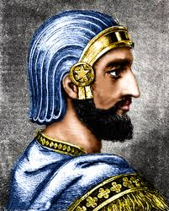
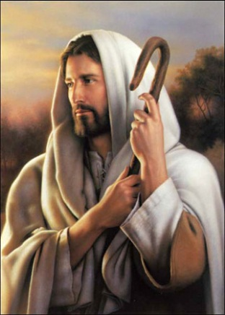
Cyrus as a type of Christ
God’s shepherd (Isa 44:28)
God’s anointed (Isa 45:1)
Illustrated God’s ultimate salvation of Israel through God’s Son
This is a study in itself…. Our goal is to focus on lessons from family & ecclesial issues of Ezra’s time
Many of the prophecies about the return of the Jews from captivity apply at this time & to Christ’s time too

Slide 18
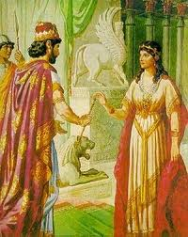
God used Unbelieving Rulers during the Captivity to Illustrate His Redemptive Plan
Cyrus (represented Christ)
King Ahaseurus (represented God)
  Mordecai (represented Christ)
  Esther (represented God’s faithful remnant)
The kingdom of Israel didn’t exist during this period

Slide 19
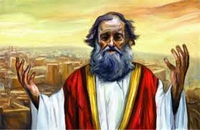
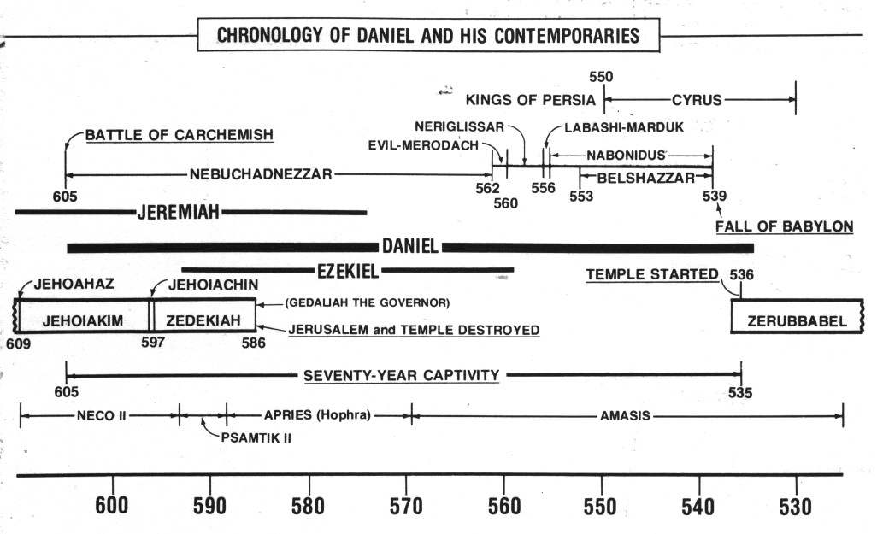
Jeremiah’s Prophecies about the 70 Years
Jer 25:11-14 after 70 yrs God will punish Babylon
Jer 29:10-14 after 70 years God will bring Jews back and give them a future with peace and hope
G

Slide 20
Jeremiah 29:10-14
God’s Unconditional Promise
10 For thus says the LORD: After seventy years are completed at Babylon, I will visit you and perform My good word toward you, and cause you to return to this place.
11 For I know the thoughts that I think toward you, says the LORD, thoughts of peace and not of evil, to give you a future and a hope.
12 Then you will call upon Me and go and pray to Me, and I will listen to you.
13 And you will seek Me and find Me, when you search for Me with all your heart.
14 I will be found by you, says the LORD, and I will bring you back from your captivity; I will gather you from all the nations and from all the places where I have driven you, says the LORD, and I will bring you to the place from which I cause you to be carried away captive.
God promised to get this done!

Slide 21
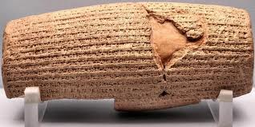
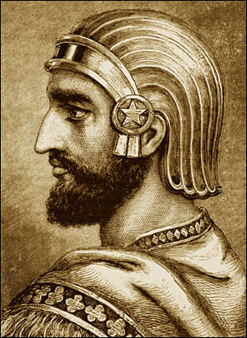
Cyrus’ Decree was recorded
Put it in writing: worth noting because this was really important later in 6:1-3
It was all of God:
  Freedom of the Jews from captivity
  Opportunity to build God’s house in Jerusalem
It’s good to reflect daily on our freedom in Christ & the opportunities we have to work in God’s family

Slide 22
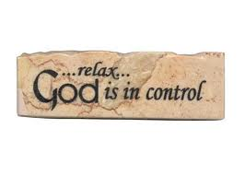
God Stirred up the Spirit
God was in complete control
Had Cyrus’ decree put in writing
Ex 35:21 LORD stirred up spirits and hearts of everyone to bring supplies for His tabernacle
Jer 51:11 LORD has raised up the spirit of the kings of the Medes against Babylon
Ezra 1:1 LORD stirred up the spirit of Cyrus to make a decree
Ezra 1:5 God stirred up the spirits of heads of Judah and Benjamin, priests and Levites, to rebuild His house
Hag 1:14 LORD stirred up the spirit of Zerubbabel, Joshua and all the remnant to go and work on His house
Thank God daily for initiating our salvation

Slide 23
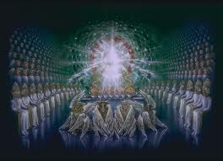
God Stirs up the Spirit of others Against His People when they go astray
1 Chron 5:26 God stirred up the spirit of Tiglath-Pileser to carry away the 2.5 tribes
2 Chron 21:16 LORD stirred up the spirit of Philistines and Arabians against Jehoram
Whether for good or bad, God is in control and trying to save a remnant
We know that in everything God works for good with those who love Him (Rom 8:28 RSV)

Slide 24

Cyrus learned a key Lesson: The God of Heaven has given me all kingdoms (v.2)
Same lesson God tried to teach Nebuchadnezzar through Daniel
God wanted all foreign nations to realize that He had allowed other nations to take Jews captive – not that their gods had triumphed over Yahweh!
Build Him a house: Note that the house is 1st priority! The Jews’ freedom is a result of God wanted His house built!
This must be a priority in our lives & ecclesias too – build a house unto our God

Slide 25

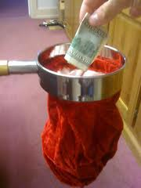
2 Types of Service:
Return to Israel & build
  1Cor 12: lots of variety in body of Christ
  v.18 God has set members as He pleased
  v.24-26 God composed body that there be no schism
Stay put: send money & supplies
  Rom 12: he who gives….liberally!
We need everyone involved in whatever capacity you can serve! So many jobs to do! Fun & exciting ecclesias tap into all the talents of its members! Learn to appreciate the help! It’s not just about Bible Study

Slide 26
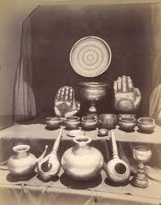
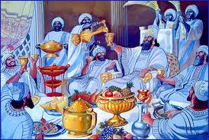
Vessels of God’s House (v.7)
1) Some taken by Nebuchadnezzar during Jehoiakim’s reign (2 Chron 36:7) others taken at end of Zedekiah’s (2 Kgs 25:14)
2) God promised he would bring them back (Jer 27:21-22)
3) Misused by Belshazzar (Dan 5:2-4)
4) Returned by Cyrus (Ezra 1:7)
God used the vessels of His house to represent the people in His house
Sheshbazzar (v.8) = Zerubbabel more on this in Ezra 5

Slide 27
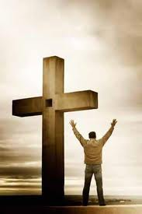

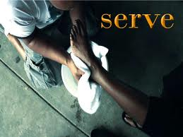
Set free to serve in God’s service
Gal 5:1, 13-16 Christ has set us free
  Don’t use freedom for the flesh
  Through love serve one another
Rejoice in our freedom
  Use it to build God’s house by working in our ecclesias
  Conduct ourselves like God’s children
Freedom brings the responsibility to serve the one who set us free!

Slide 28
1 Timothy 3:15
I write so that you may know how you ought to conduct yourself in the house of God, which is the ecclesia of the living God, the pillar and ground of the truth.
Let’s get building & serve with love, joy, peace, patience, etc…

Slide 29

Class 2: We must learn to work together now!

Slide 30
2
S
G

Slide 31
2
S
G

Slide 32
Daniel & His Contemporaries
G

