Slide 1
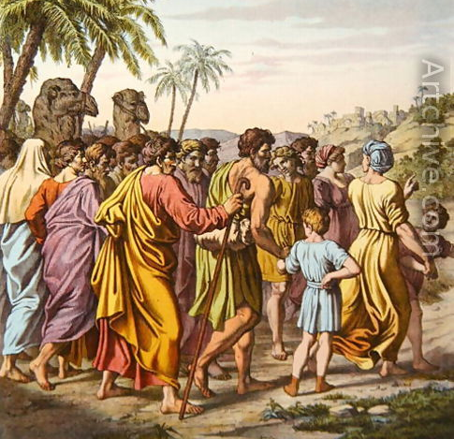
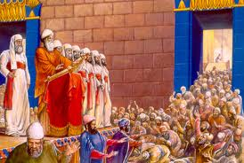
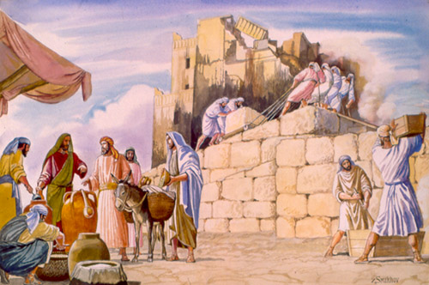
Ezra: Working together in God’s service
Class 2: We must learn to work together now!

Slide 2
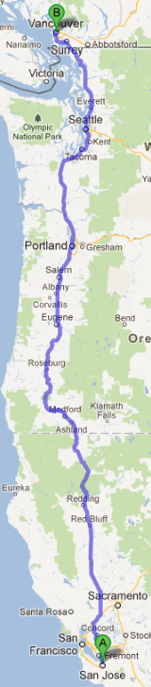
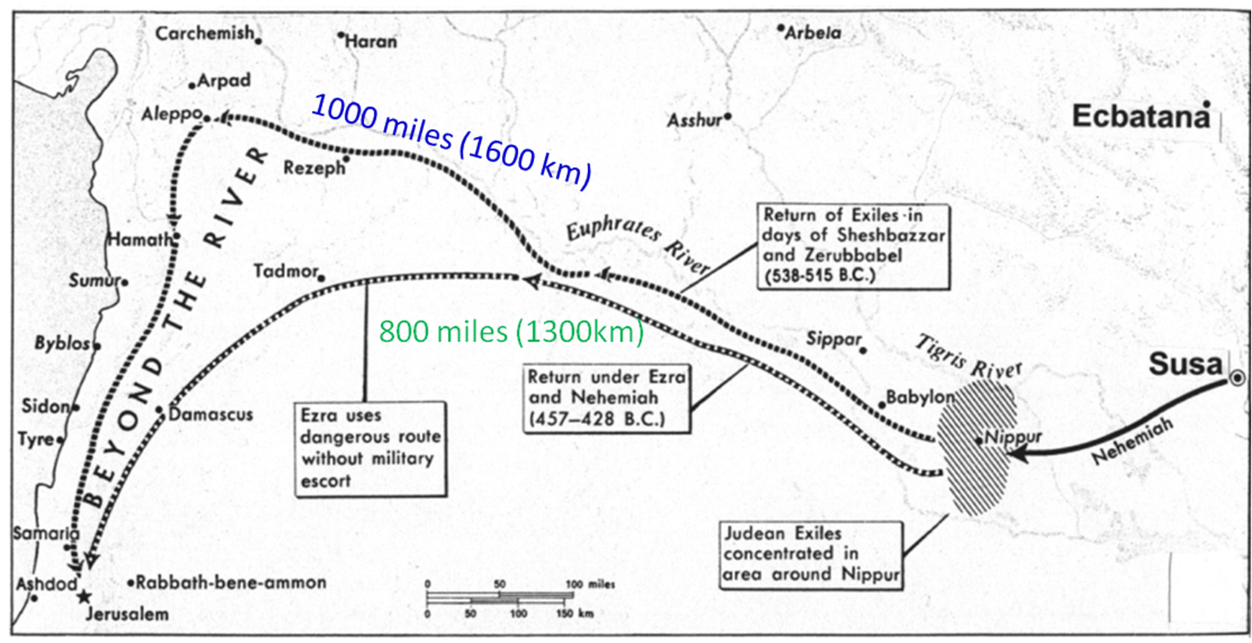
Return of the Exiles
Jeshua & Zerubabbel took the long, safe route (1000 miles) Ezra took the short, risky route

Slide 3
Some from All 12 Tribes Returned
Ezra 6:16-17 Sin offering at dedication of temple was 12 male goats, according to the number of the tribes of Israel
Ezra 8:35 Exiles returning with Ezra offered “12 bulls for all Israel” and 12 male goats for sin offering.
Mat 10:6; 15:24 Jesus and disciples sent to “lost sheep of house of Israel”
Appears that some from 10 tribes moved south early on and survived the captivity (Josh 19:9; 1 Kg 12:17; 1 Chr 9:3; 2 Chr 11:3, 13-16; 15:9)
British Israelites misunderstand this

Slide 4
Summary of those who Returned
People
Priests
Levites
Singers
Gatekeepers
Temple Servants & Solomon’s servants
Total
24,194
4,289
74
128
139
392
29,216
Notice the low number of Levites!
Much of Ezra 2 is also recorded in Neh 7 after the wall is finished

Slide 5
Comparison of the Levites
74__
29,216
Ezra 2
Num 2
Num 26
= 0.25% 1 of 400
= 3.5% 1 of 28
= 3.7% 1 of 27
22,000_
625,550
23,000_
624,730
Seems Levites not interested in returning

Slide 6
The Role of the Levites
Support group for Levites (things like Sunday school teachers, CYC leaders, seminar helpers, etc. – not high profile jobs!
Responsible to teach the truth
  Better educated
  Used to higher standard of living (probably supplied some of the money in Ezra 1)
  More easily integrated into Babylonian life
Warning: Believers today tend to shoot up the corporate ladder – Be careful – work & life-style can limit our service to God
We need lots of volunteers for the support jobs in ecclesial life today!

Slide 7
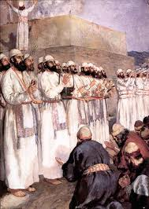
Those excluded from the Priesthood as defiled (v.62)
Shows the Jews were attempting to follow God’s recorded Law
Illustrates the need to respect dividing lines
  Ecclesial jobs & positions
  Fellowship lines
God doesn’t need the best person for a job. He can work through many people if they are willing to let him.

Slide 8
Freewill Offerings to God
To build the tabernacle (Ex 25:2; 35:21-29)
Gives it willingly with his heart (Ex 25:2)
All the men & women whose hearts were willing (35:29)
To build Solomon’s temple (1 Chron 29:5,6,9,14,17)
People rejoiced because with a loyal heart they offered willingly (v.9)
To rebuild the temple (Ezra 1:4; 1:6; 2:68-69)
According to their ability (Ezra 2:69)
To help the poor in Jerusalem (2 Cor 8 & 9)
Beyond their ability, they were freely willing (8:3)
According to what one has, and not what he doesn’t have (8:12)
As a matter of generosity and not as a grudging obligation (9:5)
God loves a cheerful giver (9:7)
Freewill giving should be in response to our faith, in appreciation for God’s gift of grace to us!
“Thanks be to God for His indescribable gift!” (2 Cor 9:15)

Slide 9
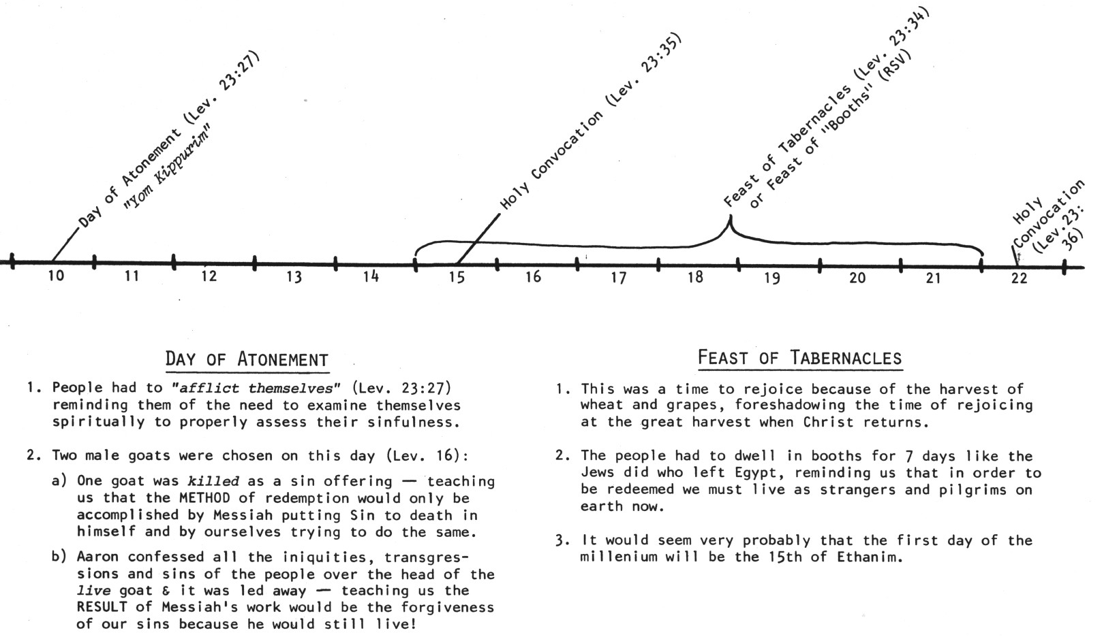
Now the 7th month (Ethanim) [3:1]
Kept Feast of Tabernacles
No mention of Day of Atonement – not ready for this yet

Slide 10
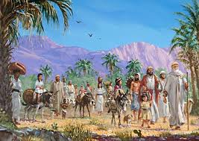
Zerubbabel = “shoot of Babylon” (Yg)
Organized the return from Babylon
Would have been king now
Really the son of Pedaiah (1 Chr 3:19), but counts as Shealtiel’s son (maybe a Levirate marriage?)
Zerubbabel represents “the king” and Joshua represents “the priest”

Slide 11
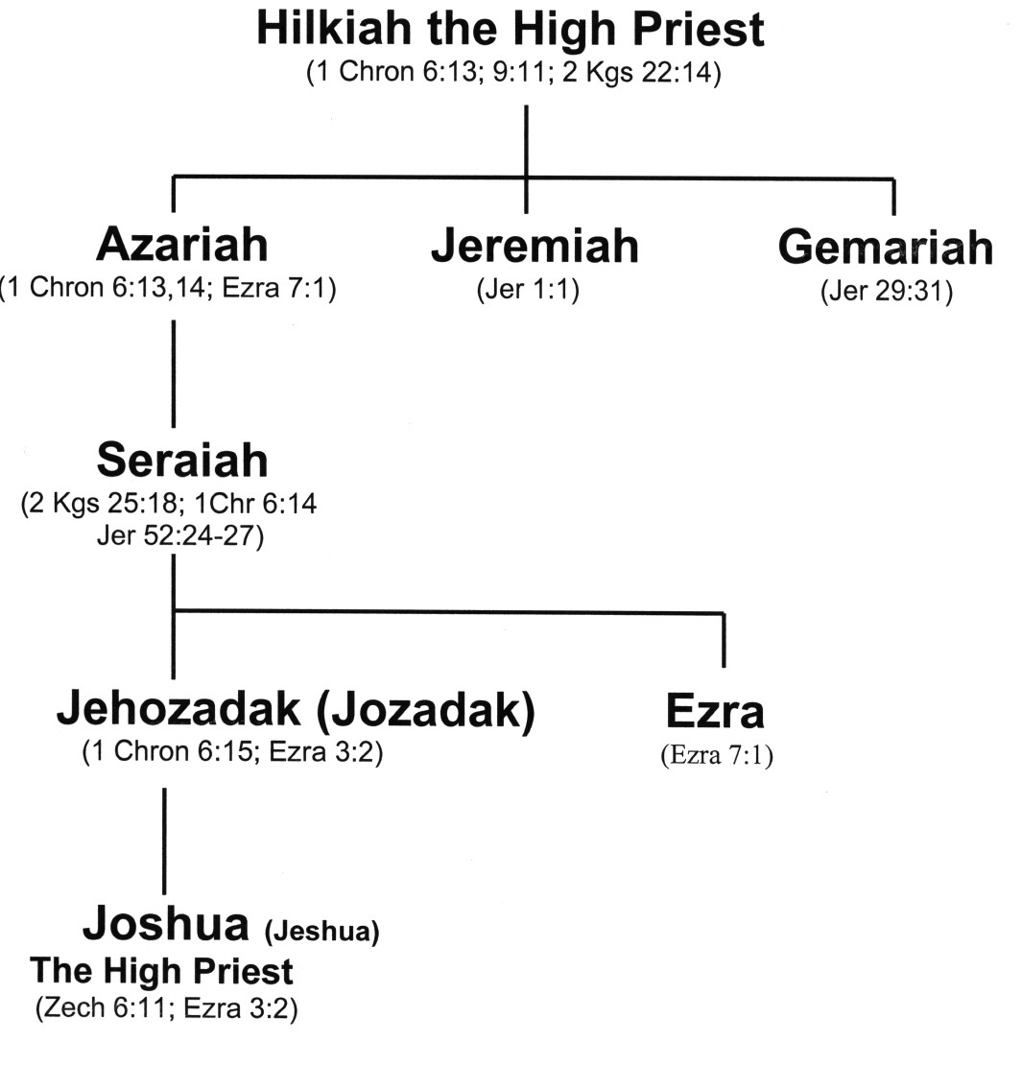
Family Line of Jeshua ( )
“God is Salvation”
Carried away captive
Ezra was his Uncle

Slide 12
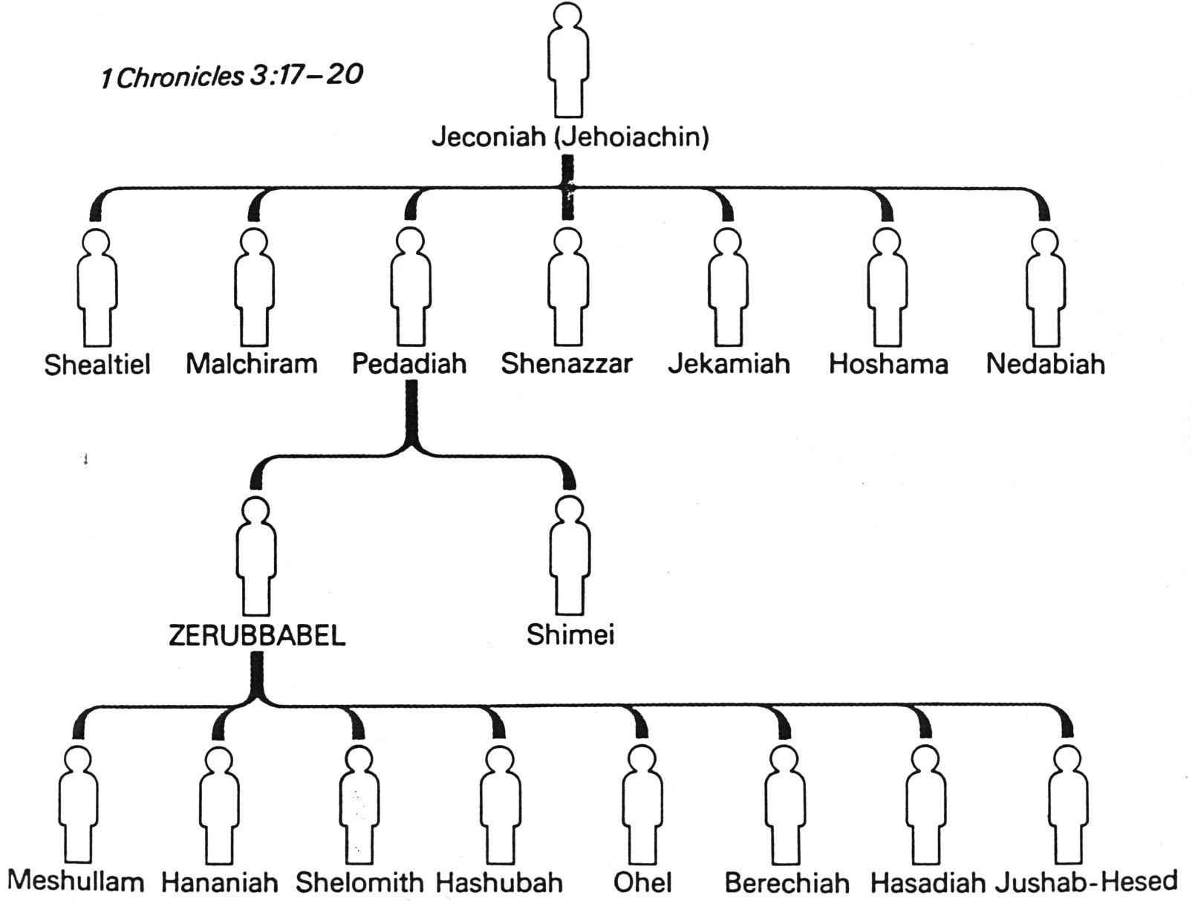
Zerubbabel’s Family Tree
1Chr 3:17-20
1Chr 3:17-20
Zerubbabel is called the “son of Shealtiel” so there was probably a Levirate marriage involved

Slide 13
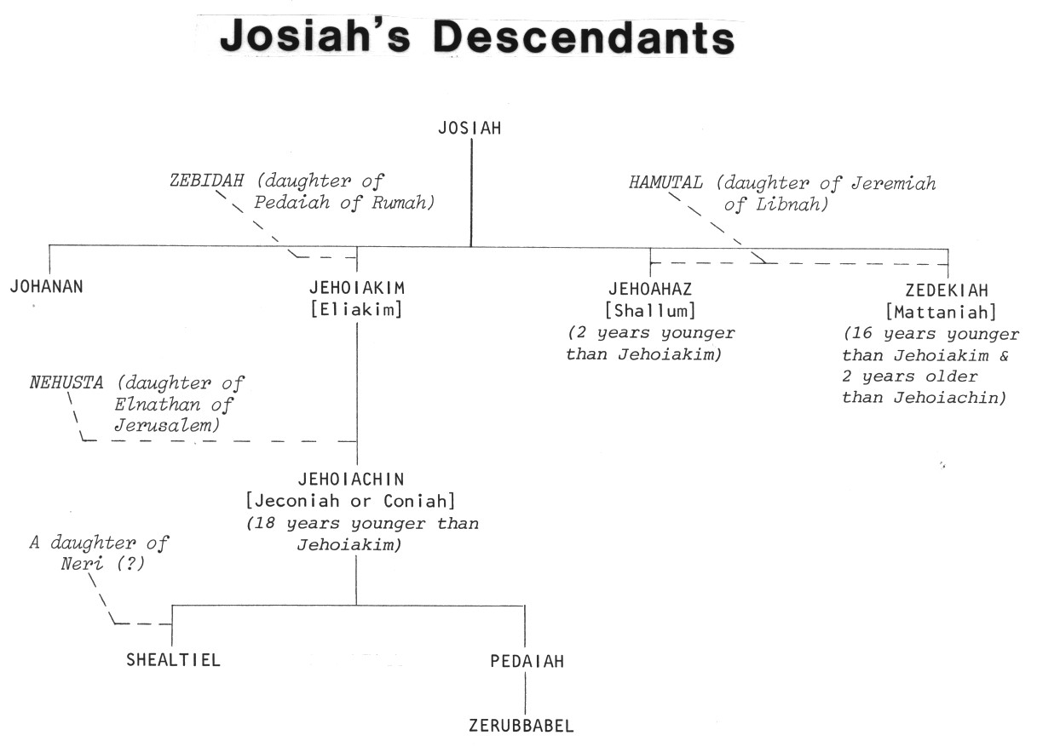
King Josiah’s Descendants
Josiah
2
1
4
3
Good King Josiah had no children who were like him!

Slide 14
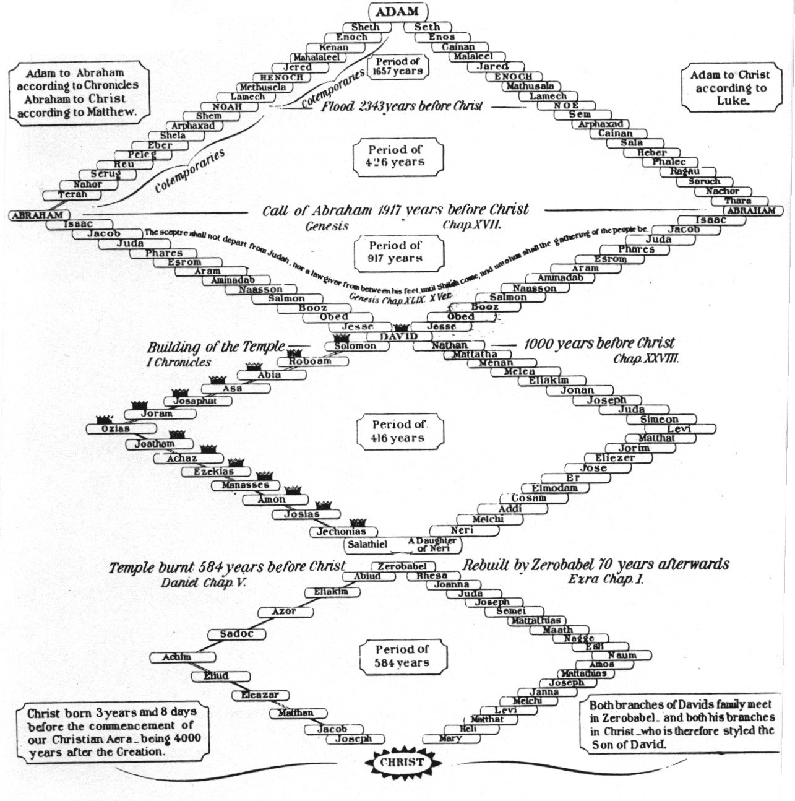
Geneologies of Jesus
Both Family lines go thru Zerubabbel

Slide 15

Jeremiah 22:24-30
24 "As I live," says the LORD, "though Coniah (Jehoiachin) the son of Jehoiakim, king of Judah, were the signet on My right hand, yet I would pluck you off;
25 "and I will give you into the hand of those who seek your life, and into the hand of those whose face you fear-- the hand of Nebuchadnezzar king of Babylon and the hand of the Chaldeans.
26 "So I will cast you out, and your mother who bore you, into another country where you were not born; and there you shall die.

Slide 16
Jeremiah 22:24-30
27 "But to the land to which they desire to return, there they shall not return.
28 "Is this man Coniah a despised, broken idol-- a vessel in which is no pleasure? Why are they cast out, he and his descendants, and cast into a land which they do not know?
Jer 22 was conditional:

Slide 17
Jeremiah 22:24-30
29 O earth, earth, earth, hear the word of the LORD!
30 Thus says the LORD: 'Write this man down as childless, a man who shall not prosper in his days; for none of his descendants shall prosper, sitting on the throne of David, and ruling anymore in Judah.' "
Jeconiah (Jehoiachin) obeyed Jeremiah & surrendered. He was released from prison in Jer 52:31-34.

Slide 18
2 Kings 24:8-12
8 Jehoiachin was eighteen years old when he became king, and he reigned in Jerusalem three months. His mother's name was Nehushta the daughter of Elnathan of Jerusalem.
9 And he did evil in the sight of the LORD, according to all that his father had done.
10 At that time the servants of Nebuchadnezzar king of Babylon came up against Jerusalem, and the city was besieged.
11 And Nebuchadnezzar king of Babylon came against the city, as his servants were besieging it.
12 Then Jehoiachin king of Judah, his mother, his servants, his princes, and his officers went out to the king of Babylon; and the king of Babylon, in the eighth year of his reign, took him prisoner. (Jehoiakim was thrown over the wall of Jerusalem! Jer 22:19)
Jeremiah 38:17-18
17 Then Jeremiah said to Zedekiah, "Thus says the LORD, the God of hosts, the God of Israel: 'If you surely surrender to the king of Babylon's princes, then your soul shall live; this city shall not be burned with fire, and you and your house shall live.
18 'But if you do not surrender to the king of Babylon's princes, then this city shall be given into the hand of the Chaldeans; they shall burn it with fire, and you shall not escape from their hand.'"

Slide 19
Jeremiah 52:31-34
31 Now it came to pass in the thirty-seventh year of the captivity of Jehoiachin king of Judah, in the twelfth month, on the twenty-fifth day of the month, that Evil-Merodach king of Babylon, in the first year of his reign, lifted up the head of Jehoiachin king of Judah and brought him out of prison.
32 And he spoke kindly to him and gave him a more prominent seat than those of the kings who were with him in Babylon.
33 So Jehoiachin changed from his prison garments, and he ate bread regularly before the king all the days of his life.
34 And as for his provisions, there was a regular ration given him by the king of Babylon, a portion for each day until the day of his death, all the days of his life.
Jeremiah’s prophecy was conditional & was not fulfilled because Jehoiachin obeyed!

Slide 20
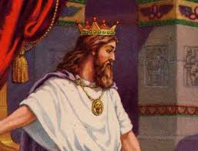
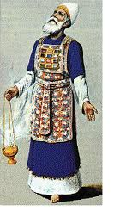
Judgment & Mercy
Zerubabbel – King – Judgment
Joshua – Priest – Mercy
The Law of Moses separated these two offices until Messiah would come who could perfectly balance judgment and mercy
This is the challenge of every parent & Ecclesial leader: properly balance judgment & mercy! Two parents & many ecclesial leaders help us to find a balance.

Slide 21
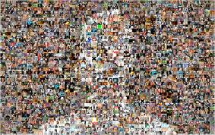
“As one Man” (3:1)
Judah & Israel were finally united!
Cost to bring about unity was huge: 70 years of captivity
Learn to value ecclesial unity and work for it constantly
  Many years of working for unity can be overturned in a moment
  Ecclesial leaders need to provide activities that will encourage unity of the members
Behold, how good and how pleasant it is for brethren to dwell together in unity! (Ps 133:1)

Slide 22
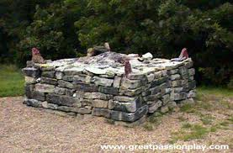
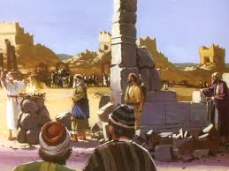
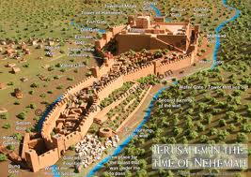
The Order of the Building
Altar – dedication to become living sacrifices
2) Temple – commitment to daily service & worship
3) Walls – (during Nehemiah) develop defenses against the evils of this world
God wanted it this way to encourage faith in His ability to provide

Slide 23
Building an Altar to Yahweh
Exodus 20:24-26
24 'An altar of earth you shall make for Me, and you shall sacrifice on it your burnt offerings and your peace offerings, your sheep and your oxen. In every place where I record My name I will come to you, and I will bless you.
25 'And if you make Me an altar of stone, you shall not build it of hewn stone; for if you use your tool on it, you have profaned it.
26 'Nor shall you go up by steps to My altar, that your nakedness may not be exposed on it.'
Deuteronomy 27:5-6
5 “And there you shall build an altar to the LORD your God, an altar of stones; you shall not use an iron tool on them.
6 "You shall build with whole stones the altar of the LORD your God, and offer burnt offerings on it to the LORD your God.
Altar all of God: no human tools Ramp, no steps: no glory for man

Slide 24
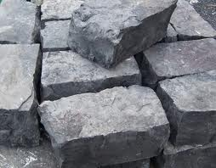
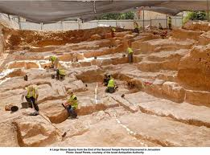
Living Stones for God’s House
1 Peter 2:4-5
4 Coming to Him as to a living stone, rejected indeed by men, but chosen by God and precious,
5 you also, as living stones, are being built up a spiritual house, a holy priesthood, to offer up spiritual sacrifices acceptable to God through Jesus Christ.
I Kings 6:7
7 And the temple, when it was being built, was built with stone finished at the quarry, so that no hammer or chisel or any iron tool was heard in the temple while it was being built.
Lesson: we must be ready now in this life! The resurrection will be too late!

Slide 25
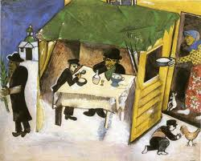
Feast of Tabernacles (v.4)
Required in Ex 23:14-17
Didn’t need a temple
Represented the final gathering of saints throughout the ages into God’s kingdom
Reminder of redemption from Egypt (sin)
  When Jews were slaves and had nothing
  God in His mercy redeemed them
Would have been encouraging & exhortational to experience the Feast at this time

Slide 26
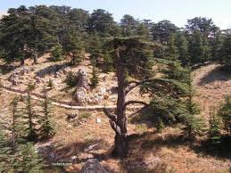
Use of foreign supplies (v.7)
As Solomon in 1Kgs 5:6-11
Only allowed foreigners to supply materials – not actually build temple
Joshua & Zerubbabel drew a line: no foreigners on site!
There are times to be selective about who we are willing to use in God’s service too!

Slide 27
Years to Build the Temple
Cyrus
Cambyses
Pseudo-Smerdis
Darius
Years to finish =
6 years
8 years
7 months
6 years (6:15)
20 years
That’s a long time to maintain interest in an ecclesial project!

Slide 28
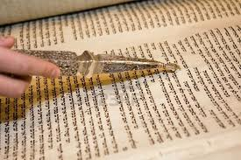
Following David’s Directions
V. 8 Levites: originally began at 25 years old (Num 8:24)
David changed to 20 years old (1 Chron 23:24) when there was no need to carry the tabernacle
V.10-11 Reenactment of 2 Chron 5 – Solomon brought ark into the new temple
David’s directions: 1 Chr 6:31; 16:4,5,7; 25:1-31
V.11 Quoted from:
1 Chron 16:34 – David brought ark into Jerusalem
2 Chron 5:13 – Solomon brought ark into Temple
Lots of responsibilities for 20-year olds. Older members must be willing to let young people be involved.

Slide 29
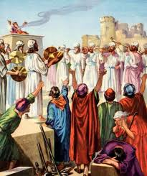
People’s Reaction to the Laying of the Foundation
Younger: Shouted and praised (excited!)
Older: Wept (disappointed)
This problem hung on for 20 years! Still around for Haggai & Zechariah
Hag 2:3-4 Is it not in your sight as nothing?
Zech 4:8-10 Who has despised the day of small things?
God wants our best effort, not best ever result!

Slide 30
Philippians 1:27 (RSV)
Only let your manner of life be worthy of the gospel of Christ, so that whether I come and see you or am absent, I may hear of you that you stand firm in one spirit, with one mind striving side by side for the faith of the gospel
So let’s go home & get more involved in ecclesial life!

Slide 31

Class 3: Don’t give up with things go wrong!

Slide 33
2
S
G

Slide 34
2
S
G

