Slide 1
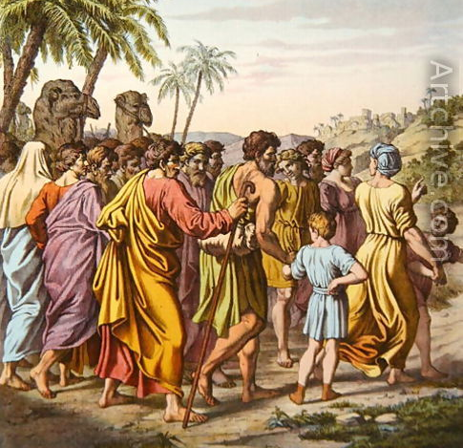
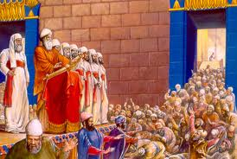
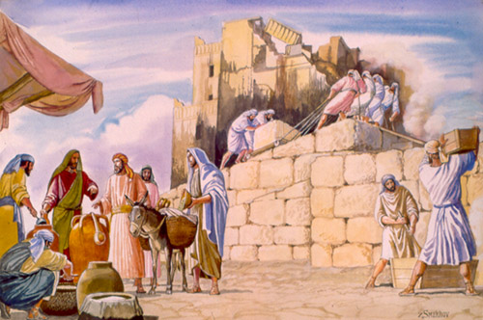
Ezra: Working together in God’s service
Class 3: Don’t give up with things go wrong!

Slide 2
Warning: the responses of Ezra 3 may have led to the tests of Ezra 4
Younger: Shouted & praised (excited!)
Older: Wept (disappointed) ☹
Hag 2:3-4 Is it not in your sight as nothing?
Zech 4:8-10 Who has despised the day of small things?
God custom makes our trials to fine-tune our spiritual lives

Slide 3
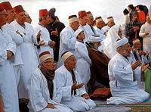
The Adversaries Challenge!
Adversaries (v.1): Samaritans – Introduced as adversaries from the start!
Let us build with you: the Jews could sure use the help!
Days of Esarhadddon (son of Sennacherib) about 130 years ago!
We worship God: but idols too! (2Kgs 17:24-33, 39-41)
Assyrians moved Jews out of North & brought in Gentiles
  Gentiles brought their idols & mixed in with Jews in the North part of Israel
  Samaritans feared Yahweh & all their other gods too
No compromise for Zerubbabel & Joshua

Slide 4

Background to the Samaritans: 2 Kings 17:28-41
28 Then one of the priests whom they had carried away from Samaria came and dwelt in Bethel, and taught them how they should fear the LORD.
29 However every nation continued to make gods of its own, and put them in the shrines on the high places which the Samaritans had made, every nation in the cities where they dwelt.
30 The men of Babylon made Succoth Benoth, the men of Cuth made Nergal, the men of Hamath made Ashima,
31 and the Avites made Nibhaz and Tartak; and the Sepharvites burned their children in fire to Adrammelech and Anammelech, the gods of Sepharvaim.
32 So they feared the LORD, and from every class they appointed for themselves priests of the high places, who sacrificed for them in the shrines of the high places.
They were adversaries from the start!

Slide 5
Background to the Samaritans: 2 Kings 17:28-41
33 They feared the LORD, yet served their own gods-- according to the rituals of the nations from among whom they were carried away.
34 To this day they continue practicing the former rituals; they do not fear the LORD, nor do they follow their statutes or their ordinances, or the law and commandment which the LORD had commanded the children of Jacob, whom He named Israel,
40 However they did not obey, but they followed their former rituals.
41 So these nations feared the LORD, yet served their carved images; also their children and their children's children have continued doing as their fathers did, even to this day.
They were adversaries from the start!

Slide 6
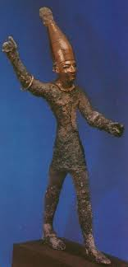
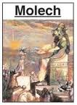

Test #1: Return to Idols?
Idol worship was a primary cause of the 70-year captivity
Were the people willing to separate from the nations, stand fast for Yahweh their God, and guard the Truth that was entrusted to them?
Yes!

Slide 7

Compromising Alliances with the World are Destructive
Lot: Political (Gen 19:1)
Sat in the gate at Sodom
Judah: Business/economic (Gen 38)
Friends with Hirah the Adullamite
Jehoshaphat: Marriage (2 Chr 18:1) Married his son (Jehoram) to Ahab’s daughter (Athaliah)
Political/Military (2 Chr 18:3) war with Ahab against Syria
Economic (2 Chr 20:35-36) built ships with Ahaziah at Ezion Geber
Dangerous behavior
And Jehu the son of Hanani the seer went out to meet him, and said to King Jehoshaphat, "Should you help the wicked and love those who hate the LORD? Therefore the wrath of the LORD is upon you. (2 Chr 19:2)
We cannot compromise in building our CYC’s, Sunday Schools, and witnessing!

Slide 8
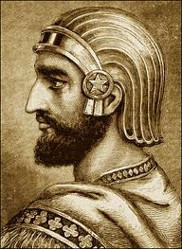
Joshua & Zerubbabel’s Defense
As Cyrus commanded (v.3):
  Cyrus told “those that go up to Jerusalem” to rebuild the temple
  So those already in the land not involved
People of the land discouraged the Jews (v.4)
  Decision not to compromise led to immediate trouble
  Some of the Jews became discouraged
Many of our decisions not to compromise with this world will cost us too. This is where faith & trust in God carry us forward!

Slide 9
People in Heb 11 who made tough decisions by Faith for long term results
Noah: Built an ark and suffered abuse for it
Abraham: Willing to offer up Isaac
Left Ur to go to an unknown land, that was having a famine when he got there!
Let Lot have first choice of the land
Moses: Demanded Pharaoh let Jews go, even though Pharaoh made life even harder for Jews
Rahab: Risked her life to hide the spies
Some long-range spiritual decisions have immediate uncomfortable results – That’s when we need faith!

Slide 10
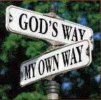

Test #2: Pressure & Endurance
Were the people ready to endure tribulation from without?
Were the people ready to endure trouble for many years and continue steadfast in their devotion to building God’s house during times of distress & disappointment when their faith was challenged?
No!

Slide 11
Ezra 4:4-7
4 Then the people of the land tried to discourage the people of Judah. They troubled them in building,
5 and hired counselors against them to frustrate their purpose all the days of Cyrus king of Persia, even until the reign of Darius king of Persia.
6 In the reign of Ahasuerus, in the beginning of his reign, they wrote an accusation against the inhabitants of Judah and Jerusalem.
7 In the days of Artaxerxes also, Bishlam, Mithredath, Tabel, and the rest of their companions wrote to Artaxerxes king of Persia; and the letter was written in Aramaic script, and translated into the Aramaic language.
Who are these Kings?

Slide 12
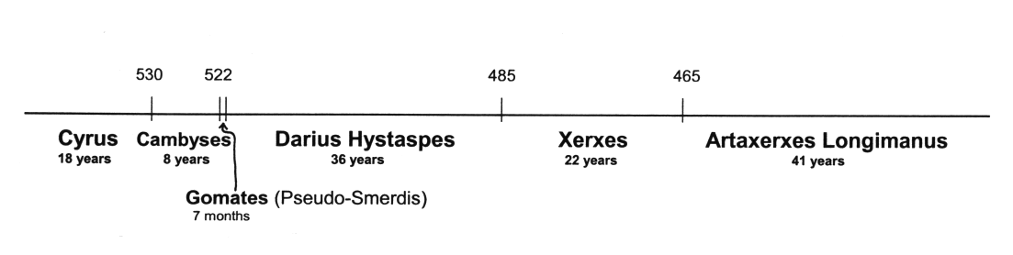
Persian Kings: Cyrus to Longimanus
Some take Ahasuerus (v.6) to be Xerxes & Artaxerxes to be Longimanus (58 years after Darius Hystaspes) and apply it to the building of the walls in Nehemiah’s time
but v.24 shows this is about the temple, not walls.
If Ezra returned in the days of Longimanus, he would be ancient! (over 130 years old)
So Ahasuerus is Cambyses & Artaxerxes is Gomates

Slide 13
Ezra 4:23-24 Shows that entire chapter is about the Temple
23 Now when the copy of King Artaxerxes' letter was read before Rehum, Shimshai the scribe, and their companions, they went up in haste to Jerusalem against the Jews, and by force of arms made them cease.
24 Thus the work of the house of God which is at Jerusalem ceased, and it was discontinued until the second year of the reign of Darius king of Persia.
Nothing in Ezra 4 is about Nehemiah’s walls

Slide 14
Ezra 4:4-7, 23-24
5 and hired counselors against them to frustrate their purpose all the days of Cyrus king of Persia, even until the reign of Darius king of Persia.
6 In the reign of Ahasuerus, in the beginning of his reign, they wrote an accusation against the inhabitants of Judah and Jerusalem.
7 In the days of Artaxerxes also, Bishlam, Mithredath, Tabel, and the rest of their companions wrote to Artaxerxes king of Persia; and the letter was written in Aramaic script, and translated into the Aramaic language.
23 Now when the copy of King Artaxerxes' letter was read before Rehum, Shimshai the scribe, and their companions, they went up in haste to Jerusalem against the Jews, and by force of arms made them cease.
24 Thus the work of the house of God which is at Jerusalem ceased, and it was discontinued until the second year of the reign of Darius king of Persia.
God gave them what many wanted

Slide 15

The Key!
The temple work is stopped in the reign of Artaxerxes of verse 7 (see v.23-23)
The temple is finished in the 6th year of the reign of Darius (6:15)
Temple work stopped
Temple finished
6
So all the kings in Ezra 4 influenced the building of the temple

Slide 16
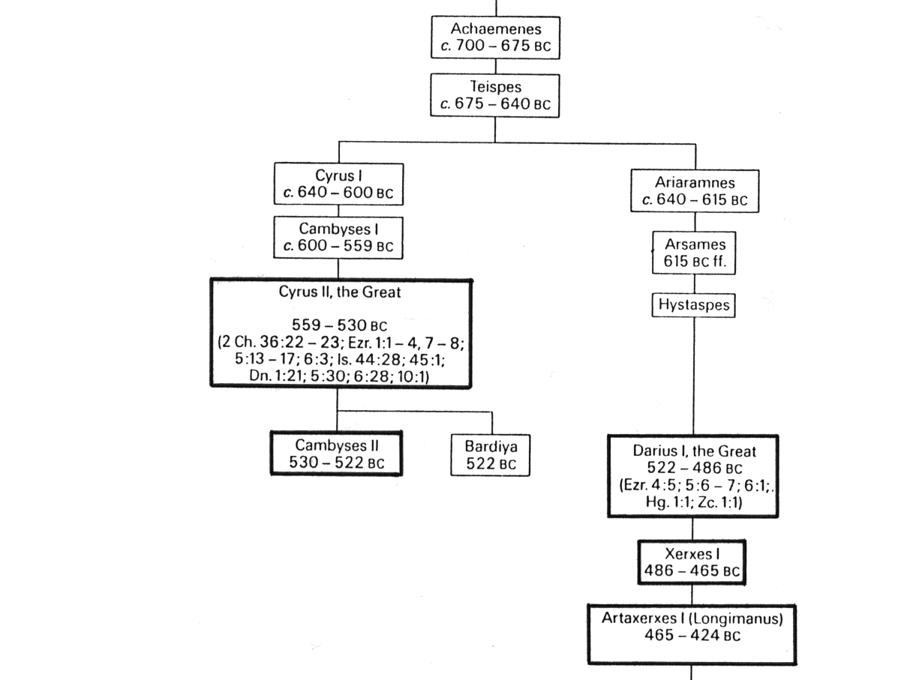
Persian Kings
The Angels ended their work with the line of Cyrus
They began working with Darius Hystaspes
Gomates

Slide 17
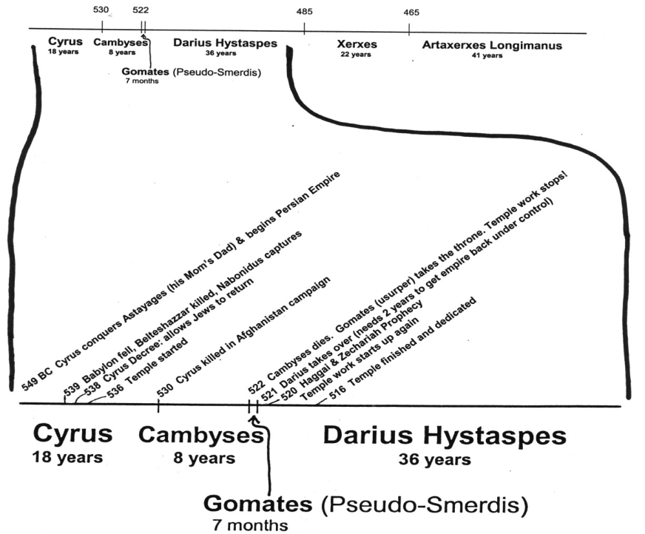
Persian Kings from Cyrus to Longimanus
Ezra only deals with Cyrus to Darius
-- 515 Ezra returns
-- 502 Nehemiah returns

Slide 18
The Kings of Ezra 4
Effect on Temple | Name in Ezra 4 | Actual Name | Length of Reign
Issued decree to build temple | Cyrus | Cyrus the Great | 9 years after decree
Did not hinder the work | Ahaseurus | Cambyses II | 8 years
Stopped work on temple | Artaxerxes | Gomates (Pseudo-Smerdis) | 7 months
Encouraged work to finish | Darius | Darius Hystaspes (Darius the Great) | 36 years

Slide 19
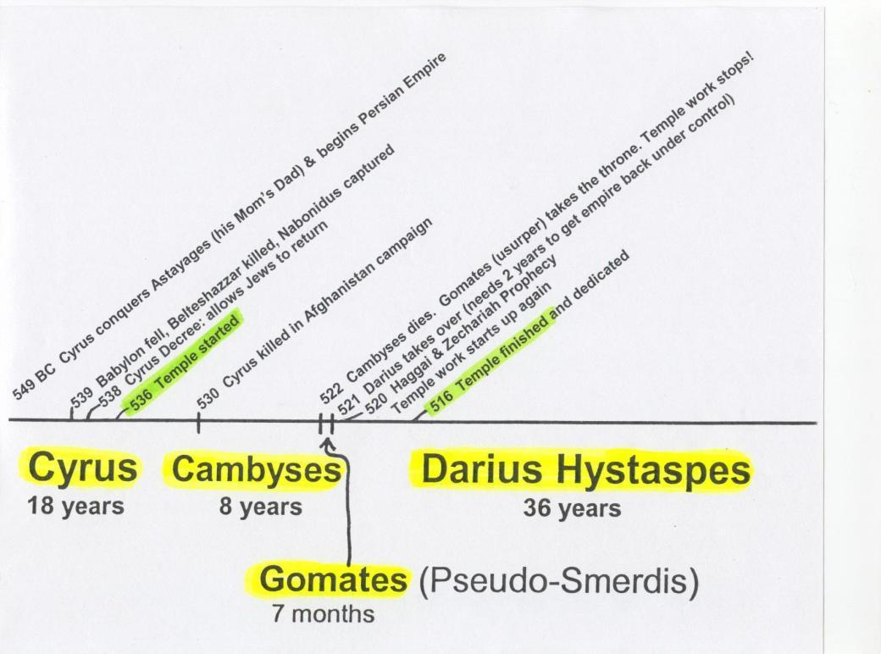
Timeline of the Persian Kings during the temple building
-- 515 Ezra returns
-- 502 Nehemiah returns
[ 10 years ]
6
7
20

Slide 20

The Samaritans’ Letter
Lies..lies.. More lies
Artaxerxes (v.7) = Gomates
V.10 check a modern version
Rebellious & evil city (v.12): trying to make Jerusalem look bad for the Persians
  v.15 “harmful to kings” & “incited sedition”
Rebuilding the walls: a lie! Misleading.
Search (v.15): about Jerusalem (not Cyrus’ decree)
  These people are not interested in Truth!
Mighty kings: David, Solomon
  Menahem (2Kgs 15:16)
  Josiah (2 Chron 34:6,7; 35:18)
Remember: God is in Control!

Slide 21


Lies of the Samaritans
1) Jews are rebuilding the city and finishing the walls (v.12)
[no mention of temple]
2) Jews will not pay taxes, tribute (v. 13)
3) Jerusalem is rebellious, harmful to kings, incited sedition - that’s the reason it was destroyed (v.15)
4) if city is finished, Persia will lose its dominion this side of Euphrates (v.16)
God used this to stop the work

Slide 22
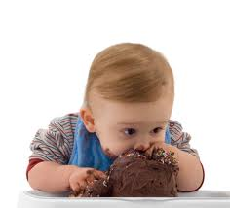
God gives them what they wanted
Have your cake & eat it too!
By force and power (v.23):
  When we complain about life God sometimes gives us what we really want
  Makes us re-think our situation
  Don’t complain about your family, ecclesia or job!
The work stopped:
  Only for about 2 years
  True believers were probably frustrated
  It was a time to test their Faith: do we really believe God is in control and using these events to save His people?
This is when faith gets you through!

Slide 23
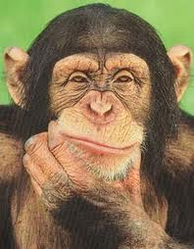
Why did God stop the work?
15 years of work had worn out and discouraged the people
Older people didn’t like the new temple
Adversaries hired counselors against them
Workers wanted to spend time on their own houses, farms and businesses
People were afraid of adversaries (8:4-5)
Now was the time for faithful believers to step forward and stir up the community to finish God’s house

Slide 24
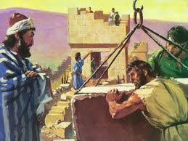
God gets the work going again!
Used Haggai & Zechariah
Similar to today: no angel visits, no spirit gifts
People needed faith to see what God & His angels were doing for them behind the scenes
Only took 4 more years to finish
It’s amazing what can be accomplished in families & ecclesias when we have the faith to get involved in God’s work!

Slide 25
Temple is finished
Then Ezra returns
Then Nehemiah builds the wall
-- 515 Ezra returns
-- 502 Nehemiah returns
[ 10 years ]
2
6
7
20

Slide 26
“The Prophets of God Helping them” (Ezra 5:1-2 )
Coordinated efforts of Haggai & Zechariah
Haggai: Exhorts and reprimands the people for their poor choices and lack of faith.
Zechariah: Encourages the people that the angels are working behind the scenes and they will help finish the temple!

Slide 27
1 Cor 15:57-58
57 But thanks be to God, who gives us the victory through our Lord Jesus Christ.
58 Therefore, my beloved brethren, be steadfast, immovable, always abounding in the work of the Lord, knowing that your labor is not in vain in the Lord.
Let’s determine to remain steadfast & immovable, even when under pressure – putting our faith & trust in our God

Slide 28

Class 4: God will Provide the Motivation to Finish!

Slide 29
2
S
G

Slide 30
1
5
G

Slide 32
2
S
G

