Slide 1



Ezra: Working together in God’s service
Class 4: God will Provide the Motivation to Finish!

Slide 2

Temple is finished
Then Ezra returns
Then Nehemiah builds the wall
-- 515 Ezra returns
-- 502 Nehemiah returns
[ 10 years ]
2
6
7
20

Slide 3
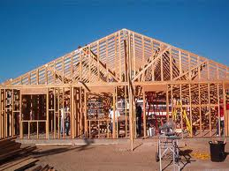
What had the People been doing over the last 15 years? (see Haggai 1:1-6)
1) Claimed the time was not right (v. 2)
not yet the end of the 70 years
2) Paneled their own homes (v. 4)
3) Tried to improve their economic situation (v. 6)
When we aren’t involved in God’s work, we tend to serve ourselves

Slide 4
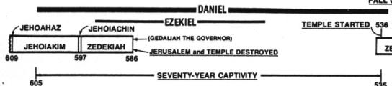
Jeremiah’s Prophecies about the 70 years
Jer 25:11-14 (during early years of Jehoiakim’s reign) after 70 years God will punish Babylon
Jer 29:10-14 (during early years of Zedekiah) after 70 years God will bring the Jews back and give them a future with peace and hope

Slide 5
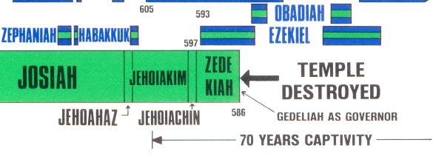
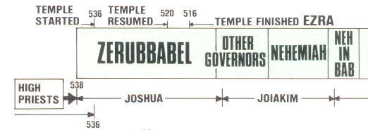
When did the 70 years start?
70 years
70 years
People justified what they really wanted to do!
Warning for today: Don’t wait till the end to get involved! God expects us to be working consistently until the end.

Slide 6
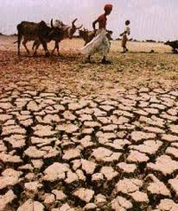
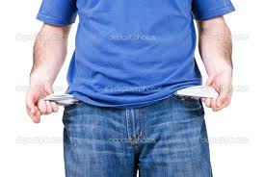
God tried to talk to the people by influencing the conditions in the land (Hag 1:5)
1) Small harvests: blight, mildew & hail (2:17)
2) Droughts
3) Cold
4) Inflation
God talked to them through economic & environmental events
We need to examine our own lives and consider how we have fared

Slide 7
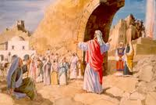
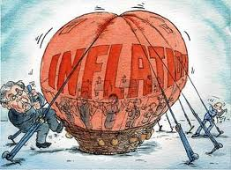

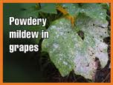
Haggai’s Message: Consider how you have fared!
God had influenced their lives
1:6 Small harvest, not enough to eat or drink, cold temperatures, high inflation
1:11; 2:17 drought, blight, mildew on crops
1:9 God blew it away!
1:8 Solution: Get involved in building temple!
1:13 God’s assurance: “I am with you”.
He stirred up the spirit of the people
1:14 Response: they came and worked
2:1-9 Don’t worry that this temple is not as good as the former. It’s latter glory will be greater
2:10-14 Nation is unclean. Much easier to learn wickedness than righteousness
2:15-23 God will bless Israel from now on because they involved again in God’s work of building
Get priorities right: Spiritual issues first!

Slide 8
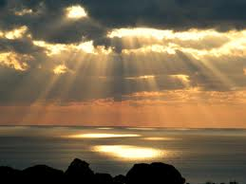
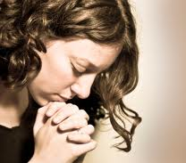
God talks to us through the experiences of life
We need to meditate and consider the events of our lives – they are not by chance!
God attempts to influence us through life events – if we are listening
He uses economics, jobs, health, family troubles, accidents, friends
We need to meditate
& consider how we have fared!
God’s talking…are we listening?

Slide 9
God raises up Darius to be King!
A few months after the temple work was forced to stop, God opened a door by bringing Darius to the throne
Some of the Jews realized this was their opportunity and began working on the temple again, but they needed more help
The angels were busy at work in the Persian Empire so that the work on the Temple could finish

Slide 10

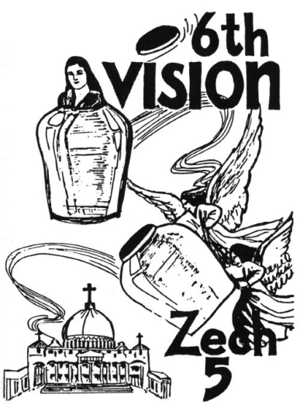

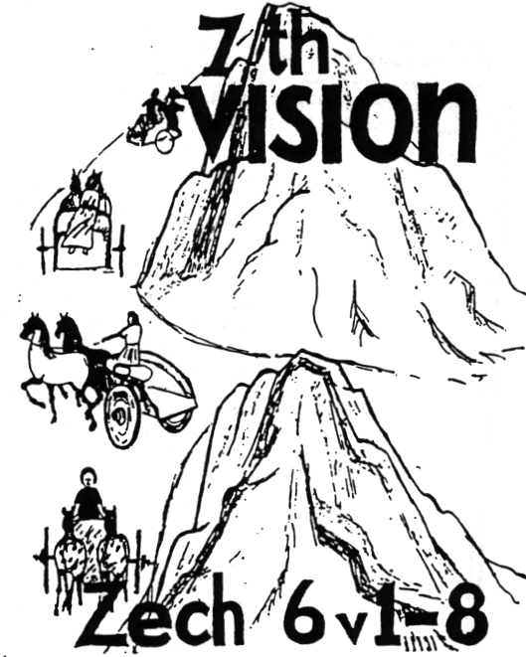
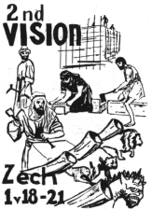
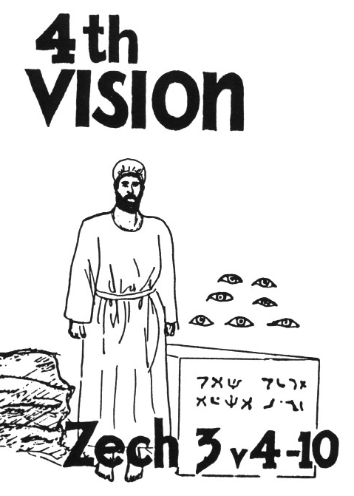
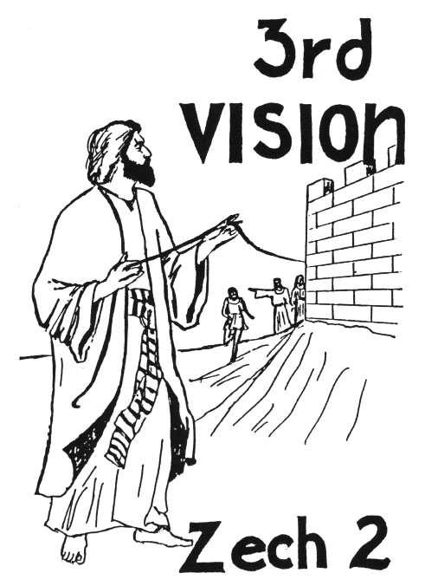
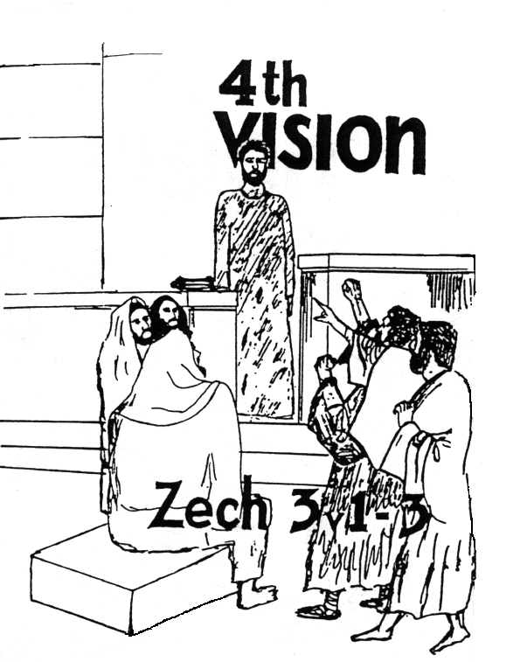
Zechariah’s
7 Night Visions
(Zech. 1-6)
God promised to help them finish the temple

Slide 11
Zechariah’s Message: the Angels are excited about finishing the temple!
1:7-11 Vision of Angels on horses patrolling earth and bringing rest
1:12 Angels ask God: how long until you will have mercy on Jerusalem?
2:1-5 Angels declare Jerusalem will be inhabited without any need of walls – God will protect it
3:1-5 Joshua stands before angel. Angel rebukes Satan.
Angel removes iniquity and clothes Joshua.
3:6-10 God will bring forth his servant “the Branch”.
7 eyes (angels) are watching over the capstone.
4:9-10 Angels rejoice to see plumb line in Zerubbabel’s hand
Angels are active today too! They want to establish God’s Kingdom & for us to be there! Cooperate with their work & don’t frustrate them!

Slide 12
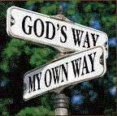
People challenged again (vs 3-4)
Tatnai = Tattenai (Governor of province)
It’s been about 16 years since Cyrus’ decree
Work stopped for about 2 years
These people are not as nasty as Samaritans - they ask questions but don’t push their view.
Elders individually challenged – need to stand up personally for our beliefs
God will continually challenge us too – He’s hoping we will grow and triumph!

Slide 13
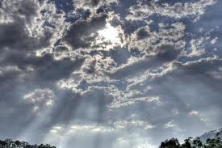
The Eye of God upon them (but not visible to human eyes!)
2 Chron 16:9 Hanani to Asa: “the eyes of the Lord run to and fro throughout the whole earth, to show Himself strong on behalf of those whose heart is loyal to Him”
Zech 3:9 See, the stone I have set in front of Joshua! There are seven eyes on that one stone (NIV)
Zech 4:10 “For who has despised the day of small things? For these seven rejoice to see the plumb line in the hand of Zerubbabel. They are the eyes of the LORD, which scan to and fro throughout the whole earth.” (angels will make sure the temple is finished!)
1 Pet 3:12 “for the eyes of the Lord are on the righteous, and His ears are open to their prayers”
Angels are hidden, but always there to help! We need to be aware of their presence & thank them.

Slide 14

The People Respond in Faith
Continued working this time – endurance through persecution & pressure
Unbelievers noticed the commitment of God’s people (v.8)
Faithfully witnessed to God (v.10) & gave God the credit (v.11)
Accepted the blame: “our fathers angered God” (v.12)
Acknowledged God brought the captivity
Referred to the political authority to build – Cyrus’ decree (v.13)
Faith in God can motivate us to move mountains & conquer giants

Slide 15
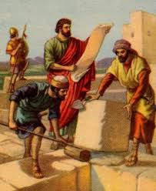
Evidence that Sheshbazzar of v.16 is Zerubbabel
Sheshbazzar
Ezra 5:14
Ezra 5:16
Zerubbabel
Hag 1:1
Zech 4:9
Governor:
Laid Temple Foundation
According to Neh 7:5 Zerubbabel led the first return of the exiles!

Slide 16
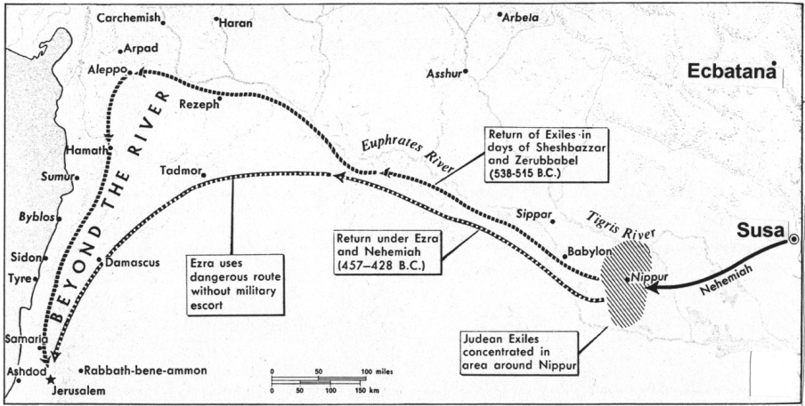
Achmetha (6:2) = Ecbatana (capital city of Cyrus)
1000 miles (1600 km)
800 miles (1300 km)
Ecbatana was the summer residence of Persian kings, Susa was used in winter

Slide 17
Comparison of the Decrees in Ezra 1 & Ezra 6
Ezra 1 (Hebrew)
Yes
No
Yes
No
Ezra 6 (Aramaic)
No
Yes
No
Yes
Yahweh Name
Size Limits
Free Will Offerings
Pay from Treasury
Some differences may have developed when being translated

Slide 18
Look at what the Angels accomplished behind the scenes!
v.6 Keep yourselves far from there
v.7 Let the work of this house of God alone
v.8 Let the cost be paid from the King’s expense from taxes (so the adversaries of Ezra 4 ended up paying to finish the temple!)
v.9 And whatever else they need --- let it be given them day by day without fail!
Now to him who by the power at work within us is able to do far more abundantly than all that we ask or think (Eph 3:20 RSV)

Slide 19
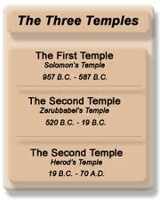
Temple is Finished!
Pray for King & Son - Persians asked everyone in empire to pray to their god for the empire (v.10)
Cyrus & Darius & Artaxerxes – we will look at this tomorrow!
Adar = 12th month. Ready for 1st month of new year for Passover & Feast of Unleavened Bread
Temple took about 20 yrs to build – Cyrus (6) + Cambyses (8) + Darius (6)
Celebrated with joy! (v.16) – remember Zech 4 “whoever despises the day of small things will rejoice”
Never despise or discourage God’s work today, no matter how small it is!

Slide 20
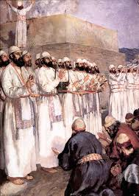
Temple service organized
Offerings (v.17): small compared to Solomon’s (1 Kings 8:63)
Sin offering: Solomon didn’t have these [maybe exiles were confessing their sins that had caused the exile]
12 Tribes: implies some from all 12 tribes did return
Priests & Levites organized (v.18): as per 1 Chr 23:6-24; 24:1-19
Ate together with all (v.21) – included Gentiles! Worship Yahweh, the God of Israel
King of Assyria (v.22): An Assyrian king began the exile, now the temple is finished during another
God wants us to rejoice in our service to Him – it’s time to celebrate what He has done for us!

Slide 21
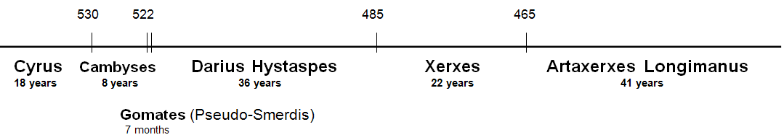
Who is Artaxerxes of Ezra 7?
Neh 5:14; 13:6 indicates that Artaxerxes reigned at least 32 years. Darius Hystaspes & Artaxerxes Longimanus are the only Persians kings to reign that long.
That narrows it down to only 2

Slide 22
Who is Artaxerxes of Ezra 7?
Artaxerxes is just a title, not a specific individual. Now his 7th year (v.7)
Most say Longimanus (58 years after Hystaspes)
  But…..Longimanus did not build the temple
  Longimanus was not mentioned before this in Ezra
Probably Darius Hystaspes
  Darius & Artaxerxes are titles like: President, Prime Minister, King, etc.
  Ezra compiled information from returned exiles in Israel and added his own experience. Different sources probably used different titles for the King.
Ezra returned as soon as the temple was finished!

Slide 23
Temple is finished
Then Ezra returns
Then Nehemiah builds the wall
-- 515 Ezra returns
-- 502 Nehemiah returns
[ 10 years ]
2
6
7
20

Slide 24
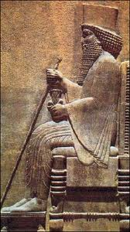
Evidence that Artaxerxes is Darius Hystaspes
Temple finished in his reign. Ezra 6:14 says “Cyrus and Darius and [even] Artaxerxes”
Artaxerxes sends Ezra back in 7th year to work in Temple, offer sacrifices & teach Jews how to worship Yahweh. Why wait 58 years to do this?
Ezra’s age: he was born before captivity began. In 7th year of Hystaspes he would be at least 94 years old. In 7th of Longimanus he would be over 152.
Compare Neh 10:2-10 with Ezra 2. Out of 30 priests & Levites who returned with Zerubbabel, 20 of them signed the covenant with Nehemiah. In Longimanus’ reign they would all be alive 92 years after Zerubbabel’s return – not very likely!
Artaxerxes is just a title

Slide 25
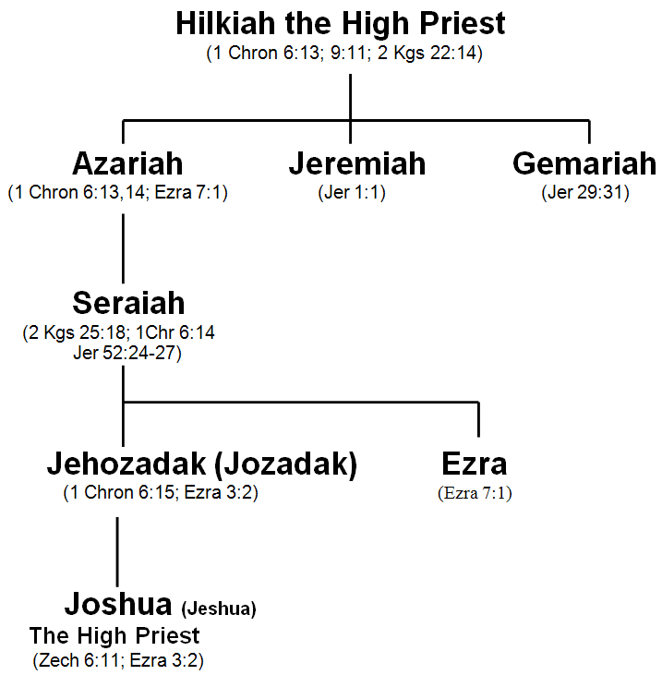
Family line of Ezra
Ezra’s Dad was killed at Riblah a month after Zedekiah
Folks who go with Longimanus don’t think Seraiah was Ezra’s Dad
Ezra is Jeshua’s uncle
G

Slide 26
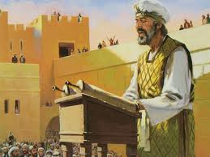
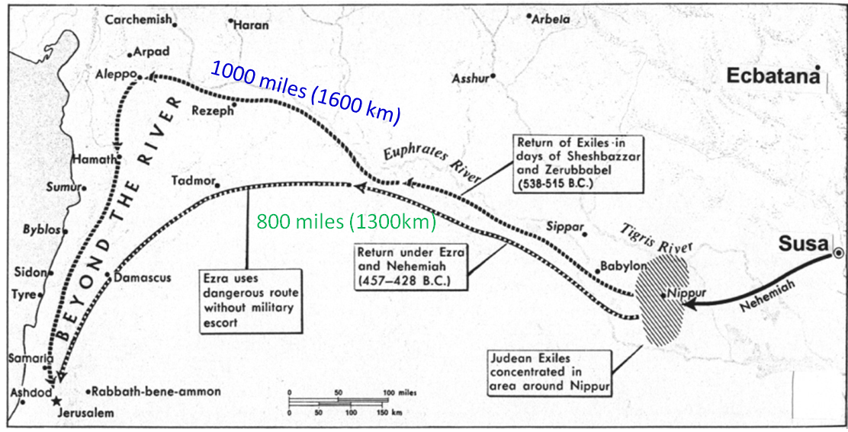
Ezra’s Preparation & Return
Skilled in Law of Moses (v.6): requires time & effort, like any other skilled job (carpenter, seamstress, etc)
Hand of God on him: from 1Kgs 18:46 when Elijah prayed for rain & ran before Ahab – time of national reformation.
Journey: 800 miles [1300 km]. Took 4 months (v.8-9)
G

Slide 27

Ezra’s Preparation (7:10)
His heart was immersed in the Law of the Lord
1) Seek [study (RSV, NASB, NKJVmg)]: “to tread or frequent” (Strongs) – He poured over the Scriptures
2) Do it – he lived his message, it was not just an academic study! [like Paul showing Gentiles Jesus Christ crucified]
3) Teach – he felt the responsibility and privilege to share with others – that’s the goal
This helps us today to be effective workers in God’s ecclesia

Slide 28

Ezra 6:14 is the key
Ezra 6:14 (RSV)
They finished their building by command of the God of Israel and by decree of Cyrus and Darius and Artaxerxes king of Persia
Ezra 6:14 (H.P.M.)
They finished their building by command of the God of Israel and by decree of Cyrus and Darius even Artaxerxes king of Persia.
Darius and Artaxerxes are different titles for the same king

Slide 29
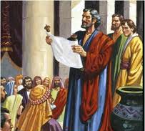
Purpose of Artaxerxes’ Decree in Ezra 7
Allowed any Jews to return (13)
Inquire about Jews following God’s laws in Judah (14)
Convey silver & gold offered by King & counselors & Jews to buy animals, grains & wine for offerings (15-18)
Convey vessels to temple for service (19)
Buy anything else needed out of King’s treasury (20)
Told treasurers in province to supply silver, wheat, wine, oil & salt (21-23)
Treasurers not to tax temple workers (24)
Gave Ezra authority to appoint officials & judges, and to impose punishments (25-26)
God gave them far more than they could “ask or think”

Slide 30
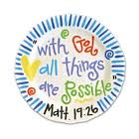
Artaxerxes helps Ezra out!
7 counselors (v.14) = 7 princes of Esther 1:14
Silver & gold – amounts in 8:25-27
Lest His wrath be against the king:
  Ezra used this as a motive in 8:22
  Pray for the King and his sons (back in 6:10)
Note use of “me” and “I” – implies Ezra was the author of the book.
Ezra prepared to seek God’s law, then God did more than Ezra could have imagined

Slide 31
Philippians 1:6 (RSV)
And I am sure that he who began a good work in you will bring it to completion at the day of Jesus Christ.
Whatever our current trials & problems, never lose Paul’s confidence in God’s ability to finish His work!

Slide 32

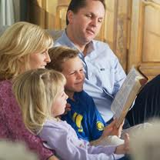
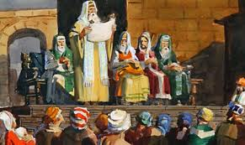
Exhortation: Leaving an Inheritance for our Children

Slide 33
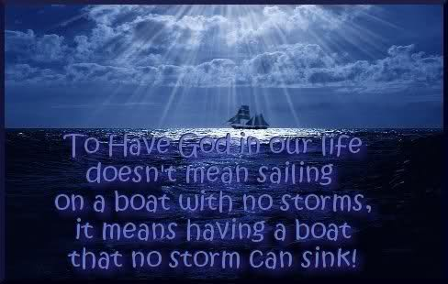
2
S
G

Slide 34
2
S
G

Slide 35
2
S
G

Slide 36

1
5
G

