Slide 1



Ezra: Working together in God’s service
Class 5: Preparation for Service is Essential

Slide 2

Temple is finished
Then Ezra returns
Then Nehemiah builds the wall
-- 515 Ezra returns
-- 502 Nehemiah returns
[ 10 years ]
2
6
7
20

Slide 3
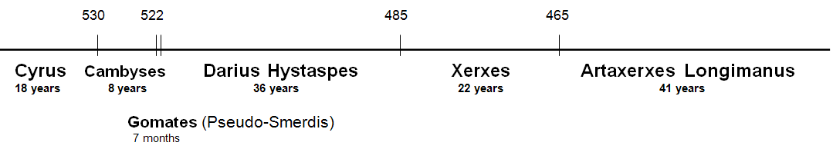
Who is Artaxerxes of Ezra 7?
Neh 5:14; 13:6 indicates that Artaxerxes reigned at least 32 years. Darius Hystaspes & Artaxerxes Longimanus are the only Persians kings to reign that long.
That narrows it down to only 2

Slide 4
Who is Artaxerxes of Ezra 7?
Artaxerxes is just a title, not a specific individual. Now his 7th year (v.7)
Most say Longimanus (58 years after Hystaspes)
  But…..Longimanus did not build the temple
  Longimanus was not mentioned before this in Ezra
Probably Darius Hystaspes
  Darius & Artaxerxes are titles like: President, Prime Minister, King, etc.
  Ezra compiled information from returned exiles in Israel and added his own experience. Different sources probably used different titles for the King.
Ezra returned as soon as the temple was finished!

Slide 5
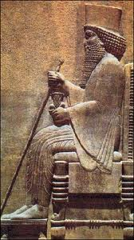
Evidence that Artaxerxes is Darius Hystaspes
Temple finished in his reign. Ezra 6:14 says “Cyrus and Darius and [even] Artaxerxes”
Artaxerxes sends Ezra back in 7th year to work in Temple, offer sacrifices & teach Jews how to worship Yahweh. Why wait 58 years to do this?
Ezra’s age: he was born before captivity began. In 7th year of Hystaspes he would be at least 94 years old. In 7th of Longimanus he would be over 152.
Compare Neh 10:2-10 with Ezra 2. Out of 30 priests & Levites who returned with Zerubbabel, 20 of them signed the covenant with Nehemiah. In Longimanus’ reign they would all be alive 92 years after Zerubbabel’s return – not very likely!
Artaxerxes is just a title

Slide 6
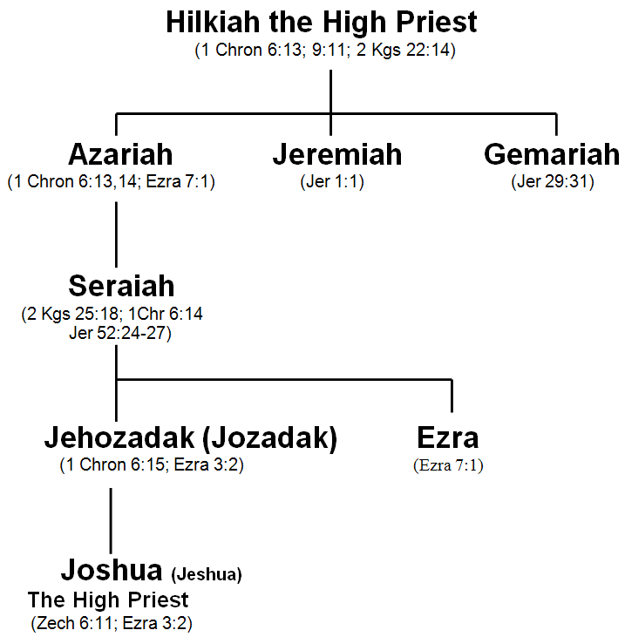
Family line of Ezra
Ezra’s Dad was killed at Riblah a month after Zedekiah
Folks who go with Longimanus don’t think Seraiah was Ezra’s Dad
Ezra is Jeshua’s uncle
G

Slide 7
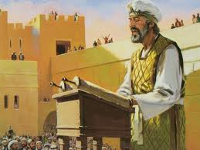
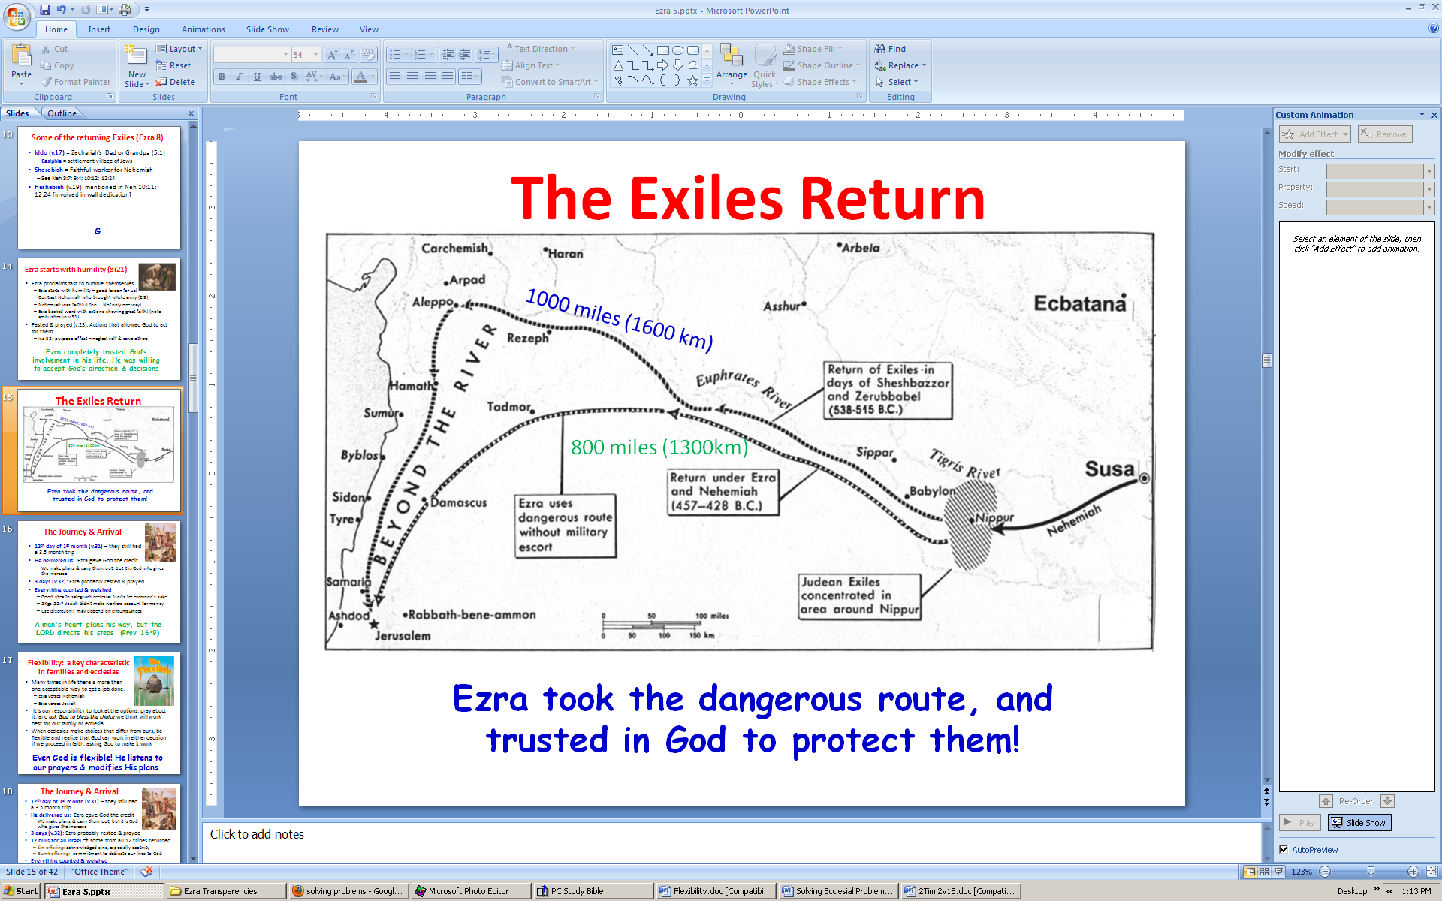
Ezra’s Preparation & Return
Skilled in Law of Moses (v.6): requires time & effort, like any other skilled job (carpenter, seamstress, etc)
Hand of God on him: from 1Kgs 18:46 when Elijah prayed for rain & ran before Ahab – time of national reformation.
Journey: 800 miles [1300 km]. Took 4 months (v.8-9)
G

Slide 8

Ezra’s Preparation (7:10)
His heart was immersed in the Law of the Lord
1) Seek [study (RSV, NASB, NKJVmg)]: “to tread or frequent” (Strongs) – He poured over the Scriptures
2) Do it – he lived his message, it was not just an academic study! [like Paul showing Gentiles Jesus Christ crucified]
3) Teach – he felt the responsibility and privilege to share with others – that’s the goal
This helps us today to be effective workers in God’s ecclesia

Slide 9

Ezra 6:14 is the key
Ezra 6:14 (RSV)
They finished their building by command of the God of Israel and by decree of Cyrus and Darius and Artaxerxes king of Persia
Ezra 6:14 (H.P.M.)
They finished their building by command of the God of Israel and by decree of Cyrus and Darius even Artaxerxes king of Persia.
Darius and Artaxerxes are different titles for the same king

Slide 10
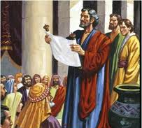
Purpose of Artaxerxes’ Decree in Ezra 7
Allowed any Jews to return (13)
Inquire about Jews following God’s laws in Judah (14)
Convey silver & gold offered by King & counselors & Jews to buy animals, grains & wine for offerings (15-18)
Convey vessels to temple for service (19)
Buy anything else needed out of King’s treasury (20)
Told treasurers in province to supply silver, wheat, wine, oil & salt (21-23)
Treasurers not to tax temple workers (24)
Gave Ezra authority to appoint officials & judges, and to impose punishments (25-26)
God gave them far more than they could “ask or think”

Slide 11

Artaxerxes helps Ezra out!
7 counselors (v.14) = 7 princes of Esther 1:14
Silver & gold – amounts in 8:25-27
Lest His wrath be against the king:
  Ezra used this as a motive in 8:22
  Pray for the King and his sons (back in 6:10)
Note use of “me” and “I” – implies Ezra was the author of the book.
Ezra prepared to seek God’s law, then God did more than Ezra could have imagined

Slide 12
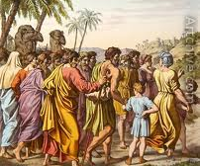
The Exiles that Returned with Ezra (Ezra 8)
Phinehas & Ithamar (v.2) = families
  Nadab & Abihu were killed (Lev 10)
  Eleazar was in the line of Phinehas
Made it to River Ahava (v.15) – took 9 days & stayed 3 (see 7:9 & 8:31)
No Levites! Similar problem in 2:40-42
  Rough life in Israel. Couldn’t own land.
  Depended on people for support
  Some (38) did come when pressured a bit!
Some folks need a push to get involved. Start out gently!

Slide 13
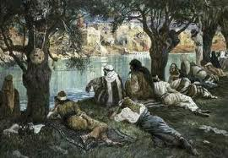
Some of the returning Exiles (Ezra 8)
Iddo (v.17) = Zechariah’s Dad or Grandpa (5:1)
  Casiphia = settlement village of Jews
Sherebiah = Faithful worker for Nehemiah
  See Neh 8:7; 9:4; 10:12; 12:24
Hashabiah (v.19): mentioned in Neh 10:11; 12:24 [involved in wall dedication]
These people returned to work in God’s service!

Slide 14
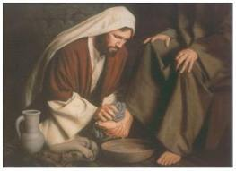
Ezra starts with humility (8:21)
Ezra proclaims fast to humble themselves
  Ezra starts with humility – good lesson for us!
  Contrast Nehemiah who brought whole army (2:9)
  Nehemiah was faithful too…. Not only one way!
  Ezra backed word with actions showing great faith! (note ambushes in v.31)
Fasted & prayed (v.23): Actions that allowed God to act for them
  Isa 58: purpose of fast – neglect self & serve others
Ezra completely trusted God’s involvement in his life. He was willing to accept God’s direction & decisions

Slide 15
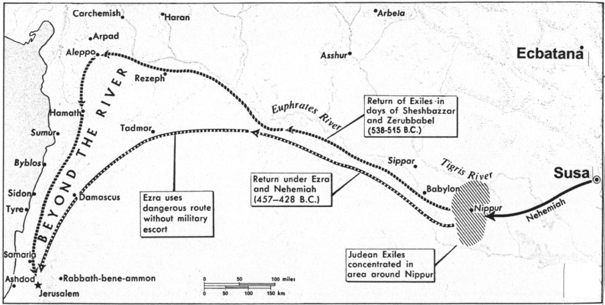
The Exiles Return
1000 miles (1600 km)
800 miles (1300km)
Ezra took the dangerous route, and trusted in God to protect them!

Slide 16
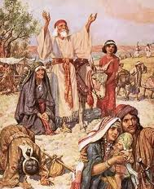
The Journey & Arrival
12th day of 1st month (v.31) – they still had a 3.5 month trip
He delivered us: Ezra gave God the credit
  We make plans & carry them out, but it is God who gives the increase
3 days (v.32): Ezra probably rested & prayed
Everything counted & weighed
  Good idea to safeguard ecclesial funds for everyone’s sake
  2Kgs 22:7 Josiah didn’t make workers account for money
  Use discretion: may depend on circumstances
A man's heart plans his way, but the LORD directs his steps (Prov 16:9)

Slide 17

Flexibility: a key characteristic in families and ecclesias
Many times in life there is more than one acceptable way to get a job done.
  Ezra verses Nehemiah
  Ezra verses Josiah
It’s our responsibility to look at the options, pray about it, and ask God to bless the choice we think will work best for our family or ecclesia.
When ecclesias make choices that differ from ours, be flexible and realize that God can work in either decision if we proceed in faith, asking God to make it work
Even God is flexible! He listens to our prayers & modifies His plans.

Slide 18
The Journey & Arrival
12th day of 1st month (v.31) – they still had a 3.5 month trip
He delivered us: Ezra gave God the credit
  We make plans & carry them out, but it is God who gives the increase
3 days (v.32): Ezra probably rested & prayed
12 bulls for all Israel → some from all 12 tribes returned
  Sin offering: acknowledged sins, especially captivity
  Burnt offering: commitment to dedicate our lives to God
Everything counted & weighed
  Good idea to safeguard ecclesial funds for everyone’s sake
  2Kgs 22:7 Josiah didn’t make workers account for money
  Use discretion: may depend on circumstances
A man's heart plans his way, but the LORD directs his steps (Prov 16:9)

Slide 19

Tomorrow we will consider how they solved an Ecclesial Problem:
It’s good to have some examples in mind
1) Joshua 22: The 2nd altar the 2.5 tribes built
2) Lev 10: Moses angry at Eleazar & Ithamar
3) Acts 15 Problem of fellowshipping Gentiles
4) Joshua 9 Gibeonites deceive Joshua & leaders
5) Judges 20-21 Levite & concubine. Benjamin nearly wiped out completely! People emotionally reacted, rather than patiently discussing a solution
6) Num 27 & 36 Daughters of Zelophehad’s inheritance
God has given us examples in the Bible so we can use them as patterns to solve our problems

Slide 20

2 Timothy 2:15 (NASB)
15 Be diligent to present yourself approved to God as a workman who does not need to be ashamed, handling accurately the word of truth.
16 But avoid worldly and empty chatter, for it will lead to further ungodliness,
17 and their talk will spread like gangrene.
Now is our time to prepare so we can be faithfully involved in God’s service in our families & ecclesias

Slide 21

Class 6: We must provide an inheritance for our children

Slide 22
2
S
G

Slide 23
2
S
G

Slide 24
1
5
G

Slide 25
1
5
G

Slide 26
Temple is finished
Then Ezra returns
Then Nehemiah builds the wall
-- 515 Ezra returns
-- 502 Nehemiah returns
[ 10 years ]
2
6
7
20

Slide 27
Temple is finished
Then Ezra returns
Then Nehemiah builds the wall
-- 515 Ezra returns
-- 502 Nehemiah returns
[ 10 years ]
2
6
7
20

Slide 28
The Exiles Return
1000 miles (1600 km)
800 miles (1300 km)
Just to get to Jerusalem was a major trip!

Slide 29
2
S
G

