Slide 1



Ezra: Working together in God’s service
Class 6: We must provide an inheritance for our children

Slide 2

Yesterday we considered how some Ecclesial Problems were solved:
1) Joshua 22: The 2nd altar the 2.5 tribes built
2) Lev 10: Moses angry at Eleazar & Ithamar
3) Acts 15 Problem of fellowshipping Gentiles
4) Joshua 9 Gibeonites deceive Joshua & leaders
5) Judges 20-21 Levite & concubine. Benjamin nearly wiped out completely! People emotionally reacted, rather than patiently discussing a solution
6) Num 27 & 36 Daughters of Zelophehad’s inheritance
God has given us examples in the Bible so we can use them as patterns to solve our problems

Slide 3
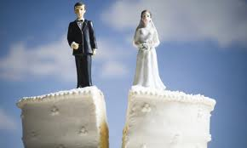
Today we look at 2 tough issues:
Marriage to unbelievers
Divorce
My Goal Today:
Help you understand how the people of Ezra’s day solved their problem
This should help us in making decisions with our problems today
Remember: God may be more interested in how we solve our problems than the end result!

Slide 4
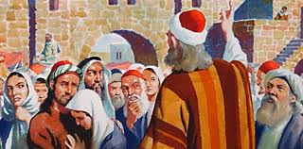
1) Acknowledge the Problem and openly discuss
Officials approach Ezra (9:1)
  Indicates Ezra has become a spiritual leader
  Ezra has wisdom and authority
People – Priests – Levites: problem throughout Israel!
  May have resulted from Gentiles who were attracted back in Ezra 7
  Some Jews then took Gentile wives who were not believers
Communication is a key to all family & ecclesial problems

Slide 5
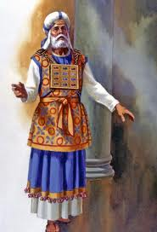
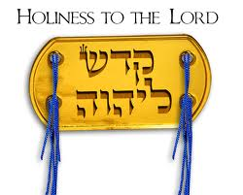
Holiness: Not separated themselves
Ex 22:31 “Be you holy for I am holy”
Lev 11-22 Clean/unclean, defilement – God tried to impress the people
You shall be holy, for I the Lord your God am holy (Lev 19:2)

Slide 6

Lev 20:24-26
24 'But I have said to you, "You shall inherit their land, and I will give it to you to possess, a land flowing with milk and honey." I am the LORD your God, who has separated [badal] you from the peoples.
25 'You shall therefore distinguish[badal] between clean animals and unclean, between unclean birds and clean, and you shall not make yourselves abominable by beast or by bird, or by any kind of living thing that creeps on the ground, which I have separated [badal] from you as unclean.
26 'And you shall be holy to Me, for I the LORD am holy, and have separated [badal] you from the peoples, that you should be Mine.

Slide 7
2 Cor 6:17-18
17 Therefore "Come out from among them and be separate, says the Lord. Do not touch what is unclean, and I will receive you."
18 "I will be a Father to you, and you shall be My sons and daughters, says the Lord Almighty.“
This is not just an OT concept!

Slide 8
Deuteronomy 7:1-6
1 "When the LORD your God brings you into the land which you go to possess, and has cast out many nations before you, the Hittites and the Girgashites and the Amorites and the Canaanites and the Perizzites and the Hivites and the Jebusites, seven nations greater and mightier than you,
2 "and when the LORD your God delivers them over to you, you shall conquer them and utterly destroy them. You shall make no covenant with them nor show mercy to them.
3 "Nor shall you make marriages with them. You shall not give your daughter to their son, nor take their daughter for your son.
4 "For they will turn your sons away from following Me, to serve other gods; so the anger of the LORD will be aroused against you and destroy you suddenly.
5 "But thus you shall deal with them: you shall destroy their altars, and break down their sacred pillars, and cut down their wooden images, and burn their carved images with fire.
6 "For you are a holy people to the LORD your God; the LORD your God has chosen you to be a people for Himself, a special treasure above all the peoples on the face of the earth.
This was the principle

Slide 9

Applying the principles
Ammonites, Moabites, Egyptians
  not specifically mentioned in Deut 7
  Principle was extended to apply
  Legalists would have claimed it did not apply!
Lesson: learn principles & apply them in faith
  Adam to Eve: “neither shall you touch it”
  If wrong to murder, then wrong to hate in heart
  If wrong to commit adultery, then wrong to look & lust
Look for ways to apply God’s principles – don’t condense them to letter of the Law

Slide 10
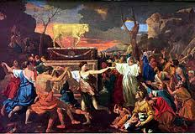
Extent of the Problem
They have taken wives for themselves & their sons
  Elders have tremendous responsibility to live by God’s standard
  Children do as parents, so parents must live by God’s standard
Holy race has mixed itself: divided loyalties & interests
  Talk to folks who have unbelieving spouses & discover the tough decisions they face
  Have someone share the issue with our CYCs
Note: mixed marriages & idolatry that followed were what caused the exile (v.14)
  Fear of punishment is not a powerful motivation in the long run
  Must learn to love the Lord our God with all our heart, soul, strength & mind (Mat 22:37; Deut 6:5)
Ecclesial elders & Parents must lead!

Slide 11
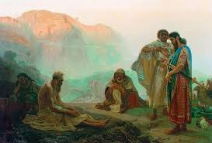
Dealing with the Issue
Rent garments, mantle, pull out hair (v.3)
  Some think Ezra over-reacted, but he was terrified about the future of God’s ecclesia
  This issue had led to the captivity in the first place, and the death of Ezra’s Dad (Seraiah)
All who trembled at God’s word (v.4)
  They were concerned about the future
  Note how the faithful were attracted to Ezra
Evening sacrifice (v.5): time of continual burnt offering – time for dedication!
Fell on my knees: before the temple (10:1)
Prayer: note that the language is normal Hebrew
  Like Paul in the NT
This is true Leadership

Slide 12
Ezra’s Approach to Mistakes:
1) Publicly acknowledge the issue is wrong and mistakes have been made (9:3)
2) Think about what we have done and the consequences of our mistakes (9:4)
3) Pray: admit mistakes and ask for God’s mercy and help (9:5-15)
4) Consider possible plans to move forward to correct the mistake (10:1-4)
5) Implement the plan, trusting in God to bless the efforts (10:5-44)
Similar strategy used by Joshua for solving the Gibeonite mistake in Joshua 9

Slide 13
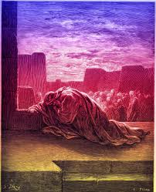
Ezra’s Prayer (9:6-15)
Begins with humility (v.6)
Confession of sin (v.7)
God’s kindness & mercy (v.8)
Purpose of Freedom: build temple (9)
Acknowledged Peoples’ failure (v.10)
God warned of the danger (v.11)
God commanded separateness (v.12)
Not punished as sins deserve [mercy] (v.13)
If break commands, there will be no remnant (v.14)
God is just, no one is righteous (v.15)
Great leaders identify with the peoples’ sin & plead for God’s help to recover

Slide 14
Finding a Solution (Ezra 10)
Ezra’s sincerity, commitment & example cause others to join (v.1)
Before the house of God: Note Solomon’s prayer in 1Kgs 8:30,35 “when they pray toward this place”
People wept bitterly: Not a sign of weakness, but a part of confession & true repentance
Shecaniah (v.2): his Dad (Jehiel) has a foreign wife (v.26), but he’s still willing to deal with the problem
There is hope: he knew about God’s great mercy when there is true repentance
Ezra’s leadership caused Shecaniah to rise to the occasion

Slide 15

Solution: Divorce the foreign wives who were not committed to Yahweh
Put away (v.3): same Hebrew word as in Deut 24:2
  Some Christadelphians claim these men only “lived with” these foreign women, but did not marry them or divorce them
  However, these foreign women were taken as wives in Ezra 9:2 (compare Deut 7:3; Gen 34:9) & as acknowledged by Ezra in 9:12 – that’s why the solution was so difficult to implement
Wives & their children = wives & children who still lived as foreigners (worshipped idols)
  In Neh 13:24, where this occurs again, the children did not know the Hebrew language
  Maybe this became a test of the commitment of the foreign wives to Yahweh
Note: this was not a simple solution of demanding every foreign wife be divorced.
  Some foreigners had joined Israel & participated in the Passover back in Ezra 6:21
  This was a selective process & took 3 months to implement
Good solutions take time and involve examining each case

Slide 16
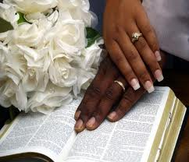
Paul’s marriage counsel in 1 Corinthians 7
v.12-14 If an unbeliever is willing to stay, then give it a try. Who knows, maybe the unbeliever will be won over to God.
v.15 If an unbeliever departs (not interested), let them go. God has called us to peace! (note: this only works if the believer is walking with God!
There wouldn’t be peace if an unbelieving spouse taught our children another language and how to worship another god!

Slide 17
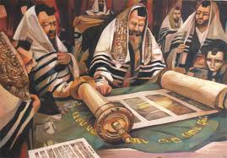
Principles Involved in the Law used by Ezra:
1) Separate ourselves to God – “be you hold”: don’t marry unbelievers: (Deut 7:1-5)
2) Marriage should be for life (Gen 2:24, Mat 19:8) Divorce was permitted (Deut 24:2), but not the Divine ideal! “for the hardness of your hearts” (Mat 19:8)
3) God wants us to raise Godly children, so he “hates divorce” (Mal 2:15) – but these families were not Godly & not raising Godly children!
The challenge of living the Truth is to weigh up all the principles, and then prayerfully choose a pathway that attempts to faithfully follow God’s way!

Slide 18
Malachi 2:13-16
13 And this is the second thing you do: you cover the altar of the LORD with tears, with weeping and crying; so He does not regard the offering anymore, nor receive it with goodwill from your hands.
14 Yet you say, "For what reason?" Because the LORD has been witness between you and the wife of your youth, with whom you have dealt treacherously; yet she is your companion and your wife by covenant.
15 But did He not make them one, having a remnant of the Spirit? And why one? He seeks godly offspring. Therefore take heed to your spirit, and let none deal treacherously with the wife of his youth.
16 "For the LORD God of Israel says that He hates divorce, for it covers one's garment with violence," says the LORD of hosts. "Therefore take heed to your spirit, that you do not deal treacherously."
Marriage was designed to teach us Godly principles and help us raise Godly children

Slide 19
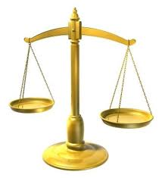
Marriage Relationship is not always the primary Issue
1) Master/slave relationship rated higher than a marriage relationship (Ex 21:1-11)
2) Marriage to ungodly unbelievers who brought evil practices into the family (Ezra 10:11, 19, 44; Neh 13:23-27)
3) Converts to Christ whose spouses desired to leave the marriage. Converts were “not under bondage” because “God has called us to peace” (1 Cor 7:12-16)
When Biblical principles conflict, we have to wisely rank them according to God’s ways

Slide 20

Conflicting Principles in the Bible:
We have to make a choice!
Sabbath OR Circumcision on 8th day
Sabbath OR Priests’ daily temple work
Showbread rules OR David’s men need food
Marriage for life OR Separateness to God
Gibeonites should die OR faithfulness to covenant
These are the issues that help us learn to live like God

Slide 21

Weighing the Issues in Ezra
Divorce was secondary
Unbeliever marriage was primary
Rigid rules don’t always produce wise solutions

Slide 22

Conflicting principles in Christ
We have to make a choice!
Use freedom to eat meat offered to idols
OR
Try not to cause others to sin
Exercise liberties we have in Christ
OR
Through love serve one another
Carry out judgments against one another
Extend God’s mercy to others
OR
The choices we make reveal our understanding of God’s character

Slide 23
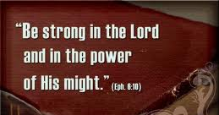
Solution is implemented
“Be courageous (strong) & do it” (10:4) from 1Chr 28:10 David to Solomon
Ezra made them swear on oath (v.5)
  Asa (2 Chr 15:12-14)
  Hezekiah (2 Chr 29:10)
  Josiah (2 Chr 34:31-32)
  Nehemiah (Neh 5:12 restore land, no interest)
  10:29 (put away foreign wives)
Chamber (v.6): in side of temple (1Kgs 6:5)
  Eliashib = high priest in Neh 3:1
  No bread or water: Ezra willing to make personal sacrifices for the sake of the community
Within 3 days (v.8): no one lived more than 3 away
  Note: Ezra’s authority & willingness to disfellowship
9th month, 20th day: 4.5 months after Ezra’s arrival in Jerusalem (7:9)
  Open square = temple court
  Heavy rain: possible drought before this? (see Hag 1:10)
Go forward, trusting God

Slide 24
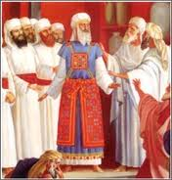
The Result: 113 divorced families
Took 90 days (v.16): didn’t rush thru in 1 week
  Note: no women married foreign men
Total in the list: 113 men
  4 of High priest’s family
  13 of other priests
  10 Levites
  86 common Israelites
Indicates problem was spread through community, but very many affected
  Low percentage of men – only 0.3%
  Much lower than our community today
  27 priests & Levites: Leaders were the worst offenders!
Maybe Ezra’s reaction was based on the failure of the Leaders

Slide 25

Ezra’s success based on:
1) Admitted the problem existed
2) Identified with the people: “our iniquities”
3) Prayed to God for help
4) Let people develop a solution
It was not Ezra’s mandate
5) Got most people to agree with plan
6) Took the time to examine each case.
Did not mandate blanket rule!
This problem & solution is in the Bible to help us today

Slide 26

As we return home…
Remember:
Grandpas & Grandmas, Dads & Moms, Aunts & Uncles, AB’s, S.S. teachers, CYC leaders…
You set the standards for your families & ecclesias. So pray for God’s wisdom! Study & then do it!
Look to the future! Make tough decisions today for sake of your children and grandchildren, so you can leave them a Godly inheritance!
Pray for God’s help & blessing: Unless the Lord builds the house we labor in vain (Psa 127:1)
“I have no greater joy than to hear that my children are walking in the truth” (3 Jn 4 NIV)

Slide 27
Hebrews 13:20-21 (RSV)
20 Now may the God of peace who brought again from the dead our Lord Jesus, the great shepherd of the sheep, by the blood of the eternal covenant,
21 equip you with everything good that you may do his will, working in you that which is pleasing in his sight, through Jesus Christ; to whom be glory for ever and ever. Amen.

Slide 29
2
17
G

Slide 30
1
5
G

Slide 31
2
S
G

