Slide 1
Life of Christ Studies
The majestic arrival of our Saviour
Mary gives birth in a dirty barn

Slide 2
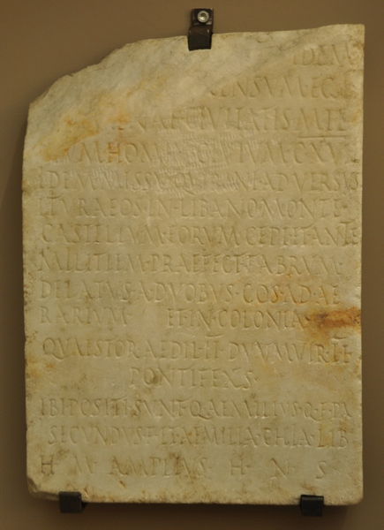
“Quintus Aemilius Secundus, from Palatine, with honors he was decorated in the camp of Divine Augustus under Publius Sulpicius Quirinius legate of Caesar in Syria, prefect of the first Augustan cohort, prefect of the navy’s second cohort. Commanded by Quirinius to conduct a census of the district of Apamea’s 117,000 citizens; He was also sent by Quirinius to capture the fortresses of the Itureans in the mountains of Lebanon.

Slide 3
Act 5:37 After this man rose up Judas of Galilee in the days of the taxing, and drew away much people after him: he also perished; and all, even as many as obeyed him, were dispersed.

Slide 4
Birth timeline of Christ
Date | Event | Scripture
June 6 BC (course of Abia) | John Conceived | Lk 1:5,26
Dec 6 BC | Angel appears to Mary | Lk 1:36
March 5 BC | John Born | Lk 1:57
Sept 5 BC | Jesus Born | Lk 2:7
March 4 BC | Herod Dies | Matt 2:19
3 BC
2 BC
1 BC
1 AD
2 AD
3 AD
4 AD
5 AD
6 AD | Quirinius Governor of Syria

Slide 5
Luke 22:11 And ye shall say unto the goodman of the house, The Master saith unto thee, Where is the guestchamber, where I shall eat the passover with my disciples?

Slide 6
Covenant of Salt
Eze 16:4 And as for thy nativity, in the day thou wast born thy navel was not cut, neither wast thou washed in water to supple thee; thou wast not salted at all, nor swaddled at all.
Lev 2:13 And every oblation of thy meat offering shalt thou season with salt; neither shalt thou suffer the salt of the covenant of thy God to be lacking from thy meat offering: with all thine offerings thou shalt offer salt.
Mark 9:49 For every one shall be salted with fire, and every sacrifice shall be salted with salt.

Slide 7
Covenant of Salt
Num 18:19 All the heave offerings of the holy things, which the children of Israel offer unto the LORD, have I given thee, and thy sons and thy daughters with thee, by a statute for ever: it is a covenant of salt for ever before the LORD unto thee and to thy seed with thee.
2Ch 13:5 Ought ye not to know that the LORD God of Israel gave the kingdom over Israel to David for ever, even to him and to his sons by a covenant of salt?

Slide 8
Parable of the Graveclothes
John 11:43 And when he thus had spoken, he cried with a loud voice, Lazarus, come forth.
John 11:44 And he that was dead came forth, bound hand and foot with graveclothes: and his face was bound about with a napkin. Jesus saith unto them, Loose him, and let him go.

Slide 9
Luke 2:9 And, lo, the angel of the Lord came upon them, and the glory of the Lord shone round about them: and they were sore afraid. | Isa 9:2 The people who walked in darkness have seen a great light; those who dwelt in a land of deep darkness, on them has light shone.
Luke 2:10 And the angel said unto them, Fear not: for, behold, I bring you good tidings of great joy, which shall be to all people. | Isa 9:3 You have multiplied the nation; you have increased its joy; they rejoice before you as with joy at the harvest, as they are glad when they divide the spoil.
Luke 2:11 For unto you is born this day in the city of David a Saviour, which is Christ the Lord. | Isa 9:6 For to us a child is born, to us a son is given; and the government shall be upon his shoulder, and his name shall be called Wonderful Counselor, Mighty God, Everlasting Father, Prince of Peace.
Luke 2:13 And suddenly there was with the angel a multitude of the heavenly host praising God, and saying, | Isa 9:7 Of the increase of his government and of peace there will be no end, on the throne of David and over his kingdom, to establish it and to uphold it with justice and with righteousness from this time forth and forevermore. The zeal of the LORD of hosts will do this.
Luke 2:14 Glory to God in the highest, and on earth peace, good will toward men.

Slide 10
Gal 4:4 But when the fulness of the time was come, God sent forth his Son, made of a woman, made under the law,
Gal 4:5 To redeem them that were under the law, that we might receive the adoption of sons.

Slide 11
Luke 2:23 (as it is written in the Law of the Lord, "Every male who first opens the womb shall be called holy to the Lord")
Exo 13:2 Sanctify unto me all the firstborn, whatsoever openeth the womb among the children of Israel, both of man and of beast: it is mine.
Exo 13:3 And Moses said unto the people, Remember this day, in which ye came out from Egypt,

Slide 12
A light to lighten the Gentiles, and the glory of thy people Israel.
Isa 49:6 And he said, It is a light thing that thou shouldest be my servant to raise up the tribes of Jacob, and to restore the preserved of Israel: I will also give thee for a light to the Gentiles, that thou mayest be my salvation unto the end of the earth.
Isa 25:7 And he will swallow up on this mountain the covering that is cast over all peoples, the veil that is spread over all nations.

Slide 13
A light to lighten the Gentiles, and the glory of thy people Israel.
Exo 29:43 And there I will meet with the children of Israel, and the tabernacle shall be sanctified by my glory.
1Sam 4:21 And she named the child Ichabod, saying, The glory is departed from Israel: because the ark of God was taken, and because of her father in law and her husband.
Eze 9:3 And the glory of the God of Israel was gone up from the cherub, whereupon he was, to the threshold of the house. And he called to the man clothed with linen, which had the writer's inkhorn by his side;

Slide 14
1Co 1:18 For the preaching of the cross is to them that perish foolishness; but unto us which are saved it is the power of God.
1Co 1:23 But we preach Christ crucified, unto the Jews a stumblingblock, and unto the Greeks foolishness;
1Co 1:24 But unto them which are called, both Jews and Greeks, Christ the power of God, and the wisdom of God.

