Slide 1
Life of Christ Studies
A visit from the Magi

Slide 2
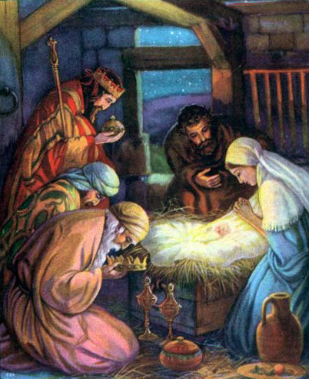

Slide 3
Magi in the OT
YLT - Jer 39:3 And come in do all the heads of the king of Babylon, and they sit at the middle gate, Nergal-Sharezer, Samgar-Nebo, Sarsechim, chief of the eunuchs, Nergal-Sharezer, chief of the Mages, and all the rest of the heads of the king of Babylon.

Slide 4
Christ the true leader
Joh 13:3 Jesus knowing that the Father had given all things into his hands, and that he was come from God, and went to God;
Joh 13:4 He riseth from supper, and laid aside his garments; and took a towel, and girded himself.
Joh 13:5 After that he poureth water into a bason, and began to wash the disciples' feet, and to wipe them with the towel wherewith he was girded.

Slide 5
Num 24:17 I shall see him, but not now: I shall behold him, but not nigh: there shall come a Star out of Jacob, and a Sceptre shall rise out of Israel, and shall smite the corners of Moab, and destroy all the children of Sheth.
Num 24:18 And Edom shall be a possession, Seir also shall be a possession for his enemies; and Israel shall do valiantly.
Num 24:19 Out of Jacob shall come he that shall have dominion, and shall destroy him that remaineth of the city.

Slide 6
Luk 2:39 And when they had performed all things according to the law of the Lord, they returned into Galilee, to their own city Nazareth.

Slide 7
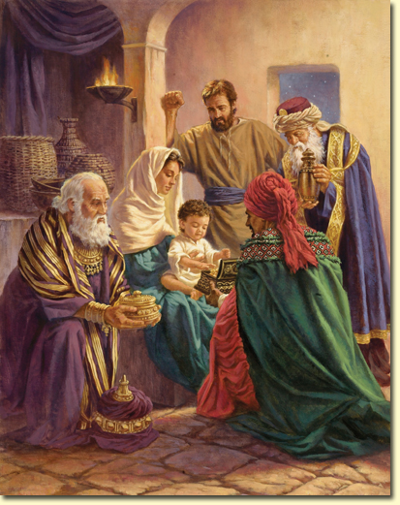

Slide 8
Gifts from the Magi
GIFT | BIBLICAL REFERENCES | MEANING
Gold | Chief of all the metals Used to represent the greatest kingdom Psa 72:15 Nations will again bring Gold to Christ the King | Kingly Aspect
Frankincense | Used Extensively in the service of the Priests Chef Ingredient of the incense Added to Sacrifices – but NOT the sin offering (Lev 5:11) | Priestly Aspect
Myrrh | Whilst used in anointing oil – every other OT reference it to do with perfume and smell In the NT it is liked with death: Mark 15:23 part of the drink they gave on the cross John 19:39 main ingredient in spices used to anoint his body | Mortal Aspect
Heb 4:15 For we do not have a high priest who is unable to sympathize with our weaknesses, but one who in every respect has been tempted as we are, yet without sin.

Slide 9
King Priest Characteristics
The King is to be Just and Righteous
2 Sam 23:3 The God of Israel said, the Rock of Israel spake to me, He that ruleth over men must be just, ruling in the fear of God.
The Priest is Compassionate and Merciful
Heb 5:1 For every high priest taken from among men is ordained for men in things pertaining to God, that he may offer both gifts and sacrifices for sins:
Heb 5:2 Who can have compassion on the ignorant, and on them that are out of the way; for that he himself also is compassed with infirmity.

Slide 10
Hos 11:1 When Israel was a child, I loved him, and out of Egypt I called my son.
The more they were called, the more they went away; they kept sacrificing to the Baals and burning offerings to idols.
Yet it was I who taught Ephraim to walk; I took them up by their arms, but they did not know that I healed them.
I led them with cords of kindness, with the bands of love, and I became to them as one who eases the yoke on their jaws, and I bent down to them and fed them.
……..
Hos 11:7 My people are bent on turning away from me, and though they call out to the Most High, he shall not raise them up at all.
How can I give you up, O Ephraim? How can I hand you over, O Israel? How can I make you like Admah? How can I treat you like Zeboiim? My heart recoils within me; my compassion grows warm and tender.
I will not execute my burning anger; I will not again destroy Ephraim; for I am God and not a man, the Holy One in your midst, and I will not come in wrath.
They shall go after the LORD; he will roar like a lion; when he roars, his children shall come trembling from the west;
they shall come trembling like birds from Egypt, and like doves from the land of Assyria, and I will return them to their homes, declares the LORD.
Ephraim has surrounded me with lies, and the house of Israel with deceit, but Judah still walks with God and is faithful to the Holy One.

Slide 11
Exo 4:22 And thou shalt say unto Pharaoh, Thus saith the LORD, Israel is my son, even my firstborn:
Exo 4:23 And I say unto thee, Let my son go, that he may serve me: and if thou refuse to let him go, behold, I will slay thy son, even thy firstborn.

Slide 12
Weeping in Ramah
Jer 40:1 The word that came to Jeremiah from the LORD after Nebuzaradan the captain of the guard had let him go from Ramah, when he took him bound in chains along with all the captives of Jerusalem and Judah who were being exiled to Babylon.

Slide 13
He shall be called a Nazarene
Psa 22:6-8 But I am a worm, and no man; a reproach of men, and despised of the people.
All they that see me laugh me to scorn: they shoot out the lip, they shake the head, saying,
He trusted on the LORD that he would deliver him: let him deliver him, seeing he delighted in him.
Psa 69:7-12 Because for thy sake I have borne reproach; shame hath covered my face.
I am become a stranger unto my brethren, and an alien unto my mother's children.
For the zeal of thine house hath eaten me up; and the reproaches of them that reproached thee are fallen upon me.
When I wept, and chastened my soul with fasting, that was to my reproach.
I made sackcloth also my garment; and I became a proverb to them.
They that sit in the gate speak against me; and I was the song of the drunkards.

Slide 14
He shall be called a Nazarene
Isa 49:7 Thus saith the LORD, the Redeemer of Israel, and his Holy One, to him whom man despiseth, to him whom the nation abhorreth, to a servant of rulers, Kings shall see and arise, princes also shall worship, because of the LORD that is faithful, and the Holy One of Israel, and he shall choose thee.
Isa 53:1-3 Who hath believed our report? and to whom is the arm of the LORD revealed?
For he shall grow up before him as a tender plant, and as a root out of a dry ground: he hath no form nor comeliness; and when we shall see him, there is no beauty that we should desire him.
He is despised and rejected of men; a man of sorrows, and acquainted with grief: and we hid as it were our faces from him; he was despised, and we esteemed him not.

