Slide 1
Who Hath Despised the
Day of Small Things?
Class 1:
A Call to Return Home

Slide 2
Classes This Week
A Call to Return Home
Consider Your Ways
The Day of Small Things
Let Us Rise Up and Build
You, O Priests, That Despise My Name
Living Now in the Day of Small Things

Slide 3
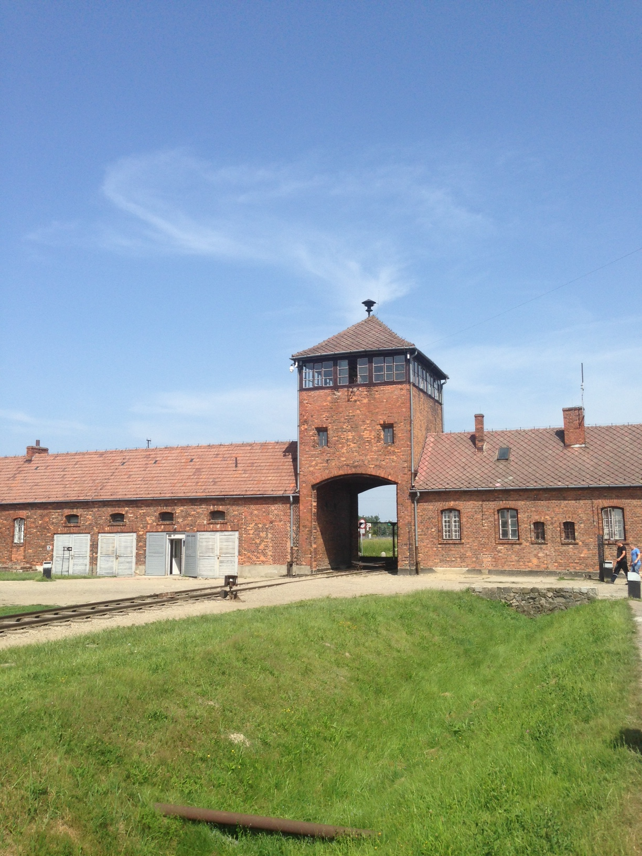
“Those who cannot remember the past are condemned to repeat it.”
George Santayana

Slide 4
Hearts weighed down
“Be careful, or your hearts will be weighed down with carousing, drunkenness and the anxieties of life, and that day will close on you suddenly like a trap. For it will come on all those who live on the face of the whole earth. Be always on the watch, and pray that you may be able to escape all that is about to happen, and that you may be able to stand before the Son of Man.”
Luke 21:34-36 NIV

Slide 5
Lost in Lust, lost in faith
“Knowing this first, that there shall come in the last days scoffers, walking after their own lusts, And saying, Where is the promise of his coming? for since the fathers fell asleep, all things continue as they were from the beginning of the creation.
2 Peter 3:3-4

Slide 6
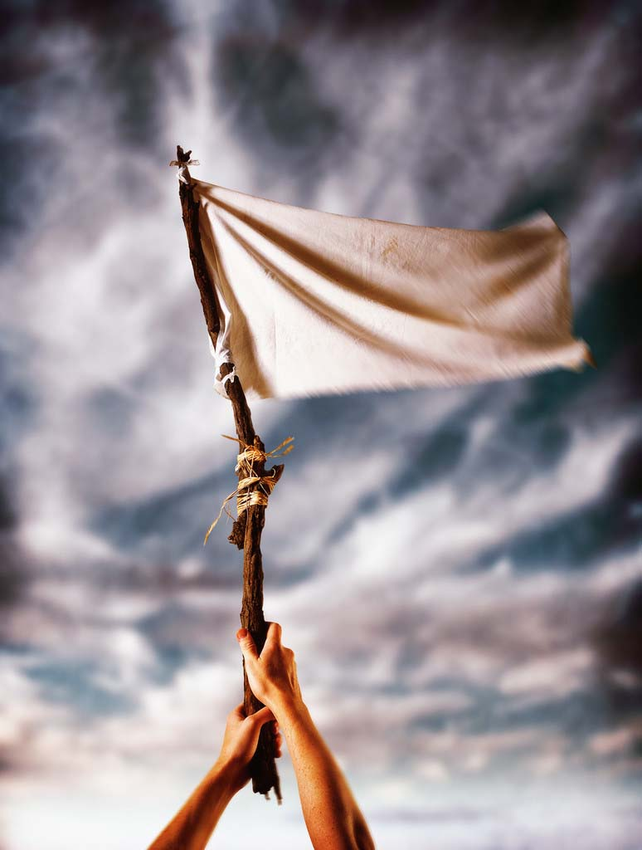
Are last day prophecies about decay of believers intended to be understood as the christadelphian body?

Slide 7
Why the study of the second temple?
They were awaiting the Messiah and were struggling with ecclesial life.
Many were “comfortable” in Babylon and many decided to tarry.
When Temple was rebuilt, it didn’t measure up to standard of Solomon’s Temple and some were disillusioned.
For many, self-examination was broken.
They struggled to deal with decay and apathy.
Their leadership had failed in their calling.
So, what can we learn now from these stories of reform?

Slide 8
The Three Temples
Solomon’s Temple
957-587 B.C.
Zerubbabel’s Temple
516 B.C. – 19 B.C.
Herod’s Temple
19 B.C. – 70 A.D.

Slide 9
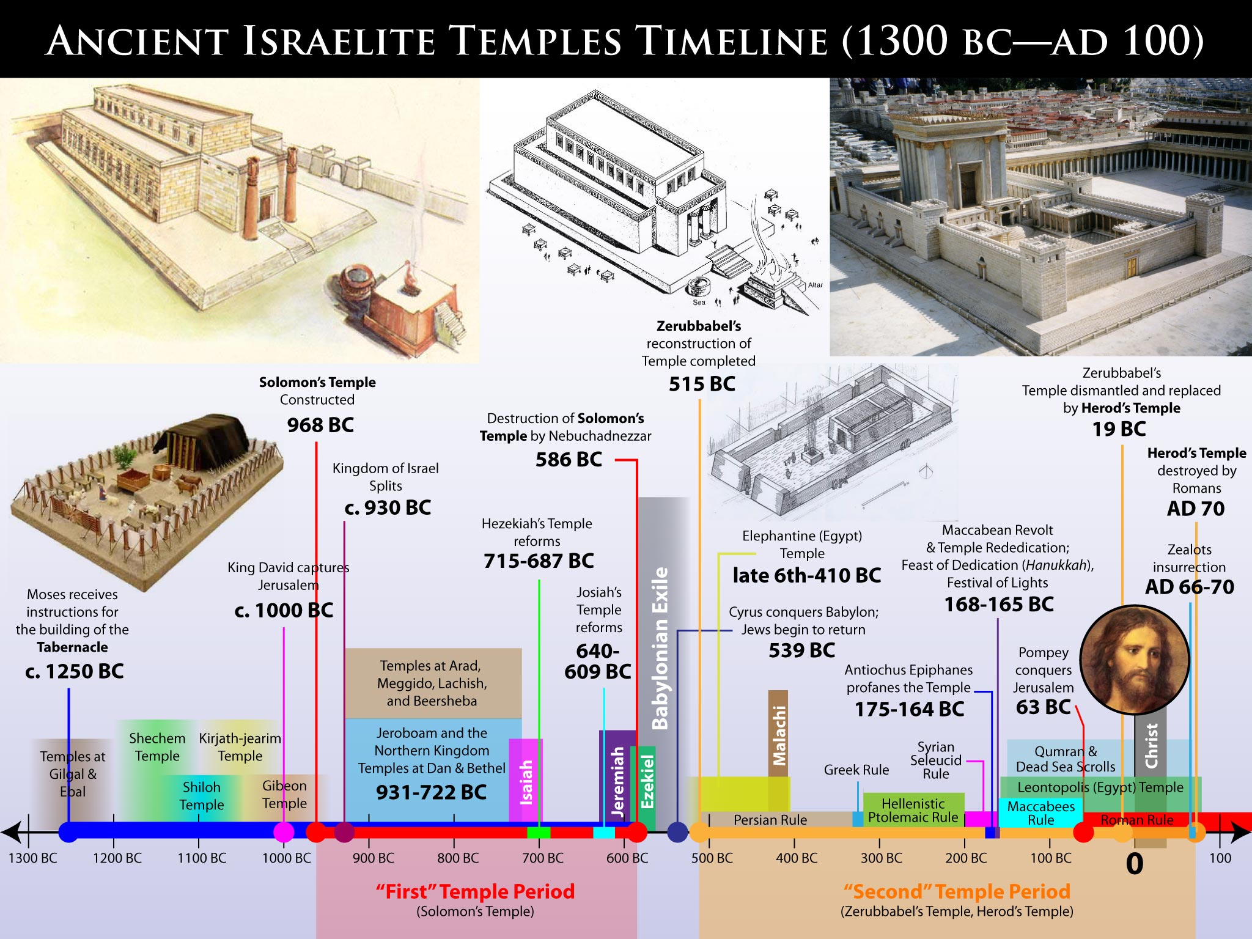

Slide 10
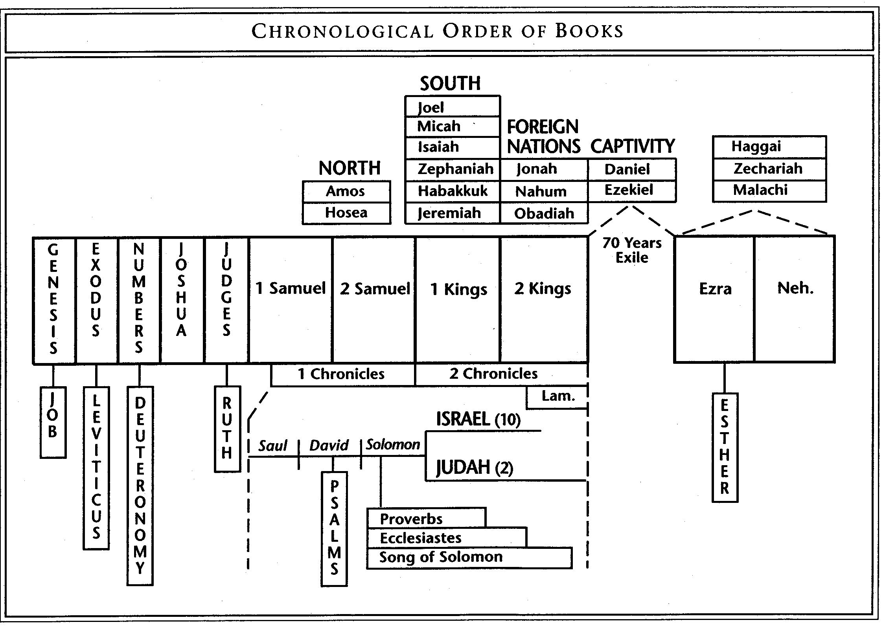

Slide 11
Another Way of thinking of this period
2 Chronicles, Jeremiah, Daniel, Ezekiel – prophecies dealing with the return and rebuild of Jerusalem.
Ezra, Nehemiah – The actual work to rebuild.
Haggai, Zechariah, Malachi – exhortations to the people about the work and their spiritual readiness.

Slide 12
Timeline – Bro. Michael Ashton, The Exiles Return - 1992
70 Years Serving Babylon (Jeremiah 25:11)
70 Years Desolation of Temple
Remaining Work
713 - Sennacherib carries 200,000 captives to Assyria
598 - Nebuchadnezzar carries away Jehoiachin, 10,000 captives, Temple treasures
587 – Temple burned, Jerusalem population taken into captivity
536 – Cyrus decrees exiles can return. Altar built, sacrifices start under Zerubbabel/Joshua
535 – Temple foundation laid, work ceases under duress
520 – Under Darius, work resumes
516 – Temple finished, desolation ends
486 – Book of Esther
458 – Ezra returns
444 – Nehemiah returns
432 - Nehemiah recalled by Artaxerxes
Nehemiah returns to Jerusalem

Slide 13
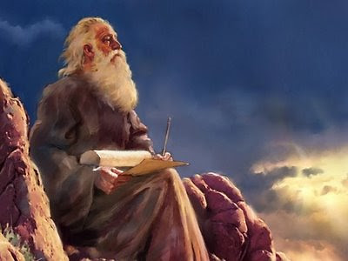
Isaiah 1-6 – condition of israel
Fleshly pride.
Lack of self-examination.
Inadequate spiritual leadership.

Slide 14
Stipulation | References
General References to the Covenant being broken | Jer. 11:1-8
1st Commandment - No other gods (Exod. 20:3) | Jer. 1:16; 7:9; 9:14; 10:13, 17; 13:10; 16:10-13; 17:1-4; 19:1-4, 13; 22:8-9; 25:4-7; 32:26-29; 44:1-6; Zeph. 1:4-9
2nd Commandment - No idols (Exod. 20:4-6) | Jer. 1:16; 2:1-3:6, 23-25; 5:7, 19; 7:6, 9, 17-19, 30; 11:9-13; 16:18; 18:15; 25:4-7; 32:34-35; Ezek. 5:8-9; 6:1-7, 11-14; Ezek. 16:35-36; 22:9; 36:17-19
3rd Commandment - No blasphemy (Exod. 20:7) | Jer. 5:1-2; 7:9; Ezek. 20:27
4th Commandment - Sabbath (Exod. 20:8-11) | Jer. 17:19-27; Ezek. 22:8, 26; Neh. 13:9-18
5th Commandment - Honour parents (Exod. 20:12) | Ezek. 22:7
6th Commandment - Murder (Exod. 20:13) | Jer. 7:9; Ezek. 22:9; 36:17-19
7th Commandment - Adultery (Exod. 20:14) | Jer. 5:7-9; 7:9; Ezek. 22:11
8th Commandment - Theft (Exod. 20:15) | Jer. 7:9
9th Commandment - False testimony (Exod. 20:16) | Jer. 7:9; Ezek. 22:9
10th Commandment - Covetousness (Exod. 20:17) | Micah 2:2-5
Human sacrifices (Deut. 12:31) | Jer. 7:31; 19:5; 32:35; Ezek. 16:20-22, 35-36; 20:31
False Prophecy | Jer. 23:9-39
Mistreating the fatherless, the alien and the widow (Exod. 22:21-24; Deut. 27:19) | Isa. 10:1-4; Jer. 5:28; 7:6; Ezek. 22:7, 29
Bribery (Exod. 23:8; Deut. 16:19) | Ezek. 22:12; Micah 3:11-12
Consulting the dead (Deut. 18:11) | Isa. 65:4
Eating unclean meats (Lev. 11:7-8) | Isa. 65:4

Slide 15
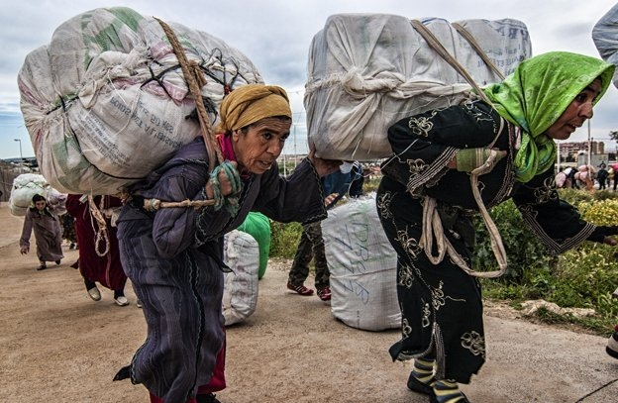
Spiritual Collapse
“Ah sinful nation, a people laden with iniquity, a seed of evildoers, children that are corrupters: they have forsaken the Lord, they have provoked the Holy One of Israel unto anger, they are gone away backward.”
Isaiah 1:4

Slide 16
As Sodom and gomorrah
“I have seen also in the prophets of Jerusalem an horrible thing: they commit adultery, and walk in lies: they strengthen also the hands of evildoers, that none doth return from his wickedness; they are all of them unto me as Sodom, and the inhabitants thereof as Gomorrah.”
Jeremiah 23:14
Not only were the prophets of Isaiah’s day contemptible, but they enabled sin and failed to turn the flock to repentance.

Slide 17
The Prophecy of Isaiah
Affluence/
Arrogance
Apathy
Apostasy
Reformation
If we agree that across our fellowship we see threats 1&2 greatly increasing, should we now be on guard for step 3 as the next major threat?

Slide 18
Conditions for Israel
“But it shall come to pass, if thou wilt not hearken unto the voice of the Lord thy God, to observe to do all his commandments and his statutes which I command thee this day; that all these curses shall come upon thee, and overtake thee:
The Lord shall bring thee, and thy king which thou shalt set over thee, unto a nation which neither thou nor thy fathers have known; and there shalt thou serve other gods, wood and stone.
The Lord shall bring a nation against thee from far, from the end of the earth, as swift as the eagle flieth; a nation whose tongue thou shalt not understand;
And he shall besiege thee in all thy gates, until thy high and fenced walls come down, wherein thou trustedst, throughout all thy land: and he shall besiege thee in all thy gates throughout all thy land, which the Lord thy God hath given thee.”
Deuteronomy 28:15,36,49,52

Slide 19
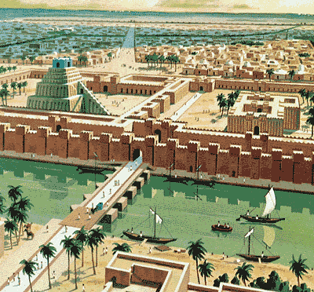
Captivity in babylon

Slide 20
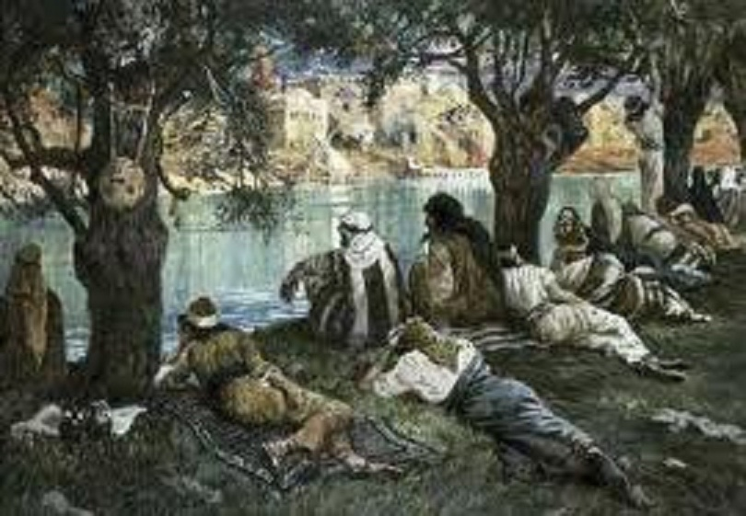
Faithful longing for zion
“By the rivers of Babylon, there we sat down, yea, we wept, when we remembered Zion. We hanged our harps upon the willows in the midst thereof. For there they that carried us away captive required of us a song; and they that wasted us required of us mirth, saying, Sing us one of the songs of Zion. How shall we sing the Lord's song in a strange land? If I forget thee, O Jerusalem, let my right hand forget her cunning. If I do not remember thee, let my tongue cleave to the roof of my mouth; if I prefer not Jerusalem above my chief joy.
Psalm 137:1-6

Slide 21
“Sent for the good”
“Thus saith the Lord, the God of Israel; Like these good figs, so will I acknowledge them that are carried away captive of Judah, whom I have sent out of this place into the land of the Chaldeans for their good. For I will set mine eyes upon them for good, and I will bring them again to this land: and I will build them, and not pull them down; and I will plant them, and not pluck them up.”
Jeremiah 23:5-6

Slide 22
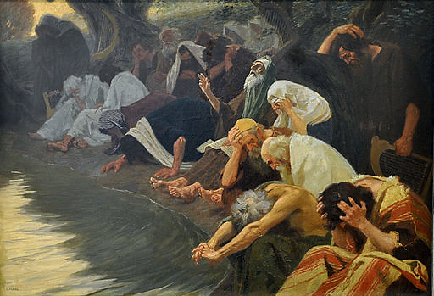
Initial Reactions to Captivity
Most were secluded, separate in camps and ghettos.
Repulsed by the godlessness and idolatry of Babylon.
Face to face with consequences of their sin.
Awareness of what has been lost.
Helped to “define and refine” as they were exposed to the utter idolatry and fleshly pride of Babylon.
Focused them on the promise of return.

Slide 23
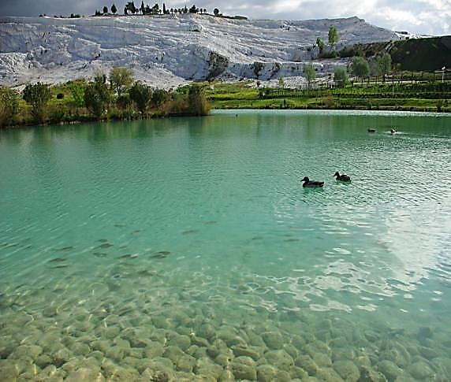
But, As Time Passed in Captivity
Jewish infrastructure established and little assimilation.
Allowed to settle by Chebar River (irrigation ditch) to build and farm.
Standard of living actually better than last years in Land, under Divine famine and ravages of foreign armies.
Became relatively free from persecution.
Allowed to maintain priests, prophets and elders.
Occupied houses and settled in to normal life.

Slide 24
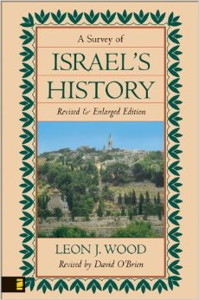
Life in Babylon – A Survey of Israel’s History – Dr. Leon Wood
Institutions maintained.
Freedom of movement.
Correspondence privileges back to Land.
Employment opportunities.
Fertile, well-watered land.

Slide 25
God Still With Them in Babylon
“Thus saith the Lord of hosts, the God of Israel, unto all that are carried away captives, whom I have caused to be carried away from Jerusalem unto Babylon; Build ye houses, and dwell in them; and plant gardens, and eat the fruit of them; Take ye wives, and beget sons and daughters; and take wives for your sons, and give your daughters to husbands, that they may bear sons and daughters; that ye may be increased there, and not diminished. And seek the peace of the city whither I have caused you to be carried away captives, and pray unto the Lord for it: for in the peace thereof shall ye have peace.”
Jeremiah 29:4-7

Slide 26
Land Restored, People Not Cast Off
“The land also shall be left of them, and shall enjoy her sabbaths, while she lieth desolate without them: and they shall accept of the punishment of their iniquity: because, even because they despised my judgments, and because their soul abhorred my statutes. And yet for all that, when they be in the land of their enemies, I will not cast them away, neither will I abhor them, to destroy them utterly, and to break my covenant with them: for I am the Lord their God. But I will for their sakes remember the covenant of their ancestors, whom I brought forth out of the land of Egypt in the sight of the heathen, that I might be their God: I am the Lord.”
Leviticus 26:43-45

Slide 27
Putting it Together
Israel was on precipice of being lost in sin.
God brought about a severe judgment on Jerusalem.
He saved many and placed them in an ideal location to change thinking and restore peaceful lives.
He put them in a land where they could retain identity.
He placed them in an idolatrous extreme to lead self-examination.
Focused them on the future and the promised return.

Slide 28
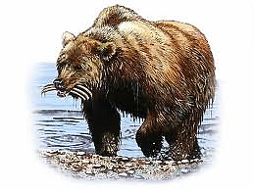
Persian “window of opportunity”

Slide 29
Jeremiah 51:11
“Make bright the arrows; gather the shields: the Lord hath raised up the spirit of the kings of the Medes: for his device is against Babylon, to destroy it; because it is the vengeance of the Lord, the vengeance of his temple.”

Slide 30
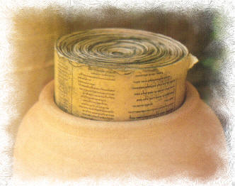
Promise to return
“Thus saith the Lord of hosts, the God of Israel; Take these evidences, this evidence of the purchase, both which is sealed, and this evidence which is open; and put them in an earthen vessel, that they may continue many days. For thus saith the Lord of hosts, the God of Israel; Houses and fields and vineyards shall be possessed again in this land.”
Jeremiah 32:14-15

Slide 31
Sound familiar?
God reveals His plan for redemption of Israel.
He reveals the nations that He will use to bring this about.
But, He doesn’t reveal all the details, He provides the outline and an understanding of the timeframe.
He asks Israel to believe in His power and the surety of His plan.
They will be able to watch the Plan unfold and take comfort in the return to the Land.
They need to be watchful and ready and not entangled in Babylon!

Slide 32
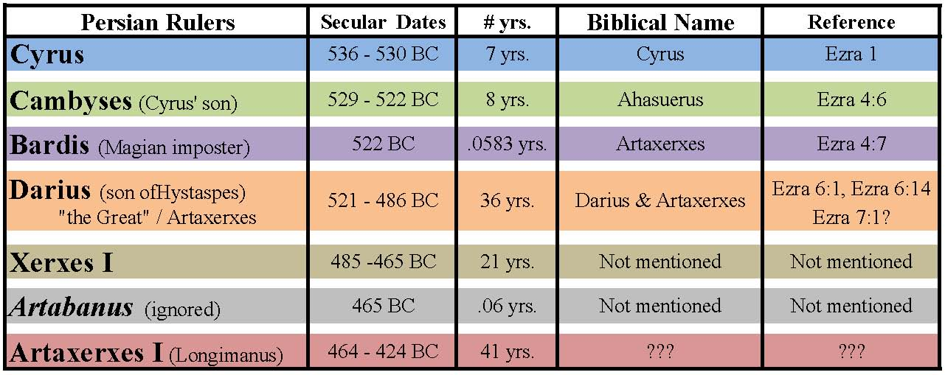
Persian Kings

Slide 33
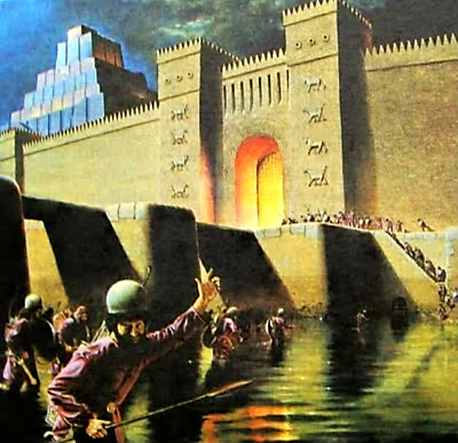
Isaiah 43:14
“Thus saith the Lord, your redeemer, the Holy One of Israel; For your sake I have sent to Babylon, and have brought down all their nobles, and the Chaldeans, whose cry is in the ships. I am the Lord, your Holy One, the creator of Israel, your King.”

Slide 34
Isaiah 44:26-28
“That confirmeth the word of his servant, and performeth the counsel of his messengers; that saith to Jerusalem, Thou shalt be inhabited; and to the cities of Judah, Ye shall be built, and I will raise up the decayed places thereof: That saith to the deep, Be dry, and I will dry up thy rivers: That saith of Cyrus, He is my shepherd, and shall perform all my pleasure: even saying to Jerusalem, Thou shalt be built; and to the temple, Thy foundation shall be laid.”
Nearly 150 years before the birth of Cyrus!

Slide 35
Isaiah 45:1-6
“Thus saith the Lord to his anointed, to Cyrus, whose right hand I have holden, to subdue nations before him; and I will loose the loins of kings, to open before him the two leaved gates; and the gates shall not be shut; I will go before thee, and make the crooked places straight: I will break in pieces the gates of brass, and cut in sunder the bars of iron: And I will give thee the treasures of darkness, and hidden riches of secret places, that thou mayest know that I, the Lord, which call thee by thy name, am the God of Israel. For Jacob my servant's sake, and Israel mine elect, I have even called thee by thy name: I have surnamed thee, though thou hast not known me. I am the Lord, and there is none else, there is no God beside me: I girded thee, though thou hast not known me: That they may know from the rising of the sun, and from the west, that there is none beside me. I am the Lord, and there is none else.”

Slide 36
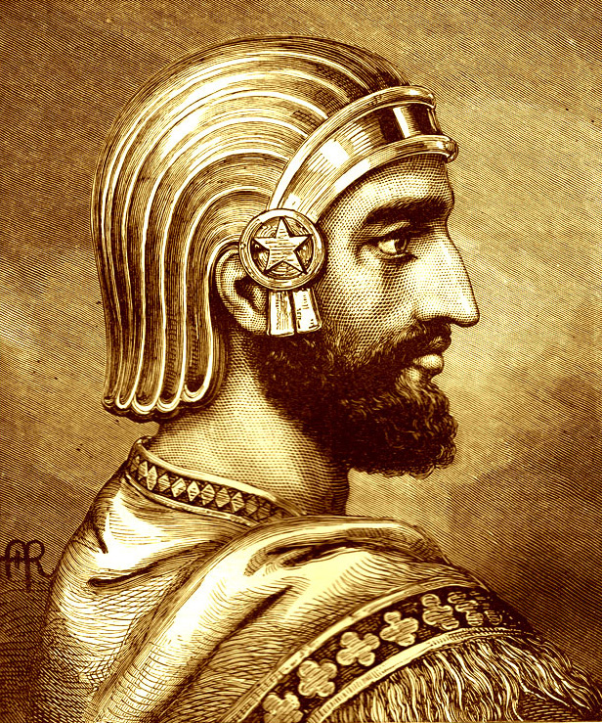
Cyrus’s conquest of babylon
He was no “God-fearing” man!
He lulled the Babylonians into inactivity during his war with Lydia, a potential ally for Babylon. Then he took maximum advantage of internal disaffection and discontent within Babylon.
With the stage thus set, the military campaign against Babylon came almost as an anticlimax.
Cyrus marched into town in the late summer of 539 BC, seized the hands of the statue of the city god Marduk as a signal of his willingness to rule as a Babylonian and not as a foreign conqueror, and was hailed by many as the legitimate successor to the throne.

Slide 37
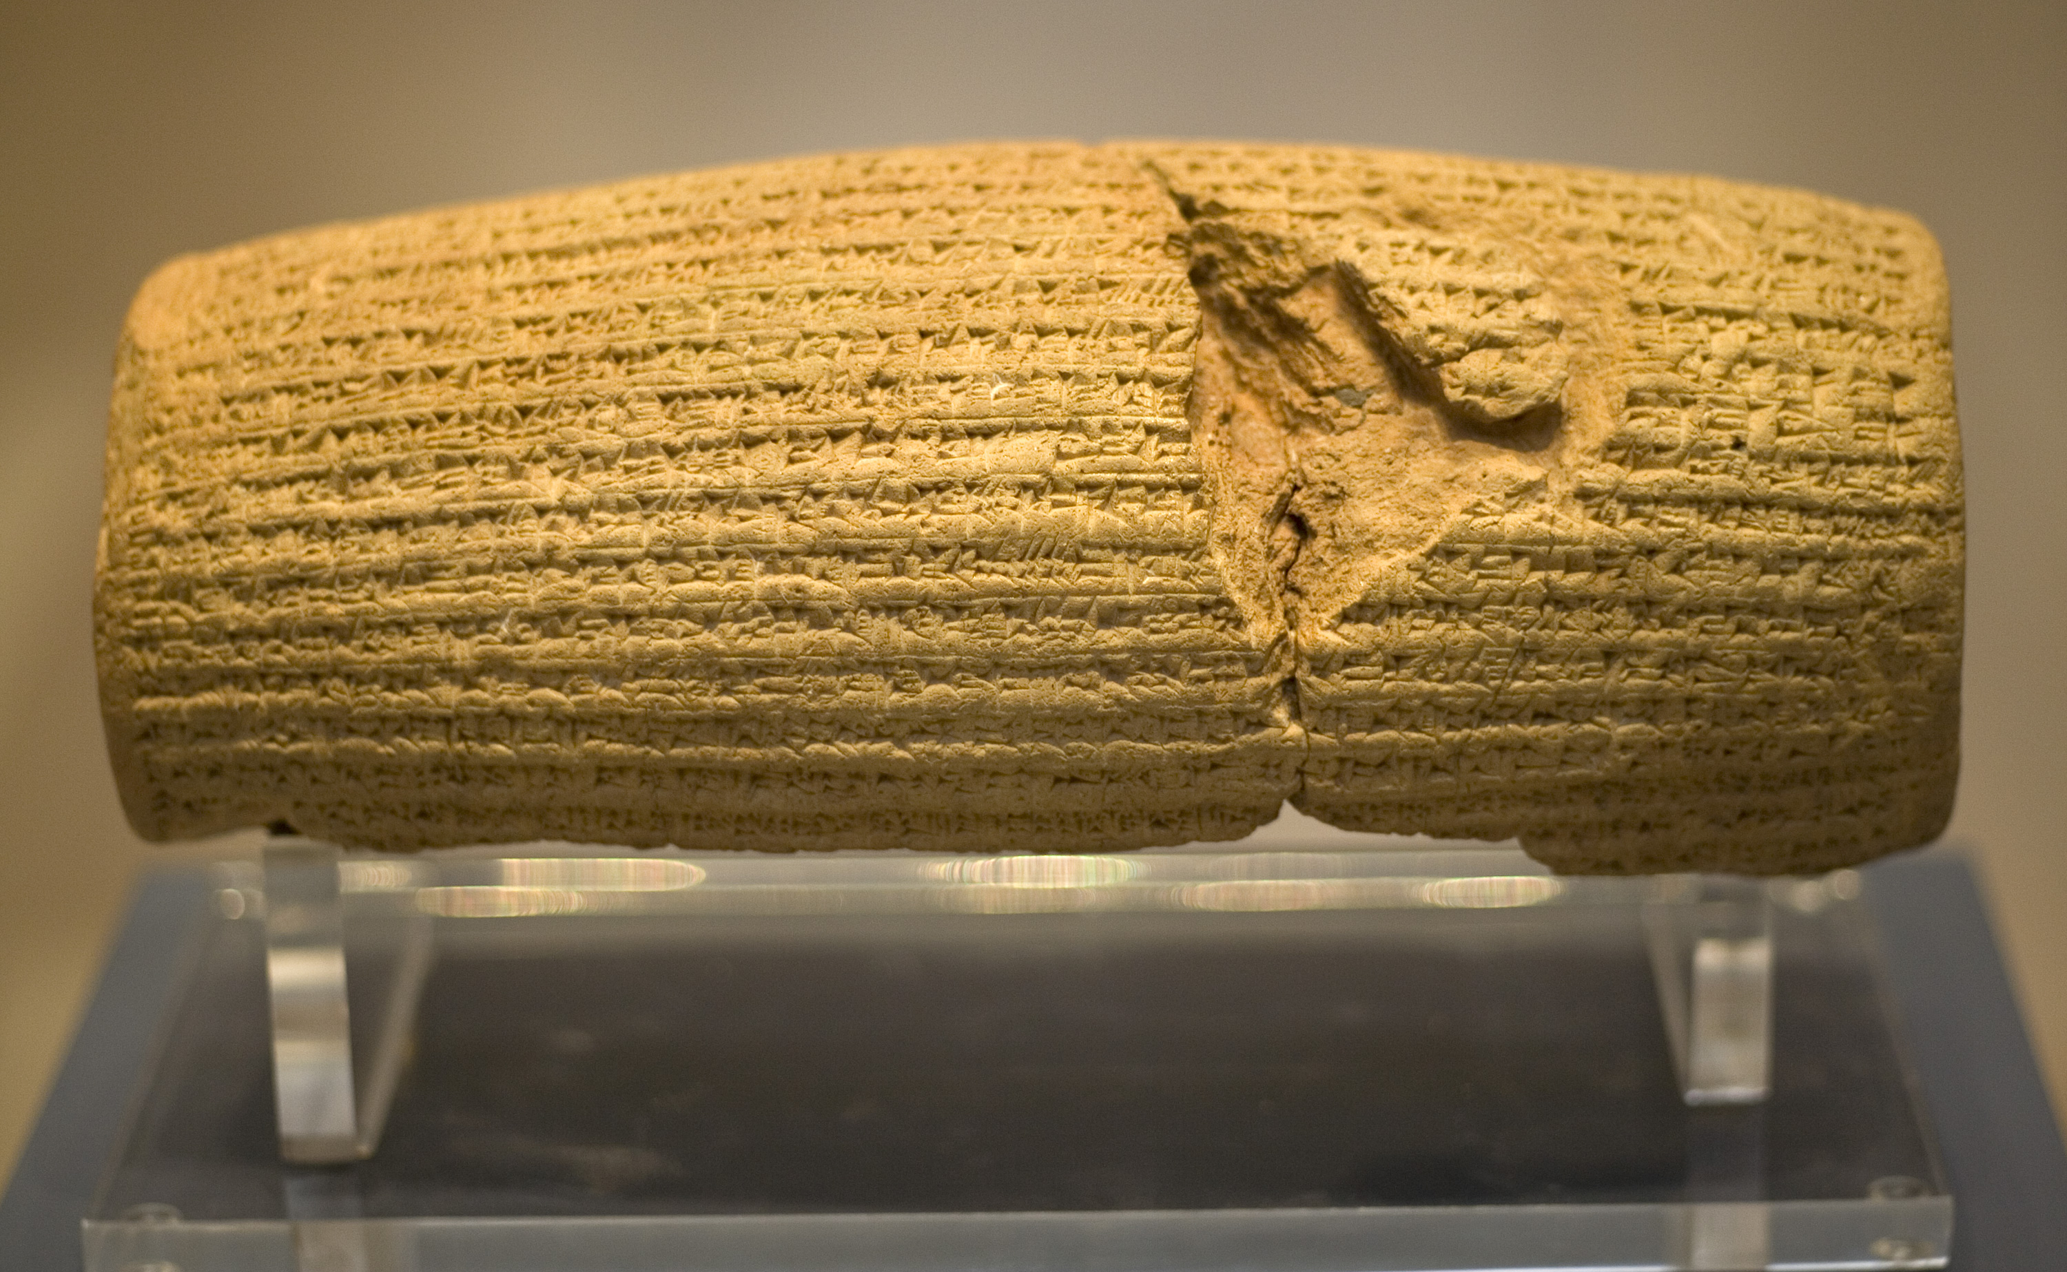
Cyrus Cylinder (539 BC)
“I announce that I will respect the traditions, customs and religions of the nations of my empire and never let any of my governors and subordinates look down on or insult them while I am alive. From now on…, I never let anyone oppress any others, and if it occurs, I will take his or her right back and penalize the oppressor.” “I will never let anyone take possession of movable and landed properties of the others by force or without compensation. While I am alive, I prevent unpaid, forced labor. Today, I announce that everyone is free to choose a religion. People are free to live in all regions and take up a job provided that they never violate other’s rights.”

Slide 38
Cyrus prophecy – approximately 537 b.c.
“Now in the first year of Cyrus king of Persia, that the word of the Lord spoken by the mouth of Jeremiah might be accomplished, the Lord stirred up the spirit of Cyrus king of Persia, that he made a proclamation throughout all his kingdom, and put it also in writing, saying, Thus saith Cyrus king of Persia, All the kingdoms of the earth hath the Lord God of heaven given me; and he hath charged me to build him an house in Jerusalem, which is in Judah. Who is there among you of all his people? The Lord his God be with him, and let him go up.”
2 Chronicles 36:22-23

Slide 39
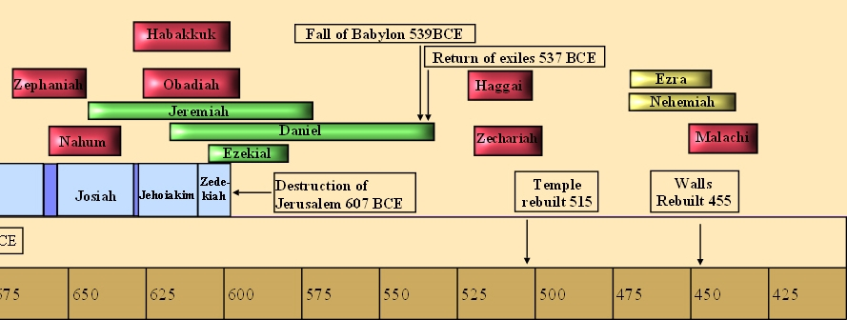
Daniel was born approximately 623 BC. At age of 90, he may have actually lived to see the return to the land, and the completion of the Temple foundation.

Slide 40
Proclamation of Cyrus
“Now in the first year of Cyrus king of Persia, that the word of the Lord by the mouth of Jeremiah might be fulfilled, the Lord stirred up the spirit of Cyrus king of Persia, that he made a proclamation throughout all his kingdom, and put it also in writing, saying, Thus saith Cyrus king of Persia, The Lord God of heaven hath given me all the kingdoms of the earth; and he hath charged me to build him an house at Jerusalem, which is in Judah. Who is there among you of all his people? his God be with him, and let him go up to Jerusalem, which is in Judah, and build the house of the Lord God of Israel, (he is the God,) which is in Jerusalem.”
Ezra 1:1-3

Slide 41
Spirit Stirred up
“Now in the first year of Cyrus king of Persia, that the word of the LORD by the mouth of Jeremiah might be fulfilled, the LORD stirred up the spirit of Cyrus…”
Ezra 1:1
“Then rose up the chief of the fathers of Judah and Benjamin, and the priests, and the Levites, with all them whose spirit God had raised, to go up to build the house of the LORD which is in Jerusalem.”
Ezra 1:5

Slide 42
Additional Details of Cyrus’s Decree
“In the first year of Cyrus the king the same Cyrus the king made a decree concerning the house of God at Jerusalem, Let the house be builded, the place where they offered sacrifices, and let the foundations thereof be strongly laid; the height thereof threescore cubits, and the breadth thereof threescore cubits; With three rows of great stones, and a row of new timber: and let the expenses be given out of the king's house: And also let the golden and silver vessels of the house of God, which Nebuchadnezzar took forth out of the temple which is at Jerusalem, and brought unto Babylon, be restored, and brought again unto the temple which is at Jerusalem, every one to his place, and place them in the house of God.”
Ezra 6:3-5

Slide 43
Psalm 126:1-4
“When the Lord turned again the captivity of Zion, we were like them that dream. Then was our mouth filled with laughter, and our tongue with singing: then said they among the heathen, The Lord hath done great things for them. The Lord hath done great things for us; whereof we are glad. Turn again our captivity, O Lord, as the streams in the south.”

Slide 44
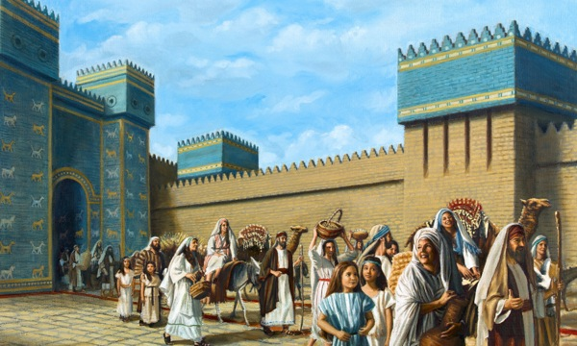
The Exiles begin to return

Slide 45
Ezra 1:5-8
“Then rose up the chief of the fathers of Judah and Benjamin, and the priests, and the Levites, with all them whose spirit God had raised, to go up to build the house of the Lord which is in Jerusalem. And all they that were about them strengthened their hands with vessels of silver, with gold, with goods, and with beasts, and with precious things, beside all that was willingly offered. Also Cyrus the king brought forth the vessels of the house of the Lord, which Nebuchadnezzar had brought forth out of Jerusalem, and had put them in the house of his gods; Even those did Cyrus king of Persia bring forth by the hand of Mithredath the treasurer, and numbered them unto Sheshbazzar, the prince of Judah.”

Slide 46
Sheshbazzar/zerubbabel
“…and numbered them unto Sheshbazzar *, the prince of Judah. All the vessels of gold and silver were five thousand and four hundred. All these did Sheshbazar bring up with them of the captivity that were brought up from Babylon unto Jerusalem.”
Ezra 1:8, 11
* Persian name given to Zerubbabel

Slide 47
Ezra 2:1-2
“Now these are the children of the province that went up out of the captivity, of those which had been carried away, whom Nebuchadnezzar the king of Babylon had carried away unto Babylon, and came again unto Jerusalem and Judah, every one unto his city; Which came with Zerubbabel: Jeshua, Nehemiah, Seraiah, Reelaiah, Mordecai, Bilshan, Mizpar, Bigvai, Rehum, Baanah. The number of the men of the people of Israel:”
Is this the same Mordecai we read of in Esther?

Slide 48
same MORDECAI?
“Now in Shushan the palace there was a certain Jew, whose name was Mordecai, the son of Jair, the son of Shimei, the son of Kish, a Benjamite; Who had been carried away from Jerusalem with the captivity which had been carried away with Jeconiah king of Judah, whom Nebuchadnezzar the king of Babylon had carried away. And he brought up Hadassah, that is, Esther, his uncle's daughter: for she had neither father nor mother, and the maid was fair and beautiful; whom Mordecai, when her father and mother were dead, took for his own daughter.”
Esther 2:5-7
Important to note this account is about lineage. It is not necessary that Mordecai was alive when he was taken (in the loins) of his fathers into captivity.

Slide 49
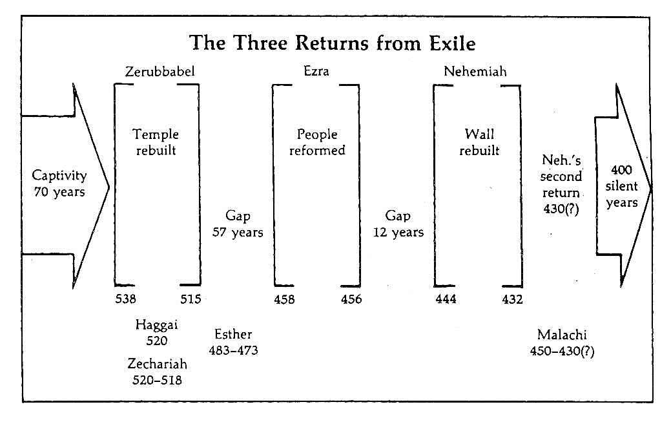

Slide 50
Age of mordecai?
Jeconiah/Jehoichin was the father of Shealtiel (born 586 BC), who was the father of Zerubbabel (Hag. 2:2). Jeconiah was 18 when he began his reign, meaning that he was born around 605 BC.
More likely, he was a contemporary of Zerubbabel (Seed of Babylon), meaning born in Babylon.
If during this time (587 BC) Mordecai was taken captive, he would have been more than 100 years old during the account of Esther. This is very unlikely.
Many scholars believe that it wasn’t Mordecai taken into captivity, but his fathers.
It is possible this is the same person, but it likely requires him to be a young man when he travels with Zerubbabel to Jerusalem, around 515 BC. So, let’s postulate he was born around 540 BC (47 years after captivity). That would make him 25 when he goes to Jerusalem and just under 50 when the story of Esther occurs.

Slide 51
a possible story?
Mordecai goes to Jerusalem as a family leader from Benjamin to begin the work in Jerusalem.
Perhaps he returns to Shushan, hearing of his niece becoming orphaned.
He returns to take care of her and raise her, not returning to the work in Jerusalem.
Yet, it is because he is in Shushan that he and Esther are there and God works His plan to save the Jewish people from the attempted genocide.
If this is so, we can see the hand of God, moving in mysterious ways, to save His people.
God always knows best!

Slide 52
List of those not found by genealogy
Ezra 2:61-63
Though many were likely from priest families, they had not retained the proper identification.
This may seem to us a small item, but I can assure you it was not.
They had lost their identity in captivity, indicating they had not been active in these roles in captivity.
The son of Koz had to marry a daughter of Barzillai the Gileadite to be called by her name and lineage.
Their priesthood was considered polluted and unable to eat of the holy things.

Slide 53
First priority – get worship right!
“And some of the chief of the fathers, when they had come to the house of the LORD which is at Jerusalem, offered freely for the house of God to set it up in his place. They gave after their ability unto the treasure of the work threescore and one thousand drams of gold, and five thousand pound of silver, and one hundred priests’ garments. So the priests and the Levites, and some of the people, and the singers, and the porters, and the Nethinims, dwelt in their cities, and all Israel in their cities.”
Ezra 2:68-70

Slide 54
Returning, But of Diffused Vision
Priests, Levites, porters, singers, Nethamin dwelt in their cities (2:70).
Quickly the vision of rebuilding Temple worship would be diverted to establishing their inheritance in land.
Build my home first!
Make me comfortable first!
Same process starts!
Affluence/
Arrogance
Apathy
Apostasy
Reformation

Slide 55
Next class
Consider Your Ways

