Slide 1
Who Hath Despised the
Day of Small Things?
Class 2:
“Consider Your Ways”

Slide 2
Outline of Ezra and Nehemiah
A party of exiles return under Zerubbabel and Joshua.
Work commences on Temple, but quickly stalls.
Haggai and Zechariah exhort people to build, but opposition causes the languishing of the work for 15 years.
Backfiring of opponents request to Darius – the work not to be hindered and Temple is completed.
60 years later, Ezra the priest comes from Babylon to find the Temple built, but spiritual conditions at a low ebb. He teaches from the Law and issues reforms, but opposition again thwarts.
Nehemiah is allowed to return to rebuild walls. With Ezra, they reinforce spiritual reform and establish a sound basis for newly settled population.

Slide 3
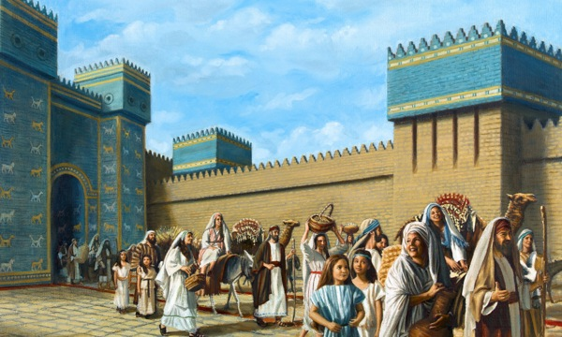
List of returnees – ezra 2
Israelites mentioned by family or place of origin.
The priests, Levites, singers, porters, Nethinim, Solomon’s servants.
Many of doubtful descent.
Unlike reentry under Joshua, they would not be permitted to “claim the land” from other people and would endure great material suffering.
Totaling 42,360 heads of household – likely 29,818 from Judah and Benjamin. Estimated 200,000 in total.

Slide 4
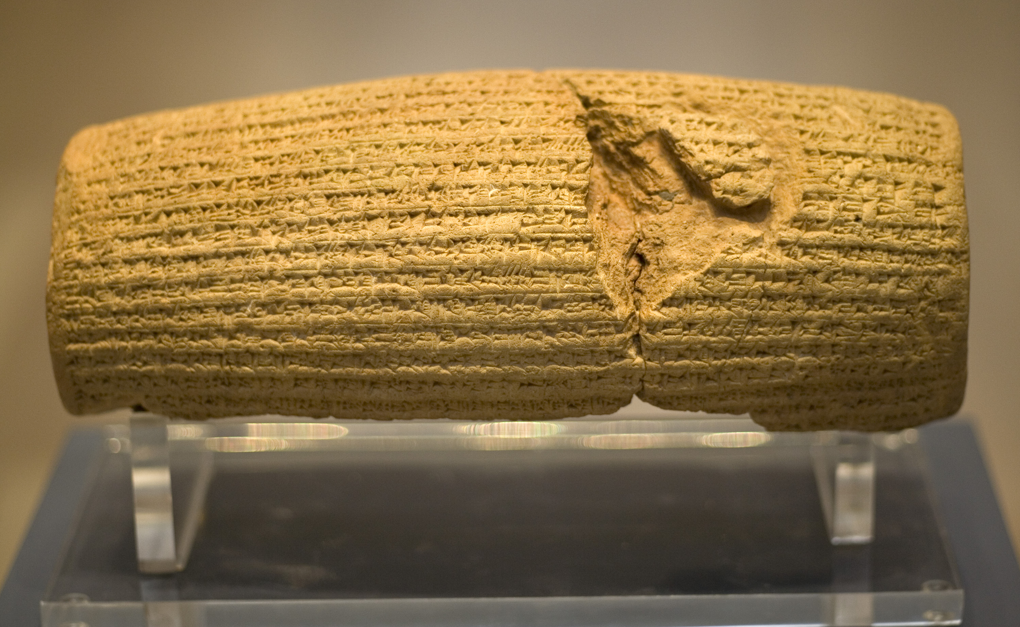
Cyrus Cylinder (539 BC)
“I announce that I will respect the traditions, customs and religions of the nations of my empire and never let any of my governors and subordinates look down on or insult them while I am alive. From now on…, I never let anyone oppress any others, and if it occurs, I will take his or her right back and penalize the oppressor.” “I will never let anyone take possession of movable and landed properties of the others by force or without compensation. While I am alive, I prevent unpaid, forced labor. Today, I announce that everyone is free to choose a religion. People are free to live in all regions and take up a job provided that they never violate other’s rights.”

Slide 5
Sheshbazzar/zerubbabel
“…and numbered them unto Sheshbazzar *, the prince of Judah. All the vessels of gold and silver were five thousand and four hundred. All these did Sheshbazar bring up with them of the captivity that were brought up from Babylon unto Jerusalem.”
Ezra 1:8, 11
* Persian name given to Zerubbabel

Slide 6
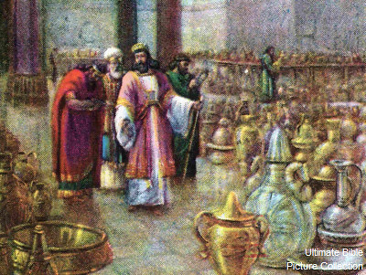
Temple Inventory Returned – 5,400 Articles
30 gold dishes
1,000 silver dishes
29 silver pans
30 gold bowls
410 matching silver bowls
1,000 other articles
Ezra 1:7-11

Slide 7
Ezra 2:1-2
“Now these are the children of the province that went up out of the captivity, of those which had been carried away, whom Nebuchadnezzar the king of Babylon had carried away unto Babylon, and came again unto Jerusalem and Judah, every one unto his city; Which came with Zerubbabel: Jeshua, Nehemiah, Seraiah, Reelaiah, Mordecai, Bilshan, Mizpar, Bigvai, Rehum, Baanah. The number of the men of the people of Israel:”
Is this the same Mordecai we read of in Esther?

Slide 8
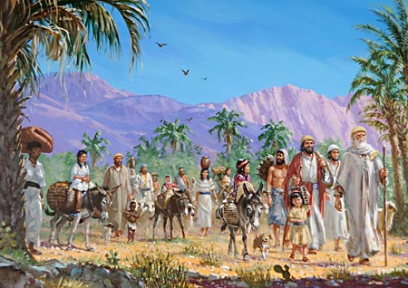
The Return – Where Did They SETTLE?
“And some of the chief of the fathers, when they came to the house of the Lord which is at Jerusalem, offered freely for the house of God to set it up in his place: They gave after their ability unto the treasure of the work threescore and one thousand drams of gold, and five thousand pound of silver, and one hundred priests' garments. So the priests, and the Levites, and some of the people, and the singers, and the porters, and the Nethinims, dwelt in their cities, and all Israel in their cities.”
Ezra 2:68-70

Slide 9
issues
While they were coming back to Jerusalem with an important mission to reestablish the Temple, they were not urgently committed to repairing the full city.
Rather than return to live in the city, they instead dwelt in the surrounding cities.
Build my home first (my inheritance) – then attend to the House of God!
This would remain a problem until the times of Nehemiah, when the city remained largely in rubble.

Slide 10
The road to reformation

Slide 11
REFORMATION BEGINS – get worship right!
“And some of the chief of the fathers, when they had come to the house of the LORD which is at Jerusalem, offered freely for the house of God to set it up in his place. They gave after their ability unto the treasure of the work threescore and one thousand drams of gold, and five thousand pound of silver, and one hundred priests’ garments. So the priests and the Levites, and some of the people, and the singers, and the porters, and the Nethinims, dwelt in their cities, and all Israel in their cities.”
Ezra 2:68-70

Slide 12
Freewill Offerings
“Then rose up the chief of the fathers of Judah and Benjamin, and the priests, and the Levites, with all them whose spirit God had raised, to go up to build the house of the Lord which is in Jerusalem. And all they that were about them strengthened their hands with vessels of silver, with gold, with goods, and with beasts, and with precious things, beside all that was willingly offered.”
Ezra 1:5-6

Slide 13
Regathering in Jerusalem AFTER 7 MONTHS
“And when the seventh month was come, and the children of Israel were in the cities, the people gathered themselves together as one man to Jerusalem. Then stood up Jeshua the son of Jozadak, and his brethren the priests, and Zerubbabel the son of Shealtiel, and his brethren, and builded the altar of the God of Israel, to offer burnt offerings thereon, as it is written in the law of Moses the man of God.”
Ezra 3:1-2

Slide 14
Zerubbabel
Mary’s Geneaology
Luke 3:27 – “Which was the son of Joanna, which was the son of Rhesa, which was the son of Zorobabel, which was the son of Salathiel, which was the son of Neri,”
Joseph’s Geneaology
Matthew 1:12-13 – “And after they were brought to Babylon, Jechonias begat Salathiel; and Salathiel begat Zorobabel; And Zorobabel begat Abiud; and Abiud begat Eliakim; and Eliakim begat Azor;”

Slide 15
Leaders for THE NEW TEMPLE
The High Priest – Jeshua
The One Who Was Qualified to Be King – Zerubbabel
Points forward to a future Temple, whose leader will be one man – Jesus Christ. He only could merge in one the Melchizedek High Priest and Kingship.

Slide 16
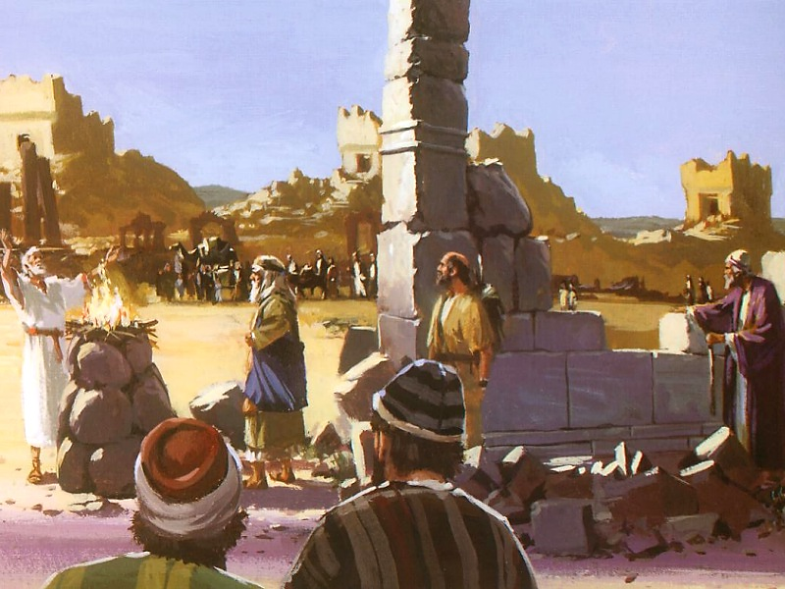
Working Despite Fear
“And they set the altar upon his bases; for fear was upon them because of the people of those countries: and they offered burnt offerings thereon unto the Lord, even burnt offerings morning and evening.”
Ezra 3:3

Slide 17
Observances Correctly Administered
“They kept also the feast of tabernacles, as it is written, and offered the daily burnt offerings by number, according to the custom, as the duty of every day required; And afterward offered the continual burnt offering, both of the new moons, and of all the set feasts of the Lord that were consecrated, and of every one that willingly offered a freewill offering unto the Lord. From the first day of the seventh month began they to offer burnt offerings unto the Lord. But the foundation of the temple of the Lord was not yet laid.”
Ezra 3:4-6
They got themselves right in worship with God before starting the work.

Slide 18
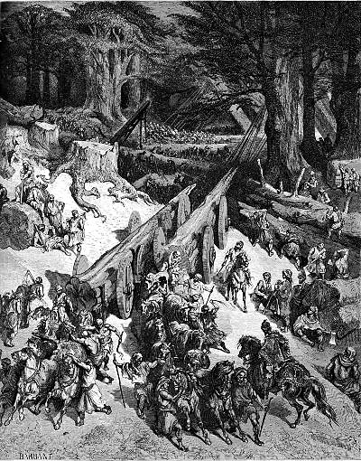
Ezra 3:7
“They gave money also unto the masons, and to the carpenters; and meat, and drink, and oil, unto them of Zidon, and to them of Tyre, to bring cedar trees from Lebanon to the sea of Joppa, according to the grant that they had of Cyrus king of Persia.”
Important note: these materials were gathered/bought by the people themselves. They were not gifts, such as Hiram gave for Solomon’s Temple. This was not missed by the Jews as the “wealth of the nations” was not part of this Temple.

Slide 19
Appointment of Levites, workmen
“Now in the second year of their coming unto the house of God at Jerusalem, in the second month, began Zerubbabel the son of Shealtiel, and Jeshua the son of Jozadak, and the remnant of their brethren the priests and the Levites, and all they that were come out of the captivity unto Jerusalem; and appointed the Levites, from twenty years old and upward, to set forward the work of the house of the Lord. Then stood Jeshua with his sons and his brethren, Kadmiel and his sons, the sons of Judah, together, to set forward the workmen in the house of God: the sons of Henadad, with their sons and their brethren the Levites.”
Ezra 3:8-9
Note – this planning was done before the completion of the Temple – in prospect.

Slide 20
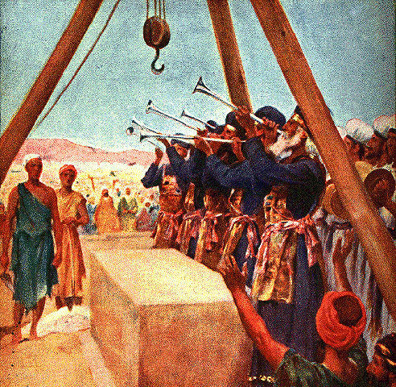
Foundation Laid
“And when the builders laid the foundation of the temple of the Lord, they set the priests in their apparel with trumpets, and the Levites the sons of Asaph with cymbals, to praise the Lord, after the ordinance of David king of Israel. And they sang together by course in praising and giving thanks unto the Lord; because he is good, for his mercy endureth for ever toward Israel. And all the people shouted with a great shout, when they praised the Lord, because the foundation of the house of the Lord was laid.”
Ezra 3:10-11

Slide 21
Just when everything was going well…

Slide 22
Opposition to Rebuilding
“Now when the adversaries of Judah and Benjamin heard that the children of the captivity builded the temple unto the Lord God of Israel; Then they came to Zerubbabel, and to the chief of the fathers, and said unto them, Let us build with you: for we seek your God, as ye do; and we do sacrifice unto him since the days of Esarhaddon king of Assur, which brought us up hither. But Zerubbabel, and Jeshua, and the rest of the chief of the fathers of Israel, said unto them, Ye have nothing to do with us to build an house unto our God; but we ourselves together will build unto the Lord God of Israel, as king Cyrus the king of Persia hath commanded us.”
Ezra 4:1-3

Slide 23
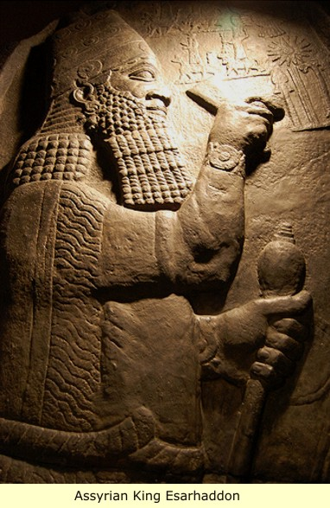
Who were these adversaries?
Samaritans.
Connected with the infiltration of Assyrians who populated the Land following Sennacherib’s conquest.
These were people who had come to the land with the purpose of assimilation.
The Jews in Jerusalem posed a threat to the edict of Esarhaddon, Sennacherib’s youngest son, nearly 200 years earlier.
They could loosely feign “brotherhood” based on the allowance of religious freedom of conquered lands.

Slide 24
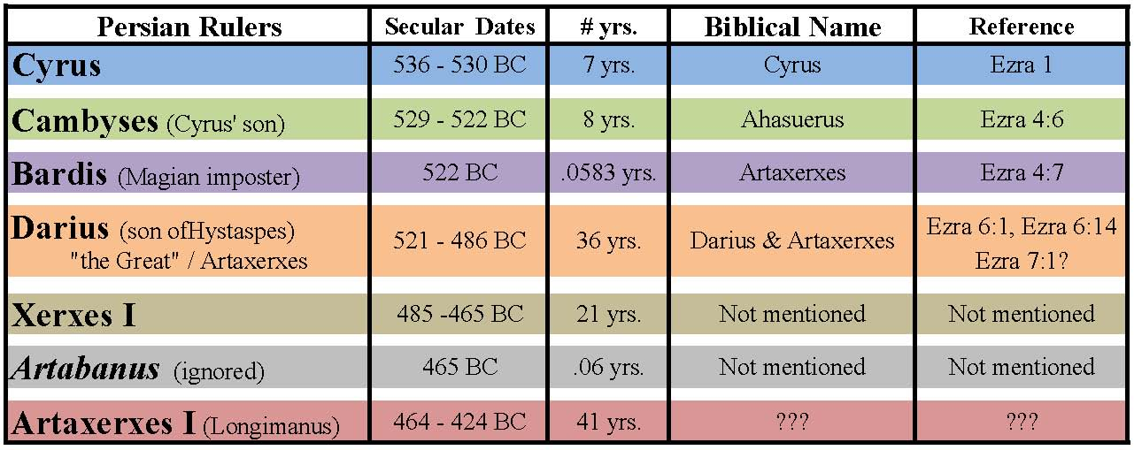

Slide 25
Bardis/Bardiya
“The Greek historian Herodotus and the Persian king Darius, in his inscription at Bīsitūn, state that Bardiya was murdered by his brother, Cambyses ll, but was later successfully impersonated by Guamata, a Magian, who was able to seize the throne when Cambyses died in 522 bce. The usurper reigned for only eight months, however, before he was slain by Darius and other Persian nobles suspicious of his origin. Certain modern historians consider that Darius, who succeeded to the throne, invented the story of Gaumata to justify his actions and that the murdered king had indeed been a son of Cyrus.”
Encyclopedia Brittanica

Slide 26
Samaritan Argument to Artaxerxes – Ezra 4:11-16
The Jews are historically rebellious.
You will eventually lose Jewish taxes.
You will eventually have no portion in this territory.

Slide 27
Reply From Artaxerxes
“The letter which ye sent unto us hath been plainly read before me. And I commanded, and search hath been made, and it is found that this city of old time hath made insurrection against kings, and that rebellion and sedition have been made therein. There have been mighty kings also over Jerusalem, which have ruled over all countries beyond the river; and toll, tribute, and custom, was paid unto them.”
Ezra 4:18-22

Slide 28
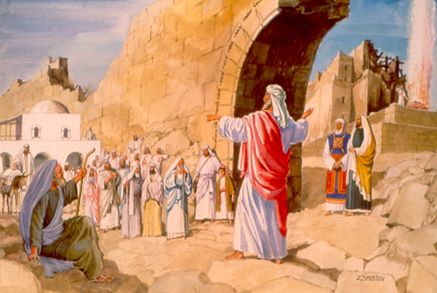
Opponents Move Quickly to Stop the Work
“Now when the copy of king Artaxerxes' letter was read before Rehum, and Shimshai the scribe, and their companions, they went up in haste to Jerusalem unto the Jews, and made them to cease by force and power. Then ceased the work of the house of God which is at Jerusalem. So it ceased unto the second year of the reign of Darius king of Persia.”
Ezra 4:23-24

Slide 29
Discouragement
“Then the people of the land weakened (ESV –discouraged) the hands of the people of Judah, and troubled them in building (ESV – “made them afraid to build”),”
Ezra 4:4

Slide 30
Reaction to set-backs

Slide 31
Return to Own Fleshly Pursuits
Thus speaketh the Lord of hosts, saying, This people say, The time is not come, the time that the Lord's house should be built.
Haggai 1:2-3
Rationalization! The assumption that God would remove all obstacles from their path.

Slide 32
Examine Yourselves!
Examine Yourself!
“Now therefore thus saith the Lord of hosts; Consider your ways. Ye have sown much, and bring in little; ye eat, but ye have not enough; ye drink, but ye are not filled with drink; ye clothe you, but there is none warm; and he that earneth wages earneth wages to put it into a bag with holes.”
Haggai 1:5-6
Failure to see that God was no longer prospering them. Inflation was up and harvests were down.

Slide 33
Discouraging Results Signal Divine Messaging
“Thus saith the Lord of hosts; Consider your ways. Go up to the mountain, and bring wood, and build the house; and I will take pleasure in it, and I will be glorified, saith the Lord. Ye looked for much, and, lo it came to little; and when ye brought it home, I did blow upon it. Why? saith the Lord of hosts. Because of mine house that is waste, and ye run every man unto his own house. Therefore the heaven over you is stayed from dew, and the earth is stayed from her fruit.”
Haggai 1:7-10

Slide 34
Get Back to Work – I Am With You!
“Then spake Haggai the Lord's messenger in the Lord's message unto the people, saying, I am with you, saith the Lord. And the Lord stirred up the spirit of Zerubbabel the son of Shealtiel, governor of Judah, and the spirit of Joshua the son of Josedech, the high priest, and the spirit of all the remnant of the people; and they came and did work in the house of the Lord of hosts, their God, In the four and twentieth day of the sixth month, in the second year of Darius the king.”
Haggai 1:13-15

Slide 35
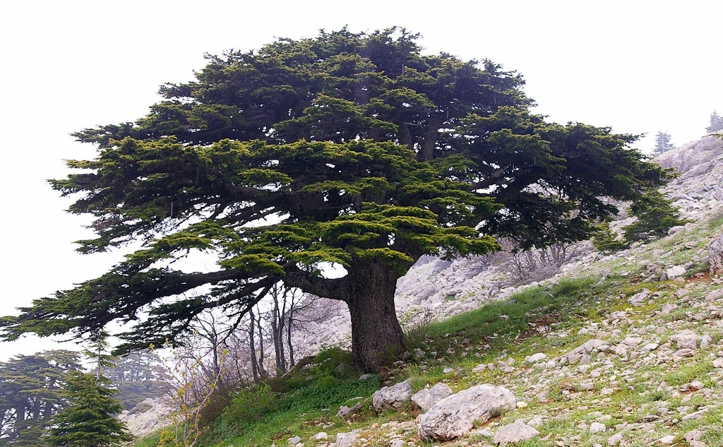
Makes one think about life in truth
Set-backs in our ecclesial work
Lack of positive response to preaching
When reaching out to unresponsive lost sheep
When trying to resolve ecclesial conflict
Trying to fight apathy and build the ecclesia
Don’t retreat! Go up to the mountain and bring wood!

Slide 36
Lessons
At times, we can see Divine signals exhorting us to repentance and/or action – if our self-examination is working properly.
Opposition to the work of the ecclesia may seem staggering at times.
We can sometimes rationalize inaction amongst ourselves.
There is a natural tendency to retreat to fleshly pursuits and move away from the challenging work before us.
In times of tumult, just chop wood – do the tasks before you. God will accept your service.
This paralysis lasted 12 years, but took only 3.5 weeks to get back in motion.

Slide 37
Purpose of ecclesias – ecclesial guide
Proclamation to those around us.
Edification of our own members.

Slide 38
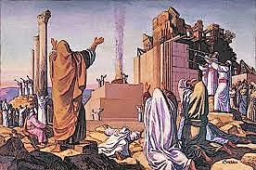
BUILDING OF THE TEMPLE – just under 3 ¼ years
Started:
Second Year of Darius
  6th month
  24th day
Finished:
Sixth Year of Darius
  9th month (Adar)
  3rd day

Slide 39
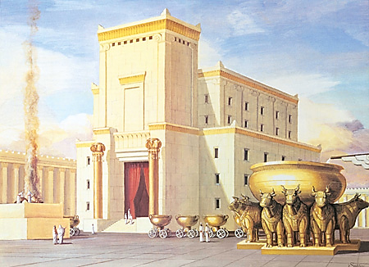
Comparing Against the Standard

Slide 40
Splendor of the Temple
Besides the grandeur of the building itself, there were details of great treasures and wealth.
Much of the wealth had been donated by the nations that came to see King Solomon.
Some of the wealth was due to victories given by God over neighboring enemies.
But most everything was due to backbreaking work against opposition.
e.g., Herod’s Temple: “And as some spake of the temple, how it was adorned with goodly stones and gifts…” Luke 21:5

Slide 41
Missing in This Temple (according to Talmud)
The ark
The sacred fire
Urim and Thummin
The Holy of Holies was empty and a stone set in its place
The candlestick
The altar of incense
The presence of God in the cloud
Also, certainly without the adorning of costly stones and gifts

Slide 42
Results
Finished the construction of the Temple.
Dedicated it to the worship of God.
Re-established the courses of the priests.
Kept the Passover.
Obeyed the feast of unleavened bread.

Slide 43
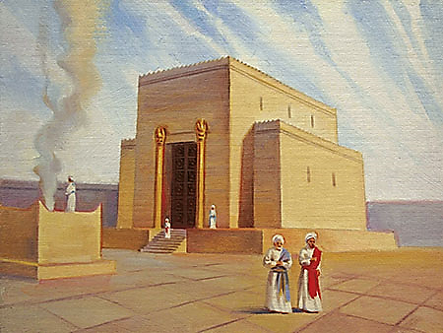
but…The Temple Before Them

Slide 44
Weeping When Compared to Solomon’s Temple
“But many of the priests and Levites and chief of the fathers, who were ancient men, that had seen the first house, when the foundation of this house was laid before their eyes, wept with a loud voice; and many shouted aloud for joy: So that the people could not discern the noise of the shout of joy from the noise of the weeping of the people: for the people shouted with a loud shout, and the noise was heard afar off.”
Ezra 3:12-13

Slide 45
Haggai 2:1-4
“In the seventh month, in the one and twentieth day of the month, came the word of the Lord by the prophet Haggai, saying, Speak now to Zerubbabel the son of Shealtiel, governor of Judah, and to Joshua the son of Josedech, the high priest, and to the residue of the people, saying, Who is left among you that saw this house in her first glory? and how do ye see it now? is it not in your eyes in comparison of it as nothing? Yet now be strong, O Zerubbabel, saith the Lord; and be strong, O Joshua, son of Josedech, the high priest; and be strong, all ye people of the land, saith the Lord, and work: for I am with you, saith the Lord of hosts:”

Slide 46
Message to 21st Century Ecclesias
Inappropriate to focus on failures, imperfections and smallness.
Don’t despise it!
See it as a reminder of what lies ahead.
What’s important to know is that God is with us.
Look forward to the latter house, when the perfect and righteous King will reign in full glory.
Look forward to a time when the ecclesia will no longer be hampered by the failings of the flesh.

Slide 47
How This Modifies Our Thinking
When we view others and their imperfections.
When we see “smallness” in the reaction to our preaching of the Gospel.
When the ecclesia falls far short of the standards of fellowship and worship.
When we see that sin has affected us and there are consequences in view.

Slide 48
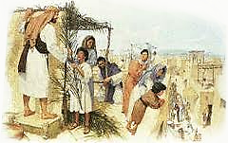
Proclamation at feast of tabernacles
“For thus saith the Lord of hosts; Yet once, it is a little while, and I will shake the heavens, and the earth, and the sea, and the dry land; And I will shake all nations, and the desire of all nations shall come: and I will fill this house with glory, saith the Lord of hosts. The silver is mine, and the gold is mine, saith the Lord of hosts. The glory of this latter house shall be greater than of the former, saith the Lord of hosts: and in this place will I give peace, saith the Lord of hosts.”
Haggai 2:6-9

Slide 49
God’s message – despise not! Get to work!

Slide 50
Next Class
The Day of Small Things

