Slide 1
Who Hath Despised the
Day of Small Things?
Class 3:
“The Day of Small Things”

Slide 2
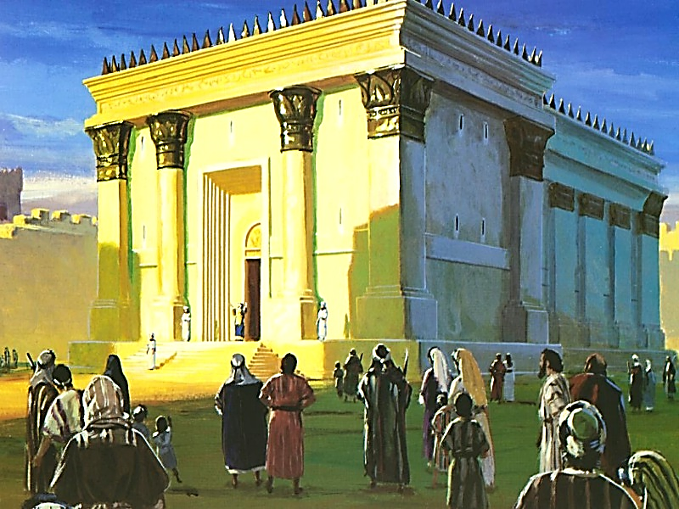

Slide 3
Small things can have big results
Moses' rod that delivered a nation from Egypt (Exodus 4:1-9),
The jawbone of an ass that in Samson's hand killed a thousand Philistines (Judges 15:14-16),
Five smooth stones that felled the giant Goliath (1 Samuel 17),
The handful of meal and a jar of oil that sustained a widow through years of famine (2 Kings 4:1-7),
Five barley loaves and a couple fish that fed a multitude (Matthew 14:13-21), and
The mustard seed Jesus said would become a great tree for birds to find shelter (Matthew 13:31-32).

Slide 4
What had occurred?
With great enthusiasm they set about rebuilding the Temple.
However, Zerubbabel the governor, got little farther than laying the foundation before opposition set in.
Neighboring adversaries fought the project, finally succeeding in getting a restraining order to halt construction (Ezra 4). Enemies mocked. Supporters became discouraged. For 12 years the site stood silent.
Failure. Zerubbabel likely felt like a failure. Zerubbabel set to work building his own wood-paneled home. His grand dream had seemingly fizzled.
He was probably like the rest of us when failure looms. We seal ourselves from more pain by denial. We protect ourselves from getting our hopes too high again. We look at the past rather than the future.

Slide 5
5 Enemies to ecclesial work (haggai 1)
Rationalization (vs. 1)
Procrastination (vs. 2)
Materialism, self-centeredness (vs. 4)
Poor self-examination (vs. 5-7)
Failure to recognize and accept Divine correction (vs. 6-11)

Slide 6
The vision of the day of “big” things

Slide 7
Riches of the Gentiles
“But ye shall be named the Priests of the Lord: men shall call you the Ministers of our God: ye shall eat the riches of the Gentiles, and in their glory shall ye boast yourselves.”
Isaiah 61:6

Slide 8
Wealth of the Gentiles
“And the Gentiles shall come to thy light, and kings to the brightness of thy rising. Lift up thine eyes round about, and see: all they gather themselves together, they come to thee: thy sons shall come from far, and thy daughters shall be nursed at thy side. Then thou shalt see, and flow together, and thine heart shall fear, and be enlarged; because the abundance of the sea shall be converted unto thee, the forces (margin: wealth) of the Gentiles shall come unto thee. The multitude of camels shall cover thee, the dromedaries of Midian and Ephah; all they from Sheba shall come: they shall bring gold and incense; and they shall shew forth the praises of the Lord.”
Isaiah 60:3-6

Slide 9
Salvation of the Nations
“Surely the isles shall wait for me, and the ships of Tarshish first, to bring thy sons from far, their silver and their gold with them, unto the name of the Lord thy God, and to the Holy One of Israel, because he hath glorified thee.
The glory of Lebanon shall come unto thee, the fir tree, the pine tree, and the box together, to beautify the place of my sanctuary; and I will make the place of my feet glorious. The sons also of them that afflicted thee shall come bending unto thee; and all they that despised thee shall bow themselves down at the soles of thy feet; and they shall call thee; The city of the Lord, The Zion of the Holy One of Israel.”
Isaiah 60:9,13-14

Slide 10
Gifts for Israel’s king
“The kings of Tarshish and of the isles shall bring presents: the kings of Sheba and Seba shall offer gifts. Yea, all kings shall fall down before him: all nations shall serve him.”
Psalm 72:10-11

Slide 11
Riches of the nations
To Israel, this was a unifying prophecy and vision – one that took them back to the days and grandeur of King Solomon.
The Temple would not only be a place for worship, but a focal point for the nations.
For them, it was about realizing their rightful position as spiritual leaders on the earth and being the most revered people across all lands.
But, this Temple fell far short.
They were surrounded by adversaries.
There were no “gifts” from the nations for the beauty and enhancement of the Temple.
This was a struggle they were going through.

Slide 12
The ecclesia today
We need to balance optimism with realism in ecclesial life.
We know the standards for service and ecclesial life.
But, our houses today aren’t fully reflective of these high standards and progress and work can often be very difficult.
A message from the Second Temple period is not to dwell on the inadequacies of out current dispensation, but on the reassurance we have that God has set a time where He will “shake the nations.”
There is a time when our faith will come to sight, when the imperfections of our current Temple are replaced by a glory never yet experienced.

Slide 13
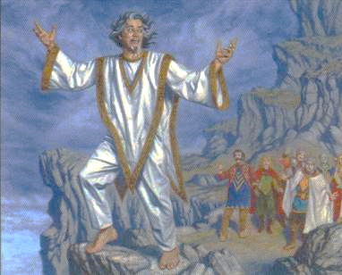
Israel’s failure: Forgetting god’s name
“How long shall this be in the heart of the prophets that prophesy lies? yea, they are prophets of the deceit of their own heart; Which think to cause my people to forget my name by their dreams which they tell every man to his neighbour, as their fathers have forgotten my name for Baal.”
Jeremiah 23:26-27

Slide 14
Fellowship of believers in this period
“Then they that feared the Lord spake often one to another: and the Lord hearkened, and heard it, and a book of remembrance was written before him for them that feared the Lord, and that thought upon his name. And they shall be mine, saith the Lord of hosts, in that day when I make up my jewels; and I will spare them, as a man spareth his own son that serveth him.”
Malachi 3:16-17

Slide 15
“Thought upon his name”
Psalm 5:11 – “But let all those that put their trust in thee rejoice: let them ever shout for joy, because thou defendest them: let them also that love thy name be joyful in thee.”
Psalm 9:9-11 – “The Lord also will be a refuge for the oppressed, a refuge in times of trouble. And they that know thy name will put their trust in thee: for thou, Lord, hast not forsaken them that seek thee. Sing praises to the Lord, which dwelleth in Zion: declare among the people his doings.”
Psalm 20:6-7 – “Now know I that the Lord saveth his anointed; he will hear him from his holy heaven with the saving strength of his right hand. Some trust in chariots, and some in horses: but we will remember the name of the Lord our God.”

Slide 16
“thought upon his name”
Psalm 86:7-11 – “In the day of my trouble I will call upon thee: for thou wilt answer me. Among the gods there is none like unto thee, O Lord; neither are there any works like unto thy works. All nations whom thou hast made shall come and worship before thee, O Lord; and shall glorify thy name. For thou art great, and doest wondrous things: thou art God alone. Teach me thy way, O Lord; I will walk in thy truth: unite my heart to fear thy name.”
John 17:6 – “I have manifested thy name unto the men which thou gavest me out of the world: thine they were, and thou gavest them me; and they have kept thy word.”

Slide 17
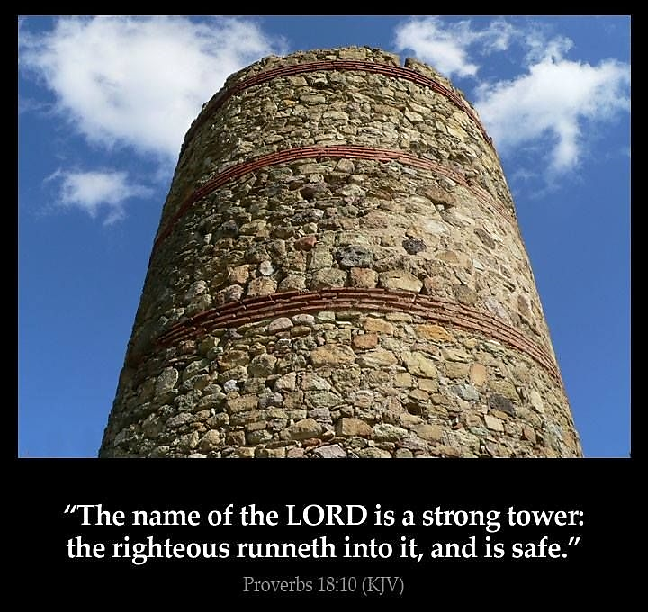

Slide 18
For your consideration…
How much of our focus is about God and His Name?
How would focusing on His Name as a primary part of our daily fellowship change us as a body?
How would we be different if we openly discussed Him and His works in OUR lives?
The jewels, the special treasure, had this as their primary definition – this is what they talked “often” about.

Slide 19
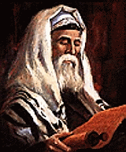
The prophecy of zechariah and the day of small things

Slide 20
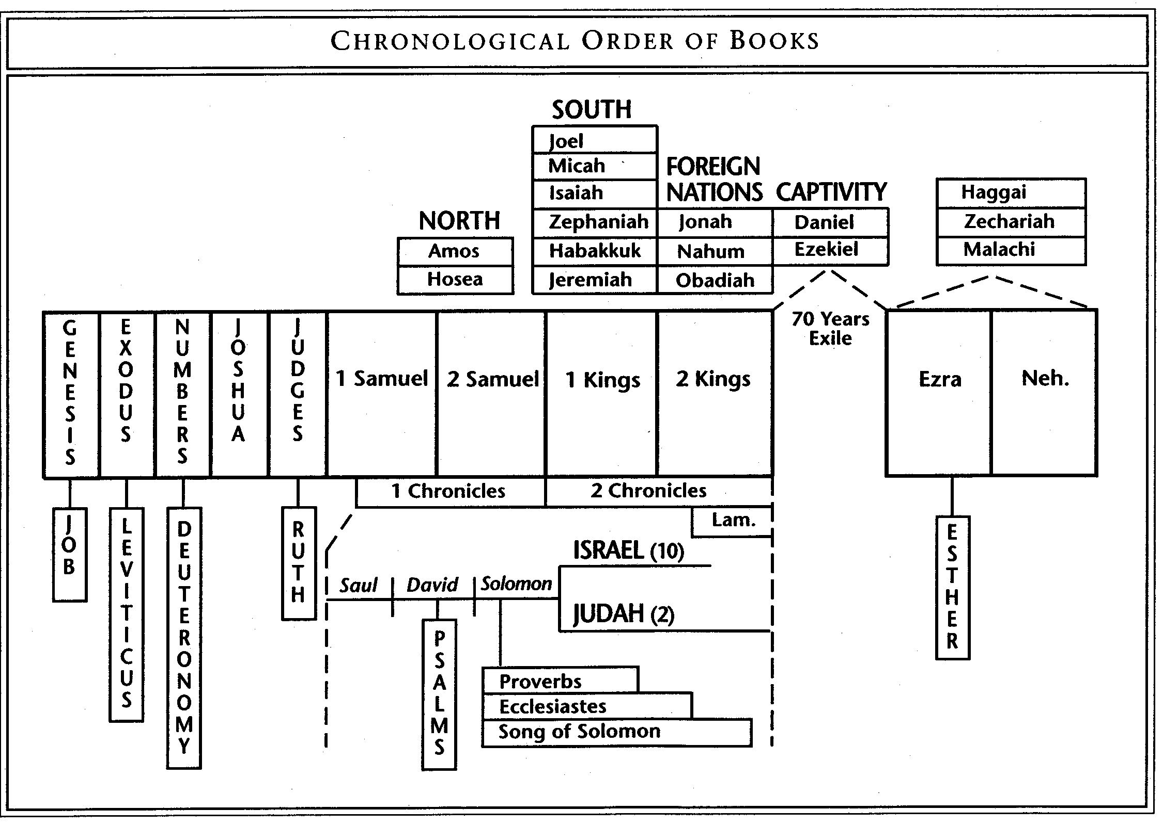

Slide 21
The vision of the seven eyes
First to Joshua the High Priest
Then to Zerubbabel, the ruler
Speaks about a stone, of which is Divinely inscribed and upon which seven eyes are associated with it.
The Apocalypse continues the vision about a Slain Lamb.
These use current people and circumstances to point forward to the day of “big things” when all the imperfections of the day are perfected.

Slide 22
The eyes of the Lord at time of king asa
“And at that time Hanani the seer came to Asa king of Judah, and said unto him, Because thou hast relied on the king of Syria, and not relied on the Lord thy God, therefore is the host of the king of Syria escaped out of thine hand. Were not the Ethiopians and the Lubims a huge host, with very many chariots and horsemen? yet, because thou didst rely on the Lord, he delivered them into thine hand. For the eyes of the Lord run to and fro throughout the whole earth, to shew himself strong in the behalf of them whose heart is perfect toward him. Herein thou hast done foolishly: therefore from henceforth thou shalt have wars.”
2 Chronicles 16:7-9

Slide 23
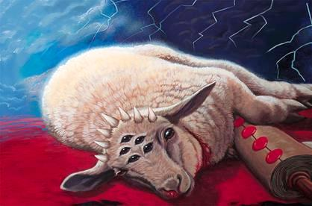
The lamb with seven horns and seven eyes
“And one of the elders saith unto me, Weep not: behold, the Lion of the tribe of Judah, the Root of David, hath prevailed to open the book, and to loose the seven seals thereof. And I beheld, and, lo, in the midst of the throne and of the four beasts, and in the midst of the elders, stood a Lamb as it had been slain, having seven horns and seven eyes, which are the seven Spirits of God sent forth into all the earth. And he came and took the book out of the right hand of him that sat upon the throne.”
Revelation 5:5-7

Slide 24
Seven eyes for the high priest
“Hear now, O Joshua the high priest, you and your friends who sit before you, for they are men who are a sign: behold, I will bring my servant the Branch. For behold, on the stone that I have set before Joshua, on a single stone with seven eyes, I will engrave its inscription, declares the Lord of hosts, and I will remove the iniquity of this land in a single day.”
Zechariah 3:8-9 (ESV)
What is engraved? Likely Exo. 28:36 of the breastplate: “And thou shalt make a plate of pure gold, and grave upon it, like the engravings of a signet, Holiness To The Lord.”

Slide 25
Later in zechariah 14
“In that day shall there be upon the bells of the horses, Holiness Unto The Lord; and the pots in the Lord's house shall be like the bowls before the altar. Yea, every pot in Jerusalem and in Judah shall be holiness unto the Lord of hosts: and all they that sacrifice shall come and take of them, and seethe therein: and in that day there shall be no more the Canaanite in the house of the Lord of hosts.”
Zechariah 14:20-21

Slide 26
Engraved single stone
It is the name engraved on the single stone that will “remove the iniquity of the land in one day.” Zechariah 4:9
Because of this engraving, it has been possible to remove iniquity
“Wherefore God also hath highly exalted him, and given him a name which is above every name. That at the name of Jesus every knee should bow, of things in heaven, and things in earth, and things under the earth, that every tongue should confess that Jesus Christ is Lord, to the glory of the Father.” Philippians 2:9-11

Slide 27
Prophecy to Joshua the High Priest
“Then take silver and gold, and make crowns, and set them upon the head of Joshua the son of Josedech, the high priest; And speak unto him, saying, Thus speaketh the Lord of hosts, saying, Behold the man whose name is The Branch; and he shall grow up out of his place, and he shall build the temple of the Lord: Even he shall build the temple of the Lord; and he shall bear the glory, and shall sit and rule upon his throne; and he shall be a priest upon his throne: and the counsel of peace shall be between them both. And the crowns shall be to Helem, and to Tobijah, and to Jedaiah, and to Hen the son of Zephaniah, for a memorial in the temple of the Lord. And they that are far off shall come and build in the temple of the Lord, and ye shall know that the Lord of hosts hath sent me unto you. And this shall come to pass, if ye will diligently obey the voice of the Lord your God.”
Zechariah 6:11-15

Slide 28
Some Observations
Why is this crown on a high priest?
Should it not be on Zerubbabel, the natural king out of Judah?
But this is not about the natural order.
It is a prophecy of Jesus, who will fulfill the role of King and Priest.
His temple will be unlike any other.
Those in his temple will be the wealth of all the nations.
Those afar will build this temple.

Slide 29
Zerubbabel to Lay Foundation of House
“Then he answered and spake unto me, saying, This is the word of the Lord unto Zerubbabel, saying, Not by might, nor by power, but by my spirit, saith the Lord of hosts. Who art thou, O great mountain? before Zerubbabel thou shalt become a plain: and he shall bring forth the headstone (ESV/YLT/NASB - “foundation” stone) thereof with shoutings, crying, Grace, grace unto it. Moreover the word of the Lord came unto me, saying, The hands of Zerubbabel have laid the foundation of this house; his hands shall also finish it; and thou shalt know that the Lord of hosts hath sent me unto you.”
Zechariah 4:6-9

Slide 30
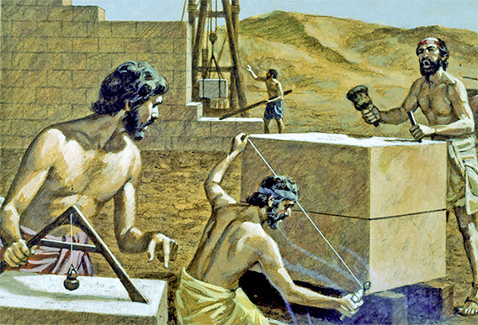
Seven eyes before the ruler
“For whoever has despised the day of small things shall rejoice, and shall see the plummet in the hand of Zerubbabel. These seven are the eyes of the Lord, which range through the whole earth.”
Zechariah 4:10 (RSV)

Slide 31
Pointing forward to the chief corner stone
“For through him we both have access by one Spirit unto the Father. Now therefore ye are no more strangers and foreigners, but fellowcitizens with the saints, and of the household of God; And are built upon the foundation of the apostles and prophets, Jesus Christ himself being the chief corner stone; In whom all the building fitly framed together groweth unto an holy temple in the Lord: In whom ye also are builded together for an habitation of God through the Spirit.”
Ephesians 2:18-20

Slide 32
The seven eyes
Certainly representative of the work of the angels.
But in the future, representative of the complete, multitudinous Christ – one with the Stone.
The Saints are described as the “eyes” of the LORD, for we are to be sent out throughout the earth to work on His behalf.
The King/Priest would remove iniquity and join all believers together in the vision of the future kingdom.

Slide 33
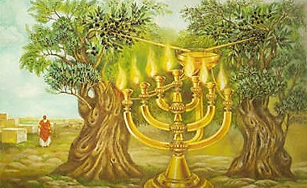
The vision of the candlestick

Slide 34
Olive trees
Hosea 14:5-6 – “I will be as the dew unto Israel: he shall grow as the lily, and cast forth his roots as Lebanon. His branches shall spread, and his beauty shall be as the olive tree, and his smell as Lebanon.”
Romans 11:17-19 – “And if some of the branches be broken off, and thou, being a wild olive tree, wert grafted in among them, and with them partakest of the root and fatness of the olive tree; Boast not against the branches. But if thou boast, thou bearest not the root, but the root thee. Thou wilt say then, The branches were broken off, that I might be grafted in.”

Slide 35
The Vision of the Candlestick
“And the angel that talked with me came again, and waked me, as a man that is wakened out of his sleep. And said unto me, What seest thou? And I said, I have looked, and behold a candlestick all of gold, with a bowl upon the top of it, and his seven lamps thereon, and seven pipes to the seven lamps, which are upon the top thereof: And two olive trees by it, one upon the right side of the bowl, and the other upon the left side thereof. So I answered and spake to the angel that talked with me, saying, What are these, my lord?”
Zechariah 4:1-4

Slide 36
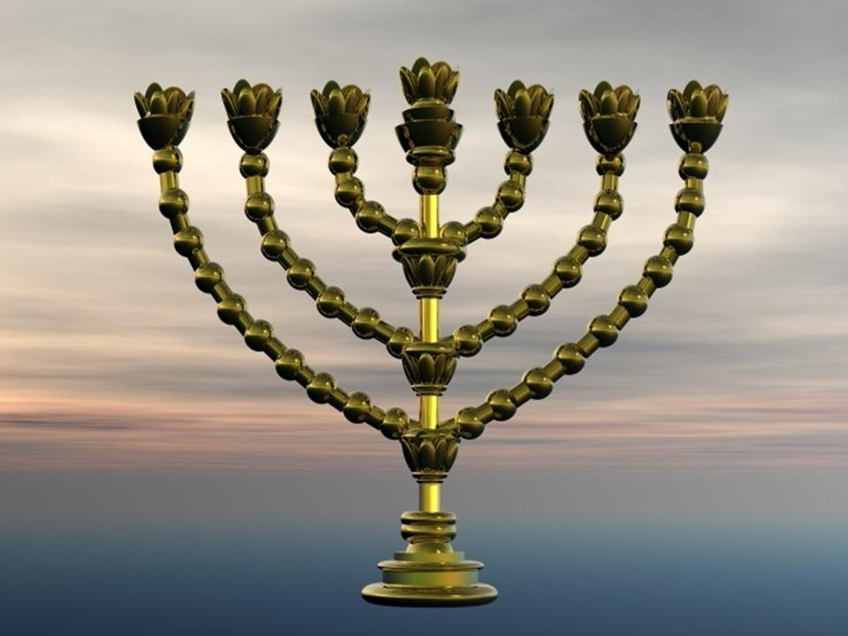
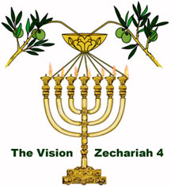
Differing candlesticks

Slide 37
Golden oil
“Then answered I, and said unto him, What are these two olive trees upon the right side of the candlestick and upon the left side thereof? And I answered again, and said unto him, What be these two olive branches which through the two golden pipes empty the golden oil out of themselves? And he answered me and said, Knowest thou not what these be? And I said, No, my lord. Then said he, These are the two anointed ones, that stand by the Lord of the whole earth.”
Zechariah 4:11-14

Slide 38
Zechariah’s Vision
In the Tabernacle, the candlestick is fed with oil daily by the priests.
In Zechariah’s vision, notice that the oil comes directly from the tree – not by hands or work of men.
The oil comes into a bowl from two branches of the trees, which perpetually feeds the candlestick and forms eternal light.
The two olive trees were prophetic of Jews and Gentiles, joined together – the “sons of oil” anointed by God.
Together, these anointed ones have an unlimited supply of oil and give light to the whole world!

Slide 39
Tying these three visions together
The High Priest, Joshua, would bear the name written by God
The ruler, Zerubbabel, would lead the formation of the spiritual house
The lampstand brings together anointed ones, Jews and Gentiles.
Together, Jew and Gentile will be an eternal supply with oil, by he who bears the name of God, by he who removes iniquity, by he who is the chief cornerstone, by he who is the author and finisher of our faith (starts it and finishes it).
Together, they will become kings and priests, ruling in the day of “great things.”

Slide 40
Why this message?
Zechariah knew many were disheartened by the “day of small things.”
Instead of sternly admonishing them to get the work done and stop their petty pursuits, his prophecy invites them to look at the staggering vision of the future.
A time when the wealth of the nations would come to Jerusalem, not by compulsion, but because of a desire to worship God.
A time the “jewels” would be assembled to shine brightly, with unlimited oil.
A time when instead of a mortal High Priest and a provisional human ruler, the worship of God would be presided over immortal Saints, Jews and Gentiles – kings and priests!

Slide 41
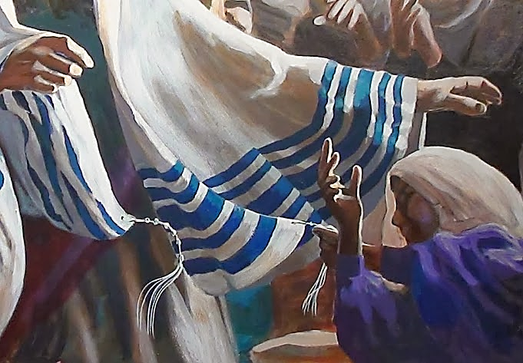
The day of “big” things
“Yea, many people and strong nations shall come to seek the LORD of hosts in Jerusalem, and to pray before the LORD. Thus saith the LORD of hosts, in those days it shall come to pass, that ten men shall take hold out of all languages of the nations, even he shall take hold of the skirt of him that is a Jew, saying, We will go with you: for we have heard that God is with you.”
Zechariah 8:22-23

Slide 42
But we don’t live now in the day of “big” things

Slide 43
southern California ecclesias
February 2013

Slide 44
Ecclesial Membership – Total 633

Slide 45
Combined Look at Attendance (633 members)

Slide 46
Participation Rates by Ecclesia Size

Slide 47
What Most Influences Attendance?
Geographic distribution of members
Size of the ecclesia
Length of time an ecclesia has been in existence

Slide 48
Adult Sunday School Attendance – 42.4%

Slide 49
Adult Sunday “Program” – 32.2% (7/11)

Slide 50
Adult Mid-Week Bible Class – 31.7%

Slide 51
How does a faithful believer react to this?

Slide 52
Talk about the kingdom!
”Therefore take no thought, saying, What shall we eat? or, What shall we drink? or, Wherewithal shall we be clothed? (For after all these things do the Gentiles seek:) for your heavenly Father knoweth that ye have need of all these things. But seek ye first the kingdom of God, and his righteousness; and all these things shall be added unto you. Take therefore no thought for the morrow: for the morrow shall take thought for the things of itself. Sufficient unto the day is the evil thereof.”
Matthew 6:31-34

Slide 53
Embrace the vision that passes all understanding
“For since the beginning of the world men have not heard, nor perceived by the ear, neither hath the eye seen, O God, beside thee, what he hath prepared for him that waiteth for him.”
Isaiah 64:4

Slide 54
Next Class
Let Us Rise Up and Build
The Work of Nehemiah

