Slide 1
Who Hath Despised the
Day of Small Things?
Class 4:
“Rise Up and Build”

Slide 2
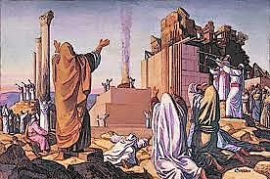
The Building Complete – Ezra Prepares Hearts to Worship Right

Slide 3
Ezra’s Preparation for Work
“This Ezra went up from Babylon; and he was a ready scribe in the law of Moses, which the Lord God of Israel had given: and the king granted him all his request, according to the hand of the Lord his God upon him. And there went up some of the children of Israel, and of the priests, and the Levites, and the singers, and the porters, and the Nethinims, unto Jerusalem, in the seventh year of Artaxerxes the king. And he came to Jerusalem in the fifth month, which was in the seventh year of the king. For upon the first day of the first month began he to go up from Babylon, and on the first day of the fifth month came he to Jerusalem, according to the good hand of his God upon him. For Ezra had prepared his heart to seek the law of the Lord, and to do it, and to teach in Israel statutes and judgments.”
Ezra 7:6-10

Slide 4
End of Artaxerxes’ Decree
“Whatsoever is commanded by the God of heaven, let it be diligently done for the house of the God of heaven: for why should there be wrath against the realm of the king and his sons? Also we certify you, that touching any of the priests and Levites, singers, porters, Nethinims, or ministers of this house of God, it shall not be lawful to impose toll, tribute, or custom, upon them. And thou, Ezra, after the wisdom of thy God, that is in thine hand, set magistrates and judges, which may judge all the people that are beyond the river, all such as know the laws of thy God; and teach ye them that know them not. And whosoever will not do the law of thy God, and the law of the king, let judgment be executed speedily upon him, whether it be unto death, or to banishment, or to confiscation of goods, or to imprisonment.”
Ezra 7:23-26

Slide 5
Ezra’s Reaction to This Overwhelming News
“Blessed be the Lord God of our fathers, which hath put such a thing as this in the king's heart, to beautify the house of the Lord which is in Jerusalem: And hath extended mercy unto me before the king, and his counsellors, and before all the king's mighty princes. And I was strengthened as the hand of the Lord my God was upon me, and I gathered together out of Israel chief men to go up with me.”
Ezra 7:27-28

Slide 6
Confession and Prayer of Ezra 9 – People, Priests and Levites
The people who came initially from captivity to the land had once again fallen into marriages and alliances with the inhabitants of the land.
And these were the early adopters of the plan to rebuild!
Were they unfamiliar with the Law or did they sin willfully?

Slide 7
the covenant of the priest Shechaniah
“Now when Ezra had prayed, and when he had confessed, weeping and casting himself down before the house of God, there assembled unto him out of Israel a very great congregation of men and women and children: for the people wept very sore. And Shechaniah the son of Jehiel, one of the sons of Elam, answered and said unto Ezra, We have trespassed against our God, and have taken strange wives of the people of the land: yet now there is hope in Israel concerning this thing. Now therefore let us make a covenant with our God to put away all the wives, and such as are born of them, according to the counsel of my lord, and of those that tremble at the commandment of our God; and let it be done according to the law. Arise; for this matter belongeth unto thee: we also will be with thee: be of good courage, and do it. Then arose Ezra, and made the chief priests, the Levites, and all Israel, to swear that they should do according to this word. And they sware.”
Ezra 10:1-5

Slide 8
Putting Away Strange Wives - Postponement
“And Ezra the priest stood up, and said unto them, Ye have transgressed, and have taken strange wives, to increase the trespass of Israel. Now therefore make confession unto the Lord God of your fathers, and do his pleasure: and separate yourselves from the people of the land, and from the strange wives. Then all the congregation answered and said with a loud voice, As thou hast said, so must we do. But the people are many, and it is a time of much rain, and we are not able to stand without, neither is this a work of one day or two: for we are many that have transgressed in this thing.”
Ezra 10:10-13

Slide 9
Named priests/levites who married strange wives
“And among the sons of the priests that were found that had taken strange wives, namely, of the sons of Jeshua…”
And they gave their hands that they would put away their wives; and being guilty, they offered a ram of the flock for their trespass.
Ezra 10:18,19

Slide 10
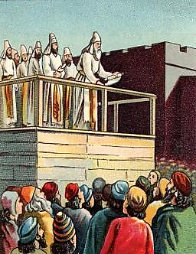
Levites who sinned
“Also of the Levites; Jozabad, and Shimei, and Kelaiah, (the same is Kelita,) Pethahiah, Judah, and Eliezer.”
Ezra 10:23
This same Kelita (8:7) stood with Erza on the wooden pulpit, having a role in the reading of the Law. Principle that one who had sinned, but repented, could afterward serve as the teacher of the very Law that he broke.

Slide 11
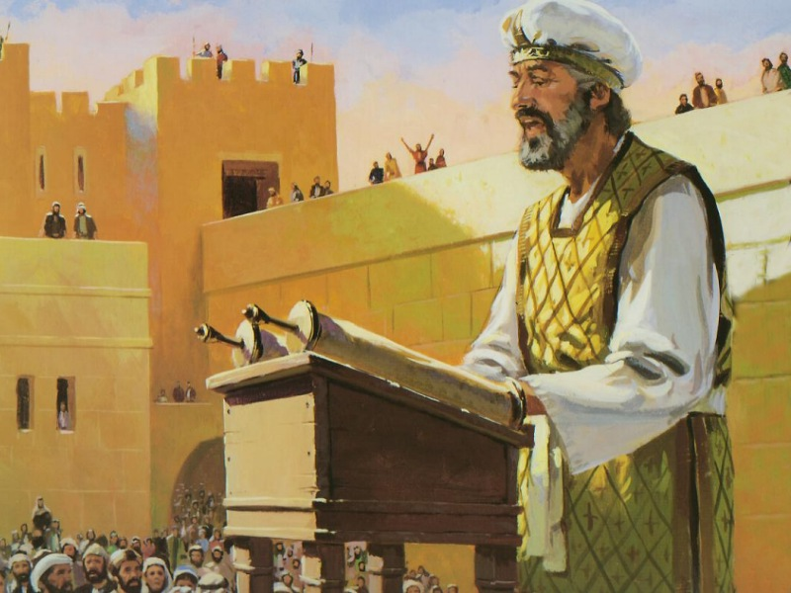
Observations
Ezra just learned of this great failure, but God had known all along.
The sound knowledge of the Law that Ezra possessed was able to point out this great sin.
The people, once confronted with their sin, generally complied with a very difficult repentance.
Ezra allowed time for repentance.
Some who had sinned, once repentant, were engaged in teaching the Law to all the people.

Slide 12
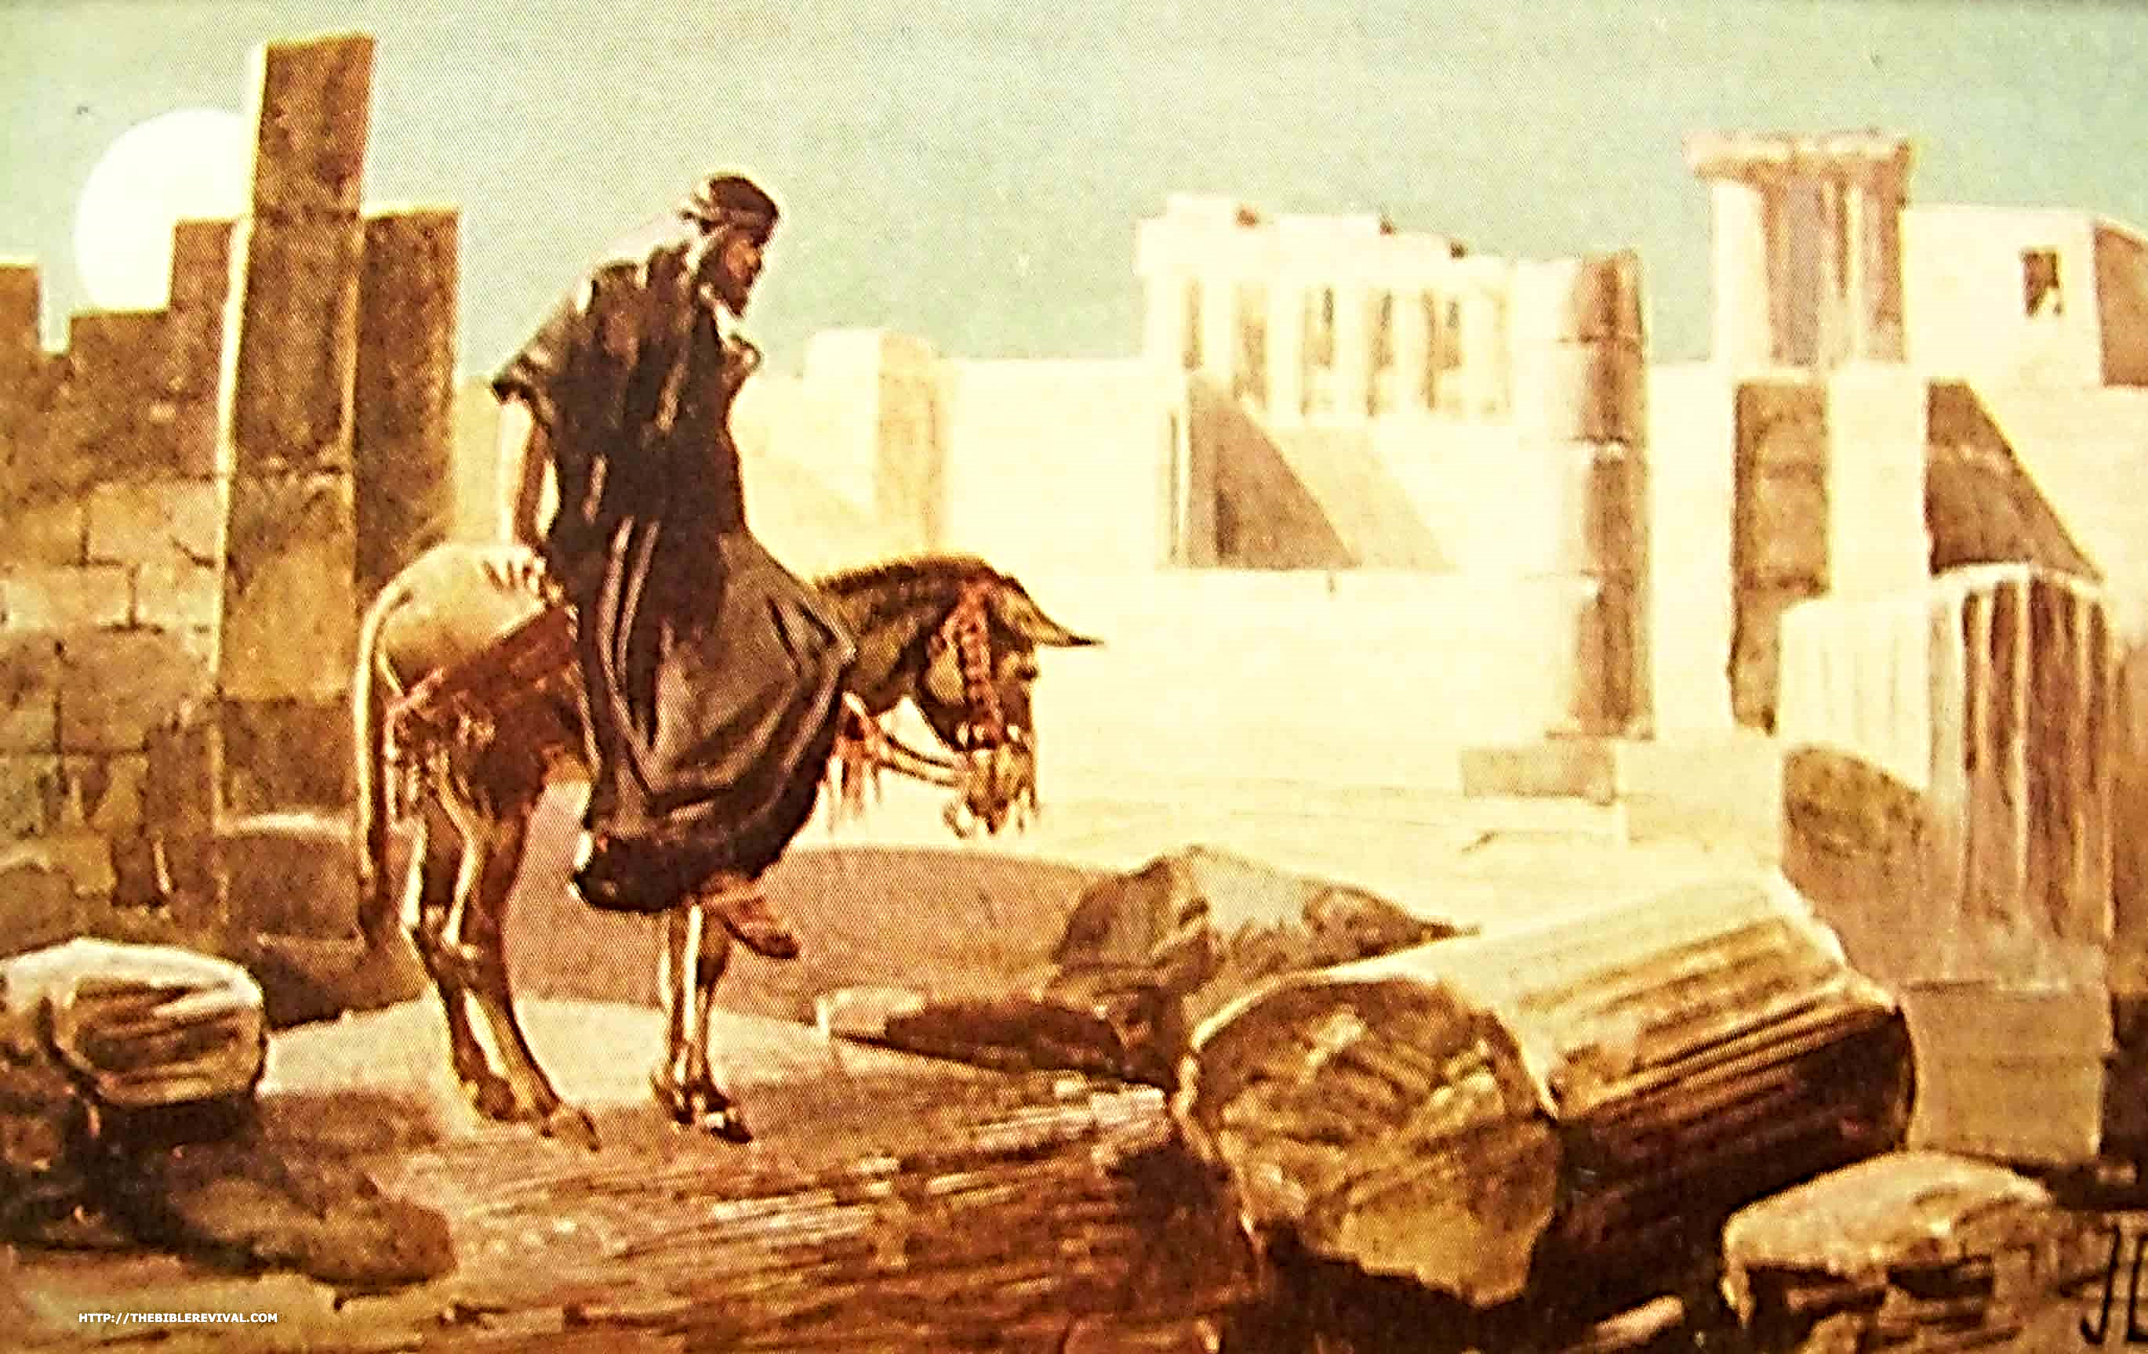
Let us rise up and build
The Work of Nehemiah

Slide 13
Timing
Temple was destroyed 586 BC
Temple foundation laid 535 BC
Temple finished 516 BC
Ezra returns to City 458 BC
Nehemiah comes to Jerusalem 444BC
Returns to Jerusalem 430 BC
70 years

Slide 14
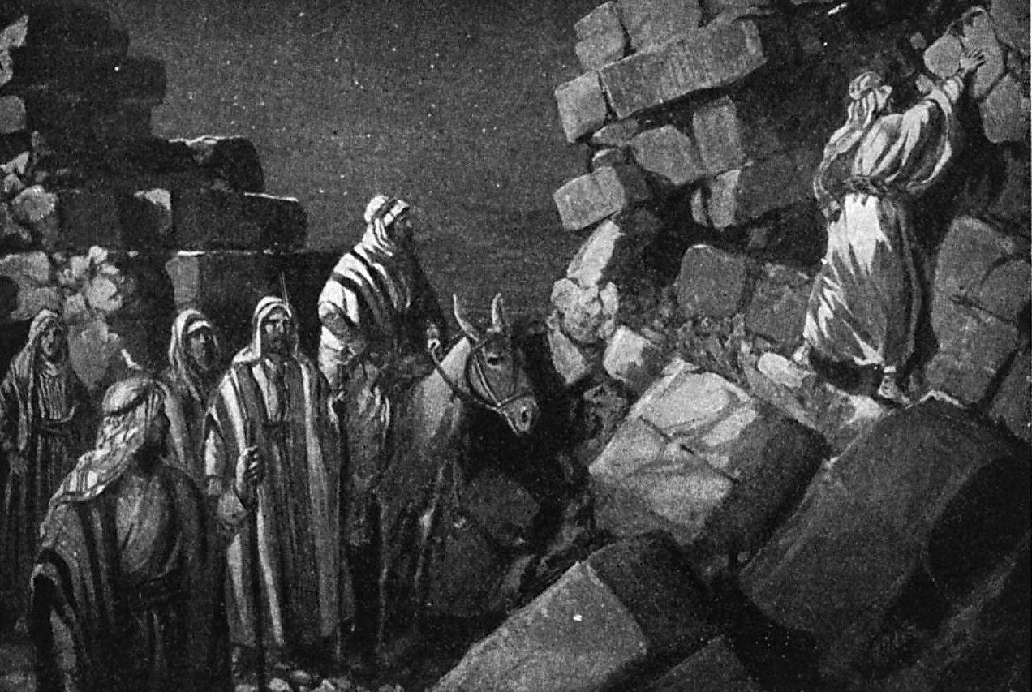
State of the City – 72 years after temple completed
Nehemiah 2:13-15 – walls broken, gates burned, streets unpassable at King’s Pool due to rubble
Nehemiah 7:4 – few city inhabitants and very few homes built
Nehemiah 11:1 – lots taken to “seed” inhabitants for the city from neighboring cities

Slide 15
Context of the Concern
“Know therefore and understand, that from the going forth of the commandment to restore and to build Jerusalem unto the Messiah the Prince shall be seven weeks, and threescore and two weeks: the street shall be built again, and the wall, even in troublous times.”
Daniel 9:25

Slide 16
Temple Built But City in Desolation
Interesting spiritual picture.
Those remaining in the province were under great duress and affliction trying to live up to vision.
Others had returned to their personal inheritance outside the area.
The walls and gates were still broken and burned – for almost 150 years!
There was no protection from enemies.
The city was a reproach – “Is this the City of God?

Slide 17
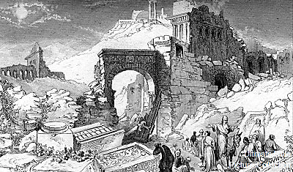
Hears of the plight in jerusalem
“The words of Nehemiah the son of Hachaliah. And it came to pass in the month Chisleu, in the twentieth year, as I was in Shushan the palace, That Hanani, one of my brethren, came, he and certain men of Judah; and I asked them concerning the Jews that had escaped, which were left of the captivity, and concerning Jerusalem. And they said unto me, The remnant that are left of the captivity there in the province are in great affliction and reproach: the wall of Jerusalem also is broken down, and the gates thereof are burned with fire.”
Nehemiah 1:1-3
This same Hanani, Nehemiah’s kinsman, is on the list of those who took strange wives in Ezra 10:18.

Slide 18
What Can One Man Do?
“And it came to pass, when I heard these words, that I sat down and wept, and mourned certain days, and fasted, and prayed before the God of heaven, And said, I beseech thee, O Lord God of heaven, the great and terrible God, that keepeth covenant and mercy for them that love him and observe his commandments: Let thine ear now be attentive, and thine eyes open, that thou mayest hear the prayer of thy servant, which I pray before thee now, day and night, for the children of Israel thy servants, and confess the sins of the children of Israel, which we have sinned against thee: both I and my father's house have sinned.”
Nehemiah 1:4-6

Slide 19
What is Required for Transformation?
Daniel 9 Petition | Nehemiah 1 Petition
Deeply cared and knew need for God’s help | Sat down and wept, mourned for days
Prepared himself by fasting, sackcloth and ashes | Prepared by fasting
Began his prayer by confessing sins of the people, now a reproach to Gentiles | Began his prayer by confessing the sins
Acknowledged that their woes were self inflicted by turning back on God | Acknowledgement that it was their sins that brought scattering and captivity
Appeal to God’s righteousness and mercy | Appeal to God’s righteousness and mercy
Request that the sanctuary’s desolation be reversed to declare His righteousness | Request that his work be prospered to rebuild the neglected fallen walls and gates

Slide 20
Our Modern transformation…
Must truly care.
A sincere dedication to Holy service.
Prayer.
Acknowledgement and confession of sin.
Appeal for God’s mercy.
Sincere desire for God’s righteousness to be manifested.

Slide 21
Against All Odds
A cupbearer in Shushan who is going to oversee a building project!
No one engaged him – he took it as his own mission.
He had a high visibility, high profile position in Persia.
Was known to the King and appointed now to governor.
Surely, there must have been better qualified and more available people to take on this work!

Slide 22
This is critical for all modern pursuits
Work engaged that does not have exaltation of God’s name at its core, is suspect and potentially vulnerable to domination by the flesh.
It must involve humility and confession of sin and the need for God.
We might apply this to some of the longstanding and unsolved controversies of our time.
If our pursuits do not have the right focus, we would be better off to stop and reassess. Does this pursuit have the declaration of God’s Name at its core?

Slide 23
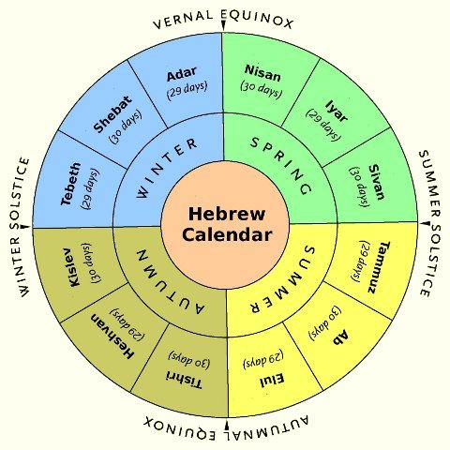
Waiting for Answer to Prayer – 4-5 months
Opportunity Presents Itself
Prayer Made

Slide 24
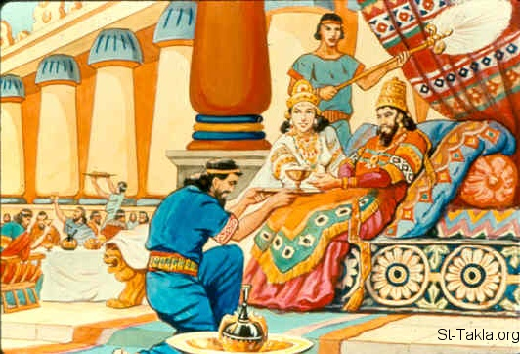
Nehemiah’s Preparation When Window Opens
“And it came to pass in the month Nisan, in the twentieth year of Artaxerxes the king, that wine was before him: and I took up the wine, and gave it unto the king. Now I had not been beforetime sad in his presence. Wherefore the king said unto me, Why is thy countenance sad, seeing thou art not sick? this is nothing else but sorrow of heart. Then I was very sore afraid, And said unto the king, Let the king live for ever: why should not my countenance be sad, when the city, the place of my fathers' sepulchres, lieth waste, and the gates thereof are consumed with fire? Then the king said unto me, For what dost thou make request? So I prayed to the God of heaven.”
Nehemiah 2:1-4

Slide 25
Notice the prepared mind
“And I said unto the king, If it please the king, and if thy servant have found favour in thy sight, that thou wouldest send me unto Judah, unto the city of my fathers' sepulchres, that I may build it. And the king said unto me, (the queen also sitting by him,) For how long shall thy journey be? and when wilt thou return? So it pleased the king to send me; and I set him a time. Moreover I said unto the king, If it please the king, let letters be given me to the governors beyond the river, that they may convey me over till I come into Judah; And a letter unto Asaph the keeper of the king's forest, that he may give me timber to make beams for the gates of the palace which appertained to the house, and for the wall of the city, and for the house that I shall enter into. And the king granted me, according to the good hand of my God upon me.”
Nehemiah 2:5-8

Slide 26
Lessons for Us?
Do NOT accept fatalistic view that failure is to be expected in the Last Days!
Reject feelings that change can only be done through committees and formal efforts.
If you see work to be done – whether great or small – accept it as your mission.
Plan for success! Nehemiah carefully calculated what was required for the job.
We must genuinely care! There’s no change without passion.
All change must begin by acknowledging only God can prosper us.

Slide 27
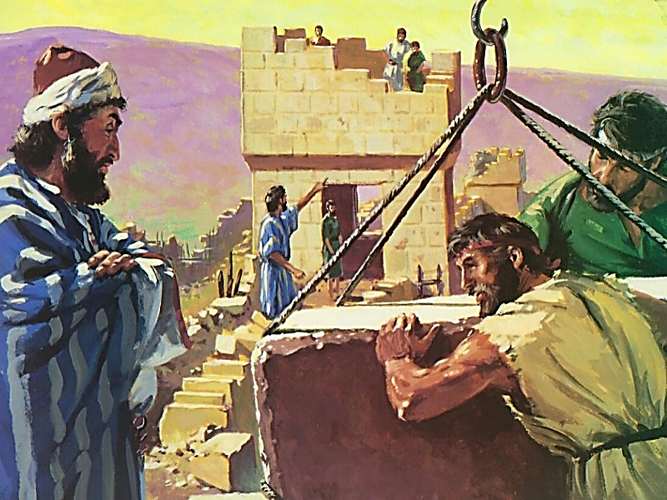
The Trials of Nehemiah
Under derision (2:19)
Half-hearted brethren (3:5)
Contempt (4:1-3)
Open opposition (4:8)
Discouragement (4:10)
Sabotage (4:11)
Internal strife (5:7)
False friendship (6:2)
Scandal (6:5)
Fear (6:13)
Alien marriages (6:18-19; 13:23-29)

Slide 28
Jerusalem and Our Ecclesias?
Gentiles given opportunity to blaspheme God because of the lethargy and indifference.
The visible physical condition of Jerusalem may also be seen in the decline of our spiritual house – some of our household is living in rubble!
Discrepancy between profession and performance.
Poor ecclesial support and apathy.
Broken self-examination versus God’s commands.

Slide 29
Immediate Opposition – An Old Nemesis
“Be it known now unto the king, that, if this city be builded, and the walls set up again, then will they not pay toll, tribute, and custom, and so thou shalt endamage the revenue of the kings. Now because we have maintenance from the king's palace, and it was not meet for us to see the king's dishonour, therefore have we sent and certified the king; That search may be made in the book of the records of thy fathers: so shalt thou find in the book of the records, and know that this city is a rebellious city, and hurtful unto kings and provinces, and that they have moved sedition within the same of old time: for which cause was this city destroyed. We certify the king that, if this city be builded again, and the walls thereof set up, by this means thou shalt have no portion on this side the river.”
Ezra 4:13-16
When Sanballat the Horonite, and Tobiah the servant, the Ammonite, heard of it, it grieved them exceedingly that there was come a man to seek the welfare of the children of Israel.
Nehemiah 2:10

Slide 30
Took Action in Face of Fear
“So I came to Jerusalem, and was there three days. And I arose in the night, I and some few men with me; neither told I any man what my God had put in my heart to do at Jerusalem: neither was there any beast with me, save the beast that I rode upon. And I went out by night by the gate of the valley, even before the dragon well, and to the dung port, and viewed the walls of Jerusalem, which were broken down, and the gates thereof were consumed with fire. Then I went on to the gate of the fountain, and to the king's pool: but there was no place for the beast that was under me to pass. Then went I up in the night by the brook, and viewed the wall, and turned back, and entered by the gate of the valley, and so returned. And the rulers knew not whither I went, or what I did; neither had I as yet told it to the Jews, nor to the priests, nor to the nobles, nor to the rulers, nor to the rest that did the work.”
Nehemiah 2:11-16

Slide 31
Let Us Rise Up and Build!
“Then said I unto them, Ye see the distress that we are in, how Jerusalem lieth waste, and the gates thereof are burned with fire: come, and let us build up the wall of Jerusalem, that we be no more a reproach. Then I told them of the hand of my God which was good upon me; as also the king's words that he had spoken unto me. And they said, Let us rise up and build. So they strengthened their hands for this good work. But when Sanballat the Horonite, and Tobiah the servant, the Ammonite, and Geshem the Arabian, heard it, they laughed us to scorn, and despised us, and said, What is this thing that ye do? will ye rebel against the king? then answered I them, and said unto them, The God of heaven, he will prosper us; therefore we his servants will arise and build: but ye have no portion, nor right, nor memorial, in Jerusalem.”
Nehemiah 2:17-20

Slide 32
Who Put “Their Necks to the Work”? – Chapter 3
High priest, Eliashib
Priests
Levites
Men of Jericho (345 men)
Meshullam, a “friend”
Tekoites
Nobles
Nethanim
Proselytes
Goldsmiths
Apothecaries
Rulers
Family groups
Rechabites
Merchants

Slide 33
Some Disappointing Failures
Nobles (3:5)
  Saw the problems, but were unwilling to bend their backs when a noteworthy opportunity to serve arises
  “Arm chair” believers

Slide 34
Matthew henry commentary
“The work was divided, so that every one might know what he had to do, and mind it, with a desire to excel; yet without contention, or separate interests. No strife appears among them, but which should do most for the public good. Every Israelite should lend a hand toward the building up of Jerusalem. Let not nobles think any thing below them, by which they may advance the good of their country. Even some females helped forward the work. Some repaired over against their houses, and one repaired over against his chamber. When a general good work is to be done, each should apply himself to that part which is within his reach. If every one will sweep before his own door, the street will be clean; if every one will mend one, we shall all be mended. Some that had first done helped their fellows. Every one must begin at home.”

Slide 35
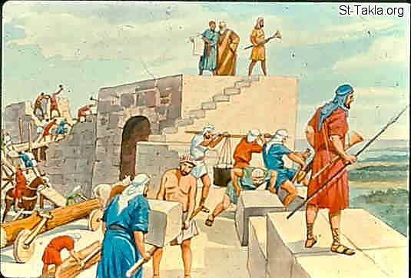
Good Work Under Trial
Sanballat, Tobiah the Amorite, Arabians, Ammonites, Ashdodites.
Conspiracy to “hinder” (margin – make an error to it).
Nehemiah instructs some to work on the wall, while others hold spears, shields, bows, habergeons (coats of mail).
Sword was girded on side as they did the work under constant threat.

Slide 36
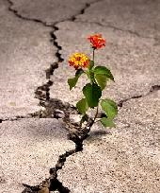
Lessons?
The ecclesia can still prosper and grow while under threat – pristine conditions are not required!
Provides a unique vision of work in the ecclesia being done with absolutely vital cooperation.
The work is protected and nurtured as brethren protect from the “fiery darts of the wicked.”

Slide 37

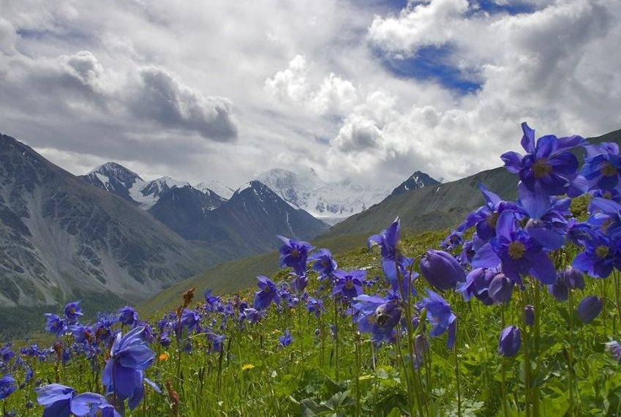
Blossom Where We Are Planted!

Slide 38
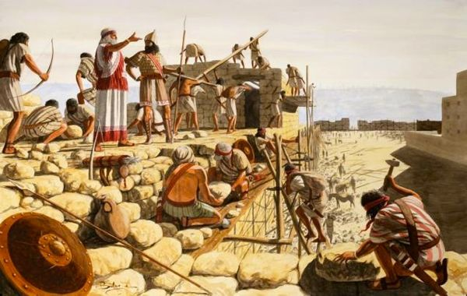
Nehemiah’s Leadership
Prayer (4:4,5,9)
Exhortation (4:14,20)
Action (4:5,21-23)
Vigilance (4:9,16-20)

Slide 39
Nobles and Rulers Taking Advantage
“And I was very angry when I heard their cry and these words. Then I consulted with myself, and I rebuked the nobles, and the rulers, and said unto them, Ye exact usury, every one of his brother. And I set a great assembly against them. And I said unto them, We after our ability have redeemed our brethren the Jews, which were sold unto the heathen; and will ye even sell your brethren? or shall they be sold unto us? Then held they their peace, and found nothing to answer. Also I said, It is not good that ye do: ought ye not to walk in the fear of our God because of the reproach of the heathen our enemies? I likewise, and my brethren, and my servants, might exact of them money and corn: I pray you, let us leave off this usury. Restore, I pray you, to them, even this day, their lands, their vineyards, their oliveyards, and their houses, also the hundredth part of the money, and of the corn, the wine, and the oil, that ye exact of them. Then said they, We will restore them, and will require nothing of them; so will we do as thou sayest. Then I called the priests, and took an oath of them, that they should do according to this promise.”
Nehemiah 5:6-12

Slide 40
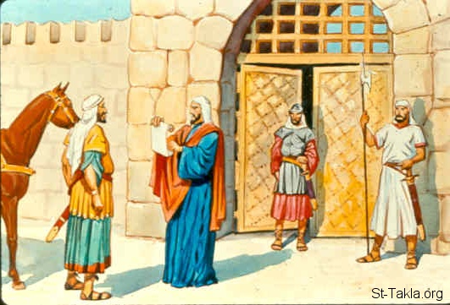
Attempting to Distract
“Now it came to pass when Sanballat, and Tobiah, and Geshem the Arabian, and the rest of our enemies, heard that I had builded the wall, and that there was no breach left therein; (though at that time I had not set up the doors upon the gates;) That Sanballat and Geshem sent unto me, saying, Come, let us meet together in some one of the villages in the plain of Ono. But they thought to do me mischief. And I sent messengers unto them, saying, I am doing a great work, so that I cannot come down: why should the work cease, whilst I leave it, and come down to you?”
Nehemiah 6:1-3

Slide 41
Filling the City
“That I gave my brother Hanani, and Hananiah the ruler of the palace, charge over Jerusalem: for he was a faithful man, and feared God above many. And I said unto them, Let not the gates of Jerusalem be opened until the sun be hot; and while they stand by, let them shut the doors, and bar them: and appoint watches of the inhabitants of Jerusalem, every one in his watch, and every one to be over against his house. Now the city was large and great: but the people were few therein, and the houses were not builded. And my God put into mine heart to gather together the nobles, and the rulers, and the people, that they might be reckoned by genealogy. And I found a register of the genealogy of them which came up at the first, and found written therein,”
Nehemiah 7:2-5

Slide 42
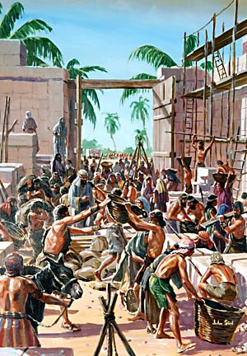
Filling the city by lot
“And the rulers of the people dwelt at Jerusalem: the rest of the people also cast lots, to bring one of ten to dwell in Jerusalem the holy city, and nine parts to dwell in other cities. And the people blessed all the men, that willingly offered themselves to dwell at Jerusalem. Now these are the chief of the province that dwelt in Jerusalem: but in the cities of Judah dwelt every one in his possession in their cities, to wit, Israel, the priests, and the Levites, and the Nethinims, and the children of Solomon's servants.”
Nehemiah 11:1-3

Slide 43
The Restored Ecclesia Calls for the Word
“And all the people gathered themselves together as one man into the street that was before the water gate; and they spake unto Ezra the scribe to bring the book of the law of Moses, which the Lord had commanded to Israel. And Ezra the priest brought the law before the congregation both of men and women, and all that could hear with understanding, upon the first day of the seventh month. And he read therein before the street that was before the water gate from the morning until midday, before the men and the women, and those that could understand; and the ears of all the people were attentive unto the book of the law. And Ezra the scribe stood upon a pulpit of wood, which they had made for the purpose; and beside him stood Mattithiah, and Shema, and Anaiah, and Urijah, and Hilkiah, and Maaseiah, on his right hand; and on his left hand, Pedaiah, and Mishael, and Malchiah, and Hashum, and Hashbadana, Zechariah, and Meshullam.”
Nehemiah 8:1-4

Slide 44
How Ezra Read
“And Ezra opened the book in the sight of all the people; (for he was above all the people;) and when he opened it, all the people stood up: And Ezra blessed the Lord, the great God. And all the people answered, Amen, Amen, with lifting up their hands: and they bowed their heads, and worshipped the Lord with their faces to the ground. Also Jeshua, and Bani, and Sherebiah, Jamin, Akkub, Shabbethai, Hodijah, Maaseiah, Kelita, Azariah, Jozabad, Hanan, Pelaiah, and the Levites, caused the people to understand the law: and the people stood in their place. So they read in the book in the law of God distinctly, and gave the sense, and caused them to understand the reading.”
Nehemiah 8:5-8

Slide 45
Ezra’s reading of the law (Nehemiah 8:8)
“And they read in the book, in the law of God, explaining – so as to give understanding to the conviction.” Young’s Literal Translation
“…making it clear and giving the meaning so that the people understood what was being read.” New International Version
“…translating to give the sense so that they understood the reading.” New American Standard Bible
“…And they read from the book, from the law of God, clearly; and they gave the sense, so that the people understood the reading.” Revised Standard Version, footnote: “or, with interpretation”

Slide 46
Offices Restored
“And at that time were some appointed over the chambers for the treasures, for the offerings, for the firstfruits, and for the tithes, to gather into them out of the fields of the cities the portions of the law for the priests and Levites: for Judah rejoiced for the priests and for the Levites that waited. And both the singers and the porters kept the ward of their God, and the ward of the purification, according to the commandment of David, and of Solomon his son. For in the days of David and Asaph of old there were chief of the singers, and songs of praise and thanksgiving unto God. And all Israel in the days of Zerubbabel, and in the days of Nehemiah, gave the portions of the singers and the porters, every day his portion: and they sanctified holy things unto the Levites; and the Levites sanctified them unto the children of Aaron.”
Nehemiah 12:44-47

Slide 47
The Word Applied – Amorites and Moabites
“On that day they read in the book of Moses in the audience of the people; and therein was found written, that the Ammonite and the Moabite should not come into the congregation of God for ever; Because they met not the children of Israel with bread and with water, but hired Balaam against them, that he should curse them: howbeit our God turned the curse into a blessing. Now it came to pass, when they had heard the law, that they separated from Israel all the mixed multitude”
Nehemiah 13:1-3

Slide 48
Eliashib’s Evil in Harboring an Amorite
“And before this, Eliashib the priest, having the oversight of the chamber of the house of our God, was allied unto Tobiah: And he had prepared for him a great chamber, where aforetime they laid the meat offerings, the frankincense, and the vessels, and the tithes of the corn, the new wine, and the oil, which was commanded to be given to the Levites, and the singers, and the porters; and the offerings of the priests. But in all this time was not I at Jerusalem: for in the two and thirtieth year of Artaxerxes king of Babylon came I unto the king, and after certain days obtained I leave of the king: And I came to Jerusalem, and understood of the evil that Eliashib did for Tobiah, in preparing him a chamber in the courts of the house of God. And it grieved me sore: therefore I cast forth all the household stuff to Tobiah out of the chamber. Then I commanded, and they cleansed the chambers: and thither brought I again the vessels of the house of God, with the meat offering and the frankincense.”
Nehemiah 13:4-9

Slide 49
Eliashib’s Grandson
“And one of the sons of Joiada, the son of Eliashib the high priest, was son in law to Sanballat the Horonite: therefore I chased him from me. Remember them, O my God, because they have defiled the priesthood, and the covenant of the priesthood, and of the Levites. Thus cleansed I them from all strangers, and appointed the wards of the priests and the Levites, every one in his business;”
Nehemiah 13:28-30

Slide 50
Profaning of the Sabbath
“In those days saw I in Judah some treading wine presses on the sabbath, and bringing in sheaves, and lading asses; as also wine, grapes, and figs, and all manner of burdens, which they brought into Jerusalem on the sabbath day: and I testified against them in the day wherein they sold victuals. There dwelt men of Tyre also therein, which brought fish, and all manner of ware, and sold on the sabbath unto the children of Judah, and in Jerusalem. Then I contended with the nobles of Judah, and said unto them, What evil thing is this that ye do, and profane the sabbath day? Did not your fathers thus, and did not our God bring all this evil upon us, and upon this city? yet ye bring more wrath upon Israel by profaning the sabbath. And it came to pass, that when the gates of Jerusalem began to be dark before the sabbath, I commanded that the gates should be shut, and charged that they should not be opened till after the sabbath: and some of my servants set I at the gates, that there should no burden be brought in on the sabbath day.”
Nehemiah 13:15-19

Slide 51
Right under their noses!
How is it possible that Israel did not see this obvious, ongoing violation of the Sabbath?
Had they strayed so far from the Word itself?
Had they failed to apply the Word to common daily practice?
The real question is whether we have any areas where we too have become blind to the violation of God’s commands right under our own noses – and what we will do when we identify them!

Slide 52
Marriages to the Heathen
“In those days also saw I Jews that had married wives of Ashdod, of Ammon, and of Moab: And their children spake half in the speech of Ashdod, and could not speak in the Jews' language, but according to the language of each people. And I contended with them, and cursed them, and smote certain of them, and plucked off their hair, and made them swear by God, saying, Ye shall not give your daughters unto their sons, nor take their daughters unto your sons, or for yourselves. Did not Solomon king of Israel sin by these things? yet among many nations was there no king like him, who was beloved of his God, and God made him king over all Israel: nevertheless even him did outlandish women cause to sin. Shall we then hearken unto you to do all this great evil, to transgress against our God in marrying strange wives?”
Nehemiah 13:23-27

Slide 53
WHAT NEHEMIAH AND EZRA JUMPSTARTED
A sound examination and reading of the Word
They didn’t do it as ritual, but with attentiveness to the message and with a zeal to apply it (think Berea in NT).
These were no dry Bible classes!
Ultimately, the reform required was going back to the commands and principles of Scripture.
This wrecked Solomon – and it was certain to destroy them too.
This is an imperative for healthy ecclesias and reformation.

Slide 54
Nehemiah 13 – detailed names of those marrying heathen women

Slide 55
A Few Lessons for Our Ecclesias
Spiritual soundness requires constant perseverance and watchfulness.
We do not consistently make the connections between our profession and what personal changes are required of us.
The close attention to the Word is required to fulfill our transformation.
God is still working with us to build cities and walls – not of stone and wood, but of faithful hearts.
Let us arise and build!

Slide 56
Next class
“You, O Priests, That Despise My Name”

