Slide 1
Who Hath Despised the
Day of Small Things?
Class 5: “You, O Priests, That Despise My Name”

Slide 2
What We Have Explored So far
The return home, met with many obstacles and set-backs.
Halted work and spiritual paralysis.
Exhortations to not dwell on day of small things, but focus on the vision of Kingdom.
The need for reform and closeness to the Word of God.
The importance of all members contributing to rebuilding the City.

Slide 3
The Final Chapter - Malachi
The spiritual blindness of the people.
The failure of the leaders.
The resulting sin.
Vision of the redeemed and the coming Sun of Righteousness.
The coming great light.

Slide 4
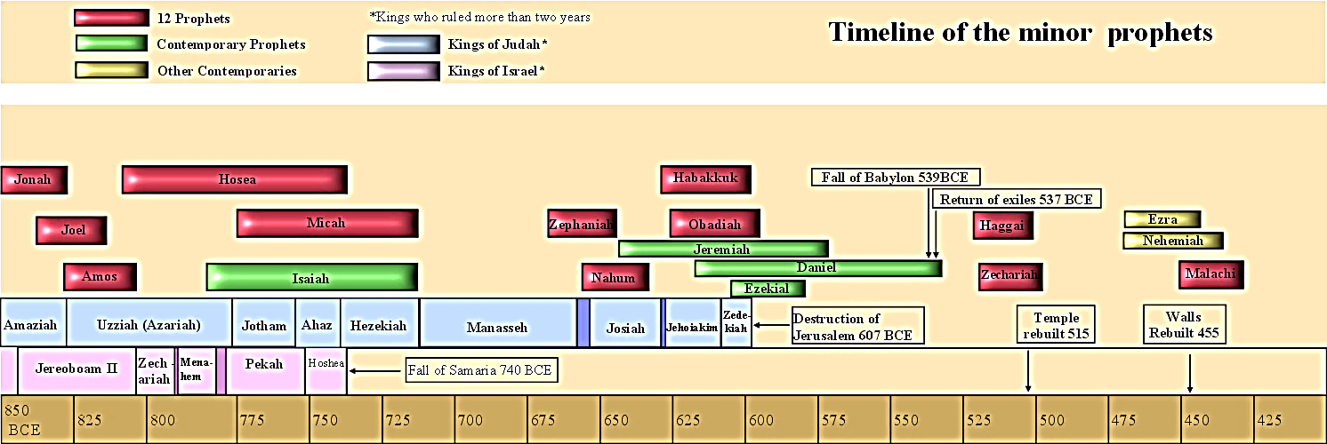
Period Timeline

Slide 5
Timing of Malachi’s Prophecy
Clearly written well after the physical work had been accomplished.
Temple has been built, city walls repaired, city inhabited now in peace.
With Persian support and minimal local threats, they are relatively “at rest.”
Free to operate as God’s people, sacrifice, worship, employ the Law.

Slide 6
Landscape
The entire prophecy is an anatomy of a people with broken self-examination.
They were “practicing” a form of religion that was expedient and did not acknowledge God even as highly as they would a human king.
The instruction from the priest leaders had failed and actually caused the spiritual failure of many.
The behavior of many of the people no longer reflected their stated faith and it was an abomination to God.
A small remnant remained faithful – the “jewels” of God.

Slide 7
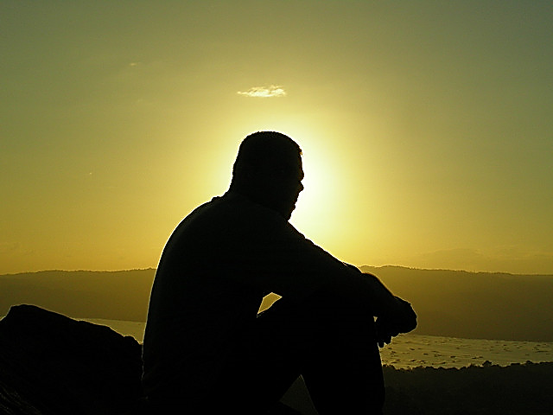
Broken self-examination – the great enemy of believers

Slide 8

Spiritual safety net
Personal examination
Edification or correction by a loving brother/sister
Ecclesial leaders – the message of Malachi focused here!
The work of the angels
2-3 are designed to get #1 working again!

Slide 9
Self-examination a key to life as a believer
“But let a man examine himself, and so let him eat of that bread and drink of that cup.”
1 Corinthians 11:28
Examine: dokimazo – to test, as with metals
2 Cor. 13:5 – “Examine yourselves, whether ye be in the faith, prove your own selves…”
Proverbs 17:3 – “The fining pot is for silver, and the furnace for gold; but the LORD trieth the hearts.”
Galatians 6:4 – “But let every man prove his own work, and then he shall have rejoicing in himself alone and not in another.”

Slide 10
self-examination
“My little children, let us not love in word, neither in tongue; but in deed and in truth. And hereby we know that we are of the truth, and shall assure our hearts before him. For if our heart condemn us, God is greater than our heart, and knoweth all things. Beloved, if our heart condemn us not, then have we confidence toward God. And whatsoever we ask, we receive of him, because we keep his commandments, and do those things that are pleasing in his sight.”
1 John 3:18-22

Slide 11

haggai 1: Unable to examine hearts, god works in natural ways
“Now therefore thus saith the Lord of hosts; Consider your ways. Ye have sown much, and bring in little; ye eat, but ye have not enough; ye drink, but ye are not filled with drink; ye clothe you, but there is none warm; and he that earneth wages earneth wages to put it into a bag with holes.”
Haggai 1:5-6

Slide 12
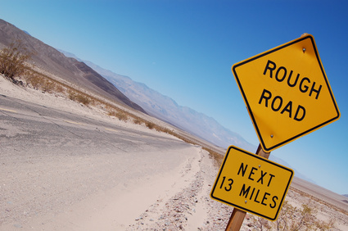
Failure and Difficulty – may be divine messaging
“For they verily for a few days chastened us after their own pleasure; but he for our profit, that we might be partakers of his holiness. Now no chastening for the present seemeth to be joyous, but grievous: nevertheless afterward it yieldeth the peaceable fruit of righteousness unto them which are exercised thereby.”
Hebrews 12:10-11

Slide 13
Problem one: failure to provide spiritual leadership

Slide 14
Standard for the priests
“And ye shall know that I have sent this commandment unto you, that my covenant might be with Levi, saith the Lord of hosts. My covenant was with him of life and peace; and I gave them to him for the fear wherewith he feared me, and was afraid before my name. The law of truth was in his mouth, and iniquity was not found in his lips: he walked with me in peace and equity, and did turn many away from iniquity. For the priest's lips should keep knowledge, and they should seek the law at his mouth: for he is the messenger of the Lord of hosts.”
Malachi 2:4-7

Slide 15
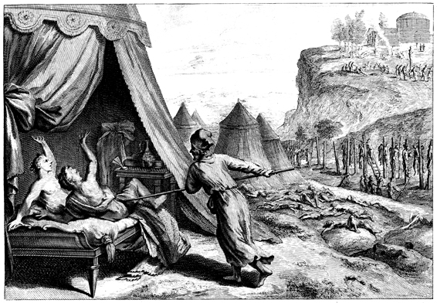
Covenant of everlasting priesthood
“Phinehas, the son of Eleazar, the son of Aaron the priest, hath turned my wrath away from the children of Israel, while he was zealous for my sake among them, that I consumed not the children of Israel in my jealousy. Wherefore say, Behold, I give unto him my covenant of peace: And he shall have it, and his seed after him, even the covenant of an everlasting priesthood; because he was zealous for his God, and made an atonement for the children of Israel.”
Numbers 25:11-13
Slaying of Zimri and Cozbi
A principle of priesthood is to take action when needed, to cut-off if required. Even as others looked on! It was Phinehas’s zealousness for God that made the difference.

Slide 16
Holiness of priest for effective teaching
”Do not drink wine nor strong drink, thou, nor thy sons with thee, when ye go into the tabernacle of the congregation, lest ye die: it shall be a statute for ever throughout your generations: And that ye may put difference between holy and unholy, and between unclean and clean; And that ye may teach the children of Israel all the statutes which the Lord hath spoken unto them by the hand of Moses.”
Leviticus 10:9-11

Slide 17
corruption was a long time in the making
“And I brought you into a plentiful country, to eat the fruit thereof and the goodness thereof; but when ye entered, ye defiled my land, and made mine heritage an abomination. The priests said not, Where is the Lord? and they that handle the law knew me not: the pastors also transgressed against me, and the prophets prophesied by Baal, and walked after things that do not profit.”
Jeremiah 2:7-8

Slide 18
Current failure…
“But you have turned from the way and by your teaching have caused many to stumble; you have violated the covenant with Levi,” says the Lord Almighty. “So I have caused you to be despised and humiliated before all the people, because you have not followed my ways but have shown partiality in matters of the law.”
Malachi 2:8-9 NIV
Vs. 9 – “And I also have made you contemptible and base before all the people, because ye have not kept my ways, but have respect of persons in [administering] the law.” Darby Translation

Slide 19
James warns of this
“For if a man wearing a gold ring and fine clothing comes into your assembly, and a poor man in shabby clothing also comes in, and if you pay attention to the one who wears the fine clothing and say, “You sit here in a good place,” while you say to the poor man, “You stand over there,” or, “Sit down at my feet,” have you not then made distinctions among yourselves and become judges with evil thoughts?”
James 2:2-4

Slide 20
What Priests Should Do
Reflection of a life that shows fear and reverence to God.
Familiar with the Law and ready to speak it and do it.
A man above reproach – iniquity not on his lips.
Living a life in peace and uprightness – an example to the flock.
A haven where a man could go for sound spiritual counsel from the Word and know he will not be discriminated against – one Law for all.
Turn many away from sin through these dimensions.

Slide 21
The promise of strong Spiritual Leaders
“For the people shall dwell in Zion at Jerusalem: thou shalt weep no more: he will be very gracious unto thee at the voice of thy cry; when he shall hear it, he will answer thee. And though the Lord give you the bread of adversity, and the water of affliction, yet shall not thy teachers be removed into a corner any more, but thine eyes shall see thy teachers: And thine ears shall hear a word behind thee, saying, This is the way, walk ye in it, when ye turn to the right hand, and when ye turn to the left.”
Isaiah 30:19-21

Slide 22
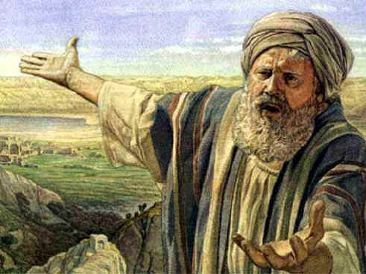
Lot as example of a righteous, caring judge
“If by turning the cities of Sodom and Gomorrah to ashes he condemned them to extinction, making them an example of what is going to happen to the ungodly; and if he rescued righteous Lot, greatly distressed by the sensual conduct of the wicked (for as that righteous man lived among them day after day, he was tormenting his righteous soul over their lawless deeds that he saw and heard);
2 Peter 2:6-8 ESV

Slide 23
Failure
They too had departed from a holy life and no longer knew God.
This failure caused many to fall in sin.
In their hearts, they despised the counsels of God and thought them to be a burden.
The application of the Law was variable and there was “respect of persons.”
When the people needed leaders, they spiritually abandoned the flock.

Slide 24
Problem two – expedient worship

Slide 25
UNCLEANLINESS AND UNHOLiNESS TRANSFERS!
‘Thus saith the Lord of hosts; Ask now the priests concerning the law, saying, If one bear holy flesh in the skirt of his garment, and with his skirt do touch bread, or pottage, or wine, or oil, or any meat, shall it be holy? And the priests answered and said, No. Then said Haggai, If one that is unclean by a dead body touch any of these, shall it be unclean? And the priests answered and said, It shall be unclean. Then answered Haggai, and said, So is this people, and so is this nation before me, saith the Lord; and so is every work of their hands; and that which they offer there is unclean.”
Haggai 2:11-14

Slide 26
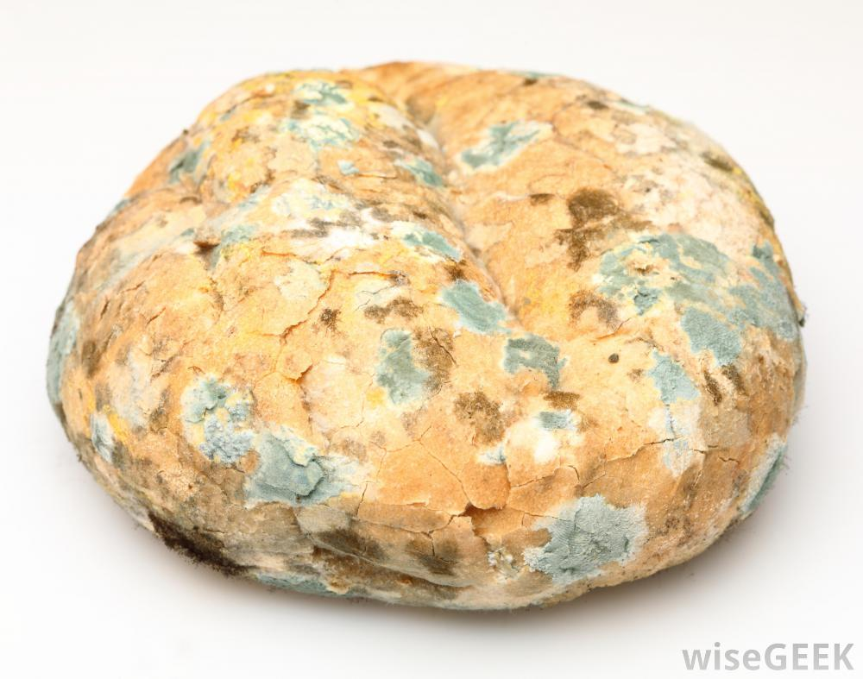
Offering of polluted bread
“A son honoureth his father, and a servant his master: if then I be a father, where is mine honour? and if I be a master, where is my fear? saith the Lord of hosts unto you, O priests, that despise my name. And ye say, Wherein have we despised thy name? Ye offer polluted bread upon mine altar; and ye say, Wherein have we polluted thee? In that ye say, The table of the Lord is contemptible.”
Malachi 1:6-7
Clearly, self-examination was also broken for the priests!

Slide 27
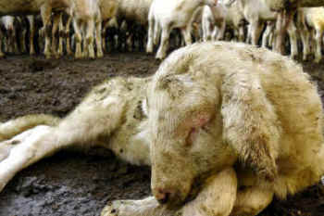
burnt offering requirements
“The animal for this sacrifice could be a young bull, lamb, goat, turtledove, or young pigeon; but it had to be a perfect and complete specimen. The type of animal chosen for this sacrifice seems to be dependent on the offerer's financial ability.” Holman Bible Dictionary
“Thou shalt not sacrifice unto the Lord thy God any bullock, or sheep, wherein is blemish, or any evilfavouredness: for that is an abomination unto the Lord thy God.” Deuteronomy 17:1

Slide 28
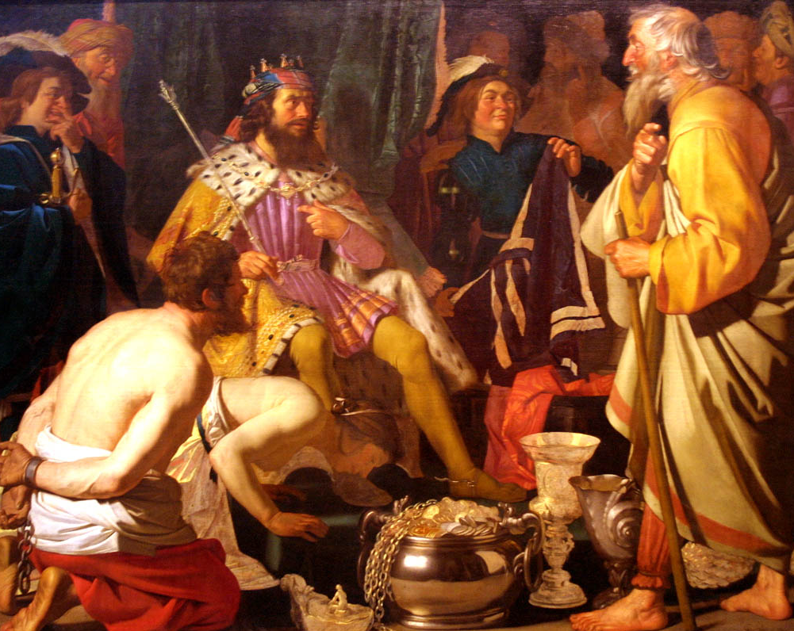
Just who are we serving?
“And if ye offer the blind for sacrifice, is it not evil? and if ye offer the lame and sick, is it not evil? offer it now unto thy governor; will he be pleased with thee, or accept thy person? saith the Lord of hosts.”
Malachi 1:8

Slide 29
Rebellion Toward the Great King
“But ye have profaned it, in that ye say, The table of the Lord is polluted; and the fruit thereof, even his meat, is contemptible. Ye said also, Behold, what a weariness is it! and ye have snuffed at it, saith the Lord of hosts; and ye brought that which was torn, and the lame, and the sick; thus ye brought an offering: should I accept this of your hand? saith the Lord. But cursed be the deceiver, which hath in his flock a male, and voweth, and sacrificeth unto the Lord a corrupt thing: for I am a great King, saith the Lord of hosts, and my name is dreadful among the heathen.”
Malachi 1:12-14

Slide 30
Reverting back to Prior Pollutions
“Moreover all the chief of the priests, and the people, transgressed very much after all the abominations of the heathen; and polluted the house of the Lord which he had hallowed in Jerusalem. And the Lord God of their fathers sent to them by his messengers, rising up betimes, and sending; because he had compassion on his people, and on his dwelling place: But they mocked the messengers of God, and despised his words, and misused his prophets, until the wrath of the Lord arose against his people, till there was no remedy.”
2 Chronicles 36:14-16

Slide 31
Prior Pollutions of priests
“Her priests have violated my law, and have profaned mine holy things: they have put no difference between the holy and profane, neither have they shewed difference between the unclean and the clean, and have hid their eyes from my sabbaths, and I am profaned among them.”
Ezekiel 22:26

Slide 32
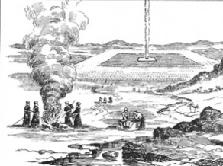
Proper handling for sin offering
“But the flesh of the bullock, and his skin, and his dung, shalt thou burn with fire without the camp: it is a sin offering.”
Leviticus 29:14

Slide 33
Offal on your faces
Likely refers to the dung, skin, intestines and organs that are separated from the animals for sacrifice in sin offering. They were to be carefully gathered and disposed and burned “without the camp.” Suggests that they were not following this command of the sin offering.
“And now, O ye priests, this commandment is for you. If ye will not hear, and if ye will not lay it to heart, to give glory unto my name, saith the Lord of hosts, I will even send a curse upon you, and I will curse your blessings: yea, I have cursed them already, because ye do not lay it to heart. Behold, I will corrupt your seed, and spread dung upon your faces, even the dung of your solemn feasts; and one shall take you away with it.”
Malachi 2:1-3

Slide 34
Diagnosing Their Failures
The fundamental “fear of God” is missing.
Operating principle that “God won’t know”
Religion is for me, not for God!
Cutting corners, expediency.
And they were to be the spiritual leaders of the people!

Slide 35
Problem 3: seeing god’s commands as wearisome

Slide 36
Secret rebellion in hearts
“Your words have been stout against me, saith the Lord. Yet ye say, What have we spoken so much against thee? Ye have said, It is vain to serve God: and what profit is it that we have kept his ordinance, and that we have walked mournfully before the Lord of hosts? And now we call the proud happy; yea, they that work wickedness are set up; yea, they that tempt God are even delivered.”
Malachi 3:13-15

Slide 37
Reversal of Nehemiah’s first Reformation
“Judah hath dealt treacherously, and an abomination is committed in Israel and in Jerusalem; for Judah hath profaned the holiness of the Lord which he loved, and hath married the daughter of a strange god. The Lord will cut off the man that doeth this, the master and the scholar, out of the tabernacles of Jacob, and him that offereth an offering unto the Lord of hosts. And this have ye done again, covering the altar of the Lord with tears, with weeping, and with crying out, insomuch that he regardeth not the offering any more, or receiveth it with good will at your hand.”
Malachi 2:11-13

Slide 38
Nehemiah’s strong actions
“In those days also saw I Jews that had married wives of Ashdod, of Ammon, and of Moab: And their children spake half in the speech of Ashdod, and could not speak in the Jews' language, but according to the language of each people. And I contended with them, and cursed them, and smote certain of them, and plucked off their hair, and made them swear by God, saying, Ye shall not give your daughters unto their sons, nor take their daughters unto your sons, or for yourselves.”
Nehemiah 13:23-25

Slide 39
Corruption of Marriage
“Yet ye say, Wherefore? Because the Lord hath been witness between thee and the wife of thy youth, against whom thou hast dealt treacherously: yet is she thy companion, and the wife of thy covenant. And did not he make one? Yet had he the residue of the spirit. And wherefore one? That he might seek a godly seed. Therefore take heed to your spirit, and let none deal treacherously against the wife of his youth. For the Lord, the God of Israel, saith that he hateth putting away: for one covereth violence with his garment, saith the Lord of hosts: therefore take heed to your spirit, that ye deal not treacherously.”
Malachi 2:14-16

Slide 40

Stages of Marriage (Malachi 2:14)
Wife of thy youth
Companion
Wife of thy covenant

Slide 41
Failure to Apply Holy Standards
“Ye have wearied the Lord with your words. Yet ye say, Wherein have we wearied him? When ye say, Every one that doeth evil is good in the sight of the Lord, and he delighteth in them; or, Where is the God of judgment?”
Malachi 2:17

Slide 42
The Truth Seen as a Series of Restrictions
“Your words have been stout against me, saith the Lord. Yet ye say, What have we spoken so much against thee? Ye have said, It is vain to serve God: and what profit is it that we have kept his ordinance, and that we have walked mournfully before the Lord of hosts? And now we call the proud happy; yea, they that work wickedness are set up; yea, they that tempt God are even delivered.”
Malachi 3:13-15

Slide 43
Asaph’s discouragement
“And they say, How doth God know? and is there knowledge in the most High? Behold, these are the ungodly, who prosper in the world; they increase in riches. Verily I have cleansed my heart in vain, and washed my hands in innocency. For all the day long have I been plagued, and chastened every morning. If I say, I will speak thus; behold, I should offend against the generation of thy children. When I thought to know this, it was too painful for me;”
Psalm 73:11-16

Slide 44
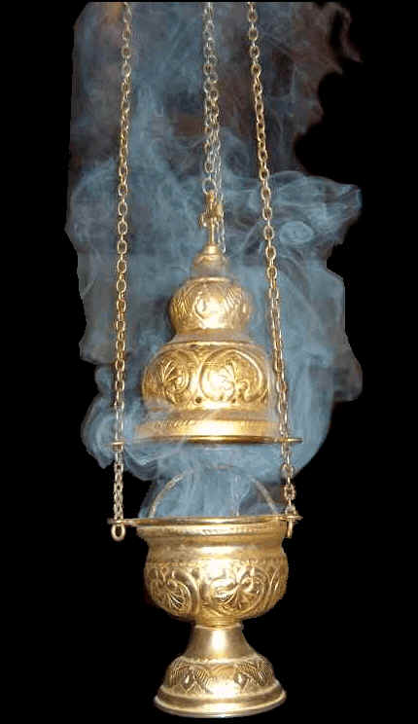
Asaph’s realization
“Until I went into the sanctuary of God; then understood I their end. Surely thou didst set them in slippery places: thou castedst them down into destruction. How are they brought into desolation, as in a moment! they are utterly consumed with terrors.”
Psalm 73:17-19

Slide 45
Robbing God
“Will a man rob God? Yet ye have robbed me. But ye say, Wherein have we robbed thee? In tithes and offerings. Ye are cursed with a curse: for ye have robbed me, even this whole nation.”
Malachi 3:8-9

Slide 46
Robbery in Burnt Offering
Isaiah 61:8 – “For I the Lord love judgment, I hate robbery for burnt offering; and I will direct their work in truth, and I will make an everlasting covenant with them.”
Proverbs 15:8 – “The sacrifice of the wicked is an abomination to the Lord: but the prayer of the upright is his delight.”
Isaiah 1:10-13 – “Hear the word of the Lord, ye rulers of Sodom; give ear unto the law of our God, ye people of Gomorrah. To what purpose is the multitude of your sacrifices unto me? saith the Lord: I am full of the burnt offerings of rams, and the fat of fed beasts; and I delight not in the blood of bullocks, or of lambs, or of he goats. When ye come to appear before me, who hath required this at your hand, to tread my courts? Bring no more vain oblations; incense is an abomination unto me; the new moons and sabbaths, the calling of assemblies, I cannot away with; it is iniquity, even the solemn meeting.”

Slide 47
The vision of purified sons of levi
“But who may abide the day of his coming? and who shall stand when he appeareth? for he is like a refiner's fire, and like fullers' soap: And he shall sit as a refiner and purifier of silver: and he shall purify the sons of Levi, and purge them as gold and silver, that they may offer unto the Lord an offering in righteousness.”
Malachi 3:2-3

Slide 48
Sound Familiar?
“The elders which are among you I exhort, who am also an elder, and a witness of the sufferings of Christ, and also a partaker of the glory that shall be revealed: Feed the flock of God which is among you, taking the oversight thereof, not by constraint, but willingly; not for filthy lucre, but of a ready mind; Neither as being lords over God's heritage, but being examples to the flock. And when the chief Shepherd shall appear, ye shall receive a crown of glory that fadeth not away.”
1 Peter 5:1-4

Slide 49
Challenges for shepherds today
Be effective watchmen against sin and expediency.
Know the Word and know God
Be committed to holiness and define it generationally.
Feed the flock by clarifying Divine principles and expectations.
Be on guard for expediency and casualness toward worship.
Be examples to the flock!

Slide 50
The standard for all priests
“Wherefore in all things it behoved him to be made like unto his brethren, that he might be a merciful and faithful high priest in things pertaining to God, to make reconciliation for the sins of the people. For in that he himself hath suffered being tempted, he is able to succour them that are tempted.”
Hebrews 2:17-18

Slide 51
Next class
Living Now in the Day of Small Things

