Slide 1
Who Hath Despised the
Day of Small Things?
Class 6:
Living Today in the Day of Small Things

Slide 2
CLASSES THIS WEEK
A Call to Return Home
Consider Your Ways
The Day of Small Things
Let Us Rise Up and Build
You, O Priests, That Despise My Name

Slide 3
THIS SUMMARY CLASS
Will attempt to capture some major lessons for our times.
In a time where we share many of the same challenges, what can we learn and apply?
How can we be a people that consider our ways, honor God, do His work and serve our ecclesias?
How can we keep the light burning brightly in our community in these Last Days?

Slide 4
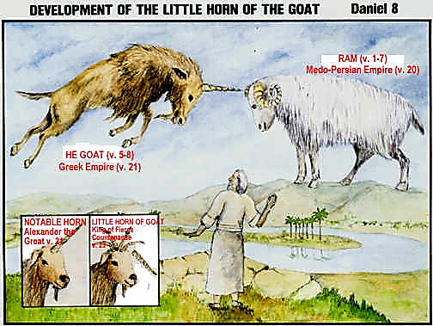

Slide 5
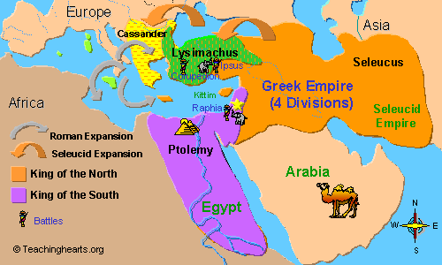

Slide 6
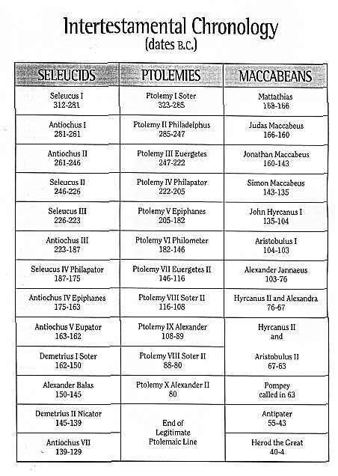
The time of darkness

Slide 7
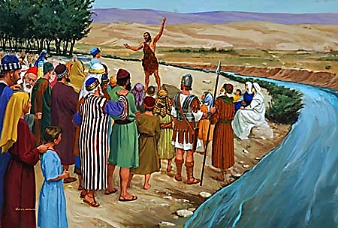
The light out of daRKNESS

Slide 8
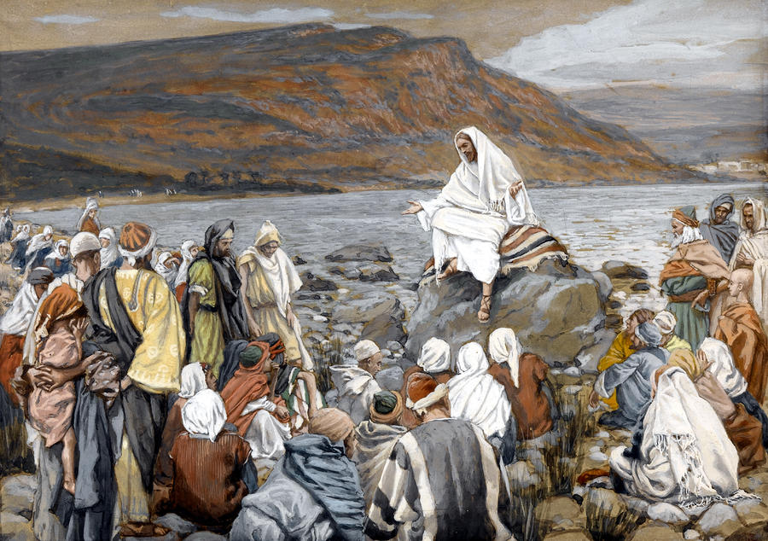
THE LIGHT

Slide 9
Living now in the day of small things

Slide 10
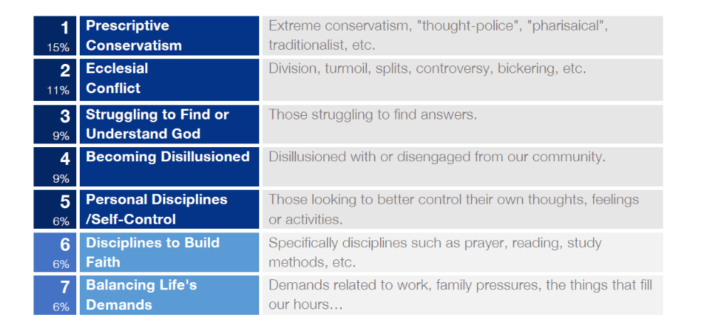
Lively Stones Collective, April 2016

Slide 11
Conditions of the last days
“And take heed to yourselves, lest at any time your hearts be overcharged with surfeiting, and drunkenness, and cares of this life, and so that day come upon you unawares. For as a snare shall it come on all them that dwell on the face of the whole earth. Watch ye therefore, and pray always, that ye may be accounted worthy to escape all these things that shall come to pass, and to stand before the Son of man.”
Luke 21:34-36

Slide 12
Faith in the last days
“And shall not God avenge his own elect, which cry day and night unto him, though he bear long with them? I tell you that he will avenge them speedily. Nevertheless when the Son of man cometh, shall he find faith on the earth?”
Luke 18:7-9

Slide 13
The miasma
“While they promise them liberty, they themselves are the servants of corruption: for of whom a man is overcome, of the same is he brought in bondage. For if after they have escaped the pollutions of the world through the knowledge of the Lord and Saviour Jesus Christ, they are again entangled therein, and overcome, the latter end is worse with them than the beginning. For it had been better for them not to have known the way of righteousness, than, after they have known it, to turn from the holy commandment delivered unto them.”
2 Peter 2:19-21

Slide 14


Slide 15
reformation, Whitaker
“ALL human institutions are born to roll downhill. Whether it be a village cricket club or a welfare society caring for the aged, or a new political party, they all start with a flurry of idealism and high endeavor. Then, after a while – just how long depending on the initial “temperature” and the number of supporters and material resources that have accrued – the momentum begins to slacken. This goes on by imperceptible degrees. The burden of activity comes to be borne more and more by fewer and fewer, until at last it is only a handful of enthusiasts that keep the concern going, helped by the not-ever-so-effectual encouragement of a greater number of nominal sympathizers, who are “leaners” rather than “lifters.”

Slide 16
Can this cycle be broken?

Slide 17
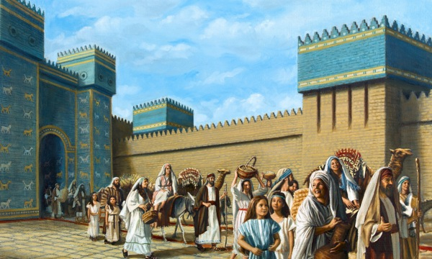
Return of the exiles

Slide 18
The Prophecy of Isaiah
Affluence/
Arrogance
Apathy
Apostasy
Reformation
This is a particular problem in Western society – not necessarily shared by brethren in many other parts of the world.
Most all of us would agree that apathy is a major problem in our ecclesias today.
By extension, this is the most likely “next” threat to our community. Hard to imagine such decay, but it is the natural outcome of apathy.
This was available at any time – it did not require a complete collapse.

Slide 19
Bro. whitaker, reformation, on affluence
“By far the biggest reason for the lowering of our spiritual temperature is the corroding influence of the affluent society. Because we can’t beat ‘em, we’ve joined ‘em. The car, the telly, the Mediterranean holiday, the plush comfortable living of a generation which dotes on nice clothes and wining and dining- all this great softness and self-indulgence, this crass materialism – has bit by bit so invaded our way of life that often it is hard to tell us apart from the dedicated materialists among whom we live. In all kinds of ways the worldy outlook takes charge of us and imperceptibly turns us into a people losing sight of their Christian idealism.”

Slide 20
For those in Babylonian captivity
Some stayed true to the vision of Jerusalem – they wept at the riverside.
But, others became increasingly comfortable in Babylon and the vision of Jerusalem lost its appeal.
When the opportunity to return home and restore the Temple and city was realized, many were too encumbered with life in the world.
Only a portion returned immediately. Some delayed their return. Some never returned.
At the core of the problem was affluence and resulting apathy.

Slide 21
Pursuit of Riches
“Do not wear yourself out to get rich; do not trust your own cleverness. Cast but a glance at riches, and they are gone, for they will surely sprout wings and fly off to the sky like an eagle.”
Proverbs 23:4-5 NIV

Slide 22
Advice to wealthy
“Command those who are rich in this present world not to be arrogant nor to put their hope in wealth, which is so uncertain, but to put their hope in God, who richly provides us with everything for our enjoyment. Command them to do good, to be rich in good deeds, and to be generous and willing to share. In this way they will lay up treasure for themselves as a firm foundation for the coming age, so that they may take hold of the life that is truly life.”
1 Timothy 6:17-19 NIV

Slide 23
I beg your indulgence for a few minutes!

Slide 24

Can you think of a more significant demographic difference in the christadelphian family in the past 50 years than dual-working parents?

Slide 25

What is most at risk?
The family unit – the very foundation of all ecclesias!
Insufficient time for daily home Bible reading or conversation.
Too exhausted for evening activities at the ecclesia.
Both parents carrying full workloads and little discretionary time for the Truth.

Slide 26
Dual-income families
Clearly, there are situations where this is required – there can be no denial.
But is the motive to have spending power above the national average, especially when young with children?
If the motive is accelerated financial capacity, do we fully embrace the commitment it requires for raising a family in the Lord?
Before having children, are we committed to a more limited material life, with a knowledge that the greatest “luxury” is to have a parent home with the children?
My observation is that this is an area for personal discussion and consideration.

Slide 27
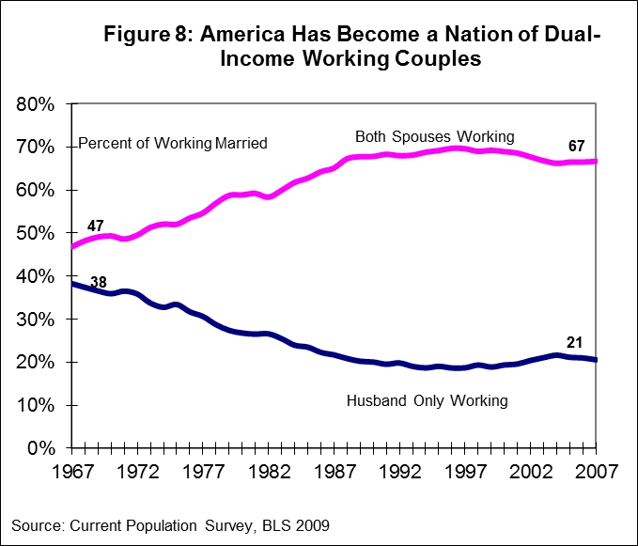

Slide 28
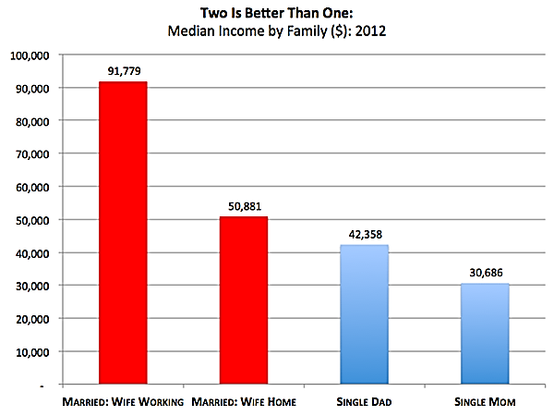

Slide 29
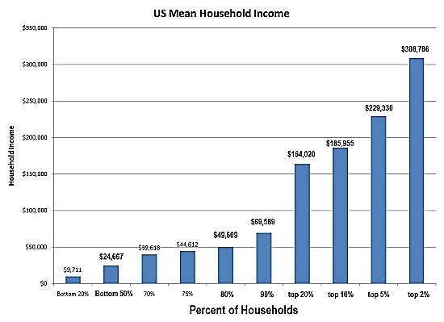

Slide 30
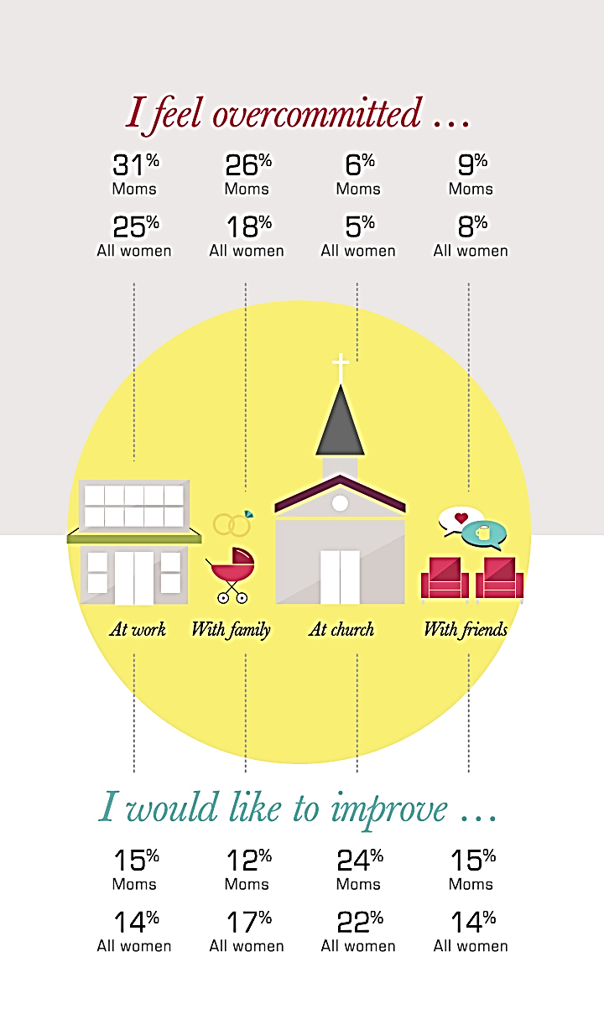
Tired & Stressed, but Satisfied: Moms Juggle Kids, Career & Identity, Barna, may 2014

Slide 31
Long-Term Effect of Spiritual Activity among Children and Teens, barna, November 2009
“When it comes to church engagement, those who attended Sunday school or other religious programs as children or as teens were much more likely than those without such experiences to attend church and to have an active faith as adults. For instance, among those who frequently attended such programs as a child, 50% said they attended a worship service in the last week, which is slightly higher than the national average and well ahead of those who rarely or never attended children’s programs. Among those who frequently attended religious programs as teenagers, 58% said they had attended a worship service in the last week. In comparison, less frequent participation as a teenager correlated with less frequent adult participation.”

Slide 32
Conclusions?
There is nothing sinful about being dual income families with small children and in many cases it is a requirement for survival.
However, the challenges dual income families face in raising spiritual seed are more difficult and requires an extraordinary commitment.
Mom and Dad have a shorter window to impact righteous values.
Surely, each of us must judge our needs and motives personally – it is not for others to do this.
But, clearly the strain and stress in our ecclesias is felt in many ways.

Slide 33
Familiarity with the word

Slide 34
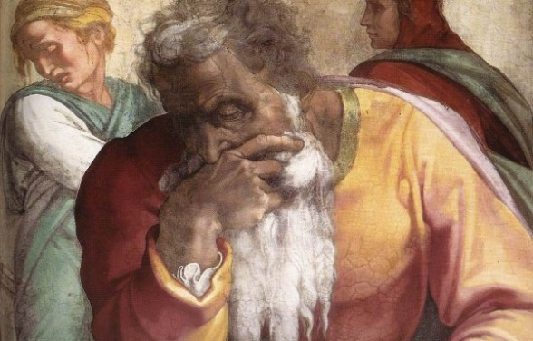
you, o priests, that despise my name

Slide 35
Robbing god?
By not reverencing and fearing God…
    Through expedient worship where we act as if God doesn’t see!
    When we count obedience as “weariness” and sacrifice.
    When we allow self-examination to lapse.
    When we use inappropriate standards of measurement.
    When we fail to act on sin we see or hear, or should know of.
    When the shepherds of the ecclesias neglect feeding the sheep.

Slide 36


Slide 37


Slide 38
Spiritual junk food
“You’re going to find that there will be times when people will have no stomach for solid teaching, but will fill up on spiritual junk food—catchy opinions that tickle their fancy. They’ll turn their backs on truth and chase mirages.”
2 Timothy 4:3-4 The Message

Slide 39
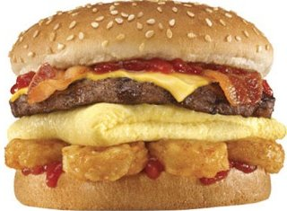

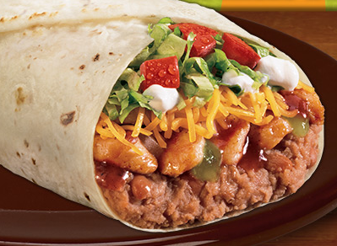
Junk food!
Junk food is calorie-dense and nutrient poor.
25% of those in US now consume predominantly junk food diets.
It takes the place of wholesome foods that are either less convenient or less appealing.
The consequences are almost always associated with poor health.

Slide 40
Spiritual junk food
Need to educate about the difference!
Sound Bible study and application can easily be replaced with convenience and “comfort.”
You may feel full, but you aren’t nourished.
The taste is appealing and eventually you lose the desire for wholesome words.
The slip to apostasy is often like this!

Slide 41
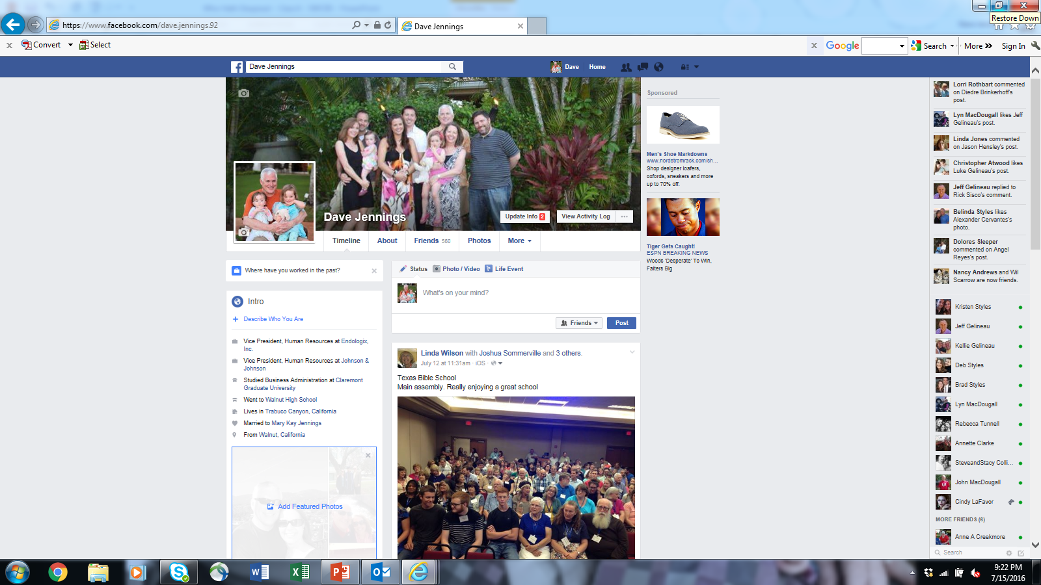

Slide 42
Agenda for our discussion?
Confusion over political engagement, expressing political opinions, voting.
The unfettered access to the Internet of our young people.
The participation in gaming that celebrates war and violence.
Viewing of inappropriate movies, cable TV and other media.
Use of social media.

Slide 43
A word to ecclesial shepherds
Be sound students and demonstrate spiritual discernment.
Be the example to the flock that edifies and uplifts.
Our responsibility to serve is never to be taken lightly.
The needs of the flock need to constantly be on our minds and in our conversations.
What spiritual food do the sheep need at this time?
Are our Sunday School and young people’s efforts meeting the needs?
Do we have an active outreach and is it balanced with what we are doing for ourselves?
When we accept work, do we get it done? There is no place for slipshod leadership of the flock. This is not a business, but we serve the Lord Christ!

Slide 44
Ensure right discussions
Ensure that our ecclesial program talks about the “day of big things!”
Create time and opportunities for open discussions about the Word and application of the principles of the Word.
We need to pray together as ecclesias and as a community. Members need to share in this critical element of our fellowship. It is powerful and it is therapeutic.

Slide 45
Get Back to Work – I Am With You!
“Then spake Haggai the Lord's messenger in the Lord's message unto the people, saying, I am with you, saith the Lord. And the Lord stirred up the spirit of Zerubbabel the son of Shealtiel, governor of Judah, and the spirit of Joshua the son of Josedech, the high priest, and the spirit of all the remnant of the people; and they came and did work in the house of the Lord of hosts, their God, In the four and twentieth day of the sixth month, in the second year of Darius the king.”
Haggai 1:13-15

Slide 46
the day of small things

Slide 47
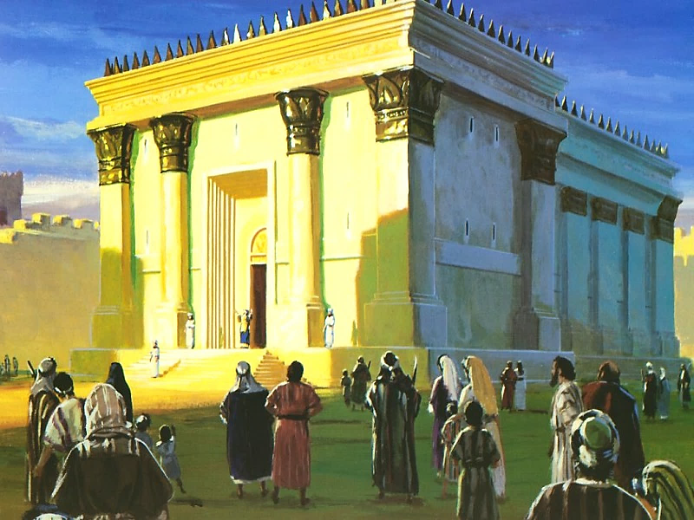

Slide 48
A people focused on the day of big things
Critical bond for our fellowship is our vision of the success and joys of the Kingdom of God.
We need to ensure that this is a message continually reinforced with our children.
It is what we must remind ourselves of when we suffer and experience set-backs.
It must be top of mind in our pursuits in the world and govern our decisions – today is the day of small things!
It puts into perspective the faults and failings we all experience personally and ecclesially – the best is yet to come. Don’t fret over weakness today.

Slide 49
For me personally…
This message has been powerful for my own reformation needs.
Why is it ecclesial life is so often a struggle?
The Truth is about a certain optimism of how life can be – personally and communally.
The optimism of the Truth comes face to face with the fact that we do not meet the standards.
Here’s where understanding the lesson of the “day of small things” applies.
God accepts our imperfections and can be glorified by, even with our imperfections.
When my faith grows weak, I now try to think of this lesson and focus on when the wealth of the nations will be claimed by our Lord.

Slide 50
Ecclesial life
Everything we see is temporary and at best a shadow of what will be by the grace of God.
Small, relatively ineffective preaching campaigns will be replaced by the nations streaming to hear the Gospel.
The imperfections of the flesh that burden us will be taken away to allow a fellowship that serves fully in the Spirit.
Our “smallness” will turn into a day of great things, encompassing the whole of the earth.

Slide 51
Because of this…
“Who is left among you that saw this house in her first glory? and how do ye see it now? is it not in your eyes in comparison of it as nothing? Yet now be strong, O Zerubbabel, saith the Lord; and be strong, O Joshua, son of Josedech, the high priest; and be strong, all ye people of the land, saith the Lord, and work: for I am with you, saith the Lord of hosts: According to the word that I covenanted with you when ye came out of Egypt, so my spirit remaineth among you: fear ye not. For thus saith the Lord of hosts; Yet once, it is a little while, and I will shake the heavens, and the earth, and the sea, and the dry land; And I will shake all nations, and the desire of all nations shall come: and I will fill this house with glory, saith the Lord of hosts.”
Haggai 2:3-7

Slide 52
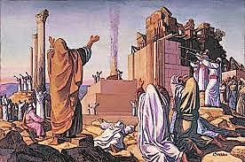
let us rise up and build

Slide 53
Thank you!

